Slide 1
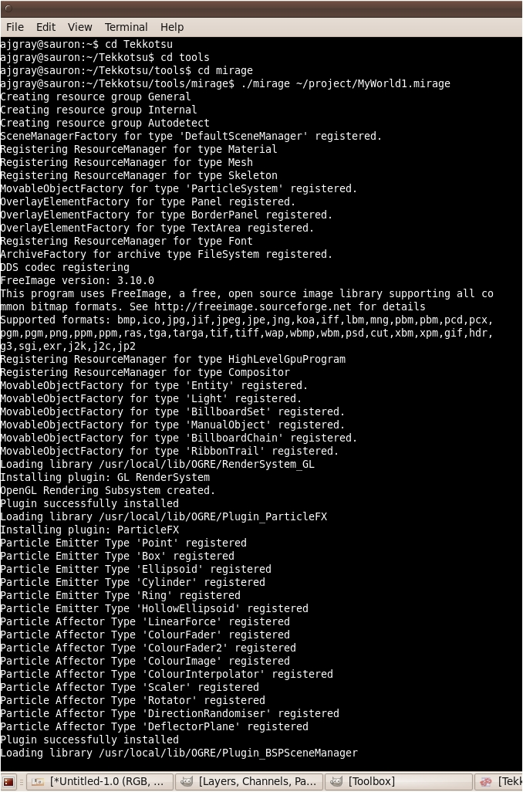
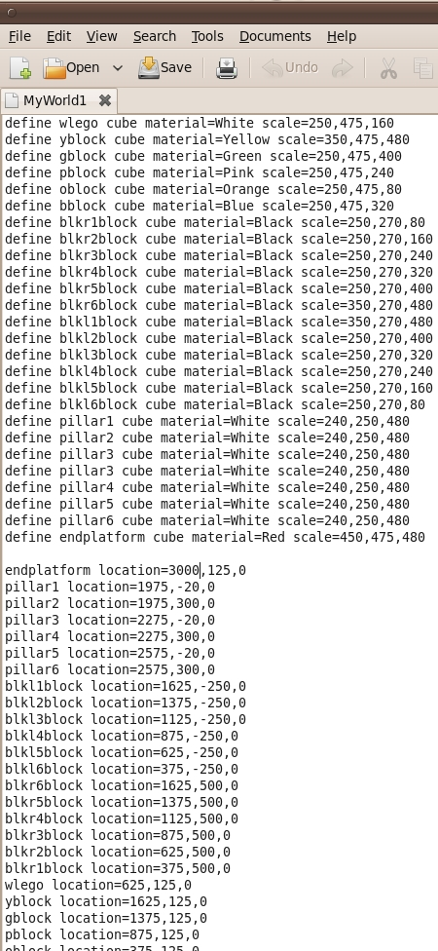
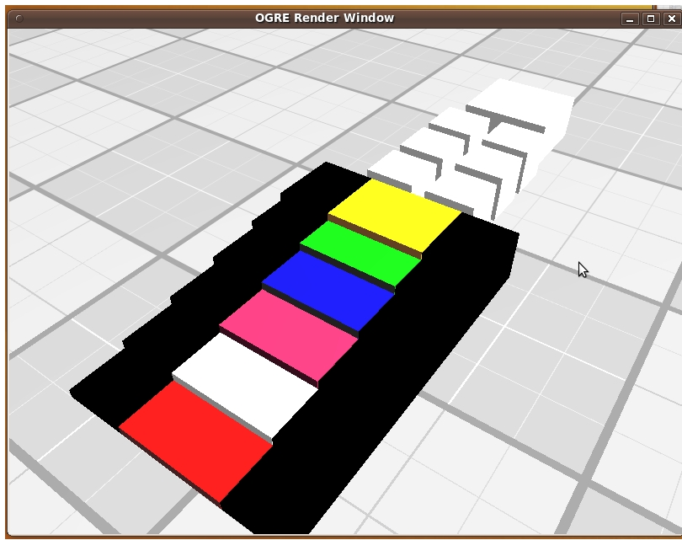
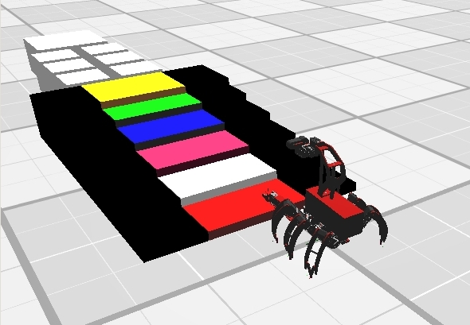
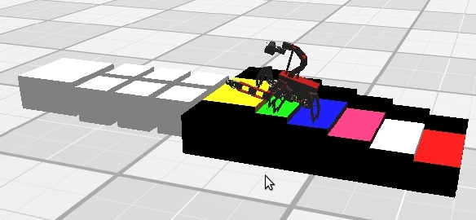
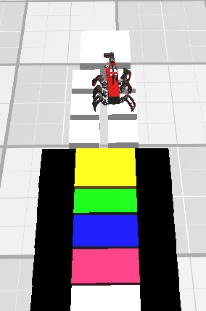
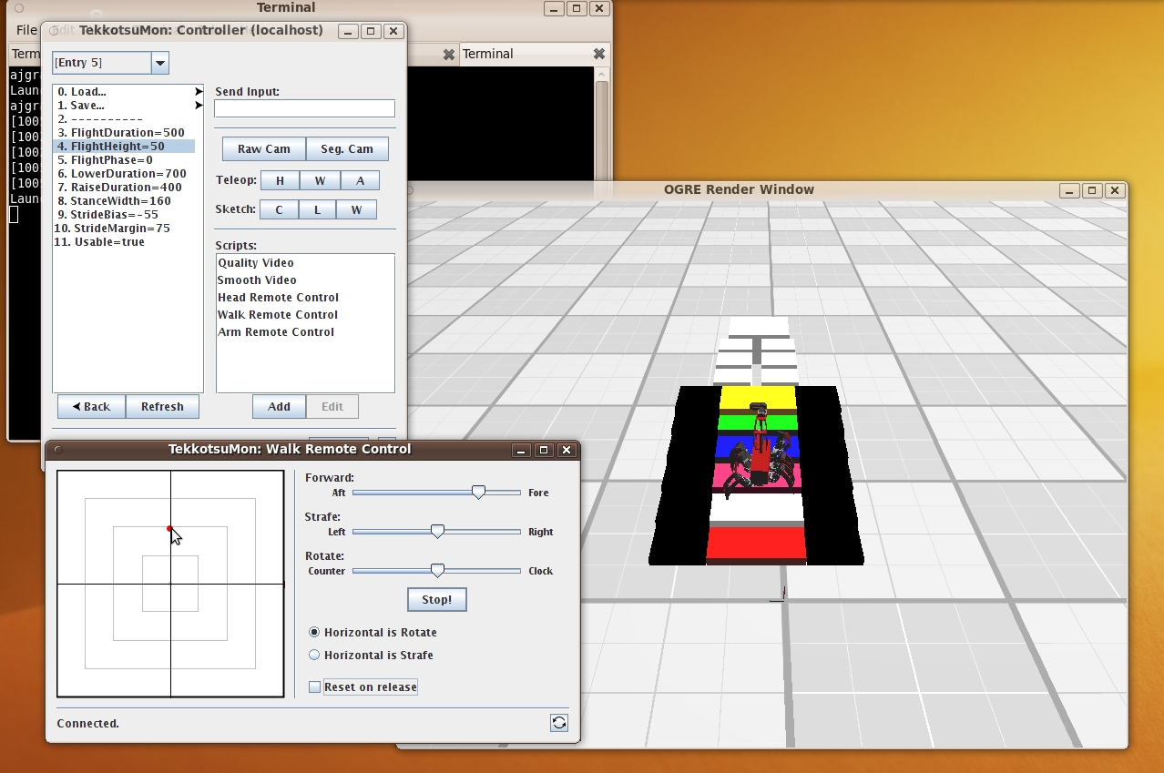
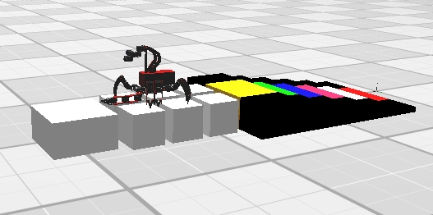
The Ultimate Stair Master
This works by typing/editing items in the terminal and whatever you program it to do or show appears in/on the world.
Terminal View
What’s happening in the program
Empty mirage window
Picture of Chiara before attempt
Linux Terminal
WorldBuilder Code
Chiara Robot on Stairs
Mirage Program with ControllerGUI
Chiara Robot on Columns
Chiara approaching platform

