Slide 1
15-251
Great Theoretical Ideas in Computer Science

Slide 2
Raising numbers to powers, Cyrptography and RSA,
Lecture 14 (October 7, 2010)
p-1
1
≡_{p}

Slide 3
How do you compute…
5⁸
using few multiplications?
First idea:
5
5²
5³
5⁴
5⁵
5⁶
5⁷
5⁸
= 5*5
= 5²*5

Slide 4
How do you compute…
5⁸
Better idea:
Used only 3 mults
instead of 7 !!!
5
5²
5⁴
5⁸
= 5⁴*5⁴
= 5*5
= 5²*5²

Slide 5
Repeated squaring calculates
a^{2k}
in k multiply operations
compare with (2^{k} – 1) multiply operations used by the naïve method

Slide 6
How do you compute…
5¹³
Use repeated squaring again?
5
5²
5⁴
5⁸
5¹⁶
too high! what now?
assume no divisions allowed…

Slide 7
How do you compute…
5¹³
Use repeated squaring again?
5
5²
5⁴
5⁸
Note that 13 = 8+4+1
13₁₀ = (1101)₂
So a¹³ = a⁸ * a⁴ * a¹
Two more multiplies!

Slide 8
To compute a^{m}
Suppose 2^{k} ≤ m < 2^{k+1}
a
a²
a⁴
a⁸
. . .
a^{2k}
This takes k multiplies
Now write m as a sum of distinct powers of 2
say, m = 2^{k} + 2^{i1} + 2^{i2} … + 2^{it}
a^{m} = a^{2k} * a^{2i1} * … * a^{2it}
at most k more multiplies

Slide 9
Hence, we can compute
a^{m}
while performing at most 2 ⎣log₂ m⎦ multiplies

Slide 10
How do you compute…
5¹³ (mod 11)
First idea: Compute 5¹³ using 5 multiplies
5
5²
5⁴
5⁸
5¹²
5¹³
= 1 220 703 125
= 5⁸*5⁴
= 5¹²*5
then take the answer mod 11
1220703125 (mod 11) = 4

Slide 11
How do you compute…
5¹³ (mod 11)
Better idea: keep reducing the answer mod 11
5
5²
5⁴
5⁸
5¹²
5¹³
25
´₁₁ 81
´₁₁ 36
´₁₁ 15
´₁₁ 3
´₁₁ 9
´₁₁ 4
´₁₁ 3
´₁₁ 4

Slide 12
Hence, we can compute
a^{m} (mod n)
while performing at most 2 ⎣log₂ m⎦ multiplies
where each time we multiply
together numbers with ⎣log₂ n⎦ + 1 bits

Slide 13
How do we implement this?
Let’s use my favorite programming language – Ocaml.
It’s a functional language that automatically infers the types of variables. It compiles to fast code. It has an interactive shell so that you can play with the functions you’ve written. (Similar to SML which you will learn about in 15-212 or 15-150.)
(* compute a to the pth power modulo n *)
let rec powermod a p n =
let sq x = (x*x) mod n in
if p=0 then 1 else
let x = sq (powermod a (p/2) n) in
if p mod 2 = 0 then x else (a*x) mod n

Slide 14
How do you compute…
5¹²¹²⁴²⁶⁵³ (mod 11)
The current best idea would still need about 54 calculations
answer = 4
Can we exponentiate any faster?

Slide 15
OK, need a little more number theory for this one…

Slide 16
First, recall…
Z_{n} = {0, 1, 2, …, n-1}
Z_{n}* = {x ∈ Z_{n} | GCD(x,n) =1}

Slide 17
Fundamental lemmas mod n:
If (x ≡_{n} y) and (a ≡_{n} b). Then
x + a ≡_{n} y + b
x * a ≡_{n} y * b
x - a ≡_{n} y – b
cx ≡_{n} cy ⇒ a ≡_{n} b
i.e., if c in Z_{n}*

Slide 18
Euler Phi Function Φ(n)
Φ(n) = size of Z_{n}*
p prime ⇒ Φ(p) = p-1
p, q distinct primes ⇒ Φ(pq) = (p-1)(q-1)

Slide 19
Fundamental lemma of powers?
If (x ≡_{n} y)
Then a^{x} ≡_{n} a^{y} ?
NO!
(2 ≡₃ 5) , but it is not the case that: 2² ≡₃ 2⁵

Slide 20
(Correct) Fundamental lemma of powers.
If a ∈ Z_{n}* and x ≡_{Φ(n)} y then a^{x} ≡_{n} a^{y}
Equivalently,
for a ∈ Z_{n}*, a^{x} ≡_{n} a^{x mod Φ(n)}

Slide 21
How do you compute…
5¹²¹²⁴²⁶⁵³ (mod 11)
121242653 (mod 10) = 3
5³ (mod 11) = 125 mod 11 = 4
Why did we
take mod 10?

Slide 22
for a ∈ Z_{n}*, a^{x} ≡_{n} a^{x mod Φ(n)}
Hence, we can compute
a^{m} (mod n)
while performing at most 2 ⎣log₂ Φ(n)⎦ multiplies
where each time we multiply
together numbers with ⎣log₂ n⎦ + 1 bits

Slide 23
343281³²⁷⁸⁴⁷³²⁴ mod 39
Step 1: reduce the base mod 39
Step 2: reduce the exponent mod Φ(39) = 24
NB: you should check that gcd(343280,39)=1 to use lemma of powers
Step 3: use repeated squaring to compute 3⁴, taking mods at each step

Slide 24
(Correct) Fundamental lemma of powers.
If a ∈ Z_{n}* and x ≡_{Φ(n)} y then a^{x} ≡_{n} a^{y}
Equivalently,
for a ∈ Z_{n}*, a^{x} ≡_{n} a^{x mod Φ(n)}

Slide 25
How do you prove the lemma for powers?
Use Euler’s Theorem
For a ∈ Z_{n}*, a ^{Φ(n)} ≡_{n} 1
Corollary: Fermat’s Little Theorem
For p prime, a ∈ Z_{p}*⇒ a^{p-1} ≡_{p} 1

Slide 26
Proof of Euler’s Theorem: for a ∈ Z_{n}*, a^{Φ(n)} ≡_{n} 1
Define a Z_{n}* = {a *_{n} x | x ∈ Z_{n}*} for a ∈ Z_{n}*
By the cancellation property, Z_{n}* = aZ_{n}*
x ≡_{n} Π ax [as x ranges over Z_{n}* ]
x ≡_{n} ∏ x (a ^{size of Zn*}) [Commutativity]
1 =_{n} a^{size of Zn*} [Cancellation]
a^{Φ(n)} =_{n} 1

Slide 27
Please remember
Euler’s Theorem
For a ∈ Z_{n}*, a ^{Φ(n)} ≡_{n} 1
Corollary: Fermat’s Little Theorem
For p prime, a ∈ Z_{p}*⇒ a^{p-1} ≡_{p} 1

Slide 28
Basic Cryptography

Slide 29
One Time Pads

Slide 30
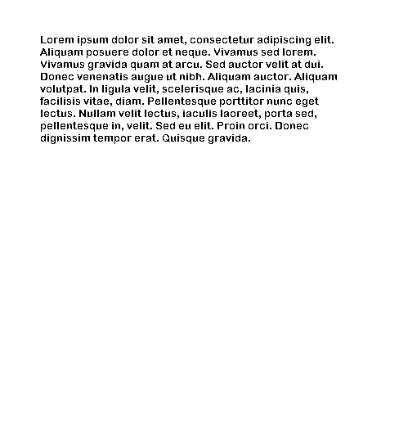
One Time Pads
they give perfect security!

Slide 31
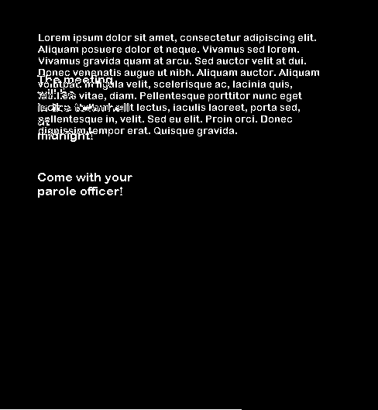
But reuse is bad
XOR
=
Can do other attacks as well

Slide 32
Agreeing on a secret
One time pads rely on having a shared secret!
Alice and Bob have never talked before
but they want to agree on a secret…
How can they do this?

Slide 33
A couple of small things
A value g in Z_{n}* “generates” Z_{n}* if
g, g², g³, g⁴, …, g^{Φ(n)}
contains all elements of Z_{n}*

Slide 34
Diffie-Hellman Key Exchange
Alice:
Picks prime p, and a generator g in Z_{p}*
Picks random a in Z_{p}*
Sends over p, g, gª (mod p)
Bob:
Picks random b in Z_{p}*, and sends over g^{b} (mod p)
Now both can compute g^{ab} (mod p)

Slide 35
What about Eve?
Alice:
Picks prime p, and a value g in Z_{p}*
Picks random a in Z_{p}*
Sends over p, g, gª (mod p)
Bob:
Picks random b in Z_{p}*, and sends over g^{b} (mod p)
Now both can compute g^{ab} (mod p)
If Eve’s just listening in,
she sees p, g, gª, g^{b}
It’s believed that computing g^{ab} (mod p) from just this information is not easy…

Slide 36
also, discrete logarithms seem hard
Discrete-Log:
Given p, g, gª (mod p), compute a
How fast can you do this?
If you can do discrete-logs fast, you can solve the Diffie-Hellman problem fast.
How about the other way? If you can break the DH key exchange protocol, do discrete logs fast?

Slide 37
Diffie Hellman requires both parties
to exchange information to share a secret
can we get rid of this assumption?

Slide 38
The RSA Cryptosystem

Slide 39
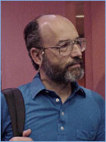
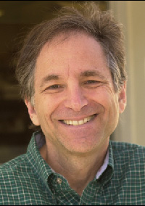
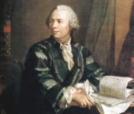
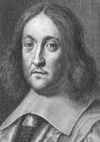
Our dramatis personae
Rivest
Shamir
Adleman
Euler
Fermat

Slide 40
Pick secret, random large primes: p,q
Multiply n = p*q
“Publish”: n
φ(n) = φ(p) φ(q) = (p-1)*(q-1)
Pick random e ∈ Z*_{φ(n)}
“Publish”: e
Compute d = inverse of e in Z*_{φ(n)}
Hence, e*d = 1 [ mod φ(n) ]
“Private Key”: d

Slide 41
p,q random primes
e random ∈ Z*_{φ(n)}
n = p*q
e*d = 1 [ mod φ(n) ]
n,e is my public key. Use it to send me a message.

Slide 42
p,q prime, e random ∈ Z*_{φ(n)}
n = p*q
e*d = 1 [ mod φ(n) ]
n, e
message m
m^{e} [mod n]
(m^{e})^{d} ≡_{n} m

Slide 44
How hard is cracking RSA?
If we can factor products of two large primes, can we crack RSA?
If we know n and Φ(n), can we crack RSA?
How about the other way? Does cracking RSA mean we must do one of these two?
We don’t know (yet)…

Slide 45
How do we generate large primes?
The density of primes is about 1/ln(n). So that if we can efficiently test the primality of a number, then we can generate primes fast.
Answer: The Miller-Rabin primality test.
(Gary Miller is one of our professors.)

Slide 46
Miller-Rabin test
The idea is to use a “converse” of Fermat’s Theorem. We know that:
a^{n-1} ≡_{n} 1
for any prime n and any a in [2, n-1]. What if we try this for some number a and it fails. Then we know that n is NOT prime. Miller-Rabin is based on this idea.
Say we write n-1 as d *2^{s} where d is odd.
Consider the following sequence of numbers mod n:
a^{d} , a^{2d}, a^{4d}. . . a^{d*2(s-1)}, a^{d*2s}= a^{n-1} ≡_{n} 1
Each element is the square of the previous one.

Slide 47
a^{d} , a^{2d}, a^{4d}. . . a^{d*2(s-1)}, a^{d*2s}= a^{n-1} ≡_{n} 1
If n is prime, then at some point the sequence hits 1 and stays there from then on.
The interesting point is: what is the number right before the first 1. If n is prime this MUST BE n-1.
Miller-Rabin Test
To test a number n, we pick a random a and generate the above sequence. If the sequence does not hit 1, then n is composite. If there’s an element before the first 1 and it’s not n-1, then n is composite.
Otherwise n is “probably prime”.

Slide 48
Miller-Rabin Analysis
If n is composite, then with a random a, the Miller-Rabin algorithm says “composite” with probability at least 3/4 .
So if we run the test 30 times and it never says “composite” then n is prime with “probability” 1-2⁻⁶⁰
In other words it’s more likely that you’ll win the lottery three days in a row than that this is giving a wrong answer.
i.e. not bloody likely.

Slide 49
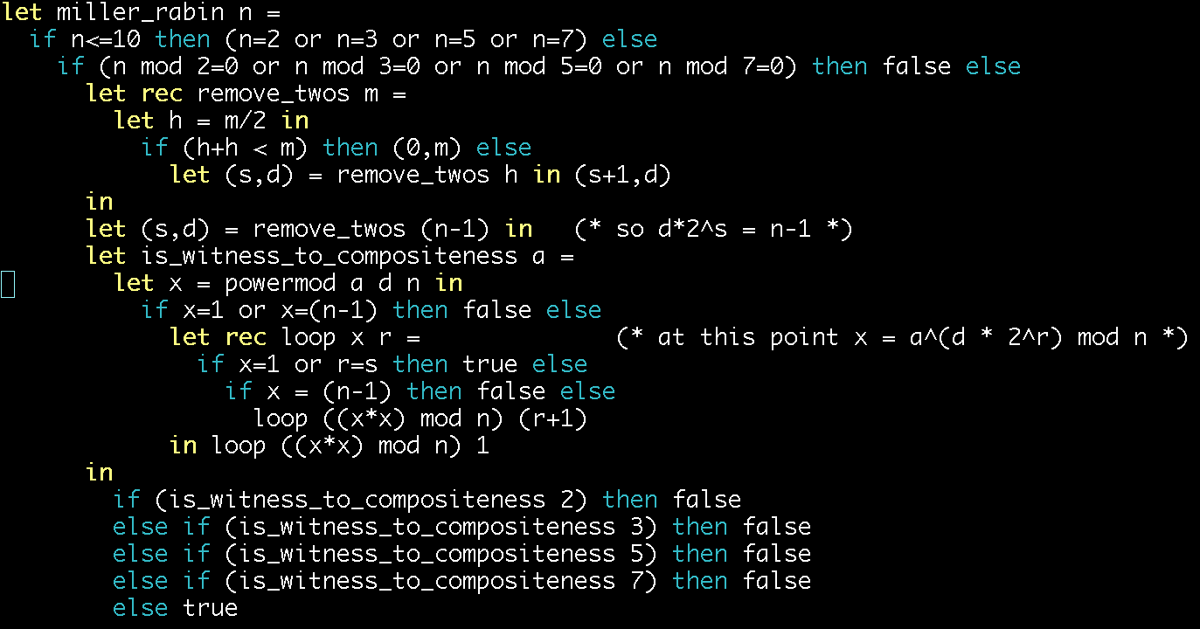
This ocaml implementation of the Miller-Rabin test does not pick random random witnesses, but rather uses 2, 3, 5, and 7. It’s guaranteed to work up to about 2 billion. See the accompanying file big_number.ml for a full high precision implementation of Miller-Rabin with random witnesses.

Slide 50
Fast exponentiation
Fundamental lemma of powers
Euler phi function φ(n) = |Z_{n}*|
Euler’s theorem
Fermat’s little theorem
Diffie-Hellman Key Exchange
RSA algorithm
Generating Large Primes
Here’s What You Need to Know…

