Slide 1
CS:APP Chapter 4
Computer Architecture
Wrap-Up
Randal E. Bryant
Carnegie Mellon University
http://csapp.cs.cmu.edu
CS:APP3e

Slide 2
Overview
Wrap-Up of PIPE Design
  Exceptional conditions
  Performance analysis
  Fetch stage design
Modern High-Performance Processors
  Out-of-order execution

Slide 3
Exceptions
  Conditions under which processor cannot continue normal operation
Causes
  Halt instruction (Current)
  Bad address for instruction or data (Previous)
  Invalid instruction (Previous)
Typical Desired Action
  Complete some instructions
    Either current or previous (depends on exception type)
  Discard others
  Call exception handler
    Like an unexpected procedure call
Our Implementation
  Halt when instruction causes exception

Slide 4
Exception Examples
Detect in Fetch Stage
jmp $-1 # Invalid jump target
.byte 0xFF # Invalid instruction code
halt # Halt instruction
Detect in Memory Stage
irmovq $100,%rax
rmmovq %rax,0x10000(%rax) # invalid address

Slide 5
Exceptions in Pipeline Processor #1
# demo-exc1.ys
irmovq $100,%rax
rmmovq %rax,0x10000(%rax) # Invalid address
nop
.byte 0xFF # Invalid instruction code
1
2
3
4
5
0x000: irmovq $100,%rax
F
D
E
M
W
Exception detected
0x00a: rmmovq %rax,0x1000(%rax)
F
D
E
M
0x014: nop
F
D
E
0x015: .byte 0xFF
F
D
Exception detected
Desired Behavior
  rmmovq should cause exception
  Following instructions should have no effect on processor state

Slide 6
Exceptions in Pipeline Processor #2
# demo-exc2.ys
0x000: xorq %rax,%rax # Set condition codes
0x002: jne t # Not taken
0x00b: irmovq $1,%rax
0x015: irmovq $2,%rdx
0x01f: halt
0x020: t: .byte 0xFF # Target
1
2
3
4
5
6
7
8
9
0x000: xorq %rax,%rax
F
D
E
M
W
0x002: jne t
F
D
E
M
0x020: t: .byte 0xFF
F
D
E
M
W
0x???: (I’m lost!)
F
D
E
M
W
0x00b: irmovq $1,%rax
F
D
E
M
W
Exception detected
Desired Behavior
  No exception should occur

Slide 7
Maintaining Exception Ordering
W
stat
icode
valE
valM
dstE
dstM
M
stat
icode
Cnd
valE
valA
dstE
dstM
E
stat
icode
ifun
valC
valA
valB
dstE
dstM
srcA
srcB
D
stat
icode
ifun
rA
rB
valC
valP
F
predPC
  Add status field to pipeline registers
  Fetch stage sets to either “AOK,” “ADR” (when bad fetch address), “HLT” (halt instruction) or “INS” (illegal instruction)
  Decode & execute pass values through
  Memory either passes through or sets to “ADR”
  Exception triggered only when instruction hits write back

Slide 8
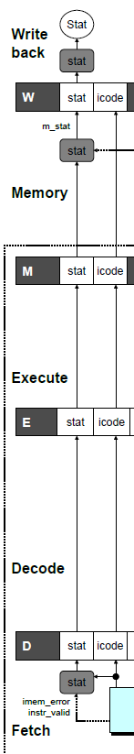
Exception Handling Logic
Fetch Stage
Memory Stage
Writeback Stage
dmem_error
# Determine status code for fetched instruction
int f_stat = [
imem_error: SADR;
!instr_valid : SINS;
f_icode == IHALT : SHLT;
1 : SAOK;
];
# Update the status
int m_stat = [
dmem_error : SADR;
1 : M_stat;
];
int Stat = [
# SBUB in earlier stages indicates bubble
W_stat == SBUB : SAOK;
1 : W_stat;
];

Slide 9
Side Effects in Pipeline Processor
# demo-exc3.ys
irmovq $100,%rax
rmmovq %rax,0x10000(%rax) # invalid address
addq %rax,%rax # Sets condition codes
1
2
3
4
5
0x000: irmovq $100,%rax
F
D
E
M
W
Exception detected
0x00a: rmmovq %rax,0x1000(%rax)
F
D
E
M
0x014: addq %rax,%rax
F
D
E
Condition code set
Desired Behavior
  rmmovq should cause exception
  No following instruction should have any effect

Slide 10
Avoiding Side Effects
Presence of Exception Should Disable State Update
  Invalid instructions are converted to pipeline bubbles
    Except have stat indicating exception status
  Data memory will not write to invalid address
  Prevent invalid update of condition codes
    Detect exception in memory stage
    Disable condition code setting in execute
    Must happen in same clock cycle
  Handling exception in final stages
    When detect exception in memory stage
      Start injecting bubbles into memory stage on next cycle
    When detect exception in write-back stage
      Stall excepting instruction
  Included in HCL code

Slide 11
Control Logic for State Changes
Setting Condition Codes
Stage Control
  Also controls updating of memory
# Should the condition codes be updated?
bool set_cc = E_icode == IOPQ &&
# State changes only during normal operation
!m_stat in { SADR, SINS, SHLT }
&& !W_stat in { SADR, SINS, SHLT };
# Start injecting bubbles as soon as exception passes through memory stage
bool M_bubble = m_stat in { SADR, SINS, SHLT }
|| W_stat in { SADR, SINS, SHLT };
# Stall pipeline register W when exception encountered
bool W_stall = W_stat in { SADR, SINS, SHLT };

Slide 12
Rest of Real-Life Exception Handling
Call Exception Handler
  Push PC onto stack
    Either PC of faulting instruction or of next instruction
    Usually pass through pipeline along with exception status
  Jump to handler address
    Usually fixed address
    Defined as part of ISA
Implementation
  Haven’t tried it yet!

Slide 13
Performance Metrics
Clock rate
  Measured in Gigahertz
  Function of stage partitioning and circuit design
    Keep amount of work per stage small
Rate at which instructions executed
  CPI: cycles per instruction
  On average, how many clock cycles does each instruction require?
  Function of pipeline design and benchmark programs
    E.g., how frequently are branches mispredicted?

Slide 14
CPI for PIPE
CPI ≈ 1.0
  Fetch instruction each clock cycle
  Effectively process new instruction almost every cycle
    Although each individual instruction has latency of 5 cycles
CPI > 1.0
  Sometimes must stall or cancel branches
Computing CPI
  C clock cycles
  I instructions executed to completion
  B bubbles injected (C = I + B)
  CPI = C/I = (I+B)/I = 1.0 + B/I
  Factor B/I represents average penalty due to bubbles

Slide 15
CPI for PIPE (Cont.)
  B/I = LP + MP + RP
  LP: Penalty due to load/use hazard stalling
    Fraction of instructions that are loads 0.25
    Fraction of load instructions requiring stall 0.20
    Number of bubbles injected each time 1
    ⇒ LP = 0.25 * 0.20 * 1 = 0.05
  MP: Penalty due to mispredicted branches
    Fraction of instructions that are cond. jumps 0.20
    Fraction of cond. jumps mispredicted 0.40
    Number of bubbles injected each time 2
    ⇒ MP = 0.20 * 0.40 * 2 = 0.16
  RP: Penalty due to ret instructions
    Fraction of instructions that are returns 0.02
    Number of bubbles injected each time 3
    ⇒ RP = 0.02 * 3 = 0.06
  Net effect of penalties 0.05 + 0.16 + 0.06 = 0.27
    ⇒ CPI = 1.27 (Not bad!)
Typical Values

Slide 16
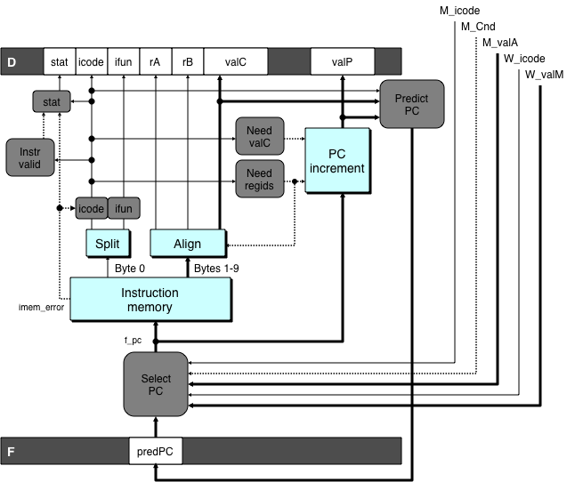
Fetch Logic Revisited
During Fetch Cycle
  Select PC
  Read bytes from instruction memory
  Examine icode to determine instruction length
  Increment PC
Timing
  Steps 2 & 4 require significant amount of time

Slide 17
Standard Fetch Timing
Select PC
need_regids, need_valC
Mem. Read
Increment
1 clock cycle
  Must Perform Everything in Sequence
  Can’t compute incremented PC until know how much to increment it by

Slide 18
A Fast PC Increment Circuit
incrPC
High-order 60 bits
Low-order 4 bits
MUX
carry
0
1
60-bit
incre-
menter
4-bit adder
Slow
Fast
need_regids
0
High-order 60 bits
need_ValC
Low-order 4 bits
PC

Slide 19
Modified Fetch Timing
need_regids, need_valC
Select PC
4-bit add
Mem. Read
MUX
Incrementer
Standard cycle
1 clock cycle
60-Bit Incrementer
  Acts as soon as PC selected
  Output not needed until final MUX
  Works in parallel with memory read

Slide 20
More Realistic Fetch Logic
Bytes 1-9
Fetch Box
  Integrated into instruction cache
  Fetches entire cache block (16 or 32 bytes)
  Selects current instruction from current block
  Works ahead to fetch next block
    As reaches end of current block
    At branch target

Slide 21
Modern CPU Design

Slide 22
Instruction Control
Grabs Instruction Bytes From Memory
  Based on Current PC + Predicted Targets for Predicted Branches
  Hardware dynamically guesses whether branches taken/not taken and (possibly) branch target
Translates Instructions Into Operations
  Primitive steps required to perform instruction
  Typical instruction requires 1–3 operations
Converts Register References Into Tags
  Abstract identifier linking destination of one operation with sources of later operations

Slide 23
Execution
Unit
Register
Prediction
Operations
Updates
OK?
Integer/
General
FP
FP
Load
Store
Functional
Branch
Integer
Add
Mult
/Div
Units
Operation Results
Addr
.
Addr
.
Data
Data
Data
Cache
Execution
Execution
  Multiple functional units
    Each can operate in independently
  Operations performed as soon as operands available
    Not necessarily in program order
    Within limits of functional units
  Control logic
    Ensures behavior equivalent to sequential program execution

Slide 24
CPU Capabilities of Intel Haswell
Multiple Instructions Can Execute in Parallel
  2 load
  1 store
  4 integer
  2 FP multiply
  1 FP add / divide
Some Instructions Take > 1 Cycle, but Can be Pipelined
  Instruction Latency Cycles/Issue
  Load / Store 4 1
  Integer Multiply 3 1
  Integer Divide 3—30 3—30
  Double/Single FP Multiply 5 1
  Double/Single FP Add 3 1
  Double/Single FP Divide 10—15 6—11

Slide 25
Haswell Operation
Translates instructions dynamically into “Uops”
  ~118 bits wide
  Holds operation, two sources, and destination
Executes Uops with “Out of Order” engine
  Uop executed when
    Operands available
    Functional unit available
  Execution controlled by “Reservation Stations”
    Keeps track of data dependencies between uops
    Allocates resources

Slide 26
High-Perforamnce Branch Prediction
Critical to Performance
  Typically 11–15 cycle penalty for misprediction
Branch Target Buffer
  512 entries
  4 bits of history
  Adaptive algorithm
    Can recognize repeated patterns, e.g., alternating taken–not taken
Handling BTB misses
  Detect in ~cycle 6
  Predict taken for negative offset, not taken for positive
    Loops vs. conditionals

Slide 27
Example Branch Prediction
Branch History
  Encode information about prior history of branch instructions
  Predict whether or not branch will be taken
State Machine
  Each time branch taken, transition to right
  When not taken, transition to left
  Predict branch taken when in state Yes! or Yes?
NT
NT
NT
T
Yes!
Yes?
No?
No!
NT
T
T
T

Slide 28
Processor Summary
Design Technique
  Create uniform framework for all instructions
    Want to share hardware among instructions
  Connect standard logic blocks with bits of control logic
Operation
  State held in memories and clocked registers
  Computation done by combinational logic
  Clocking of registers/memories sufficient to control overall behavior
Enhancing Performance
  Pipelining increases throughput and improves resource utilization
  Must make sure to maintain ISA behavior

