Slide 1
Compilers for AI
Tan Li, Chrisma Pakha

Slide 2
Outline
TVM: An automated End-to-End Optimizing Compiler for Deep Learning
Optimizing CNNs on Multicores for Scalability, Performance and Goodput
Latte: A language, Compiler, and Runtime for Elegant and Efficient Deep Learning

Slide 3
TVM: An automated end-to-end optimizing compiler for Deep learning

Slide 30
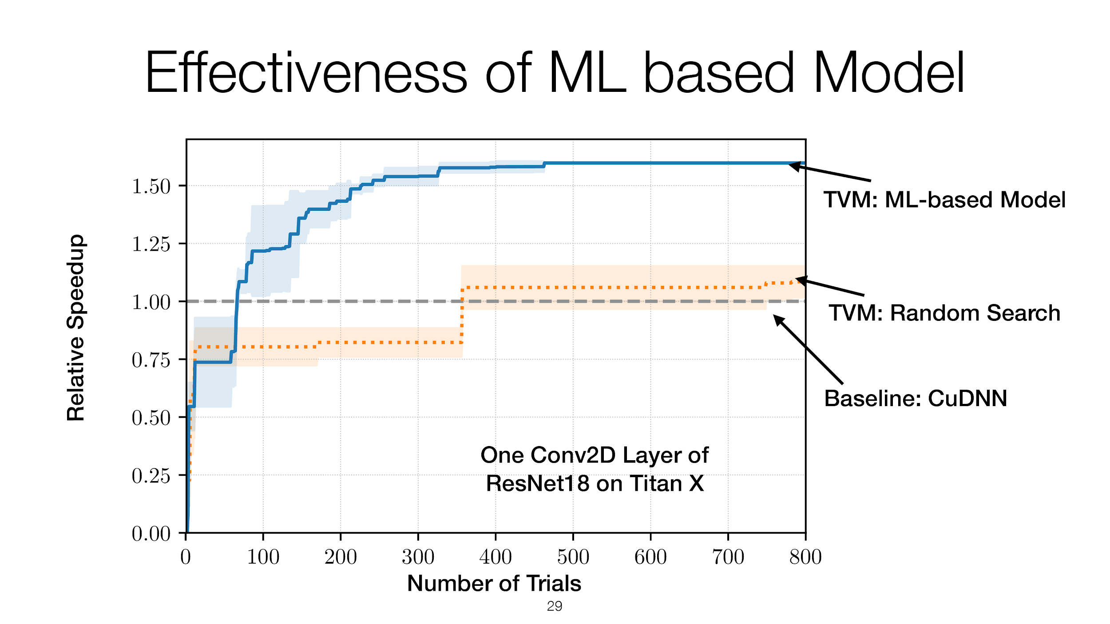

Slide 32
Optimizing CNNs on Multicores for Scalability, Performance and Goodput

Slide 33
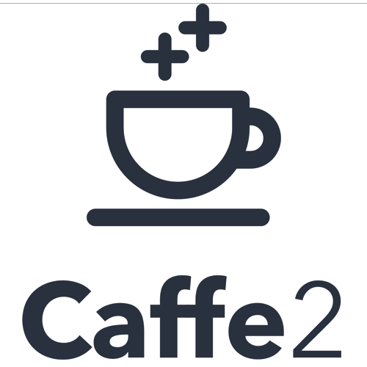
Existing approach:
Unfold Input to matrix
General Matrix Multiply Library

Slide 34
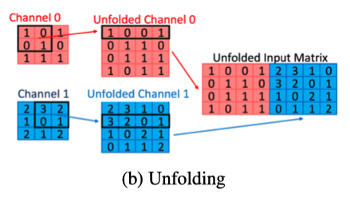
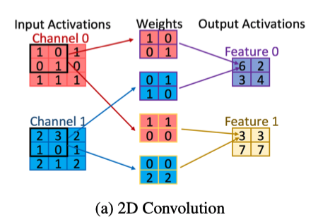
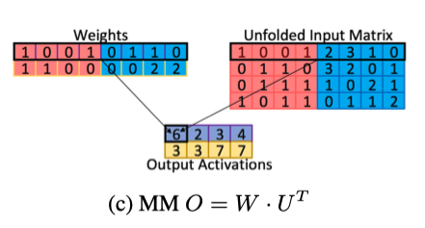
Goal: Efficient Training of CNN on CPU
Operations in Training CNN:
1. Unfold
2. Matrix Multiply

Slide 35
Performance Characterization:
1. Arithmetic Intensity (AIT): Ratio of number of arithmetic operations to the number of memory operations
2. Sparsity: The fraction of elements in data array that are zero
3. Scalability: Increase the number of cores, the number of arithmetic operation per core reduces proportionately.
4. Single Core Performance: Each core shouldn't have similar workload
5. Goodput: Rate of useful work in a computation

Slide 36
Bottleneck of performance:
1. Unfolding -> Increased Memory Access -> Reduced AIT -> Poor Single Core Performance
2. Increase the number of cores -> number of arithmetic operations in Parallel-GEMM reduced
- Good for large Matrix * large Matrix, Bad for small Matrix * small Matrix (Low AIT per core)
3. Sparse Matrix Operation -> Low goodput

Slide 37
Tricks:
1. GEMM in Parallel -> High AIT per core -> Higher Scalability
2. Sparse-Kernel -> Increase Goodput
3. Stencil-Kernel -> Compute CNN through direct convolution without unfolding -> High AIT

Slide 38
Latte: A language, Compiler, and Runtime for Elegant and Efficient Deep Learning

Slide 39
Limitation of existing Platform
Represent the neural network as an array programming model
Where network state is encoded as tensors with layers implemented as the function for this tensors. Downside is it pushes the responsibility of deriving array programming formulation of novel layers to the researchers.
Cross layer optimization Kernel fusion : Optimization method to reduce overhead of data transfer by fusing some sequential kernels into single kernel. Unable to perform kernel fusion with Static layer-specific libraries since the libraries are precompiled ahead of time.

Slide 40
Latte :
What is Latte: A DSL for deep learning. User can express network as a collection of neurons, the same way it is introduce in textbook.
Hides low level details such as parallelization, heterogenous code generation, and optimization.
Primitives use : Neurons, Ensemble(layers), Network

Slide 41
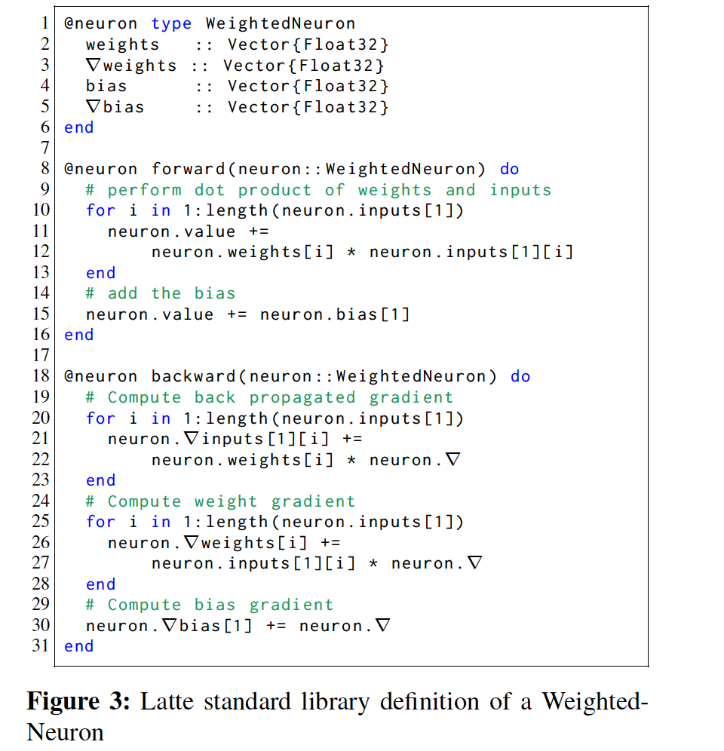
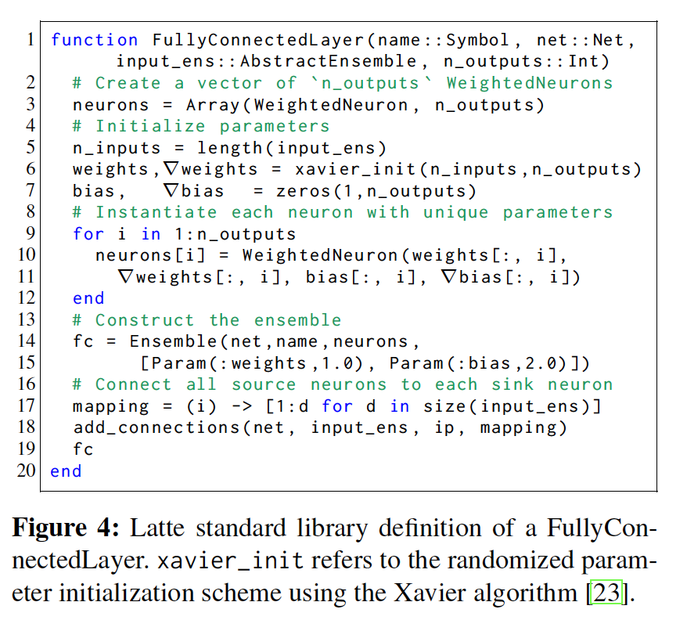

Slide 42
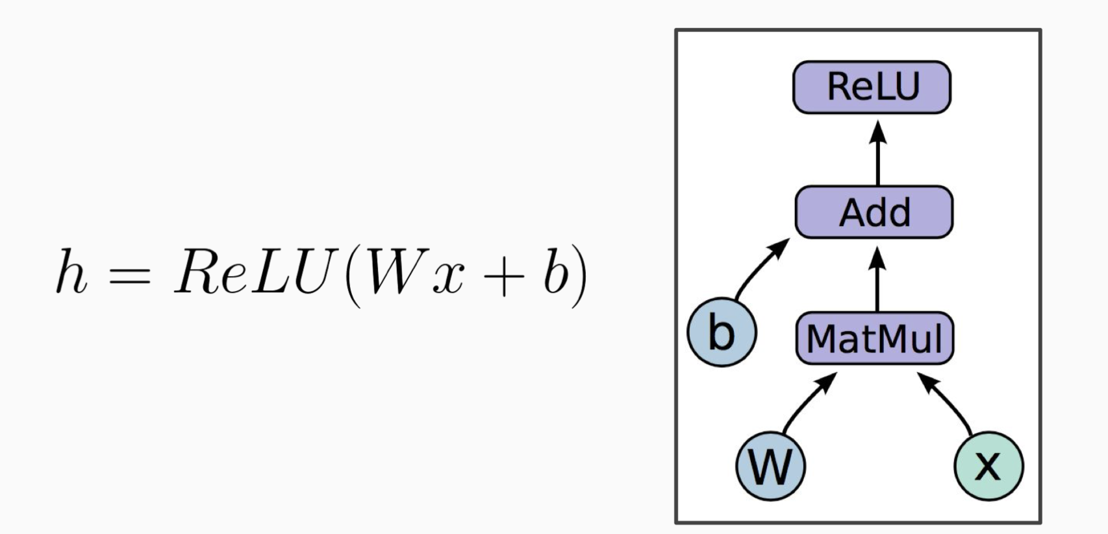
Compiler
The compiler has 4 phase :
Analysis
Synthesis
Optimization
CodeGen
Intermediate representation : User description trivially maps to a data-flow graph. Nodes represent computation while edges represent data dependency
Extends the graph engine approach by replacing generic operation on tensors with abstraction specific to neural networks.
.

Slide 43
Optimization
Type of optimization involved :
Increasing Locality
Reducing Overhead
Enabling Parallelization

Slide 44
Intra Layer Optimization
Library Kernel Pattern Matching
A pass that lowered synthesized code into library calls. Leverage highly efficient kernel from vendors. Example : A convolution layer computation into GEMM function call.
Loop Tiling
Synthesized code is loop heavy. Can benefit from loop tiling. Allow parallelization while sharing values in cache.

Slide 45
Cross Layer Fusion
This allows thread to reuse data computed for a tile to immediately compute the output of the next layer. The fusion only occurs when there is no dependence along dimensions greater than the tiled dimension.

Slide 46
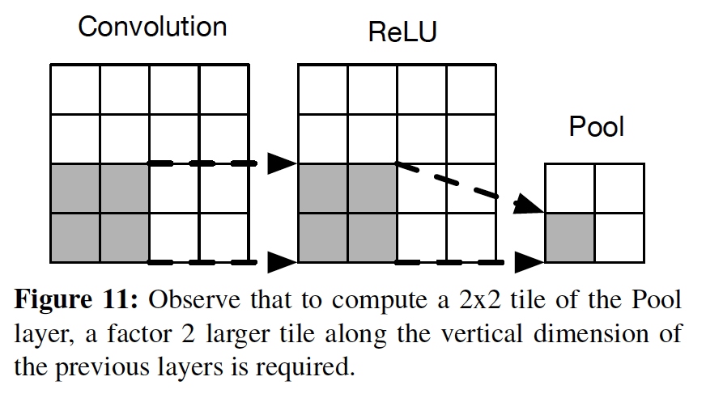

Slide 47
Parallelization
Computation of an ensemble is implicitly data-parallel across batch items since there is no dependency.
Inside an iteration of batch loop, there typically exists a tiled loop. The computation of each loop tile is also data parallel because the neuron’s output does not depend on any other neurons in the ensemble.

Slide 48
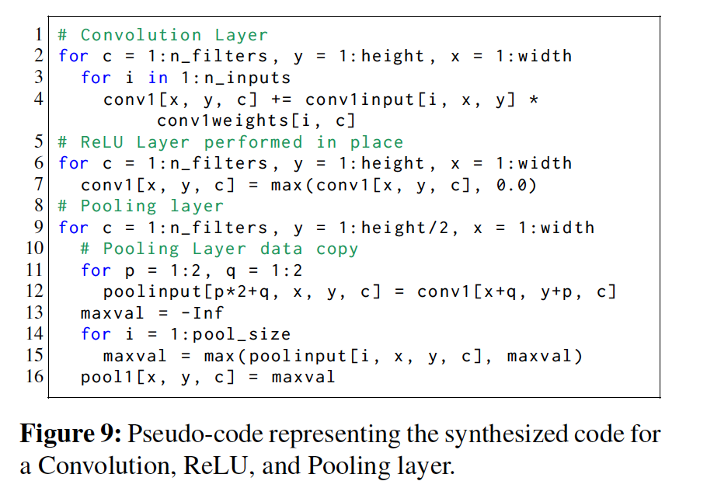
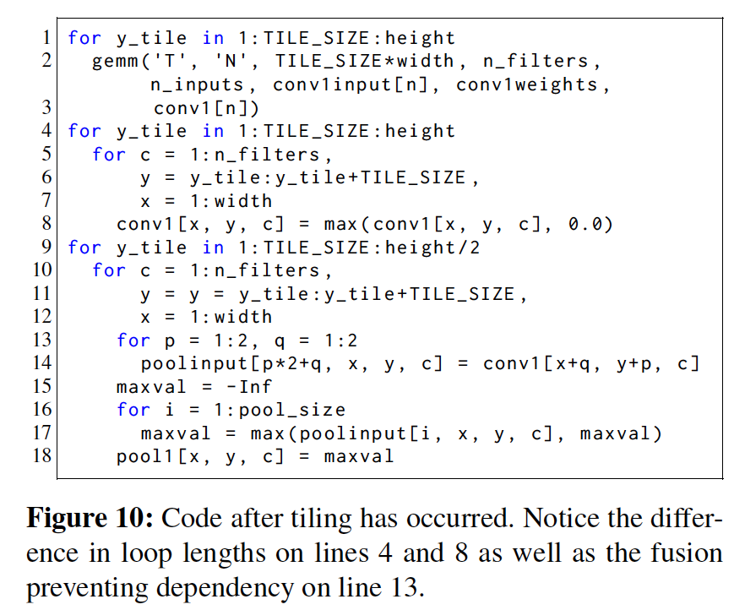

Slide 49
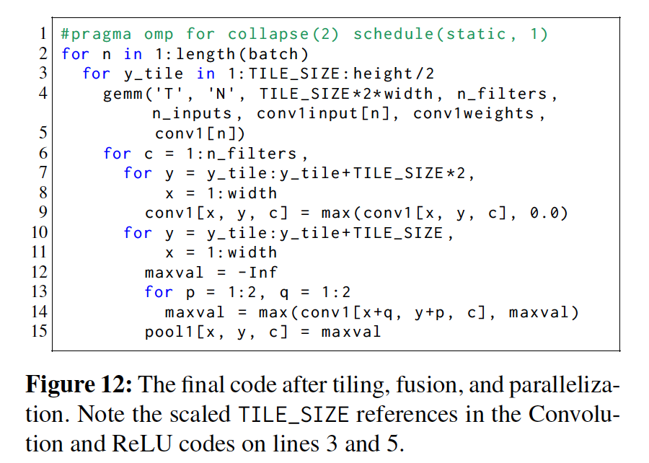

Slide 50
Conclusion
Computation and structure of Deep Learning varied a lot and is unique such that it requires its own compiler to allow significant optimization.
Target hardware for DL platform are too heterogeneous such that compiler will need a certain mechanism to generate efficient code.
Improvements in performance requires close co-design of algorithm and hardware

Slide 51
References
1. https://www.usenix.org/conference/osdi18/presentation/chen

