Slide 1
Lecture 15: Interactive Tools: Prototypers (HyperCard, Director, Visual Basic), Interface Builders, Sketching Tools
Brad Myers
05-830 Advanced User Interface Software

Slide 2
Definition
Tools that Use graphical techniques to specify UI
Usually focus on graphical parts of UI
Not same as “visual” or “graphical programming”

Slide 3
Prototyping Tools
Just show what looks like
Storyboard of screens
“Click-through prototypes”
Note: differentiate from term "rapid prototyping“
Some support for behavior: typically changing screens
Like a movie of the interaction
Goal: see some of interface very quickly (hours)
Often no possibility of migrating to real application
May not use "real" widgets
"Low Fidelity" Techniques

Slide 4
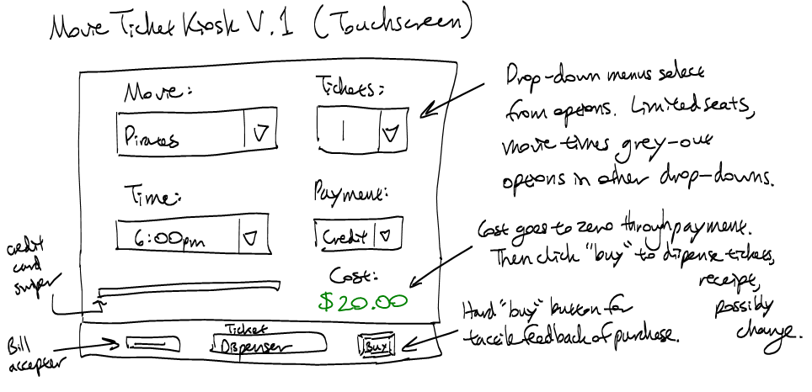
Low Fidelity Prototyping
Just use paper and/or overheads
No tools
Experimenter "plays computer"
Ask the user "what would you do now“
Experimenter shows the computer's expected response
Very cheap and easy and gets surprisingly good results
Find out if users understand organization, how to find desired operations, if understand menu names, etc.
Easy to change between sessions
Can make a movie of the paper using a regular video camera
To demonstrate/explain the interface

Slide 5
Early Prototypers
For Character Screens
24x80 DOS, often no mouse
Especially for forms-based applications
Examples: Dan Bricklin’s Demo-It (Windows v2.0 ~1987), Protoscreens for PCs from Bailey&Bailey (~1990)
Specify characters for each position of screen, or a "character graphics"
Can specify fields that are editable text
Can specify that clicking on an area causes changing to a new screen.
Also menus

Slide 6
Card Programs as Prototypers
Card Programs
Examples:
HyperCard and SuperCard for Mac
OWL's GUIDE for PCs (gone?)
Toolbook (formerly from Asymetrix then Click2Learn, then SumTotal Systems, Inc. http://www.toolbook.com)
Sequence of cards
Paint program (not "draw")
Draw pictures on each card
May be multiple layers

Slide 7
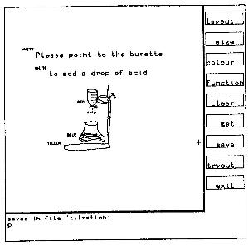
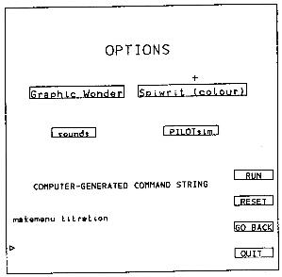
Early Research Card Systems
Menulay
Buxton, Siggraph’83 pp. 31-38
http://www.billbuxton.com/menulay.pdf
http://www.youtube.com/watch?v=Kt0oAg0haU0
vector screens, widgets, sounds, text, output C code and tables
All actions (including transitions) required C programming

Slide 8
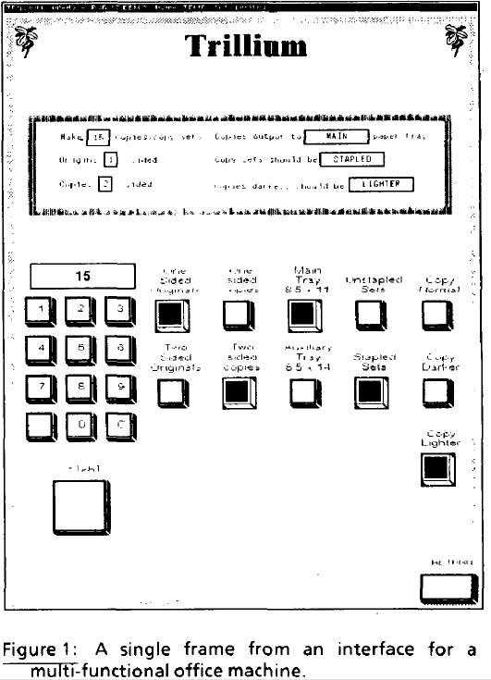
Early Research Card Systems, cont.
Trillium
Henderson, CHI’86
http://doi.acm.org/10.1145/22339.22375
Xerox copier interfaces
interpreted Lisp
Transitions defined using the interface

Slide 9
HyperCard, details
Buttons can transition to another card
Fancy transitions
Single window
Buttons can start running a script ("HyperTalk")
Script can move objects, change cards, animate, compute, etc.
Code management: who changes what; finding the script
Not good for dynamically created graphics
Complete control of individual pixels
Graphic designers have complete control
Design new widgets
Can be "real" application if sufficient power/speed
Used for original Myst game, etc.

Slide 10
Animation Programs
Example: MacroMedia’s Director (1987) – now Adobe
Also control individual pixels
Individual paintings can be specified as animation element
E.g., characters
Each can be instantiated, moved, etc.
Good control over timing, synchronization
Scripting language
Can program that when a mouse button is clicked in an area, start an animation or transition
Scripting language even more primitive than HyperTalk
Good for "Future Scenarios" when want good fidelity with real look
Not for final (real) interface unless Multi-media

Slide 11
Interface Builders
Also called Interface Development Tools (IDTs) or GUI Builders or “resource editors”
Lay out widgets to make dialog boxes, menus.
Have a palette or menu of kinds of widgets
Select widget, place with mouse in a window
Set some properties
Design menus, palettes, dialog boxes, controls
Put in “graphics” pane for main application window
Easy to use, but limited
Connect call-backs with each widget
Generates C code directly or intermediate language
Sometimes connected to an intepreter so can execute call-backs.
If not, some call-backs can be simulated, e.g. transition to another window; pop-up error

Slide 12
Interface Builders, cont.
Layout mechanisms
usually a complication
X's row and columns stuff
Galaxy's struts and springs
Java’s Layout Managers
“Resources”
store information in special files rather than in source code
positions, colors, text labels, etc.
allow for easier modification for users, internationalization, etc.
IBs Usually don't support:
Error checking of values, e.g. for text input fields
Graying of widgets depending on values and other widgets
Default values of widgets
Dynamic changing of widgets (e.g., add more items)
Dynamic changing layers (groups) of widgets (visibility) depending on values and other widgets
Any dynamically created graphical objects.

Slide 13
Interface Builders, cont.
Examples:
See “Card” systems, e.g., Menulay (1983-research system)
NeXT Interface Builder (NeXT) - 1988 popularized the name
By Jean-Marie Hullot who had an IB in Lisp at INRIA in France
Visual Basic
Resource editors in programming environments
Used to be lots of IB products
Used to be many commercial tools are in this category; over 100
See my old list (1997): http://www.cs.cmu.edu/~bam/toolnames.html
Most went out of business
Microsoft, MetroWorks, etc. include “resource editors” for “free”

Slide 14
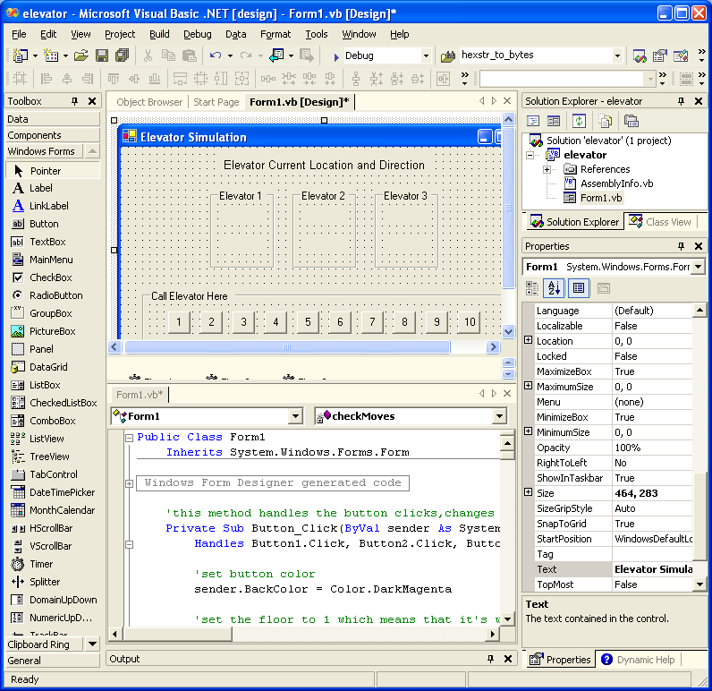
VB Screen

Slide 15
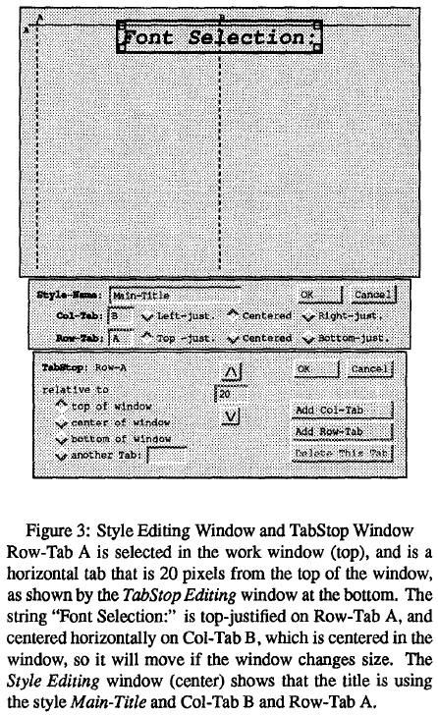
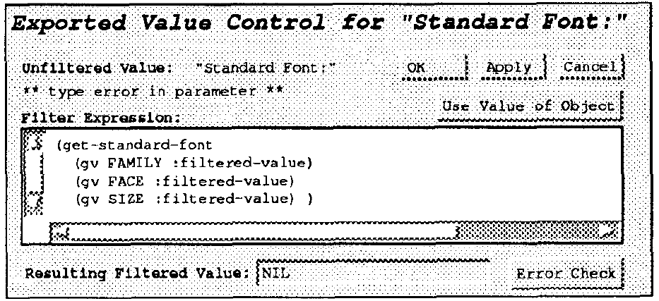
Some Research in IB
Garnet’s GILT interface builder:
Styles by example (Hashimoto, UIST’92)
http://doi.acm.org/10.1145/142621.142635 or video (1min no sound)
Graphical tab stops, absolute or relative
Graphical styles for widget properties
Eliminating Call-backs (UIST’91)
http://doi.acm.org/10.1145/120782.120805 or video (5min)
Handles error checking, data transformations, connections of widgets to each other

Slide 16
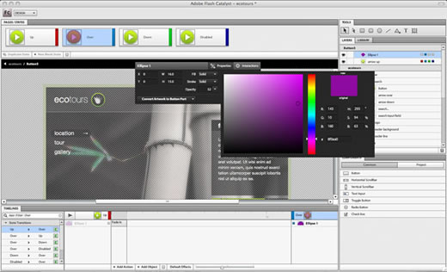
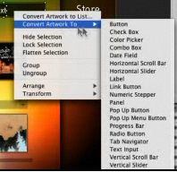
Novel IB
Adobe Catalyst (formerly Thermo)
Part of CS5.5, now discontinued in CS 6.0
Associate behaviors with the objects
Like my Lapidary (see next lecture)

Slide 17
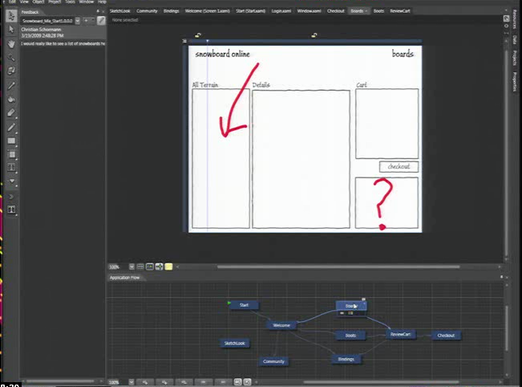
Microsoft’s Expression Blend
Microsoft new Silverlight Blend 3’s SketchFlow
http://channel9.msdn.com/Events/MIX/MIX09/C01F (1 hour video)
Behaviors, etc. as well
Landay says this has “sketching” (see 3/19/09 blog)

Slide 18
Commercial Prototypers
Search for “Prototyping tools” or “Wireframing Tools”
Here are some lists:
http://mashable.com/2010/07/15/wireframing-tools/ - “10 free wireframing tools”
http://www.uxbooth.com/blog/15-desktop-online-wireframing-tools/
http://www.tripwiremagazine.com/2010/04/15-best-wireframing-tools-for-designers.html
http://www.uie.com/articles/prototyping_tools/?link=tips100318_6
http://c2.com/cgi/wiki?GuiPrototypingTools

Slide 19
Examples:
Axure (downloaded)
On-line tools
Fluid UI
Balsamiq (http://www.balsamiq.com/)
Moqups
Mockingbird
FluidUI
Mockflow

Slide 20
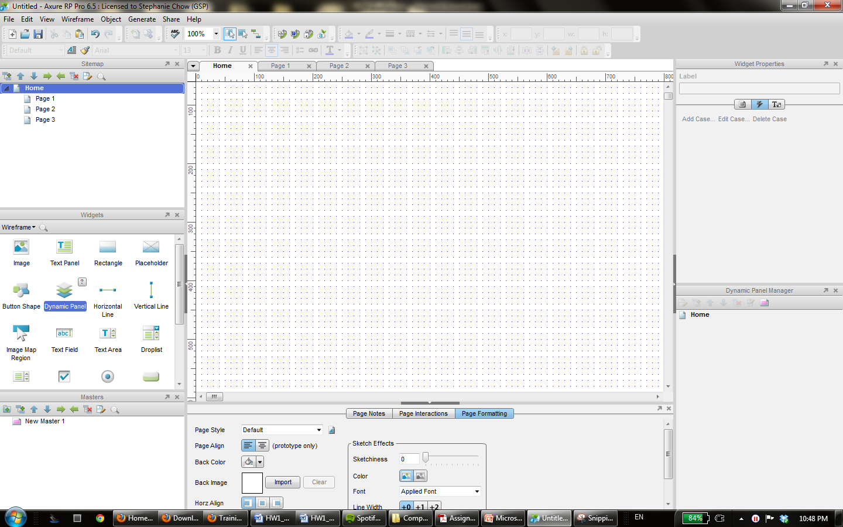
Axure
Drag and drop widgets onto your page

Slide 21
Research in Informal Tools
Sketching tools
Use before interface builders
Designed to help support the ideation phase
Menulay (saw earlier)
James Landay’s SILK tool
Infer formal widgets and widget groupings from sketches
Convert to real widgets
Sketch storyboards for transitions

Slide 22
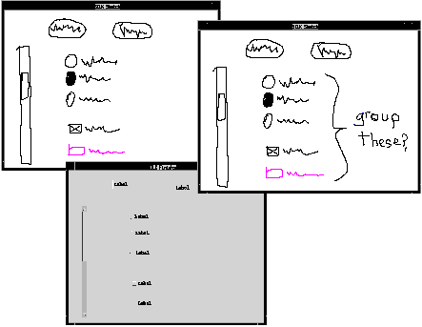
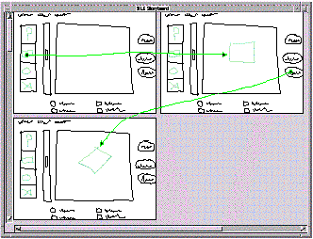
Research in Informal Tools
Main paper: http://doi.acm.org/10.1145/223904.223910
Video from CHI’96 (8:22 min)

Slide 23
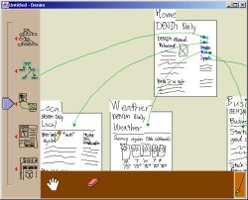
Landay’s later tool: Denim
Denim and its video

