Slide 1
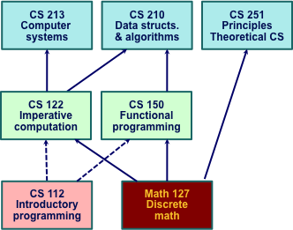
Creating a Foundational Curriculum in Computer Science
Randal E. Bryant
School of Computer Science
Carnegie Mellon University

Slide 2
Overview
CS 213
Computer systems
CS 210
Data structs.
& algorithms
CS 251
Principles
Theoretical CS
What is a Foundational Curriculum?
Evolution
  1997 Theoretical CS
  1998 Computer Systems
  2010 Programming + Algorithms
CS 122
Imperative
computation
CS 150
Functional
programming
CS 112
Introductory
programming
Math 127
Discrete
math

Slide 3
A Foundational Curriculum in CS
Intention
  A common set of courses for all CS majors
    What every CS major should know
  Taken in first two years
  Covers “core” material
    Allow maximum flexibility in later courses
Complexities
  Balancing theoretical principles & hands-on experience
    Students want job skills (summer internships + graduation)
    Foundational principles will enable lifelong learning
    Students learn by doing (writing code, solving problems)
  Need to blend with other majors on campus
    Especially computer engineering & math

Slide 4
Introducing Theoretical CS
Background
  Course created by Steven Rudich 1997
  Typically taken in first or second year
Ideas
  Algorithmic description of problem
  Finding efficient solutions
  Complexity analysis
  Lower & upper bound arguments
Not
  Enumeration of well-known & practical algorithms
CS 251
Principles
Theoretical CS
Math 127
Discrete
math

Slide 5
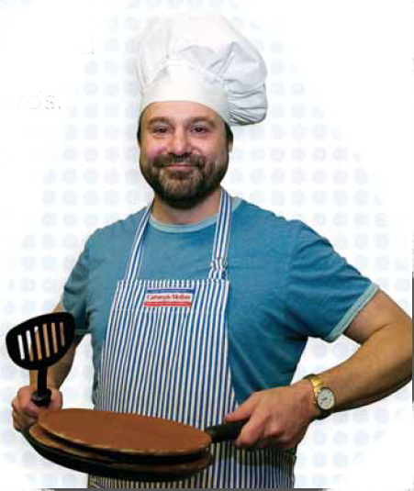
251 Example: The Pancake Problem
Task: Order stack of pancakes
➔
➔
➔

Slide 6
The Pancake Problem
Moves: Flip over any top portion
➔
➔
➔

Slide 7
The Pancake Problem
Move Possibilities

Slide 8
Flipping Example
➔
➔
➔
➔
➔
➔
6 flips suffice for this example
(not optimal)

Slide 9
Pancake Problem Complexity
“Pancake Number” P_{n}
  Number of flips to order stack of n pancakes
  Best possible algorithm
  Worst possible starting order
Bounding P_{n}
  Upper bound 2n – 3
    Algorithm iterates with 2 flips / element
  Lower bound: n (for n > 2)
    Argue need for flip, given properties of adjacent pancakes
    Demonstrate bad input case
State of the Art
n | 1 | 2 | 3 | 4 | 5 | 6 | 7 | 8 | 9 | 10 | 11 | 12 | 13 | > 13
P_{n} | 0 | 1 | 3 | 4 | 5 | 7 | 8 | 9 | 10 | 11 | 13 | 14 | 15 | ??

Slide 10
Observations about Pancake Problem
Simple Definition
  Objects found in everyday life
Not Especially Useful
  (Although well studied, with applications to network routing)
  More to demonstrate a style of thinking
Solution Expressed by Algorithm
  Defining a general solution
  Analyzing its complexity
Lower Bound Arguments
  All possible algorithms
  All possible starting points
Style of Entire Course
  How to reason like a theoretical computer scientist

Slide 11
Introduction to Computer Systems
Summary
  Randal E. Bryant & David R. O’Hallaron, 1998
  Replace computer organization / architecture
  Teach systems from programmer’s perspective
Textbook
  Computer Systems: A Programmer’s Perspective
  Widespread adoption
CS 213
Introduction to
Computer Systems
C
Programming

Slide 12
Background
1995-1997: REB/DROH teaching computer architecture course at CMU.
  Good material, dedicated teachers, but students hate it
  Don’t see how it will affect there lives as programmers

Slide 13
Memory System
Builder’s Perspective
Builder’s Perspective
  Must make many difficult design decisions
  Complex tradeoffs and interactions between components
Direct mapped or set indexed?
Synchronous
or
asynchronous?
Write through or write back?
Main
memory
Regs
L1 d-cache
L2
unified
cache
Disk
CPU
L1 i-cache
How many lines?
Virtual or physical indexing?

Slide 14
Memory System
Programmer’s Perspective
void copyij(int src[2048][2048],
int dst[2048][2048])
{
int i,j;
for (i = 0; i < 2048; i++)
for (j = 0; j < 2048; j++)
dst[i][j] = src[i][j];
}
void copyji(int src[2048][2048],
int dst[2048][2048])
{
int i,j;
for (j = 0; j < 2048; j++)
for (i = 0; i < 2048; i++)
dst[i][j] = src[i][j];
}
5.2 ms
162 ms
(Measured on 2.7 GHz
Intel Core i7)
30 times slower!
  Hierarchical memory organization
  Performance depends on access patterns
    Including how step through multi-dimensional array

Slide 15
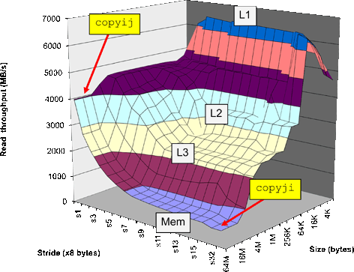
The Memory Mountain
Core i7
2.67 GHz
32 KB L1 d-cache
256 KB L2 cache
8 MB L3 cache

Slide 16
Background (Cont.)
1997: OS instructors complain about lack of preparation
  Students don’t know machine-level programming well enough
    What does it mean to store the processor state on the run-time stack?
  Our architecture course was not part of prerequisite stream

Slide 17
Birth of ICS
1997: REB/DROH pursue new idea:
  Introduce them to computer systems from a programmer's perspective rather than a system designer's perspective.
  Topic Filter: What parts of a computer system affect the correctness, performance, and utility of my C programs?
1998: Replace architecture course with new course:
  15-213: Introduction to Computer Systems
Curriculum Changes
  200 - level course
  Eliminated digital design & architecture as required courses for CS majors

Slide 18
15-213: Intro to Computer Systems
Goals
  Teach students to be sophisticated application programmers
  Prepare students for upper-level systems courses
Taught every semester to 400+ students
  All CS undergrads (core course)
  All ECE undergrads (core course)
  Many masters students
    To prepare them for upper-level systems courses
  Variety of others from math, physics, statistics, …
Preparation
  Assume know C programming

Slide 19
ICS Feedback
Students
Faculty
  Prerequisite for most upper level CS systems courses
  Required for all ECE students

Slide 20
Labs
Key teaching insight:
  Cool Labs ⇒ Great Course
A set of 1 and 2 week labs define the course.
Guiding principles:
  Be hands on, practical, and fun.
  Be interactive, with continuous feedback from automatic graders
  Find ways to challenge the best while providing worthwhile experience for the rest
  Use healthy competition to maintain high energy.

Slide 21
Bomb Lab
  Idea due to Chris Colohan, TA during inaugural offering
Bomb: C program with six phases.
Bomb Example:
% ls –l bomb
-rwxr-xr-x 1 sw19 users 26943 Nov 19 2012 bomb
./bomb
Welcome to my fiendish little bomb. You have 6 phases with
which to blow yourself up. Have a nice day!
./bomb
Welcome to my fiendish little bomb. You have 6 phases with
which to blow yourself up. Have a nice day!
Public speaking is very easy.
Phase 1 defused. How about the next one?
./bomb
Welcome to my fiendish little bomb. You have 6 phases with
which to blow yourself up. Have a nice day!
Public speaking is very easy.
./bomb
Welcome to my fiendish little bomb. You have 6 phases with
which to blow yourself up. Have a nice day!
./bomb
Welcome to my fiendish little bomb. You have 6 phases with
which to blow yourself up. Have a nice day!
Public speaking is very hard.
./bomb
Welcome to my fiendish little bomb. You have 6 phases with
which to blow yourself up. Have a nice day!
Public speaking is very hard.
BOOM!!
The bomb has blown up.

Slide 22
Let’s defuse a bomb phase!
08048b48 <phase_2>:
... # function prologue not shown
8048b50: mov 0x8(%ebp),%edx
8048b53: add $0xfffffff8,%esp
8048b56: lea 0xffffffe8(%ebp),%eax
8048b59: push %eax
8048b5a: push %edx
8048b5b: call 8048f48 <read_six_nums>
8048b60: mov $0x1,%ebx
8048b68: lea 0xffffffe8(%ebp),%esi
8048b70: mov 0xfffffffc(%esi,%ebx,4),%eax
8048b74: add $0x5,%eax
8048b77: cmp %eax,(%esi,%ebx,4)
8048b7a: je 8048b81 <phase_2+0x39>
8048b7c: call 804946c <explode_bomb>
8048b81: inc %ebx
8048b82: cmp $0x5,%ebx
8048b85: jle 8048b70 <phase_2+0x28>
... # function epilogue not shown
8048b8f: ret
# edx = &str
# eax = &num[] on stack
# push function args
# rd 6 ints from str 2 num
# i = 1
# esi = &num[] on stack
# LOOP: eax = num[i-1]
# eax = num[i-1] + 5
# if num[i-1] + 5 == num[i]
# then goto OK:
# else explode!
# OK: i++
# if (i <= 5)
# then goto LOOP:
# YIPPEE!
Solution: sequence of digits of form x x+5 x+10 x+15 x+20 x+25

Slide 23
The Beauty of the Bomb
For the Student
  Get a deep understanding of machine code in the context of a fun game
  Learn about machine code and about compilers
    Working with compiler-generated code
  Learn concepts and tools of debugging & reverse engineering
    Students must learn to use a debugger to defuse a bomb
    Forward vs backward debugging
For the Instructor
  Self-grading
  Scales to different ability levels
  Can test many different aspects of machine language
  Easy to generate variants and to port to other machines

Slide 24
Fostering “Friendly Competition”
Desire
  Challenge the best without frustrating everyone else
Method
  Web-based submission of solutions
  Server checks for correctness and computes performance score
    How many stages passed, program throughput, …
  Keep updated results on web page
    Students choose own nom de guerre
Relationship to Grading
  Students get full credit once they reach set threshold
  Push beyond this just for own glory/excitement

Slide 25
CMU Courses that Build on ICS
CS
Robotics
ECE
Parallel
Systems
Compilers
Dist.
Systems
Cog.
Robotics
Embedded
Control
Secure
Coding
Networks
Storage
Systems
Comp.
Photo.
Real-Time
Systems
Software
Engin.
Operating
Systems
Databases
Computer
Graphics
Embedded
Systems
Computer
Arch.
ICS

Slide 26
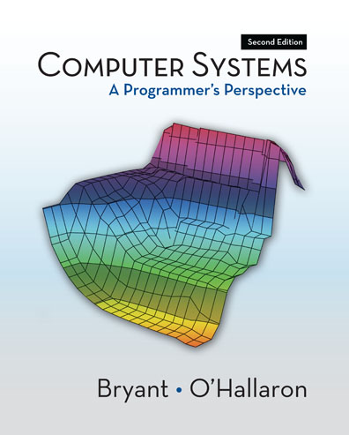
Shameless Promotion
  http://csapp.cs.cmu.edu
  Second edition Published 2010
  In use at 186 institutions worldwide

Slide 27
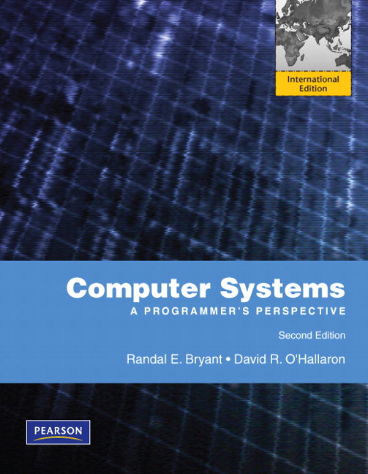
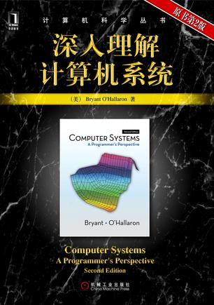
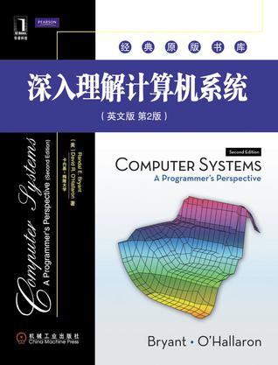
International Editions
2/3 of copies sold printed in China!

Slide 28
Overall Sales
  First + Second Editions
  As of 12/31/2011
  116,574 total

Slide 29
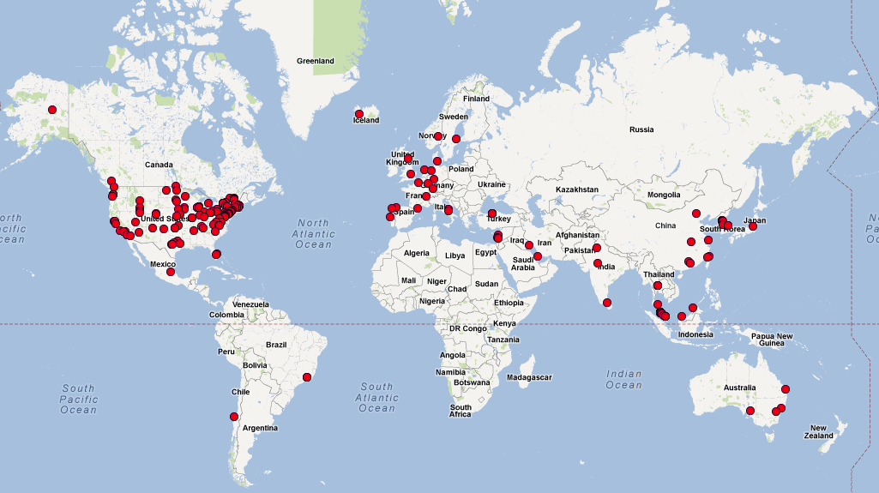
Worldwide Adoptions
186 total

Slide 30
2010 Curriculum Revision
Upgrade Introductory Programming Courses
  Emphasis on computational thinking
  For both majors & nonmajors
Introduce Parallel Thinking
  Prepare students for world in which programs run on many processors
Relocate Coverage of Java
  Not a good language for introductory programming
    Features tend to obscure basic programming concepts
    Hard to appreciate strengths until working on larger programs
  Useful when constructing large-scale software systems

Slide 31
Computational Thinking
Algorithmic Thinking
  Refine concrete task into abstract algorithmic problem
  Derive solutions with predictable worst / average case performance
Logical Thinking
  Construct system as set of layered components, each with abstract interfaces
  Reason about program execution: invariants, loops, recursion, …
Systems Thinking
  Designing reliable systems using unreliable components
  Optimize for the common case

Slide 32
2010 Core Revisions
Programming
  Provide introductory course for those with no programming experience
  Present both imperative & functional programming models
Data Structures & Algorithms
  Reason about parallel & sequential execution
CS 210
Data structs.
& algorithms
CS 122
Imperative
computation
CS 150
Functional
programming
CS 112
Introductory
programming
Math 127
Discrete
math

Slide 33
Parallel Thinking
  Guy Blelloch
Performance Parameters
  Work W Total number of operations required
  Span S Time required if had unlimited parallelism
  Processors P Number of available processors
Area = W
S

Slide 34
Execution Time
  T = Max(S, W/P)
P
Area = W
S
Unlimited Parallelism
T = S
Limited Parallelism
T = W/P
Sequential Execution
T = W

Slide 35
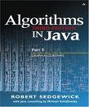
Obfuscating Parallelism
public void quickSort(int[] a, int left, int right) {
int i = left-1; int j = right;
if (right <= left) return;
while (true) {
while (a[++i] < a[right]);
while (a[right]<a[--j])
if (j==left) break;
if (i >= j) break;
swap(a,i,j); }
swap(a, i, right);
quickSort(a, left, i - 1);
quickSort(a, i+1, right); }

Slide 36
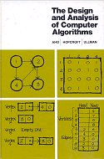
Exposing Parallelism
procedure QUICKSORT(S):
if S contains at most one element then return S
else
begin
choose an element a randomly from S;
let S₁, S₂ and S₃ be the sequences of
elements in S less than, equal to,
and greater than a, respectively;
return (QUICKSORT(S₁) followed by S₂
followed by QUICKSORT(S₃))
end

Slide 37
Quicksort Parallelism
S
S₁
S₂
S₃
  Can sort each subset in parallel
  “Divide and Conquer” parallelism

Slide 38
Preparing Students for Algorithms
  Imperative Programming
    Program transforms system state
    Common & useful model
  Functional Programming
    Program composes functions to compute output from input
    Naturally exposes parallelism
  Many programs use hybrid of both models
CS 210
Data structs.
& algorithms
CS 122
Imperative
computation
CS 150
Functional
computation
Imperative Model
Based on state transformations
Functional Model
Based on function composition
Execution
Step
G
F
Program
State

Slide 39
CS 122 Principles of Imperative Computation
  Writing and reasoning about imperative programs
    E.g., how to formulate loop invariants
  Taken by ~350 students per year
    CS + ECE + a few others
  Uses own language C0
    Similar to C, but type safe
      No pointer arithmetic
      No casting
      Allocate data with specified type
CS 122
Imperative
computation
CS 112
Introductory
programming
Math 127
Discrete
math
Execution
Step
Program
State

Slide 40
CS 122 Theme
  Must approach programming task from multiple viewpoints
Computational
Thinking
Computational Thinking
  Algorithmic principles Invariants, Pre- and Post-conditions
Programming
  Data organization
  Good coding style
Data Structures & Algorithms
  Commonly used building blocks
Data structures
& algorithms
  Programming

Slide 41
CS 122 Example: Priority Queues
Data structure
invariants
Computational Thinking
  Shape invariant
  Ordering invariant
Programming
  Embed tree in array
  Children of node i at 2i & 2i+1
Data Structures & Algorithms
  Efficient insertion & deletion
Heap data
structure
  Trees as arrays
2
4
3
9
7
8

Slide 42
Data Structure Declaration
struct heap {
int limit; /* limit > 0 */
int next; /* 1 <= next && next <= limit */
int[] values; /* \length(values) == limit */
};
next
values
limit
2
next = 6
4
3
2
4
3
9
7
8
Limit = 7
9
7
8

Slide 43
Writing & Checking Assertions
Predicate to Test Heap Property
Write as Functions in C0
  Not a specialized notation
  Can check dynamically during runtime
Experience
  Helps students learn to think about their programs systematically
bool is_heap(heap H)
//@requires H != NULL && \length(H->values) == H->limit;
{
/* Heap bounds */
if (!(1 <= H->next && H->next <= H->limit)) return false;
for (int i = 2; i < H->next; i++)
/* Parent value <= Child value */
if (!(H->values[i/2] <= H->values[i])) return false;
return true;
}

Slide 44
CS 150 Principles of Functional Programming
  Concepts of functional programs
    Looks more like math & less like programs students have written before
    Must have solid understanding of mathematical foundations
      E.g., sets & functions
  Based on earlier, 200-level course
    Question: Would freshmen be able to handle this material?
    Answer: Yes!
  Programs written in Standard ML
CS 150
Functional
programming
CS 112
Introductory
programming
Math 127
Discrete
math
G
F

Slide 45
The Power of Functional Languages
Inserting value into ordered list
  Over data of arbitrary data type
  Given order function:
    Mapping from (x, y) to { LESS, EQUAL, GREATER }
  Function ins generates function
    Takes value & list and returns new list
Important Concepts
  Polymorphism
    Single function declaration applies to any data type
    As long as it has defined comparison function
  Higher order functions
    Pass functions as arguments
    Generate functions as return values
ins : (’a * ’a -> order) -> (’a * ’a list) -> ’a list

Slide 46
Formal Reasoning
Function Application
Requires (of the arguments)
  cmp must be ordering function
  L must be in sorted order, according to cmp
Guarantees (of the result)
  L’ will contain x and the elements of L
  L’ will be in sorted order, according to cmp
L’ = ins cmp (x, L)

Slide 47
Functional Program Example
fun ins cmp (x, [ ]) = [x] Insertion into empty list
| ins cmp (x, y::L) = Insertion into list with head y
case cmp(x, y) of Comparing x to y:
GREATER => y::ins cmp (x, L) x > y
| _ => x::y::L; x ≤ y
Empty List
x
x > y
y
L
y
ins cmp (x,L)
x ≤ y
y
L
x
y
L

Slide 48
Foundation Curriculum Summary
CS 213
Computer systems
CS 210
Data structs.
& algorithms
CS 251
Principles
Theoretical CS
  Covered in first 2 years
15-year evolution
  1997: Theory
  1998: Systems
  2010:
    Parallel & sequential algorithms
    Functional programming
    Imperative computation
CS 122
Imperative
computation
CS 150
Functional
programming
CS 112
Introductory
programming
Math 127
Discrete
math

Slide 49
Our Contrarian Perspective
Conventional Wisdom
  We need to make CS more appealing by making it more fun
    Programming games, robots, …
    (This is fine for young students)
  Students want to learn the latest technology
    Android apps, Ruby on Rails, …
    This will help them get jobs
Our Viewpoint
  Requirements for software quality are increasing
    Safety critical systems
    Reduce vulnerability to cyberattack
  Must create foundations for lifelong learning
  Implication: Core curriculum should focus on fundamentals
    Mathematical principles
    Formal reasoning

Slide 50

Motivating Students
  Premier companies understand the need for greater rigor
  Their interview questions reinforce this to students

Slide 51
Some Things We’ve Learned
Students Can Understand & Appreciate Deep Concepts
  Must be presented well
  Must reinforce with hands-on experience
  Helps them do well on interview questions
Students Learn More from Assignments than from Lectures
  Solving challenging mathematical-style problems
  Writing programs

Slide 52
More Information about Curriculum Changes
Bryant, Sutner, Stehlik
  “Introductory Computer Science Education at Carnegie Mellon University, a Dean’s Perspective”
  CMU-CS-10-140
http://www.cs.cmu.edu/~bryant/pubdir/cmu-cs-10-140.pdf

