Slide 1
Carnegie Mellon
Dynamic Memory Allocation
15-213: Introduction to Computer Systems Recitation 11: Monday, Nov 3, 2014
SHAILIN DESAI
SECTION L
1

Slide 2
Carnegie Mellon
Today
Lecture Review
Macros and Inline Functions
Malloc Lab
Heap Checker
2

Slide 3
Carnegie Mellon
Today
Lecture Review
Macros and Inline Functions
Malloc Lab
Heap Checker
3

Slide 4
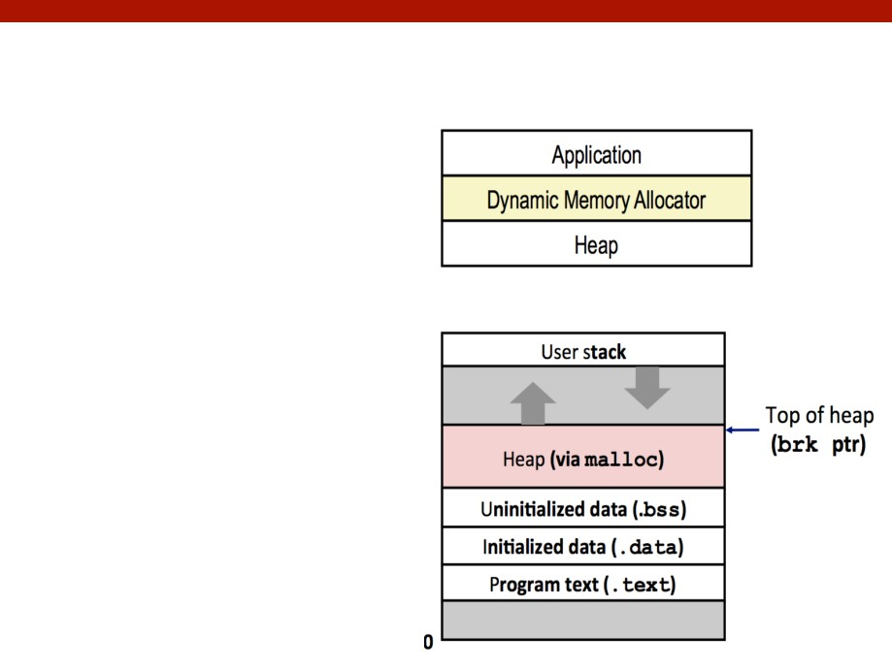
Carnegie Mellon
Dynamic Memory Allocation
Programmers use
dynamic memory allocators (such as
malloc) to acquire VM at run time.
Dynamic memory
allocators manage an area of process virtual memory known as the heap.
4

Slide 5
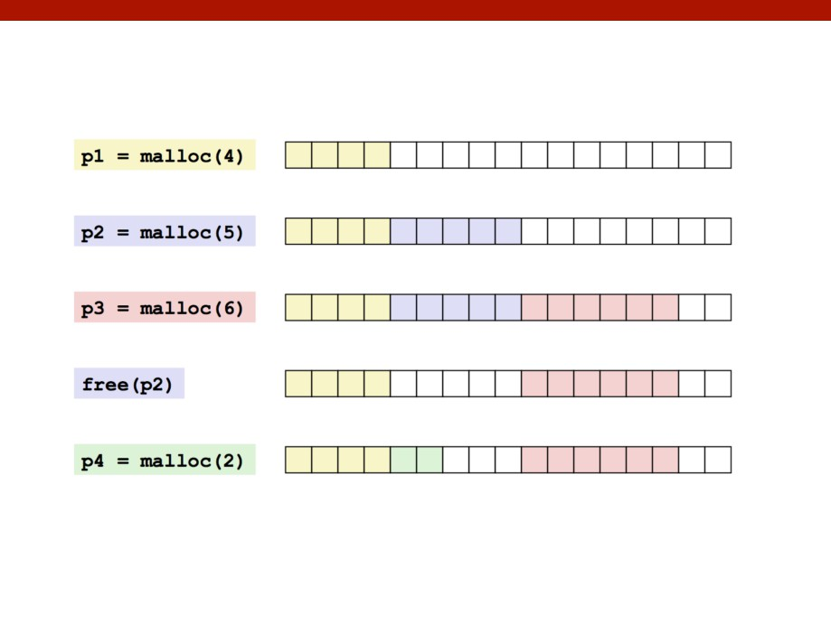
Carnegie Mellon
Dynamic Memory Allocation
How do we know where to put the next block?
5

Slide 6
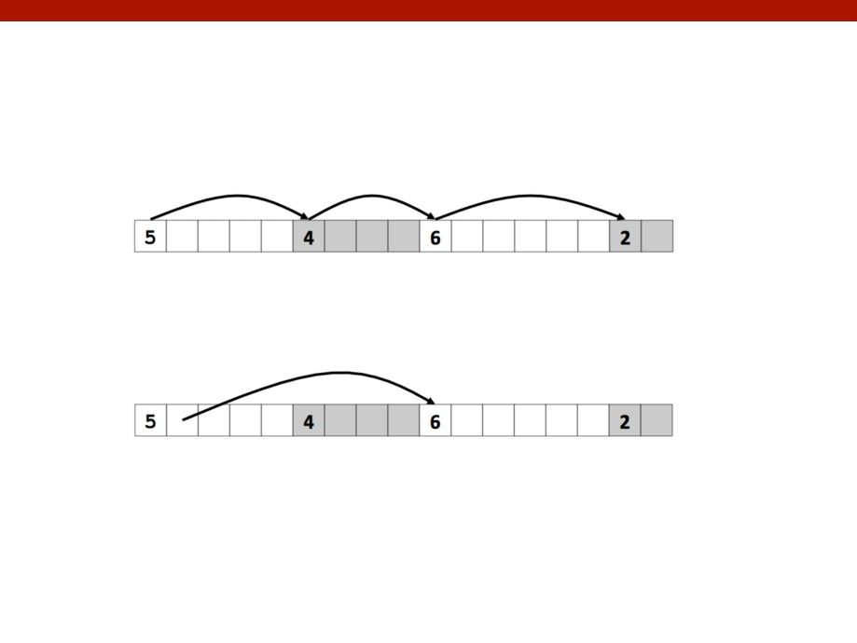
Carnegie Mellon
Keeping Track of Free Blocks
Method 1: Implicit list using length—links all blocks
Method 2: Explicit list among the free blocks using pointers
Method 3: Segregated free list
Different free lists for free blocks of different size classes
6

Slide 7
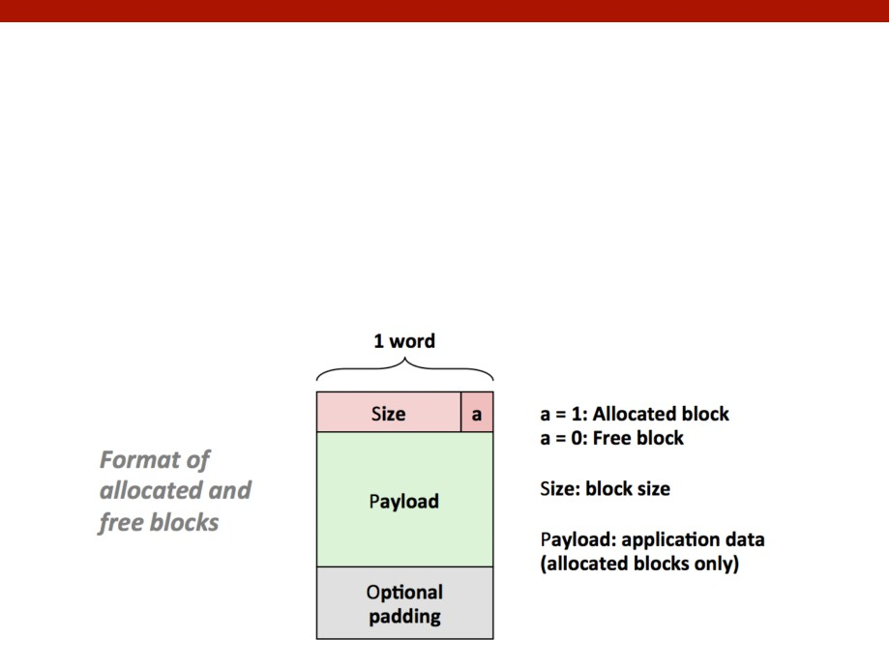
Carnegie Mellon
Method 1: Implicit List
For each block, we need both size and allocation status
Could store this information in two words: wasteful!
Standard trick
If blocks are aligned, some low-order address bits are always 0 Instead of storing an always-0 bit, use it as a allocated/free flag
ti

Slide 8
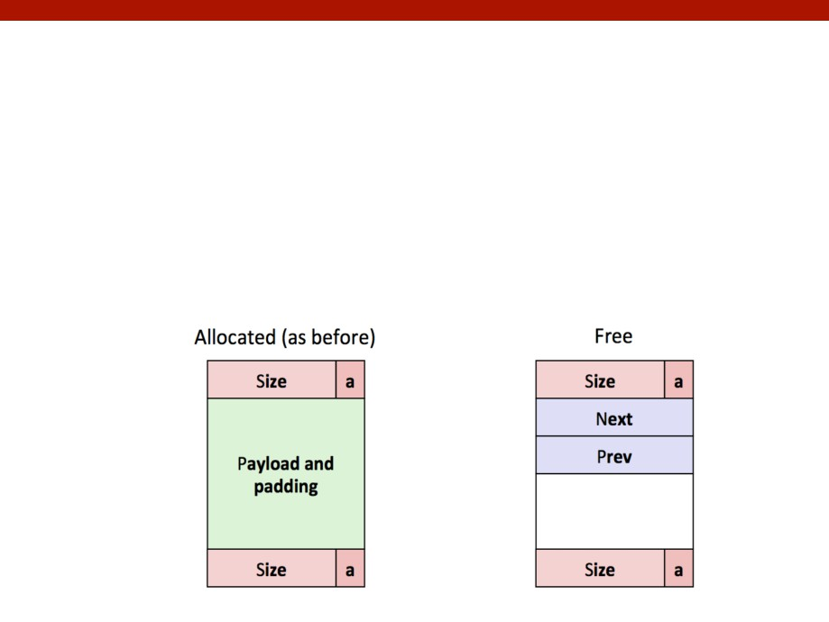
Carnegie Mellon
Method 2: Explicit List
Maintain list(s) of free blocks instead of all blocks
The “next” free block could be anywhere
So we need to store forward/back pointers, not just sizes Still need boundary tags for coalescing
Luckily we track only free blocks, so we can use payload area
8

Slide 9
Carnegie Mellon
Method 2: Explicit Free Lists
Logically…
But physically…
9

Slide 10
Carnegie Mellon
Method 3: Segregated List
Each size class of blocks has its own free list
Small sized blocks: more lists for separate classes
Larger sizes: one class for each two-power size
10

Slide 11
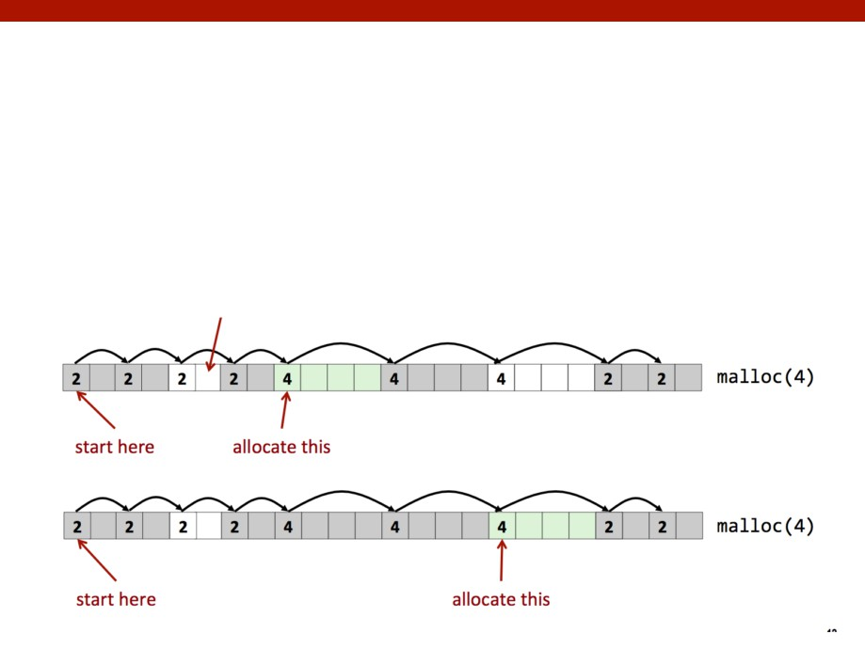
Carnegie Mellon
Finding a Free Block
First fit:
Search list from beginning, choose first free block that fits
Can take linear time in total number of blocks (allocated and free)
In practice it can cause “splinters” at beginning of list
Many small free blocks left at beginning
11

Slide 12
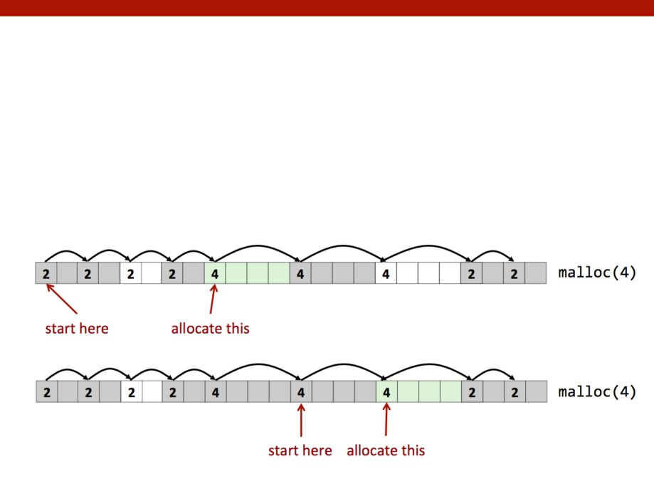
Carnegie Mellon
Finding a Free Block
Next fit:
Like first fit, but search list starting where previous search finished
Should often be faster than first fit: avoids re-scanning unhelpful blocks
Some research suggests that fragmentation is worse
12

Slide 13
Carnegie Mellon
Finding a Free Block
Best fit:
Search the list, choose the best free block: fits, with fewest bytes left over
Keeps fragments small: usually improves memory utilization
Will typically run slower than first fit
If the block we find is larger than we need, split it
13

Slide 14
Carnegie Mellon
Finding a Free Block
What happens if we can’t find a block?
Need to extend the heap
Use the brk() or sbrk() system calls
In mallocLab, use mem_sbrk()
sbrk(requested space) allocates space and returns pointer to start of new space
sbrk(0) returns pointer to top of current heap
Use what you need, add the rest as a whole
free block
14

Slide 15
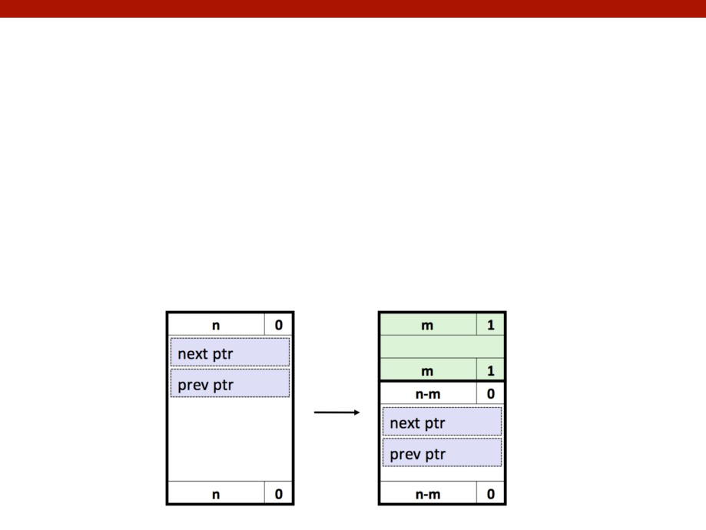
Carnegie Mellon
Splitting a Block
What happens if the block we have is too big?
Split between portion we need and the leftover free space
For implicit lists: correct the block size
For explicit lists: correct the previous and next pointers
For segregated lists:
determine correct size list
Insert with insertion policy (more on this later)
15

Slide 16
Carnegie Mellon
Freeing Blocks
Simplest implementation:
Need only clear the “allocated” flag void free_block(ptr p) { *p = *p & -2 }
But can lead to external fragmentation:
There is enough free space, but the allocator can’t find it
16

Slide 17
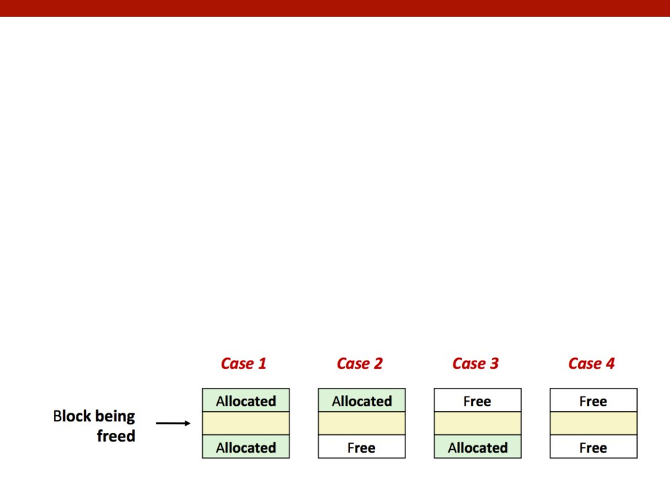
Carnegie Mellon
Freeing Blocks
Need to combine blocks nearby in memory (coalescing)
For implicit lists:
Simply look backwards and forwards using block sizes
For explicit lists:
Look backwards/forwards using block sizes, not next/prev pointers
For segregated lists:
use the size of new block to determine proper list
Insert back into list based on insertion policy (LIFO, FIFO)
1ti

Slide 18
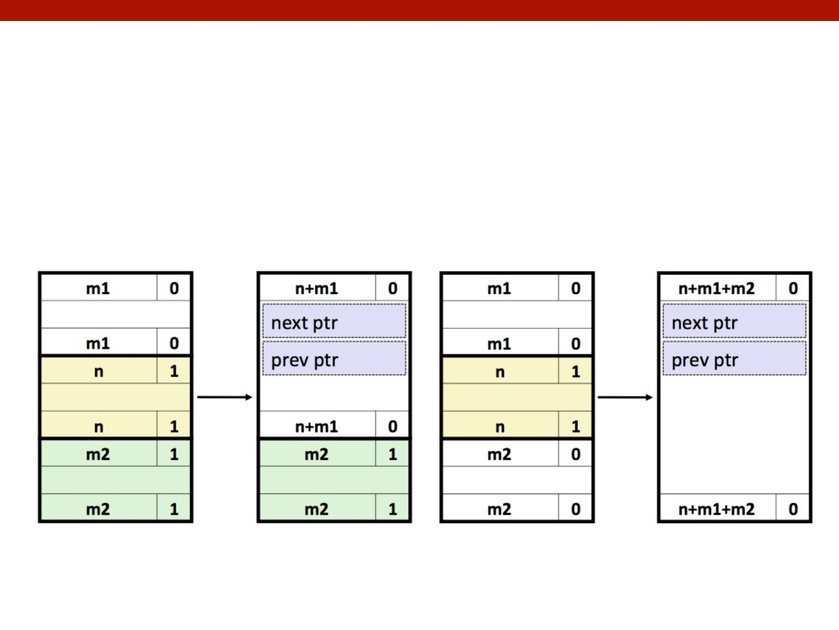
Carnegie Mellon
Freeing Blocks
Graphical depiction (both implicit & explicit):
(these are physical mappings)
18

Slide 19
Carnegie Mellon
Insertion Policy
Where in the free list do you put a newly freed block?
LIFO (last-in-first-out) policy
Insert freed block at the beginning of the free list
Pro: simple and constant time
Con: studies suggest fragmentation is worse than address ordered
Address-ordered policy
Insert freed blocks so that free list blocks are always in address order:
addr(prev) < addr(curr) < addr(next)
Con: requires search
Pro: fragmentation is lower than LIFO
19

Slide 20
Carnegie Mellon
Today
Lecture Review
Macros and Inline Functions
Malloc Lab
Heap Checker
20

Slide 21
Carnegie Mellon
Macros
C Preprocessor looks at macros in the preprocessing step of compilation
Use #define to avoid magic numbers:
#define TRIALS 100
Function like macros - short and heavily used code snippets
#define GET_BYTE_ONE(x)
((x) & 0xff)
#define GET_BYTE_TWO(x)
(((x) >> 8) & 0xff)
Inline functions
Ask the compiler to insert the complete body of the function in every place that the function is called (simply replacing code)
inline int fun(int a, int b)
Requests compiler to insert assembly of fun wherever a call to fun is made
Both are useful for malloclab
21

Slide 22
Carnegie Mellon
Assert()
assert(expr)
If expr is false, the calling process is terminated
If expr is true, it does nothing
May be turned off at compile time with option -DNDEBUG
As always, “Man is your friend.”
For style points: you MUST use asserts in your code
22

Slide 23
Carnegie Mellon
Debugging
Using printf, assert, etc only in debug mode:
#define DEBUG
#ifdef DEBUG
# define dbg_printf(...) printf(__VA_ARGS__)
# define dbg_assert(...) assert(__VA_ARGS__)
# define dbg(...)
#else
# define dbg_printf(...)
# define dbg_assert(...)
# define dbg(...)
#endif
23

Slide 24
Carnegie Mellon
Today
Lecture Review
Macros and Inline Functions
Malloc Lab
Heap Checker
24

Slide 25
Carnegie Mellon
Malloclab
You need to implement the following functions:
int mm_init(void);
void *malloc(size_t size);
void free(void *ptr);
Void *realloc(void *ptr, size_t size);
void *calloc (size_t n, size_t size);
void mm_checkheap(int verbose);
Scored on space efficiency and throughput
Cannot call system memory functions
Use helper functions (as static/inline functions)
May want to consider practicing version control
25

Slide 26
Carnegie Mellon
Malloclab
Inline
Essentially copies function code into location of each function call
Avoids overhead of stack discipline/function call (once assembled)
Can often be used in place of macros
Strong type checking and input variable handling, unlike macros.
Static
Resides in a single place in memory
Limits scope of function to the current translations unit (file)
Should use this for helper functions only called locally
Avoids polluting namespace.
static inline
Not surprisingly, can be used together
26

Slide 27
Carnegie Mellon
Today
Lecture Review
Macros and Inline Functions
Malloc Lab
Heap Checker
2ti

Slide 28
Carnegie Mellon
Heap Checker
Int mm_checkheap(int verbose) is critical for debugging
Write this early
update it when you change your free list implementation
It should ensure that you haven’t lost control of any part of heap
memory (everything should either be allocated or listed)
Look over lecture notes on garbage collection (particularly mark & sweep).
This function is meant to be correct, not efficient.
28

Slide 29
Carnegie Mellon
Heap Checker
Once you’ve settled on a design, write the heap checker that checks all the invariants of the particular design
The checking should be detailed enough that the heap check passes if and only if the heap is truly well-formed
Call the heap checker before/after the major operations whenever the heap should be well-formed
Define macros to enable/disable it conveniently
e.g.
29

Slide 30
Heap Checker
The mm checkheap function takes a single integer argument that you can use any way you want.
One very useful technique is to use this argument to pass in the line number of the call site:
mm_checkheap(__LINE__);
If mm checkheapdetects a problem with the heap, it can print the line number where mm checkheap
was called, which allows you to call mm checkheap at numerous places in your code while you are
debugging.
The mm_checkheap function takes a single integer argument that you can use any way you want.
One very useful technique is to use this argument to pass in the line number of the call site:
mm_checkheap(__LINE__);
If mm_checkheap detects a problem with the heap, it can print the line number where mm_checkheap was called, which allows you to call mm_checkheap at numerous places in your code while you are debugging.

Slide 31
Carnegie Mellon
Invariants (non-exhaustive)
Block level:
Header and footer match
Payload area is aligned
List level:
Next/prev pointers in consecutive free blocks are consistent
Free list contains no allocated blocks
All free blocks are in the free list
No contiguous free blocks in memory (unless you defer coalescing)
No cycles in the list (unless you use circular lists)
Segregated list contains only blocks that belong to the size class
Heap level:
Prologue/Epilogue blocks are at specific locations (e.g. heap boundaries)
and have special size/alloc fields
All blocks stay in between the heap boundaries
And your own invariants (e.g. address order)
30

Slide 32
Carnegie Mellon
Hare and Tortoise Algorithm
Detects cycles in linked lists
Set two pointers “hare” and “tortoise” to the beginning of the list
During each iteration, move the hare pointer forward two nodes and move the tortoise forward one node. If they are pointing to the same node after this, the list has a cycle.
If the tortoise reaches the end of the list, there are no cycles.
31

Slide 33
Carnegie Mellon
Asking for help
It can be hard for the TAs to debug your allocator, because this is a more open-ended lab
Before asking for help, ask yourself some questions:
What part of which trace file triggers the error?
Around the point of the error, what sequence of events do you expect?
What part of the sequence already happened?
If you can’t answer, it’s a good idea to gather more information…
How can you measure which step worked OK?
printf, breakpoints, watchpoints…
32

Slide 34
Carnegie Mellon
Debugging
Valgrind!
Powerful debugging and analysis technique
Rewrites text section of executable object file
Can detect all errors as debugging malloc
Can also check each individual reference at runtime
Bad pointers
Overwriting
Referencing outside of allocated block
GDB
You know how to use this (hopefully)
33

Slide 35
Carnegie Mellon
Beyond Debugging: Error prevention
It is hard to write code that are completely correct the first time, but certain practices can make your code less error-prone
Plan what each function does before writing code
Draw pictures when linked list is involved
Consider edge cases when the block is at start/end of list
Document your code as you write it
34

Slide 36
Carnegie Mellon
Questions?
Good luck!:D
35

