Slide 1
Heterogeneous Parallelism and Hardware Specialization
Lecture 19:

Slide 2
Let’s begin this lecture by reminding you…
That we observed in assignment 1 that a well-optimized parallel implementation of a compute-bound application was about 44 times faster on than the output of single-threaded C code compiled with gcc -O3.

Slide 3
You need to buy a new computer…

Slide 4
You need to buy a computer system
Core
Core
Core
Core
Core
Core
Core
Core
Core
Core
Core
Core
Core
Core
Core
Core
Core
Core
Core
Core
Processor A
4 cores
Each core has sequential performance P
Processor B
16 cores
Each core has sequential performance P/2
All other components of the system are equal.
Which do you pick?
Notes:
everything else is equal

Slide 5

Amdahl’s law revisited
f = fraction of program that is parallelizable
n = parallel processors
Assumptions:
Parallelizable work distributes perfectly onto n processors of equal capability
Notes:
f/n because this fraction of work is parallelized perfectly onto n processors

Slide 6
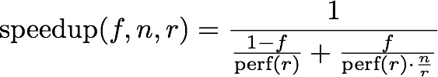
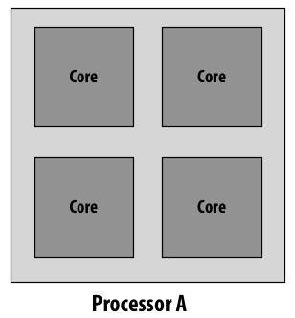
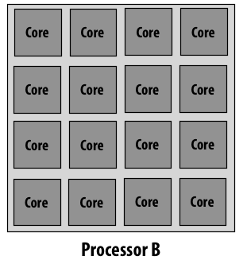
Rewrite Amdahl’s law in terms of resource limits
Relative to processor with 1 unit of resources, n=1. Assume perf(1) = 1
f = fraction of program that is parallelizable
n = total processing resources (e.g., transistors on a chip)
r = resources dedicated to each processing core,
each of the n/r cores has sequential performance perf(r)
More general form of Amdahl’s Law in terms of f, n, r
Two examples where n=16
rA = 4
rB = 1
[Hill and Marty 08]
Notes:
NOTE: rewrite amdahl’s law in terms of resources N and not cores. (If r=1 then it’s the same as original version)
terms in the denominator are time. (amount of work / rate)
sequential: perf is perf(r)
parallel: perf is perf(r) * (n/r)
this slide assumes perf(1) = 1
\mathrm{speedup}(f,n,r) = \frac{1}{\frac{1-f}{\textrm{perf}(r)} + \frac{f}{\textrm{perf}(r)\cdot\frac{n}{r}}}

Slide 7
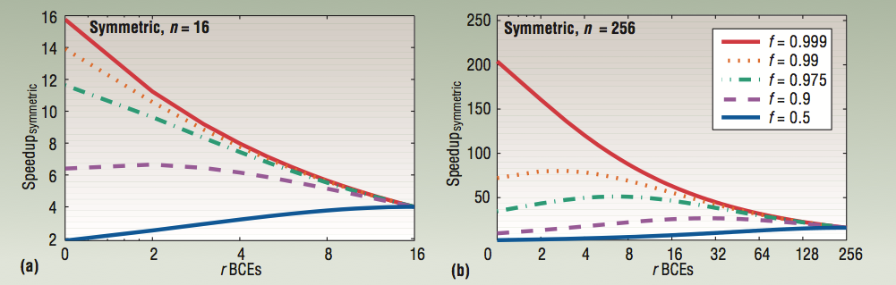

Speedup (relative to n=1)
1
1
Up to 16 cores (n=16)
Up to 256 cores (n=256)
X-axis = r (chip with many small cores to left, fewer “fatter” cores to right)
Each line corresponds to a different workload
Each graph plots performance as resource allocation changes, but total chip resources resources kept the same (constant n per graph)
perf(r) modeled as
[Figure credit: Hill and Marty 08]
Notes:
left fig: left, 16 cores, each /w performance=1. RIGHT, 1 core, performance=sqrt(16)
MOST LINES (LOOK AT RED), performance decreases as more powerful cores are used
BLUE LINE, performance ***increases*** as more powerful cores are used (left: 2, right 4)
But there’s a mixture of sequential work AND parallel WORK
THINK ABOUT GAMUT OF WORKLOADS (X=1, good for one but not the other)

Slide 8

Asymmetric set of processing cores
Example: n=16
One core: r = 4
Other 12 cores: r = 1
Core
Core
Core
Core
Core
Core
Core
Core
Core
Core
Core
Core
Core
(of heterogeneous processor with n resources, relative to uniprocessor with one unit worth of resources, n=1)
one perf(r) processor + (n-r) perf(1)=1 processors
[Hill and Marty 08]
Notes:
parallelize onto all the cores, assuming perfect speedup
perf r for the big core, perf 1 for the other n-r cores (so perf(r) + n - r)
\mathrm{speedup}(f,n,r) = \frac{1}{\frac{1-f}{\textrm{perf}(r)} + \frac{f}{\textrm{perf}(r) + (n-r)}}

Slide 9
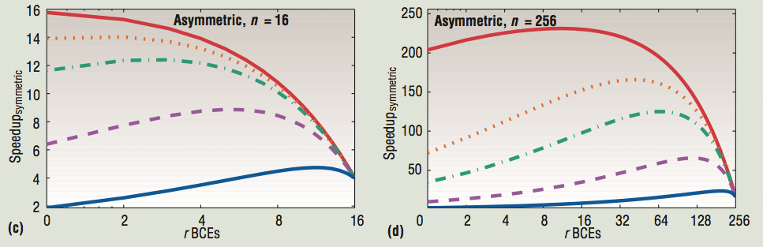
Speedup (relative to n=1)
[Source: Hill and Marty 08]
X-axis for symmetric architectures gives r for all cores (many small cores to left, few “fat” cores to right)
(chip from prev. slide)
X-axis for asymmetric architectures gives r for the single “fat” core (assume rest of cores are r = 1)
Notes:
top graphs are what I showed you before
idea: sacrifice a bit on best max performance for better performance in the middle
ONE WAY TO THINK ABOUT IS, TAKE A LARGE SPEEDUP IN SERIAL SECTION FOR PERCENTAGE SLOWDOWN IN PARALLEL SECTION (run blue line well, and use rest of resources to keep red lines high up there… but a little loss)

Slide 10
Heterogeneous processing
Observation: most “real world” applications have complex workload characteristics *
They have components that can be widely parallelized.
And components that are difficult to parallelize.
They have components that are amenable to wide SIMD execution.
And components that are not.
(divergent control flow)
They have components with predictable data access
And components with unpredictable access, but those accesses might cache well.
Idea: the most efficient processor is a heterogeneous mixture of resources (“use the most efficient tool for the job”)
* You will likely make a similar observation during your projects

Slide 11
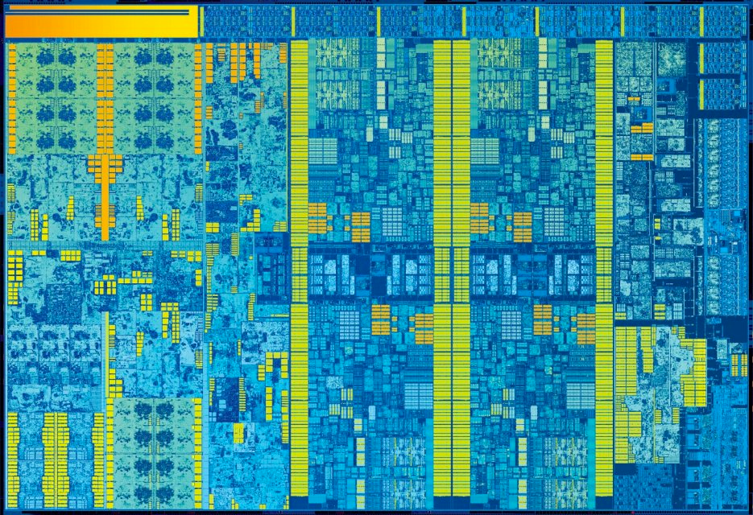
Example: Intel “Skylake" (2015)
(6th Generation Core i7 architecture)
CPU
core
CPU
core
System
Agent
(display,
memory,
I/O
controllers)
Integrated
Gen9 GPU
graphics + media
Shared LLC
CPU
core
CPU
core
4 CPU cores + graphics cores + media accelerators

Slide 12
Example: Intel “Skylake" (2015)
(6th Generation Core i7 architecture)
CPU cores and graphics cores share same memory system
Also share LLC (L3 cache)
  Enables, low-latency, high-bandwidth communication between CPU and integrated GPU
Graphics cores cache coherent with CPU
CPU
core
CPU
core
System
Agent
(display,
memory,
I/O)
Integrated
Gen9 GPU
graphics + media
Shared LLC
CPU
core
CPU
core

Slide 13
More heterogeneity: add discrete GPU
Keep discrete (power hungry) GPU unless needed for graphics-intensive applications
Use integrated, low power graphics for basic graphics/window manager/UI
CPU Core 0
…
CPU Core 3
Gen9 Graphics
High-end discrete GPU
(AMD or NVIDIA)
Ring interconnect
PCIe x16 bus
L3 cache (8 MB)
Memory controller
DDR3 Memory
DDR5 Memory

Slide 14
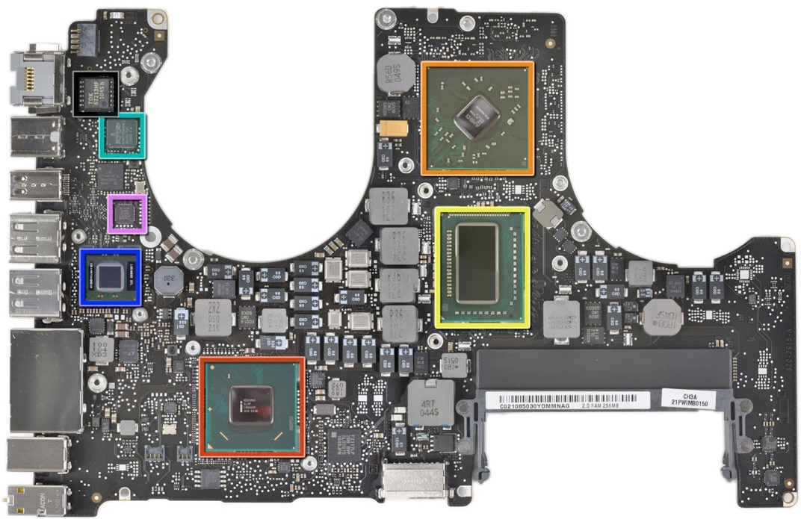
15in Macbook Pro 2011 (two GPUs)
AMD Radeon HD GPU
Quad-core Intel Core i7 CPU
(contains integrated GPU)
From ifixit.com teardown
Notes:
for kicks, lets go through some examples
this is my laptop, and like about every computing device there are two main processors in it the CPU.
And a GPU for 3D graphics

Slide 15
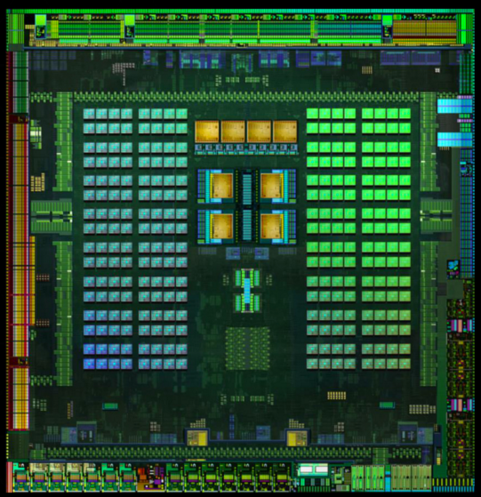
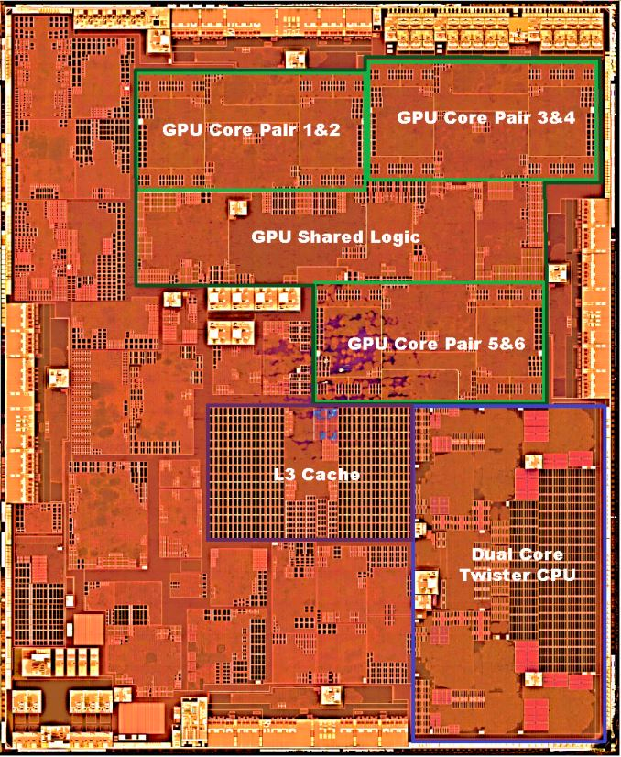
Mobile heterogeneous processors
NVIDIA Tegra X1
Four ARM Cortex A57 CPU cores for applications
Four low performance (low power) ARM A53 CPU cores
One Maxwell SMM (256 “CUDA” cores)
Apple A9
Dual Core 64 bit CPU
GPU PowerVR GT6700 (6 “core”) GPU
A9 image credit Chipworks, obtained from
http://www.anandtech.com/show/9686/the-apple-iphone-6s-and-iphone-6s-plus-review/3
Notes:
Why 4+4?

Slide 16
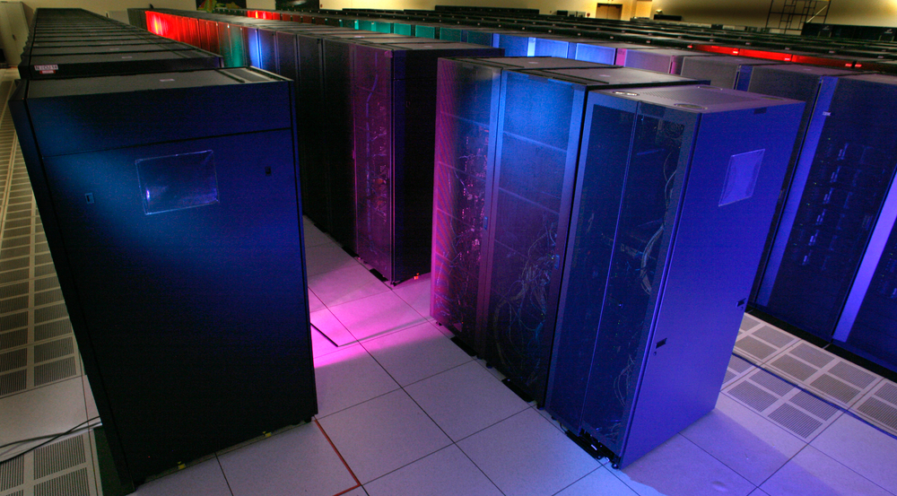
Supercomputers use heterogeneous processing
Los Alamos National Laboratory: Roadrunner
Fastest US supercomputer in 2008, first to break Petaflop barrier: 1.7 PFLOPS
Unique at the time due to use of two types of processing elements
(IBM’s Cell processor served as “accelerator” to achieve desired compute density)
  6,480 AMD Opteron dual-core CPUs (12,960 cores)
  12,970 IBM Cell Processors (1 CPU + 8 accelerator cores per Cell = 116,640 cores)
  2.4 MWatt (about 2,400 average US homes)
Notes:
first
data-parallel programming for CELL (proprietary)
OpenMP, on Opterons
MPI across chips

Slide 17
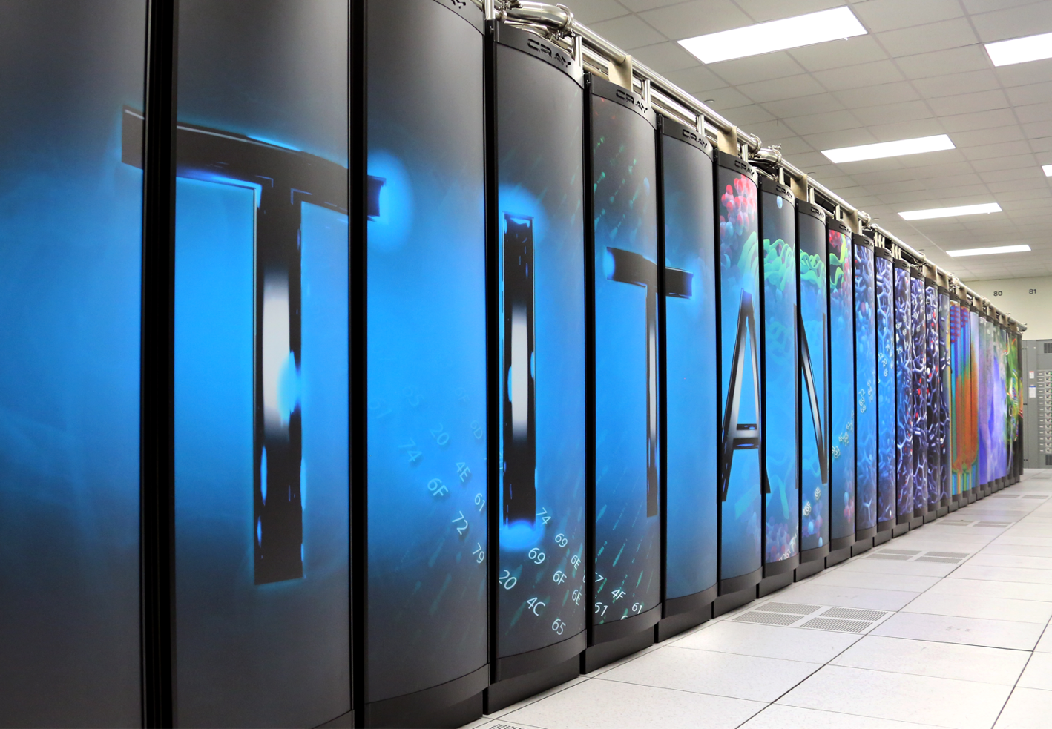
GPU-accelerated supercomputing
Oak Ridge Titan (world’s #5)
18,688 AMD Opteron 16-core CPUs
18,688 NVIDIA Tesla K20X GPUs
710 TB RAM
Estimated machine cost $97M
Estimated annual power/operating cost: ~ $9M *
* Source: NPR

Slide 18
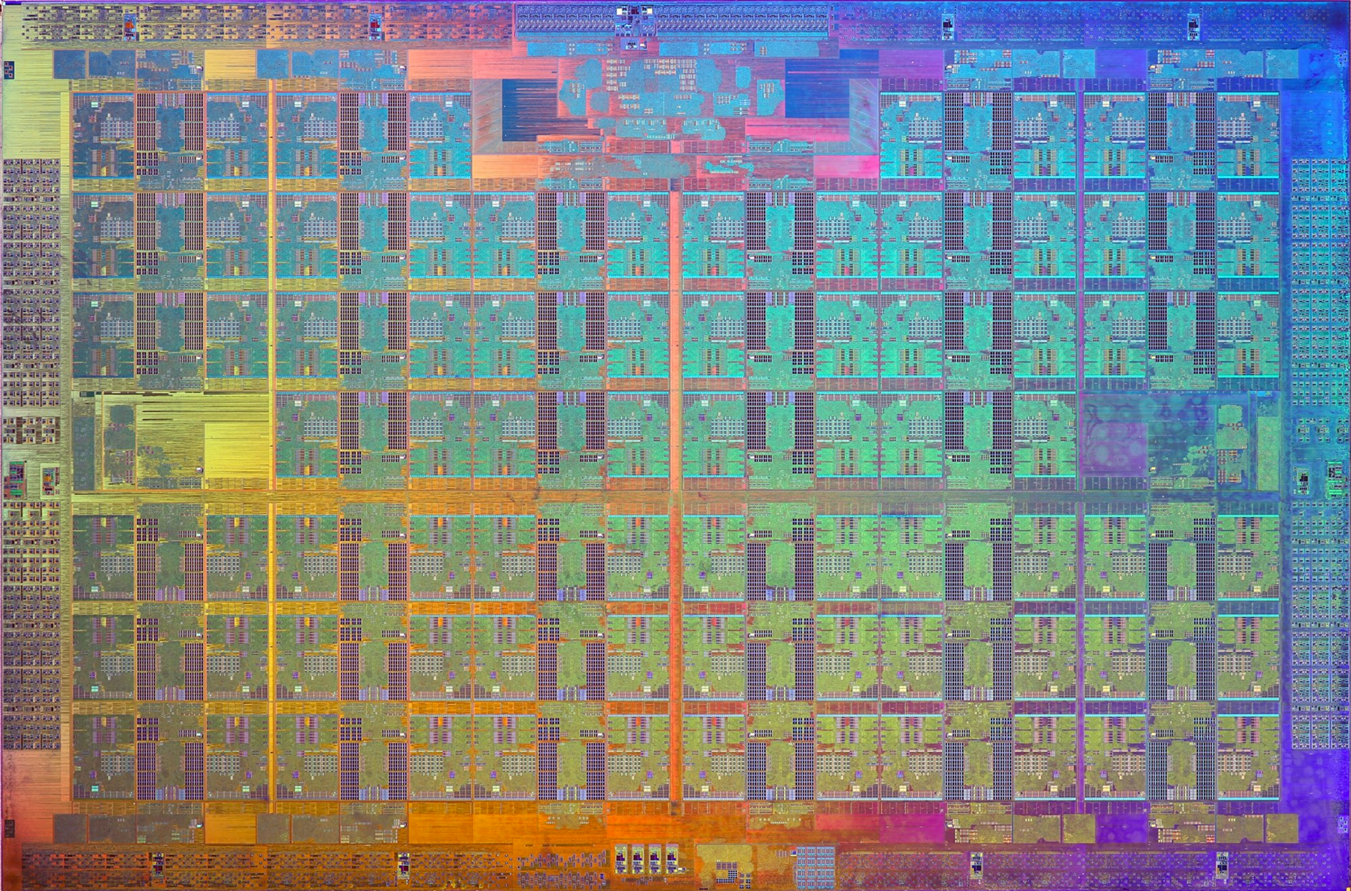
Intel Xeon Phi (Knights Landing)
72 “simple” x86 cores (1.1 Ghz, derived from Intel Atom)
16-wide vector instructions (AVX-512), four threads per core
Targeted as an accelerator for supercomputing applications

Slide 19
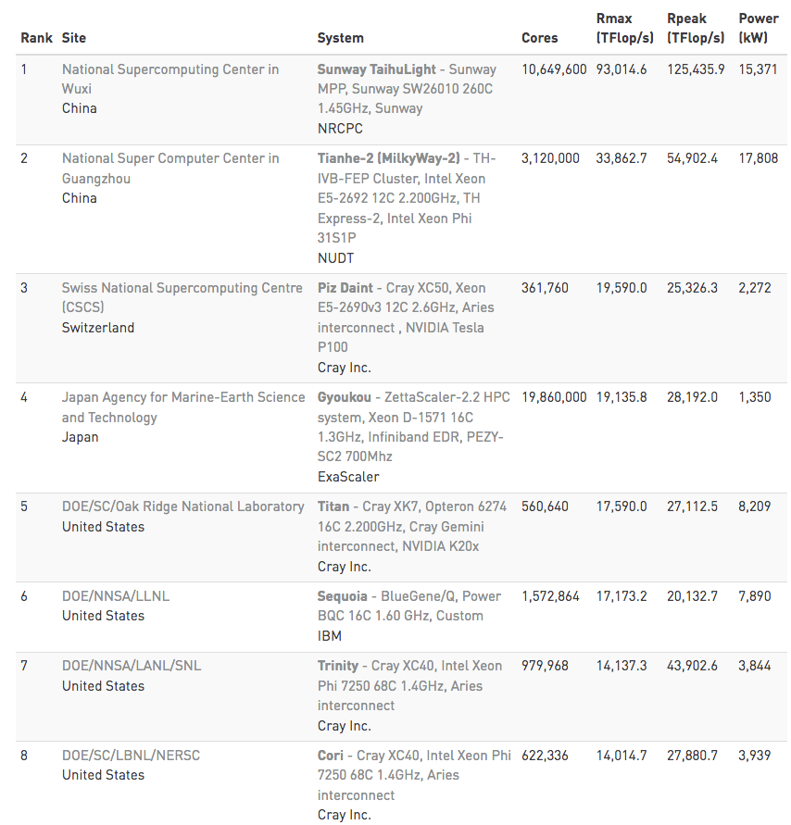
Heterogeneous architectures for supercomputing
Source: Top500.org Fall 2017 rankings
Xeon Phi
NVIDIA GPU
NVIDIA GPU
Xeon Phi
Xeon Phi
Notes:
Tianhe-2 is 208 MFlops/Watt

Slide 20
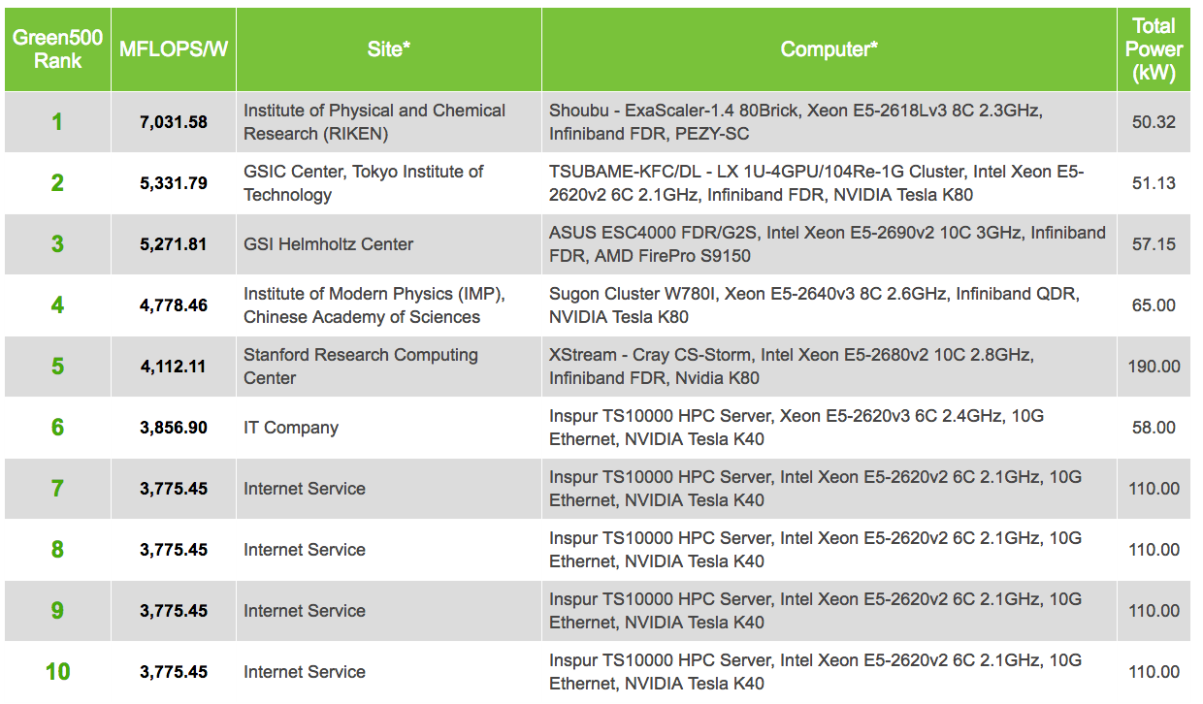
Green500: most energy efficient supercomputers
Efficiency metric: MFLOPS per Watt
Source: Green500 Fall 2015 rankings

Slide 21
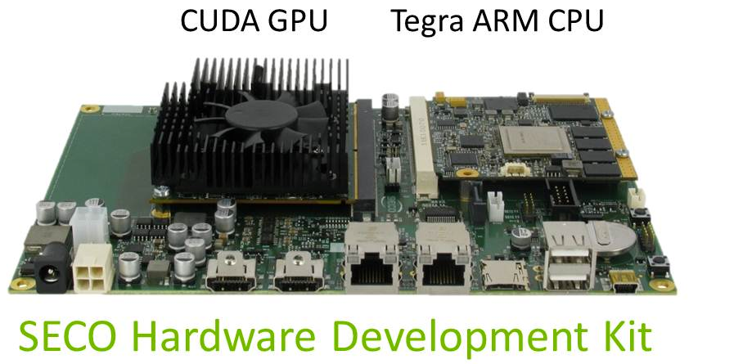
Research: ARM + GPU Supercomputer
Observation: the heavy lifting in supercomputing applications is the data-parallel part of workload
  Less need for “beefy” sequential performance cores
Idea: build supercomputer out of power-efficient building blocks
  ARM CPUs (for control/scheduling) + GPU cores (primary compute engine)
Project underway at Barcelona Supercomputing Center
  www.montblanc-project.eu

Slide 22
Energy-constrained computing
Supercomputers are energy constrained
  Due to shear scale
  Overall cost to operate (power for machine and for cooling)
Datacenters are energy constrained
  Reduce cost of cooling
  Reduce physical space requirements
Mobile devices are energy constrained
  Limited battery life
  Heat dissipation

Slide 23
Limits on chip power consumption
General mobile processing rule: the longer a task runs the less power it can use
  Processor’s power consumption is limited by heat generated (efficiency is required for more than just maximizing battery life)
Electrical limit: max power that can be supplied to chip
Die temp: (junction temp -- Tj): chip becomes unreliable above this temp (chip can run at high power for short period of time until chip heats to Tj)
Case temp: mobile device gets too hot for user to comfortably hold
(chip is at suitable operating temp, but heat is dissipating into case)
Power
Battery life: chip and case are cool, but want to reduce power consumption to sustain long battery life for given task
iPhone 6 battery: 7 watt-hours
9.7in iPad Pro battery: 28 watt-hours
15in Macbook Pro: 99 watt-hours
Time
Slide credit: adopted from original slide from M. Shebanow: HPG 2013 keynote
Notes:
current I = Q/t (change per unit time)
Energy is spent moving charge through a voltage difference
power P = energy/t = (QV)/t = (Q/t)V = IV = (I^2)R (applying Olm’s Law: V=IR)
Since P=IV, fixing power and increasing voltage reduces current, which results lost energy from resistance

Slide 24
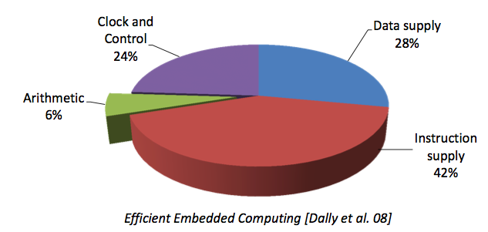
Efficiency benefits of compute specialization
Rules of thumb: compared to high-quality C code on CPU...
Throughput-maximized processor architectures: e.g., GPU cores
  Approximately 10x improvement in perf / watt
  Assuming code maps well to wide data-parallel execution and is compute bound
Fixed-function ASIC (“application-specific integrated circuit”)
  Can approach 100-1000x or greater improvement in perf/watt
  Assuming code is compute bound and
  and is not floating-point math
[Source: Chung et al. 2010 , Dally 08]
[Figure credit Eric Chung]

Slide 25
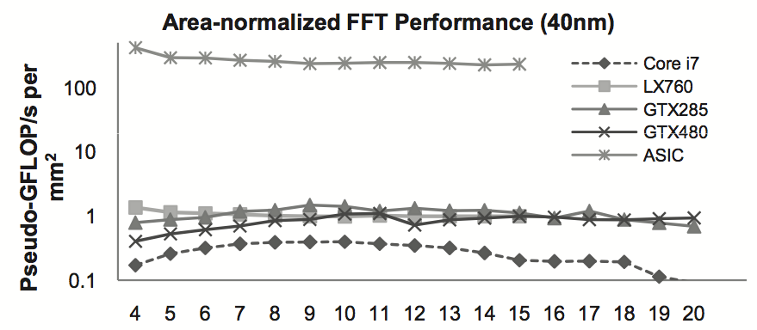
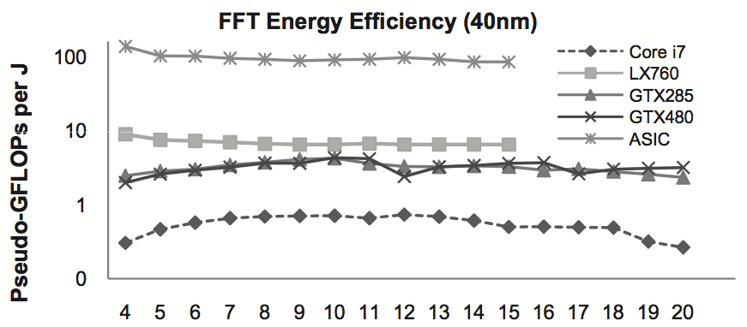
Hardware specialization increases efficiency
FPGA
GPUs
ASIC delivers same performance as one CPU core with ~ 1/1000th the chip area.
GPU cores: ~ 5-7 times more area efficient than CPU cores.
lg2(N) (data set size)
FPGA
GPUs
ASIC delivers same performance as one CPU core with only ~ 1/100th the power.
lg2(N) (data set size)
[Chung et al. MICRO 2010]

Slide 26


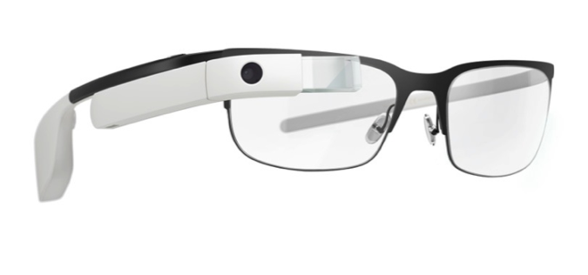
Benefits of increasing efficiency
Run faster for a fixed period of time
  Run at higher clock, use more cores (reduce latency of critical task)
  Do more at once
Run at a fixed level of performance for longer
  e.g., video playback
  Achieve “always-on” functionality that was previously impossible
Google Glass: ~40 min recording per charge (nowhere near “always on”)
Moto X:
Always listening for “ok, google now”
Device contains ASIC for detecting this audio pattern.
iPhone:
Siri activated by button press or holding phone up to ear
Notes:
fundamentally different interaction with the device
Just not possible

Slide 27
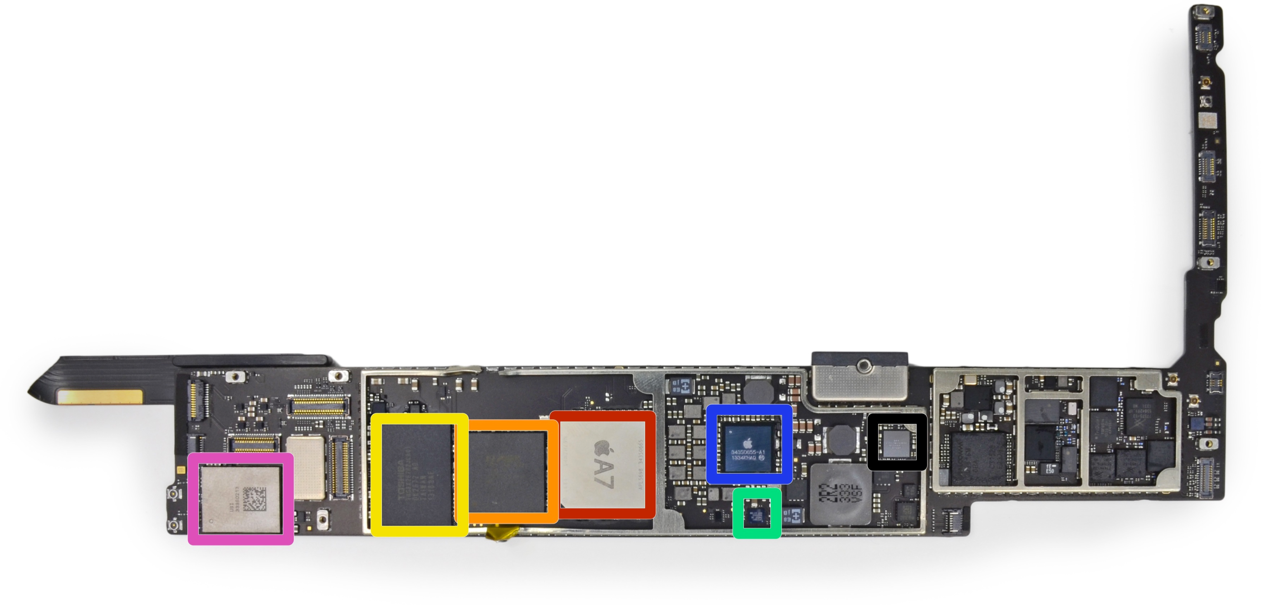
Example: iPad Air (2013)
Apple A7 Processor
Core
Core
Dual-core 64-bit ARM CPU
4MB L3
Imagination
PowerVR
GPU
Video
Encode/Decode
Image
Processor
Touchscreen controllers
Flash memory
Motion co-processor
(accelerometer, gyro, compass, etc.)
DRAM
Image Credit: ifixit.com

Slide 28
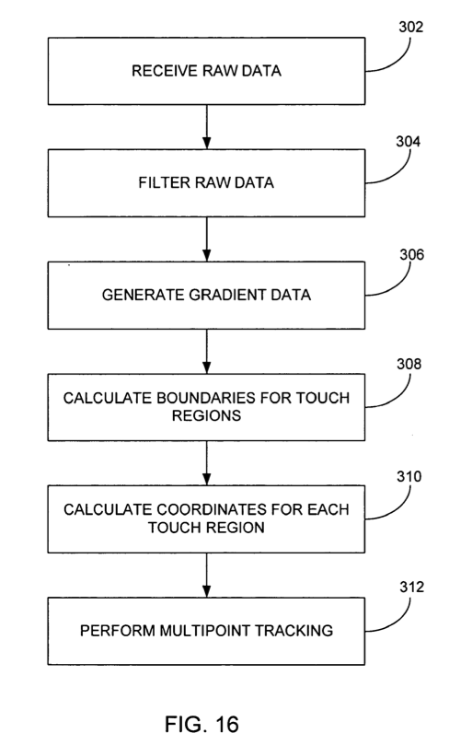
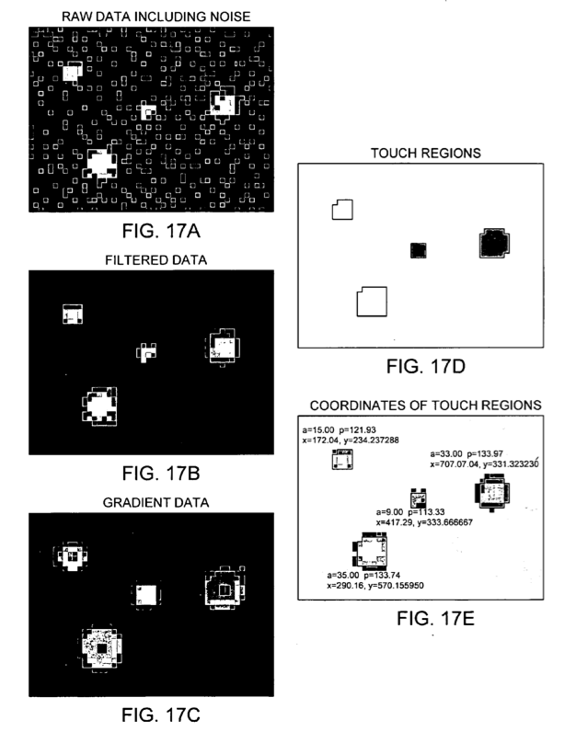
Original iPhone touchscreen controller
Separate digital signal processor to interpret raw signal from capacitive touch sensor (do not burden main CPU)
From US Patent Application 2006/0097991

Slide 29
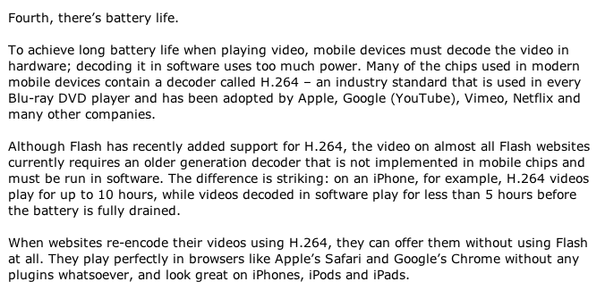
Modern computing: efficiency often matters more than in the past, not less
Steve Jobs’ “Thoughts on Flash”, 2010
http://www.apple.com/hotnews/thoughts-on-flash/
(Justification for why Apple won’t support Adobe Flash)

Slide 30
Example: image processing on a Nikon D7000
Process 16 MPixel RAW data from sensor to obtain JPG image:
On camera: ~ 1/6 sec per image
Adobe Lightroom a quad-core Macbook Pro laptop: 1-2 sec per image
This is a older camera: much, much faster image processing performance on a modern smart phone (burst mode)

Slide 31

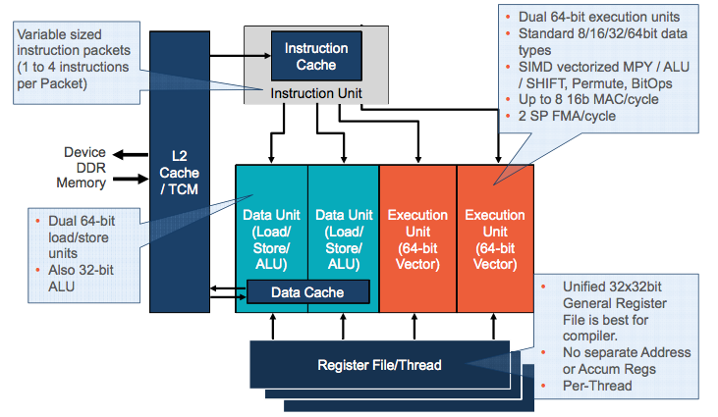
Qualcomm Hexagon Digital Signal Processor
Originally used for audio/LTE support on Qualcomm SoC’s
Multi-threaded, VLIW DSP
Third major programmable unit on Qualcomm SoCs
  Multi-core CPU
  Multi-core GPU (Adreno)
  Hexagon DSP

Slide 32



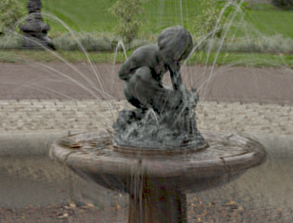
Up next? application programmable image signal processors
All modern systems have fixed-function support for common image processing tasks: image/video encode/decode, sensor to image conversion, etc.
Computational photography: use of advanced algorithms to make better photographs and videos
  Large space of (rapidly evolving techniques)
Automatic panoramas
High Dynamic Range (HDR) and low light enhancement
Remove camera shake

Slide 33
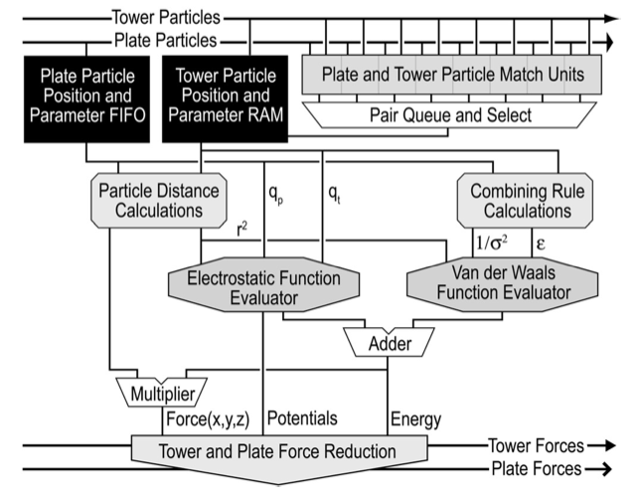
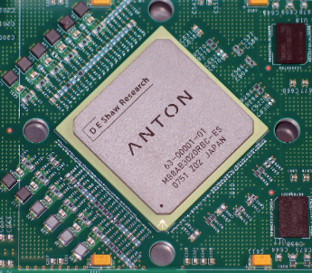
Anton supercomputer
[Developed by DE Shaw Research]
Supercomputer highly specialized for molecular dynamics
  Simulates time evolution of proteins
ASIC for computing particle-particle interactions (512 of them in machine)
Throughput-oriented subsystem
for efficient fast-fourier transforms
  Custom, low-latency communication
  network designed for communication patterns of N-body simulations

Slide 34
GPU’s are heterogeneous multi-core processors
Graphics-specific, fixed-function compute resources
Compute resources your CUDA programs used in assignment 2
SIMD
Exec
SIMD
Exec
SIMD
Exec
SIMD
Exec
Texture
Texture
Cache
Cache
Cache
Cache
Texture
Texture
SIMD
Exec
SIMD
Exec
SIMD
Exec
SIMD
Exec
Tessellate
Tessellate
Tessellate
Tessellate
Cache
Cache
Cache
Cache
GPU
Memory
Clip/Cull
Rasterize
Clip/Cull
Rasterize
SIMD
Exec
SIMD
Exec
SIMD
Exec
SIMD
Exec
Clip/Cull
Rasterize
Clip/Cull
Rasterize
Cache
Cache
Cache
Cache
Zbuffer /
Blend
Zbuffer /
Blend
Zbuffer /
Blend
SIMD
Exec
SIMD
Exec
SIMD
Exec
SIMD
Exec
Zbuffer /
Blend
Zbuffer /
Blend
Zbuffer /
Blend
Cache
Cache
Cache
Cache
Scheduler / Work Distributor
GPU

Slide 35
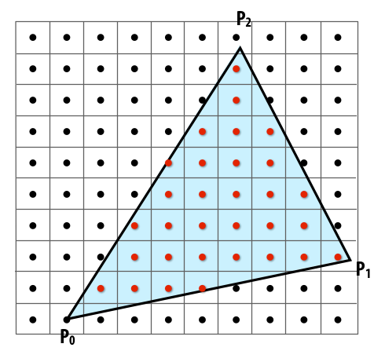
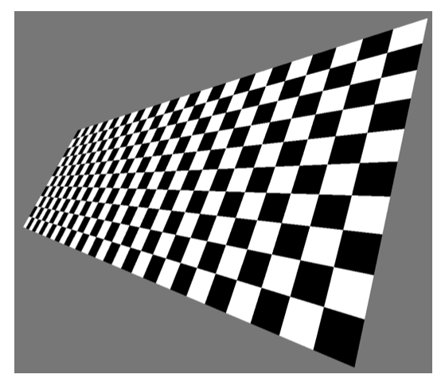
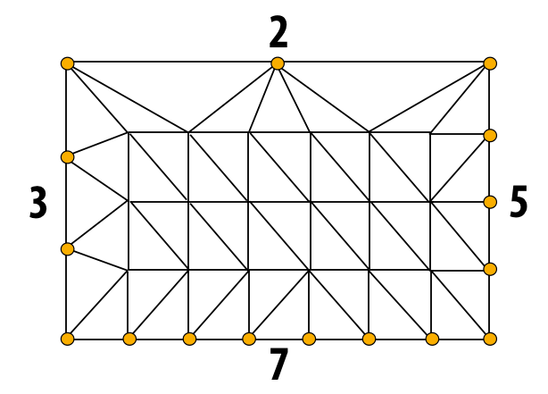
Example graphics tasks performed in fixed-function HW
Rasterization:
Determining what pixels a triangle overlaps
Texture mapping:
Warping/filtering images to apply detail to surfaces
Geometric tessellation:
computing fine-scale geometry from coarse geometry

Slide 36
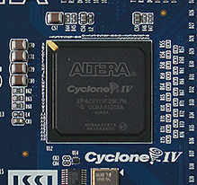
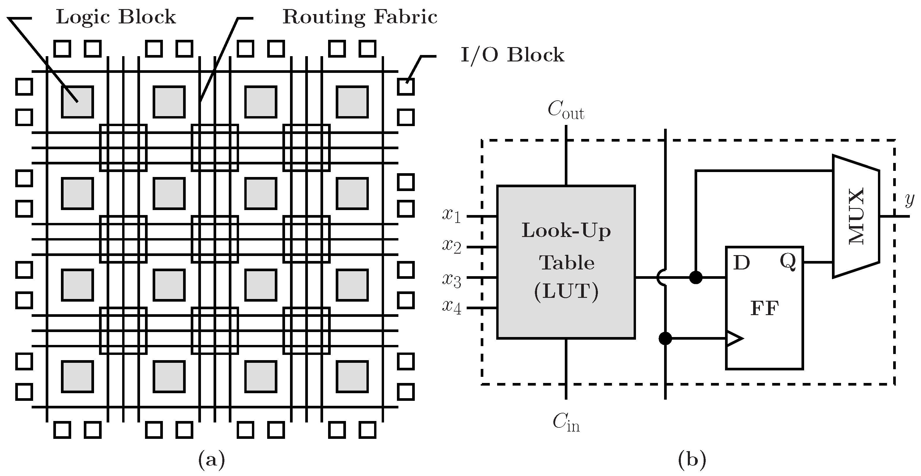
FPGAs (Field Programmable Gate Arrays)
Middle ground between an ASIC and a processor
FPGA chip provides array of logic blocks, connected by interconnect
Programmer-defined logic implemented directly by FGPA
Flip flop (a register)
Programmable lookup table (LUT)
Image credit: Bai et al. 2014

Slide 37
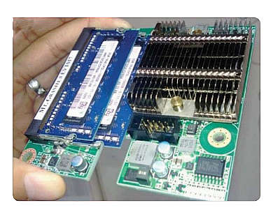
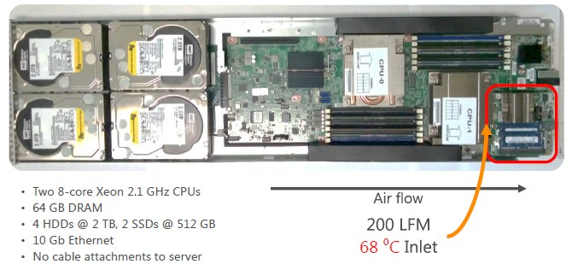
Project Catapult
[Putnam et al. ISCA 2014]
FPGA board
Microsoft Research investigation of use of FPGAs to accelerate datacenter workloads
Demonstrated offload of part of Bing Search’s document ranking logic
1U server (Dual socket CPU + FPGA connected via PCIe bus)

Slide 38
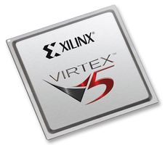
Summary: choosing the right tool for the job
Throughput-oriented
processor (GPU)
FPGA/Future
reconfigurable logic
Energy-optimized CPU
Programmable DSP
ASIC
Video encode/decode,
Audio playback,
Camera RAW processing,
neural nets (future?)
~10X more efficient
~100X???
(jury still out)
~100-1000X
more efficient
Easiest to program
Difficult to program
(making it easier is active area of research)
Not programmable +
costs 10-100’s millions of dollars to design / verify / create
Credit Pat Hanrahan for this taxonomy

Slide 39
Challenges of heterogeneous designs

Slide 40
Challenges of heterogeneity
So far in this course:
  Homogeneous system: every processor can be used for every task
  To get best speedup vs. sequential execution, “keep all processors busy all the time”
Heterogeneous system: use preferred processor for each task
  Challenge for system designer: what is the right mixture of resources to meet performance, cost, and energy goals?
    Too few throughput-oriented resources (lower peak performance/efficiency for parallel workloads -- should have used resources for more throughput cores)
    Too few sequential processing resources (get bitten by Amdahl’s Law)
    How much chip area should be dedicated to a specific function, like video?
    (these resources are taken away from general-purpose processing)
Implication: increased pressure to understand workloads accurately at chip design time

Slide 41
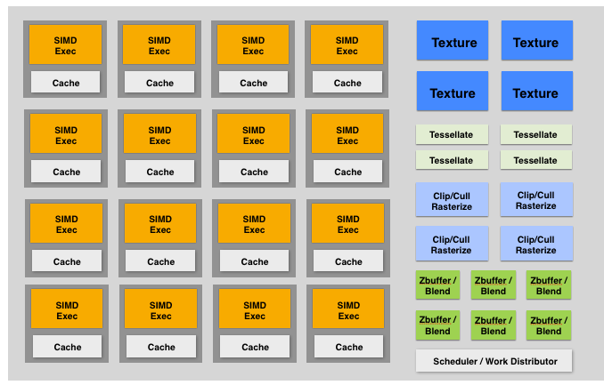
Pitfalls of heterogeneous designs
[Molnar 2010]
Say 10% of the workload is rasterization
Let’s say you under-provision the fixed-function rasterization unit on GPU:
Chose to dedicate 1% of chip area used for rasterizer, really needed 20% more throughput: 1.2% of chip area
Problem: rasterization is bottleneck, so the expensive programmable processors (99% of chip) are idle waiting on rasterization. So the other 99% of the chip runs at 80% efficiency!
Tendency is to be conservative, and over-provision fixed-function components (diminishing their advantage)
Notes:
1% of the chip is rasterizer
it’s a pipeline

Slide 42
Challenges of heterogeneity
Heterogeneous system: preferred processor for each task
  Challenge for hardware designer: what is the right mixture of resources?
    Too few throughput oriented resources (lower peak throughput for parallel workloads)
    Too few sequential processing resources (limited by sequential part of workload)
    How much chip area should be dedicated to a specific function, like video? (these resources are taken away from general-purpose processing)
    Work balance must be anticipated at chip design time
      System cannot adapt to changes in usage over time, new algorithms, etc.
  Challenge to software developer: how to map programs onto a heterogeneous collection of resources?
    Challenge: “Pick the right tool for the job”: design algorithms that decompose well into components that each map well to different processing components of the machine
    The scheduling problem is more complex on a heterogeneous system
    Available mixture of resources can dictate choice of algorithm
    Software portability & maintenance nightmare (we’ll revisit this next class)

Slide 43
Reducing energy consumption idea 1:
use specialized processing
Reducing energy consumption idea 2:
move less data

Slide 44
Data movement has high energy cost
Rule of thumb in mobile system design: always seek to reduce amount of data transferred from memory
  Earlier in class we discussed minimizing communication to reduce stalls (poor performance). Now, we wish to reduce communication to reduce energy consumption
“Ballpark” numbers
  Integer op: ~ 1 pJ *
  Floating point op: ~20 pJ *
  Reading 64 bits from small local SRAM (1mm away on chip): ~ 26 pJ
  Reading 64 bits from low power mobile DRAM (LPDDR): ~1200 pJ
Implications
  Reading 10 GB/sec from memory: ~1.6 watts
  Entire power budget for mobile GPU: ~1 watt (remember phone is also running CPU, display, radios, etc.)
  iPhone 6 battery: ~7 watt-hours (compare: Macbook Pro laptop: 99 watt-hour battery)
  Exploiting locality matters!!!
[Sources: Bill Dally (NVIDIA), Tom Olson (ARM)]
Suggests that recomputing values, rather than storing and reloading them, is a better answer when optimizing code for energy efficiency!
* Cost to just perform the logical operation, not counting overhead of instruction decode, load data from registers, etc.
Notes:
exploit locality
compression hardware

Slide 45
Three trends in energy-optimized computing
Compute less!
  Computing costs energy: parallel algorithms that do more work than sequential counterparts may not be desirable even if they run faster
Specialize compute units:
  Heterogeneous processors: CPU-like cores + throughput-optimized cores (GPU-like cores)
  Fixed-function units: audio processing, “movement sensor processing” video decode/encode, image processing/computer vision?
  Specialized instructions: expanding set of AVX vector instructions, new instructions for accelerating AES encryption (AES-NI)
  Programmable soft logic: FPGAs
Reduce bandwidth requirements
  Exploit locality (restructure algorithms to reuse on-chip data as much as possible)
  Aggressive use of compression: perform extra computation to compress application data before transferring to memory (likely to see fixed-function HW to reduce overhead of general data compression/decompression)

Slide 46
Summary
Heterogeneous parallel processing: use a mixture of computing resources that each fit with mixture of needs of target applications
  Latency-optimized sequential cores, throughput-optimized parallel cores, domain-specialized fixed-function processors
  Examples exist throughout modern computing: mobile processors, servers, supercomputers
Traditional rule of thumb in “good system design” is to design simple, general-purpose components
  This is not the case with emerging processing systems (optimized for perf/watt)
  Today: want collection of components that meet perf requirement AND minimize energy use
Challenge of using these resources effectively is pushed up to the programmer
  Current CS research challenge: how to write efficient, portable programs for emerging heterogeneous architectures?

