Slide 1
Accelerators/Specialization/ Emerging Architectures
Presented by Euiwoong Lee

Slide 2
Papers
Putnam et al.A Reconfigurable Fabric for Accelerating Large-Scale Datacenter Services, in ISCA 2014
St. Amant et al. General-purpose code acceleration with limited-precision analog computation, in ISCA 2014 + α
Madhavan, Sherwood, Strukov. Race logic: a hardware acceleration for dynamic programming algorithms, in ISCA 2014

Slide 3
Motivation
The good days are over.
“Iron Triangle” (from St. Amant et al.)
Performance
Efficiency
Generality
We can choose any two at the expense of the third.

Slide 4
Application Specific Designs
It will be wasteful to run different programs on the same general-purpose processor.
One extreme: CPU
The other extreme: ASIC (Application-specific integrated circuit)
In between? Beyond the extremes?

Slide 5
Application Specific Designs
GPU
FPGA: A field-programmable gate array (FPGA) is an integrated circuit designed to be configured by a customer or a designer after manufacturing – hence "field-programmable". [wikipedia]

Slide 6
Another dimension
How to represent numbers?
Currently, we use digital, even for real numbers.
Analog?
Many choices to measure.
How to add, subtract, or apply complicated functions to them?

Slide 7
Spectrum
Putnam et al.
(general purpose?)
Image from Esmaeilzadeh et al. MICRO 2012

Slide 8
Spectrum
Putnam et al.
(general purpose?)
St. Amant et al.
(general purpose??)
Image from Esmaeilzadeh et al. MICRO 2012

Slide 9
Spectrum
Putnam et al.
(general purpose?)
St. Amant et al.
(general purpose??)
Madhavan et al.
(specific)
Image from Esmaeilzadeh et al. MICRO 2012

Slide 10
Papers
Putnam et al. A Reconfigurable Fabric for Accelerating Large-Scale Datacenter Services, in ISCA 2014
St. Amant et al. General-purpose code acceleration with limited-precision analog computation, in ISCA 2014 + α
Madhavan, Sherwood, Strukov. Race logic: a hardware acceleration for dynamic programming algorithms, in ISCA 2014

Slide 11
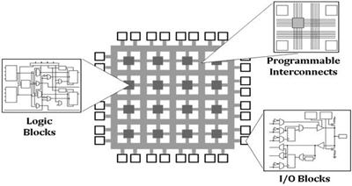
FPGA
Image from www.ni.com

Slide 12
FPGA
Main Challenge: The need to ﬁt the accelerated function into the available reconﬁgurable area.
Current reconﬁguration times for standard FPGAs are too slow to make this approach practical.
Multiple FPGAs provide scalable area, but cost more, consume more power, and are wasteful when unneeded.
Using a single small FPGA per server restricts the workloads that may be accelerated, and may make the associated gains too small to justify the cost.

Slide 13
Large-Scale Datacenter Services [Putnam et al. 14] – 23 authors!
Large-Scale Datacenter reduces variance of load.
While reliability is important, the scale of the datacenter permits sufﬁcient redundancy that a small rate of faults and failures is tolerable.

Slide 14
Large-Scale Datacenter Services [Putnam et al. 14]
Specialization of individual servers have issues
Loses homogeneity
Datacenter services evolve extremely rapidly, making non-programmable hardware features impractical

Slide 15
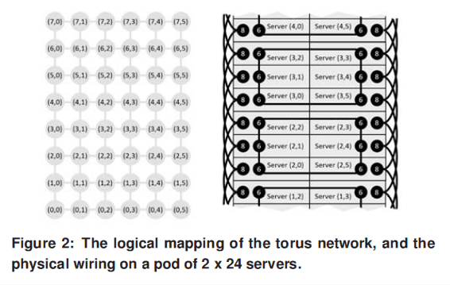
Implementation
Attach one FPGA to each server, and connect 48 servers as 6*8 torus

Slide 16
Experiments
Attach one FPGA to each server, and connect 48 servers as 6*8 torus
Do it 34 times, so total 1632 servers.
Actually ran the Bing web search engine.
Improved the throughput of each server by 95%.

Slide 17
Papers
Putnam et al. A Reconfigurable Fabric for Accelerating Large-Scale Datacenter Services, in ISCA 2014
St. Amant et al. General-purpose code acceleration with limited-precision analog computation, in ISCA 2014 + α
Madhavan, Sherwood, Strukov. Race logic: a hardware acceleration for dynamic programming algorithms, in ISCA 2014

Slide 18
Motivation
“Iron Triangle” again
Performance
Efficiency
Generality
Is there another component whose sacrifice can possibly improve all three?
Precision.

Slide 19
Neural Processing Unit [Esmaeilzadeh et al. 12]
Tolerance to approximation is one such program characteristic that is growing increasingly important.
Key idea: Learn how an original region of approximable code behaves and replace the original code with an efficient computation of the learned model.

Slide 20
Neural Processing Unit [Esmaeilzadeh et al. 12]
Programmer marks “approximable” code.
(1) Code observation: Collets data
(2) Training: Decides the topology of neural network and its weights.
(3) Code generation: Generates a configuration for the NPU that implements the trained neural network, and replaces each call.

Slide 21
Mixed-signal implementation for NPU [St. Amant et al. 14]
Numbers are represented in “analog ways”
Currents, Voltages, Resistances.
Operations
Addition: Kirchhoff’s Law (I = I1 + I2)
Multiplication: Ohm’s Law (V = I * R)
Even non-linear functions possible (transistors with saturation mode)

Slide 22
Issues for analog computation
(1) Error
(2) The amount of information
(3) Good for only specific operations
(4) Determining where the D/A boundaries lie
(5) How to store?

Slide 23
Issues for analog computation
(3) Good for only specific operations
(4) Determining where the D/A boundaries lie
(5) How to store?
Their solution: D-A interface is located in a single-neuron level.

Slide 24
NPU with analogue computation
(1) Error
Errors are inherent, but NPU is built for approximation anyway.
Let the compiler do the “hard work” of estimating / preventing error at once.

Slide 25
Deciding range of values
(2) Amount of information: theoretically, can represent all real values?
Large value
Large voltages and currents => more energy
Finer scale
Susceptible to noise
Their final answer: 8 bits

Slide 26
Deciding topology of network
Large degree
More parallelism
But similar problem as before (e.g. more currents => energy)
Their decision: again max. number of inputs = 8

Slide 27
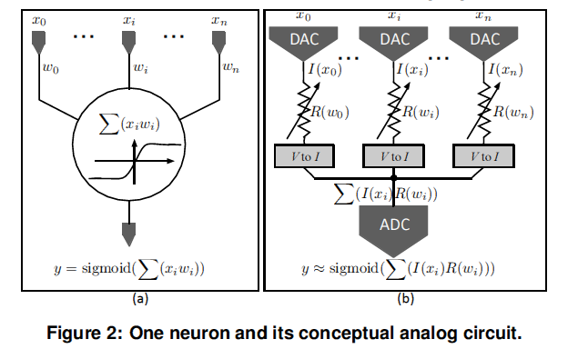
One neuron

Slide 28
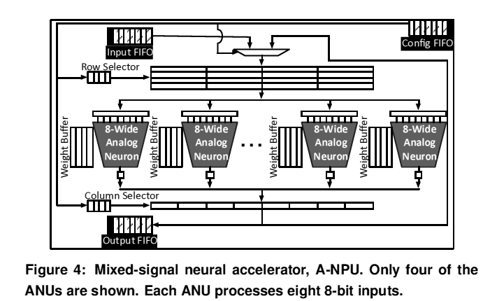
NPU

Slide 29
Papers
Putnam et al.A Reconfigurable Fabric for Accelerating Large-Scale Datacenter Services, in ISCA 2014
St. Amant et al. General-purpose code acceleration with limited-precision analog computation, in ISCA 2014 + α
Madhavan, Sherwood, Strukov. Race logic: a hardware acceleration for dynamic programming algorithms, in ISCA 2014

Slide 30
Beyond electricity
“Real physics” or “Real chemistry”
Exotic fully customized systems exploiting novel physics and based on nontraditional technologies
D-Wave computer, which utilizes quantum annealing phenomena to solve optimization problems
Reaction-diffusion systems made up of 2D chemical substrates can be used to solve 2D Voronoi Diagram Problems

Slide 31
One natural(?) way to represent numbers
Time
Use the well-studied problem domain of sequence alignment to test the potential of this new logic.

Slide 32
Similarity between sequences
Given two strings A and B.
How many edits (insertions, deletions, substitutions) do we need to perform to transform A to B?
Example:
s1 = ACGTGCA
s2 = CCTGCAA
3 edits (A -> C, Delete G, Insert A) are enough

Slide 33
Similarity between sequences
Generalization
Each operation has different scores
Even “match” has nonzero score
We can maximize / minimize the score (in maximization, insertion / deletion will have lower score than match)
In the following example, score for match = insertion = deletion = 1, substitution = 2 (and will minimize).

Slide 34
Dynamic Programming
 | A | C | G | T | G | C | A
C
C
T
G
C
A
A
Let $s_{\{i, j\}}$ be the minimum edit distance between B₁…B_{i} and A₁…A_{j}.

Slide 35
Dynamic Programming
$s_{\{i, j\}}=min⁡(s_{\left\{i−1,j \right\}}+δ\left(−,A_{j}\right),$
$s_{\left\{i,j−1 \right\}}+δ\left(B_{i}, − \right)$,
${ s}_{\left\{i,j \right\}}+δ\left(B_{i},A_{j}\right))$
$δ\left(−,A_{j}\right)$, $δ\left(B_{i}, − \right),δ\left(B_{i},A_{j}\right)$ indicate the cost for deletion, addition, substitution (match) respectively

Slide 36
Dynamic Programming
 | A | C | G | T | G | C | A
C | 2
C
T
G
C
A
A

Slide 37
Dynamic Programming
 | A | C | G | T | G | C | A
C | 2 | 2 | 3 | 4 | 5 | 6 | 7
C
T
G
C
A
A

Slide 38
Dynamic Programming
 | A | C | G | T | G | C | A
C | 2 | 2 | 3 | 4 | 5 | 6 | 7
C | 3 | 3 | 4 | 5 | 6 | 7 | 8
T
G
C
A
A

Slide 39
Dynamic Programming
 | A | C | G | T | G | C | A
C | 2 | 2 | 3 | 4 | 5 | 6 | 7
C | 3 | 3 | 4 | 5 | 6 | 7 | 8
T | 4 | 4 | 5 | 5 | 6 | 7 | 8
G
C
A
A

Slide 40
Dynamic Programming
 | A | C | G | T | G | C | A
C | 2
C
T
G
C
A
A

Slide 41
Dynamic Programming
 | A | C | G | T | G | C | A
C | 2 | 2
C | 3
T
G
C
A
A

Slide 42
Dynamic Programming
 | A | C | G | T | G | C | A
C | 2 | 2 | 3
C | 3 | 3
T | 4
G
C
A
A

Slide 43
Dynamic Programming
 | A | C | G | T | G | C | A
C | 2 | 2 | 3 | 4
C | 3 | 3 | 4
T | 4 | 4
G | 5
C
A
A

Slide 44
Dynamic Programming
 | A | C | G | T | G | C | A
C | 2 | 2
C
T
G
C
A
A

Slide 45
Dynamic Programming
 | A | C | G | T | G | C | A
C | 2 | 2 | 3
C | 3 | 3
T
G
C
A
A

Slide 46
Dynamic Programming
 | A | C | G | T | G | C | A
C | 2 | 2 | 3 | 4
C | 3 | 3 | 4
T | 4 | 4
G
C
A
A

Slide 47
Dynamic Programming
 | A | C | G | T | G | C | A
C | 2 | 2 | 3 | 4 | 5
C | 3 | 3 | 4 | 5
T | 4 | 4 | 5 | 5
G | 5 | 5 | 5
C
A
A

Slide 48
Race Logic
Utilizes a new data representation to accelerate a broad class of optimization problems, such as those solved by dynamic programming algorithms
The core idea of Race Logic is to use race conditions set up in a circuit to perform useful computation.

Slide 49
Race Logic
Utilizes a new data representation to accelerate a broad class of optimization problems, such as those solved by dynamic programming algorithms
Score δ represented as delay time (synchronized)
The core idea of Race Logic is to use race conditions set up in a circuit to perform useful computation.
Minimization performed as OR (each cell starts to work when the earliest message arrives).

Slide 50
Race Logic
δ_{deletion}
δ_{insertion}
δ_{sub}

Slide 51
Race Logic (time t)
1
δ_{deletion}
δ_{insertion}
δ_{sub}

Slide 52
Race Logic (time t + δ_{insertion})
1
δ_{deletion}
1
δ_{insertion}
δ_{sub}
1

Slide 53
Race Logic (time t + δ_{sub})
1
1
1
δ_{deletion}
1
δ_{insertion}
δ_{sub}
1
1

Slide 54
Race Logic
Cell (0,0) sends 1.
As soon as it receives 1, each cell propagates 1 to three directions after corresponding delays.
The best score is just the time when the last cell receives 1!
For maximization, we can use AND instead of OR (start to work after receiving 1 from all incoming directions)

Slide 55
Performance
Area
Scales quadratically with N
Latency
Linearly with N (assuming all scores are small)
Energy (if the whole area is clocked every cycle)
Cubic with N

Slide 56
Idea to Save Energy
 | A | C | G | T | G | C | A
C | 2 | 2 | 3 | 4 | 5
C | 3 | 3 | 4 | 5
T | 4 | 4 | 5 | 5
G | 5 | 5 | 5
C
A
A
Two marked areas do not need to be clocked at time 5

Slide 57
Idea to Save Energy
 | A | C | G | T | G | C | A
C | 2 | 2 | 3 | 4 | 5
C | 3 | 3 | 4 | 5
T | 4 | 4 | 5 | 5
G | 5 | 5 | 5
C
A
A
Activate the clock for each region when needed.

Slide 58
Idea to Save Energy
 | A | C | G | T | G | C | A
C | 2 | 2 | 3 | 4 | 5
C | 3 | 3 | 4 | 5
T | 4 | 4 | 5 | 5
G | 5 | 5 | 5
C
A
A
Fine granulity: a large number of multi-cell regions that require every cycle clocking
Coarse granulity: clocking one multi-cell region for very long

Slide 59
Results
Compared to Lipton and Lopresti 1985
Systolic Array
Area scales linearly
But still,
4* faster
3* higher throughput for sequence matching per area
5* lower power density

Slide 60
One weakness
What if scores are large integers, or even real numbers?
Convert to (approximately) equivalent small integers

Slide 61
Conclusion
Efforts to run each program on the “right” chip on many levels.
FPGA vs ASIC
How much portion of program will be specially accelerated?
Precision becomes another dimension
How to represent data: natural/exotic operations based on science

