Slide 1
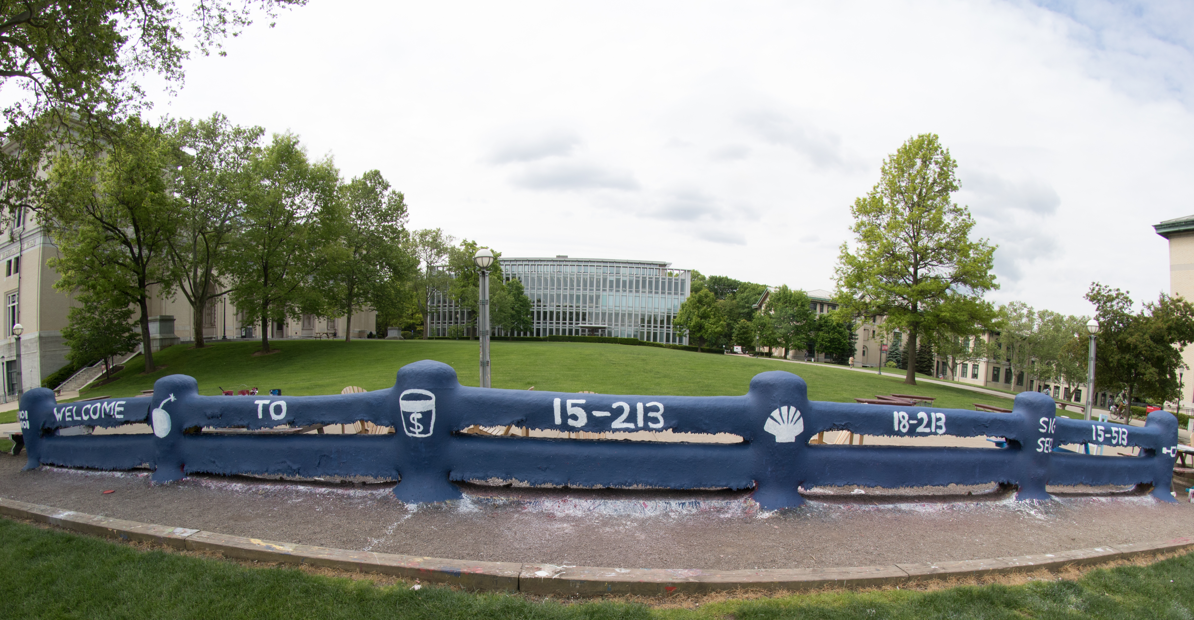
14-513
18-613

Slide 2
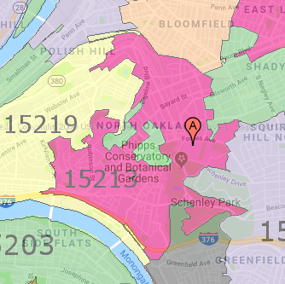
Course Overview 18-213/18-613: Computer Systems
An 15-213/18-213/15-513/14-513/18-613 Ecosystem Course
1st Lecture, August 26th, 2024
Instructors:
Gregory Kesden
Vyas Sekar

Slide 3
18-213/18-613 In A Nutshell

Slide 4
Why Are We Here?
“This course provides a programmers view of how computer systems execute programs, store information, and communicate.”
“It enables students to become more effective programmers, especially in dealing with issues of performance, portability and robustness.”
“It also serves as a foundation for courses on compilers, networks, operating systems, and computer architecture, where a deeper understanding of systems-level issues is required.”
From the official course description, emphasis added.

Slide 5
Why Are We Here?
Topics covered include:
machine-level code and its generation by optimizing compilers,
performance evaluation and optimization,
computer arithmetic,
memory organization and management,
networking technology and protocols, and
supporting concurrent computation.
Also from the official course description

Slide 6
Who Are You? (And, Who Is Everyone Else?)

Slide 7
Who Are You?
18-213
ECE Undergrads
18-613
MS in Electrical and Computer Engineering (Pittsburgh and Silicon Valley)
MS in Software Engineering (Silicon Valley)
MS in Artificial Intelligence Engineering
Interlopers ☺
Others who happened to want the flexibility of a remote class this summer, since the other related offerings are Pittsburgh-centric.
You are most welcome and invited!

Slide 8
Where Is Everyone Else? Sibling Offering
15-213
Undergrads in CS (Majors, 2nd majors, minors)
14-513/15-513
Other Masters Students (Outside of the College of Engineering)

Slide 9
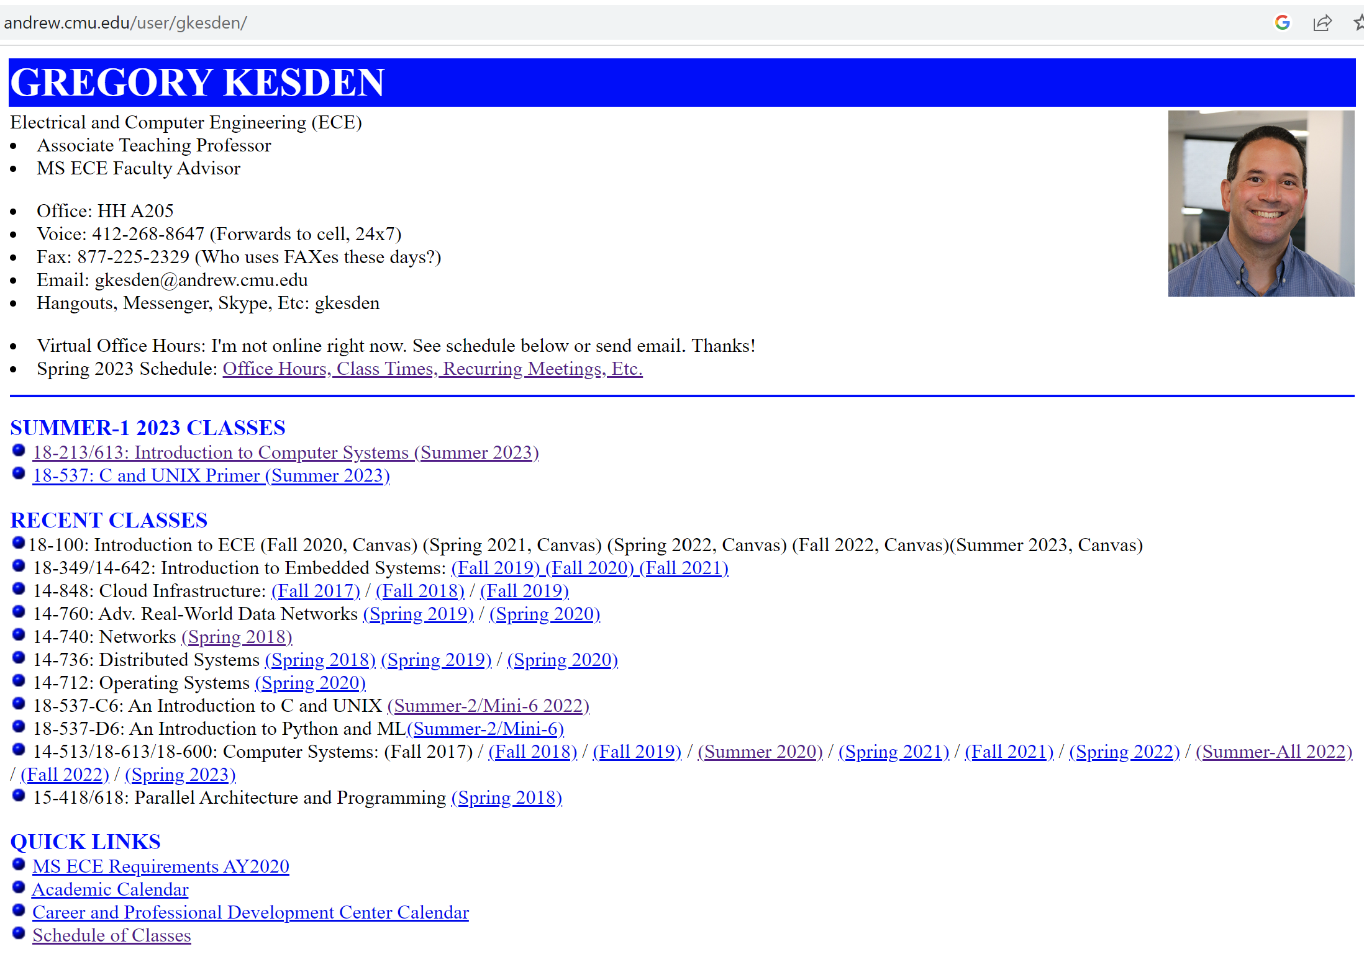
Who Am I? Gregory Kesden

Slide 10
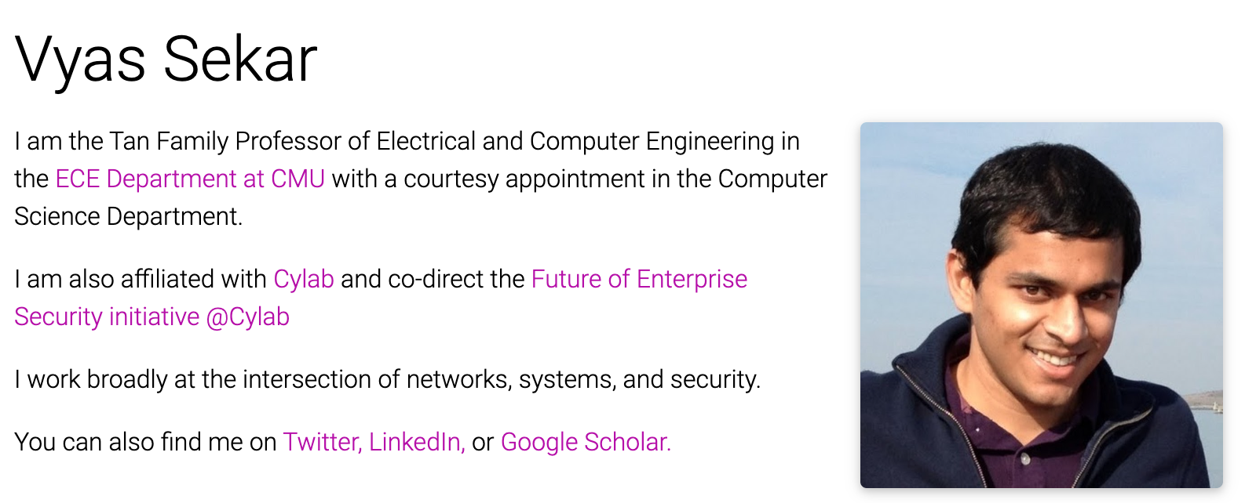
Who Am I? Vyas Sekar
B.Tech, IIT Madras CSE,2003 PhD, CMU CSD, 2010 Chennai→
Pittsburgh → Berkeley → Long Island → Pittsburgh
→ SF Bay Area → Pittsburgh
Research: Networking, Security, Systems Web: http://users.ece.cmu.edu/~vsekar/
Non-work: Run, squash, frisbee, cryptic crosswords, trivia, word puzzles

Slide 11
About The Course Topical Coverage In Detail

Slide 12
Programs and Data
Topics
Bit operations, arithmetic, assembly language programs
Representation of C control and data structures
Includes aspects of architecture and compilers
Assignments
L0 (C programming Lab): Test/refresh your C programming abilities
L1 (datalab): Manipulating bits
L2 (bomblab): Defusing a binary bomb
L3 (attacklab): The basics of code injection attacks

Slide 13
The Memory Hierarchy
Topics
Memory technology, memory hierarchy, caches, disks, locality
Includes aspects of architecture and OS
Assignments
L4 (cachelab): Building a cache simulator and optimizing for locality.
Learn how to exploit locality in your programs.

Slide 14
Virtual Memory
Topics
Virtual memory, address translation, dynamic storage allocation
Includes aspects of architecture and OS
Assignments
L5 (malloclab): Writing your own malloc package
Get a real feel for systems-level programming

Slide 15
Exceptional Control Flow
Topics
Hardware exceptions, processes, process control, Unix signals, nonlocal jumps
Includes aspects of compilers, OS, and architecture
Assignments
L6 (tshlab): Writing your own Unix shell.
A first introduction to concurrency

Slide 16
Networking, and Concurrency
Topics
High level and low-level I/O, network programming
Internet services, Web servers
concurrency, concurrent server design, threads
I/O multiplexing with select
Includes aspects of networking, OS, and architecture
Assignments
L7 (proxylab): Writing your own Web proxy
Learn network programming and more about concurrency and synchronization.

Slide 17
What Makes This Course Different? Course Perspective and Overarching Theme

Slide 18
Course Perspective
Most (Many?) Systems Courses are Builder-Centric
Computer Architecture
Design pipelined processor in Verilog
Operating Systems
Implement sample portions of operating system
Compilers
Write compiler for simple language
Networking
Implement and simulate network protocols

Slide 19
Course Perspective (Cont.)
Our Course is Programmer-Centric
By knowing more about the underlying system, you can be more effective as a programmer
Enable you to
Write programs that are more reliable and efficient
Incorporate features that require hooks into OS
E.g., concurrency, signal handlers
Cover material in this course that you won’t see elsewhere
Not just a course for dedicated hackers
We bring out the hidden hacker in everyone!

Slide 20
Course Theme: (Systems) Knowledge is Power!
Systems Knowledge
How hardware (processors, memories, disk drives, network infrastructure) plus software (operating systems, compilers, libraries, network protocols) combine to support the execution of application programs
How you as a programmer can best use these resources
Useful outcomes
Become more effective programmers
Able to find and eliminate bugs efficiently
Able to understand and tune for program performance
Prepare for later “systems” classes in CS, ECE, INI, ...
Compilers, Operating Systems, Networks, Computer Architecture, Embedded Systems, Storage Systems, Computer Security, etc.

Slide 21
It’s Important to Understand How Things Work
Why do I need to know this stuff?
Abstraction is good, but don’t forget reality
Most CS courses emphasize abstraction
(CE courses less so)
Abstract data types
Asymptotic analysis
These abstractions have limits
Especially in the presence of bugs
Need to understand details of underlying implementations
Sometimes the abstract interfaces don’t provide the level of control or performance you need

Slide 22
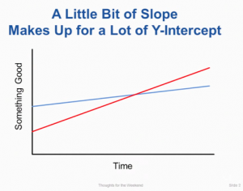
Aside: Ousterhout’s “Law”
“how fast you learn is a lot more important
than how much you know to begin with”
Source: https://briankeng.com/2015/07/a-little-bit-of-slope/

Slide 23
About The Course How We Get There

Slide 24
Course Components
Lectures
Higher level concepts
Labs (8)
The heart of the course
1-2+ weeks each
Provide in-depth understanding of an aspect of systems
Programming and measurement
Exams (midterm + final)
Test your understanding of concepts & mathematical principles

Slide 25
Lab Rationale
Each lab has a well-defined goal such as solving a puzzle or winning a contest
Doing the lab should result in new skills and concepts
We try to use competition in a fun and healthy way
Set a reasonable threshold for full credit
Post intermediate results (anonymized) on Autolab scoreboard for glory!

Slide 26
Course Resources

Slide 27
Textbooks
Randal E. Bryant and David R. O’Hallaron,
Computer Systems: A Programmer’s Perspective, Third Edition (CS:APP3e), Pearson, 2016
http://csapp.cs.cmu.edu
This book really matters for the course!
How to solve labs
Practice problems typical of exam problems
Electronic editions available (Don’t get paperback version!)
On reserve in Sorrells Library
Brian Kernighan and Dennis Ritchie,
The C Programming Language, Second Edition, Prentice Hall, 1988
Still the best book about C, from the originators
Even though it does not cover more recent extensions of C
On reserve in Sorrells Library

Slide 28
Online Resources
Web site: https://www.cs.cmu.edu/~18213
Contains the schedule, deadlines, course policies, and many other resources.
Autolab: https://ics.autolabproject.com/
Used to distribute labs, let you test your solutions, compete against each other, and for final grading

Slide 29
Online Resources
Piazza: https://piazza.com/cmu/fall2024/18x13
Q&A among your peers and privately with course staff
Can be anonymous with peers.
Canvas: https://www.canvas.cmu.edu
Video links are automatically uploaded here after processing
Look for “Panopto”
Access is automatically managed by the University, updating each night to sync with the official course roster.

Slide 30
Getting Help
Carnegie Mellon
Email, Call, or Zoom the Instructor
See web site for instructors’ availability and coordinates.
Greg’s cell phone is 412-818-7813
Piazza
https://piazza.com/cmu/fall2024/18x13
TA Office Hours
https://office-hours-01.andrew.cmu.edu:4443/
Small Group Sessions
We’ll organize those this week
Appointments
By request

Slide 31
Facilities
Labs will use the Intel Computer Systems Cluster
The “shark machines”
linux> ssh shark.ics.cs.cmu.edu
21 servers donated by Intel for 213/513/613
10 student machines (for student logins)
1 head node (for instructor logins)
10 grading machines (for autograding)
Each server: Intel Core i7: 8 Nehalem cores, 32 GB DRAM, RHEL 6.1
Rack-mounted in Gates machine room
Login using your Andrew ID and password

Slide 32
Course Policies

Slide 33
Policies: Grading
Labs (50%):
weighted according to effort (Detailed on Web site)
Final Exam (25%):
Comprehensive, proctored, at the end.
No note sheet, we’ll provide a reference sheet.
Midterm Exam
Midterm exam stands in for final exam for midsemester grades but then counts as two homework assignments
Only one homework drop can be used on the midterm exam
Homework (20%)
Weekly Problem sets (about 12-14 assignments), mostly, or inspired by, former exam questions
Drop lowest two (2) homeworks
Small Group/Participation (5%, or 10% penalty)
Small groups are mandatory.
Counts 5% of your final grade, unless you attend less than 60%, in which case you lose 10% of your final score.
In person, except a few CMU-SV (Zoom, Camera on)
Final grades based on a straight scale (90/80/70/60)

Slide 34
Timeliness
Grace days
5 grace days for the semester
Limit of 0, 1, or 2 grace days per lab used automatically
Covers scheduling crunch, out-of-town trips, illnesses, minor setbacks
Lateness penalties
Once grace day(s) used up, get penalized 15% per day
No handins later than 3 days after due date
Catastrophic events
Major illness, death in family, …
Formulate a plan (with your academic advisor) to get back on track
Advice
Once you start running late, it’s really hard to catch up
Try to save your grace days until the last few labs

Slide 35
A Personal Touch
You’ll soon be organized into groups of 5 students and a TA facilitator
Each TA facilitator only has 2 groups.
The goal is to give you personal attention and to help you enjoy getting to know and working with some of your wonderful colleagues.
If you need anything, your TA should be your first stop
They focus on only 10 students. Their goal is to know you well.
They have time allocated each week for 1:1 meetings with students in their group – if you need help, don’t let it go to waste, just ask
They are very empowered.
If you need anything, e.g. schedule adjustments, just ask. They’ll work with you in a personal way to adjust deadlines to your needs.
But they aren’t allowed to “kick the can”. They need to make adjustments that lead to getting caught up. They are asked to consider the whole schedule and ensure a good path to success.

Slide 36
Academic Integrity, and Violations Thereof
Doing one’s own work and giving credit where credit is due for the ideas and work of others are very important in the academic culture at CMU and across the United States, among many other places
Even what may seem to some to be small failures to do one’s own work or credit others are taken very seriously here
Course penalties ranging from -100% on the assignment to an R in the class
Program penalties ranging from probation to dismissal
Other consequences, such as loss of eligibility for scholarships, fellowships, awards, etc

Slide 37
AIVs vis-à-vis AI Tools
AI tools, such as, but not limited to, ChatGPT and Co-Pilot may be used to get help with understanding APIs, libraries, frameworks, provided code, error/warning/info messages, and similar, as well as tools taught in the course, such as GDB, and valgrind, and lecture material.
AI tools, such as, but not limited to, ChatGPT and Co-Pilot, may not be used to get partial or complete solutions to any portion of any assignment, or to get explanations or instructions for completing any assignment, e.g. you cannot ask ChatGPT what special cases should be considered for malloc lab’s coalesce, or what steps are required to allocate a miniblock, or which accesses are cache hits vs misses for cache configuration and trace given in a homework assignment.
In general, you may use AI tools for help understanding course material of any kind, but you may not ask it to generate anything toward any assignment, e.g. code, steps, special cases, answers, etc.
Please keep in mind: Responses you receive from an AI tool may well be attributable to publicly accessible materials and not properly cited by the AI tool, they may be given to other students in response to their queries, and they may be incorrect, inapplicable, or incomplete. En caveat emptor. You, not your tools, are wholly responsible for your submissions.
Please treat responses from AI Tools as if they came from a person or a published work and cite them to the AI Tool in any case where you would cite the contribution should it have been made by a person or have come from a published work.

Slide 38
Consider “Speeding” on the Highway
The posted sign says, “65 MPH”
In some places this means, “Go 60 MPH to be safe, because if you cross 65 MPH, you’ll likely be pulled over, fined, and your insurance will cost a lot more. And, be careless too often and you’ll lose your license.”
The speed limit is set to protect lives. It makes no sense to risk killing a person, widowing someone, orphaning someone, or disabling someone for life just to get somewhere a few minutes faster.
In some places this means, “Don’t go less than 65 MPH or over 79 MPH”
Cars are pretty safe, speed limits are set very conservatively, I’m an especially good driver, and if I go slower, I’ll slow down everyone behind me and they’ll be annoyed, people will honk at me, and my friends won’t let me drive.”
Conditions – and culture – define one’s view.
It varies drastically from place to place.

Slide 39
Our Culture
Credit must be given for other people’s intellectual contributions (.)
Ideas
Work product
Using other people’s intellectual property when it isn’t allowed is like trespassing – but worse.
It isn’t allowed (.)
Using other people’s intellectual property without proper citation isn’t allowed.
It is like stealing a rental car.

Slide 40
Know the Policies
Look at the syllabus, course web site, University Web site, and any departmental or program information:
Read the policies
Ask questions
Follow the policies
Work that isn’t yours can’t influence your project work
Things you google, or find on git, or your seniors tell you, or your friends tell you.
You can’t give unauthorized assistance
Even after you leave the class.
The policy is retroactive
You can be punished in accordance with the policy – even after graduation.

Slide 41
How to Avoid AIVs
Start early
Don’t rely on marathon programming sessions
Your brain works better in small bursts of activity
Ideas / solutions will come to mind while you’re doing other things
Plan for stumbling blocks
Assignment is harder than you expected
Code doesn’t work
Bugs hard to track down
Life gets in the way
Minor health issues
Unanticipated events

Slide 42
Diving In: Great Realities

Slide 43
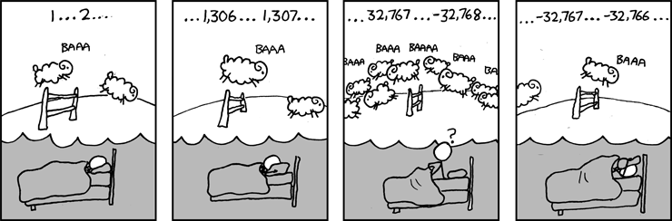
Great Reality #1: Ints are not Integers, Floats are not Reals
Example 1: Is x² ≥ 0?
Float’s: Yes!
Int’s:
40000 * 40000 --> 1600000000
50000 * 50000 --> ?
Example 2: Is (x + y) + z = x + (y + z)?
Unsigned & Signed Int’s: Yes!
Float’s:
(1e20 + -1e20) + 3.14 --> 3.14
1e20 + (-1e20 + 3.14) --> ??
Source: xkcd.com/571

Slide 44
Computer Arithmetic
Does not generate random values
Arithmetic operations have important mathematical properties
Cannot assume all “usual” mathematical properties
Due to finiteness of representations
Integer operations satisfy “ring” properties
Commutativity, associativity, distributivity
Floating point operations satisfy “ordering” properties
Monotonicity, values of signs
Observation
Need to understand which abstractions apply in which contexts
Important issues for compiler writers and serious application programmers

Slide 45
Great Reality #2: You’ve Got to Know Assembly
Chances are, you’ll never write programs in assembly
Compilers are much better & more patient than you are
But: Understanding assembly is key to machine-level execution model
Behavior of programs in presence of bugs
High-level language models break down
Tuning program performance
Understand optimizations done / not done by the compiler
Understanding sources of program inefficiency
Implementing system software
Compiler has machine code as target
Operating systems must manage process state
Creating / fighting malware
x86 assembly is the language of choice!

Slide 46
Great Reality #3: Memory Matters Random Access Memory Is an Unphysical Abstraction
Memory is not unbounded
It must be allocated and managed
Many applications are memory dominated
Memory referencing bugs especially pernicious
Effects are distant in both time and space
Memory performance is not uniform
Cache and virtual memory effects can greatly affect program performance
Adapting program to characteristics of memory system can lead to major speed improvements

Slide 47
Great Reality #4: There’s more to performance than asymptotic complexity
Constant factors matter too!
And even exact op count does not predict performance
Easily see 10:1 performance range depending on how code written
Must optimize at multiple levels: algorithm, data representations, procedures, and loops
Must understand system to optimize performance
How programs compiled and executed
How to measure program performance and identify bottlenecks
How to improve performance without destroying code modularity and generality

Slide 48
Why The Performance Differs
copyij
copyji

Slide 49
Great Reality #5: Computers do more than execute programs
They need to get data in and out
I/O system critical to program reliability and performance
They communicate with each other over networks
Many system-level issues arise in presence of network
Concurrent operations by autonomous processes
Coping with unreliable media
Cross platform compatibility
Complex performance issues

Slide 50
Coming Up
Lab 0 is out: Enjoy!
Lab 1 comes out Thursday
Next class: From Signals to Bits to Integer Arithmetic
Always: How can we be of service? Please reach out!

Slide 51
Welcome and Enjoy!

