Slide 1
14-513
18-613

Slide 2
Cache Memories 18-213/18-613: Introduction to Computer Systems 11th Lecture, June 5, 2024

Slide 3
Reminder: AIV Policy
http://www.cs.cmu.edu/~18213/academicintegrity.html
No unauthorized use of information
Borrowing code: by copying, retyping, looking at a file
Describing: verbal description of code from one person to another
Searching the Web for solutions
Copying code from a previous course or online solution
Reusing your code from a previous semester (here or elsewhere)
No unauthorized supplying of information
Providing copy: Giving a copy of a file to someone
Providing access:
Putting material in unprotected directory
Putting material in unprotected code repository (e.g., Github)
No collaborations beyond high-level, strategic advice
Anything more than block diagram or a few words
Start early. Make frequent github commits. Plan for stumbling blocks. Use available help. Don’t panic: Far better to turn in 25% correct solution than get an AIV.

Slide 4
Today
Cache memory organization and operation CSAPP 6.4-6.5
Performance impact of caches
The memory mountain CSAPP 6.6.1
Rearranging loops to improve spatial locality CSAPP 6.6.2
Using blocking to improve temporal locality CSAPP 6.6.3

Slide 5
Recall: General Cache Concepts
Smaller, faster, more expensive
memory caches a subset of
the blocks
Cache
8
4
9
14
3
Data is copied in block-sized transfer units
4
Larger, slower, cheaper memory
viewed as partitioned into “blocks”
Memory
0
1
2
3
4
4
5
6
7
8
9
10
11
12
13
14
15

Slide 6
General Cache Concepts: Hit
Request: 14
Data in block b is needed
Block b is in cache:
Hit!
Cache
8
9
14
3
14
Memory
0
1
2
3
4
5
6
7
8
9
10
11
12
13
14
15

Slide 7
General Cache Concepts: Miss
Request: 12
Data in block b is needed
Block b is not in cache:
Miss!
Cache
8
9
14
3
12
Block b is fetched from
memory
12
Request: 12
Block b is stored in cache
Placement policy: determines where b goes
Replacement policy: determines which block gets evicted (victim)
Memory
0
1
2
3
4
5
6
7
8
9
10
11
12
12
13
14
15

Slide 8
Working Set, Locality, and Caches
Working Set: The set of data a program is currently “working on”
Definition of “currently” depends on context, e.g., in this loop
Includes accesses to data and instructions
Principle of Locality: Programs tend to use data and instructions with addresses near or equal to those they have used recently
Nearby addresses: Spatial Locality
Equal addresses: Temporal locality
Caches take advantage of temporal locality by storing recently used data, and spatial locality by copying data in block-sized transfer units
Locality reduces working set sizes
Caches are most effective when the working set fits in the cache

Slide 9
Recall: 3 Types of Cache Misses
Cold (compulsory) miss
Cold misses occur because the cache starts empty and this is the first reference to the block.
Capacity miss
Occurs when the set of active cache blocks (working set) is larger than the cache.
Conflict miss
Occurs when the cache is large enough, but too many data objects all map (by the placement policy) to the same limited set of blocks
E.g., if the placement policy maps both 0 and 8 to the same block, then referencing 0, 8, 0, 8, 0, 8, ... would miss every time.

Slide 10
CPU Cache Memories
Cache memories are small, fast SRAM-based memories managed automatically in hardware
Hold frequently accessed blocks of main memory
CPU looks first for data in cache
Typical system structure:
CPU chip
Register file
ALU
Cache
memory
System bus
Memory bus
Main
memory
Bus interface
I/O
bridge

Slide 11
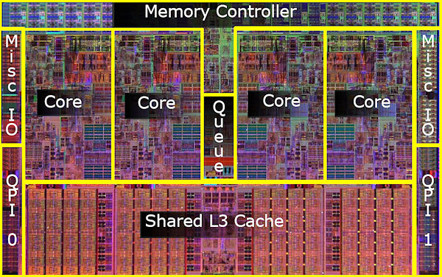
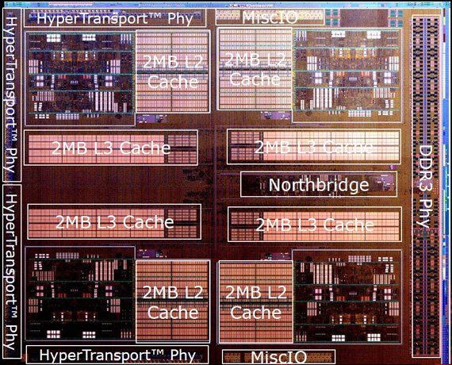
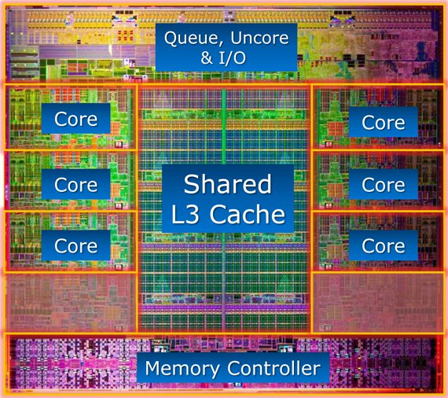
What it Really Looks Like
CPU chip
Register file
ALU
Cache
memory
Bus interface
Nehalem
AMD FX 8150
Core i7-3960X

Slide 12
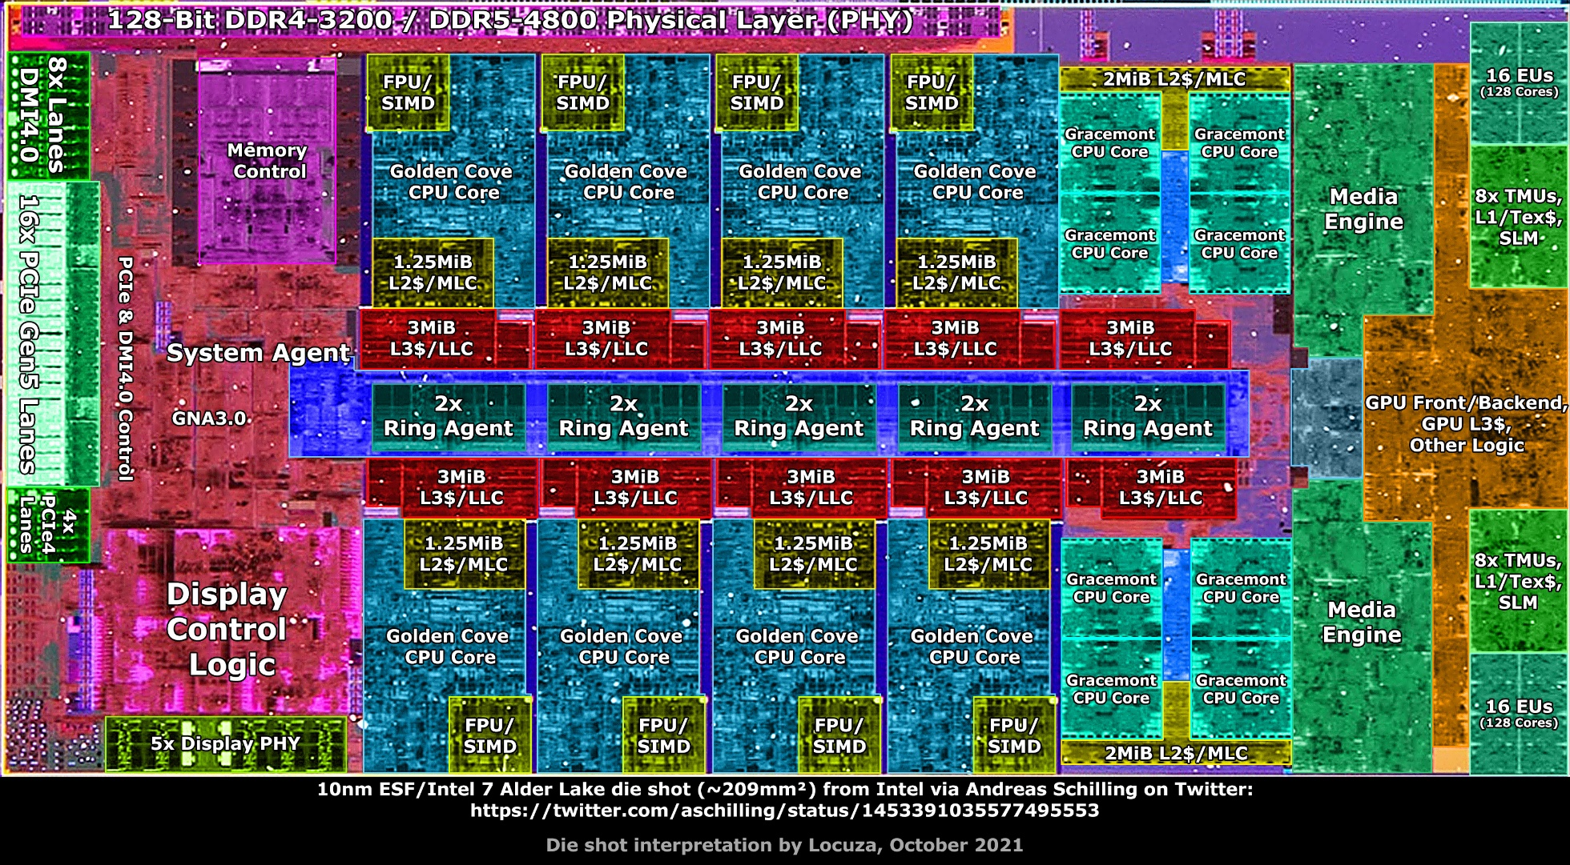
What it Really Looks Like (Cont.)
L1 caches per P-core: 32KB Instruction & 48KB Data
L1 caches per E-core: 64KB Instruction & 32KB Data
L2 caches: 1.25MB per P-core, 2MB per four E-cores
L3 cache: 30MB shared among all cores
Intel Alder Lake (2021)
8 P-cores + 8 E-cores
Notes:
Intel processor, launched in 2021, with 8 Golden Cove high-performance cores (P-cores) and 8 Gracemont power-efficient cores (E-cores)

Slide 13
General Cache Organization (S, E, B)
E = 2e lines per set
set
line
S = 2^{s} sets
Cache size
= S x E x B data bytes
v
tag
0
1
2
B-1
valid bit
B = 2^{b} bytes per cache block (the data)

Slide 14
Cache Read
Locate set
Check if any line in set has matching tag
Yes + line valid: hit
Locate data starting at offset
E = 2e lines per set
Address of word:
t bits
s bits
b bits
S = 2^{s} sets
tag
set
index
block
offset
data begins at this offset
v
tag
0
1
2
B-1
valid bit
B = 2^{b} bytes per cache block (the data)

Slide 15
Example: Direct Mapped Cache (E = 1)
Direct mapped: One line per set
Assume: cache block size B=8 bytes
Address of int:
v
tag
0
1
2
3
4
5
6
7
t bits
0…01
100
v
tag
0
1
2
3
4
5
6
7
find set
S = 2^{s} sets
v
tag
0
1
2
3
4
5
6
7
v
tag
0
1
2
3
4
5
6
7

Slide 16
Example: Direct Mapped Cache (E = 1)
Direct mapped: One line per set
Assume: cache block size B=8 bytes
Address of int:
valid? +
match: assume yes (= hit)
t bits
0…01
100
v
tag
0
1
2
3
4
5
6
7
tag
block offset

Slide 17
Example: Direct Mapped Cache (E = 1)
Direct mapped: One line per set
Assume: cache block size B=8 bytes
Address of int:
valid? +
match: assume yes (= hit)
t bits
0…01
100
v
tag
0
1
2
3
4
5
6
7
block offset
int (4 Bytes) is here
If tag doesn’t match (= miss): old line is evicted and replaced

Slide 18
Direct-Mapped Cache Simulation
t=1
s=2
b=1
4-bit addresses (address space size M=16 bytes)
S=4 sets, E=1 Blocks/set, B=2 bytes/block
Address trace (reads, one byte per read):
0 [0000₂],
1 [0001₂],
7 [0111₂],
8 [1000₂],
0 [0000₂]
x
xx
x
miss
(cold)
hit
miss
(cold)
miss
(cold)
miss
(conflict)
v
Tag
Block
Set 0
1
0
M[0-1]
0
0
M[0-1]
1
1
M[8-9]
Set 1
0
Set 2
0
Set 3
1
0
M[6-7]
0
Notes:
Pause at the end of this slide to consider that M[0] and M[8] have nothing to do with one another, but that they interfere with one anothers’ existences in the cache.

Slide 19
E-way Set Associative Cache (Here: E = 2)
E = 2: Two lines per set
Assume: cache block size B=8 bytes
Address of short int:
2 lines per set
t bits
0…01
100
v
tag
0
1
2
3
4
5
6
7
v
tag
0
1
2
3
4
5
6
7
v
tag
0
1
2
3
4
5
6
7
v
tag
0
1
2
3
4
5
6
7
find set
v
tag
0
1
2
3
4
5
6
7
v
tag
0
1
2
3
4
5
6
7
v
tag
0
1
2
3
4
5
6
7
v
tag
0
1
2
3
4
5
6
7
S sets

Slide 20
E-way Set Associative Cache (Here: E = 2)
E = 2: Two lines per set
Assume: cache block size B=8 bytes
Address of short int:
compare both
t bits
0…01
100
valid? +
match: yes (= hit)
v
tag
0
1
2
3
4
5
6
7
tag
v
tag
0
1
2
3
4
5
6
7
block offset

Slide 21
E-way Set Associative Cache (Here: E = 2)
E = 2: Two lines per set
Assume: cache block size B=8 bytes
Address of short int:
compare both
t bits
0…01
100
valid? +
match: yes (= hit)
v
tag
0
1
2
3
4
4
5
tag
5
6
7
v
tag
0
1
2
3
4
5
6
7
block offset
short int (2 Bytes) is here
No match or not valid (= miss):
One line in set is selected for eviction and replacement
Replacement policies: random, least recently used (LRU), …

Slide 22
2-Way Set Associative Cache Simulation
t=2
s=1
b=1
xx
x
x
4-bit addresses (M=16 bytes)
S=2 sets, E=2 blocks/set, B=2 bytes/block
Address trace (reads, one byte per read):
0 [0000₂],
1 [0001₂],
7 [0111₂],
8 [1000₂],
0 [0000₂]
miss
hit
miss
miss
hit
v
Tag
Block
1
00
M[0-1]
Set 0
0
1
10
M[8-9]
0
1
01
M[6-7]
Set 1
0
0
Notes:
For the same trace as before, we get a hit for the second 0 with a 2-way set associative cache (instead of a miss with a direct-mapped cache).

Slide 23
What about writes?
Multiple copies of data exist:
L1, L2, L3, Main Memory, Disk
What to do on a write-hit?
Write-through (write immediately to memory)
Write-back (defer write to memory until replacement of line)
Each cache line needs a dirty bit (set if data differs from memory)
What to do on a write-miss?
Write-allocate (load into cache, update line in cache)
Good if more writes to the location will follow
No-write-allocate (writes straight to memory, does not load into cache)
Typical
Write-through + No-write-allocate
Write-back + Write-allocate
v
d
tag
0
1
2
B-1
valid bit
dirty bit
B = 2^{b} bytes

Slide 24
Why Index Using Middle Bits?
Direct mapped: One line per set
Assume: cache block size 8 bytes
Standard Method:
Middle bits indexing
Address of int:
v
tag
0
1
2
3
4
5
6
7
t bits
0…01
100
v
tag
0
1
2
3
4
5
6
7
find set
S = 2^{s} sets
v
tag
0
1
2
3
4
5
6
7
Alternative Method:
High bits indexing
Address of int:
v
tag
0
1
2
3
4
5
6
7
1…11
t bits
100
find set

Slide 25
Illustration of Indexing Approaches
0000xx
0001xx
0010xx
64-byte memory
6-bit addresses
16 byte, direct-mapped cache
Block size = 4. (Thus, 4 sets; why?)
2 bits tag, 2 bits index, 2 bits offset
0011xx
0100xx
0101xx
0110xx
0111xx
1000xx
1001xx
Set 0
1010xx
Set 1
1011xx
Set 2
1100xx
Set 3
1101xx
1110xx
1111xx
Notes:
16byte direct mapped $, 4B blocks -> must be 4 sets to account for all 16B of cache

Slide 26
Middle Bits Indexing
0000xx
0001xx
0010xx
Addresses of form TTSSBB
TT Tag bits
SS Set index bits
BB Offset bits
Makes good use of spatial locality
0011xx
0100xx
0101xx
0110xx
0111xx
1000xx
1001xx
Set 0
1010xx
Set 1
1011xx
Set 2
1100xx
Set 3
1101xx
1110xx
1111xx

Slide 27
High Bits Indexing
0000xx
0001xx
0010xx
Addresses of form SSTTBB
SS Set index bits
TT Tag bits
BB Offset bits
Program with high spatial locality would generate lots of conflicts
0011xx
0100xx
0101xx
0110xx
0111xx
1000xx
1001xx
Set 0
1010xx
Set 1
1011xx
Set 2
1100xx
Set 3
1101xx
1110xx
1111xx
Notes:
Go from block with set index bits 00 to 01, displace the line sitting in set 0 from the block with set index 00.

Slide 28
Intel Core i7 Cache Hierarchy
Processor package
Core 0
Core 3
L1 i-cache and d-cache:
32 KB, 8-way,
Access: 4 cycles
L2 unified cache:
256 KB, 8-way,
Access: 10 cycles
L3 unified cache:
8 MB, 16-way,
Access: 40-75 cycles
Block size: 64 bytes for all caches.
Regs
Regs
L1
d-cache
L1
i-cache
L1
d-cache
L1
i-cache
…
L2 unified cache
L2 unified cache
L3 unified cache
(shared by all cores)
Main memory

Slide 29
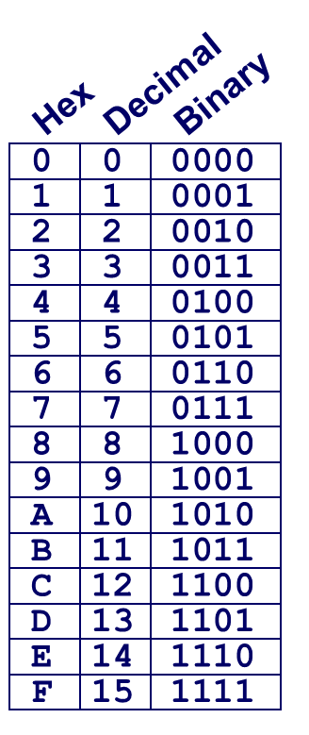
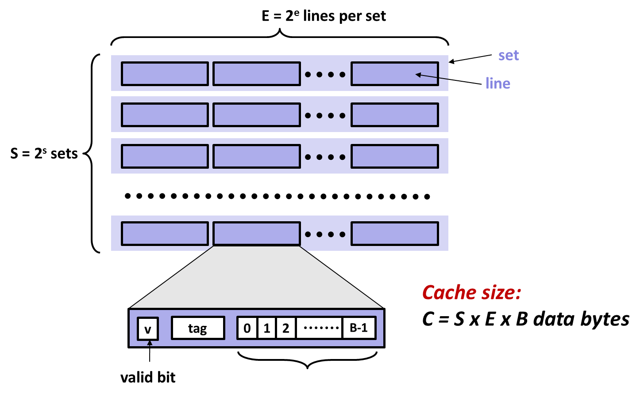
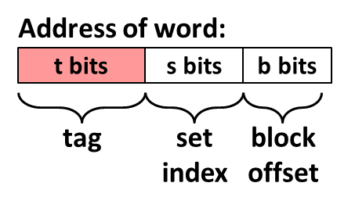
Example: Core i7 L1 Data Cache
32 KB 8-way set associative
64 bytes/block
47 bit address range
B =
S = , s =
E = , e =
C =
Stack Address: 0x00007f7262a1e010
Block offset: 0x??
Set index: 0x??
Tag: 0x??
Block offset: . bits
Set index: . bits
Tag: . bits
Notes:
B = 64 (2^6)
E = 8 (2^3)
S = 64 (2^6) [need to infer from B, E, and Cache Size]
Cache Size = 2^15 (32768)

Slide 30
Example: Core i7 L1 Data Cache
32 kB 8-way set associative 64 bytes/block
47 bit address range
B = 64
S = 64, s = 6
E = 8, e = 3
C = 64 x 64 x 8 = 32,768
Stack Address: 0x00007f7262a1e010
Block offset: 0x??
Set index: 0x??
Tag: 0x??
Block offset: 6 bits
Set index: 6 bits
Tag: 35 bits

Slide 31
Example: Core i7 L1 Data Cache
32 kB 8-way set associative 64 bytes/block
47 bit address range
B = 64
S = 64, s = 6
E = 8, e = 3
C = 64 x 64 x 8 = 32,768
Stack Address: 0x00007f7262a1e010
Block offset: 0x10
Set index: 0x0
Tag: 0x7f7262a1e
Block offset: 6 bits
Set index: 6 bits
Tag: 35 bits
0000 0001 0000
Notes:
0x010 => 0000 0001 0000, say that it awkwardly segments the bits, but that’s ok

Slide 32
Cache Performance Metrics
Miss Rate
Fraction of memory accesses not found in cache (misses / accesses) = 1 – hit rate
Typical numbers (as %):
3-10% for L1
can be quite small (e.g., < 1%) for L2, depending on size, etc.
Hit Time
Time to deliver a cached block to the processor
includes time to determine whether line is in cache
Typical numbers:
4 clock cycle for L1
10 clock cycles for L2
Miss Penalty
Additional time required because of a miss
typically 50-200 cycles for main memory (Trend: increasing!)

Slide 33
How Bad Can a Few Cache Misses Be?
Huge difference between a hit and a miss
Could be 100x, if just L1 and main memory
Would you believe 99% hits is twice as good as 97%?
Consider this simplified example: cache hit time of 1 cycle miss penalty of 100 cycles
Average access time:
97% hits: 1 cycle + 0.03 x 100 cycles = 4 cycles
99% hits: 1 cycle + 0.01 x 100 cycles = 2 cycles
This is why “miss rate” is used instead of “hit rate”

Slide 34
Writing Cache Friendly Code
Make the common case go fast
Focus on the inner loops of the core functions
Minimize the misses in the inner loops
Repeated references to variables are good (temporal locality)
Stride-1 reference patterns are good (spatial locality)
Key idea: Our qualitative notion of locality is quantified through our understanding of cache memories

Slide 35
Quiz Time!
Canvas Quiz: Day 10 – Cache Memories

Slide 36
Today
Cache organization and operation
Performance impact of caches
The memory mountain
Rearranging loops to improve spatial locality
Using blocking to improve temporal locality

Slide 37
The Memory Mountain
Read throughput (read bandwidth)
Number of bytes read from memory per second (MB/s)
Memory mountain: Measured read throughput as a function of spatial and temporal locality.
Compact way to characterize memory system performance.

Slide 38
Memory Mountain Test Function
long data[MAXELEMS]; /* Global array to traverse */
/* test - Iterate over first "elems" elements of
* array "data" with stride of "stride“,
* using 4x4 loop unrolling.
*/
int test(int elems, int stride) {
long i, sx2=stride*2, sx3=stride*3, sx4=stride*4;
long acc0 = 0, acc1 = 0, acc2 = 0, acc3 = 0;
long length = elems, limit = length - sx4;
/* Combine 4 elements at a time */
for (i = 0; i < limit; i += sx4) {
acc0 = acc0 + data[i];
acc1 = acc1 + data[i+stride];
acc2 = acc2 + data[i+sx2];
acc3 = acc3 + data[i+sx3];
}
/* Finish any remaining elements */
for (; i < length; i++) {
acc0 = acc0 + data[i];
}
return ((acc0 + acc1) + (acc2 + acc3));
}
Call test() with many combinations of elems
and stride.
For each elems and stride:
1. Call test() once to warm up the caches.
2. Call test() again and measure the read throughput(MB/s)
mountain/mountain.c

Slide 39
The Memory Mountain
Core i7 Haswell
2.1 GHz
32 KB L1 d-cache
256 KB L2 cache
8 MB L3 cache
64 B block size
Aggressive prefetching
L1
Ridges
of temporal locality
L2
L3
Slopes
of spatial locality
Mem
Notes:
Slopes of spatial locality – increase stride, degrade throughput because burn through blocks faster
Ridges of temporal – As increase size, can’t fit in level of cache any more, drop to next one down. Data in cache because of warm up before test run.
Prefetching – do better than we expect.

Slide 40
Closer Look at Stride Effects
128K
Miss rate = stride/8
Miss rate = 1.0
8 elems per cache block
stride

Slide 41
Today
Cache organization and operation
Performance impact of caches
The memory mountain
Rearranging loops to improve spatial locality
Using blocking to improve temporal locality

Slide 42
Matrix Multiplication Example
Description:
Multiply N x N matrices
Matrix elements are doubles (8 bytes)
O(N³) total operations
N reads per source element
N values summed per destination
but may be able to hold in register
Variable sum
held in register
/* ijk */
for (i=0; i<n; i++) {
for (j=0; j<n; j++) {
sum = 0.0;
for (k=0; k<n; k++)
sum += a[i][k] * b[k][j];
c[i][j] = sum;
}
}
matmult/mm.c

Slide 43
Miss Rate Analysis for Matrix Multiply
Assume:
Block size = 32B (big enough for four doubles)
Matrix dimension (N) is very large
Approximate 1/N as 0.0
Cache is not even big enough to hold multiple rows
Analysis Method:
Look at access pattern of inner loop
j
k
j
=
x
i
i
k
C
A
B

Slide 44
Layout of C Arrays in Memory (review)
C arrays allocated in row-major order
each row in contiguous memory locations
Stepping through columns in one row:
for (i = 0; i < N; i++)
sum += a[0][i];
accesses successive elements
if block size (B) > sizeof(a_{ij}) bytes, exploit spatial locality
miss rate = sizeof(a_{ij}) / B
Stepping through rows in one column:
for (i = 0; i < n; i++)
sum += a[i][0];
accesses distant elements
no spatial locality!
miss rate = 1 (i.e. 100%)

Slide 45
Matrix Multiplication (ijk)
/* ijk */
for (i=0; i<n; i++) {
for (j=0; j<n; j++) {
sum = 0.0;
for (k=0; k<n; k++)
sum += a[i][k] * b[k][j];
c[i][j] = sum;
}
}
Inner loop:
(*,j)
(i,j)
(i,*)
A
B
C
matmult/mm.c
Row-wise
Column-
wise
Fixed
Miss rate for inner loop iterations:
A B C
0.25 1.0 0.0
Block size = 32B (four doubles)

Slide 46
Matrix Multiplication (jik)
/* jik */
for (j=0; j<n; j++) {
for (i=0; i<n; i++) {
sum = 0.0;
for (k=0; k<n; k++)
sum += a[i][k] * b[k][j];
c[i][j] = sum
}
}
Inner loop:
(*,j)
(i,j)
(i,*)
A
B
C
matmult/mm.c
Row-wise
Column-
wise
Fixed
Misses per inner loop iteration:
A B C
0.25 1.0 0.0
Same analysis as ijk
Block size = 32B (four doubles)
Notes:
Can go quickly through this slide. Only point is that the outer loop order doesn’t change the analysis

Slide 47
Matrix Multiplication (kij)
/* kij */
for (k=0; k<n; k++) {
for (i=0; i<n; i++) {
r = a[i][k];
for (j=0; j<n; j++)
c[i][j] += r * b[k][j];
}
}
Inner loop:
(i,k)
(k,*)
(i,*)
A
B
C
matmult/mm.c
Fixed
Row-wise
Row-wise
Miss rate for inner loop iterations:
A B C
0.0
0.25
0.25
Block size = 32B (four doubles)

Slide 48
Matrix Multiplication (jki)
Inner loop:
/* jki */
for (j=0; j<n; j++) {
for (k=0; k<n; k++) {
r = b[k][j];
for (i=0; i<n; i++)
c[i][j] += a[i][k] * r;
}
}
(*,k)
(*,j)
(k,j)
A
B
C
matmult/mm.c
Column-
wise
Fixed
Column-
wise
Miss rate for inner loop iterations:
A B C
0.0
1.0
1.0
Block size = 32B (four doubles)

Slide 49
Summary of Matrix Multiplication
for (i=0; i<n; i++) {
for (j=0; j<n; j++) {
sum = 0.0;
for (k=0; k<n; k++)
sum += a[i][k] * b[k][j];
c[i][j] = sum;
}
}
ijk (& jik):
2 loads, 0 stores
avg misses/iter = 1.25
for (k=0; k<n; k++) {
for (i=0; i<n; i++) {
r = a[i][k];
for (j=0; j<n; j++)
c[i][j] += r * b[k][j];
}
}
kij (& ikj):
2 loads, 1 store
avg misses/iter = 0.5
for (j=0; j<n; j++) {
for (k=0; k<n; k++) {
r = b[k][j];
for (i=0; i<n; i++)
c[i][j] += a[i][k] * r;
}
}
jki (& kji):
2 loads, 1 store
avg misses/iter = 2.0

Slide 50
Core i7 Matrix Multiply Performance
Cycles per inner loop iteration
jki / kji (2.0)
ijk / jik (1.25)
kij / ikj (0.5)

Slide 51
Today
Cache organization and operation
Performance impact of caches
The memory mountain
Rearranging loops to improve spatial locality
Using blocking to improve temporal locality

Slide 52
Example: Matrix Multiplication
c = (double *) calloc(sizeof(double), n*n);
/* Multiply n x n matrices a and b */
void mmm(double *a, double *b, double *c, int n) {
int i, j, k;
for (i = 0; i < n; i++)
for (j = 0; j < n; j++)
for (k = 0; k < n; k++)
c[i*n + j] += a[i*n + k] * b[k*n + j];
}
j
c
a
b
=
x
i

Slide 53
Cache Miss Analysis
Assume:
Matrix elements are doubles
Cache line = 8 doubles
Cache size C << n (much smaller than n)
First iteration:
n/8 + n = 9n/8 misses
Afterwards in cache: (schematic)
n
=
x
=
x
8 wide
Notes:
n/8 – comes from taking n and doing it in chunks of 8 that fit in a cache line, with perfect stride 1 accesses across the row
N – comes from missing on everything but the 1 double needed going down a column

Slide 54
Cache Miss Analysis
Assume:
Matrix elements are doubles
Cache line = 8 doubles
Cache size C << n (much smaller than n)
Second iteration:
Again: n/8 + n = 9n/8 misses
Total misses:
9n/8 n² = (9/8) n³
n
=
x
8 wide

Slide 55
Blocked Matrix Multiplication
c = (double *) calloc(sizeof(double), n*n);
/* Multiply n x n matrices a and b */
void mmm(double *a, double *b, double *c, int n) {
int i, j, k;
for (i = 0; i < n; i+=L)
for (j = 0; j < n; j+=L)
for (k = 0; k < n; k+=L)
/* L x L mini matrix multiplications */
for (i1 = i; i1 < i+L; i1++)
for (j1 = j; j1 < j+L; j1++)
for (k1 = k; k1 < k+L; k1++)
c[i1*n+j1] += a[i1*n + k1]*b[k1*n + j1];
}
matmult/bmm.c
j1
c
a
b
c
=
x
+
i1
Block size L x L

Slide 56
Cache Miss Analysis
Assume:
Cache line = 8 doubles. Blocking size L ≥ 8
Cache size C << n (much smaller than n)
Three blocks fit into cache: 3L² < C
First (block) iteration:
Misses per block: L²/8
Blocks per Iteration: 2n/L
(omitting matrix c)
Misses per Iteration:
2n/L x L²/8 = nL/4
Afterwards in cache (schematic)
n/L blocks
=
x
Block size L x L
=
x
Notes:
L^2 / 8 comes from taking L^2 bytes per block and perfectly caching them 8 doubles at a time.
2n/L comes from doing n/L blocks of size L^2 in each source matrix

Slide 57
Cache Miss Analysis
Assume:
Cache line = 8 doubles. Blocking size L ≥ 8
Cache size C << n (much smaller than n)
Three blocks fit into cache: 3L² < C
Second (block) iteration:
Same misses as
first iteration
2n/L x L²/8 = nL/4
Total misses:
nL/4 misses per iteration x (n/L)² iterations = n³/(4L) misses
n/L blocks
=
x
Block size L x L
Notes:
n/L is the dimension of the matrix in blocks. (n/L)^2 is the number of iterations.
nL/4 is the misses per iteration. N^3/4L is the total miss count.

Slide 58
Blocking Summary
No blocking: (9/8) n³ misses
Blocking: (1/(4L)) n³ misses
Use largest block size L, such that L satisfies 3L² < C
Fit three blocks in cache! Two input, one output.
Reason for dramatic difference:
Matrix multiplication has inherent temporal locality:
Input data: 3n², computation 2n³
Every array elements used O(n) times!
But program has to be written properly
Notes:
3L^2 to accommodate M3 = M1 x M2, with M1,2,3 all supplying blocks of dim L^2

Slide 59
Cache Summary
Cache memories can have significant performance impact
You can write your programs to exploit this!
Focus on the inner loops, where bulk of computations and memory accesses occur.
Try to maximize spatial locality by reading data objects sequentially with stride 1.
Try to maximize temporal locality by using a data object as often as possible once it’s read from memory.

Slide 60
Supplemental slides

Slide 61
The Memory Mountain
Core i5 Haswell
3.1 GHz
32 KB L1 d-cache
256 KB L2 cache
8 MB L3 cache
64 B block size
Aggressive prefetching
L1
Ridges
of temporal locality
L2
L3
Slopes
of spatial locality
Mem

Slide 62
Cache Capacity Effects from Memory Mountain
Core i7 Haswell
3.1 GHz
32 KB L1 d-cache
256 KB L2 cache
8 MB L3 cache
64 B block size
Main Memory
L3
L2
L1
Slice through memory mountain with stride=8

Slide 63
Modeling Block Size Effects from Memory Mountain
Core i7 Haswell
2.26 GHz
32 KB L1 d-cache
256 KB L2 cache
8 MB L3 cache
64 B block size
Stride s

Slide 64
2008 Memory Mountain
Core 2 Duo
2.4 GHz
32 KB L1 d-cache
6MB L2 cache
64 B block size
No prefetching

Slide 65
Matrix Multiplication (ikj)
/* ikj */
for (i=0; i<n; i++) {
for (k=0; k<n; k++) {
r = a[i][k];
for (j=0; j<n; j++)
c[i][j] += r * b[k][j];
}
}
Inner loop:
(i,k)
(k,*)
(i,*)
A
B
C
matmult/mm.c
Fixed
Row-wise
Row-wise
Misses per inner loop iteration:
A B C
0.0 0.25 0.25
Block size = 32B (four doubles)

Slide 66
Matrix Multiplication (kji)
/* kji */
for (k=0; k<n; k++) {
for (j=0; j<n; j++) {
r = b[k][j];
for (i=0; i<n; i++)
c[i][j] += a[i][k] * r;
}
}
Inner loop:
(*,k)
(*,j)
(k,j)
A
B
C
matmult/mm.c
Column-
wise
Fixed
Column-
wise
Misses per inner loop iteration:
A B C
1.0 0.0 1.0
Block size = 32B (four doubles)

Slide 67
Recap: Stack and instruction pointers
Shared
Libraries
The stack pointer (%rsp) points to the top of the stack
The instruction pointer (%rip) points to the next instruction to be executed
They are independent
But linked by call and ret instructions
Stack
rsp
Heap
Data
Text
rip

Slide 68
Recap: stack operations
push %rax =
more stuff
rsp

Slide 69
Recap: stack operations
push %rax =
sub %rsp, 8
mov %rax, (%rsp)
more stuff
rax
rsp

Slide 70
Recap: stack operations
push %rax =
sub %rsp, 8
mov %rax, (%rsp)
call func =
more stuff
rax
rsp

Slide 71
Recap: stack operations
push %rax =
sub %rsp, 8
mov %rax, (%rsp)
call func =
sub %rsp, 8
mov %rip, (%rsp)
jmp func
more stuff
rax
rip
rsp

Slide 72
Recap: stack operations
push %rax =
sub %rsp, 8
mov %rax, (%rsp)
call func =
sub %rsp, 8
mov %rip, (%rsp)
jmp func
ret =
more stuff
rax
rip
rsp

Slide 73
Recap: stack operations
push %rax =
sub %rsp, 8
mov %rax, (%rsp)
call func =
sub %rsp, 8
mov %rip, (%rsp)
jmp func
ret =
mov (%rsp), %rip
add %rsp, 8
more stuff
rax
rsp

Slide 74
Recap: stack operations
push %rax =
sub %rsp, 8
mov %rax, (%rsp)
call func =
sub %rsp, 8
mov %rip, (%rsp)
jmp func
ret =
mov (%rsp), %rip
add %rsp, 8
pop %rax =
more stuff
rax
rsp

Slide 75
Recap: stack operations
push %rax =
sub %rsp, 8
mov %rax, (%rsp)
call func =
sub %rsp, 8
mov %rip, (%rsp)
jmp func
ret =
mov (%rsp), %rip
add %rsp, 8
pop %rax =
mov (%rsp), %rax
add %rsp, 8
more stuff
rsp

