Slide 1

14-513
18-613

Slide 2
Machine-Level Programming III: Procedures
18-213/18-613: Introduction to Computer Systems
6th Lecture, Feb 1, 2024

Slide 3
If you’re struggling with assembly
Chapter 3 of the textbook is your friend
  More detailed explanations of everything in these lectures
  Work through the practice problems
  Ask for help with the practice problems
  Today’s lecture will take us to the end of 3.7
Lots of tips, tricks, and guides have been posted on Piazza
Talk it out with a friend
  “Help me understand what jmp *.L32(,%rdx,8) does in general” is an OK discussion to have; not an AIV
  “Help me understand what jmp *.L32(,%rdx,8) does in phase 8 of this binary bomb”, on the other hand, is an AIV
  If you haven’t got a friend handy, try a rubber duck. Really!

Slide 4
Recap: Finding Jump Table in Binary
00000000004005e0 <switch_eg>:
. . .
4005e9: ff 24 fd f0 07 40 00 jmpq *0x4007f0(,%rdi,8)
. . .
% gdb switch
(gdb) x /8xg 0x4007f0
0x4007f0: 0x0000000000400614 0x00000000004005f0
0x400800: 0x00000000004005f8 0x0000000000400602
0x400810: 0x0000000000400614 0x000000000040060b
0x400820: 0x000000000040060b 0x2c646c25203d2078
(gdb)

Slide 5
Switch Statements on the Shark Machines
Nuance: It is desirable for addresses to be relative rather than absolute.
  Since offsets can be smaller than whole addresses, the code takes up less memory
  Relative vs absolute addresses also make it easier to link code by making it “position independent”. We’ll talk more about that later.
  To this end, x86-64 has an addressing mode which provides hardware support for managing addresses relative to the %rip.
Nuance: Loads and stores with 64-bit displacement are available only via %eax.
  Why? Its all wires! (See Prof. Nace in 18-240 for details!)

Slide 6
Switch Statements on the Shark Machines
To make things work nicely with the constraints on the prior page:
  Rather than keeping absolute addresses, the jump table address is kept relative to the %rip.
  The address of the target code is placed into the %rax, because only that register can contain a 64-bit target address

Slide 7
Switch Statements on the Shark Machines
The code that does the jumping looks like this:
# Handle the cases too small or too large for the switch
# Negative cases look large to ja and offsets can be used
# to shift the smallest case to 0.
0x00000000004017e9 <+41>: cmp $0xc,%esi
0x00000000004017ec <+44>: ja 0x401818 <foo+88>
# Get a pointer to the jump table
# %rip points to next addr, so %rdx becomes 0x498018 (jump table)
0x00000000004017ee <+46>: lea 0x96823(%rip),%rdx
# Get offset from %rsi-th index of jump table
0x00000000004017f5 <+53>: movslq (%rdx,%rsi,4),%rax
# Add that offset to the address of the jump table
0x00000000004017f9 <+57>: add %rdx,%rax
# Jump to that address, ultimately an offset from %rip
0x00000000004017fc <+60>: jmp *%rax

Slide 8
Switch Statements on the Shark Machines
The jump table contains offsets relative to the start of the jump table
(gdb) x/20dw 0x498008
0x498018: -616376 -616448 -616448 -616448
0x498028: -616472 -616448 -616461 -616448
0x498038: -616392 -616448 -616416 -616448
0x498048: -616416 0 0 0
(gdb) x/20xw 0x498008
0x498008: 0x74636e75 0x206e6f69 0x216f6f66 0x00000000
0x498018: 0xfff69848 0xfff69800 0xfff69800 0xfff69800
0x498028: 0xfff697e8 0xfff69800 0xfff697f3 0xfff69800
0x498038: 0xfff69838 0xfff69800 0xfff69820 0xfff69800
0x498048: 0xfff69820 0x00000000 0x00000000 0x00000000

Slide 9
Switch Statements on the Shark Machines
Ultimately, the target address is equal to the %rip + the offset to the start of jump table, plus an offset (possibly negative) from the start of the jump table to the target code.
  This target address is computed, placed into the %rax, and jumped to
# Get a pointer to the jump table
# %rip points to next addr, so %rdx becomes 0x498018 (jump table)
0x00000000004017ee <+46>: lea 0x96823(%rip),%rdx
# Get offset from %rsi-th index of jump table
0x00000000004017f5 <+53>: movslq (%rdx,%rsi,4),%rax
# Add that offset to the address of the jump table
0x00000000004017f9 <+57>: add %rdx,%rax
# Jump to that address, ultimately an offset from %rip
0x00000000004017fc <+60>: jmp *%rax

Slide 10
Today
Procedures
  Mechanisms CSAPP 3.7 preamble
  Stack Structure CSAPP 3.7.1
  Calling Conventions
    Passing control CSAPP 3.7.2
    Passing data CSAPP 3.7.3
    Managing local data CSAPP 3.7.4 – 3.7.5
  Illustration of Recursion CSAPP 3.7.6
Notes:
~half the slides are for the “Managing local data” part.

Slide 11
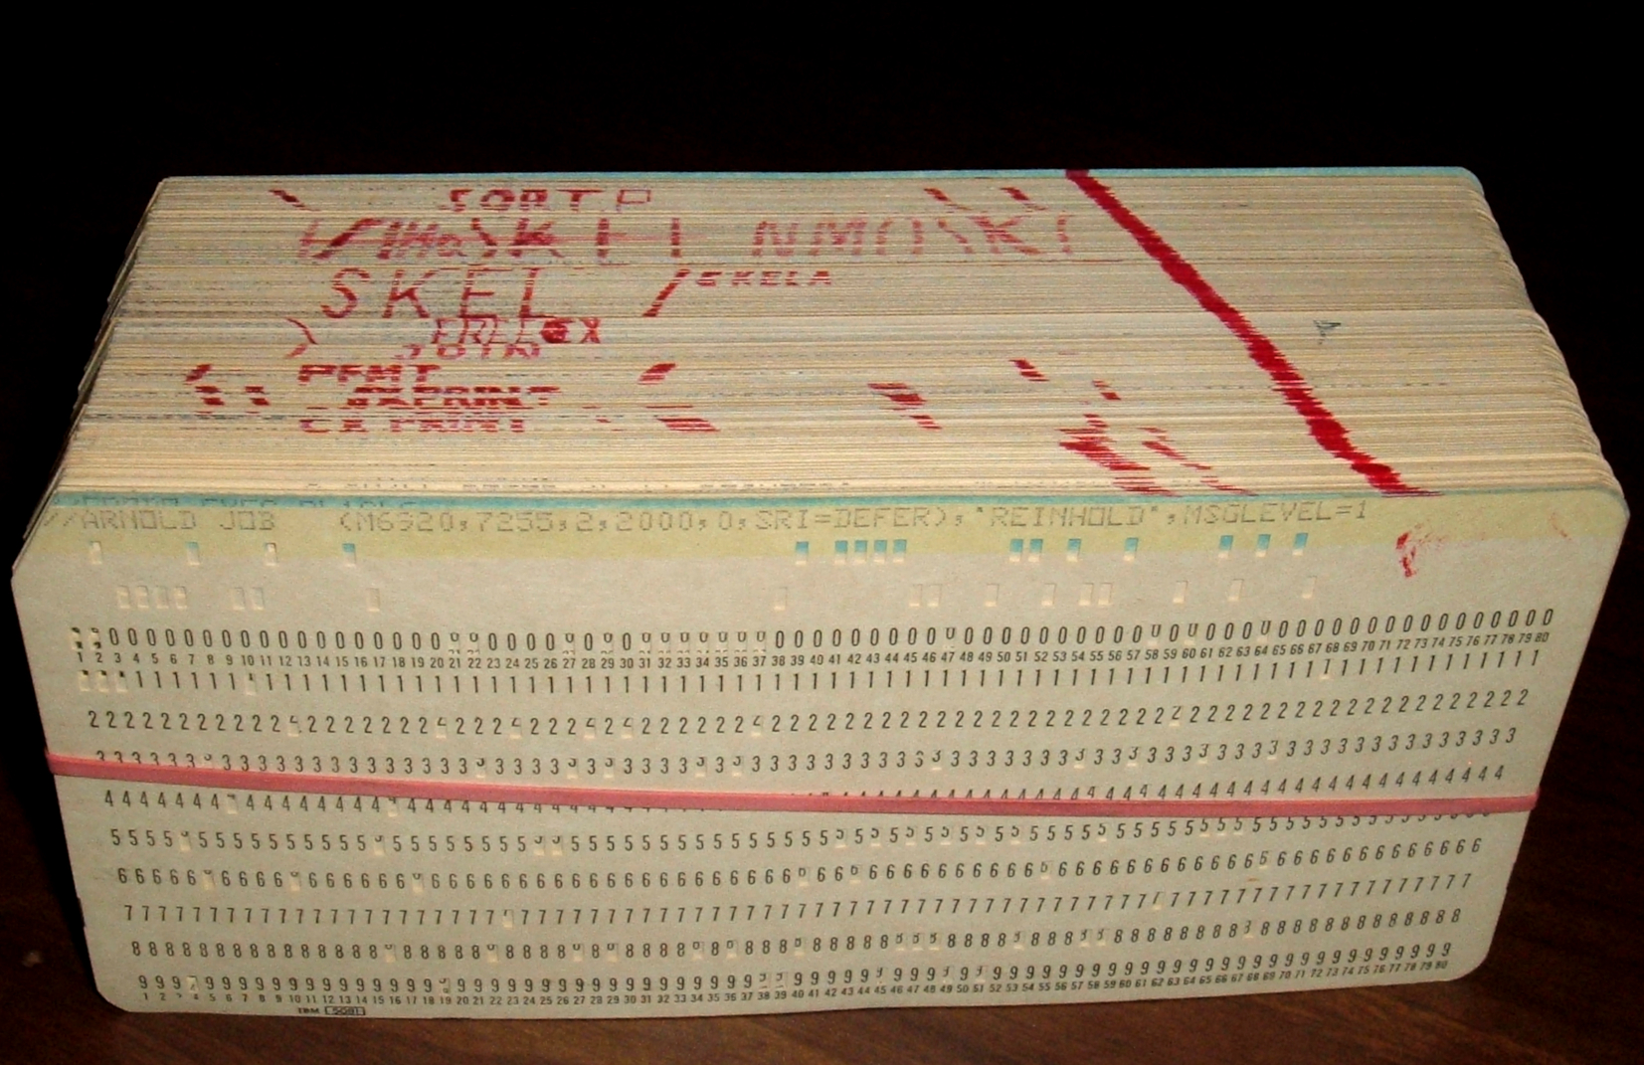
Procedures

Slide 12
Mechanisms in Procedures
P(…) {
•
•
y = Q(x);
print(y)
•
}
What’s needed?
Passing control
  To beginning of procedure code
  Back to return point
Passing data
  Procedure arguments
  Return value
Memory management
  Allocate during procedure execution
  Deallocate upon return
int Q(int i)
{
int t = 3*i;
int v[10];
•
•
return v[t];
}
Notes:
Ask the students what’s needed, before revealing the answer

Slide 13
Mechanisms in Procedures
P(…) {
•
•
y = Q(x);
print(y)
•
}
Passing control
  To beginning of procedure code
  Back to return point
Passing data
  Procedure arguments
  Return value
Memory management
  Allocate during procedure execution
  Deallocate upon return
int Q(int i)
{
int t = 3*i;
int v[10];
•
•
return v[t];
}

Slide 14
Mechanisms in Procedures
P(…) {
•
•
y = Q(x);
print(y)
•
}
Passing control
  To beginning of procedure code
  Back to return point
Passing data
  Procedure arguments
  Return value
Memory management
  Allocate during procedure execution
  Deallocate upon return
int Q(int i)
{
int t = 3*i;
int v[10];
•
•
return v[t];
}

Slide 15
Mechanisms in Procedures
P(…) {
•
•
y = Q(x);
print(y)
•
}
Passing control
  To beginning of procedure code
  Back to return point
Passing data
  Procedure arguments
  Return value
Memory management
  Allocate during procedure execution
  Deallocate upon return
int Q(int i)
{
int t = 3*i;
int v[10];
•
•
return v[t];
}

Slide 16
Mechanisms in Procedures
P(…) {
•
•
y = Q(x);
print(y)
•
}
Passing control
  To beginning of procedure code
  Back to return point
Passing data
  Procedure arguments
  Return value
Memory management
  Allocate during procedure execution
  Deallocate upon return
Mechanisms all implemented with machine instructions
x86-64 implementation of a procedure uses only those mechanisms required
int Q(int i)
{
int t = 3*i;
int v[10];
•
•
return v[t];
}

Slide 17
Mechanisms in Procedures
P(…) {
•
•
y = Q(x);
print(y)
•
}
Machine instructions implement the mechanisms, but the choices are determined by designers.
These choices make up the
Application Binary Interface (ABI).
Passing control
  To beginning of procedure code
  Back to return point
Passing data
  Procedure arguments
  Return value
Memory management
  Allocate during procedure execution
  Deallocate upon return
Mechanisms all implemented with machine instructions
x86-64 implementation of a procedure uses only those mechanisms required
int Q(int i)
{
int t = 3*i;
int v[10];
•
•
return v[t];
}

Slide 18
Today
Procedures
  Mechanisms
  Stack Structure
  Calling Conventions
    Passing control
    Passing data
    Managing local data
  Illustration of Recursion

Slide 19
x86-64 Stack
Carnegie Mellon
Region of memory managed with stack discipline
Memory viewed as array of bytes.
Different regions have different purposes.
(Like ABI, a policy decision)
stack
memory
code

Slide 20
x86-64 Stack
Carnegie Mellon
Stack “Bottom”
Region of memory
managed with
stack discipline
stack
code
Stack Pointer: %rsp
Stack “Top”

Slide 21
x86-64 Stack
Region of memory managed with stack discipline
Grows toward lower addresses
Register %rsp contains
lowest stack address
  address of “top” element
Stack “Bottom”
Increasing
Addresses
Stack Grows
Down
(toward lower addresses)
Stack Pointer: %rsp
Stack “Top”

Slide 22
x86-64 Stack: Push
pushq Src
  Fetch operand at Src
  Decrement %rsp by 8
  Write operand at address given by %rsp
Stack “Bottom”
val
Increasing
Addresses
Stack Grows
Down
Stack Pointer: %rsp
Stack “Top”

Slide 23
x86-64 Stack: Push
pushq Src
  Fetch operand at Src
  Decrement %rsp by 8
  Write operand at address given by %rsp
Stack “Bottom”
val
Increasing
Addresses
Stack Grows
Down
Stack Pointer: %rsp
-8
Stack “Top”

Slide 24
x86-64 Stack: Pop
Carnegie Mellon
popq Dest
  Read value at address given by %rsp
  Increment %rsp by 8
  Store value at Dest (usually a register)
Stack “Bottom”
Increasing
Addresses
Stack Grows
Down
Stack Pointer: %rsp
val
Stack “Top”

Slide 25
x86-64 Stack: Pop
popq Dest
  Read value at address given by %rsp
  Increment %rsp by 8
  Store value at Dest (usually a register)
Stack “Bottom”
Increasing
Addresses
val
Stack Grows
Down
Stack Pointer: %rsp
+8
Stack “Top”

Slide 26
x86-64 Stack: Pop
popq Dest
  Read value at address given by %rsp
  Increment %rsp by 8
  Store value at Dest (usually a register)
Stack “Bottom”
Increasing
Addresses
Stack Grows
Down
Stack Pointer: %rsp
val
(The memory doesn’t change,
only the value of %rsp)
Stack “Top”

Slide 27
Today
Procedures
  Mechanisms
  Stack Structure
  Calling Conventions
    Passing control
    Passing data
    Managing local data
  Illustration of Recursion

Slide 28
Code Examples
void multstore(long x, long y, long *dest)
{
long t = mult2(x, y);
*dest = t;
}
0000000000400540 <multstore>:
400540: push %rbx # Save %rbx
400541: mov %rdx,%rbx # Save dest
400544: callq 400550 <mult2> # mult2(x,y)
400549: mov %rax,(%rbx) # Save at dest
40054c: pop %rbx # Restore %rbx
40054d: retq # Return
long mult2(long a, long b)
{
long s = a * b;
return s;
}
0000000000400550 <mult2>:
400550: mov %rdi,%rax # a
400553: imul %rsi,%rax # a * b
400557: retq # Return
Notes:
Will cover in detail shortly

Slide 29
Procedure Control Flow
Use stack to support procedure call and return
Procedure call: call label
  Push return address on stack
  Jump to label
Return address:
  Address of the next instruction right after call
  Example from disassembly
Procedure return: ret
  Pop address from stack
  Jump to address

Slide 30
Control Flow Example #1
•
•
•
0x130
0000000000400540 <multstore>:
•
•
400544: callq 400550 <mult2>
400549: mov %rax,(%rbx)
•
•
0x128
0x120
%rsp
0x120
%rip
0x400544
0000000000400550 <mult2>:
400550: mov %rdi,%rax
•
•
400557: retq

Slide 31
Control Flow Example #2
•
•
•
0x130
0000000000400540 <multstore>:
•
•
400544: callq 400550 <mult2>
400549: mov %rax,(%rbx)
•
•
0x128
0x120
0x118
0x400549
%rsp
0x118
%rip
0x400550
0000000000400550 <mult2>:
400550: mov %rdi,%rax
•
•
400557: retq
Notes:
0x120-0x118 = 8

Slide 32
Control Flow Example #3
•
•
•
0x130
0000000000400540 <multstore>:
•
•
400544: callq 400550 <mult2>
400549: mov %rax,(%rbx)
•
•
0x128
0x120
0x118
0x400549
%rsp
0x118
%rip
0x400557
0000000000400550 <mult2>:
400550: mov %rdi,%rax
•
•
400557: retq

Slide 33
Control Flow Example #4
•
•
•
0x130
0000000000400540 <multstore>:
•
•
400544: callq 400550 <mult2>
400549: mov %rax,(%rbx)
•
•
0x128
0x120
%rsp
0x120
%rip
0x400549
0000000000400550 <mult2>:
400550: mov %rdi,%rax
•
•
400557: retq

Slide 34
Today
Procedures
  Mechanisms
  Stack Structure
  Calling Conventions
    Passing control
    Passing data
    Managing local data
  Illustrations of Recursion & Pointers

Slide 35
Procedure Data Flow
Registers
Stack
First 6 integer arguments
Return value
• • •
%rdi
%rsi
Arg n
%rdx
• • •
%rcx
%r8
Arg 8
%r9
Arg 7
%rax
Only allocate stack space when needed

Slide 36
Data Flow
Examples
void multstore
(long x, long y, long *dest) {
long t = mult2(x, y);
*dest = t;
}
0000000000400540 <multstore>:
# x in %rdi, y in %rsi, dest in %rdx
• • •
400541: mov %rdx,%rbx # Save dest
400544: callq 400550 <mult2> # mult2(x,y)
# t in %rax
400549: mov %rax,(%rbx) # Save at dest
• • •
long mult2
(long a, long b)
{
long s = a * b;
return s;
}
0000000000400550 <mult2>:
# a in %rdi, b in %rsi
400550: mov %rdi,%rax # a
400553: imul %rsi,%rax # a * b
# s in %rax
400557: retq # Return
Notes:
Rdi, rsi outer => x,y; rdi,rsi inner => a,b. Change names without moving data.
Mov rdx, rbx => defer until caller/callee save

Slide 37
Today
Procedures
  Mechanisms
  Stack Structure
  Calling Conventions
    Passing control
    Passing data
    Managing local data
  Illustration of Recursion

Slide 38
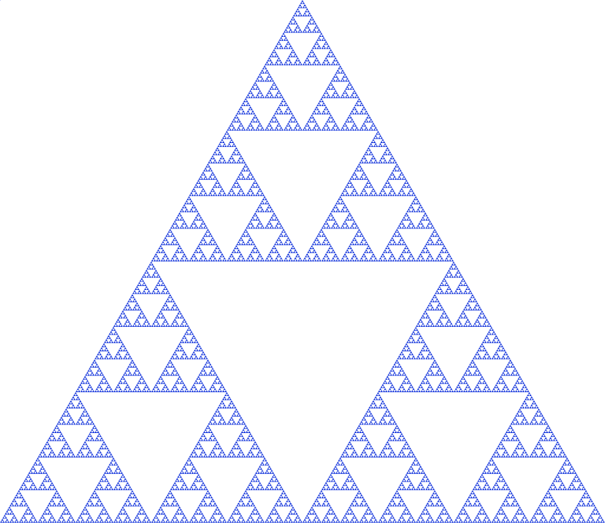
Stack-Based Languages
Languages that support recursion
  e.g., C, Pascal, Java
  Code must be “Reentrant”
    Multiple simultaneous instantiations of single procedure
  Need some place to store state of each instantiation
    Arguments
    Local variables
    Return address
Stack discipline
  State for given procedure needed for limited time
    From when called to when return
  Callee returns before caller does
Stack allocated in Frames
  state for single procedure instantiation

Slide 39
Call Chain Example
Example
Call Chain
yoo(…)
{
•
•
who();
•
•
}
yoo
who(…)
{
• • •
amI();
• • •
amI();
• • •
}
who
amI(…)
{
•
•
amI();
•
•
}
amI
amI
amI
amI
Procedure amI() is recursive

Slide 40
Stack Frames
Previous Frame
Frame for proc
Contents
  Return information
  Local storage (if needed)
  Temporary space (if needed)
Management
  Space allocated when enter procedure
    “Set-up” code
    Includes push by call instruction
  Deallocated when return
    “Tear-down” code
    Includes pop by ret instruction
Frame Pointer: %rbp
(Optional) x
Stack Pointer: %rsp
Stack “Top”
Notes:
When rbp not optional? Variable arity argument passing – need to track extents of args on stack to allow deallocation during tear-down

Slide 41
Example
Stack
yoo
yoo(…)
{
•
•
who();
•
•
}
yoo
%rbp
yoo
who
%rsp
amI
amI
amI
amI

Slide 42
Example
Stack
yoo
who
yoo(…)
{
•
•
who();
•
•
}
yoo
who(…)
{
• • •
amI();
• • •
amI();
• • •
}
yoo
who
%rbp
amI
amI
%rsp
amI
amI

Slide 43
Example
Stack
yoo
who
amI
yoo(…)
{
•
•
who();
•
•
}
yoo
who(…)
{
• • •
amI();
• • •
amI();
• • •
}
yoo
amI(…)
{
•
•
amI();
•
•
}
who
amI
amI
%rbp
amI
%rsp
amI

Slide 44
Example
Stack
yoo
who
amI
amI
yoo(…)
{
•
•
who();
•
•
}
yoo
who(…)
{
• • •
amI();
• • •
amI();
• • •
}
yoo
amI(…)
{
•
•
amI();
•
•
}
who
amI(…)
{
•
•
amI();
•
•
}
amI
amI
amI
%rbp
amI
%rsp

Slide 45
Example
Stack
yoo
who
amI
amI
amI
yoo(…)
{
•
•
who();
•
•
}
yoo
who(…)
{
• • •
amI();
• • •
amI();
• • •
}
yoo
amI(…)
{
•
•
amI();
•
•
}
who
amI(…)
{
•
•
amI();
•
•
}
amI
amI
amI(…)
{
•
•
amI();
•
•
}
amI
amI
%rbp
%rsp

Slide 46
Example
Stack
yoo
who
amI
amI
yoo(…)
{
•
•
who();
•
•
}
yoo
who(…)
{
• • •
amI();
• • •
amI();
• • •
}
yoo
amI(…)
{
•
•
amI();
•
•
}
who
amI(…)
{
•
•
amI();
•
•
}
amI
amI
amI
%rbp
amI
%rsp

Slide 47
Example
Stack
yoo
who
amI
yoo(…)
{
•
•
who();
•
•
}
yoo
who(…)
{
• • •
amI();
• • •
amI();
• • •
}
yoo
amI(…)
{
•
•
amI();
•
•
}
who
amI
amI
%rbp
amI
%rsp
amI

Slide 48
Example
Stack
yoo
who
yoo(…)
{
•
•
who();
•
•
}
yoo
who(…)
{
• • •
amI();
• • •
amI();
• • •
}
yoo
who
%rbp
amI
amI
%rsp
amI
amI

Slide 49
Example
Stack
yoo
who
amI
yoo(…)
{
•
•
who();
•
•
}
yoo
who(…)
{
• • •
amI();
• • •
amI();
• • •
}
yoo
amI(…)
{
•
•
amI();
•
•
}
who
amI
amI
%rbp
amI
%rsp
amI

Slide 50
Example
Stack
yoo
who
yoo(…)
{
•
•
who();
•
•
}
yoo
who(…)
{
• • •
amI();
• • •
amI();
• • •
}
yoo
who
%rbp
amI
amI
%rsp
amI
amI

Slide 51
Example
Stack
yoo
yoo
yoo(…)
{
•
•
who();
•
•
}
%rbp
yoo
who
%rsp
amI
amI
amI
amI

Slide 52
x86-64/Linux Stack Frame
Current Stack Frame (“Top” to Bottom)
  “Argument build:”
  Parameters for function about to call
  Local variables
  If can’t keep in registers
  Saved register context
  Old frame pointer (optional)
Caller Stack Frame
  Return address
    Pushed by call instruction
  Arguments for this call
Caller
Frame
Arguments
7+
Frame pointer
%rbp
Return Addr
Old %rbp
(Optional)
Saved
Registers
+
Local
Variables
Argument
Build
(Optional)
Stack pointer
%rsp

Slide 53
Example: incr
long incr(long *p, long val) {
long x = *p;
long y = x + val;
*p = y;
return x;
}
incr:
movq (%rdi), %rax
addq %rax, %rsi
movq %rsi, (%rdi)
ret
Register | Use(s)
%rdi | Argument p
%rsi | Argument val, y
%rax | x, Return value

Slide 54
Example: Calling incr #1
Initial Stack Structure
long call_incr() {
long v1 = 15213;
long v2 = incr(&v1, 3000);
return v1+v2;
}
. . .
Rtn address
%rsp
call_incr:
subq $16, %rsp
movq $15213, 8(%rsp)
movl $3000, %esi
leaq 8(%rsp), %rdi
call incr
addq 8(%rsp), %rax
addq $16, %rsp
ret
Resulting Stack Structure
. . .
Rtn address
15213
%rsp+8
Unused
%rsp
Notes:
Why the unused bytes? Could be alignment. Or space to spill something later.

Slide 55
Example: Calling incr #2
Stack Structure
long call_incr() {
long v1 = 15213;
long v2 = incr(&v1, 3000);
return v1+v2;
}
. . .
Rtn address
15213
%rsp+8
Unused
%rsp
call_incr:
subq $16, %rsp
movq $15213, 8(%rsp)
movl $3000, %esi
leaq 8(%rsp), %rdi
call incr
addq 8(%rsp), %rax
addq $16, %rsp
ret
Register | Use(s)
%rdi | &v1
%rsi | 3000
Notes:
Leaq: stash known address of “15213” for use in function. Will be safely there until return to call_incr

Slide 56
Example: Calling incr #2
Stack Structure
long call_incr() {
long v1 = 15213;
long v2 = incr(&v1, 3000);
return v1+v2;
}
. . .
Rtn address
15213
%rsp+8
Aside 1: movl $3000, %esi
Note: movl -> %exx zeros out high order 32 bits.
Why use movl instead of movq? 1 byte shorter.
Unused
%rsp
call_incr:
subq $16, %rsp
movq $15213, 8(%rsp)
movl $3000, %esi
leaq 8(%rsp), %rdi
call incr
addq 8(%rsp), %rax
addq $16, %rsp
ret
Register | Use(s)
%rdi | &v1
%rsi | 3000

Slide 57
Example: Calling incr #2
Stack Structure
long call_incr() {
long v1 = 15213;
long v2 = incr(&v1, 3000);
return v1+v2;
}
. . .
Rtn address
15213
%rsp+8
Unused
%rsp
Aside 2: leaq 8(%rsp), %rdi
Computes %rsp+8
Actually, used for what it is meant!
call_incr:
subq $16, %rsp
movq $15213, 8(%rsp)
movl $3000, %esi
leaq 8(%rsp), %rdi
call incr
addq 8(%rsp), %rax
addq $16, %rsp
ret
Register | Use(s)
%rdi | &v1
%rsi | 3000

Slide 58
Example: Calling incr #2
Stack Structure
long call_incr() {
long v1 = 15213;
long v2 = incr(&v1, 3000);
return v1+v2;
}
. . .
Rtn address
15213
%rsp+8
Unused
%rsp
call_incr:
subq $16, %rsp
movq $15213, 8(%rsp)
movl $3000, %esi
leaq 8(%rsp), %rdi
call incr
addq 8(%rsp), %rax
addq $16, %rsp
ret
Register | Use(s)
%rdi | &v1
%rsi | 3000

Slide 59
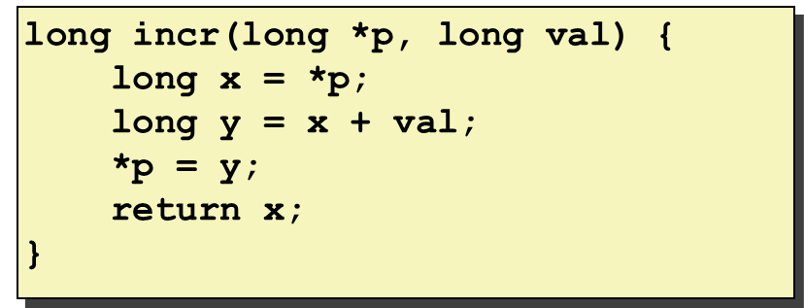
Example: Calling incr #3a
Stack Structure
long call_incr() {
long v1 = 15213;
long v2 = incr(&v1, 3000);
return v1+v2;
}
. . .
Rtn address
15213
%rsp+8
Unused
%rsp
call_incr:
subq $16, %rsp
movq $15213, 8(%rsp)
movl $3000, %esi
leaq 8(%rsp), %rdi
call incr
addq 8(%rsp), %rax
addq $16, %rsp
ret
Register | Use(s)
%rdi | &v1
%rsi | 3000

Slide 60
Example: Calling incr #3b
Stack Structure
long call_incr() {
long v1 = 15213;
long v2 = incr(&v1, 3000);
return v1+v2;
}
. . .
Rtn address
18213
%rsp+8
Unused
%rsp
call_incr:
subq $16, %rsp
movq $15213, 8(%rsp)
movl $3000, %esi
leaq 8(%rsp), %rdi
call incr
addq 8(%rsp), %rax
addq $16, %rsp
ret
Register | Use(s)
%rdi | &v1
%rsi | 3000

Slide 61
Example: Calling incr #4
Stack Structure
long call_incr() {
long v1 = 15213;
long v2 = incr(&v1, 3000);
return v1+v2;
}
. . .
Rtn address
18213
%rsp+8
Unused
%rsp
call_incr:
subq $16, %rsp
movq $15213, 8(%rsp)
movl $3000, %esi
leaq 8(%rsp), %rdi
call incr
addq 8(%rsp), %rax
addq $16, %rsp
ret
Register | Use(s)
%rax | Return value, 15213

Slide 62
Example: Calling incr #5a
Stack Structure
long call_incr() {
long v1 = 15213;
long v2 = incr(&v1, 3000);
return v1+v2;
}
. . .
Rtn address
18213
%rsp+8
Unused
%rsp
call_incr:
subq $16, %rsp
movq $15213, 8(%rsp)
movl $3000, %esi
leaq 8(%rsp), %rdi
call incr
addq 8(%rsp), %rax
addq $16, %rsp
ret
Register | Use(s)
%rax | Return value
Updated Stack Structure
. . .
Rtn address
%rsp

Slide 63
Example: Calling incr #5b
Updated Stack Structure
long call_incr() {
long v1 = 15213;
long v2 = incr(&v1, 3000);
return v1+v2;
}
. . .
Rtn address
%rsp
call_incr:
subq $16, %rsp
movq $15213, 8(%rsp)
movl $3000, %esi
leaq 8(%rsp), %rdi
call incr
addq 8(%rsp), %rax
addq $16, %rsp
ret
Register | Use(s)
%rax | Return value
Final Stack Structure
. . .
%rsp

Slide 64
Register Saving Conventions
When procedure yoo calls who:
  yoo is the caller
  who is the callee
Can a register be used for temporary storage?
  Contents of register %rdx overwritten by who
  If a callee clobbers your register, its value is lost!
    Need coordination between caller/callee
yoo:
• • •
movq $15213, %rdx
call who
addq %rdx, %rax
• • •
ret
who:
• • •
subq $18213, %rdx
• • •
ret

Slide 65
Register Saving Conventions
When procedure yoo calls who:
  yoo is the caller
  who is the callee
Can a register be used for temporary storage?
Conventions
  “Caller Saved”
    Caller must save values in its stack frame before call
  “Callee Saved”
    Callee saves values in its frame before using
    Callee restores values before returning

Slide 66
x86-64 Linux Register Usage #1
%rax
  Return value
  Also caller-saved
  Can be modified by procedure
%rdi, ..., %r9
  Integer arguments
  Also caller-saved
  Can be modified by procedure
%r10, %r11
  Caller-saved
  Can be modified by procedure
Caller-saved
Return value
%rax
%rdi
%rsi
%rdx
Caller-saved
Arguments
%rcx
%r8
%r9
%r10
Caller-saved
Temporaries
%r11

Slide 67
x86-64 Linux Register Usage #2
%rbx, %r12, %r13, %r14
  Callee-saved
  Callee must save & restore
%rbp
  Callee-saved
  Callee must save & restore
  May be used as frame pointer
  Compiler decides use of rbp
%rsp
  Special form of callee save
  Restored to original value upon exit from procedure
%rbx
%r12
Callee-saved
Temporaries
%r13
%r14
%rbp
Special
%rsp

Slide 68
Quiz Time!
Canvas Quiz: Day 6 - Machine Procedures

Slide 69
Callee-Saved Example #1
Initial Stack Structure
long call_incr2(long x) {
long v1 = 15213;
long v2 = incr(&v1, 3000);
return x+v2;
}
. . .
Rtn address
%rsp
x comes in register %rdi.
We need %rdi for the call to incr.
Where should be put x, so we can use it after the call to incr?
Notes:
Note that call_incr2 differs from call_incr that we saw earlier, in returning x+v2 instead of v1+v2.

Slide 70
Callee-Saved Example #2
Initial Stack Structure
long call_incr2(long x) {
long v1 = 15213;
long v2 = incr(&v1, 3000);
return x+v2;
}
. . .
Rtn address
%rsp
call_incr2:
pushq %rbx
subq $16, %rsp
movq %rdi, %rbx
movq $15213, 8(%rsp)
movl $3000, %esi
leaq 8(%rsp), %rdi
call incr
addq %rbx, %rax
addq $16, %rsp
popq %rbx
ret
Resulting Stack Structure
. . .
Rtn address
Saved %rbx
%rsp
Notes:
We are a callee, must save %rbx (to stack)

Slide 71
Callee-Saved Example #3
Initial Stack Structure
long call_incr2(long x) {
long v1 = 15213;
long v2 = incr(&v1, 3000);
return x+v2;
}
. . .
Rtn address
Saved %rbx
%rsp
call_incr2:
pushq %rbx
subq $16, %rsp
movq %rdi, %rbx
movq $15213, 8(%rsp)
movl $3000, %esi
leaq 8(%rsp), %rdi
call incr
addq %rbx, %rax
addq $16, %rsp
popq %rbx
ret
Resulting Stack Structure
. . .
Rtn address
Saved %rbx
%rsp+8
%rsp

Slide 72
Callee-Saved Example #4
Stack Structure
long call_incr2(long x) {
long v1 = 15213;
long v2 = incr(&v1, 3000);
return x+v2;
}
. . .
Rtn address
Saved %rbx
%rsp+8
call_incr2:
pushq %rbx
subq $16, %rsp
movq %rdi, %rbx
movq $15213, 8(%rsp)
movl $3000, %esi
leaq 8(%rsp), %rdi
call incr
addq %rbx, %rax
addq $16, %rsp
popq %rbx
ret
%rsp
x is saved in %rbx,
a callee saved register
Notes:
Rdi is x;

Slide 73
Callee-Saved Example #5
Stack Structure
long call_incr2(long x) {
long v1 = 15213;
long v2 = incr(&v1, 3000);
return x+v2;
}
. . .
Rtn address
Saved %rbx
15213
%rsp+8
call_incr2:
pushq %rbx
subq $16, %rsp
movq %rdi, %rbx
movq $15213, 8(%rsp)
movl $3000, %esi
leaq 8(%rsp), %rdi
call incr
addq %rbx, %rax
addq $16, %rsp
popq %rbx
ret
Unused
%rsp
x is saved in %rbx,
a callee saved register

Slide 74
Callee-Saved Example #6
Stack Structure
long call_incr2(long x) {
long v1 = 15213;
long v2 = incr(&v1, 3000);
return x+v2;
}
. . .
Rtn address
Saved %rbx
18213
%rsp+8
call_incr2:
pushq %rbx
subq $16, %rsp
movq %rdi, %rbx
movq $15213, 8(%rsp)
movl $3000, %esi
leaq 8(%rsp), %rdi
call incr
addq %rbx, %rax
addq $16, %rsp
popq %rbx
ret
Unused
%rsp
Upon return from incr:
x safe in %rbx
Return val v2 in %rax
Compute x+v2: addq %rbx, %rax
Notes:
If incr() used rbx, it had to restore call_incr2()’s rbx value before returning

Slide 75
Callee-Saved Example #7
Stack Structure
long call_incr2(long x) {
long v1 = 15213;
long v2 = incr(&v1, 3000);
return x+v2;
}
. . .
Rtn address
Saved %rbx
%rsp
18213
call_incr2:
pushq %rbx
subq $16, %rsp
movq %rdi, %rbx
movq $15213, 8(%rsp)
movl $3000, %esi
leaq 8(%rsp), %rdi
call incr
addq %rbx, %rax
addq $16, %rsp
popq %rbx
ret
Unused
Return result in %rax

Slide 76
Callee-Saved Example #8
Initial Stack Structure
long call_incr2(long x) {
long v1 = 15213;
long v2 = incr(&v1, 3000);
return x+v2;
}
. . .
Rtn address
Saved %rbx
%rsp
18213
call_incr2:
pushq %rbx
subq $16, %rsp
movq %rdi, %rbx
movq $15213, 8(%rsp)
movl $3000, %esi
leaq 8(%rsp), %rdi
call incr
addq %rbx, %rax
addq $16, %rsp
popq %rbx
ret
Unused
final Stack Structure
. . .
Rtn address
%rsp
Saved %rbx
18213
Unused
Notes:
Remember: we saved %rbx onto stack earlier. Need to restore.

Slide 77
Today
Procedures
  Mechanisms
  Stack Structure
  Calling Conventions
    Passing control
    Passing data
    Managing local data
  Illustration of Recursion

Slide 78
Recursive Function
/* Recursive popcount */
long pcount_r(unsigned long x) {
if (x == 0)
return 0;
else
return (x & 1)
+ pcount_r(x >> 1);
}
pcount_r:
movl $0, %eax
testq %rdi, %rdi
je .L6
pushq %rbx
movq %rdi, %rbx
andl $1, %ebx
shrq %rdi
call pcount_r
addq %rbx, %rax
popq %rbx
.L6:
rep; ret

Slide 79
Recursive Function Terminal Case
/* Recursive popcount */
long pcount_r(unsigned long x) {
if (x == 0)
return 0;
else
return (x & 1)
+ pcount_r(x >> 1);
}
pcount_r:
movl $0, %eax
testq %rdi, %rdi
je .L6
pushq %rbx
movq %rdi, %rbx
andl $1, %ebx
shrq %rdi
call pcount_r
addq %rbx, %rax
popq %rbx
.L6:
rep; ret
Register | Use(s) | Type
%rdi | x | Argument
%rax | Return value | Return value
Notes:
Load up 0 return, test rdi for 0, jump to L6. rep;ret -> no-op padding that is more efficient than actual nop.

Slide 80
Recursive Function Register Save
pcount_r:
movl $0, %eax
testq %rdi, %rdi
je .L6
pushq %rbx
movq %rdi, %rbx
andl $1, %ebx
shrq %rdi
call pcount_r
addq %rbx, %rax
popq %rbx
.L6:
rep; ret
/* Recursive popcount */
long pcount_r(unsigned long x) {
if (x == 0)
return 0;
else
return (x & 1)
+ pcount_r(x >> 1);
}
Register | Use(s) | Type
%rdi | x | Argument
. . .
Rtn address
Saved %rbx
%rsp

Slide 81
Recursive Function Call Setup
/* Recursive popcount */
long pcount_r(unsigned long x) {
if (x == 0)
return 0;
else
return (x & 1)
+ pcount_r(x >> 1);
}
pcount_r:
movl $0, %eax
testq %rdi, %rdi
je .L6
pushq %rbx
movq %rdi, %rbx
andl $1, %ebx
shrq %rdi
call pcount_r
addq %rbx, %rax
popq %rbx
.L6:
rep; ret
Register | Use(s) | Type
%rdi | x >> 1 | Recursive argument
%rbx | x & 1 | Callee-saved
Notes:
Put x into rbx; (safe – callee-saved) and with 1 to get addend, shift rdi to make new arg.

Slide 82
Recursive Function Call
/* Recursive popcount */
long pcount_r(unsigned long x) {
if (x == 0)
return 0;
else
return (x & 1)
+ pcount_r(x >> 1);
}
pcount_r:
movl $0, %eax
testq %rdi, %rdi
je .L6
pushq %rbx
movq %rdi, %rbx
andl $1, %ebx
shrq %rdi
call pcount_r
addq %rbx, %rax
popq %rbx
.L6:
rep; ret
Register | Use(s) | Type
%rbx | x & 1 | Callee-saved
%rax | Recursive call return value

Slide 83
Recursive Function Result
/* Recursive popcount */
long pcount_r(unsigned long x) {
if (x == 0)
return 0;
else
return (x & 1)
+ pcount_r(x >> 1);
}
pcount_r:
movl $0, %eax
testq %rdi, %rdi
je .L6
pushq %rbx
movq %rdi, %rbx
andl $1, %ebx
shrq %rdi
call pcount_r
addq %rbx, %rax
popq %rbx
.L6:
rep; ret
Register | Use(s) | Type
%rbx | x & 1 | Callee-saved
%rax | Return value
Notes:
Remember rbx is save because the callee had to restore it before returning.

Slide 84
Recursive Function Completion
/* Recursive popcount */
long pcount_r(unsigned long x) {
if (x == 0)
return 0;
else
return (x & 1)
+ pcount_r(x >> 1);
}
pcount_r:
movl $0, %eax
testq %rdi, %rdi
je .L6
pushq %rbx
movq %rdi, %rbx
andl $1, %ebx
shrq %rdi
call pcount_r
addq %rbx, %rax
popq %rbx
.L6:
rep; ret
Register | Use(s) | Type
%rax | Return value | Return value
. . .
%rsp

Slide 85
Observations About Recursion
Handled Without Special Consideration
  Stack frames mean that each function call has private storage
    Saved registers & local variables
    Saved return pointer
  Register saving conventions prevent one function call from corrupting another’s data
    Unless the C code explicitly does so (e.g., buffer overflow in later Lecture)
  Stack discipline follows call / return pattern
    If P calls Q, then Q returns before P
    Last-In, First-Out
Also works for mutual recursion
  P calls Q; Q calls P

Slide 86
x86-64 Procedure Summary
Important Points
  Stack is the right data structure for procedure call/return
    If P calls Q, then Q returns before P
Recursion (& mutual recursion) handled by normal calling conventions
  Can safely store values in local stack frame and in
  callee-saved registers
  Put function arguments 7+ at top of stack
  Result return in %rax
Pointers are addresses of values
  On stack or global
Caller
Frame
Arguments
7+
Return Addr
%rbp
(Optional)
Old %rbp
Saved
Registers
+
Local
Variables
Argument
Build
%rsp

Slide 87
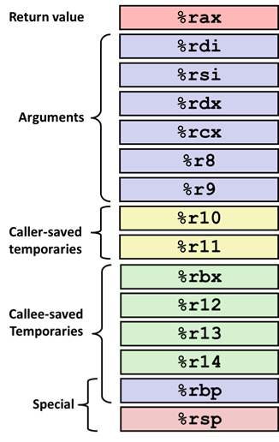
Small Exercise
long add5(long b0, long b1, long b2, long b3, long b4) {
return b0+b1+b2+b3+b4;
}
long add10(long a0, long a1, long a2, long a3, long a4, long a5,
long a6, long a7, long a8, long a9) {
return add5(a0, a1, a2, a3, a4)+
add5(a5, a6, a7, a8, a9);
}
Where are a0,…, a9 passed?
rdi, rsi, rdx, rcx, r8, r9, stack
Where are b0,…, b4 passed?
rdi, rsi, rdx, rcx, r8
Which registers do we need to save?
Ill-posed question. Need assembly.
Notes:
1)Rdi, rsi, rdx, rcx, r8, r9, stack
2)rdi,rsi,rdx,rcx,r8

Slide 88
Small Exercise
long add5(long b0, long b1, long b2, long b3, long b4) {
return b0+b1+b2+b3+b4;
}
long add10(long a0, long a1, long a2, long a3, long a4, long a5,
long a6, long a7, long a8, long a9) {
return add5(a0, a1, a2, a3, a4)+
add5(a5, a6, a7, a8, a9);
}
add10:
pushq %rbp
pushq %rbx
movq %r9, %rbp
call add5
movq %rax, %rbx
movq 48(%rsp), %r8
movq 40(%rsp), %rcx
movq 32(%rsp), %rdx
movq 24(%rsp), %rsi
movq %rbp, %rdi
call add5
addq %rbx, %rax
popq %rbx
popq %rbp
ret
add5:
addq %rsi, %rdi
addq %rdi, %rdx
addq %rdx, %rcx
leaq (%rcx,%r8), %rax
ret

