Slide 1
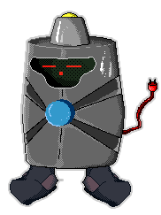
picoCTF: Teaching 10,000 High School Students to Hack
V-Unit Project
Peter Chapman
peter@cmu.edu
This material is based upon work supported by the National Science Foundation Graduate Research Fellowship Program under Grant No. 0946825. Any opinions, findings, and conclusions or recommendations expressed in this material are those of the author(s) and do not necessarily reflect the views of the National Science Foundation.

Slide 2
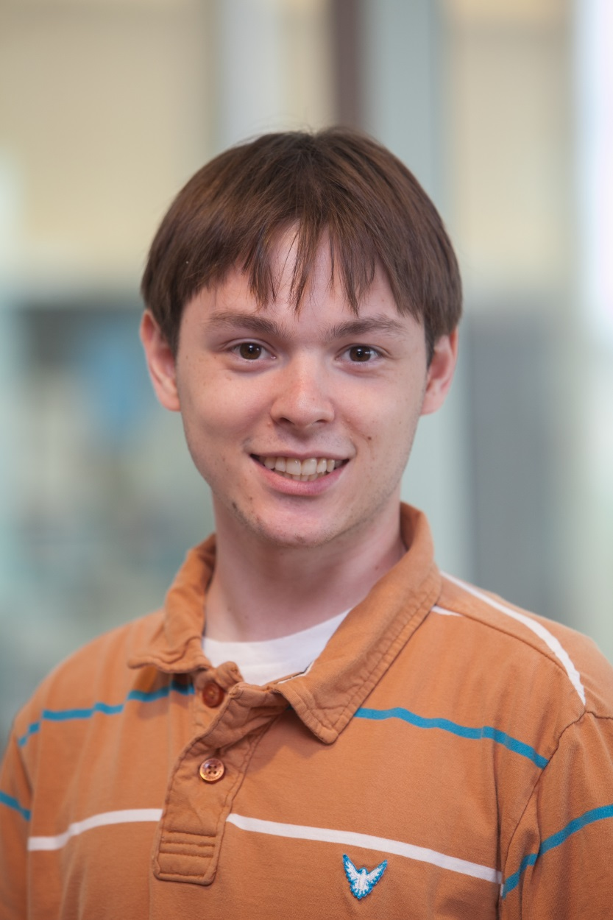
Peter Chapman
1st Year PhD Student in Computer Science Department
Working with David Brumley in the Software Security Research Group
Completed a V-Unit as the Technical Lead for picoCTF

Slide 3
1. Building the largest computer security competition
Lots of students solving hard problems
2. Impact and evaluation
3. The future of picoCTF

Slide 4
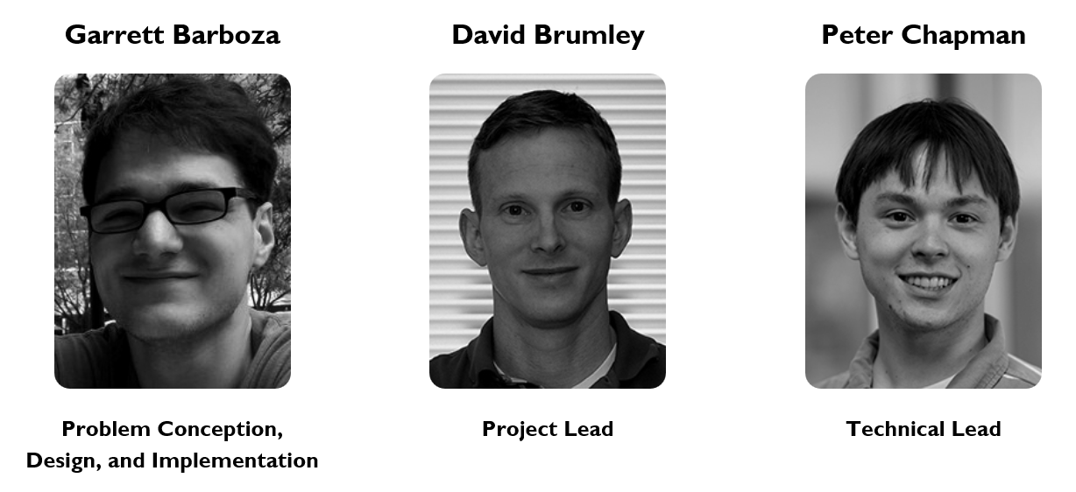
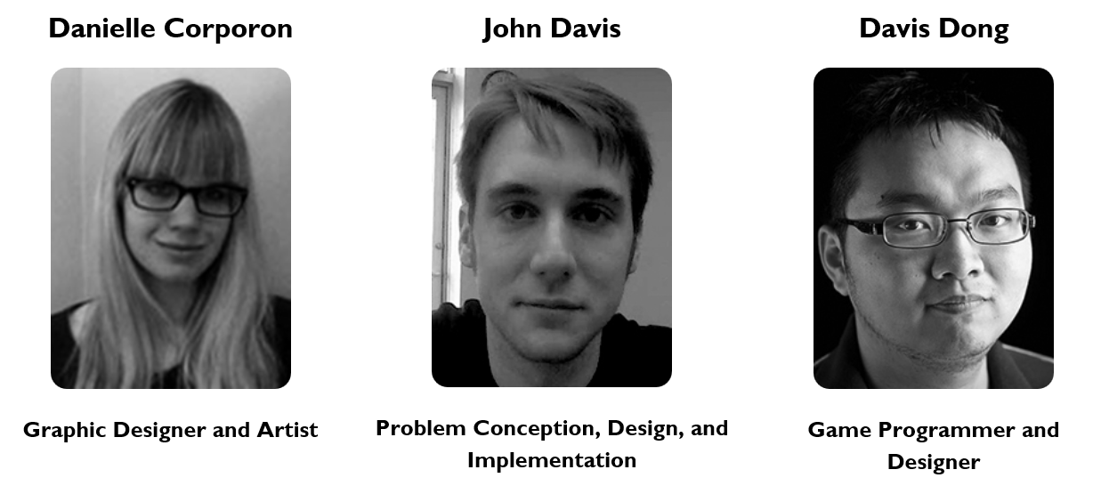
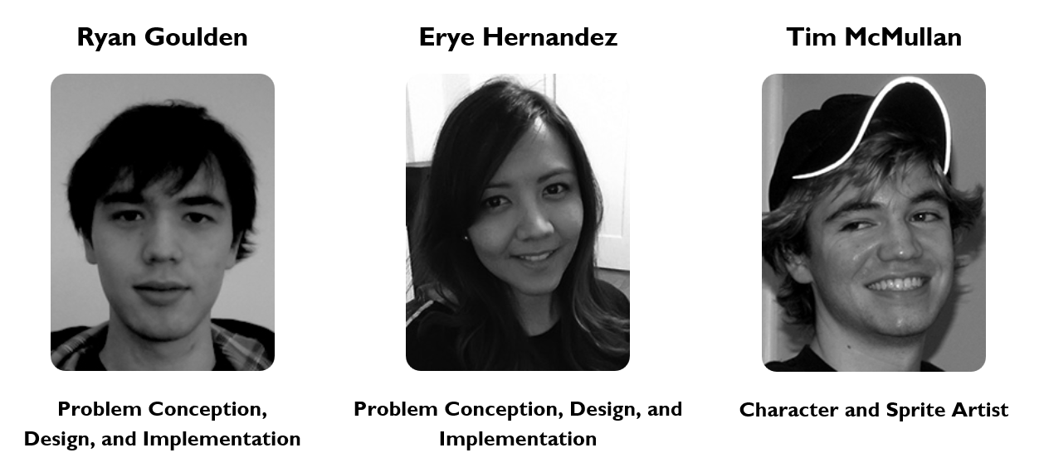
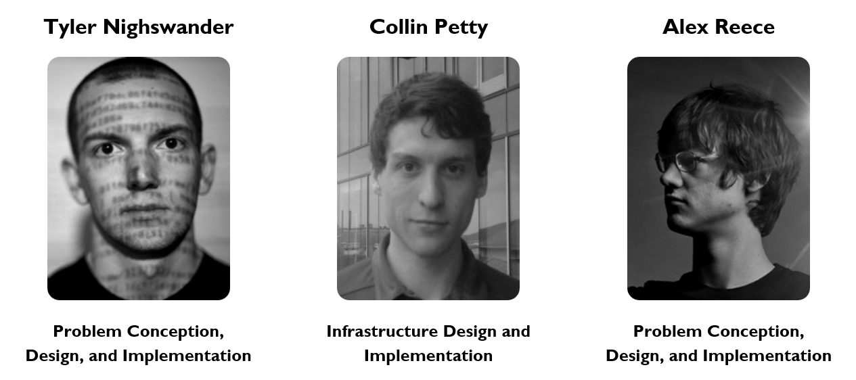
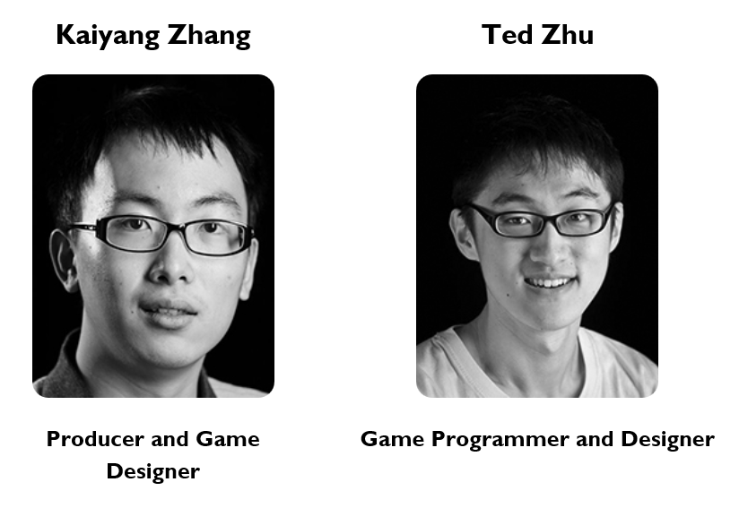
The Team

Slide 5
Ethics Disclaimer
We do not condone and actively discourage illegally breaking into systems, stealing personal information, or disrupting computing services.
Hacking is the computer science equivalent of taking apart a car.

Slide 6
The Origins of picoCTF
Why am I here?

Slide 7
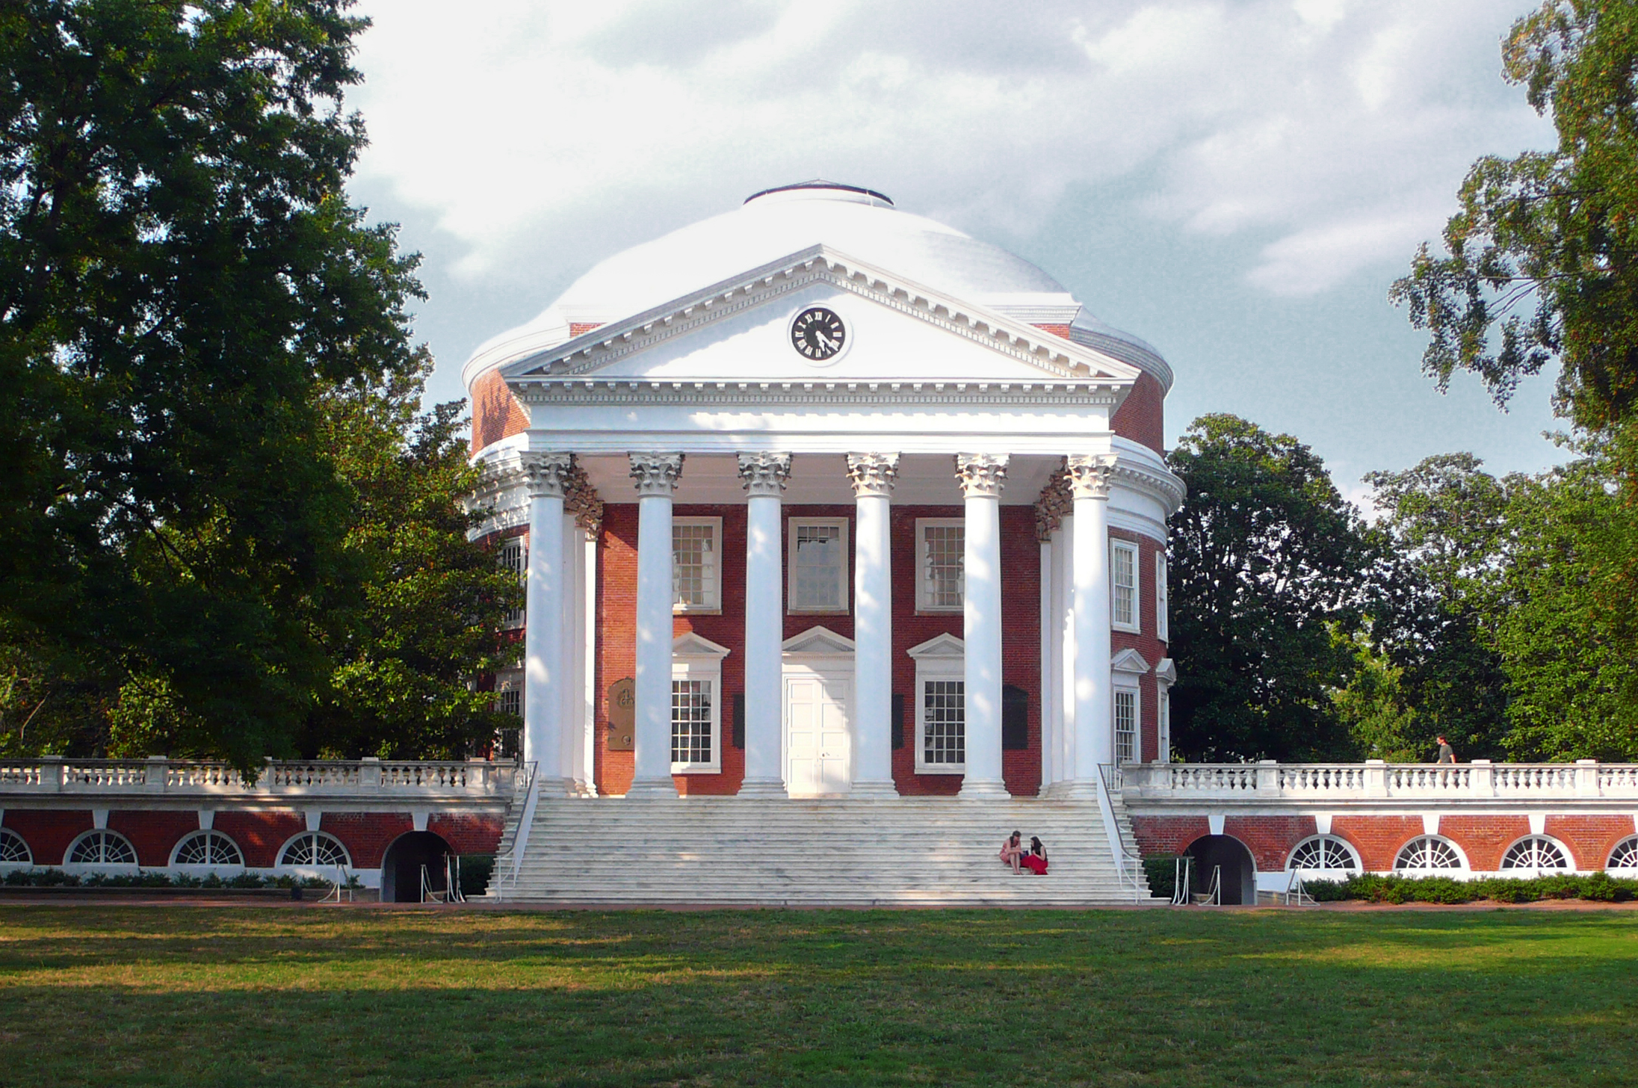
Attended the University of Virginia in 2008

Slide 8

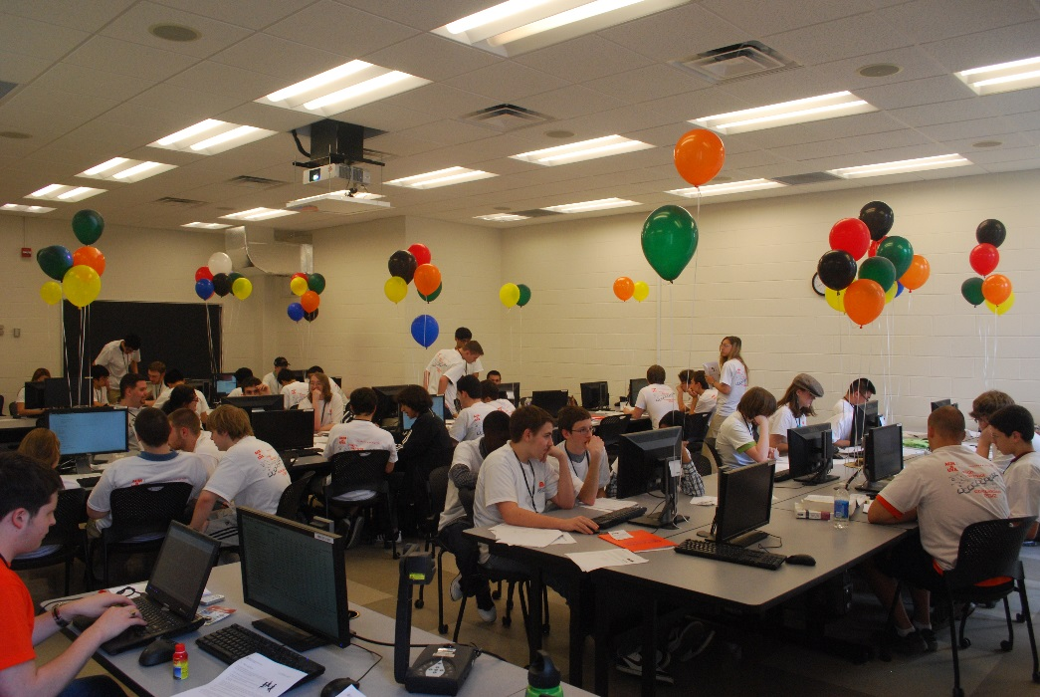

Collegiate
High Schools

Slide 9
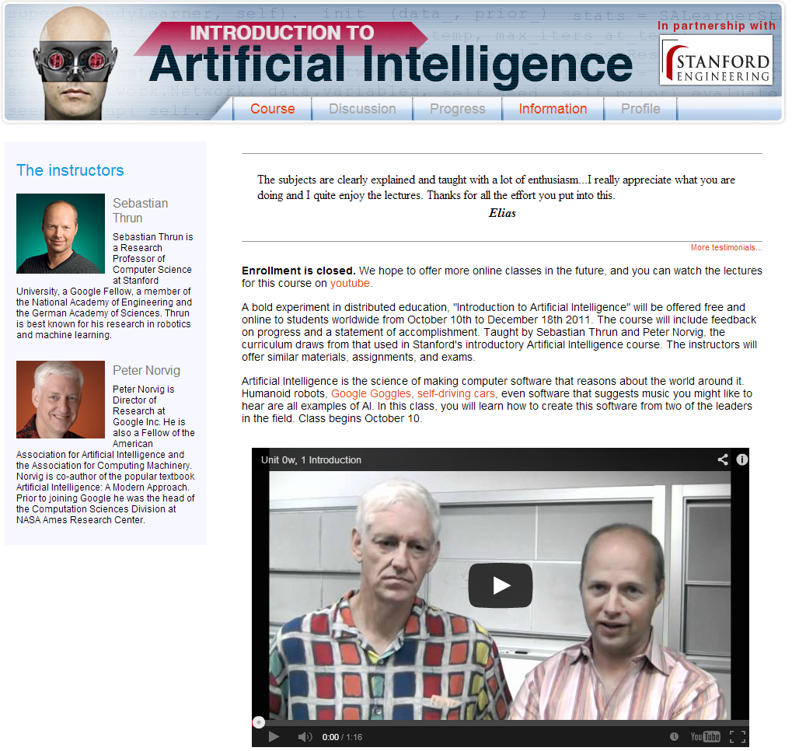
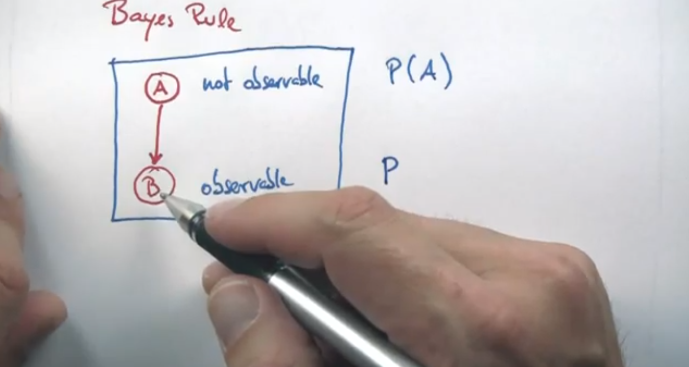
Meanwhile…

Slide 10

Technology has the potential to truly revolutionize education by simultaneously reducing cost and increasing quality.
Founded Fall 2011

Slide 11
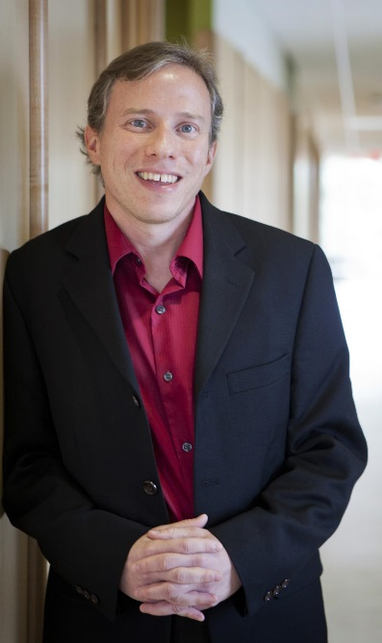
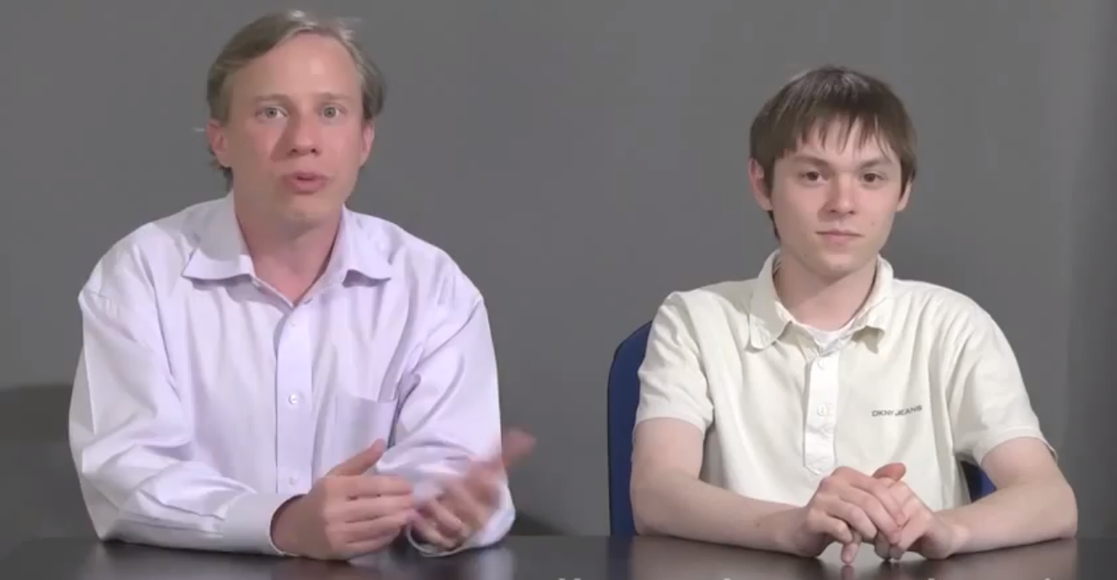
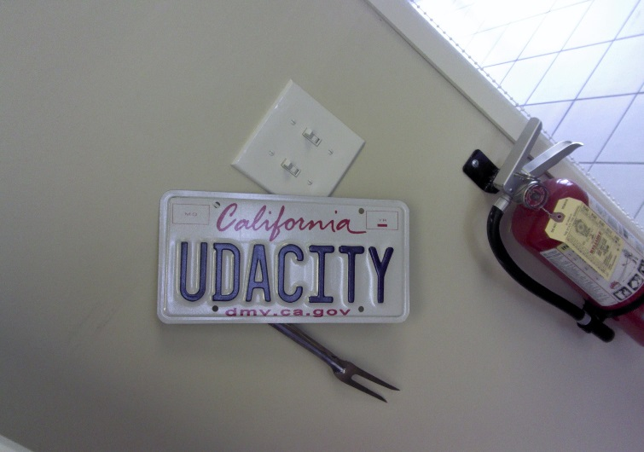
I got a job!
David Evans
Associate Professor at UVa
Udacity Vice President of Education
My Research Advisor

Slide 12

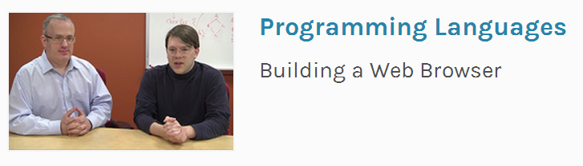
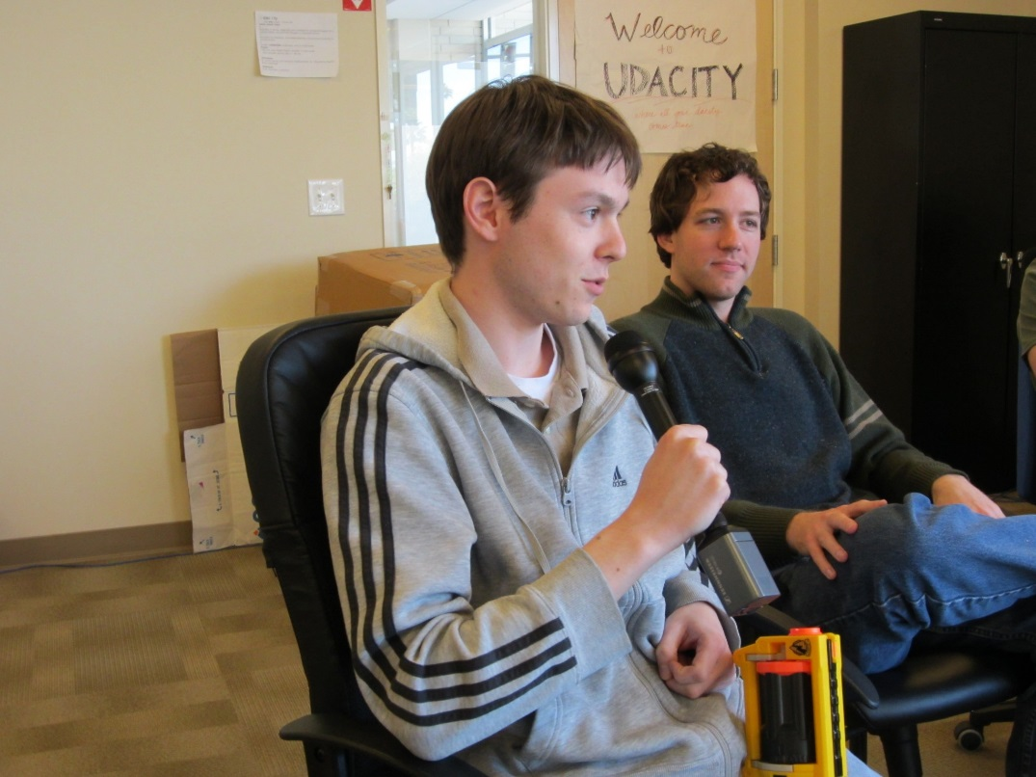
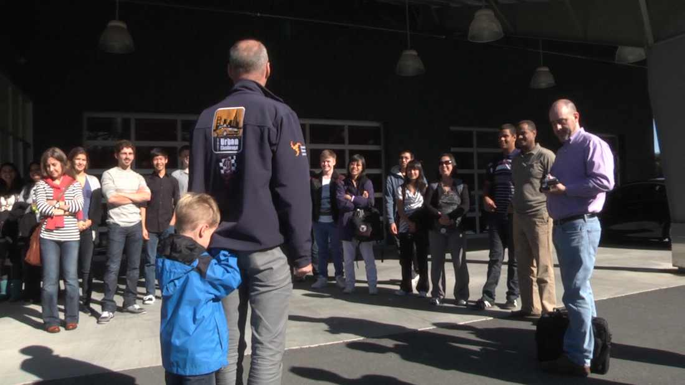
Udacity
Collegiate
High Schools
2,500 Students over 400 Teams

Slide 13
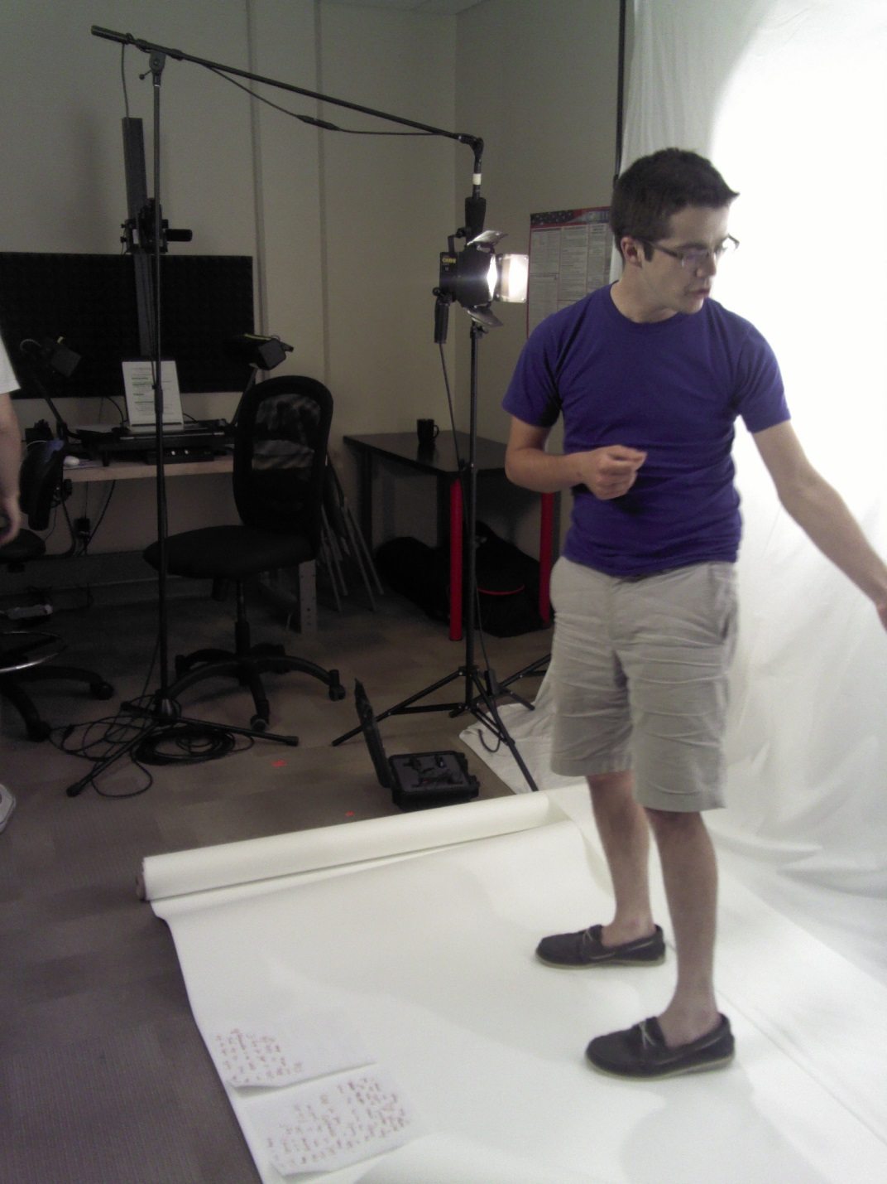
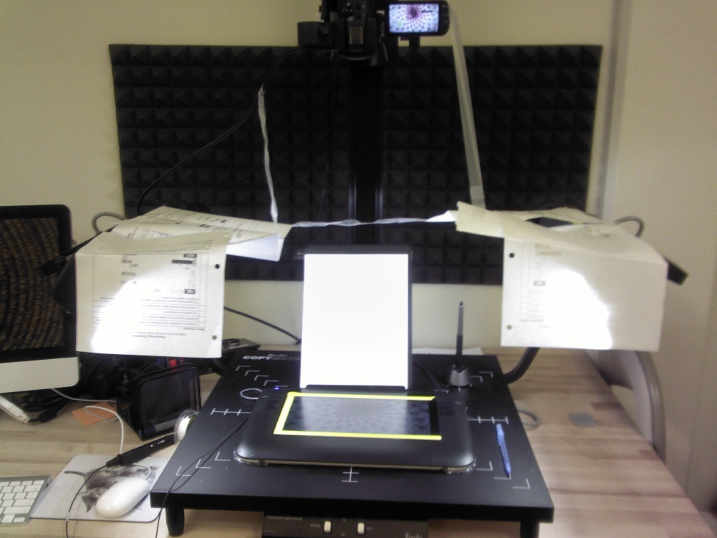

Slide 14
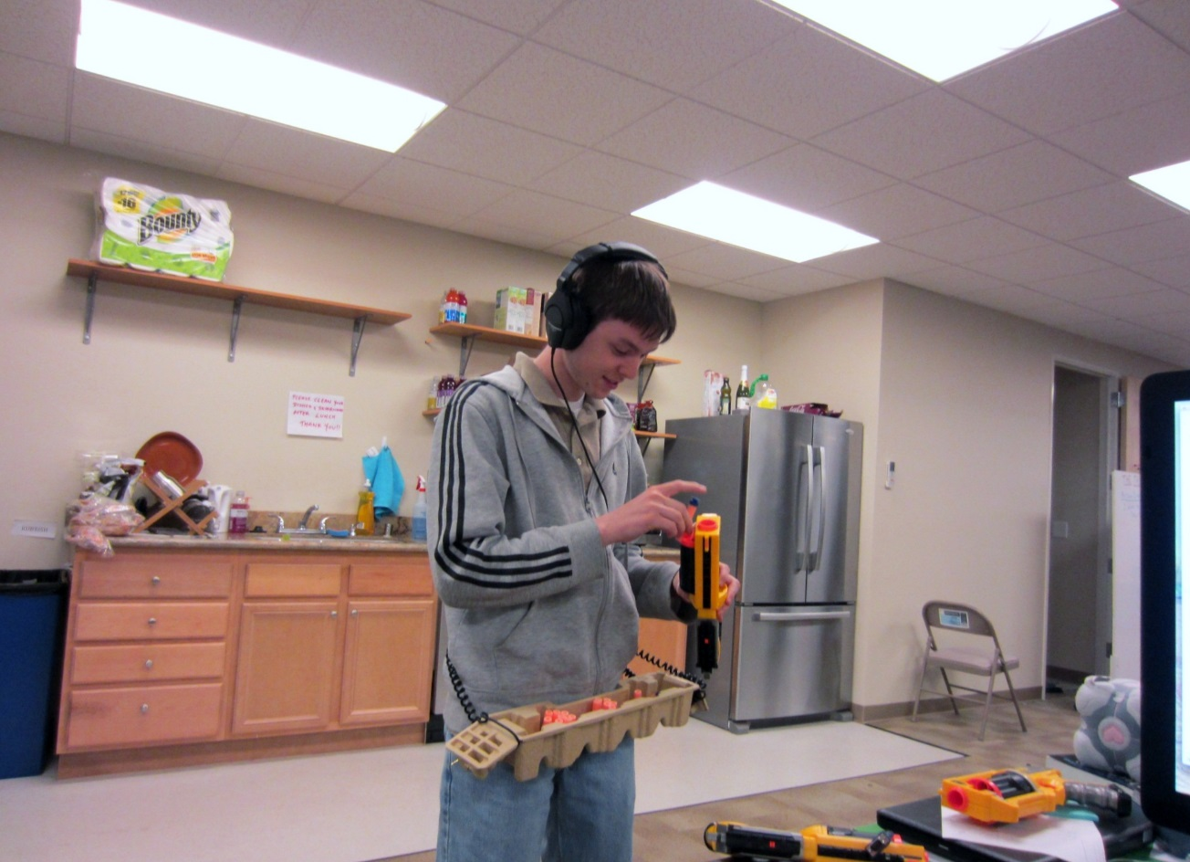
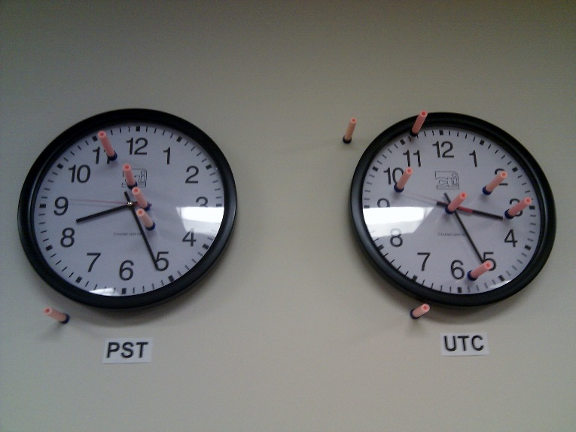

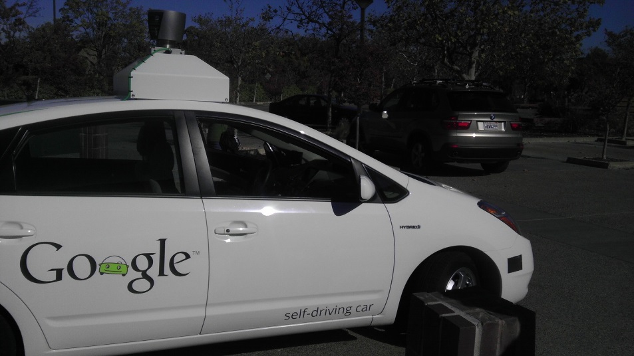

Slide 15
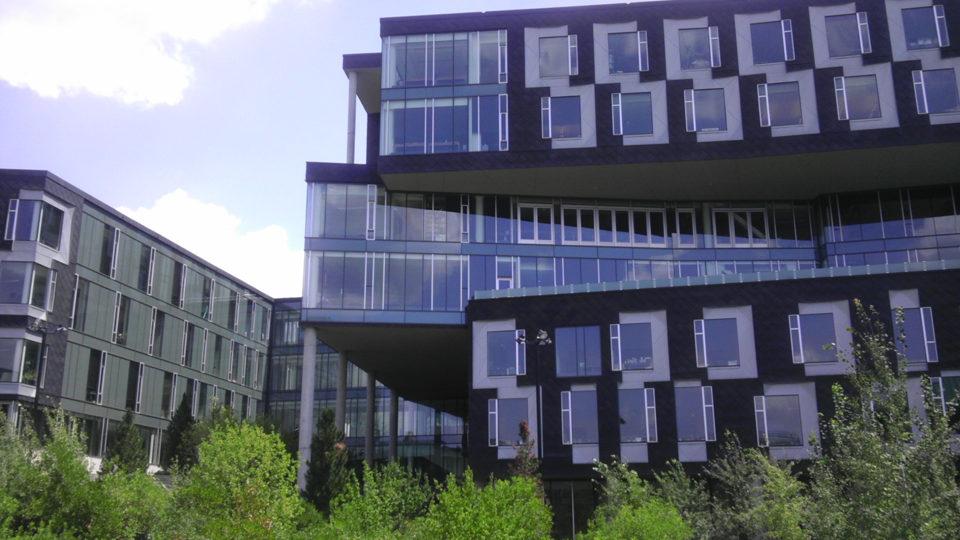
Carnegie Mellon University
2012

Slide 16
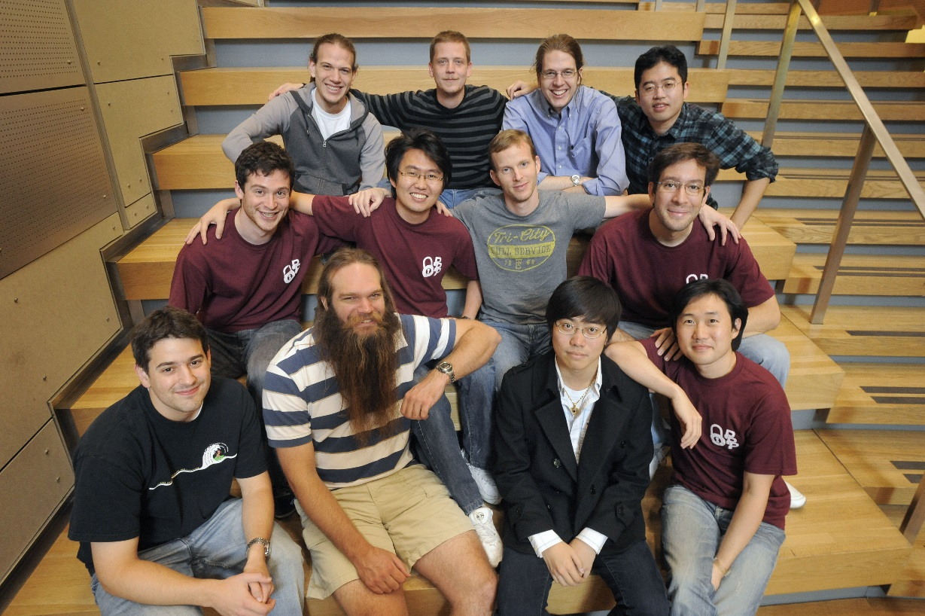
Plaid Parliament of Pwning
Old Picture!
Computer Security Research Group
Undergraduates, Graduate Students, and Staff
Primarily Play in Capture-the-Flag Competitions
Primarily Play in Capture-the-Flag Competitions

Slide 17
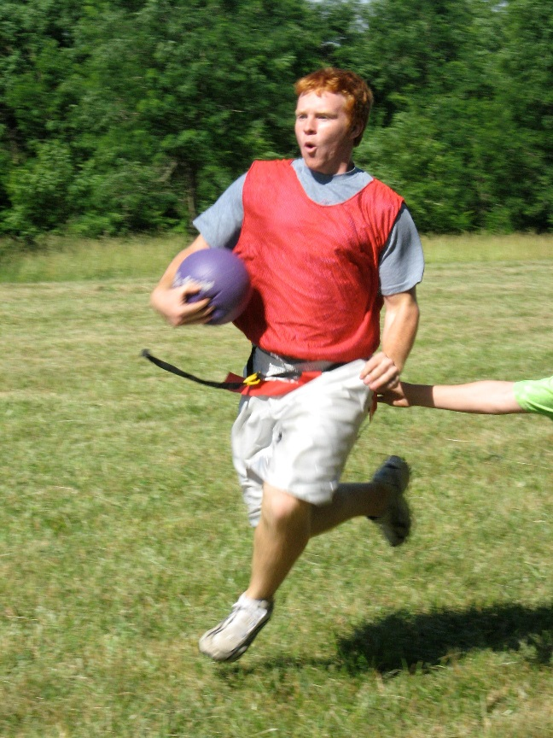
Capture the Flag Competitions
CTFs
Digital
[1]
Open-Ended and Difficult

Slide 18
CTF Competitions
Cryptography
Digital Forensics
Reverse Engineering
Binary Exploitation
Web Security

Slide 19
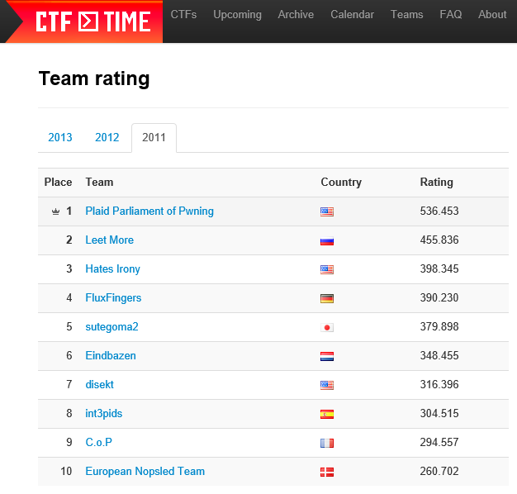
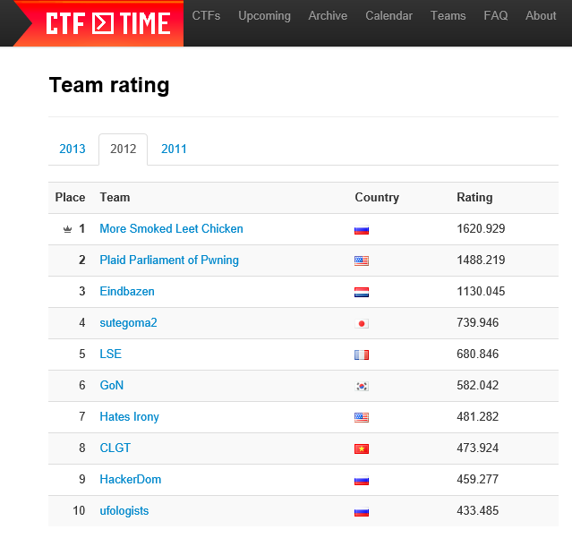
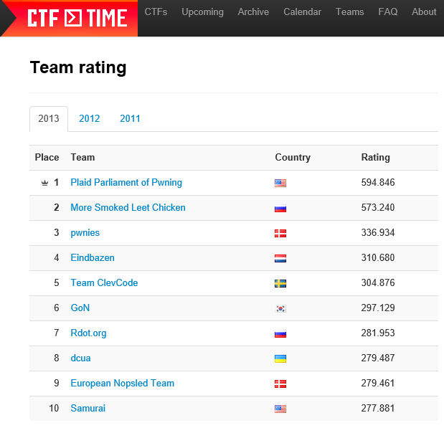
PPP is a world leader.
I wanted in.

Slide 20
National Security Agency
NSA logo pending government review of this document.
Interested in High School Education
Love CTFs!
Collegiate
High Schools

Slide 21
picoCTF
- PPP likes the letter P.
- PPP hosts a competition named PlaidCTF for professionals.
picoCTF is meant to be lighter version of PlaidCTF.

Slide 22
Goals
An authentic, fun, and interactive hacking experience.
Encourage students to pursue degrees of computer science, regardless of incoming background.
Nationally recognize and inspire top competitors to become industry leaders.
NSA
It is a real hacking competition.
It exists.

Slide 23

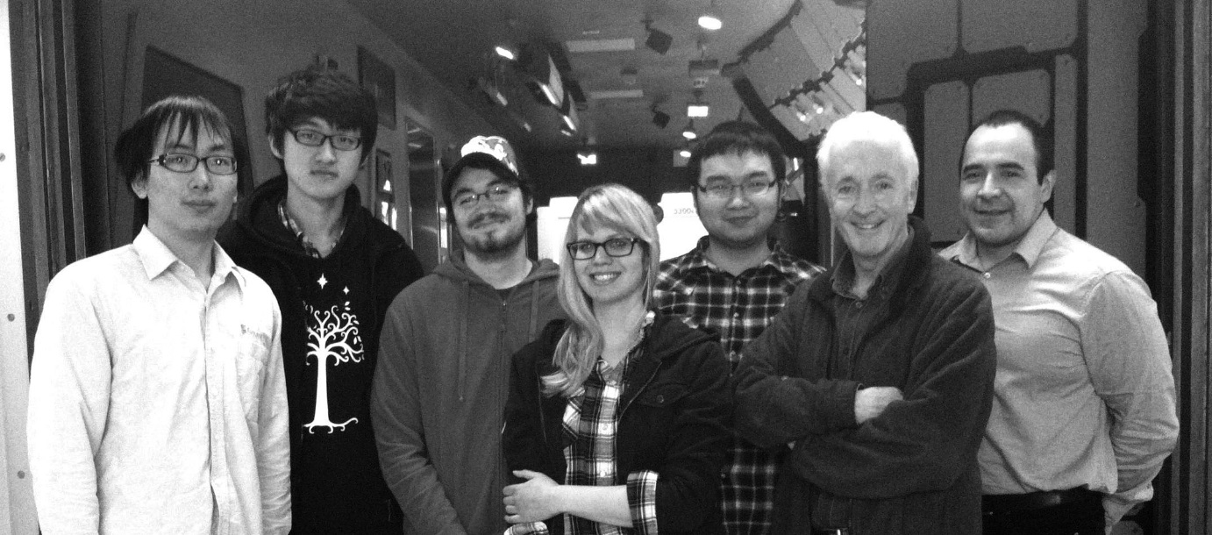
Entertainment Technology Center
Experts in game development and design.

Slide 24
4 Months Later…

Slide 25


Slide 26
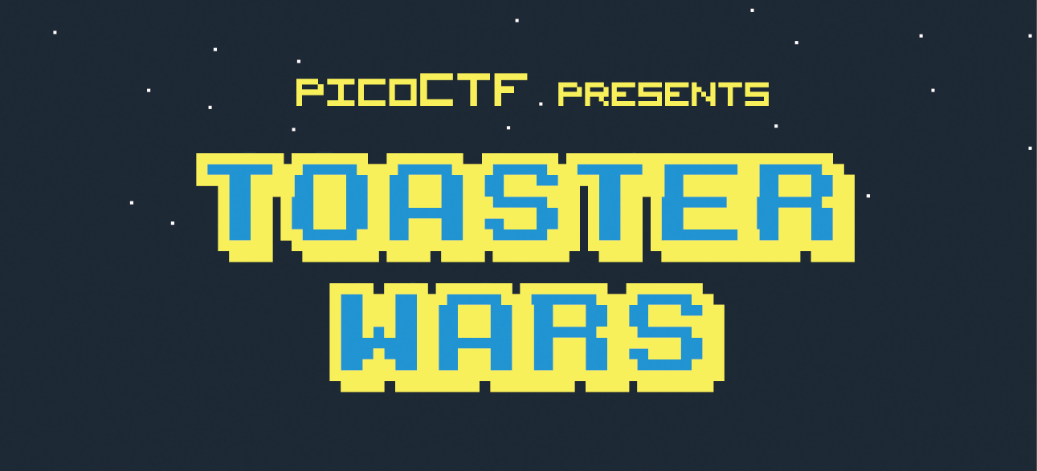
April 26 7:00 AM EDT - May 6 11:59 PM EDT
A polished presentation to welcome students and add legitimacy.

Slide 27
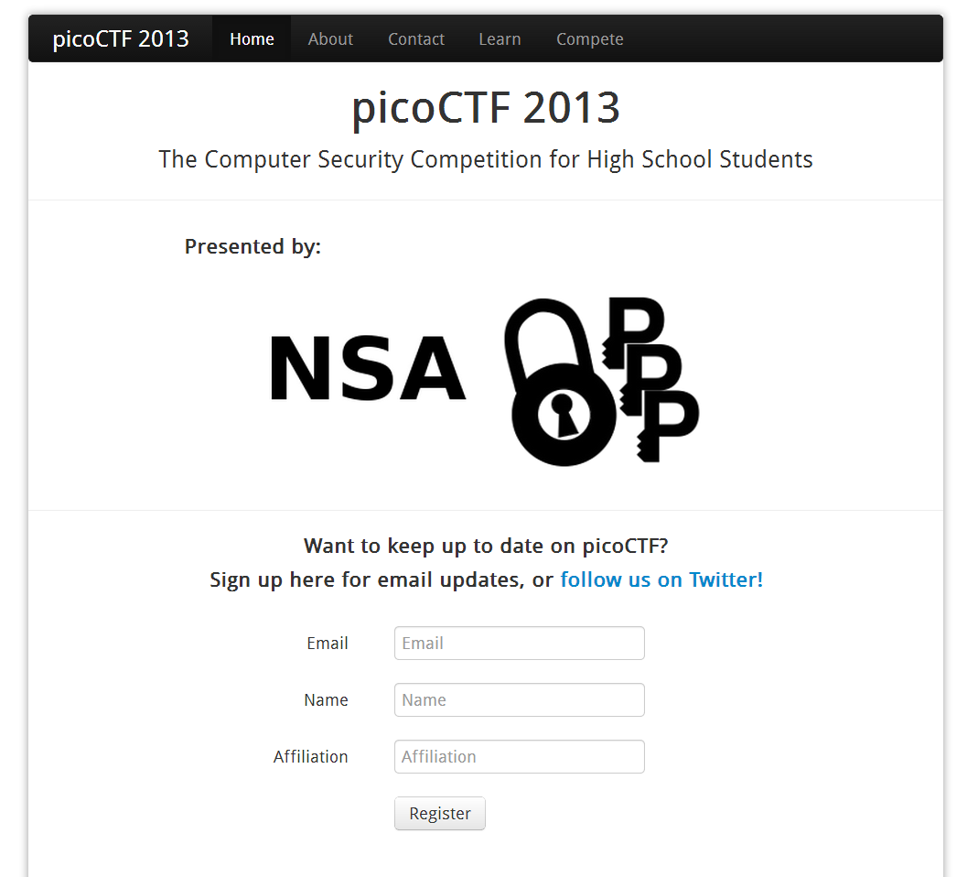

Slide 28
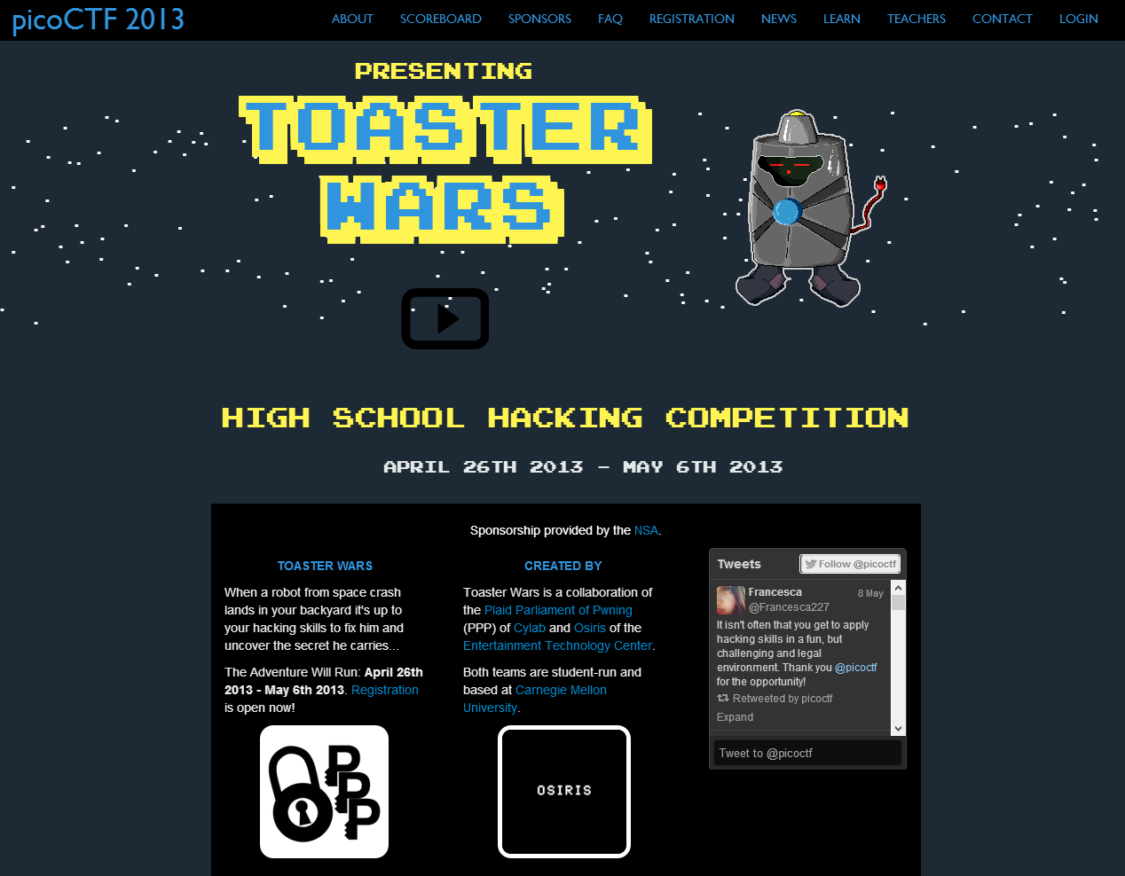

Slide 29
Eligibility
Anyone can play!
Winners must be:
Attending school in the United States
A 6th to 12th grade student
On a team of 5 or fewer eligible players
Sponsorship & Competition Legitimacy

Slide 30
Winners
3 Winning Teams
Top 3 teams whose players are individually eligible.
3 Winning Schools
Top 3 schools whose team is individually eligible and all players attend the school.
Reach students through schools!

Slide 31
Prizes
 | Cash | AWS Credit | Wiley Books
1st Place School | $8,000 | $250 | 7 Books
2nd Place School | $4,000 | $250 | 5 Books
3rd Place School | $2,000 | $250 | 3 Books
1st Place Team | $4,000 | $1,000 | 7 Books
2nd Place Team | $2,000 | $250 | 5 Books
3rd Place Team | $1,000 | $250 | 3 Books
Winning teams also received trophies, t-shirts, and certificates

Slide 32









Sponsors

Slide 33





Sponsors
Finding sponsors is work.
You have to be very careful when approaching companies, even informally.

Slide 34
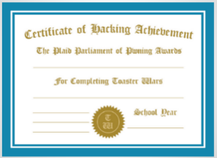
Competition Organization
Level 1
Level 2
Level 3
Level 4
No programming experience necessary,
computer know-how useful
Basic programming experience
AP Computer Science
Hard. Very hard.
Each skill level can finish with accomplishment.

Slide 35
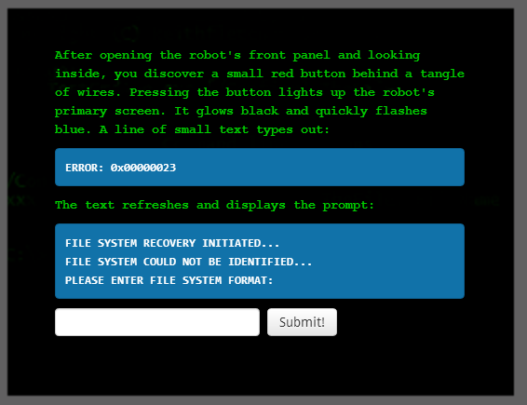
Scoring
Problems have point values corresponding to difficulty.
The tie breaker is last problem solved.

Slide 36
Rules
No limitations on resources or tools.
Hackers don’t follow rules!
Persons not on the team, including teachers, can only facilitate solving problems.
Breaking rules results in disqualification and notification of school district.
Interference with the operation of other teams or the competition infrastructure is prohibited.
Winning teams won’t break the rules. Strict rules add legitimacy.

Slide 37
picoctf.com

Slide 38





Infrastructure
Client
Static Content
Impact
Bootstrap
jQuery
nginx
nginx
memcached
Flask
Dynamic Content
Ubuntu Server
Shell Server
MongoDB
Python
Persistence
Evaluation

Slide 39
How did it go?
Please don’t break. Please don’t break. Please don’t break.

Slide 40
Success!
2,589 Registered Teams
1,938 Participated
172,482 Submissions
47,229 Unique Visitors
558,080 Pageviews
1,785,384 Logged Events
8-10,000 Students
The largest computer security competition ever held.

Slide 41
Publicity
Unreliable. Need cats.
Social Media
Paid Advertising
Press Releases and Interviews
Computer Science Teachers Association
Expensive or ineffective.
Works.
Works.

Slide 42
Students Discovery

Slide 43
Teacher Discovery
Leverage existing infrastructure.

Slide 44
Demographics
11th or 12th Grade
Prior Programming Experience
Fun!

Slide 45
Affiliations

Slide 46
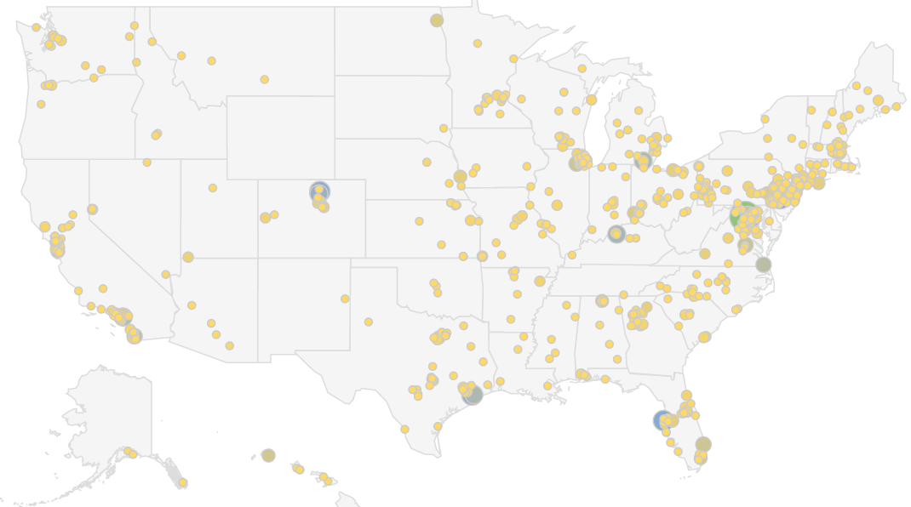
Affiliations
955 different schools.

Slide 47
Educational Impact

Slide 48
Educational Impact
Compared to typical course work, how much do you think you learned?

Slide 49
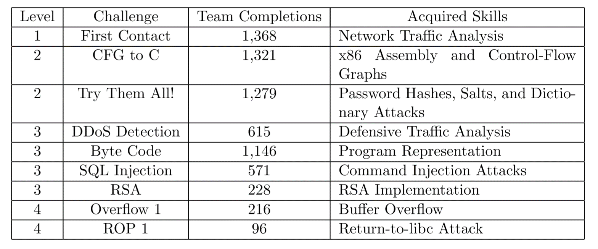
Educational Impact
A non-trivial exercise for graduate students

Slide 50
Will you encourage your students to compete next year?

Slide 51
Unsolicited Message from Pennsylvania Teacher
Wow! I haven't seen something like this light the fire of such a wide range of students in my 22 years of teaching computer science… Neither robotics, ACSL, face-face or online traditional programming contests, Logo, Alice, block based languages a la Scratch or AppInventor, early HTML development, or any other single CS phenomenon has ever inspired so many students to fight to get access in the computer lab after school and ask me cerebral questions such as bit-wise arithmetic or syntax questions on languages they haven't learned in school!
THERE IS NO DOUBT IN MY MIND THAT THIS CONTEST WILL SINGLE-HANDEDLY ATTRACT MANY STUDENTS TO CAREERS IN CYBERSECURITY AND COMPUTER SCIENCE IN GENERAL!

Slide 52
picoCTF 2014
It’s never too early!

Slide 53
picoCTF 2014
Fall Competition Date
Focused Computer Security Curriculum and Educational Content
Emerging Partnerships to Expand Scope
Team and Instructor Management
Robust Communication System

Slide 54
Automatically Generated Problems
Hacking is a skill that requires practice
Generate problem variations for students to practice!
New evaluation types:
  Timed Solves
  Multiple Solves
We encourage and reward students to automate solutions?

Slide 55
picoCTF
Largest computer security competition ever held.
Polish and presentation matter at scale.
Leverage existing organizations for support and growth.
The line between competition and course can be fine.

Slide 56
Questions?
This material is based upon work supported by the National Science Foundation Graduate Research Fellowship under Grant No. 0946825.

Slide 57
Resource Credits
1. http://en.wikipedia.org/wiki/File:River_Ridge_2007.jpg

