Slide 1
Rethinking NetFlow:
A Case for a Coordinated “RISC”
Architecture for Flow Monitoring
Vyas Sekar
Joint work with
Mike Reiter, Hui Zhang
David Andersen, Anupam Gupta,
Ramana Kompella, Walter Willinger

Slide 2

Flow Monitoring is critical for effective Network Management
Traffic
Engineering
Accounting
Worm
Detection
Network
Forensics
Many management applications
Evolving and growing over time
Need high-fidelity measurements
Analyze new
user apps
…….
Botnet
analysis
Anomaly
Detection

Slide 3


Requirements for monitoring
Network
Operations
Center
Respect resource constraints
High flow coverage
Provide network-wide goals
Low data management overhead
High-fidelity for all applications
Flow reports
report = ( flow = same src-dst, ports, proto) + pkt/byte counters

Slide 4
Sampling due to resource constraints
Routers cannot record every packet/flow
  Constraints: CPU, Memory, Bandwidth
Resource constraints don’t go away!
  Network demands scale even as routers become more powerful
Some form of sampling is inevitable
  Record/report only a subset of the traffic

Slide 5
Current solution
Uniform packet sampling, e.g., Cisco NetFlow
  Each router independently samples packets
  Aggregates sampled packets into flow reports
✓
Respect resource constraints
✗
Biased towards
large flows
High flow coverage
✗
Provide network-wide goals
Too coarse
✗
Redundant
measurements
Low data management overhead
✗
High-fidelity for all applications
Not very good
for security

Slide 6
How do we meet the requirements?
Respect resource constraints
High flow coverage
Part 1: Coordinated Sampling
Provide network-wide goals
Low data mgmt overhead
Part 2:
“RISC” monitoring
High-fidelity for all applications

Slide 7
How do we meet the requirements?
Respect resource constraints
High flow coverage
Part 1: Coordinated Sampling
Provide network-wide goals
Low data mgmt overhead
Part 2:
“RISC” monitoring
High-fidelity for all applications

Slide 8

High-level idea
Packet sampling has low flow coverage
due to bias toward large flows
Sampling algorithm not biased to large flows
Routers sample independently →
Wasted measurements
Can’t reason about network-wide goals
Treat routers in the network as a system to be managed in a coordinated fashion!

Slide 9
Part 1 Outline
Motivation
Design of cSamp (Coordinated Sampling)
Evaluation
Practical deployment

Slide 10
Design
Random flow sampling (single router)
  Sample flows not packets
Hash-based coordination (single path)
  Efficient, non-redundant sampling
  Coordination without explicit communication
Network-wide optimization (whole network)
  Satisfy network-wide constraints and objectives

Slide 11
Design (single router)
Random flow sampling
  Sample flows not packets

Slide 12
Flow sampling
Version IHL TOS Length
Identification Flags Offset
TTL Protocol Checksum
Source IP address
Destination IP address
……
SourcePort DestinationPort
Hash
Packet header
Flowid ∈ [0,Max]
Flow memory
(flow, counter #pkts)
3
1
Hash range
[3,10]
6
1
Compute hash, log if in range
1
1
6
1
3
1
1
1
6
1
3
1
1
1
1
1
6
1
3
1
1
Sample flows, not packets, to increase flow coverage

Slide 13
Design (single path)
Random flow sampling (single router)
  Sample flows not packets
Hash-based coordination
  Efficient, non-redundant sampling
  Coordination without explicit communication

Slide 14
Hash-based coordination
Stream:
5
3
1
6
1
8
1
1
Hash range
Flow memory
Hash range
Flow memory
[1,4]
1
4
[7,9]
8
1
3
1
R2
R1
Non-overlapping hash-ranges avoids redundant monitoring
Coordination without communication

Slide 15
Design (whole network)
Random flow sampling (single router)
  Sample flows not packets
Hash-based coordination (single path)
  Efficient, non-redundant sampling
  Coordination without explicit communication
Network-wide optimization
  Satisfy network-wide constraints and objectives

Slide 16
Network-wide view
Moving from a single-path to network?
Many paths = Origin-Destination (OD) pairs in a network
e.g., NYC-PIT, PIT-SFO

Slide 17
Network-wide coordination
[1,5]
[3,7]
[7,9]
[1,3]
[1,2]
[5,8]
Assign non-overlapping ranges per OD-pair/path

Slide 18
cSamp algorithm on each router
Sampling
Manifest
Flow memory
OD Range
[5,10]
2
1
[1,4]
Red vs. Green?
2
1. Get OD-Pair from packet
2. Compute hash (flow = packet 5-tuple)
3. Look up hash-range for OD-pair from sampling manifest
4.Log if hash falls in range for this OD-pair

Slide 19
Overall system architecture
Network
Operations
Center
Generate
sampling
manifests
Applications
Configuration Dissemination
[3,7]
[1,5]
[7,9]
[5,9]
[1,2]
[5,8]
Flow reports

Slide 20
Framework for generating manifests
Objective:
Max ∑_{i} _{ε ODPairs} Coverage_{i} × Traffic_{i}
Subject to achieving maximum
Min_{i ε ODPairs} {Coverage_{i}}
Inputs
OD-pair info
Traffic, Path(routers)
Linear
Program
Output
Sampling manifests
Network-wide
optimization
{<OD-Pair,Hash-range>}
per router
Router constraints
e.g., SRAM for flow
records

Slide 21
Part 1 Outline
Motivation
Design of cSamp (Coordinated Sampling)
Evaluation
Practical deployment

Slide 22
cSamp vs. other sampling solutions
Metrics reflect initial goals
  Coverage, network-wide goals, redundancy
Flow sampling
  Fixed-rate and Maximal flow sampling
  Use same memory (400K flow records)
Packet sampling
  1-in-100 and 1-in-50 (edge)
  Allow infinite memory

Slide 23
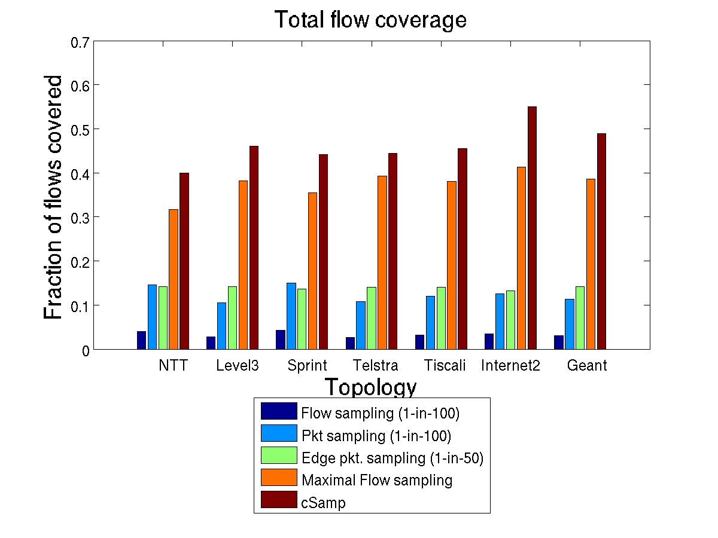
Total flow coverage
cSamp is 2-3X better than packet sampling, 30% over maximal flow sampling

Slide 24
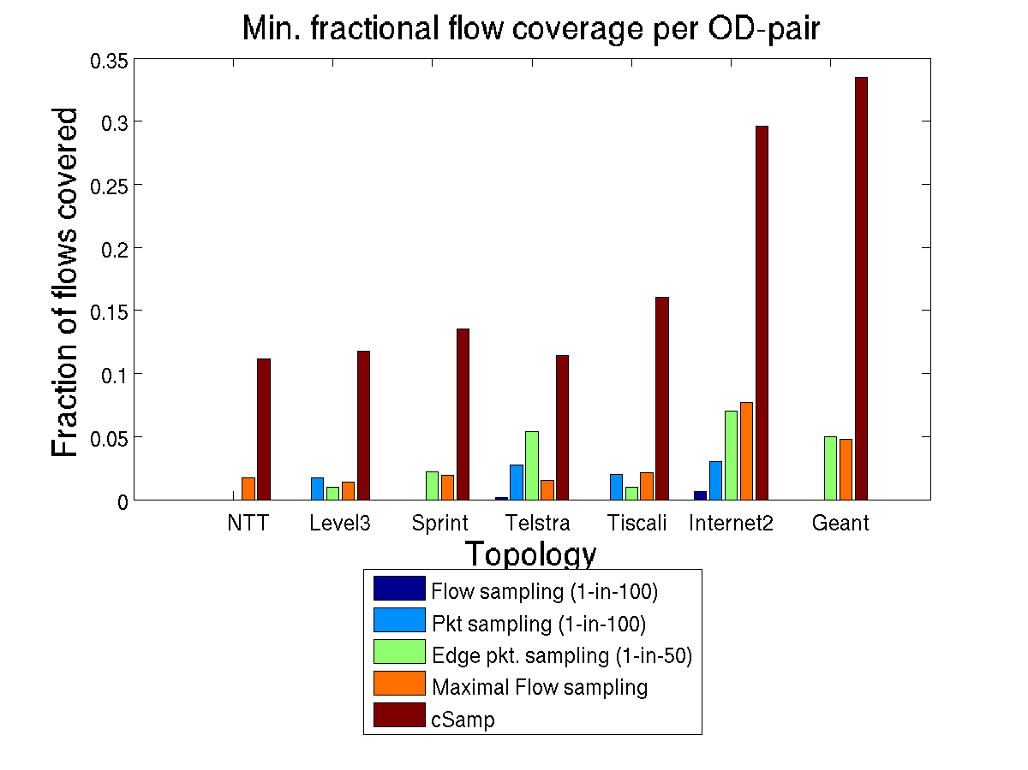
Minimum fractional coverage
cSamp is significantly better than other solutions!
Maximal flow sampling is inadequate for network-wide objectives

Slide 25
How do these solutions fare?
Requirements | Packet Sampling (NetFlow) | Flow Sampling | cSamp
Respect resource constraints | ✓ | ✓ | ✓
High flow coverage | ✗ | ✓ | ✓
Network-wide goals | ✗ | ✗ | ✓
Minimize redundant measurements | ✗ | ✗ | ✓

Slide 26
Part 1 Outline
Motivation
Design of cSamp (Coordinated Sampling)
Evaluation
Practical deployment

Slide 27
Practical Issues
What about traffic dynamics?
  History + short-term adaptation
2. Is the optimization scalable?
Need two improvements
(binary search + max-flow)
3. What about multi-path routing?
Simple, lightweight extension
4. How do interior routers identify OD-pairs?
  Assume ingress routers mark packets

Slide 28
How do interior routers identify OD-pairs?
  Assume ingress routers mark packets
Why we may want to avoid this ….
Extra overhead on ingress
OD-pair id might be ambiguous (multi-egress peers)
Need to modify packet headers or add shim header
May require overhaul of routing infrastructure

Slide 29
Can we realize the benefits of cSamp without
requiring OD-pair identification?
Use local info. at router to make sampling decisions
“Stitch” coverage for a path across routers on that path

Slide 30
What local info can I get from packet and routing table?
R0
R1
R1
SamplingSpec
Granularity at which sampling decisions are made
R2
R3
R4
{Previous Hop, My Id, NextHop}
How much traffic to sample for this SamplingSpec?
SamplingAtom
Discrete hash-ranges, select some of them to log

Slide 31
“Stitching” together coverage
R1
=
R6
union
R3
R4
R5
R2
R7
union
=

Slide 32
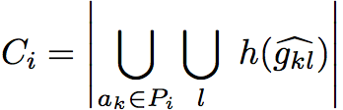
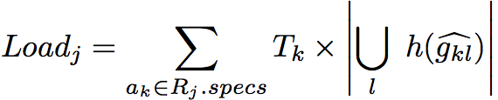
Problem Formulation
Coverage for path P_{i}
Load on router R_{j}
Maximize:
Total flow coverage: ∑_{i} T_{i}C_{i}
Minimum fractional coverage: min_{i} {C_{i} }
Subject To:
∀ j, Load_{j} ≤ L_{j}

Slide 33
Maximize:
Total flow coverage: ∑_{i} T_{i}C_{i}
Min. frac coverage: min_{i} {C_{i} }
Subject To:
∀ j, Load_{j} ≤ L_{j}
Sorry .. NP-hard!
Can’t even approximate min without resource augmentation
Total flow coverage:
Submodular maximization with partition-knapsack constraints
Efficient greedy algorithm with near-optimal performance
Min. fractional flow coverage:
Intelligent augmentation much better than theoretical guarantee
Partial/incremental deployment of adding OD-pair identifiers

Slide 34
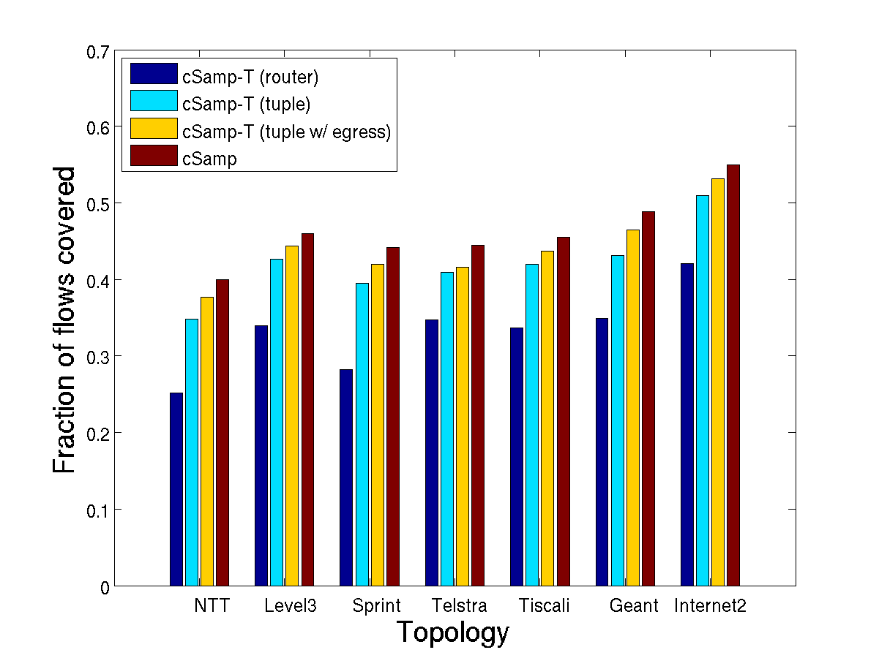
Total flow coverage
cSamp-T (tuple+) gives near-ideal total flow coverage vs. cSamp
cSamp-T (“tuple”, “tuple+”) gives near-ideal total coverage

Slide 35
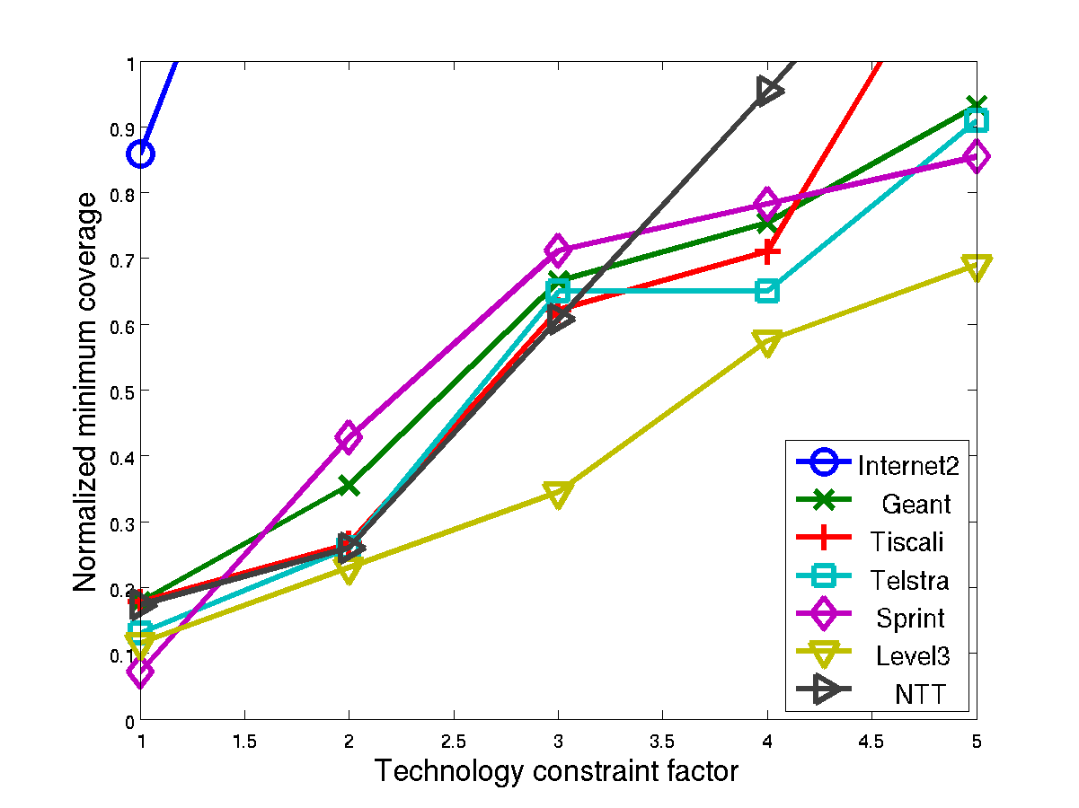
Minimum fractional coverage
With smart resource augmentation, cSamp-T gives good min. frac. coverage

Slide 36
How do we meet the requirements?
Respect resource constraints
High flow coverage
Part 1: Coordinated Sampling
Provide network-wide goals
Low data mgmt overhead
Part 2:
“RISC” monitoring
High-fidelity for all applications

Slide 37
Port
Addr
Port
Addr
Entropy
Super
Spreaders
Src
Dst
Heavy
Hitters
What functionality should we put on routers ?
Outdegree
histogram
FSD
Change
Detection

Slide 38
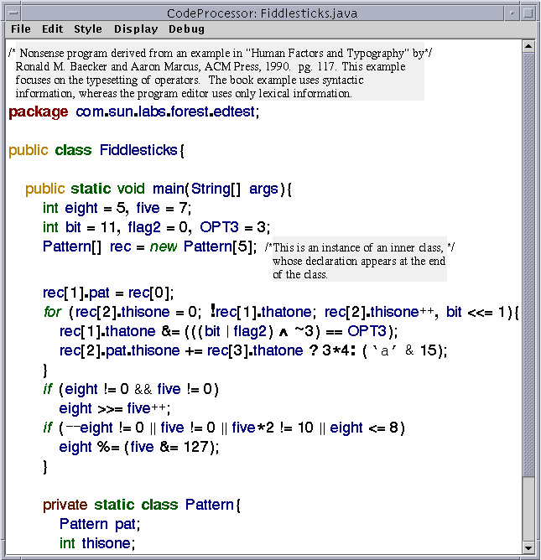
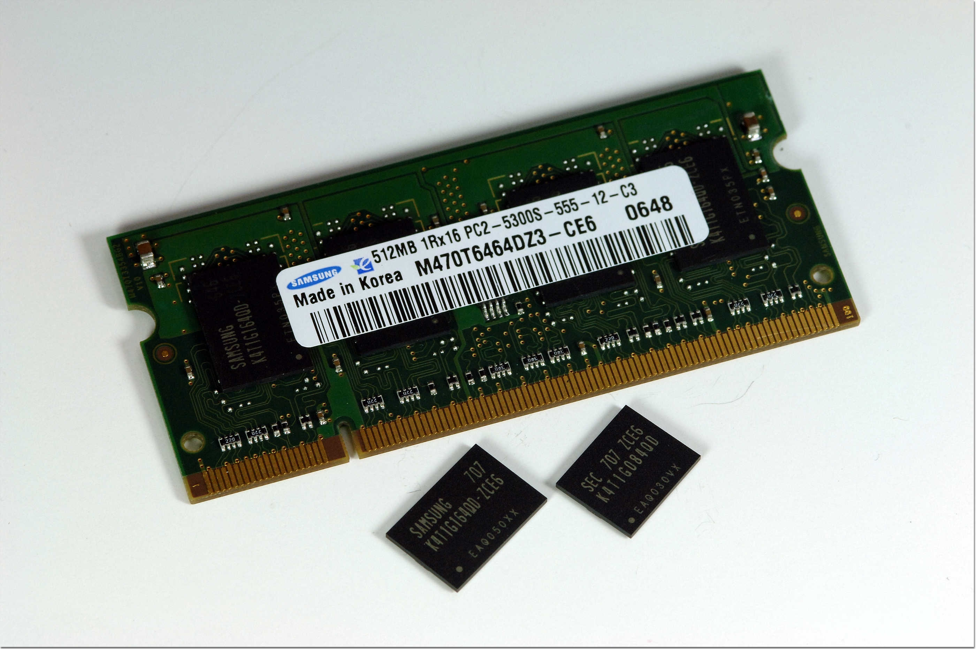
Current Research: Application-Specific!
Port
Addr
Port
Addr
Entropy
Super
Spreaders
Src
Dst
Heavy
Hitters
Outdegree
histogram
FSD
Change
Detection
Separate
Counters &
Estimation algorithms
Per App
Traffic
Why? Application-specific approaches provide higher fidelity

Slide 39
Alternative: “RISC”
Port
Addr
Port
Addr
Entropy
Super
Spreaders
Src
Dst
Heavy
Hitters
Outdegree
histogram
FSD
Change
Detection
Generic
Data
Collection
Decouple Collection
and Computation
Traffic
Why? Late-binding to applications, Easier to implement, “Future-proof”

Slide 40
RISC vs. Application-Specific
Requirements | Application Specific | RISC 1.0 NetFlow | RISC 2.0
Fidelity across applications | ✓ | ✗ | ?
Implementation Complexity | ✗ | ✓ | ?
Processing Overhead | ✗ | ✓ | ?
Changing Applications | ✗ | ✗ | ?
Enable Diagnostics | ✗ | ✓ | ?
Revisit this perception that RISC does not provide good performance

Slide 41
Why this might make sense?
Primary bottleneck for high-speed monitoring = SRAM counters
Each app-specific algorithm requires dedicated counters
Look at aggregate memory usage across applications
Pool in these resources into a few sampling primitives
Run these with sufficient fidelity!

Slide 42
Challenges
What RISC primitives should we implement?
Combination of flow sampling, sample and hold, cSamp
Does it perform comparably to application-specific approaches?
Yes! RISC with aggregate resources is comparable or even better

Slide 43
Challenges
What RISC primitives should we implement?
Combination of flow sampling, sample and hold, cSamp
Does it perform comparably to application-specific approaches?
Yes! RISC with aggregate resources is comparable or even better

Slide 44
What RISC primitives should we implement?
Requirements | RISC 2.0
Fidelity across applications | ?
Implementation Complexity | ?
Processing Overhead | ?
Changing Applications | ?
Enable Diagnostics | ?
Two broad classes
“Structure”
→ Flow Sampling
“Volume”
→ Sample and Hold
Coordination
Network-wide
Optimization
Provide flow reports like NetFlow

Slide 45
Sample and Hold
Algorithm
If flow is already logged → update
Sample packet with probability p
If new flow → create counter
Flow memory
(flow, counter #pkts)
1
1
2
3
4
6
1
1
1
6
1
3
1
1
1
6
1
3
1
1
1
1
1
6
1
3
1
1
Accurate counts of “heavy hitters” with few counters

Slide 46
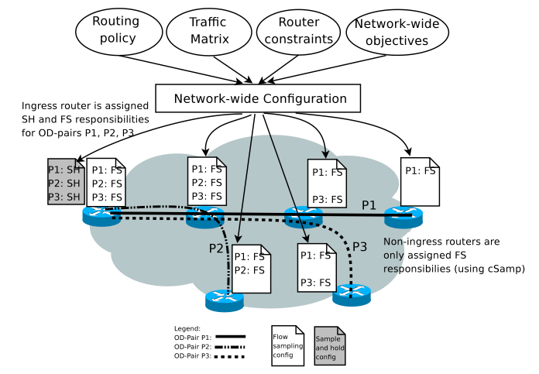
Putting the pieces together

Slide 47
Challenges
What RISC primitives should we implement?
Combination of flow sampling, sample and hold, cSamp
Does it perform comparably to application-specific approaches?
Yes! RISC with aggregate resources is comparable or even better

Slide 48
Port
Addr
Port
Addr
Entropy
Super
Spreaders
Src
Dst
Heavy
Hitters
Outdegree
histogram
FSD
Change
Detection
Calculate aggregate memory usage
Compute “Relative Accuracy Difference”
+ → good
- → bad
FlowSamp + Sample & Hold

Slide 49
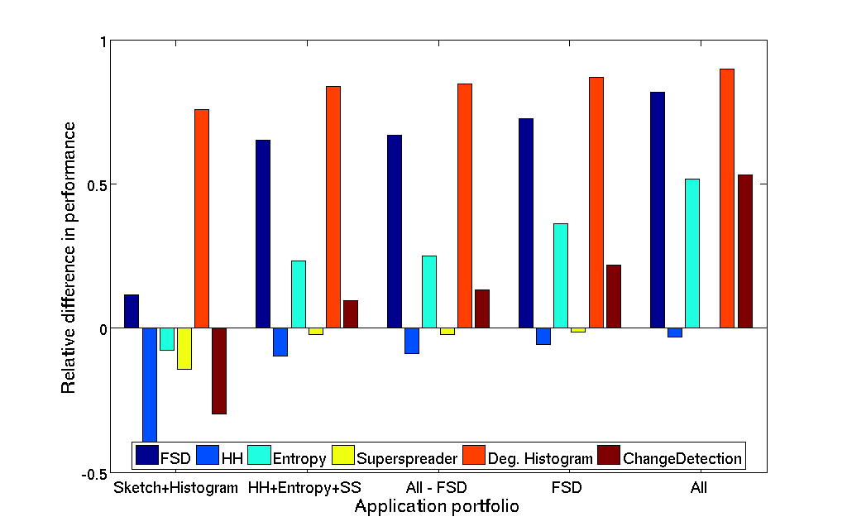
Sensitivity to Application Portfolio
“Relative Accuracy Difference”
+ → good
- → bad
Bigger app. portfolio or Some resource intensive apps
⇒ Better gains for RISC approach
Bigger portfolio → More resources

Slide 50
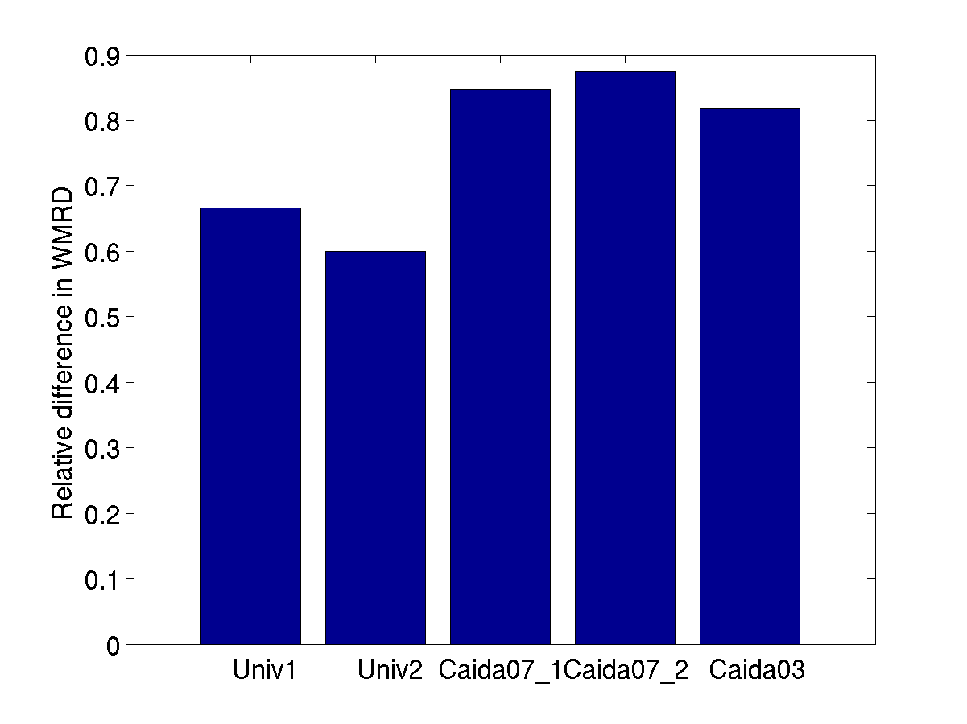
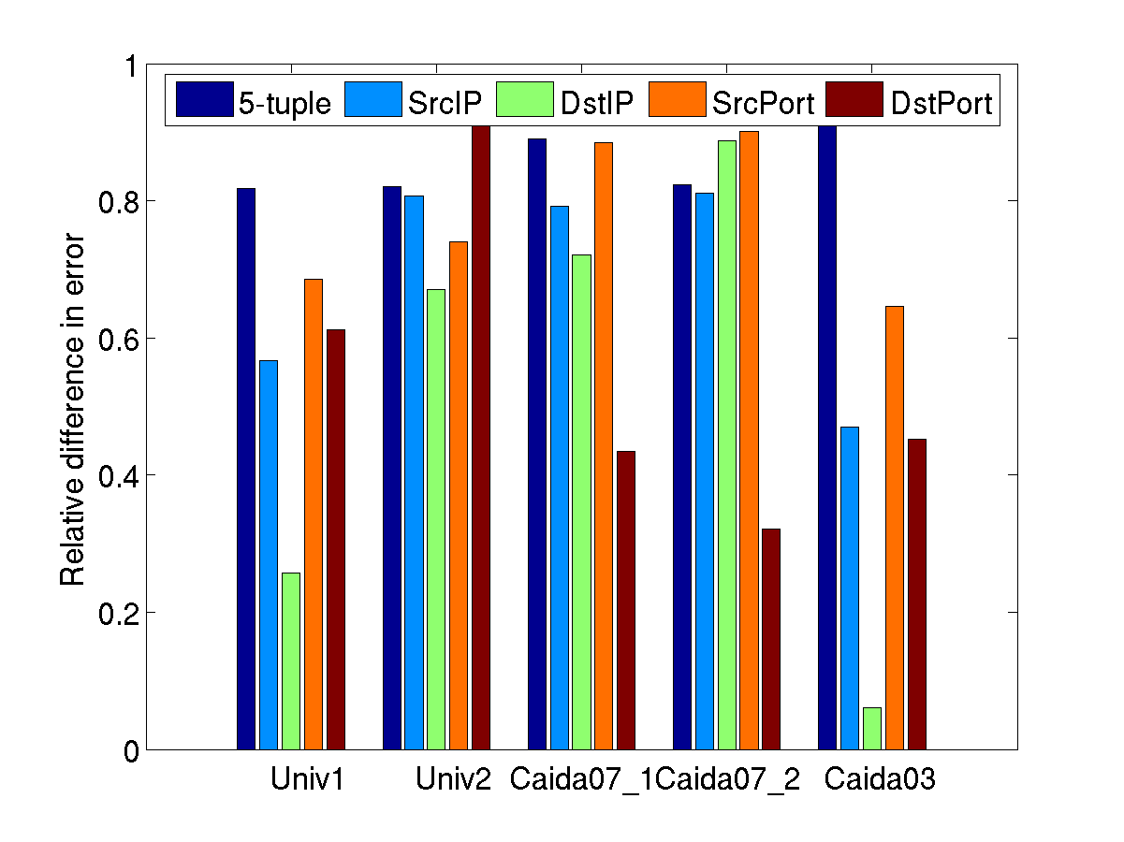
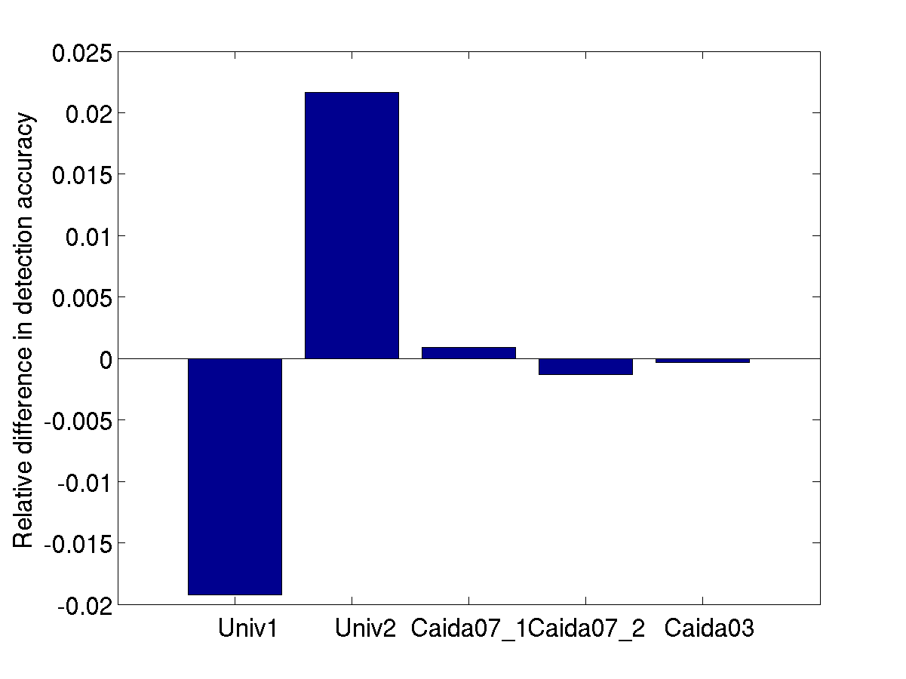
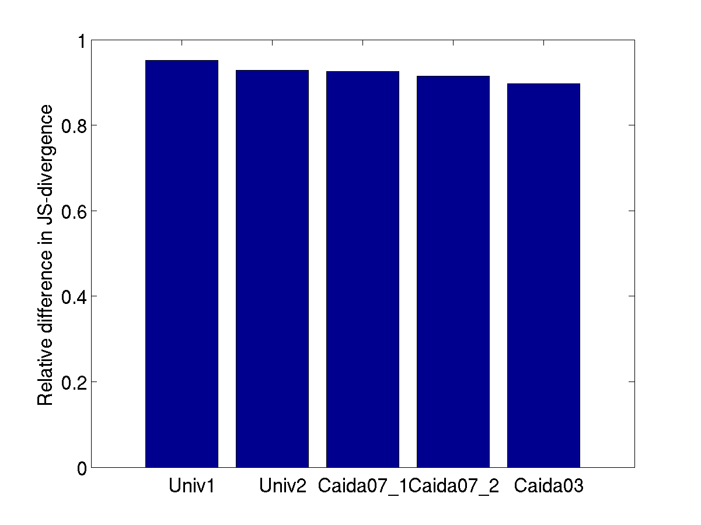
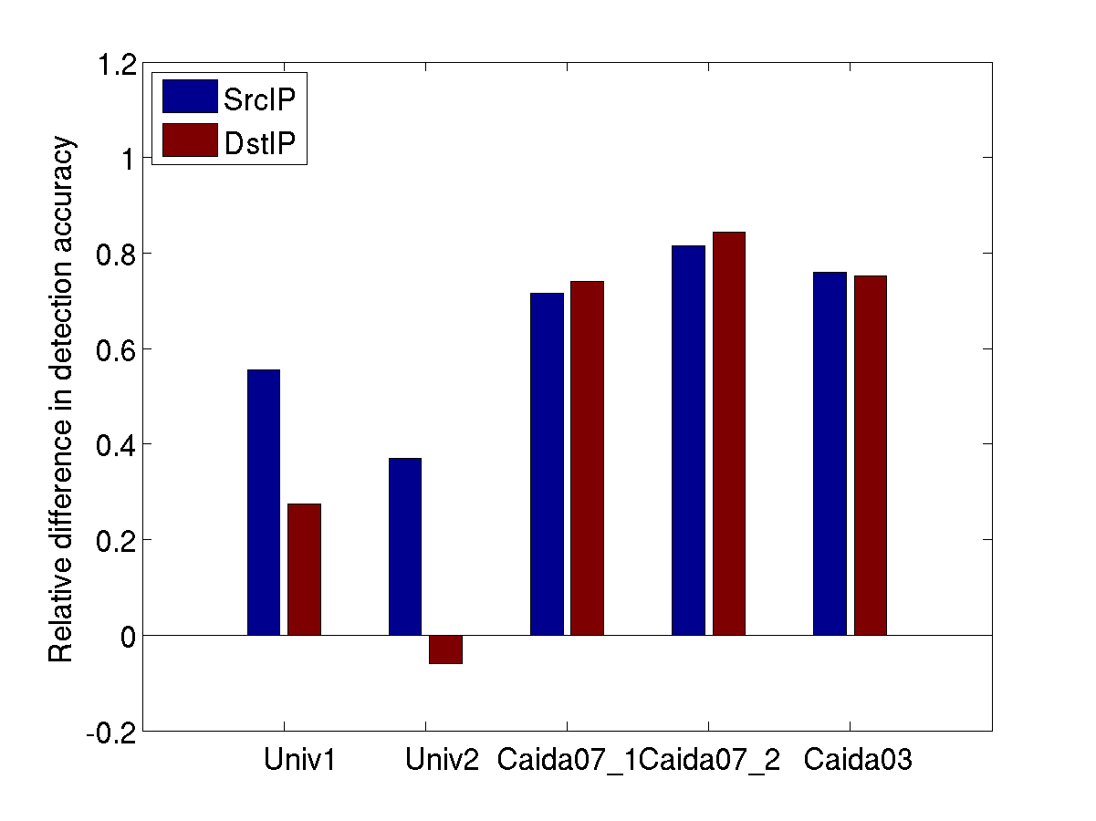
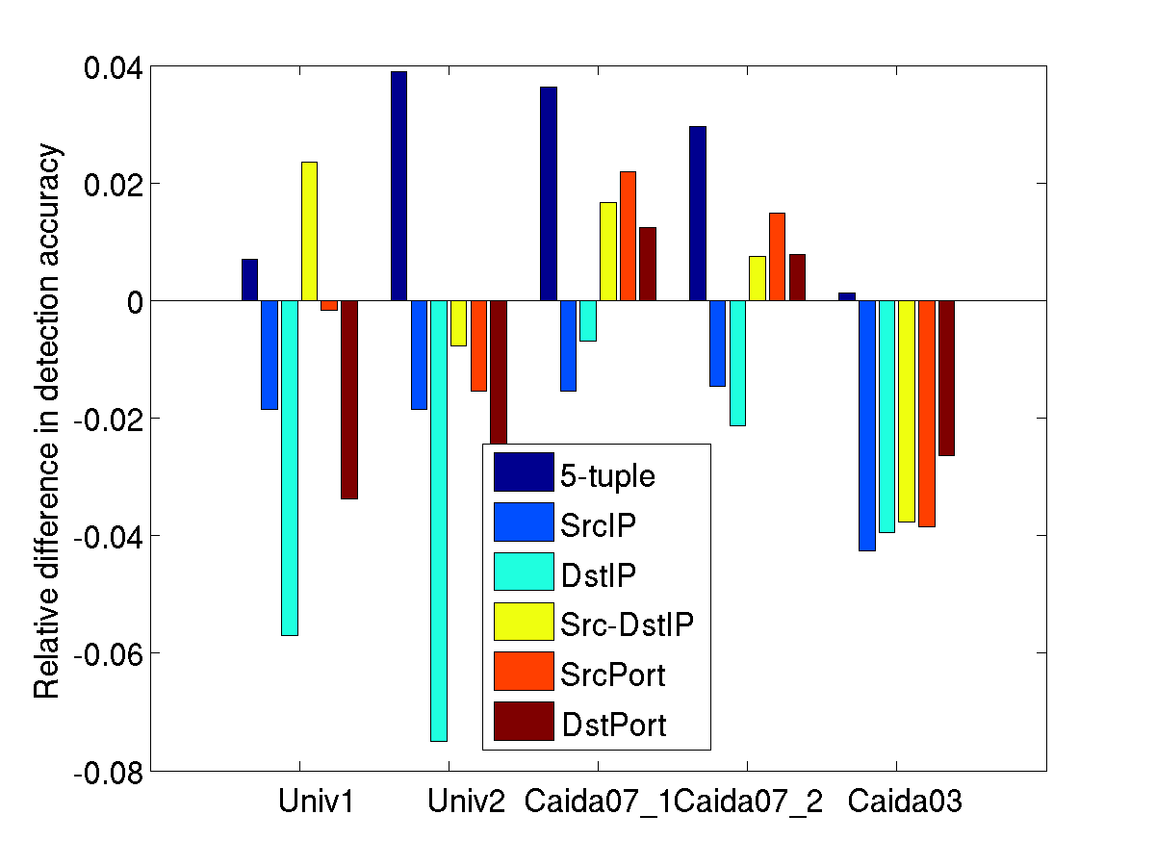
Evaluation: Single Router
“Relative Accuracy Difference”
+ → good
- → bad
RISC > Application-specific for most applications
Worse for heavyhitter, but not by much!

Slide 51
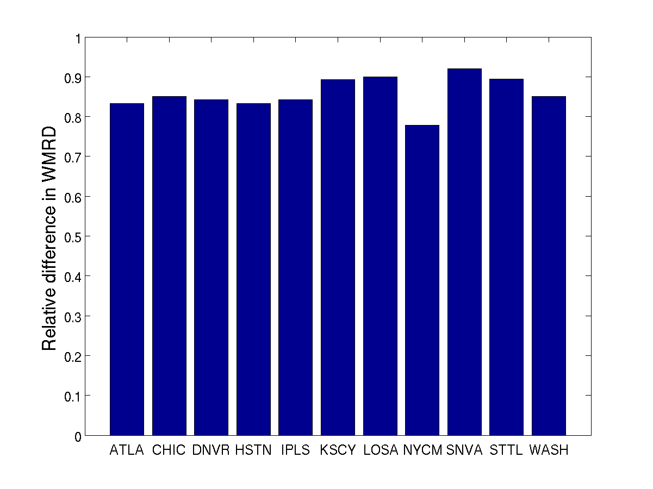
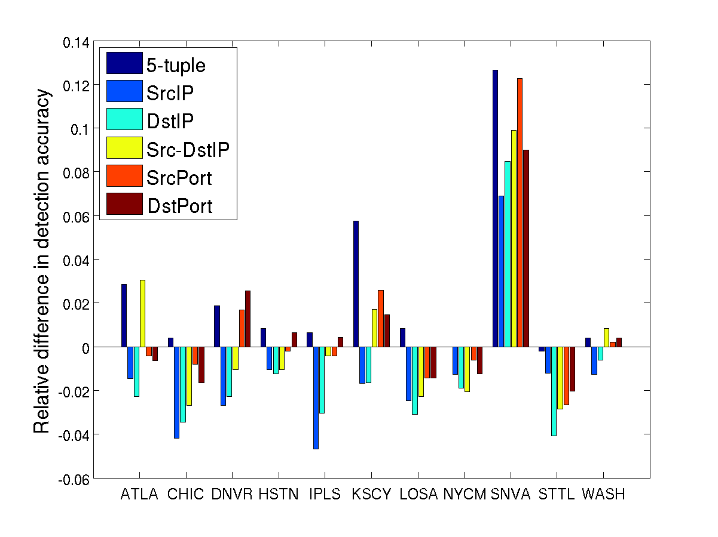
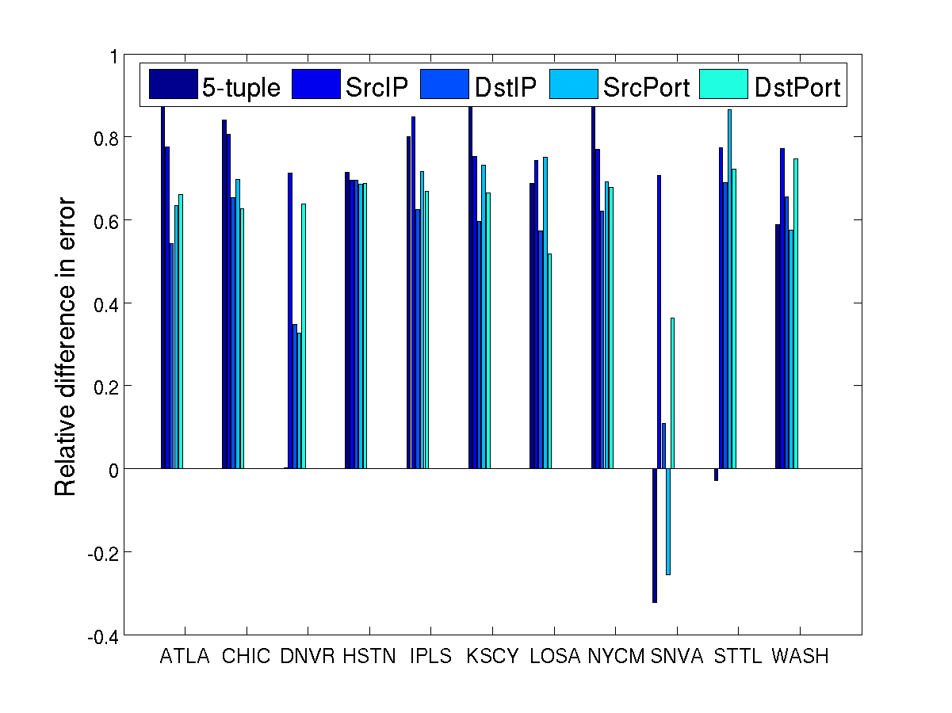
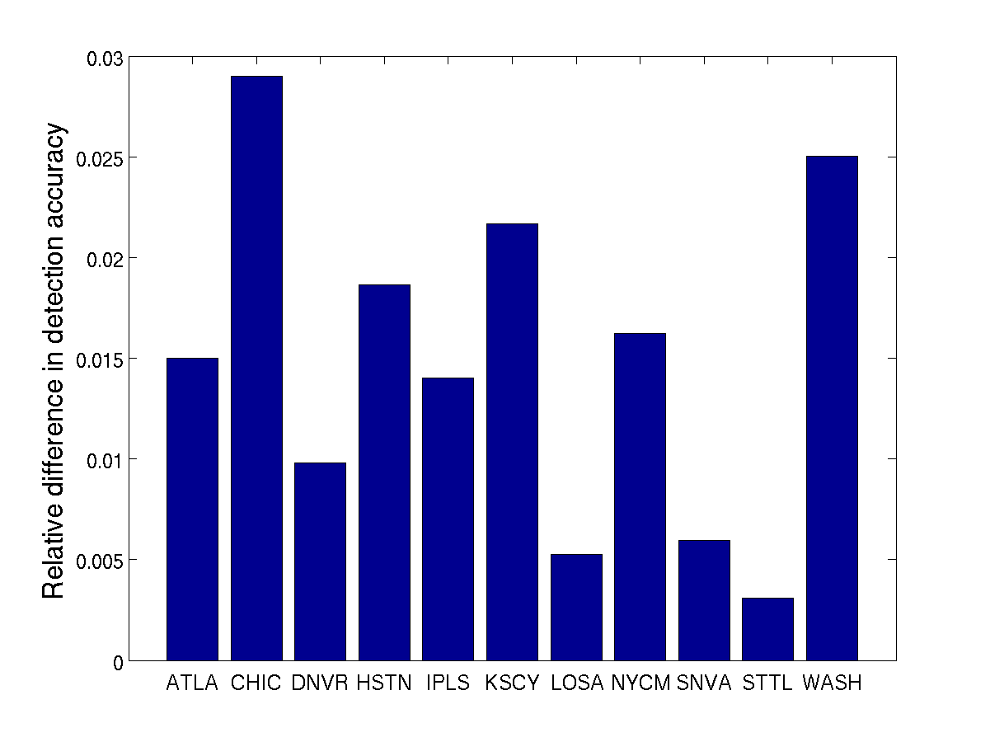
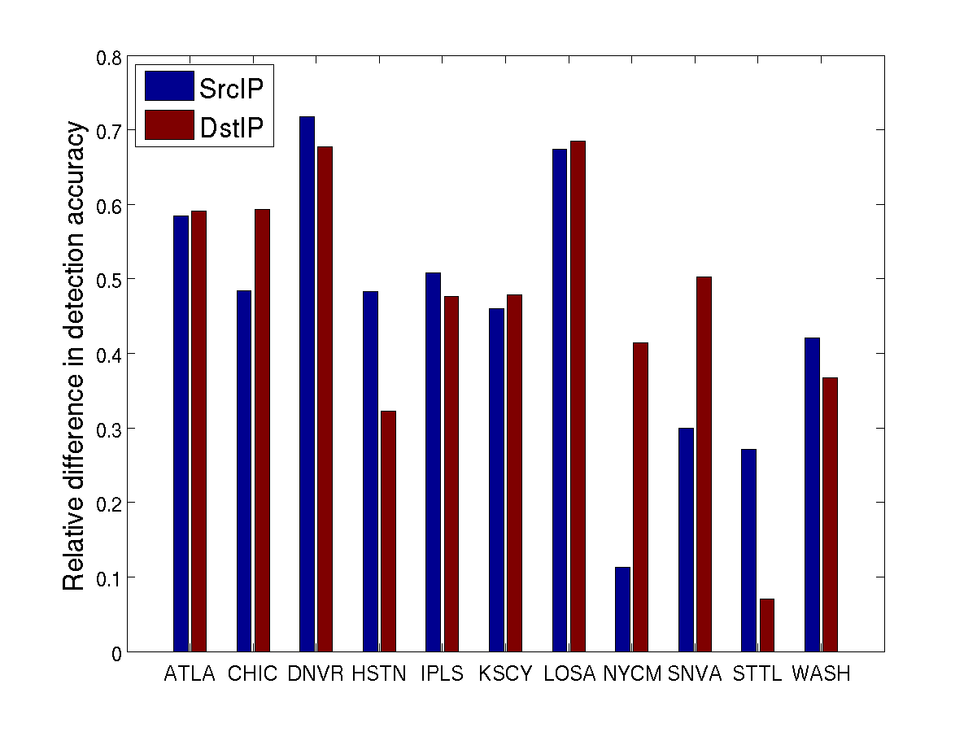
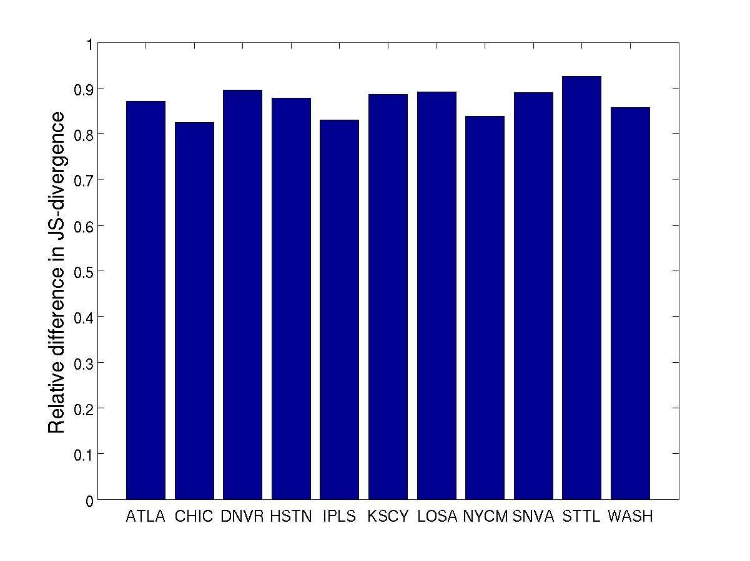
Network-wide evaluation: Per-Ingress
“Relative Accuracy Difference”
+ → good
- → bad
Results for network-wide per ingress mirror
single router evaluation
RISC > Application-specific for most applications

Slide 52
RISC vs. Application-Specific
Requirements | Application Specific | RISC 1.0 NetFlow | RISC 2.0 FS, SH, cSamp
Fidelity across applications | ✓ | ✗ | ✓
Implementation Complexity | ✗ | ✓ | ✓
Processing Overhead | ✗ | ✓ | ✓
Changing Applications | ✗ | ✗ | ✓
Enable Diagnostics | ✗ | ✓ | ✓
Yes, We Can!

Slide 53
Meeting requirements for
Flow Monitoring
Respect resource constraints
High flow coverage
Coordinated
Sampling
With “RISC”
primitives
Provide network-wide goals
Low data mgmt overhead
High-fidelity for all applications

Slide 54
Looking beyond flow monitoring
WAN optimization, Content-Aware Networking
“Intelligent and targeted caching of traffic at selected nodes of the network can help engineer traffic by reducing load and avoiding hot spots, cut end-to-end latency, and enhance the end-user experience.”
  SmartRE (with Ashok Anand, Aditya Akella)
Intrusion Detection/Prevention for Enterprises (ongoing work .. )

Slide 55
Thanks! www.cs.cmu.edu/~vyass www.cs.cmu.edu/~4D vyass@cs.cmu.edu

