Slide 1
Optimization problems, subexponential time, & Lasserre algorithms
Ryan O’Donnell CMU
Venkat Guruswami CMU
Ali K. Sinop CMU
David Witmer CMU
John Wright CMU Yuan Zhou CMU
Boaz Barak MSRNE
David Steurer MSRNE
Featuring work by:

Slide 2
Fundamental Algorithms Problems
Polynomial time
Not polynomial time
Õ(n) — truly efficient
2^{Ω(n)} — truly inefficient
Another problem
A problem

Slide 3
Fundamental Algorithms Problems
Polynomial time
Not polynomial time
Õ(n) — truly efficient
2^{n1/3}
2^{Ω(n)}
Factoring
3Sat
(probably)

Slide 4
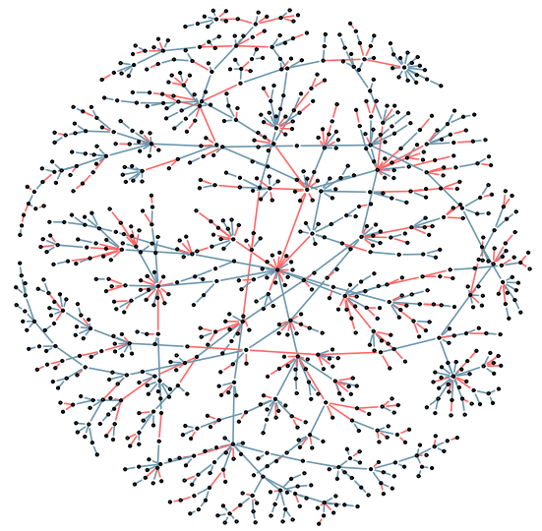
Balanced-Separator
Input:
A graph on n nodes.
Output:
A division into two parts of size between n/3 and 2n/3 nodes.
Goal:
“Cut” as few edges as possible.
An extremely fundamental algorithmic task.
Its complexity is almost completely unknown.

Slide 5
Balanced-Separator
Finding the exact optimal solution is NP-hard, (probably) time 2^{Ω(n)}.
Perfectly possible that there is an O(n log n) algorithm which gets within 1% of the optimal solution.
Perfectly possible that getting a solution which is at most 100 times worse than optimal requires time 2^{Ω(n)}.
[2011]: (Probably) no poly-time algorithm which gets within 0.000000000000000001% of optimum.

Slide 6
Similarly embarrassing situation for…
Coloring 3-colorable graphs
2Sat
Finding the maximum cut in a graph
Finding the smallest ‘vertex cover’ in a graph
Many other fundamental CSP and graph probs.

Slide 7
UG(ϵ) as a Grand Unified Theory?
Input:
List of 2-vbl equations over integers:
x₁−x₂=10, x₁−x₅=2, x₃−x₁₅=5, …
Promise:
There’s an assignment satisfying all but an ϵ fraction of the equations.
Task:
Output an assignment satisfying at least 1/2 of the equations.

Slide 8
UG(ϵ) as a Grand Unified Theory?
The following are* at least as hard as UG(ϵ):
Solving Balanced-Separator to w/i factor 100 of optimal.
Finding 2Sat solutions where # of unsatisfied clauses is at most 100× optimal # of unsatisfied clauses.
Coloring a 3-colorable graph using 1000 colors.
Doing better than we currently know how to do on many other fundamental CSP and graph problems.

Slide 9
So how hard (or easy) is UG(ϵ)?
[Khot ’02]: Conjectured that ∀ϵ, it’s NP-hard.
[ABS’10]: Solvable in time 2^{nO(ϵ1/6)}.
(Basically about as easy as an NP-hard problem could possibly be.)
[O Wr’12]: Showed UG(.4) is NP-hard, and (probably) requires 2^{Ω(n)} time.
[O Wi’12]: Improved some analysis in [ABS’10].

Slide 10
Q: We know that many basic problems (coloring 3-colorable graphs, 2Sat, etc.) are at least as hard as UG(ϵ).
Could they also have 2^{nϵ}-time algorithms?
A: [GS’11,’12]: progress for Balanced-Separator.
Q: How did [ABS] do it?
A: There algorithm was a bit ad hoc, but [GS’11], [BRS’11] show how to do it using the “Lasserre algorithm”.

Slide 11
Lasserre Algorithm (2001)
A generalization of a generalization of a a generalization of linear programming.
A generic “black box” algorithmic technique you can try on a wide variety of problems.
Comes with a crank you can turn: for each k = 1, 2, 3, … you can run a Lasserre(k) algorithm in time ≈ n^{k}.
Gives stronger results as you increase k.

Slide 12
What we know for many optimization problems:
solution quality
Opt.
Okay
running time
poly(n)
n^{log(n)}
2^{n}

Slide 13
What could be the case using Lasserre(k):
solution quality
Opt.
Okay
running time
poly(n)
n^{log(n)}
2^{n}

Slide 14
So how well does Lasserre(k) do?
Problem 1: It’s hard to understand.
Problem 2: It’s hard to analyze.
Big progress by [BBHKSZ’12]:
Develops new understanding of Lasserre.
Shows Lasserre(8) solves all known hard instances of UG(ϵ).
Perhaps Lasserre(8) actually solves UG(ϵ)!

Slide 15
The latest (as of Thursday)
Joint followup work with Yuan Zhou:
Develops (dare I say?) an even better understanding of Lasserre.
Shows Lasserre(4) solves known hard instances of Balanced-Separator.
Gives a little evidence that Lasserre might not solve all of our optimization problems.

Slide 16
To Be Continued…

Slide 17
What is the Lasserre algorithm?
Write the problem with polynomial inequalities.
E.g.: Balanced-Separator
Have variable x_{i} for each vertex.
Supposed to be ±1, so add the polynomial constraints x_{i}² = 1
Supposed to be between n/3 and 2n/3 vertices on each side, so add the polynomial constraint
−n/3 ≤ ∑ x_{i} ≤ n/3

Slide 18
What is the Lasserre algorithm?
Suppose I give you a multivariate polynomial,
P(x₁, x₂, x₃, …, x_{n})
and I want to prove to you that
P(x) ≥ 18 whenever Q(x₁, x₂, …, x_{n}) ≥ 0,
where Q(x) is another multivariate polynomial.
It’s NP-hard, but…

Slide 19
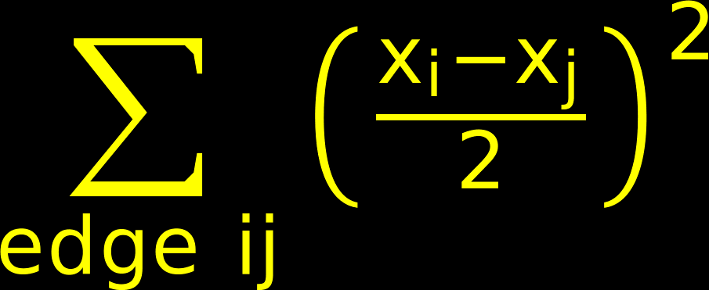
E.g.: Balanced-Separator
x_{i}² = 1 for each vertex i,
−n/3 ≤ ∑ x_{i} ≤ n/3
minimize
= # of cut edges

