Slide 1
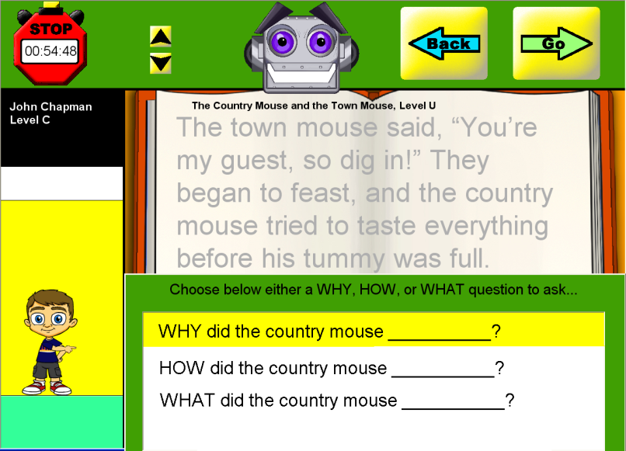
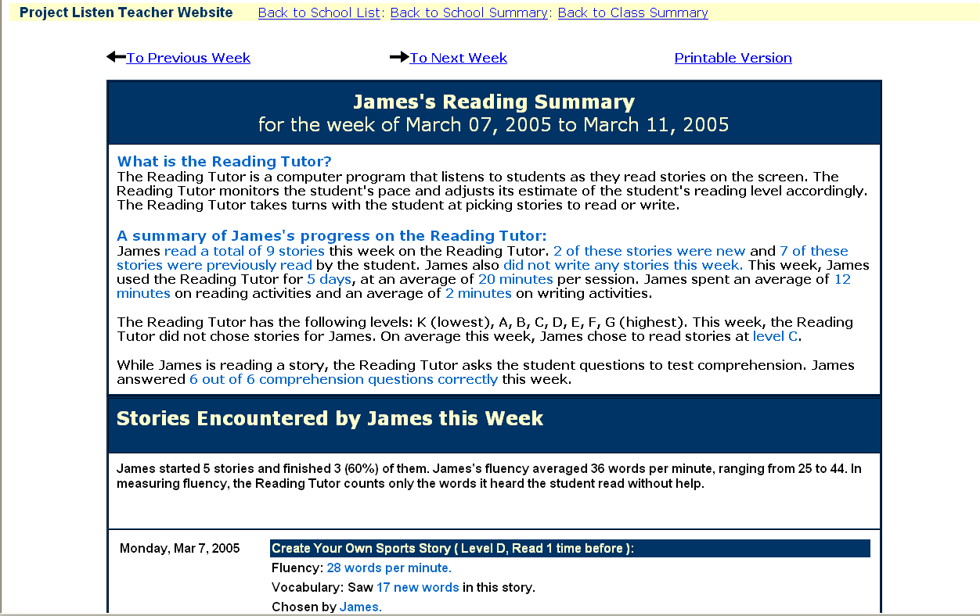
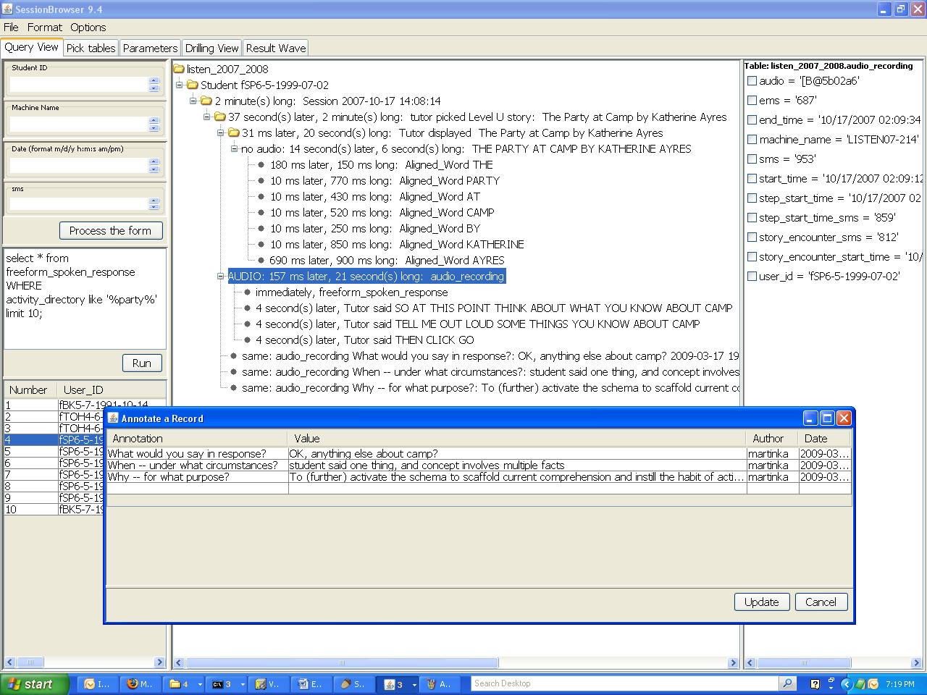
Carnegie Mellon
Why, What, and How to Log?
Lessons from LISTEN
Project
LISTEN
www.cs.cmu.edu/~listen
Jack Mostow
Carnegie Mellon University
Joseph E. Beck
Worcester Polytechnic Institute
Tutoring
Why to log:
Reporting
Browsing
What to log:
Environment
Raw input
Interpreted input
Student model
Tutor decisions
Events
Tutor output
# Rows | Table Name
967 | story | Title | Story_Level | Directory | Author | Creation_Date | Story_Text
11 | school | Name | Address | City | Zipcode | State | Country | District
39 | class | School_Name | Class_Name | Status | Class_ID
545 | student | School_Name | First_Name | Middle_Name | Last_Name | Nickname | Sex | Date_Of_Birth
464,459 | student_click | Machine_Name | Start_Time | ms | Help_Start_Time | Help_sms | Type | Target
9,792 | audio_recording | User_ID | Machine_Name | Start_Time | End_Time | sms | ems | Story_Encounter_Start_Time
19,581 | word_swap_click | User_ID | Machine_Name | Start_Time | sms | Word_Swap_Sentence_Encounter_Start_Time | Word_Swap_Sentence_Encounter_sms | Word
106,742 | multiple_choice_question | User_ID | Machine_Name | Start_Time | End_Time | sms | ems | Story_Encounter_Start_Time
18,640 | text_editor | User_ID | Machine_Name | Start_Time | End_Time | sms | ems | Story_Encounter_Start_Time
9,379 | freeform_spoken_response | User_ID | Machine_Name | Start_Time | End_Time | sms | ems | Story_Encounter_Start_Time
497,164 | utterance | Machine_Name | Sentence_Encounter_Start_Time | Sentence_Encounter_sms | User_ID | Start_Time | End_Time | Wave_FilePath
1,769,011 | hypothesis_word | Machine_Name | Hypothesis_Word | Start_Time | End_Time | sms | ems | Utterance_Start_Time
3,610,055 | aligned_word | Machine_Name | Utterance_Start_Time | Utterance_sms | Utterance_Count | Interaction_Type | User_ID | Sentence_Encounter_Start_Time
269,743 | student_word_data | School_Name | Creation_Date | User_ID | Word | Word_Key | Count
8,115 | student_word_production_time_grade_estimate | School_Name | User_ID | Bin | Count
78,173 | student_performance | School_Name | User_ID | Time | Ms | Machine_Name | WordStartTime | WordStartMs
79,832 | knowledge_tracing | School_Name | User_ID | Student_Performance_Time | Student_Performance_Ms | Skill | Prior_Learned | Pr_Learned
41,358 | event_response | Machine_Name | User_ID | Start_Time | sms | End_Time | ems | Intervention_Directory
184,070 | help_given | Machine_Name | Decided_Time | dms | Start_Time | sms | End_Time | ems
3,273 | launch | Machine_Name | Version | Launch_Time | Log_Name | Volume | sms
80 | crash_dump | Machine_Name | Time | File_Name | Dump
10,576 | session | User_ID | Start_Time | End_Time | Machine_Name | Log_Name | Exit_Through | sms
194,869 | script | User_ID | Script_Name | Start_Time | End_Time | sms | ems | Machine_Name
179,723 | set_variable | Machine_Name | Time | ms | User_ID | Variable | Value | Script_Start_Time
315,100 | step | User_ID | Step_Name | Start_Time | End_Time | sms | ems | Interface_Object
21,817 | story_encounter | Start_Time | End_Time | Machine_Name | Session_Start_Time | Exit_Through | Story_Directory | User_ID
362,683 | sentence_encounter | User_ID | Machine_Name | Start_Time | End_Time | sms | ems | Story_Encounter_Start_Time
4,201 | word_builder | User_ID | Machine_Name | Start_Time | End_Time | sms | ems | Story_Encounter_Start_Time
26,589 | word_builder_word_encounter | User_ID | Machine_Name | Start_Time | End_Time | sms | ems | Word_Builder_Start_Time
11,728 | word_swap_sentence_encounter | User_ID | Machine_Name | Start_Time | End_Time | sms | ems | Story_Encounter_Start_Time
1,985,366 | audio_output | Machine_Name | Start_Time | sms | Audio_Text | User_ID | Help_Start_Time | Help_sms
How to log:
Thou shalt not file; log to a database.
Log user, computer, and start time.
Include end time.
Index user, computer, and start time.
Index thy parent to keep it handy.
Design databases to pool data from several servers.
Log each year’s data to its own database.
Log each type of event to its own table.
Name fields consistently in and across databases.
Log non-events carefully.
This work was supported in part by the National Science Foundation under ITR/IERI Grant No. REC-0326153 and in part by the Institute of Education Sciences, U.S. Department of Education, through Grants R305B070458, R305A080157, and R305A080628 to Carnegie Mellon University. The opinions expressed are those of the authors and do not necessarily represent the views of the Institute, the U.S. Department of Education, or the National Science Foundation. We thank the educators, students, and members of Project LISTEN who have helped generate, log, and analyze our data.

