Slide 1




Lessons from Project LISTEN:
What have we learned from a Reading Tutor that listens?
Jack Mostow, Director
Project LISTEN
(www.cs.cmu.edu/~listen)
Carnegie Mellon University

Slide 2
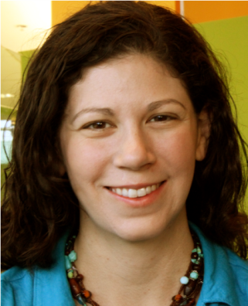
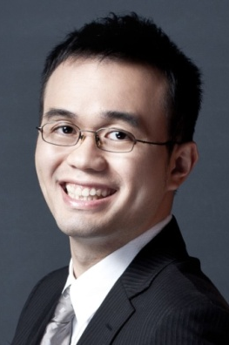
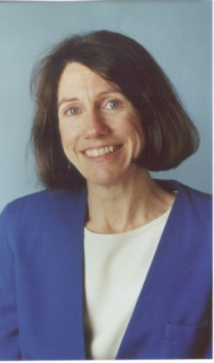
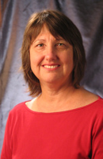
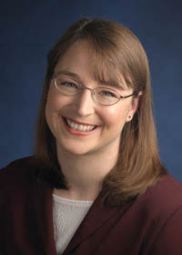

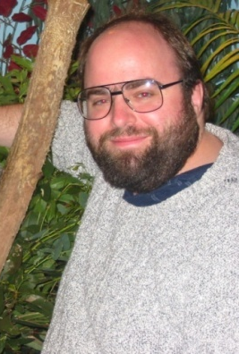
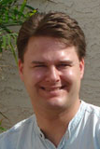


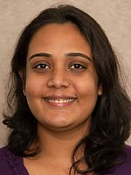

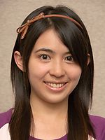


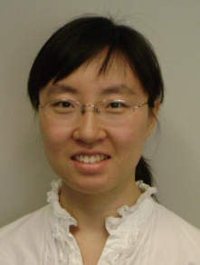

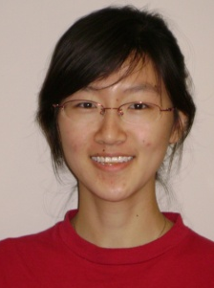



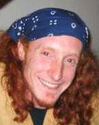
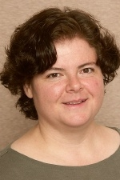
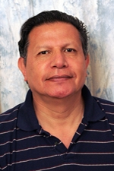

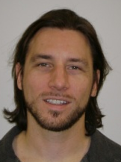

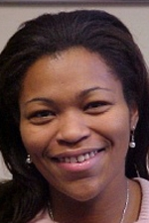
LISTEN faculty, students, staff…

Slide 3
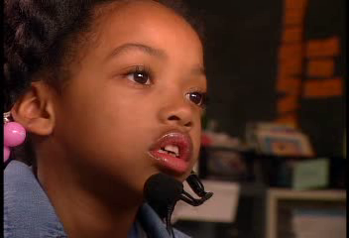
Project LISTEN’s Reading Tutor

Slide 4
Project LISTEN’s Reading Tutor
John Rubin (2002). The Sounds of Speech (Show 3). On Reading Rockets (Public Television series commissioned by U.S. Department of Education). Washington, DC: WETA.
Available at www.cs.cmu.edu/~listen.

Slide 5


What is “reading”?
Skills targeted by the Reading Tutor
Phonics
  Decode
  Spell
Fluency
  Identify words quickly, accurately, effortlessly
  Read expressively
Vocabulary
  Retrieve word meaning
Comprehension
  Make meaning from print
understand
pronounce
speak
/k ae t/
cat
My cat is fat
cat
transcribe
hear
Notes:
+ I would adjust the levels of audio across all videos.
Note: 2, 3, 4 IES grants

Slide 6
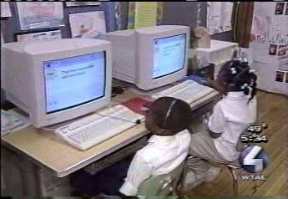
The Reading Tutor listens, logs, and experiments
Hundreds of children, thousands of sessions
Millions of words of longitudinal data to mine
Randomized controlled trials

Slide 7
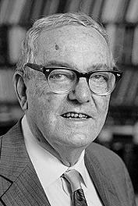
How to do research
1. Pick a research question.
  Significant = people care
  Right-sized = not too hard
2. Pick a novel approach to it.
  “Secret weapon” as source of power [Herb Simon]
  Reframing, device, data, representation, methodology, …
This talk: a few examples from Project LISTEN
  E.g. use speech recognition to improve reading.
  Note: sometimes we pick approach before question.
Notes:
The higher level take home message was not entirely clear. I though you'd give a talk about how to conduct good scientific research, but later the focus was more on the Project Listen (which itself is very lovely). One way to organize the talk may be to provide higher level lecture about ideal scientific research ("you should have a research question and secret weapon…") and then map the Project Listen experiences onto it, which might what you tried to do.
Slide 7: seems of little relevance to AI & Ed.
Jack: glad you found the comments useful. After I hit the "send" key, it occurred to me that you might be annoyed by some of them -- the line between constructive and rude is very much in the eye of the beholder!!. The one comment I forgot to make was that your "secret weapon" comment was right on!! I too have used Herb's "secret weapon" idea in talking about my own career. (See p 11 of the this chapter ... from my festschrift volume.):
http://www.psy.cmu.edu/~klahr/pdf/Klahr%20draft%20for%20distribution.pdf
.... and if you want to read an entire chapter devoted to his influence on me, see:
http://www.psy.cmu.edu/~klahr/pdf/klahr%202004.pdf
Its from an edited volume of chapters from a vast range of researchers who were influenced by Herb, published a couple of hears after his death:
Augier, M. & March, J. G. (Eds.) Models of a Man: Essays in Memory of Herbert A. Simon . Cambridge , MA : MIT Press.

Slide 8
Questions
Does the tutor help? Compare gains to alternatives
What should a reading tutor do?
Why and how to listen?
What do kids like?
What do kids know?
What practice helps?
Does help help?
What help helps?
  Independent reading
  ELL BAU: Human tutors
  Canada, Ghana, India
Notes:
8: Too much of a laundry list of questions ...
This slide is good, but felt a bit rushed -- in general, you should pick fewer things to cover more completely.
3. I'd suggest dropping the repeated mention of prizes and awards for your work. Your audience already knows that you are the leading light in the field ... that's why you are giving a keynote. To repeatedly list this prize and that "best paper" award seems a little tacky and unnecessary.
[Jack Mostow] I especially appreciate this tip – it’s the sort of delicate issue that only a true friend would mention.
And even if you didn't mention the prizes, the listing of a bunch of papers on various slides really serves no purpose for this kind of talk. People don't come to a talk to look at a resume projected on the screen.
[Jack Mostow] Well put ;-).
Better to list a set of issues/challenges and the "nugget" of the core solution to them that each of your projects represents. To you, or to people already familiar with your work, sure, "Mostow and Blinkenthorp, 2008", represents one scientific acheivement and "Bumbleberg and Mostow, 2005", represents another, but for most people, its just text on a screen: An audience can't extract that from simply looking at a bunch of meeting dates. Let the work speak for itself.

Slide 9
What practice helps? type effects:
Learning curve for word reading time
  Average for 770,858 encounters of less-frequent words

Slide 10
Learning curve for exponential model
How to model practice? type effects:
How to model practice type effects?
Learning decomposition (Beck EDM06)
Idea: count each type of exposure separately
performance = A ∙ e ^{–b ∙}
(t₁+ t₂)
t
(t₁ …+ β_{i} ∙ t_{i} + …)
β ∙
performance on 1st encounter
learning rate
impact of type 2 exposure compared to type 1
impact of type i exposure compared to type 1
number of trials
Faster
Fewer errors
Less help
10
8/4/2013
Notes:
+ It was not clear why you spent a not-so-small amount of time for the
+ mini lecture of learning curve

Slide 11
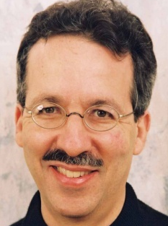

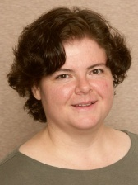

How does the amount of context in which words are practiced affect fluency growth? Embed an experiment (SSSR2012)
Jack Mostow, Jessica Nelson, Martin Kantorzyk, Donna Gates, and Joe Valeri
Project LISTEN
www.cs.cmu.edu/~listen
Carnegie Mellon University
This work was supported by the Institute of Education Sciences, U.S. Department of Education, through Grant R305A080628 to Carnegie Mellon University. The opinions expressed are those of the authors and do not necessarily represent the views of the Institute or U.S. Department of Education.

Slide 12
Connected text builds fluency better than reading isolated words. Why?
– which reading processes transfer to new text?
Context | Processes enabled
Isolation | Decoding, word recognition
Bigram | Parafoveal lookahead at 2nd word
Phrase | Syntactic parsing
Sentence | Intra-sentential comprehension
Notes:
Morph into similar table for 5 words preview and outcome sentence

Slide 13
How much context builds fluency best?
Within-subject, within-story experiment
Before story, preview 5 hardest new words
  Preview = 1. Tutor shows; 2. Child reads; 3. Tutor reads.
  Hardest = longest (# letters)
  New = word root not seen before in Reading Tutor
Independent variable: amount of context
  Randomize assignment of word to treatment and order
  Compare no-exposure control; isolation; bigram; phrase; sentence
Outcome: first encounter of word in story
  Help = whether child clicks on word
  Latency = pause before word
  Production = time to say word
This word is very difficult to learn.
very difficult
very difficult to learn
difficult

Slide 14
Analysis of 3958 completed trials
(112 2nd and 3rd graders, 332 distinct target words)
Outcome measures
  % accepted by ASR as read correctly
  % child clicked for help
  % hesitated (of words accepted without help)
  Log latency per letter if hesitated
  Log production time per letter
Predictors in linear mixed effects regressions
  Treatment (fixed)
  Word (random)
  Child (random)
  Time (7 to 1274 seconds) since preview (fixed)

Slide 15
Results from 3958 completed trials:
% child clicked for help
Preview in phrase or sentence reduced help requests at first encounter in story
Notes:
#24-26 would like to know if the differences among bars are statistically significant.

Slide 16
Results from 3958 completed trials:
% hesitated (of words accepted without help)
Preview in bigram, phrase, or sentence reduced likelihood of hesitations …

Slide 17
Results from 3958 completed trials:
Latency (ms) per letter if hesitated
… but preview was n.s. for hesitation duration!

Slide 18
Summary of fluency context experiment
For initial encounter of “hard” word in story:
  Preview in more context reduced help requests and hesitations.
  … but (to our surprise!) not hesitation duration.
  Hypothesis: if can’t retrieve the word, just decode it.
Follow-up for all hesitations:
  Latency per letter is independent of any predictors we tried!
Notes:
#27 I couldn't fully get the summary. Partly because I need more time to read the slides. Partly because I had trouble connecting the first sentence to the previous graphs.
27: This was interesting -- about the right length, but a little fast
Question: Is there any way to detect decoding (as opposed slow fluent reading)? For instance, it seems high frequency of a word may relatively better predict fluent reading time whereas length (in
phonemes?) may better predict decoding reading time. You (or someone
else) have probably looked at this, but I wonder ...
What future work?
-- resolve vs. isolated
-- effects of story identity/difficulty
-- suggestions?

Slide 19
Does help help?
Knowledge tracing
Student Knowledge (K_{i})
Student Knowledge (K_{i+1})
Knew
(K₀)
Learn
Forget
Guess Slip
Student Performance (C_{i})
Student Performance (C_{i+1})
Notes:
Transition to knowledge tracing was a little rough ...
Unshaded means latent, unobserved variable.
Shaded means observed variable.
This graphical model is equivalent to KT.

Slide 20
Does help help?
Knowledge tracing + help node
Student Knowledge (K_{i})
Student Knowledge (K_{i+1})
Knew
(K₀)
Learn
Forget
Teach
Tutor Help
(H_{i})
Guess Slip
Scaffold
Student Performance (C_{i})
Student Performance (C_{i+1})
Notes:
Should the Teach link point to Learn or Ki+1 rather than Ki?
Unshaded means latent, unobserved variable.
Shaded means observed variable.
This graphical model is equivalent to KT.

Slide 21
Does help help?
Initial knowledge effect
Students likelier to get help on unknown words
 | No help given | Help given
Already know | 0.660 | 0.278
Learn | 0.083 | 0.088
Guess | 0.655 | 0.944
Slip | 0.058 | 0.009
Notes:
Unshaded means latent, unobserved variable.
Shaded means observed variable.
This graphical model is equivalent to KT.

Slide 22
Does help help?
Teaching effect
Students likelier to learn when get help
  Help helps!
 | No help given | Help given
Already know | 0.660 | 0.278
Learn | 0.083 | 0.088
Guess | 0.655 | 0.944
Slip | 0.058 | 0.009
Notes:
#15-16 I'm lost a bit. What were the decimal points again?
Unshaded means latent, unobserved variable.
Shaded means observed variable.
This graphical model is equivalent to KT.

Slide 23
Does help help?
Scaffolding effect
Students likelier to perform correctly with help
 | No help given | Help given
Already know | 0.660 | 0.278
Learn | 0.083 | 0.088
Guess | 0.655 | 0.944
Slip | 0.058 | 0.009
Notes:
Unshaded means latent, unobserved variable.
Shaded means observed variable.
This graphical model is equivalent to KT.

Slide 24
What help helps?
Experiment to compare scaffolding
Student is reading a story
‘People sit down and …’
Student needs help on a word
Student clicks ‘read.’
Randomized choice among feasible types
Tutor chooses what help to give
Student continues reading
‘… read a book.’
Time passes…
Student sees word in a later sentence
‘I love to read stories.’
Outcome: success = recognize word as read fluently
(How) does the type of help affect the next encounter?
Notes:
Explain outcome = word read OK, then explain segmentation artifact; read ASR as “automatic speech recognizer”

Slide 25
Helped 270 students on 180,909 words (average success rate 66.1%)
Example: ‘People sit down and read a book.’
Whole word:
  56,791 Say Word
  24,841 Say In Context
Decomposition:
  22,933 One Grapheme
  19,677 Sound Out
  14,223 Onset Rime
  6,280 Syllabify
Analogy:
  13,671 Starts Like
  13,165 Rhymes With
Semantic:
  14,685 Recue
  2,285 Show Picture
  488 Sound Effect
Which types stood out?
  Best: Rhymes With 69.2% ± 0.4%
  Worst: Recue 55.6% ± 0.4%
Notes:
Slide 18: not clear what the message is
Use words to illustrate interventions; don’t mouse over hyperlinks (only SayWord & RhymesWith)

Slide 26
What helped which words?
Depended on how long before saw word again.
Supplying the word helped best in the short term…
But rhyming hints had longer lasting benefits.
 | Same day: | Later day:
Grade 1 words: | Say In Context, Onset Rime | Onset Rime
Grade 2 words: | Say In Context, Rhymes With | Rhymes With
Grade 3 words: | Say In Context | Rhymes With, One Grapheme
Notes:
19: Nice results. You didn't say what "onset rhyme" is. Here's another place where you could spend more time (if you cut time from elsewhere).

Slide 27
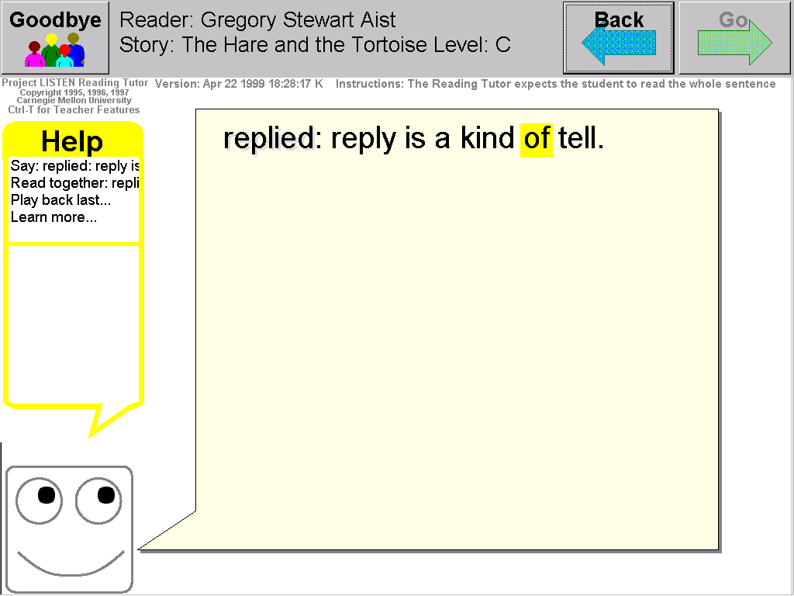
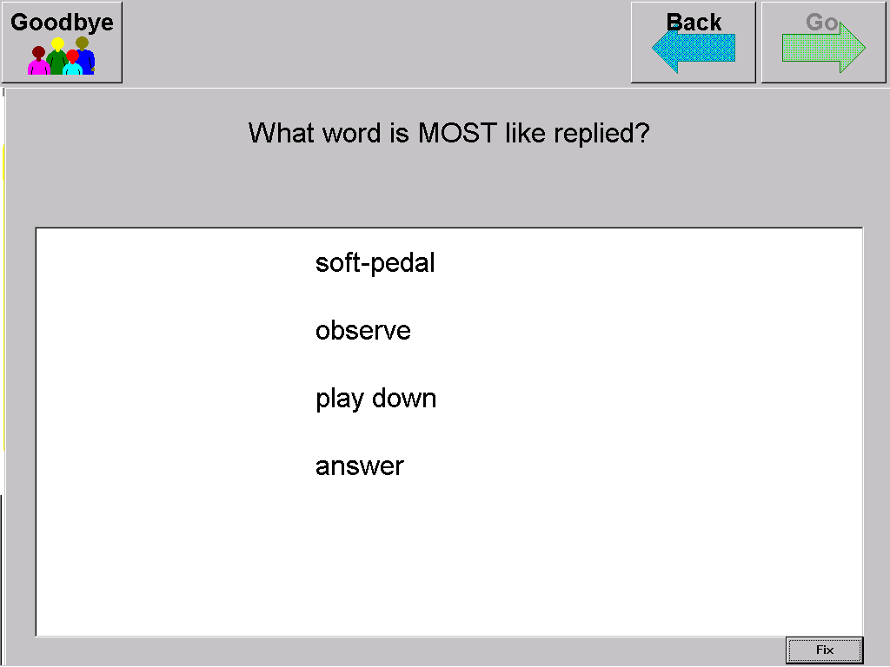
  Do quick vocabulary explanations help?
  Compare gains with vs. without.
Explain some new words; later, test each new word.
Randomize choices among alternative tutor actions
Log student performance as trial outcomes
Helped for rarer words, like astronaut
Notes:
33: A nice result, but I'd say either 0 or 2-3 slides

Slide 28
Do follow-on vocabulary activities help? “Rolling admission” dosage experiment*
Skip pretest of no-exposure control words
Pretest word; discard if already known
See word in story
Explain quickly in context
Teach word after story
Remind meaning; relate other words
Reintroduce; ask cloze question
Reintroduce; apply to situations
Reintroduce; ask factoid questions
Post-test word
Delayed post-test 1 week later
(*Example videos reconstructed from logged data)
Elicit active processing to build lexical quality needed later to retrieve rich meaning

Slide 29
% of taught words learned (delayed posttest)
  No-exposure See +Quick +Teach +Relate +Cloze +Apply +Factoid
  11 sec 80 sec 120 sec 40 sec 39 sec 68 sec

Slide 30
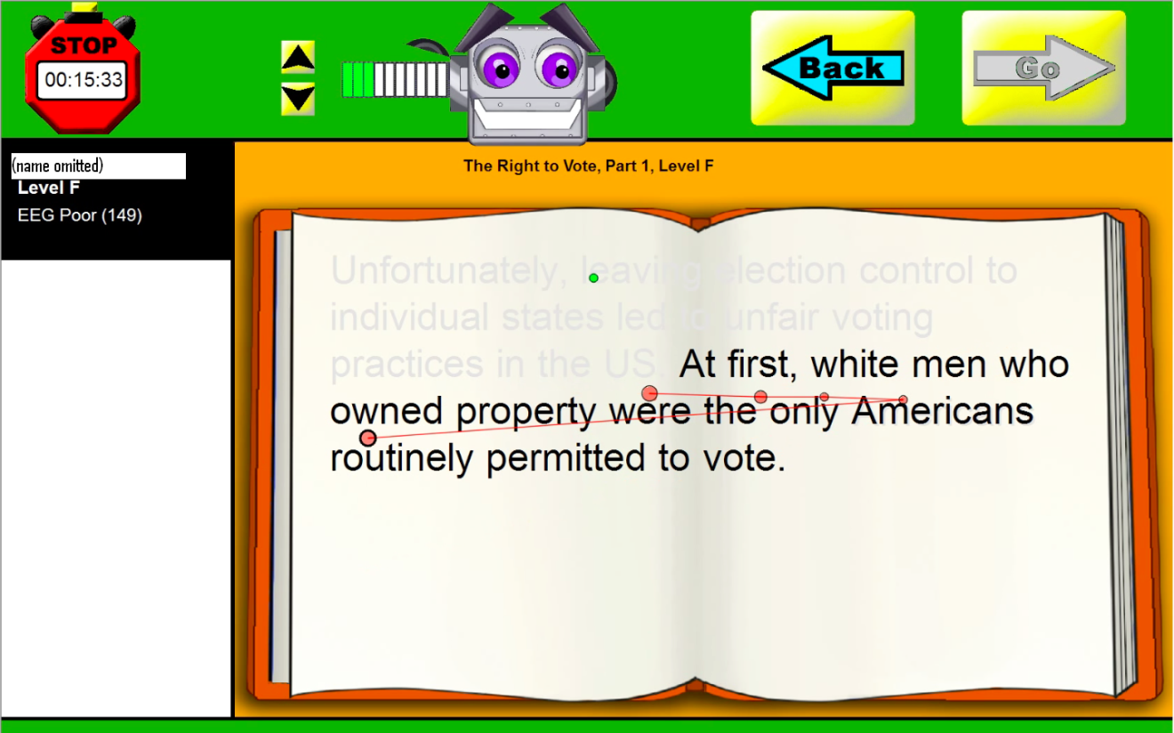
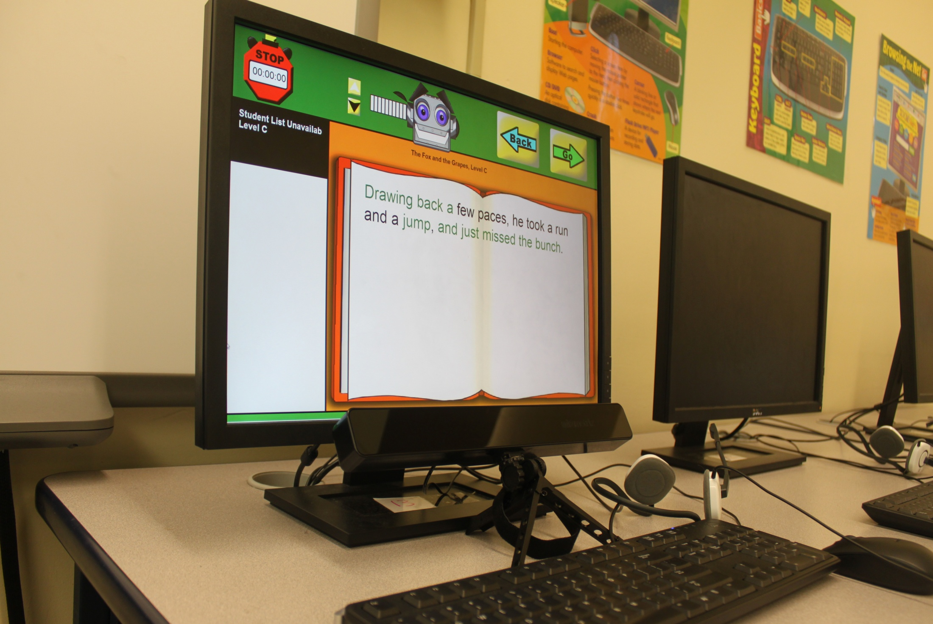
How to trace learning? Add sensors
Project LISTEN adding sensors
Eye Tracker
Log
Gaze
Path
EEG Headband
Microphone
Headset
Child (not shown)

Slide 31
Some research questions about sensors
How well can portable eye trackers follow kids’ reading?
  Field-test: they work OK sometimes but not others.
How can we overcome mistracking due to squirming?
  Reframe as how to get kids to sit where they’re tracked well.
  Kid-test prototype feature to dim screen when they’re not.
Can low-cost EEG detect students’ mental states?
  Do experiment to get EEG data of reading easy and hard text
  Train classifier to tell easy vs. hard from EEG (AIED11)

Slide 32
EEG while reading an easy sentence
When spring winds warm the earth, a farmer plants hundreds of pumpkin seeds.

Slide 33
EEG while reading a hard sentence
In regard to propaganda the early advocates of universal literacy and a free press envisaged only two possibilities: the propaganda might be true, or it might be false.

Slide 34
Is this EEG from an easy or hard sentence?
The first and most important rule of legitimate or popular government, that is to say, of government whose object is the good of the people, is therefore, as I have observed, to follow in everything.

Slide 35
What can we learn from a Reading Tutor that Listens? Lessons for reading
Fluency
  Wide reading > repeated reading (for most kids)
  Spaced > massed (first time see word today > later today)
  Kid choice > tutor choice (thanks to story, not who chose it?)
  Word itself > root or rime
  Rhyming hints > supplying the word (in the long run)
  Longer context (e.g. sentence) > shorter or none
  Kids accept prosody display (but does it help?)
Vocabulary
  “Rolling admissions” spreads out pre- and post-testing
  Our automated activities boost % of taught words learned

Slide 36
Lessons about…
Children: everything’s a score; unpredictable
Reading: wide builds fluency faster; rhyming hints rock
Speech technology: silences are golden-ish
Educational data mining: log to databases, not files!
AIED research in schools: avoid testing, finesse attrition
Notes:
1. General issue about the domain: I'm wondering how advances in speech recognition, over the life of your project, has affected it. You were way ahead of the curve in attempting to use the existing speech recognition technology when you started ... does the current status of that technology affect your work in any way? (As I think about it, I realize that your recognition challenge was made manageable because you knew a priori what the target words were, but still, it must require a lot of processing to figure out what the near misses actually are saying ... )
[Jack Mostow] The most noticeable difference is real-time response. Back then machines were slower, so sometimes the recognizer would lag behind the student. To get the student to wait, we recorded sounds – including chewing noises.
2. Related issue: how much "better" is the tutor than it was 20 years ago, as a tutor?
[Jack Mostow] We haven’t done a between-subjects controlled comparison of learning gains between the two versions, because it would be so costly to run a study with the power necessary to detect differences in standard measures of reading skills – especially because unlike in other domains, kids get lots of reading instruction outside the tutor. However, the tutor is definitely “bigger” than it was 20 years ago – not just in scaling to enough reading material to last an entire school year, but in adding things to address phonics, vocabulary, and comprehension.
42: You didn't mention the intelligent tutors lesson in the talk -- actually it sounds more EDM like -- so I'd suggest leaving it out here on 42.
Finesse attrition point was interesting, but went by fast -- candidate for expansion.
Lessons about:
children: Everything's a score ("I beat you though!"); unpredictable (Dividing by 7)
reading: wide > repeated for fluency, rhyming rocks
speech technology: Silences are golden [ISADEPT12]
intelligent tutors: LR-DBN traces multiple subskills with half the errors [EDM12 Best Student Paper]
educational data mining: Files evil, DB good
[hairy script [2001] vs. concise query
Joe Beck story about replicating Vincent's analysis on RT data -- during his talk
Realtime use e.g. vocab experiment]
doing AIED research in schools: testing, attrition -> "rolling admissions" design

Slide 37
Conclusion: Map question to approach.
Secret weapons Project LISTEN has used*:
Reframing: replay → browse; track → guide; …
Devices: speech, EEG, gaze
Corpora: oral reading, Google n-grams, BNC
Databases: WordNet, children’s dictionary
Representations: DBN, SCONE, …
Analysis methods: LD, KT, LR, IRT, …
(* See AIED2013 paper for references.)
Notes:
43: Too much of a laundry list. I'd suggest leaving this out. Or pick a single point or two.

Slide 38

Thank you! Questions?
  Papers and videos at www.cs.cmu.edu/~listen
Notes:
Thank you.

