Slide 1
Steering Evolution and Biological Adaptation Strategically: Computational Game Theory and Opponent Exploitation for Treatment Planning, Drug Design, and Synthetic Biology
Tuomas Sandholm
Professor
Carnegie Mellon University
Computer Science Department
Machine Learning Department
Ph.D. Program in Algorithms, Combinatorics, and Optimization
CMU/UPitt Joint Ph.D. Program in Computational Biology
Patent pending

Slide 2
Vision [AAAI-15]
Living organisms evolve/adapt to challenges => key difficulty in developing therapies since challenged organisms develop resistance
Idea: harness evolution/adaptation strategically for therapeutic/technological goals
Model this as a 2-player 0-sum incomplete-information game
A strategy (contingent plan) is computed for the specific game at hand
0.3
0.2
0.5
Information set
0.5
0.5

Slide 3
Scalability of (near-)equilibrium finding in 2-player 0-sum games
Information sets
Cepheus [Bowling et al.]
Tartanian7 [Brown, Ganzfried & Sandholm]
5.5 * 10¹⁵ nodes
Slumbot [Jackson]
Hyperborean [Bowling et al.]
Hyperborean [Bowling et al.]
Hyperborean [Bowling et al.]
Hyperborean [Bowling et al.]
GS3 [Gilpin, Sandholm & Sørensen]
Losslessly abstracted
Rhode Island Hold’em
[Gilpin & Sandholm]

Slide 4
Leading approach to computing game-theoretic strategies for even larger games [Gilpin & Sandholm EC-06, J. of the ACM 2007…] Now used by all competitive No-Limit Texas Hold’em programs
Original game
Abstracted game
Automated abstraction
10¹⁶¹
Equilibrium-finding
algorithm
Nash equilibrium
Reverse model
Nash equilibrium
[Foreshadowed by Shi & Littman 01, Billings et al. IJCAI-03]
Notes:
Safe. Sometimes too conservative

Slide 5
Safe but sometimes to conservative…

Slide 6
Opponent modeling & exploitation
Start playing game theoretically. Adjust toward exploiting opponent in points of the game where good data about opponent’s play has been amassed [Ganzfried & Sandholm 2011]
ε-safe best response [Johanson et al. 2007, Johanson & Bowling 2009]
Compute a set of strategies. Use (no-regret) learning to determine which performs best [Bard et al. 2013]
Best response (stochastic optimization) -> trajectory-based optimization, policy gradient, …
Safe opponent exploitation [Ganzfried & Sandholm 2012, 2015]
Evolution and biological adaptation are myopic => can trap it
More generally, minimize opponents’ utility (multi-trap, ...)
Recently started studying complexity of, and algorithms for, this [Kroer & Sandholm IJCAI-15]

Slide 7
Benefits
Most medical treatment today is myopic => Puts treater at same disadvantage that opponent has
Algorithms can often solve games better than humans
Speed & automation => custom plans
Potential to guide medical research
Notes:
Most valuable knowledge to generate is knowledge that enhances the value of the treatment plans most

Slide 8
Applications

Slide 9
Battling disease within an individual patient
E.g., opponent = HIV
Opponent’s actions include evolving the virus pool within patient
Treater’s actions include treatments (e.g., drug/cocktail) and tests
Could even include de novo drugs from large/infinite space
A model can be used to predict how well each of the drugs in the cocktails would bind to each mutation at each site
Notes:
There’s data
What locations are most typical mutation sites and what the most typical mutations at each site are
Treatment outcomes for different segments of patient population

Slide 10
Battling disease in patient population
E.g., opponent = pandemic
Actions of disease at any point in the game:
Spread of various strands and mutations to different regions/population segments
Actions of treater at any point in the game:
Which drug/cocktail/quaranteening/tests to use in which part of the population

Slide 11
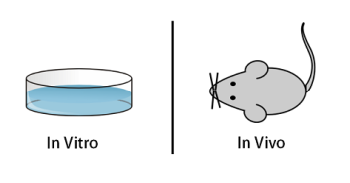
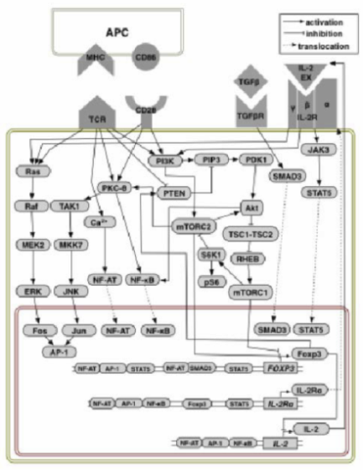
Steering a patient’s own immune system
“Opponent” = one’s own T cell population
Tune it to fight cancer, autoimmune disease, infection, …
Actions of treater at any point in the game:
Block cytokine receptor signaling
Alter transcription factor expression
Add or remove cytokines
Reversible antisense translational repression
Can be done in combinations and for different durations
Plan

Slide 12
Applications beyond battling diseases
Cell repurposing
Could one evolve
a blood cell into a liver cell
a cancer cell (T47D) into a (M1) macrophage
…
Could one grow a missing organ or limb?
Synthetic biology
Evolve bacteria that eat toxins or biofilms without introducing foreign genetic material

Slide 13
Tackling questions in natural science
Enables one to formalize and potentially answer fundamental questions in natural science
Can a certain kind of cell be transformed into a certain other kind of cell using evolutionary pressures using a given set of manipulations?
How much more power do multi-step treatment plans offer?
Does there exist a strategy that will destroy a given diverse cell population (e.g., cancer) in a way that leaves no persistors?
What is inherently impossible to achieve via evolution?
Notes:
Strategy (that uses only a given set of available manipulations and tests)

