Slide 1
The OPTN Kidney Paired Donation Pilot Program (KPDPP): Reaching the Tipping Point in 2013
Ruthanne Leishman, RN,MPH¹, Darren Stewart, MS¹, Catherine Monstello, CPHQ¹, Wida Cherikh, PhD¹, Tuomas Sandholm, PhD², Rich Formica, MD³ and Mark Aeder, MD⁴. ¹UNOS, Richmond, VA; ²Carnegie Mellon Univ, Pittsburgh, PA; ³Yale Univ, New Haven, CT and ⁴Univ Hosp Case Med Ctr, Cleveland, OH.
2014
World Transplant Congress
San Francisco

Slide 2
Financial Disclosure Statement
I have no financial relationships to disclose within the past 12 months relevant to my presentation.
Notes:
I have no disclosures.

Slide 3
Acknowledgments
This analysis reflects work performed on behalf of and in conjunction with the OPTN Kidney Transplantation Committee and the KPD Work Group.
This work was supported wholly or in part by Health Resources and Services Administration contract 234-2005-370011C. The content is the responsibility of the authors alone and does not necessarily reflect the views or policies of the Department of Health and Human Services, nor does mention of trade names, commercial products, or organizations imply endorsement by the U.S. Government.
Notes:
This work was supported by HRSA under the OPTN contract specified here, though the content is solely the responsibility of the authors.

Slide 4
Background
The OPTN KPDPP was launched in 2010
Centers enter candidates & donors into online system
Algorithms search for 2-way/3-way/chain exchanges
Policy and online system enhancements continue
Increases in participation, match offers, & transplants
Analyses based on OPTN KPD database
Notes:
The OPTN KPDPP was launched in 2010 the “valuable consideration” clause in NOTA was amended to exclude KPD
The program continues to make important policy and online system enhancements to increase transplant opportunities for patients with willing but incompatible living donors
This presentation highlights progress made by the OPTN KPDPP in participation, match offers, and txs.

Slide 5
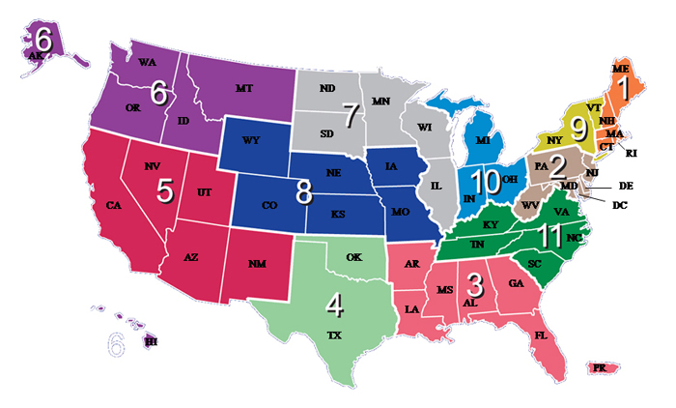
Participation by Region
Region | Programs/ Region
1 | 14/14
2 | 21/30
3 | 7/22
4 | 19/28
5 | 15/30
6 | 3/9
7 | 17/22
8 | 11/18
9 | 9/13
10 | 12/19
11 | 10/22
Total | 138/228
Notes:
Over 61%, or 138 of the 231 active U.S. living donor kidney programs, have signed agreements to participate in the OPTN KPDPP. All 11 OPTN/UNOS regions participating we have truly become a national program. Here you see the number of programs participating in relation to the total number in each region. The percentage of hospital participation in each region varies from 32-100% with an average of 60% per region participating.

Slide 6
The Tipping Point
Innovation Theory
Notes:
Malcolm Gladwell popularized Everett Roger’s theory of diffusion of innovations in his best selling book The tipping point. The Tipping Point indicating where a new idea or approach ‘catches fire’

Slide 7
The “Diffusion Curve”: Reaching the Tipping Point
Tipping Point
Innovation Theory
Notes:
The tipping point is generally achieved when about 20% of a population adopts a new initiative

Slide 8
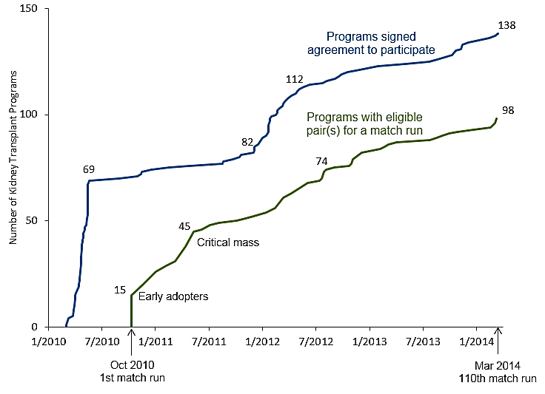
Rate of Adoption of the OPTN KPDPP
Tipping Point
Notes:
Over 61%, of the active U.S. living donor kidney programs, have signed agreements to participate in the OPTN KPDPP –and more importantly 98 programs having entered at least one donor/candidate pair into a match run

Slide 9
Sharply Increasing Number of Transplants
As of July 24: 110 transplants
Notes:
As the program has grown with increased center participation, we are also continuing to increase the number of transplants facilitated. The first two transplants occurred in December 2010, and by the end of 2011 we had 17 total transplants. By the end of 2012, 27 transplants had been facilitated, but 2013 is when the program really took off, resulting in an additional 52 transplants, for a total of 79 through the end of 2013. As of just last week, 110 transplants have taken place.

Slide 10
Improving Match Success Rates
Success rates have improved, but work still needed. Overall, about 10% of matches resulting in transplant.
Notes:
This increase in transplant can be attributed to multiple improvements in the OPTN KPDPP, most notably, the increased number of matches being found coupled with a rise in the match success rate. Match success rates are defined as the percentage of matches (one TC and his matched donor) that were accepted and led to a transplant.
DATA: from 3% in 2012 to 10% in 2013.

Slide 11
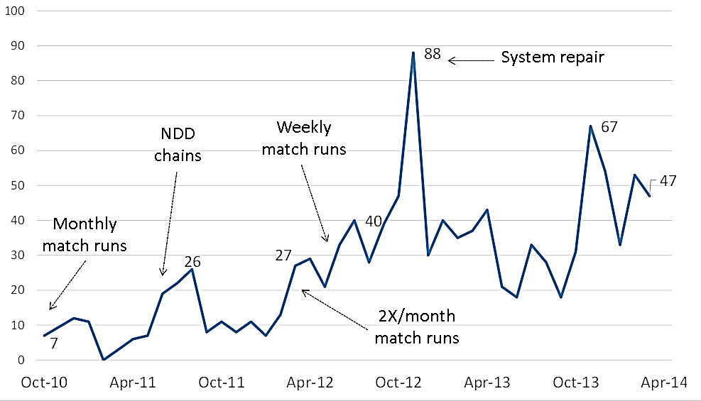
Matches Found Per Month
Average of 44 match offers sent per month in 2014.
Notes:
The other factor I mentioned that is helping to increase the # of transplants is the increases in matches found per month. Increasing the match run frequency has created more match opportunities for everyone in the system with an average of 44 matches offered each month in 2014, compared to 2012 where our average was less than 30 (???). We are currently running our matches 2x/week through the end of August, when we will evaluate its effect on number of people transplanted.

Slide 12
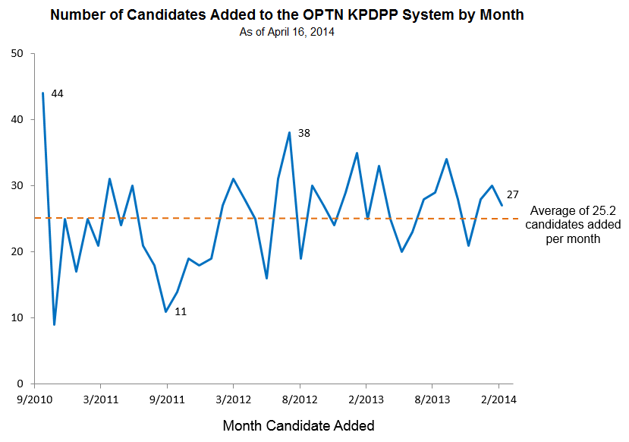
Trends in Candidates Added to OPTN KPD System
Over 1,000 candidates have been added so far.
Notes:
In addition to increased frequency of match runs, matches offered has improved due to an increase in the number of candidates added to the system each month, with a total average of 25. The first quarter 2014 with its monthly average of 28 candidates added, reflects the continued growth of the program.

Slide 13
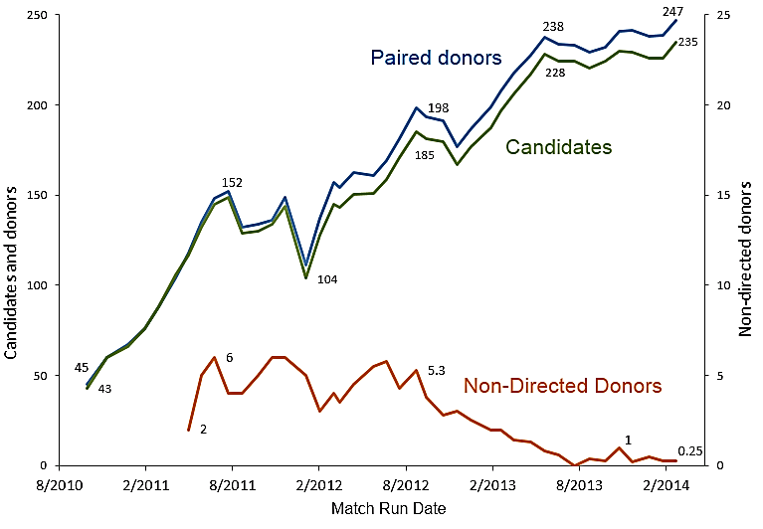
Average # of Eligible Candidates and Donors per Match Run
Consistently ~250 pairs entered into each match run.
Notes:
This increase in monthly additions has dramatically improved the number of candidate-donor pairs eligible for each match run since KPDPP first started. In the first quarter of 2014, the numbers had grown to average 247 donors and 235 candidates per match run, with a record of 270 donors and 256 candidates included in a recent match run.
The KPD Work Group continues to explore ways to encourage programs to enter NDDs into the system, including providing the option of bridge donation. In bridge donation, a paired donor at the end of a chain can opt to become a non-directed donor in a future match run, turning a short chain into a potentially much longer chain that will result in more patients receiving transplants Just a few weeks ago, we had our first bridge donor opt to become an NDD, which extended their chain by matching with an O candidate.

Slide 14
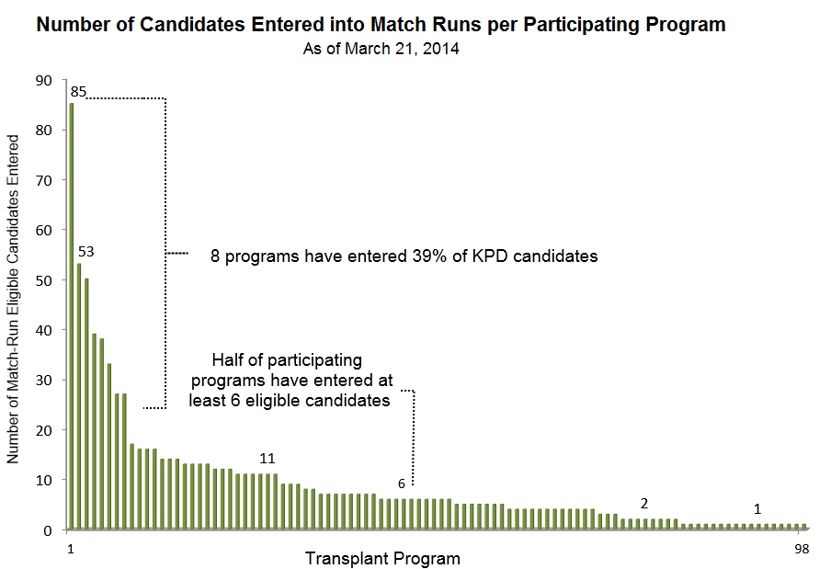
Eligible Candidates by Program
Wide range in participation among the 98 programs.
Notes:
The number of candidates entered by each transplant hospitals varies greatly with just 8 programs having entered 39% of candidates, ½ having entered at least 6 candidates, and the remaining ½ entering only 1-5 candidates. So we still have some work to do with hospitals entering more pairs into the system

Slide 15
Summary
Increase hospital participation Increase number of pairs
= Increase number of transplants
Notes:
In Summary – increase in transplant program participation has led to an increase in pair in each match run which has increased the number of transplants

Slide 16
Conclusion
The OPTN KPDPP is a robust, increasingly successful KPD program available to all LKD programs.
Reached a ‘tipping point’ with the majority of the U.S. LD transplant programs participating
Reached another ‘tipping point’ with 52 transplants in 2013
Consistent pool of around 250 pairs for each match run
Continue to work on ways to increase the match success rate
Notes:
The OPTN KPDPP is a robust, increasingly successful KPD program available to all LKD programs. We have reached a tipping point in terms of number of transplant hospitals participating and the number of transplants facilitated. With a consistent pool of around 250 pairs for each math run, we are continuing to work on improving participation and match success rate.

Slide 17
2013-2014 KPD Work Group
Mark Aeder, MD (Chair)
John Friedewald, MD
Richard Formica Jr., MD
Adam Bingaman, MD, Ph.D
Mary Amanda Dew, Ph.D
Matthew Cooper, MD
Lloyd Ratner, MD
Mariza Turner, RN
Mary Leffell, Ph.D
Gene Ridolfi
Nancy Reinsmoen, Ph.D, D(ABHI)
Pat McDonough, RN, CPTC, CCTC
Michael Rees, MD, Ph.D
Mike Gallichio, MD
Eric Gibney, MD
Alvin Roth, Ph.D
Stuart Flechner, MD, JSWG Chair
Sommer Gentry, Ph.D, TA
Tuomas Sandholm, Ph.D, TA
Itai Ashlagi, Ph.D, TA
JSWG = Joint Societies Work Group; TA = Technical Advisor
Notes:
I would also like to thank our workgroup and all the member of our subcommittees for all the work they are doing to help with the success of the OPTN KPD program.

