Slide 1

Kidney Exchange
With an emphasis on computation & work from CMU
John P. Dickerson
15-892 – Foundations of Electronic Marketplaces

Slide 2


This talk
Motivation – sourcing organs for needy patients
Computational dimensions of organ exchange
  Dimension #1: Post-match failure
  Dimension #2: Egalitarianism
  Dimension #3: Dynamism
FutureMatch framework
  Preliminary results from CMU on real data
Take-home message & future research
  Ongoing: multi-organ exchange, stochastic matching, competing exchanges, …
This is a fairly CMU-centric lecture because some of it is on my thesis work, but I am happy to talk about anything related to kidney exchange!

Slide 3
High-Level Motivation
Organ Failure
Kidney Failure

Slide 4

Kidney transplantation in the US
US waitlist: over 100,000
  36,395 added in 2013
4,421 people died while waiting
11,152 people received a kidney from the deceased donor waitlist
5,264 people received a kidney from a living donor
  Some through kidney exchanges!
  Our software runs UNOS national kidney exchange

Slide 5




Wife
Husband
Donors
Patients
Friend
Friend
(2- and 3-cycles, all surgeries performed simultaneously)

Slide 6
Non-directed donors & chains
NDD
D1
D2
D3
…
P1
P2
P3
Not executed simultaneously, so no length cap required based on logistic concerns

Slide 7
Fielded exchanges around the world
NEPKE (started 2003/2004, now closed)
United Network for Organ Sharing (UNOS)
  US-wide, 140+ transplant centers
  Went live Oct. 2010, conducts biweekly matches
Alliance for Paired Donation
Paired Donation Network (now closed)
National Kidney Registry (NKR)
San Antonio
Canada
Netherlands
England
Portugal (just started!)
Israel (about to start)
Others …?
Around 1000 transplants in US, driven by chains!
(Current as of late 2014)

Slide 8
Clearing problem
k-cycle (k-chain): a cycle (chain) over k vertices in the graph such that each candidate obtains the organ of the neighboring donor
The clearing problem is to find the “best” disjoint collection consisting of cycles of length at most L, and chains
  Typically, 2 ≤ L ≤ 5 for kidneys (e.g., L=3 at UNOS)
3
1
2

Slide 9
Hardness & formulation
“Best” = maximum cardinality
L=2: polynomial time
L>2: NP-complete [Abraham, Blum, Sandholm 2007]
  Significant gains from using L>2
State of the art (national kidney exchange):
  L=3
  Formulate as MIP, one decision variable per cycle
  Specialized branch-and-price can scale to 10,000 patient-donor pairs (cycles only) [Abraham, Blum, Sandholm 2007]
  Harder in practice (+chains)

Slide 10
Basic IP formulation #1
“Best” = maximum cardinality
Binary variable x_{ij} for each edge from i to j
Maximize
Σ x_{ij}
Subject to
Σ_{j} x_{ij} = Σ_{j} x_{ji} for each vertex i
Σ_{j} x_{ij} ≤ 1 for each vertex i
Σ_{1≤k≤L} x_{i(k)i(k+1)} ≤ L-1 for paths i(1)…i(L+1)
(no path of length L that doesn’t end where it started – cycle cap)

Slide 11
Basic IP formulation #2
“Best” = maximum cardinality
Binary variable x_{c} for each cycle/chain c of length at most L
Maximize
Σ |c|x_{c}
Subject to
Σ_{c : i in c} x_{c} ≤ 1 for each vertex i

Slide 12
Comparison
“Best” = maximum cardinality
IP #1 is the most basic edge formulation
IP #2 is the most basic cycle formulation
Tradeoffs in number of variables, constraints
  IP #1: O(|E|^{L}) constraints vs. O(|V|) for IP #2
  IP #1: O(|V|²) variables vs. O(|V|^{L}) for IP #2
IP #2’s relaxation is weakly tighter than #1’s. Quick intuition in one direction:
  Take a length L+1 cycle. #2’s LP relaxation is 0.
  #1’s LP relaxation is (L+1)/2 – ½ on each edge

Slide 13
The big problem
What is “best”?
  Maximize matches right now or over time?
  Maximize transplants or matches?
  Prioritization schemes (i.e. fairness)?
  Modeling choices?
  Incentives? Ethics? Legality?
Optimization can handle this, but may be inflexible in hard-to-understand ways
Want humans in the loop at a high level (and then CS/Opt handles the implementation)

Slide 14
Dimension #1: Post-Match Failure

Slide 15
Matched ≠ Transplanted
Only around 8% of UNOS matches resulted in an actual transplant
  Similarly low % in other exchanges [ATC 2013]
Many reasons for this. How to handle?
One way: encode probability of transplantation rather than just feasibility
  for individuals, cycles, chains, and full matchings

Slide 16
Failure-aware model
Compatibility graph G
  Edge (v_{i}, v_{j}) if v_{i}’s donor can donate to v_{j}’s patient
  Weight w_{e} on each edge e
Success probability q_{e} for each edge e
Discounted utility of cycle c
u(c) = ∑w_{e} • ∏q_{e}
Value of successful cycle
Probability of success

Slide 17
Failure-aware model
Discounted utility of a k-chain c
Cannot simply “reweight by failure probability”
Utility of a match M: u(M) = ∑ u(c)
Exactly first i transplants
Chain executes in entirety

Slide 18
Our problem
Discounted clearing problem is to find matching M* with highest discounted utility
Maximum cardinality
3
Maximum expected transplants
1
2

Slide 19
Theoretical result #1

Slide 20
G(n, t(n), p): random graph with
  n patient-donor pairs
  t(n) altruistic donors
  Probability Θ(1/n) of incoming edges
Constant transplant success probability q
Theorem
For all q∈ (0,1) and α, β > 0, given a large G(n, αn, β/n), w.h.p. there exists some matching M’ s.t. for every maximum cardinality matching M,
u_{q}(M’) ≥ u_{q}(M) + Ω(n)

Slide 21
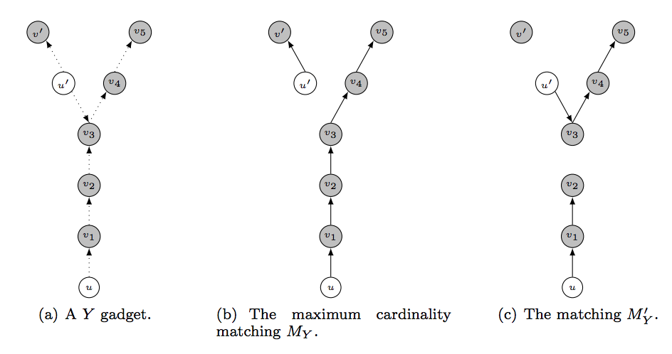
Brief intuition: Counting Y-gadgets
For every structure X of constant size, w.h.p. can find Ω(n) structures isomorphic to X and isolated from the rest of the graph
Label them (alt vs. pair): flip weighted coins, constant fraction are labeled correctly → constant × Ω(n) = Ω(n)
Direct the edges: flip 50/50 coins, constant fraction are entirely directed correctly → constant × Ω(n) = Ω(n)

Slide 22
In theory, we’re losing out on expected actual transplants by maximizing match cardinality.
… What about in practice?

Slide 23
UNOS
2010-2014

Slide 24
Solving this new problem
Real-world kidney exchanges are still small
  UNOS pool: 281 donors, 260 patients [2 Feb 2015]
Undiscounted clearing problem is NP-hard when cycle/chain cap L ≥ 3 [Abraham et al. 2007]
  Special case of our problem
The current UNOS solver will not scale to the projected nationwide steady-state of 10,000
  Empirical intractability driven by chains

Slide 25
We can’t use the current solver
Branch-and-bound IP solvers use upper and lower bounds to prune subtrees during search
Upper bound: cycle cover with no length cap
  PTIME through max weighted perfect matching
Proposition:
The unrestricted discounted maximum cycle cover problem is NP-hard.
(Reduction from 3D-Matching)

Slide 26
Incrementally solving very large IPs
#Decision variables grows linearly with #cycles and #chains in the pool
  Millions, billions of variables
  Too large to fit in memory
Branch-and-price incrementally brings variables into a reduced model [Barnhart et al. 1998]
Solves the “pricing problem” – each variable gets a real-valued price
  Positive price → resp. constraint in full model violated
  No positive price cycles → optimality at this node

Slide 27
Considering only “good” chains
Theorem:
Given a chain c, any extension c’ will not be needed in an optimal solution if the infinite extension has non-positive value.
Optimistic future value of infinite extension
Donation to waitlist
Discounted utility of current chain
Pessimistic sum of LP dual values in model

Slide 28
Scaling experiments
|V| | CPLEX | Ours | Ours without chain curtailing
10 | 127 / 128 | 128 / 128 | 128 / 128
25 | 125 / 128 | 128 / 128 | 128 / 128
50 | 105 / 128 | 128 / 128 | 125 / 128
75 | 91 / 128 | 126 / 128 | 123 / 128
100 | 1 / 128 | 121 / 128 | 121 / 128
150 |  | 114 / 128 | 95 / 128
200 |  | 113 / 128 | 76 / 128
250 |  | 94 / 128 | 48 / 128
500 |  | 107 / 128 | 1 / 128
700 |  | 115 / 128
900 |  | 38 / 128
1000
Runtime limited to 60 minutes; each instance given 8GB of RAM.
|V| represents #patient-donor pairs; additionally, 0.1|V| altruistic donors are present.

Slide 29
In theory and practice, we’re helping the global bottom line by considering post-match failure …
… But can this hurt some individuals?

Slide 30
Dimension #2: Egalitarianism

Slide 31
Sensitization at UNOS
Highly-sensitized patients: unlikely to be compatible with a random donor
Deceased donor waitlist: 17%
Kidney exchanges: much higher (60%+)
“Easy to match” patients
“Hard to match” patients

Slide 32
Price of fairness
Efficiency vs. fairness:
  Utilitarian objectives may favor certain classes at the expense of marginalizing others
  Fair objectives may sacrifice efficiency in the name of egalitarianism
Price of fairness: relative system efficiency loss under a fair allocation [Bertismas, Farias, Trichakis 2011]
[Caragiannis et al. 2009]

Slide 33




Price of fairness in kidney exchange
Recall: want a matching M* that maximizes utility function
Price of fairness: relative loss of match efficiency due to fair utility function

Slide 34
Theoretical result #2

Slide 35


Under the “most stringent” fairness rule:
Theorem
Assume “reasonable” level of sensitization and “reasonable” distribution of blood types. Then, almost surely as n → ∞,
(And this is achieved using cycles of length at most 3.)

Slide 36
Linear efficiency loss
Sublinear loss
Notes:
Under- and self-demanded pairs are white, over-demanded pairs are gray, and reciprocal pairs are black.
Regular edges appear in the efficient matching, while dashed edges represent 3-cycles from the efficient matching that may be disturbed via fair matching.

Slide 37
From theory to practice
Price of fairness is low in theory
Fairness criterion: extremely strict.
Theoretical assumptions (standard):
  Big graphs (“n → ∞”)
  Dense graphs
  Cycles (no chains)
  No post-match failures
  Simplified patient-donor features
What about the price of fairness in practice?

Slide 38
Toward usable fairness rules
In healthcare, important to work within (or near to) the constraints of the fielded system
  [Bertsimas, Farias, Trichakis 2013]
  Our experience with UNOS
We now present two (simple, intuitive) rules:
  Lexicographic: strict ordering over vertex types
  Weighted: implementation of “priority points”

Slide 39
Lexicographic fairness
Find the best match that includes at least α fraction of highly-sensitized patients.
Matching-wide constraint:
  Present-day branch-and-price IP solvers rely on an “easy” way to solve the pricing problem
  Lexicographic constraints → pricing problem requires an IP solve, too!
Strong guarantee on match composition …
  … but harder to predict effect on efficiency

Slide 40
Weighted fairness
Value matching a highly-sensitized patient at (1+β) that of a lowly-sensitized patient, β>0
Re-weighting is a preprocess → works with all present-day kidney exchange solvers
Difficult to find a “good” β?
  Empirical exploration helps strike a balance

Slide 41
Theory vs. “Practice”
Lexicographic fairness

Slide 42
Price of fairness: Generated data
Size | Saidman (US) | Saidman (UNOS) | Heterogeneous
10 | 0.24% (1.98%) | 0.00% (0.00%) | 0.98% (5.27%)
25 | 0.58% (1.90%) | 0.19% (1.75%) | 0.00% (0.00%)
50 | 1.18% (2.34%) | 1.96% (6.69%) | 0.00% (0.00%)
100 | 1.46% (1.80%) | 1.66% (3.64%) | 0.00% (0.00%)
150 | 1.20% (1.86%) | 2.04% (2.51%) | 0.00% (0.00%)
200 | 1.43% (2.08%) | 1.55% (1.79%) | 0.00% (0.00%)
250 | 0.80% (1.24%) | 1.86% (1.63%) | 0.00% (0.00%)
500 | 0.72% (0.74%) | 1.67% (0.82%) | 0.00% (0.00%)
Average (st.dev.) % loss in efficiency for three families of random graphs, under the strict lexicographic rule.
Good: aligns with the theory
Bad: standard generated models aren’t realistic

Slide 43
Real UNOS runs
Lexicographic fairness, varying failure rates

Slide 45
Real UNOS runs
Weighted fairness, varying failure rates

Slide 47
Contradictory goals
Earlier, we saw failure-aware matching results in tremendous gains in #expected transplants
Gain comes at a price – may further marginalize hard-to-match patients because:
  Highly-sensitized patients tend to be matched in chains
  Highly-sensitized patients may have higher failure rates (in APD data, not in UNOS data)

Slide 48
Real UNOS runs, weighted fairness, constant probability of failure (x-axis), increase in expected transplants over deterministic matching (y-axis)

Slide 49
UNOS distributional generator
Generated UNOS runs, weighted fairness, constant probability of failure (x-axis), increase in expected transplants over deterministic matching (y-axis)

Slide 50
APD failure rate
UNOS failure rate
Generated (top row) and real (bottom row) UNOS runs, weighted fairness (x-axis), bimodal failure probability (APD failures in left column, UNOS failures in right column), increase in expected transplants over deterministic matching (y-axis)

Slide 51
Fairness vs. efficiency can be balanced in theory and in practice in a static model …
… But how should we match over time?

Slide 52
Dimension #3: Dynamism

Slide 53
Dynamic kidney exchange
Kidney exchange is a naturally dynamic event
Can be described by the evolution of its graph:
  Additions, removals of edges and vertices
Vertex Removal | Edge Removal | Vertex/Edge Add
Transplant, this exchange | Matched, positive crossmatch | Normal entrance
Transplant, deceased donor waitlist | Matched, candidate refuses donor
Transplant, other exchange ("sniped") | Matched, donor refuses candidate
Death or illness | Pregnancy, sickness changes HLA
Altruist runs out of patience
Bridge donor reneges

Slide 54
Our dynamic model
Exits
Stays
Enters

Slide 55
Dynamic matching via potentials
Full optimization problem is very difficult
  Realistic theory is too complex
  Trajectory-based methods do not scale
Approximation idea:
  Associate with each “element type” its potential to help objective in the future
  (Must learn these potentials)
  Combine potentials with edge weights, perform myopic maximum utility matching

Slide 56
What’s a potential?
Given a set of features Θ representing structural elements (e.g., vertex, edge, subgraph type) of a problem:
  The potential P_{θ} for a type θ quantifies the future usefulness of that element
E.g., let Θ = {O-O, O-A, …, AB-AB, •-O, …, •-AB}
  16 patient-donor types, 4 altruist types
  O-donors better than A-donors, so: P_{•-O} > P_{•-A}

Slide 57
Using potentials to inform myopia
Using heavy one-time computation to learn potential of each type θ
Adjust solver to take them into account at runtime
  E.g., P_{•-O} = 2.1 and P_{O-AB} = 0.1
  Edges between O-altruist and O-AB pair has weight: 1 – 0.5(2.1+0.1) = -0.1
  Chain must be long enough to offset negative weight

Slide 58
Potentials: simple example
Potentials assigned only on whether or not a vertex is an altruist
Two time periods
Notes:
Altruist a and pairs p₁ and p₂ are in the pool for both time periods, pair p₃ arrives in the second period
Myopic matching: use a to match p₁ and p₂; leaves p₃ unmatched
Assign positive potential to a: no match in period one, then
Matches a with p₁, p₂, and p₃ in period two (if potential is “medium”)
Matches p₁, p₂, and p₃ in a cycle without a (if a’s potential is high)

Slide 59
Expressiveness tradeoff
In kidney exchange:
  20 vertex types
  244 edge types (208 cyclic edges, 36 chain edges)
  1000s of 3-cycle types, et cetera.
Allowing larger structural elements:
  increases expressive power of potentials
  increases size of hypothesis space to explore
Expressiveness Theory
Vertex vs. Edge: lose at least 1/3
Edge vs. Cycle: lose at least ½
Cycle vs. Graph: lose at least (L-1)/L
Is it that bad in practice?

Slide 60
Simulation results
Vertex potentials

Slide 62
We can learn to maximize a utility function over time (negative theory, positive experiments) …
… But how should we choose an objective?

Slide 63
FutureMatch
A framework for learning to match in dynamic environments
[Dickerson Sandholm AAAI-2015]

Slide 64
Balancing failure and fairness
Saw that we can strike a balance realizing gains of both matching methods
Highly dependent on distribution of graphs
Useful empirical visualization tool for policymakers needing to, e.g., define “acceptable” price of fairness
What about fairness-aware, failure-aware, dynamic matching?

Slide 65
FutureMatch: Learning to match in dynamic environments
Offline (run once or periodically)
Domain expert describes overall goal
Take historical data and policy input to learn a weight function w for match quality
Take historical data and create a graph generator with edge weights set by w
Using this generator and a realistic exchange simulator, learn potentials for graph elements as a function of the exchange dynamics
Online (run every match)
Combine w and potentials to form new edge weights on real input graphs
Solve maximum weighted matching and return match

Slide 66
Example objective: MaxLife
Maximize the aggregate length of time donor organs will last in patients …
  … with fairness “nobs”, failure-awareness, etc.
Learn survival rates from all living donations in US since 1987 (~75k trans.)
Translate to edge weight
Learn potentials, then combine into new weights

Slide 67
The details are in the paper, but …
We show it is possible to:
  Increase overall #transplants a lot at a (much) smaller decrease in #marginalized transplants
  Increase #marginalized transplants a lot at no or very low decrease in overall #transplants
  Increase both #transplants and #marginalized
Again, sweet spot depends on distribution:
  Luckily, we can generate – and learn from – realistic families of graphs!

Slide 68
Take-home message
Contradictory wants in kidney exchange!
In practice, can (automatically) strike a balance between these wants
  Keeps the human in the loop
Some improvements (e.g., failure-awareness) are unilaterally good, given the right balance with other wants

Slide 69
Lots left to do!
Fairness:
  Theoretical guarantees in better models
  More general definitions
Modeling:
  More accurate models (multiple exchanges, legality, more features on patient/donor)
Dynamics:
  Better optimization methods
  Faster “means vs. ends” loop with humans
Better static optimization methods also help here!

Slide 70
Better static optimization methods
Recall two main methods for solving big IPs for kidney exchange:
  Branch-and-price = B&B + column generation
  Constraint generation
Many different ways to do these:
  E.g., how do I solve the pricing problem?
  E.g., which constraints should I add to the model?
Big runtime changes [Anderson et al. PNAS-2015, Glorie et al. MSOM-2014]

Slide 71
Review: Edge formulation
Objective = maximum cardinality
Binary variable x_{ij} for each edge from i to j
Maximize
Σ x_{ij}
Subject to
Σ_{j} x_{ij} = Σ_{j} x_{ji} for each vertex i
Σ_{j} x_{ij} ≤ 1 for each vertex i
Σ_{1≤k≤L} x_{i(k)i(k+1)} ≤ L-1 for paths i(1)…i(L+1)
(no path of length L that doesn’t end where it started – cycle cap)

Slide 72
State of the art for edge formulation
[Anderson et al. PNAS-2015]
Builds on the prize-collecting traveling salesperson problem [Balas Networks-89]
  PC-TSP: visit each city (patient-donor pair) exactly once, but with the additional option to pay some penalty to skip a city (penalized for leaving pairs unmatched)
They maintain decision variables for all cycles of length at most L, but build chains in the final solution from decision variables associated with individual edges
Then, an exponential number of constraints could be required to prevent the solver from including chains of length greater than K; these are generated incrementally until optimality is proved.
  Leverage cut generation from PC-TSP literature to provide stronger (i.e. tighter) IP formulation

Slide 73
Review: Cycle formulation
Objective = maximum cardinality
Binary variable x_{c} for each cycle/chain c of length at most L
Maximize
Σ |c|x_{c}
Subject to
Σ_{c : i in c} x_{c} ≤ 1 for each vertex i

Slide 74
DFS to solve pricing problem
[Abraham et al. PNAS-2015]
Pricing problem:
  Optimal dual solution π* to reduced model
  Find non-basic variables with positive price (for a maximization problem)
    0 < weight of cycle – sum of duals in π* of constituent vertices
First approach [Abraham et al. EC-2007] explicitly prices all feasible cycles and chains through a DFS
  Can speed this up in various ways, but proving no positive price cycles exist still takes time poly in chain/cycle cap = bad for even reasonable caps

Slide 75
Modified Bellman-Ford for pricing
[Glorie et al. MSOM-2014, Plaut et al. AAAI-2016]
Idea: solve a structured alternate optimization problem that implicitly prices variables
Price (for max card, weight): w_{c} – Σ_{v in c} δ_{v}
  But: w_{c} = Σ_{e in c} w_{e}
Take G=(V,E), create G’=(V,E) s.t. all edges e = (u,v) are reweighted r_{e} = δ_{v} – w_{e}
  Positive price cycles in G = negative weight cycles in G’
Bellman-Ford finds shortest paths
  Undefined in graphs with negative weight
  Adapt B-F to prevent internal looping
    Shortest path is NP-hard (reduce from Hamiltonian path:
      Set edge weights to -1, given edge (u,v) in E, ask if shortest path from u to v is weight 1-|V| → visits each vertex exactly once
    We only need some short path (or proof that no negative cycle exists)
  Now pricing runs in time O(|V||E|cap²)

Slide 76
Experimental results
Note: Anderson et al.’s algorithm (CG-TSP) is very strong for uncapped aka “infinite-length” chains, but a chain cap is often imposed in practice

Slide 77
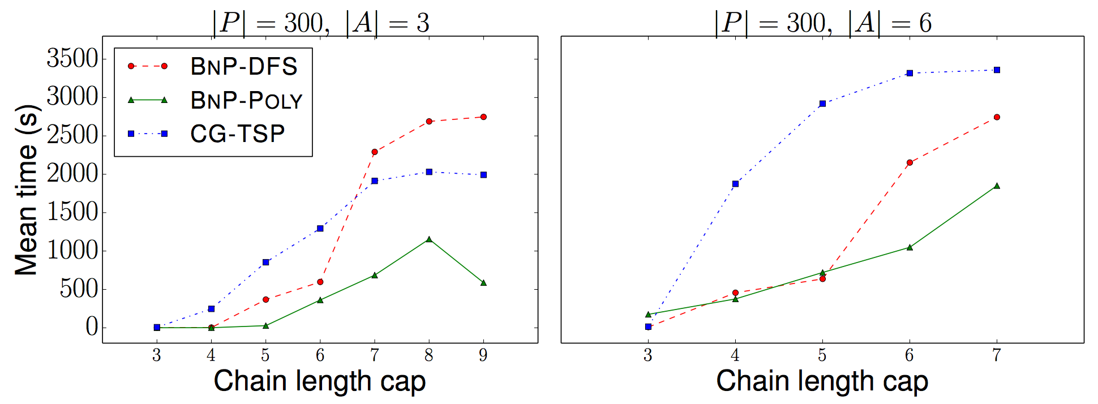
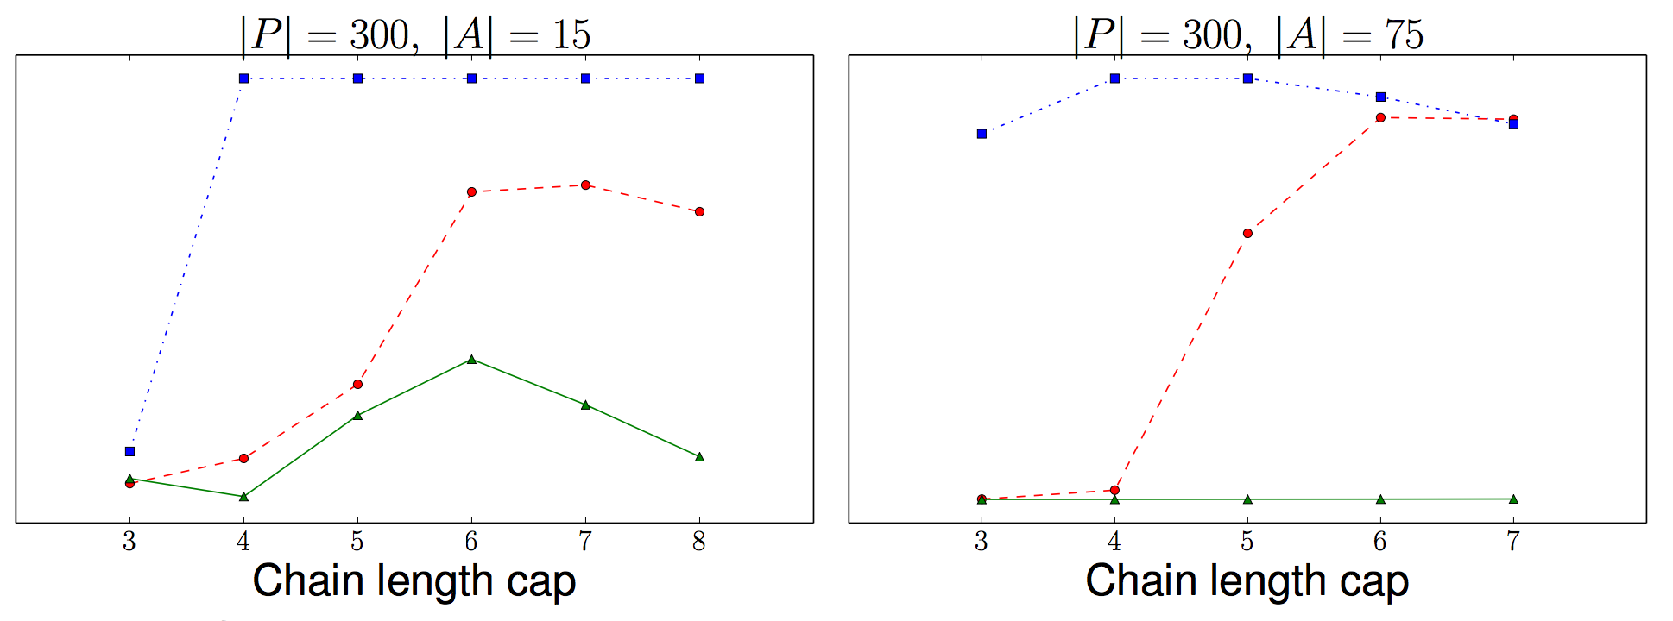
Experimental results

Slide 78
Ideas that are a bit further away from being put into practice
(but hopefully will be someday soon!)

Slide 79

Moving beyond kidneys
[Dickerson Sandholm AAAI-2014, JAIR-2016]
Chains are great! [Anderson et al. 2015, Ashlagi et al. 2014, Rees et al. 2009]
Kidney transplants are “easy” and popular:
  Many altruistic donors
Liver transplants: higher mortality, morbidity:
  (Essentially) no altruistic donors
P1
P2
P3
P4
…
Kidney
A
Kidney
Liver
Kidney
D1
D2
D3
D4

Slide 80
Would this help?
Theory: adapted Erdős-Rényi models
Dense model [Saidman et al. 2006]
  Constant probability of edge existing
  Less useful in practice [Ashlagi et al. 2012, Ashlagi Jaillet Manshadi 2013]
Sparse model [Ashlagi et al. 2012]
  1-λ fraction is highly-sensitized (p_{H} = c/n)
  λ fraction is lowly-sensitized (p_{L} > 0, constant)
Not all kidney donors want to give livers
  Constant probability p_{K→L} > 0
[Dickerson Procaccia Sandholm 2013, 2014]

Slide 81
Sparse graph, many altruists
n_{K} kidney pairs in graph D_{K}
n_{L} = γn_{K} liver pairs in graph D_{L}
Number of altruists t(n_{K})
Constant cycle cap z
Theorem
Assume t(n_{K}) = βn_{K} for some constant β>0. Then, with probability 1 as n_{K} → ∞,
Any efficient matching on D = join(D_{K},D_{L}) matches Ω(n_{K}) more pairs than the aggregate of efficient matchings on D_{K} and D_{L}.
Building on [Ashlagi et al. 2012]

Slide 82
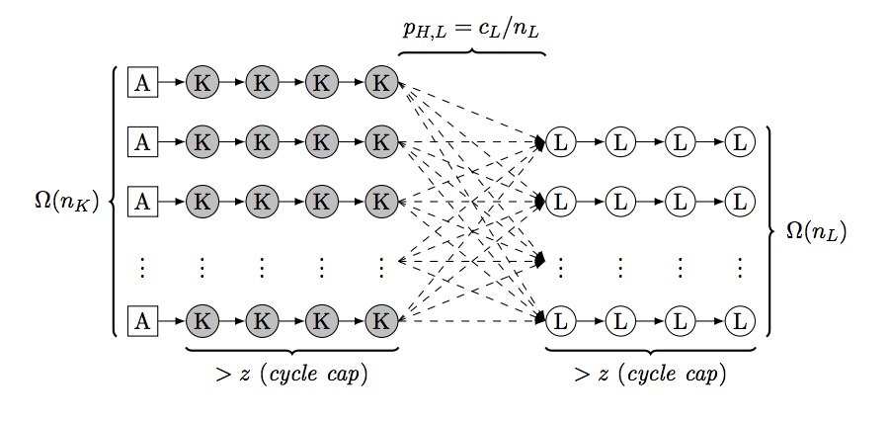
Intuition
Find a linear number of “good cycles” in D_{L} that are length > z
  Good cycles = isolated path in highly-sensitized portion of pool and exactly one node in low portion
Extend chains from D_{K} into the isolated paths (aka can’t be matched otherwise) in D_{L}, of which there are linearly many
  Have to worry about p_{K→L}, and compatibility between vertices
Show that a subset of the dotted edges below results in a linear-in-number-of-altruists max matching
  → linear number of D_{K} chains extended into D_{L}
  → linear number of previously unmatched D_{L} vertices matched

Slide 83
Sparse graph, few altruists
n_{K} kidney pairs in graph D_{K}
n_{L} = γn_{K} liver pairs in graph D_{L}
Number of altruists t – no longer depends on n_{K}!
λ is frac. lowly-sensitized
Constant cycle cap z
Theorem
Assume constant t. Then there exists λ’ > 0 s.t. for all λ < λ’
Any efficient matching on D = join(D_{K},D_{L}) matches Ω(n_{K}) more pairs than the aggregate of efficient matchings on D_{K} and D_{L}.
With constant positive probability.
Building on [Ashlagi et al. 2012]

Slide 84
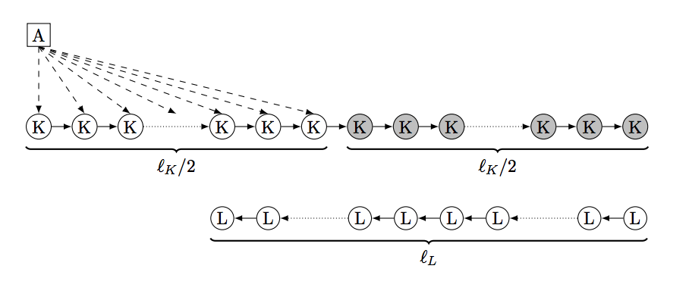
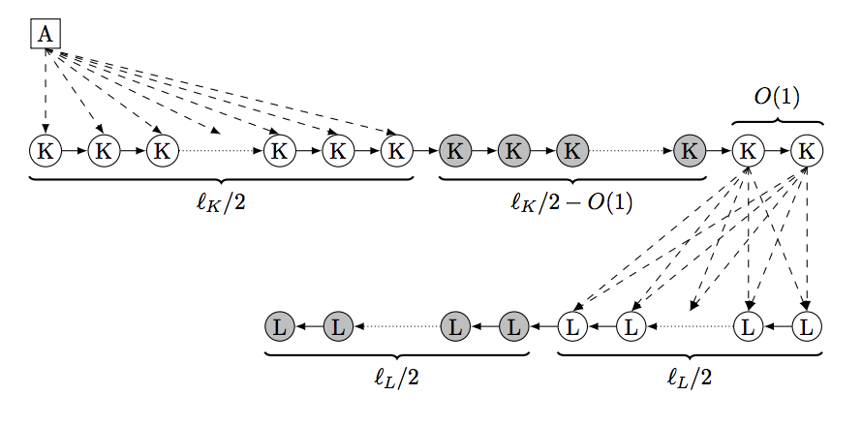
Intuition
For large enough λ (i.e., lots of sensitized patients), there exist pairs in D_{K} that can’t be matched in short cycles, thus only in chains
  Same deal with D_{L}, except there are no chains
Connect a long chain (+altruist) in D_{K} into an unmatchable long chain in D_{L}, such that a linear number of D_{L} pairs are now matched

Slide 85
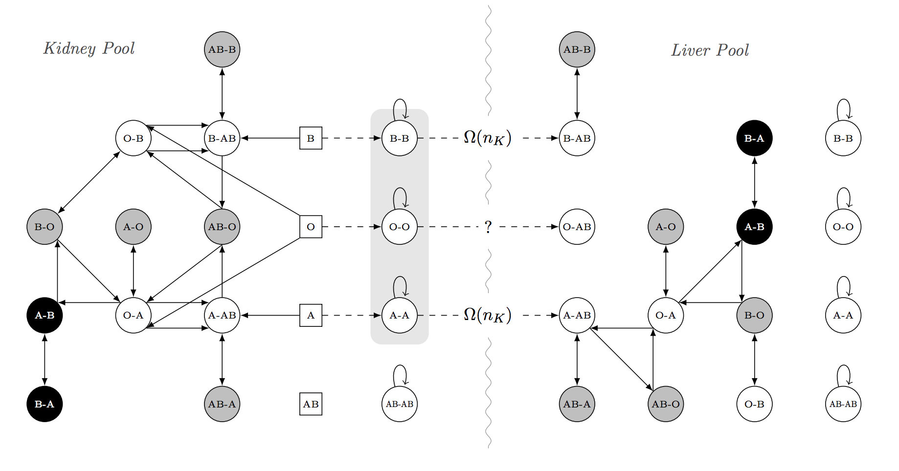
Dense graph, many altruists
Take efficient matching on the kidney exchange graph alone, extend a linear number of chains into the leftover pairs after an efficient matching in the liver exchange alone.

Slide 86
FutureMatch + multi-organ exchange?
Combination results in
  Linear gain in theory
  Big gains in simulation
Equity problems
  Kidneys ≠ livers
  Hard to quantify cross-organ risk vs. reward
Let FutureMatch sort it out?
Also: lung exchange!
[Ergin Sönmez Ünver 2015]

Slide 87
Stochastic matching and k-set packing with application to kidney exchange
[Blum et al. EC-2015]

Slide 88
Recall: Failure-aware matching
Theorem: In a sparse random graph model, for any failure probability p, w.h.p. there exists a matching that is “linearly better” than any max-cardinality matching
Practice: Solved via branch-and-price
  One binary decision variable per cycle/chain
  Upper-bounding is now NP-hard
  Pricing problem is (empirically) much easier.
Maybe this is a good idea …

Slide 89
Pre-match edge testing
Complementary idea: perform a small amount of testing before a match run to query for (non)existence of edges
  E.g., more extensive medical testing, donor interviews, surgeon interviews, etc.
Cast as a stochastic matching problem (special case of stochastic k-set packing):
Given a graph G(V,E), choose subset of edges S such that:
|M(S)| ≥ (1-ε) |M(E)|
Need: “sparse” S, where every vertex has O(1) incident tested edges

Slide 90
General theoretical results
Adaptive: select one edge per vertex per round, test, repeat
Stochastic matching:
(1-ε) approximation with O_{ε}(1) queries per vertex, in O_{ε}(1) rounds
Stochastic k-set packing:
(2/k – ε) approximation with O_{ε}(1) queries per vertex, in O_{ε}(1) rounds
Non-adaptive: select O(1) edges per vertex, test all at once
Stochastic matching:
(0.5-ε) approximation with O_{ε}(1) queries per vertex, in 1 round
Stochastic k-set packing:
(2/k – ε)² approximation with O_{ε}(1) queries per vertex, in 1 round

Slide 91
Adaptive algorithm
For R rounds, do:
Pick a max-cardinality matching M in graph G, minus already-queried edges that do not exist
Query all edges in M
Input Graph
r | Base graph | Matching picked | Result of queries
1:
2:

Slide 92
Intuition for adaptive algorithm
If at any round r, the best solution on edges queried so far is small relative to omniscient …
  ... then current structure admits large number of unqueried, disjoint augmenting structures
  For k=2, simply augmenting paths
Augmenting structures might not exist, but can query in parallel in a single round
  Structures are constant size → exist with constant probability
  Structures are disjoint → queries are independent
  → Close a constant gap per round

Slide 93
UNOS Data
Even 1 or 2 extra tests results in a huge lift in practice!

Slide 94
Competing Dynamic Matching Markets
Ongoing work with Das et al.

Slide 95
Motivation
Dynamic matching markets are typically modeled in isolation, with each agent entering a single market.
Real-world applications (e.g kidney exchange) often involve multiple matching platforms drawing from overlapping pools. Questions:
  Whether competing platforms increase global loss relative to a single centralized matching platform.
  How does one platform’s matching policy affect global loss in a multi-platform setting?
UNOS only
NKR only
Both
Notes:
I gonna talk about dynamic matching markets today. The typical models of dynamic matching (you have seen of them) will have the market being isolated in a single market, and all the agents are constrained to enter that particular market. Traditional research focuses on the effects of different rules in that market on the outcomes of the population.
However, in reality, for example in markets like kidney exchange, there exists multiple platforms that are competing and they may have overlapping pools of agents they are drawing from.
This work is the initial step for us to understand what goes on in these kind of competing markets. And the particular questions I goanna focus on in today’s talk are:
first, in these competing markets whether some measure of social welfare which in this case is global loss that is the number of agents who end up being unmatched is increased relative to when there is a single centralized clearinghouse.
And the second question we gonna look at is how the policy that is used by each of the markets in this competing setting affects these measures of social welfare /*such as global loss*/

Slide 96
Kidney exchange is dynamic
Patient-donor pairs (agents) arrive gradually over time
  Stay in the market to find a compatible pair
  May leave if the patient’s condition deteriorates to the point where kidney transplants become infeasible
Only considering undirected 2-matching so far
Notes:
Why do I say a kidney exchange is dynamic? It’s because, patient-donor paris, which are the agents, do not enter in a single time, instead, they arrive gradually over time.
They will stay in the market until they find a compatible pair, unless the patient situation is too bad that kidney transplants are no longer feasible. in which case that the agents leave the market.

Slide 97
Planner / Clearinghouse platform
Minimizes the number of agents who perish (leave the exchange without finding a match)
Knows agent’s expiration time
Has only probabilistic knowledge about future incoming agents
Selects a subset of acceptable transactions at any point in time
Notes:
So goal of the planner is to minimize number of the agents who do this which we call it perishing.
following Akubarpour et al, we assume that the planner knows each agent’s expiration time
And the planner has only probabilistic knowledge about the future incoming agents, that is she knows the distribution of the agents that incoming and the probability of edges being formed between two agents. But doesn’t know which agents will appear and who they will form edge with
select
The natural next question is what kind of algorithm to use for this matching?

Slide 98
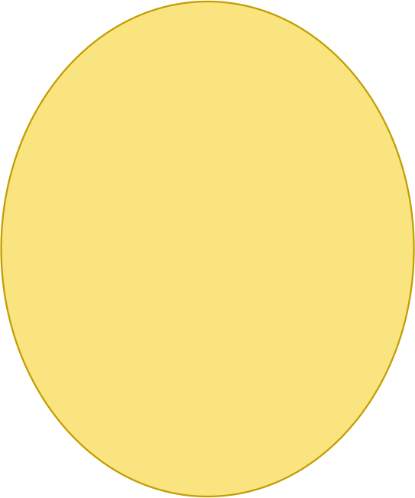
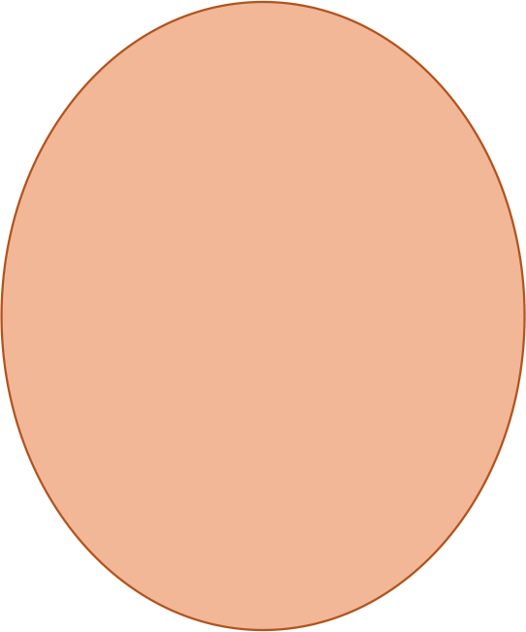
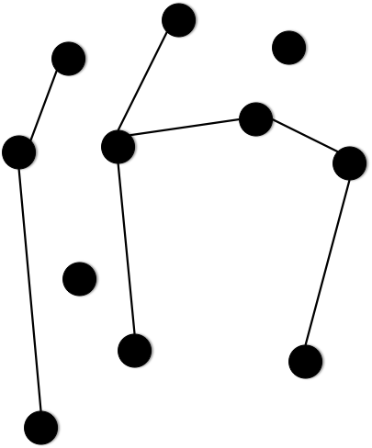
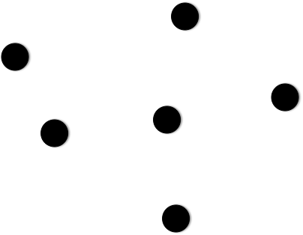
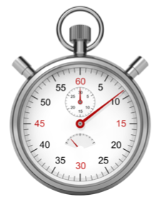

Greedy and patient exchanges
[Akbarpour et al., EC-14]
Greedy algorithm
Patient algorithm
Notes:
In akbarpour et al’s paper they analyze two approaches, namely, greedy and patient exchanges.

Slide 99


Greedy exchange
Greedy algorithm
Notes:
In the Greedy exchange, the only point at which the exchange tries to match is when an agent enters the market. If there are acceptable transactions between that agent and any others in the market, the exchange will randomly chose one, and these two agents leaves.
/*each entering agent immediately by selecting one of its neighbors (if a neighbor exists at the time of entry) uniformly at random. One obvious consequence of this is that the remaining graph of unmatched agents at any instant is always empty. */

Slide 100
Patient exchange
Critical
Patient algorithm
Notes:
The Patient exchange will allow the agents to accumulate in the market even if there are edges between them. When an agent becomes critical that is she is about to perish which is known by the planner, if there are edges from this agent to others, again, randomly pick one and these two agents leave.
attempts to match each agent only at the instant she becomes critical. As with Greedy, if a critical agent has multiple neighbors, only one is selected uniformly at random.
解释critical: here we define the agent is critical at the point that she is about to perish

Slide 101

Greedy and patient exchanges
Loss
≥
Greedy algorithm
Patient algorithm
[Akbarpour et al., EC-14]
Notes:
we can get the Greedy exchange has substantially higher loss comparing to the Patient exchange

Slide 102

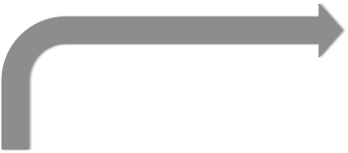







Competing exchanges
Patient algorithm
How do interactions between overlapping pools, different policies affect social welfare?
Greedy algorithm
Notes:
The central question of this paper is what happens in a situation where a greedy exchange and a patient exchange exist simultaneously and compete with each other to match some shared portion of the population.
How the global welfare is affected

Slide 103
Model details
Agents (patient-donor pairs) arrive at the market according to a Poisson process, with rate parameter m ≥ 1
The sojourn of an agent is drawn from an exponential distribution, with rate parameter λ = 1
Pr(acceptable transaction) = d/m, 0 ≤ d ≤ m
Average degree of node in graph
Notes:
Here if some details of model.
following akubarpour et al, we define the sojourn of an agent is the time until expiring.
Recall that the edge is formed between two agents if they are compatible for a match. d is the average degree of an agent in the graph thus formed, we set d to be smaller than m

Slide 104
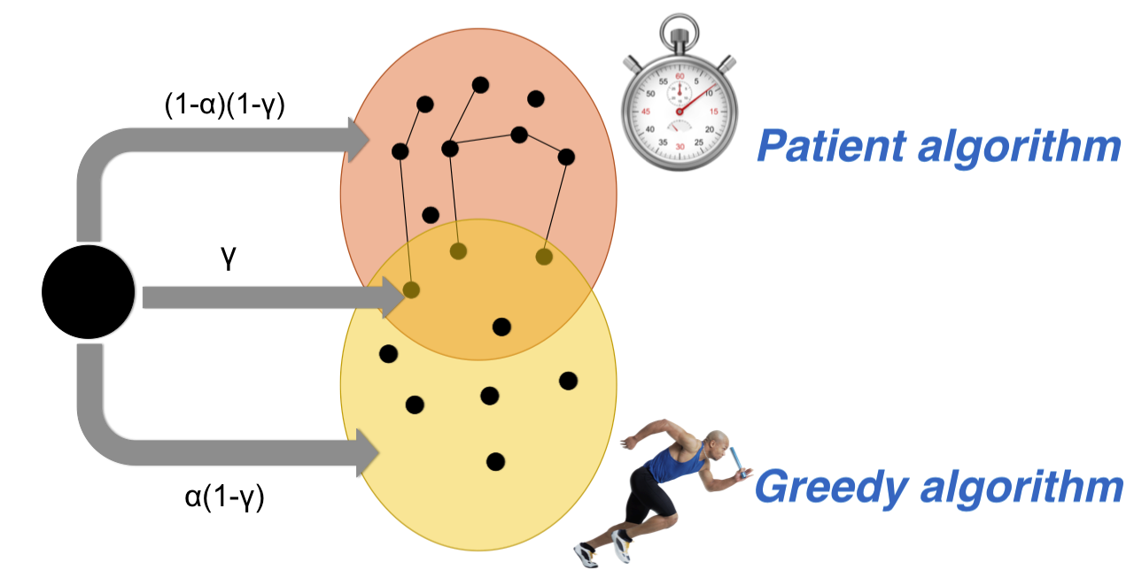
Model details
Notes:
Every agent has 3 possibilities, she could enter both exchanges simultaneously, gamma
or she could enter greedy…….
or patient…/

Slide 105
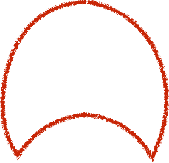
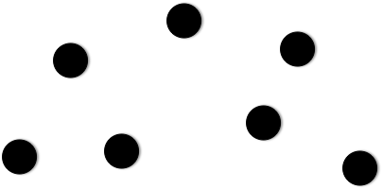


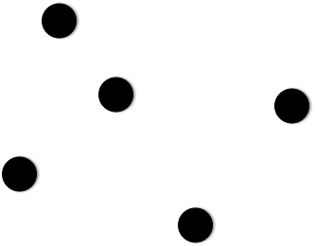
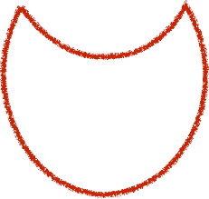


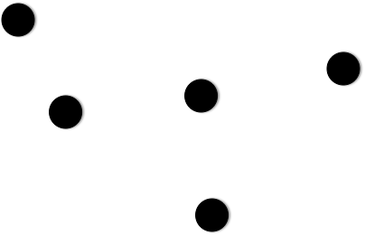


Three pools
Notes:
As we’ve already complete the description of our model. Now let’s derive the overall loss of this com-m.
\hat{Z}_{g,t} is the number of agents of greedy_c at any time
the both_c are the common part

Slide 106
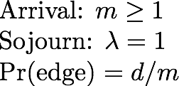
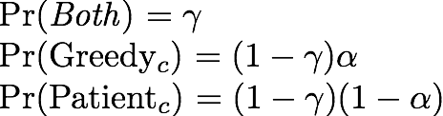

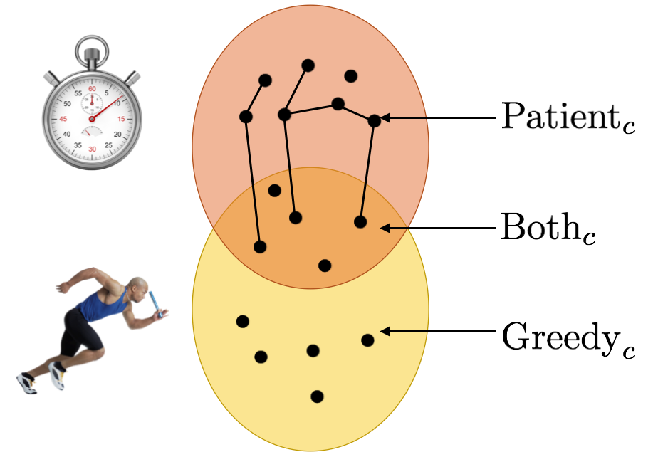

Proof sketch - bound on overall loss
Notes:
In the paper we have proof demonstration shows this is the lower bound on the loss of greedy-c part
And of course Greedy-c is part of this whole market.
therefore this is the lower bound on the loss of the whole competing markets
We proof a bound on the overall loss under the constraint that Greedyc is more likely to receive agents than the overlapping Bothc exchange
For large enough values of T and m

Slide 107
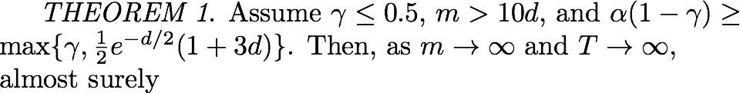
Proof sketch - bound on overall loss
Notes:
As Akbarpour et al’s paper showes that running an individual patient market results in exponentially small loss,
So comparing to their results, we give our theorem 1, under these constrains, which showed that A single Patient market outperforms the Competing markets

Slide 108
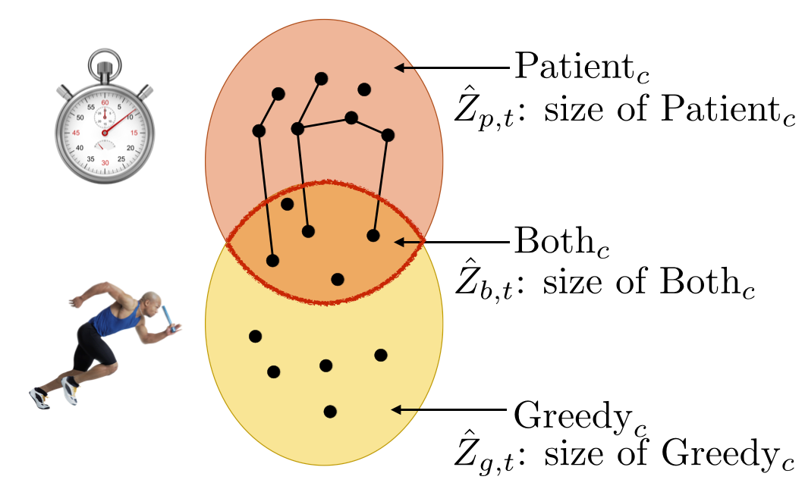
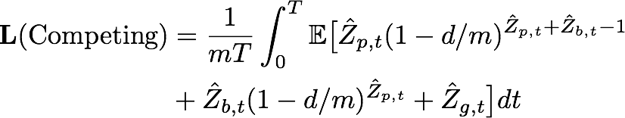
Expression for overall loss
Notes:
In the paper we show the exact expression for the loss of the competing markets in terms of the size of each component pool at any time, which is given by this integral
And it turns out, this can be well approximated by

Slide 109

Expression for overall loss
Notes:
…. this expressions here, which makes use of these khi terms, these terms are the expected size of the component pool under the stationary distribution of the Markov chain, which follows AK’s analysis. And we will use this approximation in our simulation.
the expected size of the component pool under the stationary distribution, as the Markov chain on the size of each component market has a unique stationary distribution.
An numerical approximation, use it later

Slide 110

Simulation setup
Agents (patient-donor pairs) arrive at the market according to a Poisson process, with rate parameter m = 100
The sojourn of an agent is drawn from an exponential distribution, with rate parameter λ = 1
Pr(acceptable transaction) = 0.02
can be approximated well using Monte Carlo simulations
Notes:
Agents arrival rate is = to 100
the expected size of the component pools under the stationary distribution

Slide 111
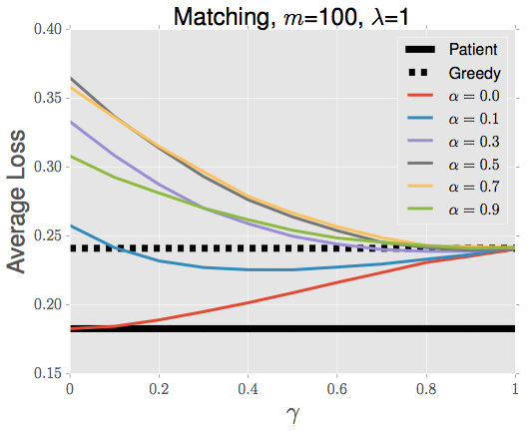


Simulation results
Notes:
This result shows that
Gamma is the probability of entering both markets. So we can see, with gamma increasing, the competing markets behave more and more like the single greedy market. because for the agents entering both markets, they would always take the first match from greedy market,
Alpha is the probability … if the agents do not enter both
One observation is that everything is worse than the patient market, so we can see the basic flavor of the theoretical results holds across the whole parameter range.
In the situation that the markets do not overlap substantially (i.e. \gamma is low )and agents are more likely to enter the greedy side of the market (\alpha is high), we can see the compete is worse than a greedy
This is due to the decrease in market thickness on the Patient market side
An agent chooses enter Both market with probability gamma and enter only greedy market with probability alpha(1-gamma).
Average loss under various values of γ and 𝛼. Everything is worse than a single centralized patient market
Significant loss, even worse than greedy market only

Slide 112

Kidney exchange experiments
Edges are determined by medical characteristics (Pr(acceptable transaction) ≠ d/m)
  UNOS (Real patient profiles)
  SAIDMAN (Simulated patient profiles)
Can incorporate longer cycles, chains, etc.
  We consider 2- and 3-cycles
Notes:
we perform our experiments on real data from United Network for Organ Sharing (UNOS) nationwide exchange and also simulate data base on the simulator from Saidman et al
The results are quiet similar …..
So far the model and simulation results we’ve talked about is based on classic matching setting which is pairwise matching
but in KD, the longer cyc and chains are pretty important
especially 3
so we also incorporate 3-cycles in our experiments

Slide 113
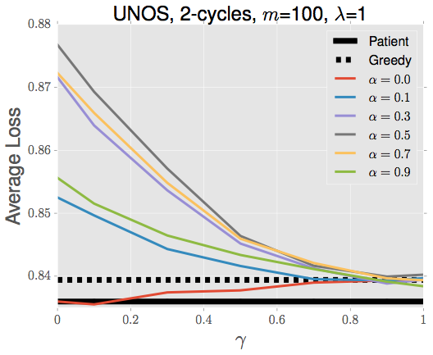
Experimental results
Experiment
Simulation
Notes:
In the left graph, We shows the results of kidney exp based on UNOS data with 2-cycles
So we can see we get quiet Similar qualitative pattern as our simulation results here
And also in the KD experiment, for any non-zero \alpha, the competing market is doing significantly worse than a single greedy Greedy market

Slide 114
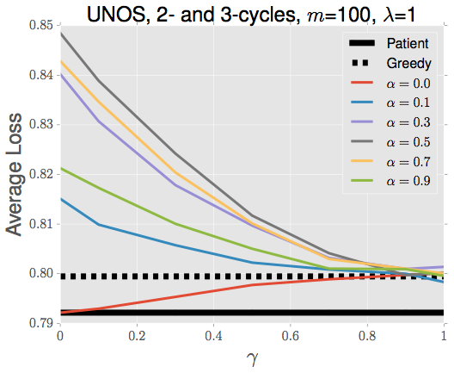
Experimental results
Notes:
We then incorporate 3 cycles, here is the UNOS data with 2 and 3 cycles
As you can see, we get lower loss but the pattern is same

Slide 115
Future research
Relax assumptions: agents select subset of platforms to enter, platforms select matching policy, et cetera …
Bounds on loss: generalize, tighten, n > 2 platforms
Notes:
For future research, as our current model is stochastic in terms of which market of agent entering and which policy of platform using
one interesting next step

Slide 116





Questions?
Pubs: jpdickerson.com/pubs/dickerson15futurematch.pdf
jpdickerson.com/pubs.html
Code: github.com/JohnDickerson/KidneyExchange
Very incomplete list of CMU folks working on kidney exchange/matching:
{ Avrim Blum, John Dickerson, Alan Frieze, Anupam Gupta, Nika Haghtalab, Jamie Morgenstern, Ariel Procaccia, R. Ravi, Tuomas Sandholm }
Thanks to:

Slide 117
Kidney Exchange
Backup Slides

Slide 118
Efficient matching with cycles and chains of length at most 3 in a dense kidney exchange ABO model [Dickerson Procaccia Sandholm AAMAS-2012]

Slide 119
Simulating dynamic kidney exchange (two time periods)

Slide 120
Generated UNOS runs, median number of transplants as |V| increases (x-axis) for each of the objective functions.

Slide 121
Price of fairness: UNOS data
Metric | Minimum | Average | Maximum | St. Dev.
Loss % (Objective) | 0.00% | 2.76% | 19.04% | 4.84%
Loss % (Cardinality) | 0.00% | 4.09% | 33.33% | 8.18%
Loss (Cardinality) | 0 | 0.55 | 4 | 1.1
Minimum, average, and maximum loss in objective value and match size due to the strict lexicographic fairness rule, across the first 73 UNOS match runs, in a deterministic model.

Slide 122
Acknowledgments
This material was funded by NSF grants IIS- 1320620, CCF-1101668, CCF-1215883, and IIS-0964579, by an NDSEG fellowship, a Facebook fellowship, and used the Pittsburgh Supercomputing Center in partnership with the XSEDE, which is supported by NSF grant OCI-1053575. We thank Intel Corporation for machine gifts.

