Slide 1
Effects of New KPD Histocompatibility Policy on Refusal Rate and Transplants
R Leishman¹, M Aeder², M S Leffell³, C Murphey⁴, N Reinsmoen⁵, S Saidman⁶,
T Sandholm⁷, A Toll¹, A Harper¹ and NTurgeon⁸
¹UNOS, Richmond, VA; ²Univ Hosp Med Ctr, Cleveland, OH; ³Johns Hopkins
Univ, Baltimore, MD; ⁴SW Immunodiagnostics, San Antonio, TX; ⁵CedarsSinai
Health, Los Angeles, CA; ⁶Mass Gen Hosp, Boston, MA; ⁷Carnegie Mellon Univ, Pittsburgh, PA;
and ⁸Emory Univ, Atlanta, GA.
ATC 2017
Chicago, IL
kidneypaireddonation@unos.org

Slide 2
Ruthanne Leishman RN, MPH OPTN KPDPP Program Manager UNOS, Richmond, VA, USA
The Joint Annual Congress of the American Society of Transplant Surgeons and The American Society of Transplantation
I have no financial relationships with commercial interests to disclose
AND
My presentation does not include discussion of off-label or investigational use.

Slide 3
Acknowledgments
This analysis reflects work performed on behalf of and in conjunction with the OPTN Kidney Transplantation Committee and the Kidney Paired Donation Work Group.
This work was supported wholly or in part by Health Resources and Services Administration contract 234-2005-370011C. The content is the responsibility of the authors alone and does not necessarily reflect the views or policies of the Department of Health and Human Services, nor does mention of trade names, commercial products, or organizations imply endorsement by the U.S. Government.
Notes:
This work was supported by HRSA under the OPTN contract specified here, though the content is solely the responsibility of the authors.

Slide 4
Remaining 48% (n=160)
Actual Match Offer Refusals
Match Runs: Jan-Sep 2014
Notes:
At the 2015 ATC we reported that 1/3 of match offer refusals in the OPTN KPD program were related to a positive crossmatch.

Slide 5
Background: Crossmatch-related refusal reasons
Match Runs: Jan-Sep 2014 (n=52)
Virtual +crossmatch can be due to:
Non-required donor antigens not entered (HLA-DQA1, HLA-DQB1, and HLA-DPB1)
Non-required donor antigens not screened
Candidate unacceptable antigens not entered or updated
Notes:
2/3’s of reported crossmatch related refusals were do to positive virtual crossmatch. Positive virtual crossmatch can occur because there are certain donor antigens that are not required and therefore not entered by the donor hospital, some antigens such as DP and DQ are not screen by the system even if entered, and sometimes the candidate hospital does not enter all the candidate unacceptable. Either because they are willing to look at offers if the unacceptable is weakly positive or they are willing to consider desensitization in combination with KPD.

Slide 6
Solution
Implement KPD histocompatibility requirements
Goals
Reduce the number of match offer refusals related to positive crossmatch
Increase match offer success rate (define as # of offers that results in transplantation)
Notes:
To address this problem the KPD WG and Kidney committee developed histocompatibility requirements with the goals of reducing the number of match offer refusals related to positive virtual or actual XM and in doing so hopefully increase the match offer success rate – which is the number of match offers that result in a candidate being transplanted.

Slide 7
KPD Histocompatibility requirements policy
Implemented January 21, 2016
Donor HLA-DQA1, HLA-DQB1, and HLA-DPB1 required
All donor HLA screened against candidate unacceptable antigens
Specific candidate screening requirements
Serological split level molecular typing
Solid-phase single phenotype or solid-phase single-antigen test to identify unacceptables antigens
Candidate unacceptables reviewed by 2 individuals, prior to first match run
Retesting candidate:
Every 110 days When any potentially sensitizing event occurs
When reactivating a candidate, if inactive more than 90 days
When a match is refused due to unacceptable physical crossmatch
Notes:
After a public comment period and approval by the UNOS board of directors, the KPD Histocompatibility were programmed into UNEt and implemented January 21, 2016. Among other things, policy includes requirement that all Donor HLA be entered including HLA-DQA1, HLA-DQB1 , and HLA-DPB1; Specific candidate screening requirements include candidate HLA must be performed and reported at the serological split level molecular typing, that solid=phase single phenotype or solid-phase single antigen test is used to idneify unacceptable antigens, that the unaccepatblaes are reviewed by 2 individuals prior to a candidate being in their first match run, and one person must be from the HLA lab, and finally that the candidate must be retested and unacceptables updated every 110 days, when reactivating after 90 days of inactivation, and when a match offer is refused due to an unacceptable physical crossmatch

Slide 8
Methods
XM refusal rates were compared for pre (6/2/14–1/21/16) vs post (1/22/16–2/2/2017) policy periods.
A logistic regression model analyzed match outcomes of transplanted or not transplanted, controlled for the time periods, candidate CPRA, candidate age, donor age, donor BMI, and donor ABO.
Notes:
XM refusal rates were compared for the pre vs post policy periods using a logistic regression model to analyze match outcomes of transplanted or not transplanted. The model controlled for time period, candidate CPRA, candidate age, donor age, donor BMI and donor ABO

Slide 9
Results – Decrease in XM related refusals
Notes:
Comparing the pre vs post policy period we see a significant decrease in the refusals related to crossmatch from over 28% of match refusals down to under 12%. Of course being a percentage of total match offers the percentage of refusals in the candidate and donor related refusal reasons has increased

Slide 10
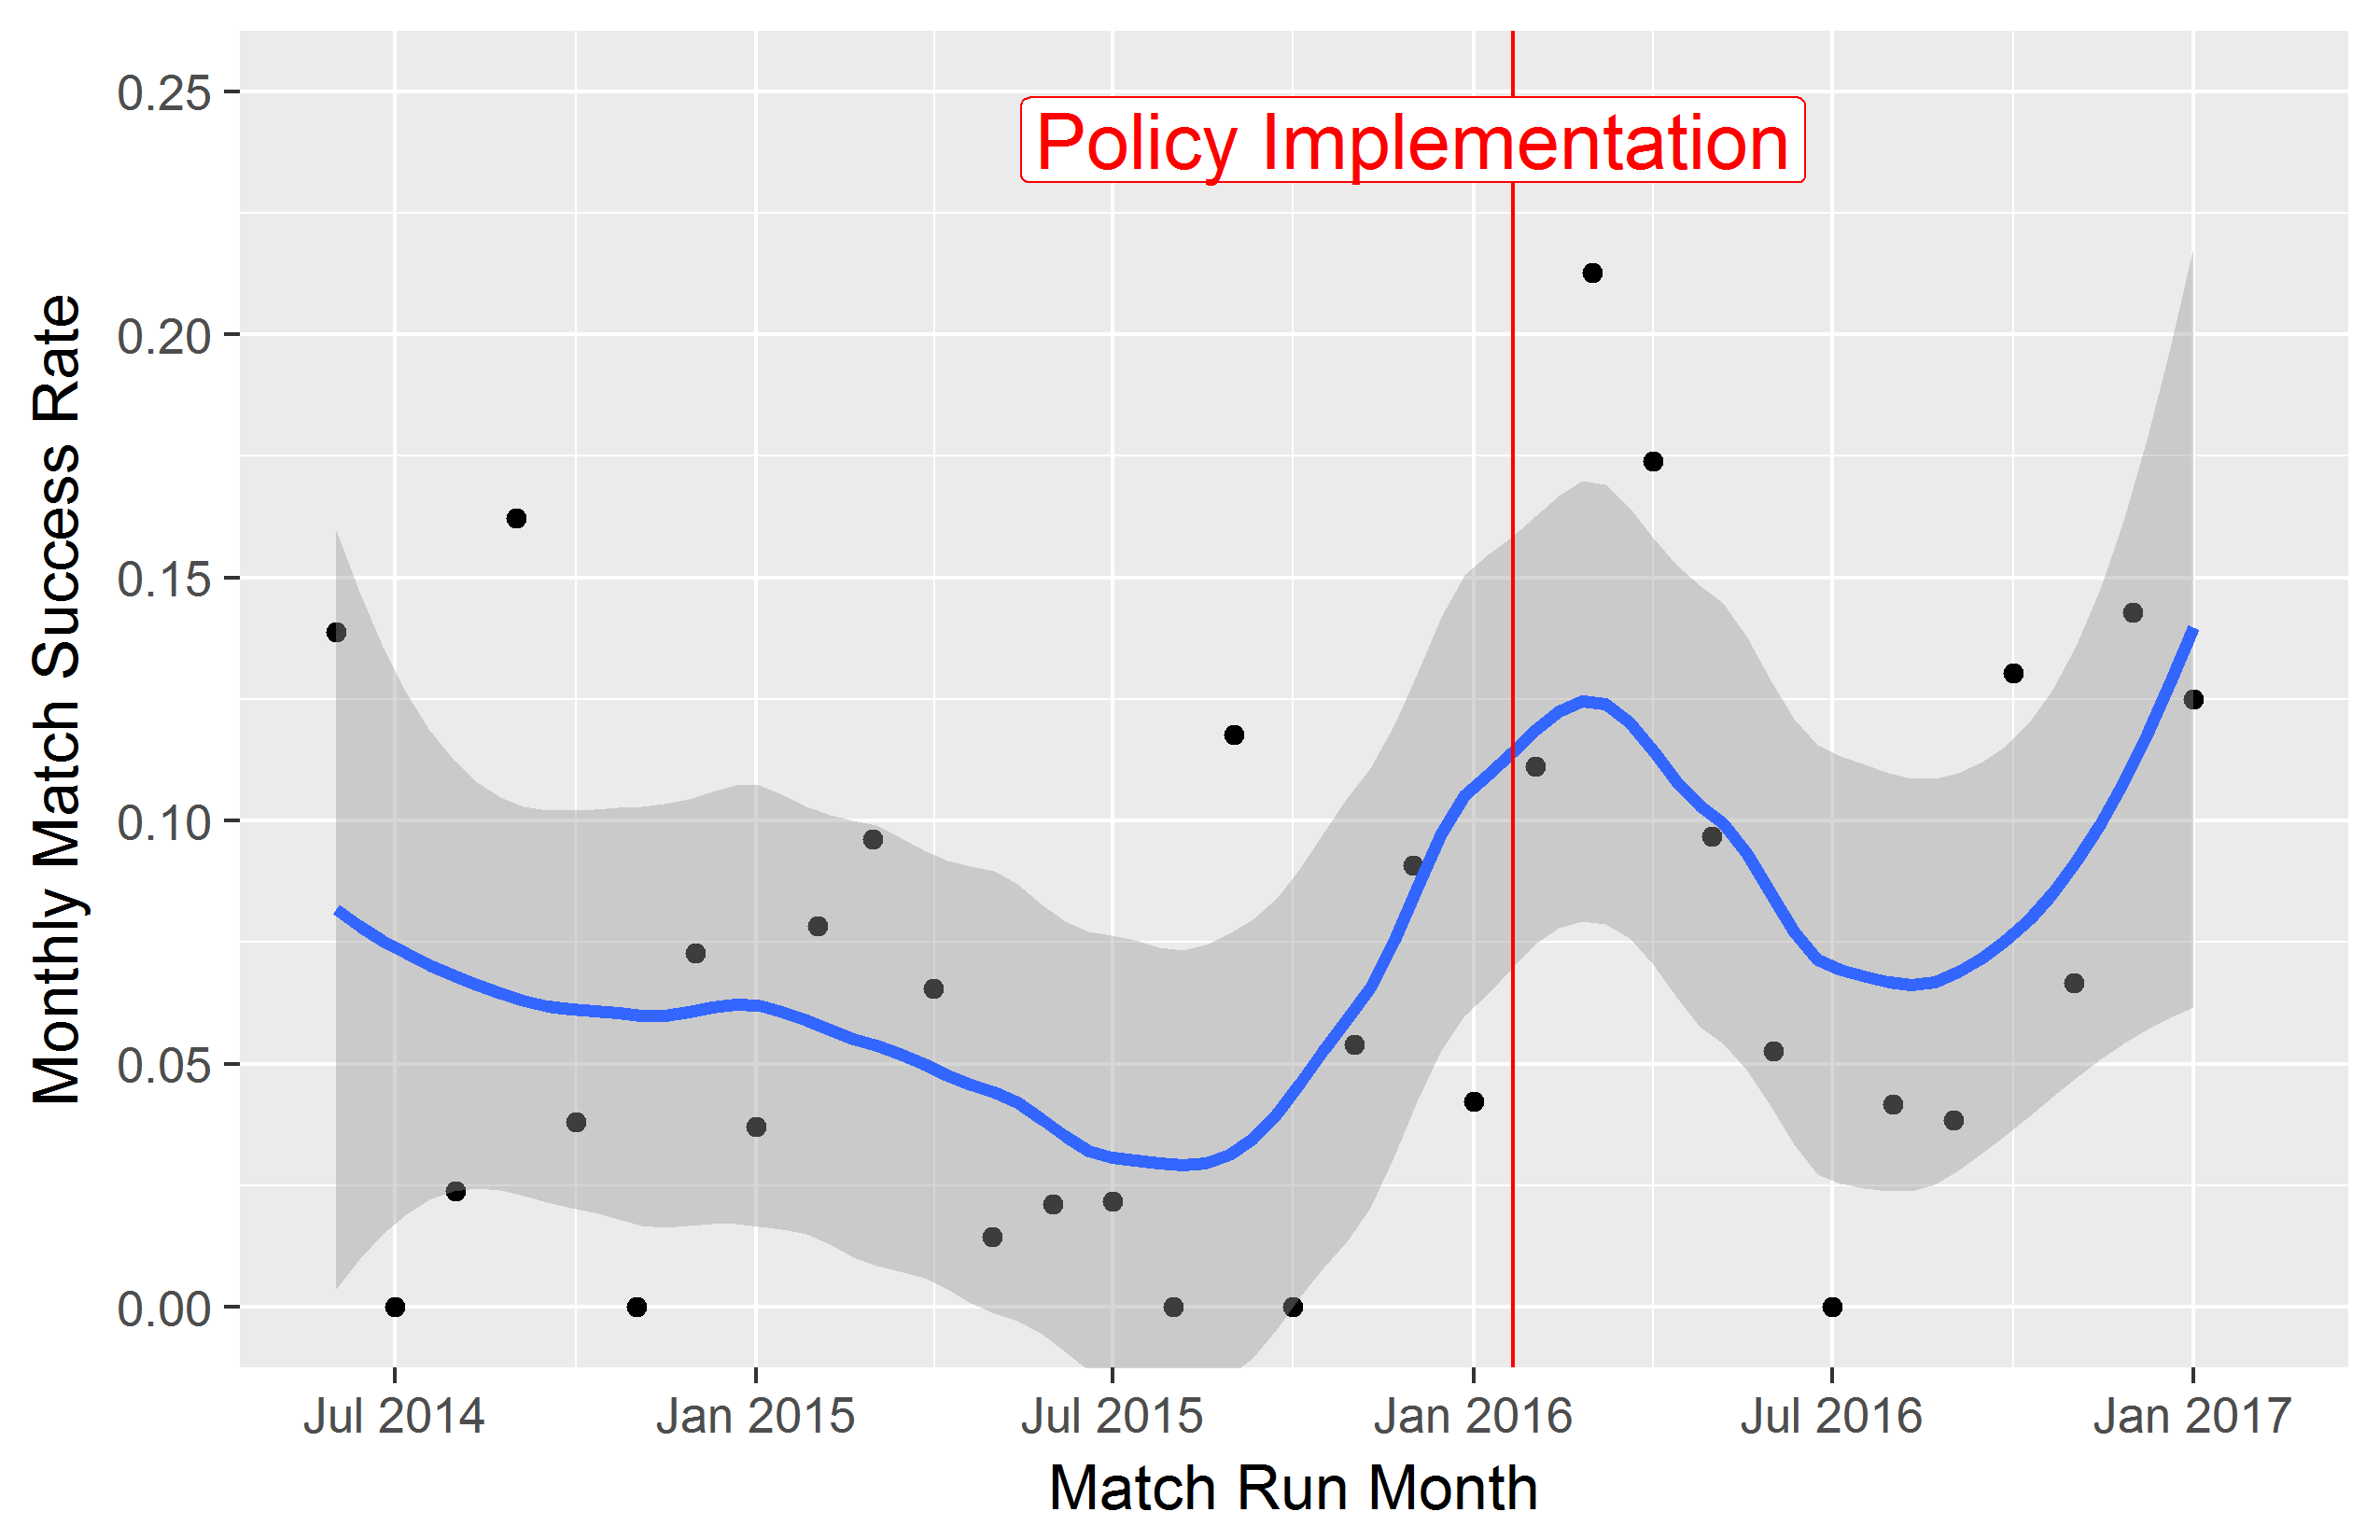
Results – Match Success Rate
Univariate Analysis
Pre-Policy: 5%
Post-Policy: 10%
p < 0.001
Logistic Model
118% increase in odds
p < 0.001
Only significant factor after adjusting for other covariates
Notes:
Of the 1543 matches from June 2, 2014 to February 2, 2017, 95 proceeded to transplant. Without controlling for any other variables we see significantly more matches resulted in a transplant after the policy was implemented (10% vs 5%, p < 0.001).
Candidate age, candidate CPRA, donor age, BMI and donor blood type were significantly different when comparing the pre- and post-histo policy periods
After controlling for candidate CPRA, candidate age, donor age, donor BMI, and donor blood type, matches found in the post policy period compared to the pre-policy period have an increased log odds of proceeding to transplant by 0.78 (p < 0:001). In other words, in the post-policy period we expect to see a 118% increase in the odds of a match proceeding to transplant.
Other covariates: CPRA, candidate age, donor age, donor BMI, donor blood type

Slide 11
Discussion
Decrease in refusal rate related to unacceptable crossmatches
Increase in match success rate
Many highly sensitized candidates became ineligible after implementation, decreasing the mean CPRA of matched candidates decreased
The mean CPRA of eligible candidates is now increasing as unacceptables are updated.
Longer term analysis will determine whether the increased probability of transplant resulted from the policy's intention vs ineligibility of some sensitized candidates.
Further improvements to the program will be based on longer term findings.
Now looking at donor-related refusal reasons
Notes:
We have seen a decrease in the match refusals related to unacceptable crossmatches. So far the histocompatibility policy has had a positive impact the match success rate. However, the histocompatibility policy required sensitized transplant centers to enter more information on unacceptable antigens. As a result, many sensitized candidates became ineligible for match runs and the candidates that were matched generally had lower CPRA. As required histocompatibility information is entered for sensitized candidates and their donors, and they become re-eligible for match runs we are seeing an increase in the average candidate CPRA eligible for match runs. A longer term analysis is needed to determine if the increase in probability of transplant resulted from the policy’s intention vs ineligibility of some sensitized candidates. Further improvement to the program will be based on longer term findings.

Slide 12
Thank you!

