Slide 1
15-112
Lecture 2
OOP Part 1
Instructor: Pat Virtue

Slide 2
Thursday Logistics

Slide 3

As you walk in
Quiz will start at the beginning of lecture
Have pencil/pen ready
Silence phones

Slide 4
Quiz
Before we start
Don’t open until we start
Make sure your name and Andrew ID are on the front
Read instruction page
No questions (unless clarification on English)
Additional info
25 min

Slide 5

Quiz Break
Turn to your neigbhor
Thoughts on Term Projects?

Slide 6

Announcements
Midterm
OOP Scope 8.1-8.4
TP
Pre-reading Form due Mon 5pm
AI
 | Sun | Mon | Tue | Wed | Thu | Fri | Sat
Week 10 |  |  |  |  | Last quiz! OOP Part1 |  | HW10 due
Week 11 |  | TP form due 5pm | Review |  | Midterm 2
Week 12 |  | TP0 due 5pm | OOP Part2 |  | 🦃

Slide 7
Announcements
HW10 Tip
Backtracking performance

Slide 8
OOP

Slide 9
Object Oriented Programming
Quick example
class Pet:
def __init__(self, name):
self.name = name
def sayHello(self):
print(f'Hi my name is {self.name}')
sweetness = Pet('Walter')

Slide 10

Poll 1
What is sweetness in this code?
Select all that apply.
A class
An object
A string
An instance of Pet
A method
An attribute (property)
None of the above
class Pet:
def __init__(self, name):
self.name = name
def sayHello(self):
print(f'Hi my name is {self.name}')
sweetness = Pet('Walter')

Slide 11

Poll 2
What is self in this code?
Select all that apply.
A class
An object
A string
An instance of Pet
A method
An attribute (property)
None of the above
class Pet:
def __init__(self, name):
self.name = name
def sayHello(self):
print(f'Hi my name is {self.name}')
sweetness = Pet('Walter')

Slide 12
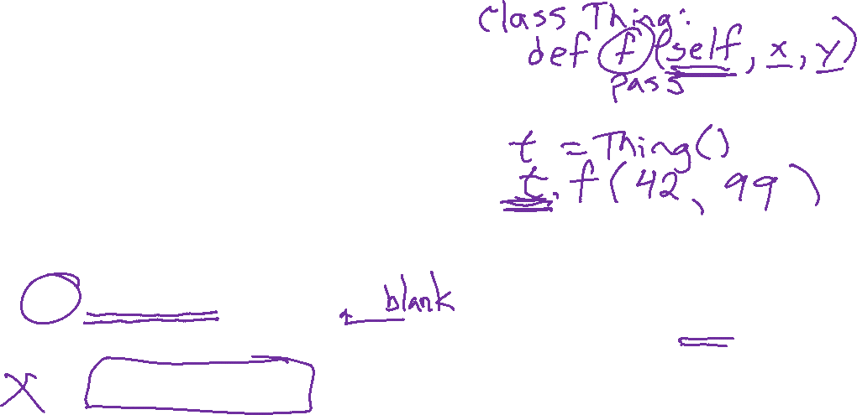
Poll 3
Which of the following lines prints, "Hi my name is Walter"?
Select all that apply.
print(sweetness)
print(sweetness.name)
sweetness.sayHello()
sayHello(sweetness)
Pet.sayHello()
Pet.sayHello('Walter')
None of the above
class Pet:
def __init__(self, name):
self.name = name
def sayHello(self):
print(f'Hi my name is {self.name}')
sweetness = Pet('Walter')

Slide 13
OOP: Constructor
Syntax reference
class CLASSNAME:
def __init__(self):
CONSTRUCTOR_BODY
VARIABLE_NAME = CLASSNAME()

Slide 14
OOP: Constructor
Syntax reference
class CLASSNAME:
def __init__(self, CONSTRUCTOR_PARAM1, CONSTRUCTOR_PARAM2):
CONSTRUCTOR_BODY
VARIABLE_NAME = CLASSNAME(CONSTRUCTOR_ARG1, CONSTRUCTOR_ARG2)

Slide 15
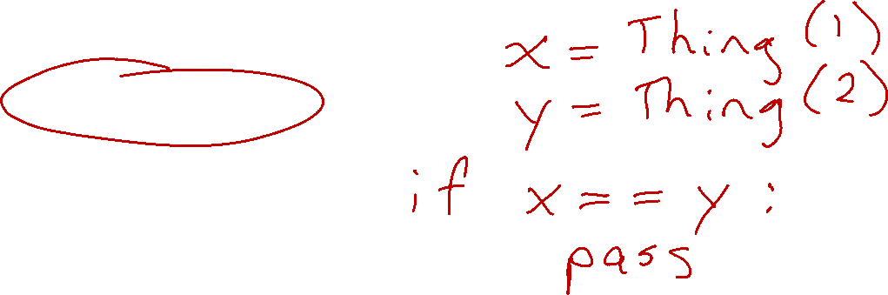
OOP: Special methods within a Class
__str__(self):
__repr__(self):
__eq__(self, other):
__hash__(self):

Slide 16
OOP Example
Polynomial exercise

Slide 17


OOP Example
Goodreads book data
books.csv
book_index,title,publication_year,book_id,link
0,The Hunger Games (The Hunger Games; #1),2008,2767052,https://www.goodreads.com/book/show/2767052-the-hunger-games
1,Twilight (Twilight; #1),2006,41865,https://www.goodreads.com/book/show/41865.Twilight
2,The Fault in Our Stars,2012,11870085,https://www.goodreads.com/book/show/11870085-the-fault-in-our-stars
3,Divergent (Divergent; #1),2012,13335037,https://www.goodreads.com/book/show/13335037-divergent
4,Catching Fire (The Hunger Games; #2),2009,6148028,https://www.goodreads.com/book/show/6148028-catching-fire

Slide 18
OOP: Special methods within a Class
__str__(self):
__repr__(self):
__eq__(self, other):
__hash__(self):

Slide 19

Poll 4
class Pet:
def __init__(self, name):
self.name = name
def __eq__(self, other):
# WHAT IS self HERE?
# TODO
What will be the type of self in the __eq__ method?
Object
Class
Pet
String
Boolean
Not enough information

Slide 20

Poll 5
class Pet:
def __init__(self, name):
self.name = name
def __eq__(self, other):
# WHAT IS other HERE?
# TODO
What will be the type of other in the __eq__ method?
Object
Class
Pet
String
Boolean
Not enough information

