Slide 1
15-112
Lecture 2
OOP Part 2 &
TP Tech
Instructor: Pat Virtue

Slide 2

Announcements
 | Sun | Mon | Tue | Wed | Thu | Fri | Sat
Week 12 |  | TP0 due 5pm | OOP Part2 |  | 🦃
Week 13 |  | TP1 due 5pm | Cool Stuff |  | Cool Stuff | TP2 due 5pm
Week 14 |  |  | TP User Study | TP3 due 5pm | TP Showcase
Week 15 |  |  |  |  |  | Final 1-4 pm

Slide 3
Topics
OOP and Animations
Events++
Movement: Basic Physics
OOP Inheritance
Images
Sprites
Organizing code in separate python files

Slide 4
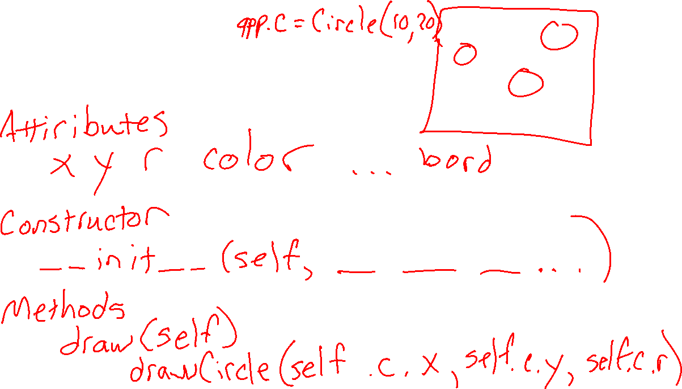
OOP and Animation
Blob class

Slide 5
OOP and Animation
class Blob:
def __init__(self, x, y, r=20):
self.x = x
self.y = y
self.r = r
self.color = 'cornflowerBlue'
def draw(self):
drawCircle(self.x, self.y, self.r,
fill=self.color)
Blob class
def onAppStart(app):
app.blobs = []
def onMousePress(app, mx, my):
newBlob = Blob(mx, my)
app.blobs.append(newBlob)
def redrawAll(app):
for blob in app.blobs:
blob.draw()

Slide 6
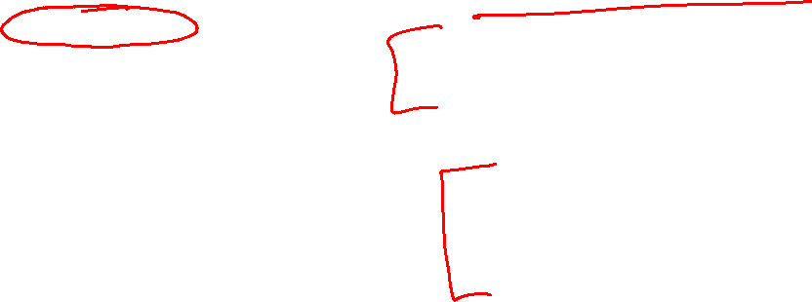

OOP and Animation
class BlinkingBlob:
def __init__(self, x, y, r=20):
self.x = x
self.y = y
self.r = r
self.color = 'cornflowerBlue'
self.blinkOn = True
def onStep(self):
self.blinkOn = not self.blinkOn
def draw(self):
if self.blinkOn:
fillColor = self.color
else:
fillColor = None
drawCircle(self.x, self.y, self.r,
fill=fillColor)
BlinkingBlob class
def onAppStart(app):
app.blobs = []
def onMousePress(app, mx, my):
newBlob = BlinkingBlob(mx, my)
app.blobs.append(newBlob)
def onStep(app):
for blob in app.blobs:
blob.onStep()
def redrawAll(app):
for blob in app.blobs:
blob.draw()

Slide 7
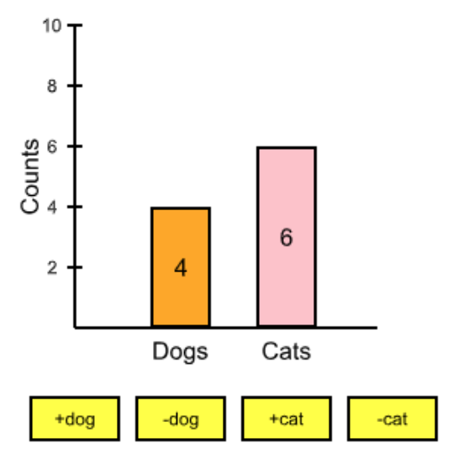
OOP-ing
Starting from 3.3.7 exercise

Slide 8
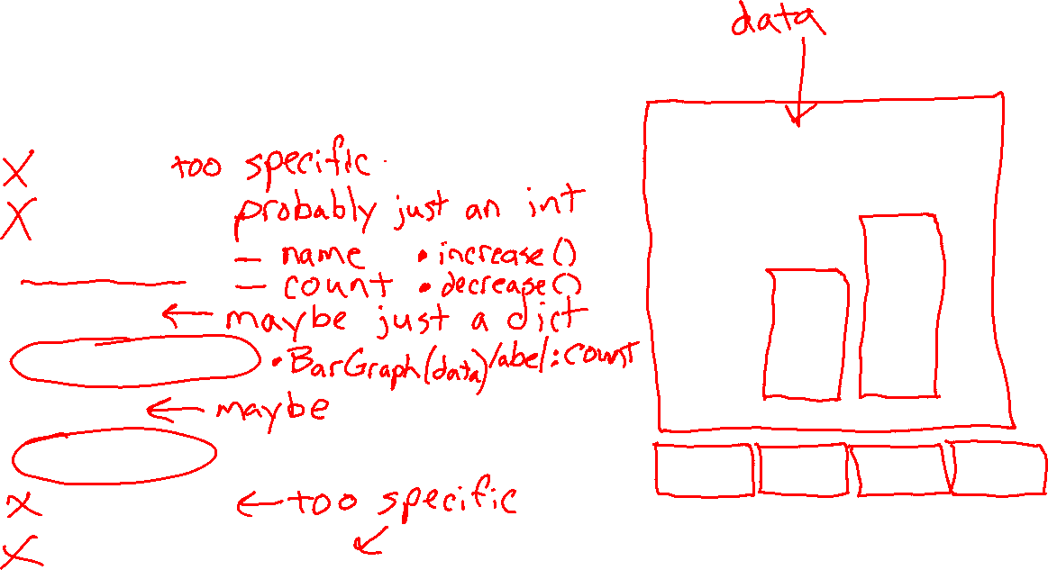
Poll 1
Which of the following classes would be helpful to create?
Dog
DogCount
Animal
Data
BarGraph
Bar
Button
DogButton
IncreaseDogButton

Slide 9
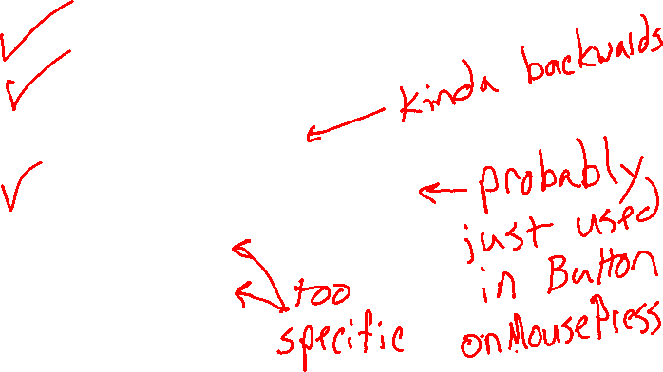
Poll 2
Which of the following methods would be helpful for a Button class?
draw
onMousePress
onButtonPress
getLeftTopRightBotton
getCount
getAnimal

Slide 10
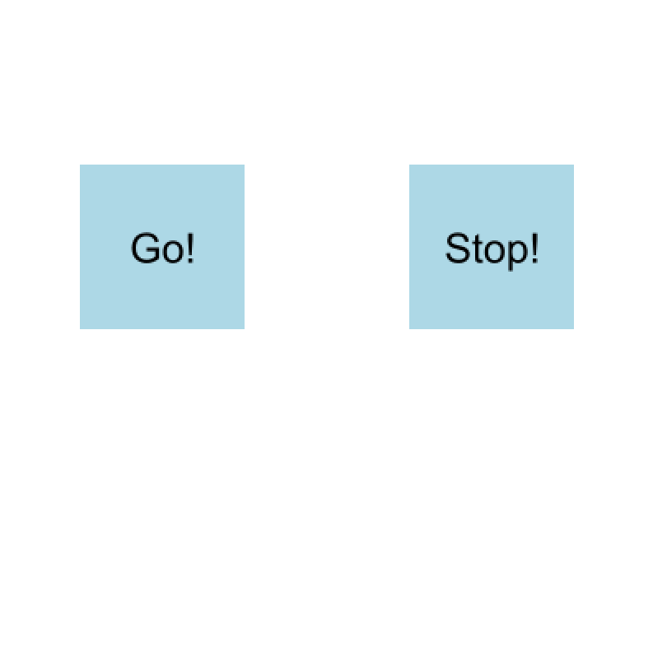
OOP and Animations
Example: Button Class
def onAppStart(app):
button1 = Button(50, 200, 100,
'Go!')
button2 = Button(250, 200, 100,
'Stop!')
app.buttons = [button1, button2]
def onMousePress(app, mx, my):
for button in app.buttons:
button.onMousePress(mx, my)
def redrawAll(app):
for button in app.buttons:
button.draw()
>>> Go! button clicked!
Stop! button clicked!
Go! button clicked!
Stop! button clicked!
Go! button clicked!
Stop! button clicked!

Slide 11
OOP and Animations
class Button:
def __init__(self, x, y, size, text):
self.x = x
self.y = y
self.text = text
self.size = size
self.color = 'lightBlue'
def pointInBounds(self, px, py):
...
def onMousePress(self, mx, my):
if self.pointInBounds(mx, my):
print(f'{self.text} button clicked!')
def draw(self):
drawRect(self.x, self.y, self.size, self.size,
fill=self.color)
cx = self.x+self.size/2
cy = self.y+self.size/2
drawLabel(self.text, cx, cy, align='center',
size=self.size/4)
Example: Button Class
def onAppStart(app):
button1 = Button(50, 200, 100,
'Go!')
button2 = Button(250, 200, 100,
'Stop!')
app.buttons = [button1, button2]
def onMousePress(app, mx, my):
for button in app.buttons:
button.onMousePress(mx, my)
def redrawAll(app):
for button in app.buttons:
button.draw()

Slide 12
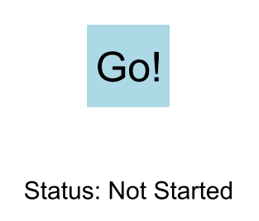
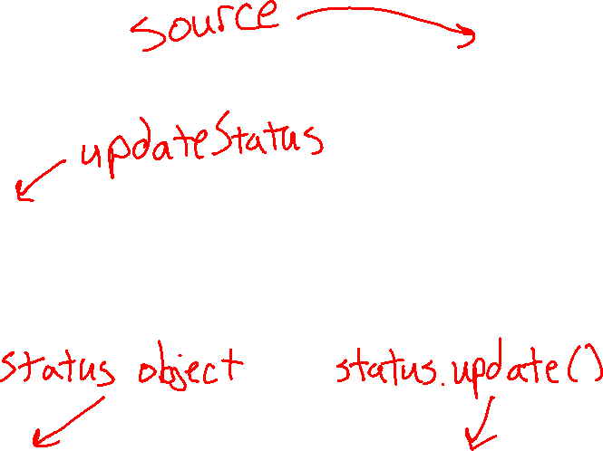
OOP Events
Connecting controls with models
Callback pattern
Provide the source with a function (a callback function)
When the event happens in the source, the source will call the callback function
Observer (listener) pattern
Provide the source with an object that contains a specific update function
When the event happens in the source, the source will call the object's update function.

Slide 13
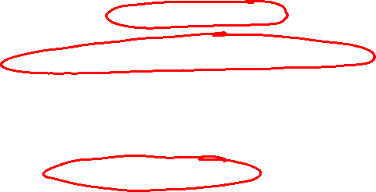

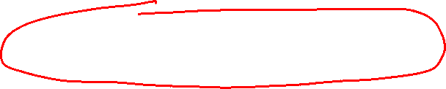
Callback Pattern
Source
class Button:
def __init__(self, x, y, size, text,
callbackFunction):
...
self.callback = callbackFunction
def onMousePress(self, mx, my):
if self.pointInBounds(mx, my):
# Call callback function
self.callback()
...
Example
Click Go button to change status from "Not Started" to "Started"
Application code
def onAppStart(app):
app.status = StatusData()
app.button = Button(150, 100, 100, 'Go!',
app.status.update)
# Note: No () after update. We want to
# pass the update function not call it
def onMousePress(app, mx, my):
app.button.onMousePress(mx, my)
def redrawAll(app):
app.button.draw()
drawLabel(app.status.text, 200, 300)
Callback function will be the update function
class StatusData:
def __init__(self):
self.text = 'Status: Not Started'
# The callback function given to source
def update(self):
self.text = 'Status: Started!'

Slide 14
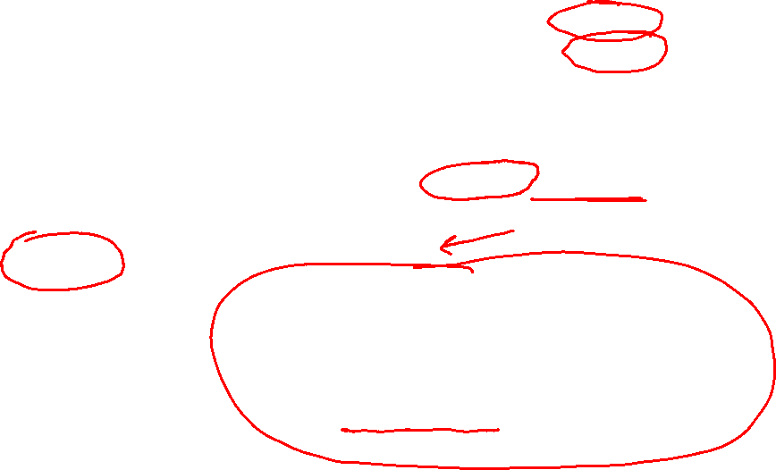
Observer Pattern
Source
class Button:
def __init__(self, x, y, size, text):
...
self.observers = set()
def addObserver(self, observer):
self.observers.add(observer)
def onMousePress(self, mx, my):
if self.pointInBounds(mx, my):
for observer in self.observers:
observer.update()
...
Example
Click Go button to change status from "Not Started" to "Started"
Application code
def onAppStart(app):
app.status = StatusData()
app.button = Button(150, 100, 100, 'Go!')
app.button.addObserver(app.status)
def onMousePress(app, mx, my):
app.button.onMousePress(mx, my)
def redrawAll(app):
app.button.draw()
drawLabel(app.status.text, 200, 300)
Observer object
class StatusData:
def __init__(self):
self.text = 'Status: Not Started'
# Listens for update from source
def update(self):
self.text = 'Status: Started!'

Slide 15
More Events
CS Academy Docs: Advanced Events
def onKeyPress(app, key, modifiers)
def onMousePress(app, mouseX, mouseY, button)

Slide 16
Topics
OOP and Animations
Events++
Movement: Basic Physics
OOP Inheritance
Images
Sprites
Organizing code in separate python files

Slide 17
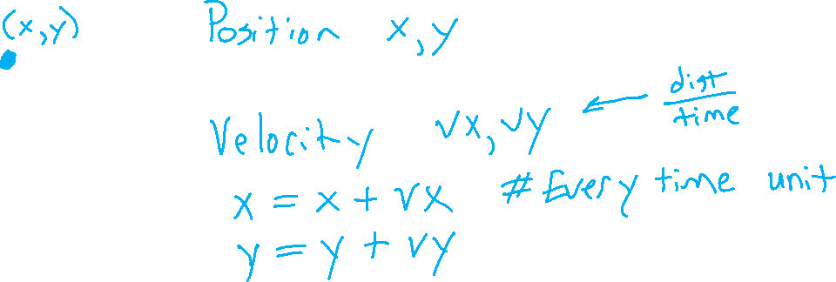
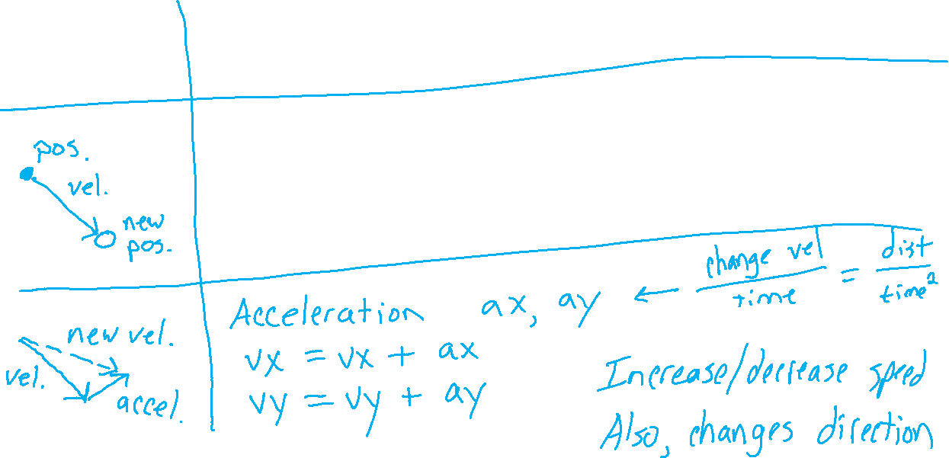
Movement: Basic Physics

Slide 18

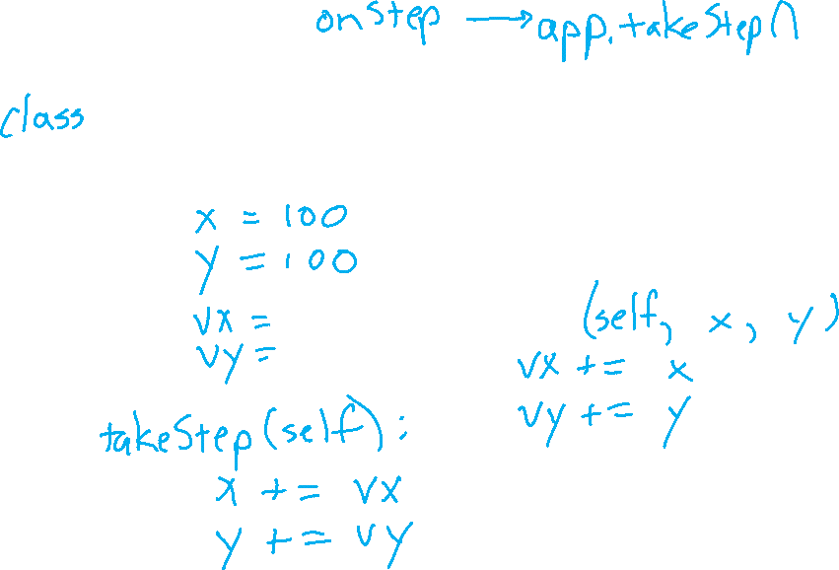




Movement: Basic Physics

Slide 19
Movement: Example
class Thing:
def __init__(self, x, y):
self.x = x
self.y = y
self.vx = 0
self.vy = 0
def takeStep(self):
self.x += self.vx
self.y += self.vy
def accelerate(self, ax, ay):
self.vx += ax
self.vy += ay
def accelerateTowardsPoint(self, x, y, scale):
# Accelerate (change velocity) towards point
ax = (x - self.x) * scale
ay = (y - self.y) * scale
self.accelerate(ax, ay)
def draw(self):
drawCircle(self.x, self.y, 15)
def onAppStart(app):
app.thing = Thing(200, 200)
def onStep(app):
app.thing.takeStep()
def onMousePress(app, mx, my):
# Accelerate towards mouseClick
# Scale it down to be resonable
scale = 0.01
app.thing.accelerateTowardsPoint(
mx, my, scale)
def redrawAll(app):
app.thing.draw()

Slide 20
OOP Inheritance
class FarmAnimal:
def __init__(self, name):
self.name = name
self.says = 'Generic Animal Sound'
def speak(self):
return f'{self.name} says {self.says}'
class Pig(FarmAnimal):
def __init__(self, name):
super().__init__(name)
self.says = 'Oink'
class Cow(FarmAnimal):
def __init__(self, name):
super().__init__(name)
self.says = 'Moo'
animal1 = FarmAnimal('Fred')
animal2 = Pig('Barney')
From Notes

Slide 21
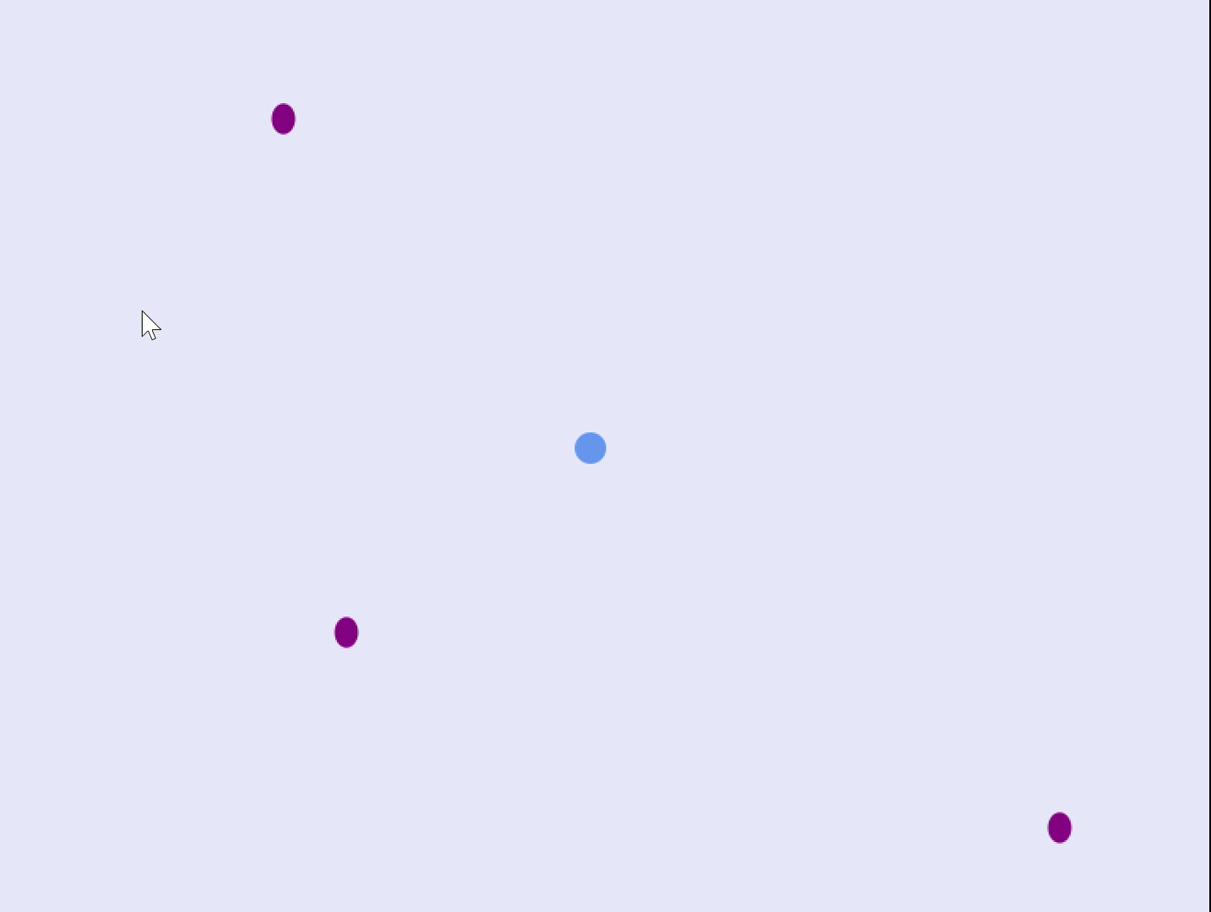
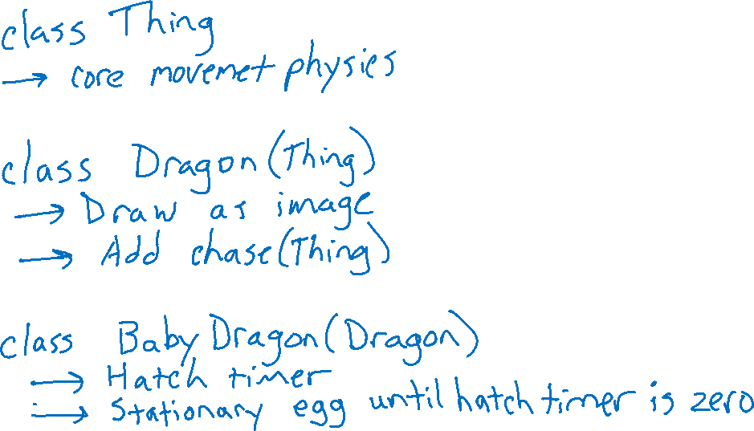
OOP Inheritance
Dragon example
Image source: https://www.silhouette.pics/tags/overhead-dragon.php

Slide 22
OOP Inheritance
Dragon example
class Dragon(Thing):
def __init__(self, x, y, size):
super().__init__(x, y, size)
imFilename = 'dragon.png'
imPIL = Image.open(imFilename)
self.image = CMUImage(imPIL)
self.target = None
def chase(self, thing):
self.target = thing
def takeStep(self):
# Use superclass to move with physics
super().takeStep()
if self.target is not None:
self.accelerateTowardsPoint(
self.target.x, self.target.y)
def draw(self):
angle = calcAngle(self.vx, self.vy)
drawImage(self.image,
self.x, self.y, align='center',
width=self.size, height=self.size,
rotateAngle=angle)

Slide 23
OOP Inheritance
Dragon example
class BabyDragon(Dragon):
def __init__(self, x, y, mother):
super().__init__(x, y, mother.size/4)
self.eggColor = 'purple'
hatchTime = 10
self.hatchTimer = hatchTime
self.chase(mother)
def takeStep(self):
if self.hatchTimer > 0:
self.hatchTimer -= 1
else:
# Use superclass to move
super().takeStep()
def drawEgg(self):
width = 0.3 * self.size
height = 1.3 * width
drawOval(self.x, self.y,
width, height,
fill=self.eggColor)
def draw(self):
if self.hatchTimer > 0:
self.drawEgg()
else:
# Use superclass to draw
# as a dragon
super().draw()

Slide 24
Topics
OOP and Animations
Events++
Movement: Basic Physics
OOP Inheritance
Images
Sprites
Organizing code in separate python files

Slide 25


Images
Pillow (PIL) Image allows for a ton of image operations
def onAppStart(app):
imageFilename = 'dragon.png'
imPIL = Image.open(imageFilename)
# insert any PIL image manipulation here, e.g. crop
imPIL = imPIL.crop((200, 100, 340, 425))
app.imCMU = CMUImage(imPIL)
def redrawAll(app):
drawImage(app.imCMU, 100, 100)
Image source: https://www.silhouette.pics/tags/overhead-dragon.php

Slide 26
Images
Aspect ratio to display image with desired size without distortion
def onAppStart(app):
imageFilename = 'dragon.png'
imPIL = Image.open(imageFilename)
app.imCMU = CMUImage(imPIL)
aspectRatio = imPIL.width / imPIL.height
app.imHeight = 200
app.imWidth = rounded(app.imHeight * aspectRatio)
def redrawAll(app):
drawImage(app.imCMU, 100, 100,
width=app.imWidth, height=app.imHeight)

Slide 27
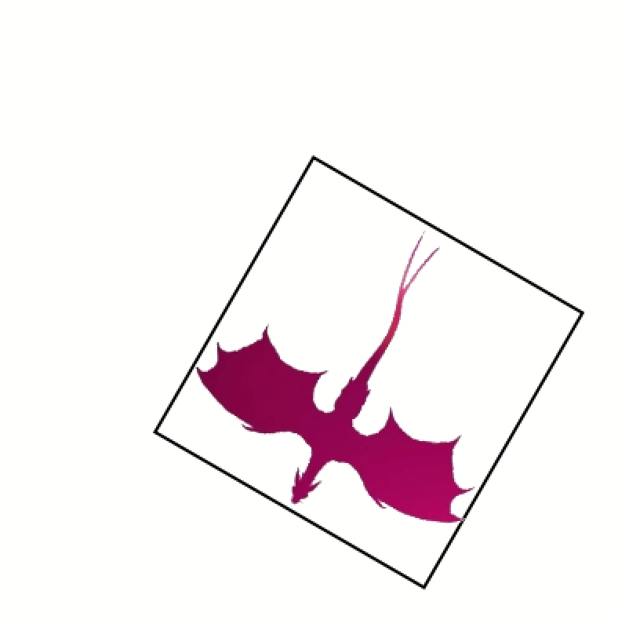


Images
Rotation using rotateAngle parameter
drawImage(app.image, app.x, app.y, align='center',
rotateAngle=angle)
You can certainly do this, but you only have to pay attention to the align parameter (and it has limitations)
Changed image file to put the dragon's neck at the center
Image source: https://www.silhouette.pics/tags/overhead-dragon.php
x=100, y=100, align='left-top'
x=200, y=200, align='center'
x=200, y=200, align='center'

Slide 28
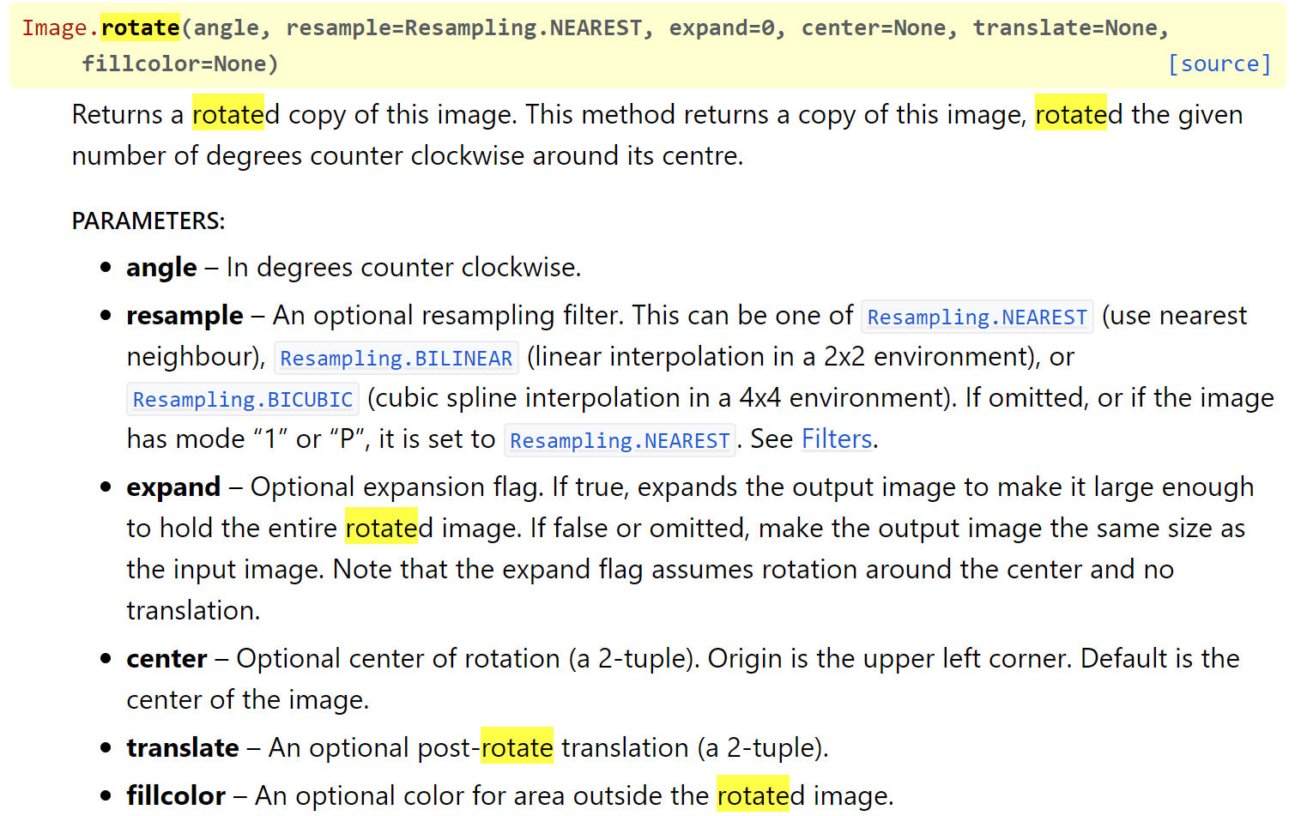
Images
Rotation using PIL rotate
More flexibility
But more complex
Directly rotate the image before drawing
imPIL = imPIL.rotate(angle)
https://pillow.readthedocs.io/en/stable/reference/Image.html#PIL.Image.Image.rotate

Slide 29
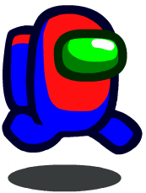
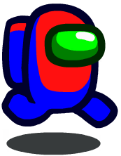
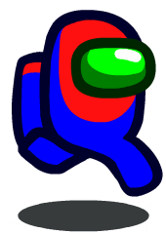
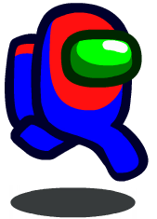
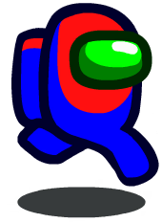
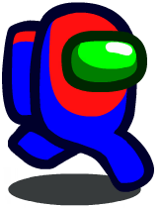
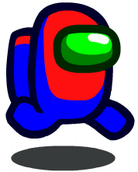
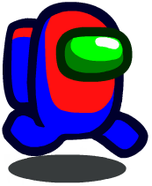
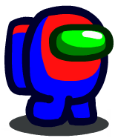
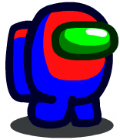
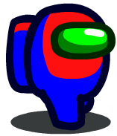
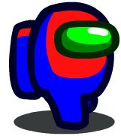
Sprites
Sprite images: https://www.spriters-resource.com/pc_computer/amongus/sheet/157129/
AmongUs Example
def onAppStart(app):
numImages = 12
app.images = []
for i in range(numImages):
filename = f'images/im{i}.png'
imPIL = Image.open(filename)
imCMU = CMUImage(imPIL)
app.images.append(imCMU)
app.imageIndex = 0
def onStep(app):
app.imageIndex += 1
app.imageIndex %= len(app.images)
def redrawAll(app):
image = app.images[app.imageIndex]
drawImage(image, 200, 200)
im0.png | im1.png | im2.png | im3.png | im4.png | im5.png | im6.png | im7.png | im8.png | im9.png | im10.png | im11.png

Slide 30

Sprites
Images from gif file
def onAppStart(app):
myGif = Image.open('kirby.gif')
app.images = []
for frameIndex in range(myGif.n_frames):
# Set the desired frame in the gif
myGif.seek(frameIndex)
# Copy the image frame from the gif
imPIL = myGif.copy()
imCMU = CMUImage(imPIL)
app.images.append(imCMU)
app.imageIndex = 0

Slide 31
Topics
OOP and Animations
Events++
Movement: Basic Physics
OOP Inheritance
Images
Sprites
Organizing code in separate python files

Slide 32
Organizing code in different files
Term projects certainly get large enough that putting all of your code in one file gets a bit nutty. You can organize your code in separate *.py files to add some sanity to your life ☺
One convention (though not necessarily a Python convention) is to put one class per file. You can also put more than one class in a file.
The key to this organization is to name your files such that it is easy to infer what is inside it.
Mechanics
Let's say file2.py has class A in it, you can add the following line to file1.py to access class A within file1.py:
from blob import Blob

Slide 33
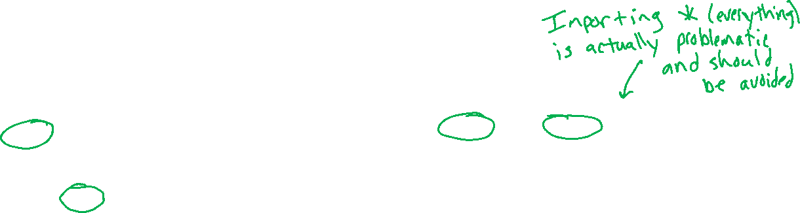
Organizing code in different files
main_app.py
Example
from cmu_graphics import *
from blob import Blob
def onAppStart(app):
app.blobs = []
def onMousePress(app, mx, my):
newBlob = Blob(mx, my)
app.blobs.append(newBlob)
def redrawAll(app):
for blob in app.blobs:
blob.draw()
def main():
runApp()
main()
blob.py
from cmu_graphics import *
class Blob:
def __init__(self, x, y, r=20):
self.x = x
self.y = y
self.r = r
self.color = 'lightBlue'
def draw(self):
drawCircle(self.x, self.y,
self.r, fill=self.color)

