Slide 1
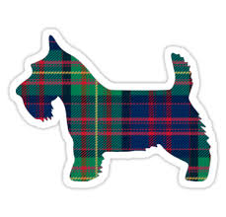

As you walk in
Introduce your self to people around you
Log into piazza.com (we’ll use it for polls in class)
    Any device is fine
    On a phone, the browser tends to work better than the app for polls

Slide 2

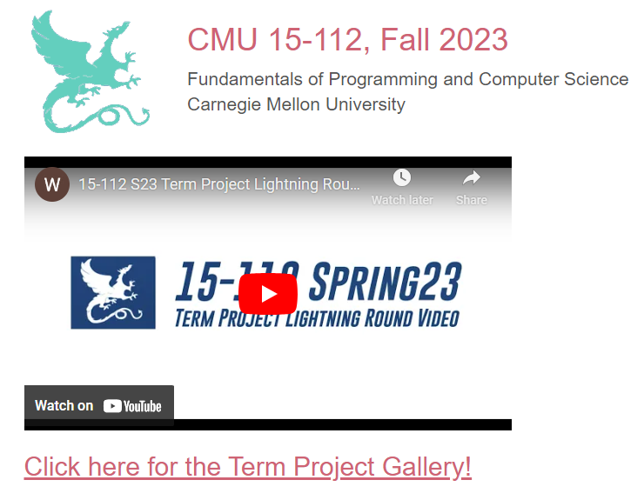
www.cs.cmu.edu/~112/gallery.html

Slide 3
www.cs.cmu.edu/~112/gallery.html

Slide 4
15-112
Lecture 2
Basic Programming Constructs
Instructor: Pat Virtue

Slide 5
Tuesday Logistics

Slide 6
[Practice] Poll 1
Are you new to CMU?

Slide 7
Course Team
https://www.cs.cmu.edu/~112/staff.html

Slide 8
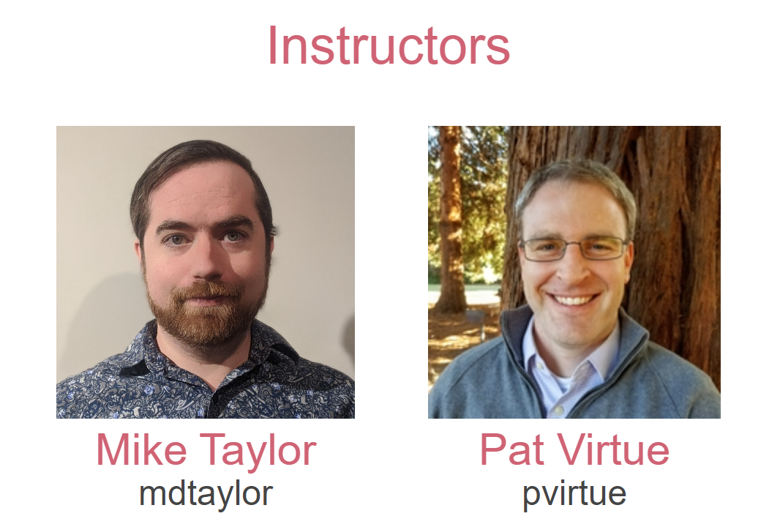

Slide 9
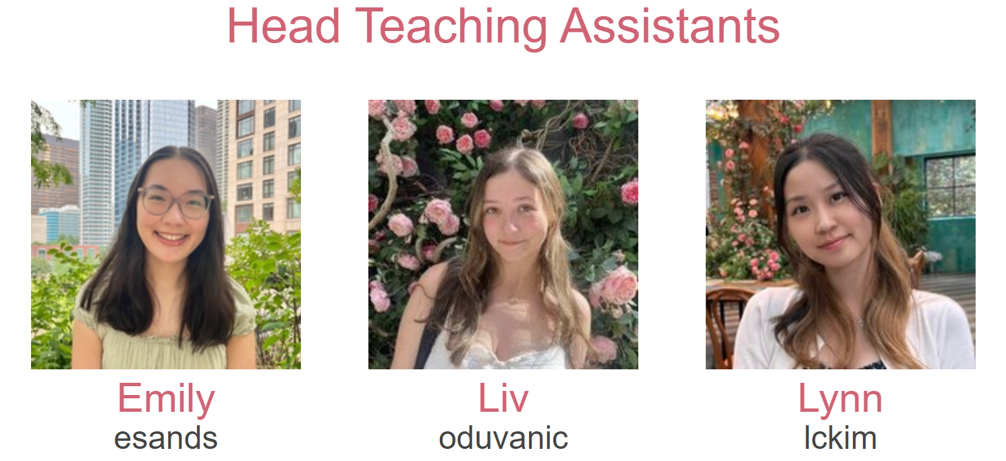
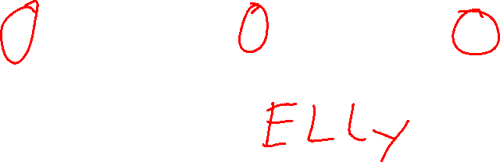

Slide 10
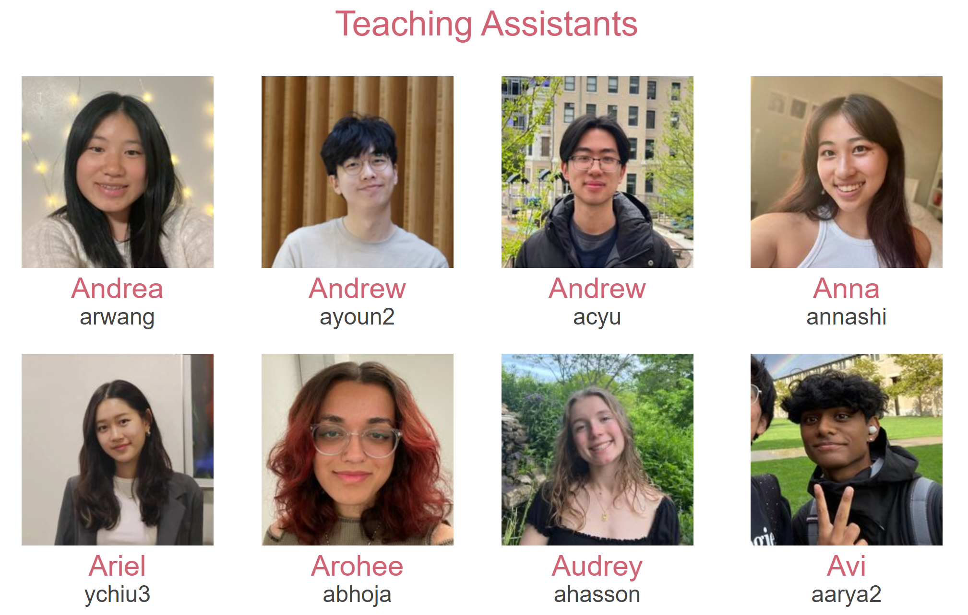

Slide 11
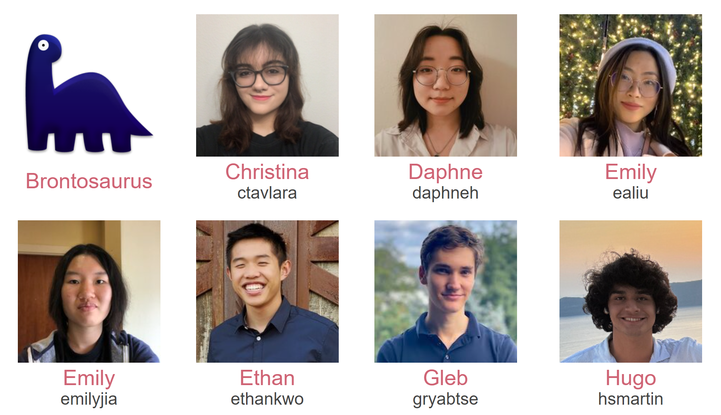

Slide 12
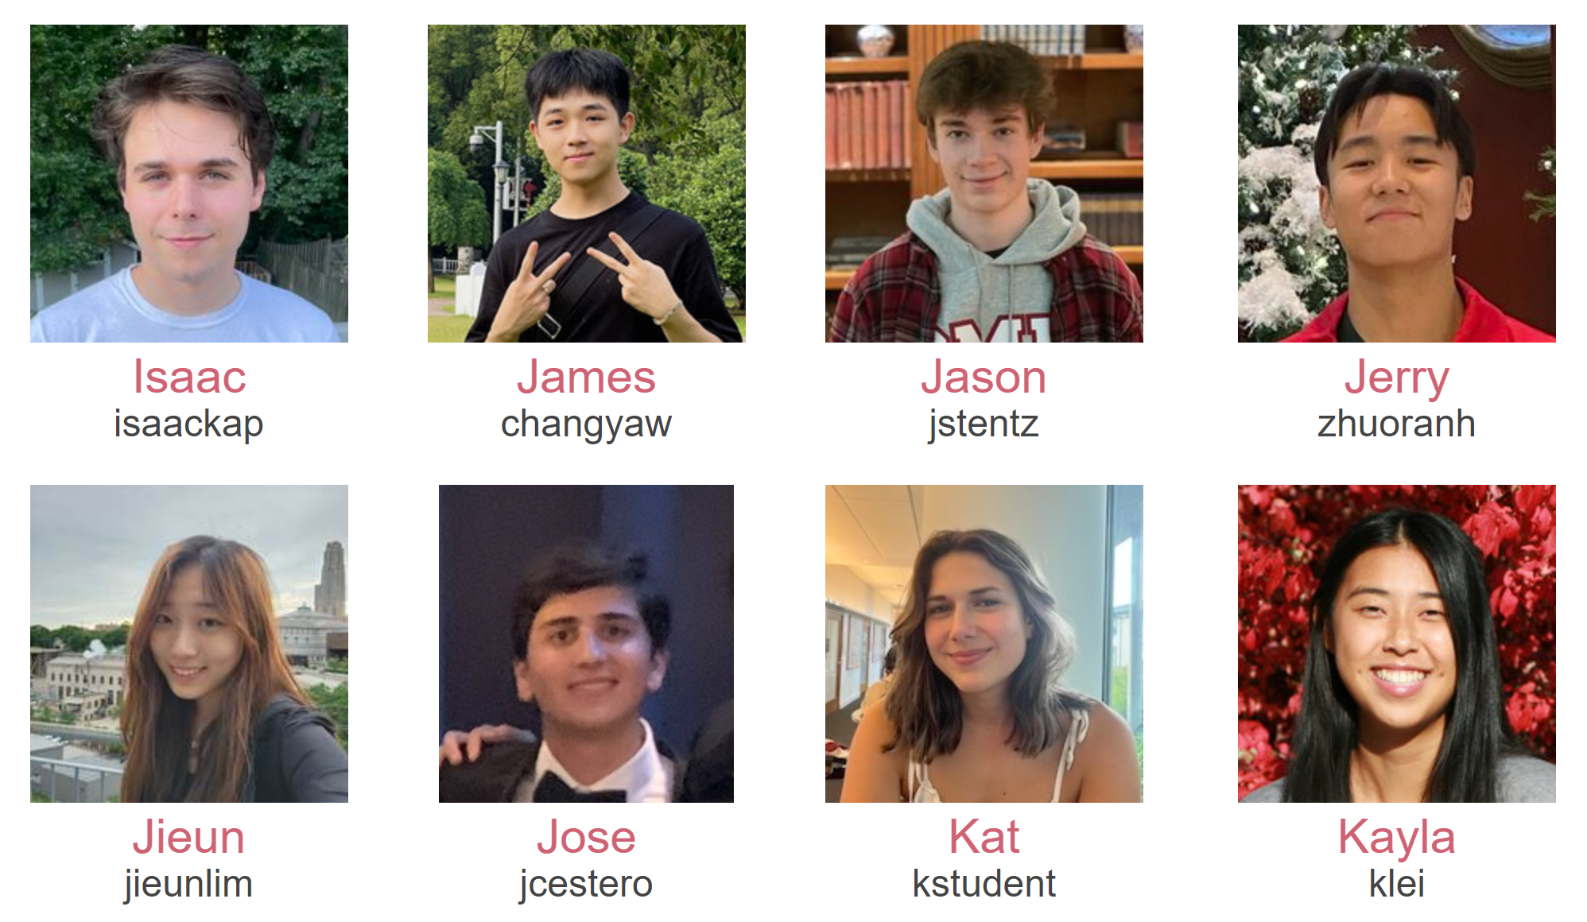

Slide 13
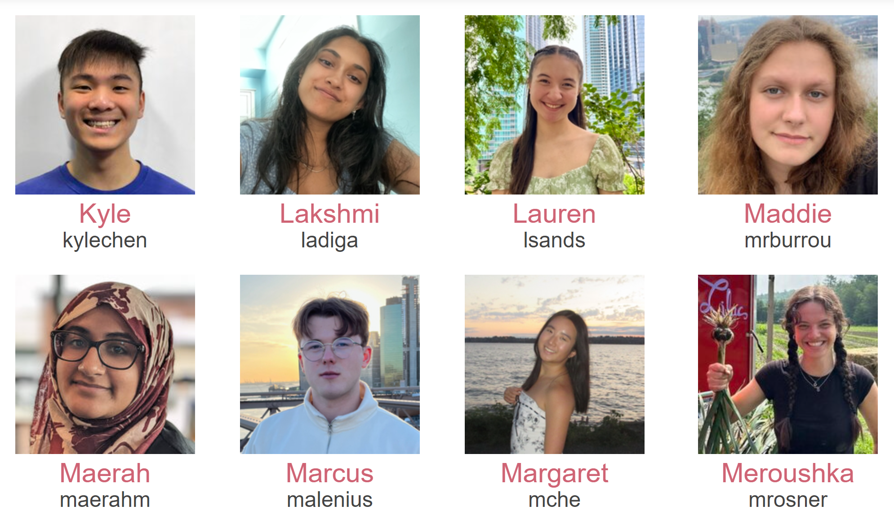

Slide 14
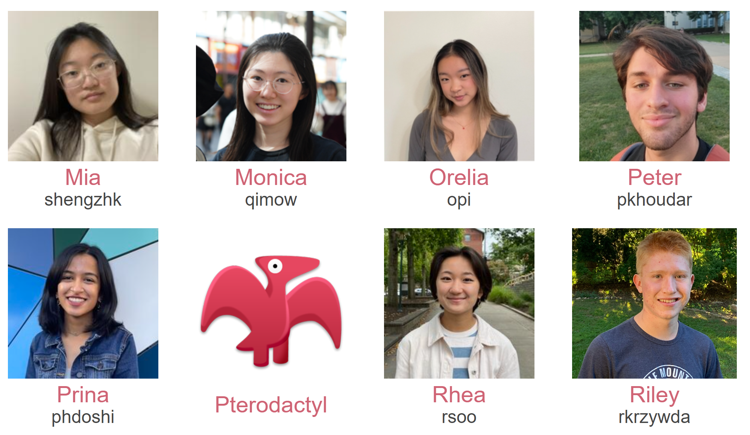

Slide 15
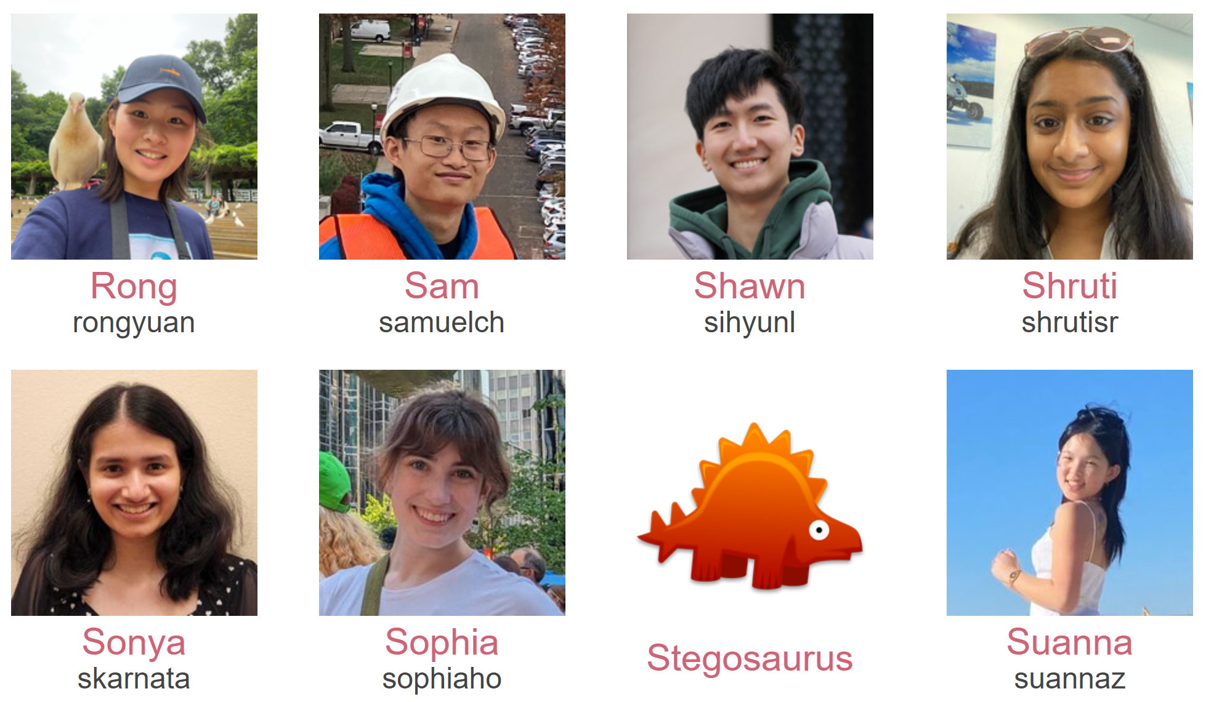

Slide 16
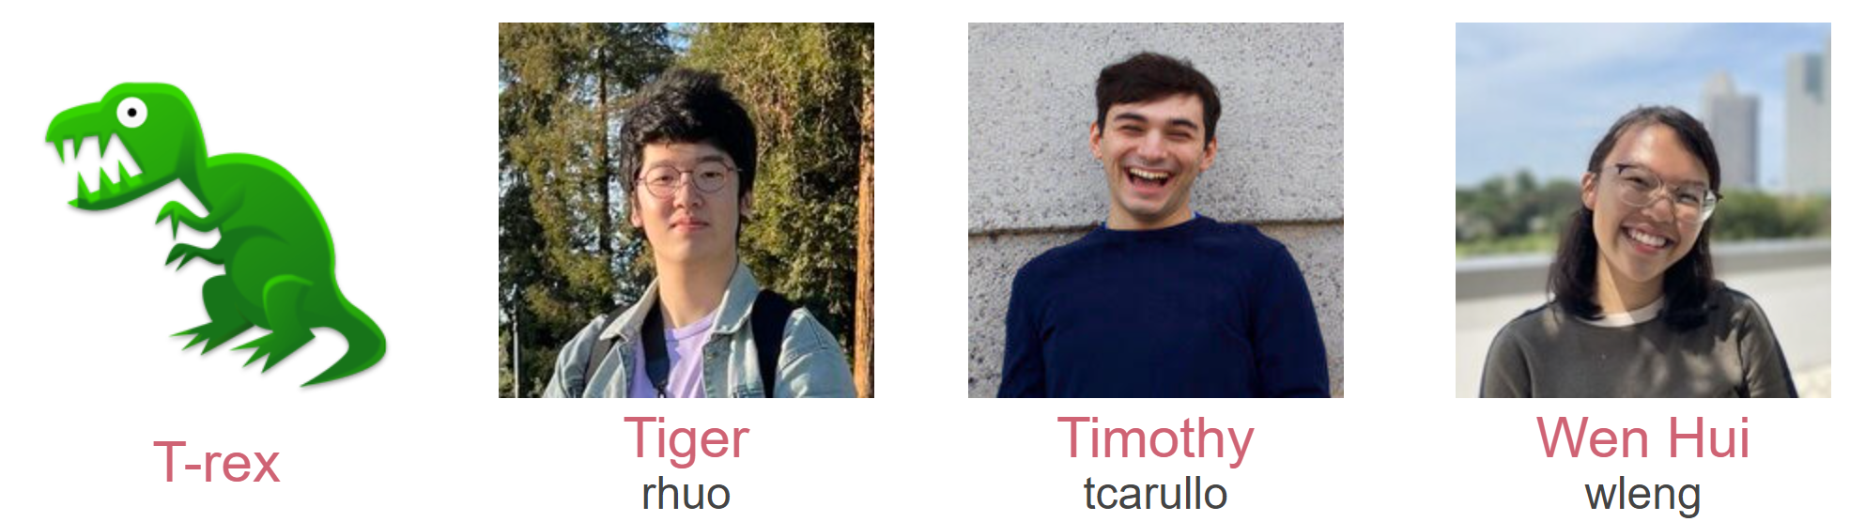

Slide 17

Course Team
Course administrative assistant
Marcie!

Slide 18
Course Team
Students!

Slide 19

[Practice] Poll 2
What college are you in?
BXA
CFA
CIT
DC
MCS
SCS
TSB
MIS/CMU/Other

Slide 20
[Practice] Poll 2 Take 2
What college is a person sitting next to you in?
BXA
CFA
CIT
DC
MCS
SCS
TSB
Other

Slide 21
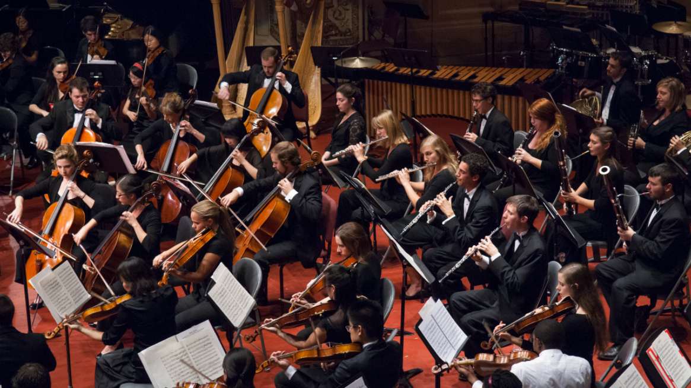
Course Team
Students!

Slide 22
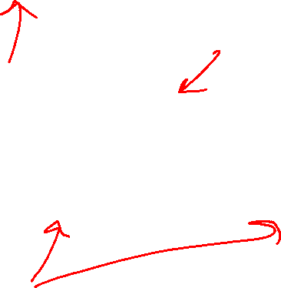
Course Information
Website: https://www.cs.cmu.edu/~112
Communication: https://piazza.com
If piazza doesn’t work:
E-mail: pvirtue@andrew.cmu.edu, mdtaylor@andrew.cmu.edu

Slide 23
Announcements
Recitation
Wednesday & Friday
  Both days required
  Attend your assigned section
  Friday: GHC 5th Floor Clusters

Slide 24
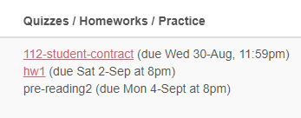
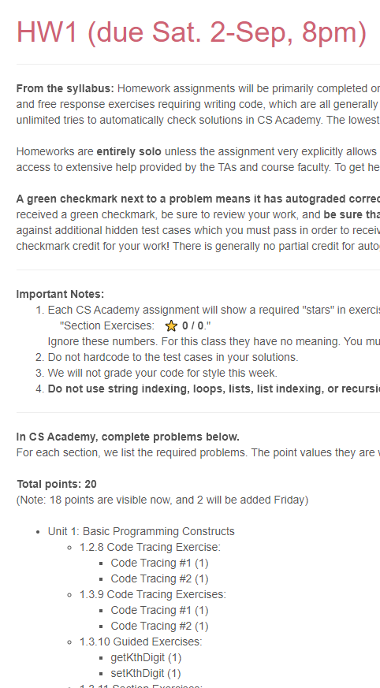
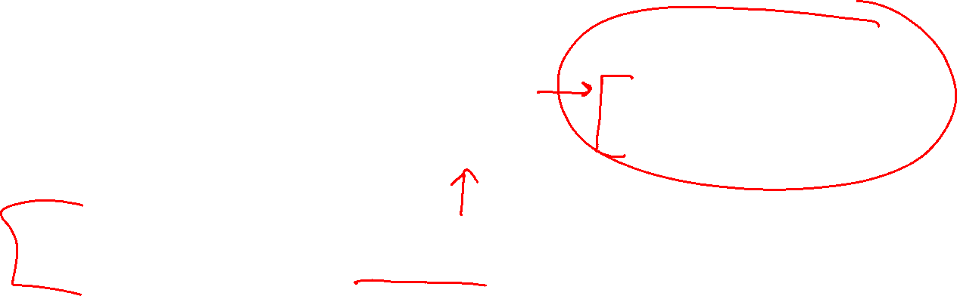
Announcements
Assignments:
https://www.cs.cmu.edu/~112/schedule.html
112 student contract
    Due Tomorrow 8/30, 11:59 pm
HW1
    Due Saturday 9/2, 8 pm
Week 2 Pre-reading Checkpoint
    Released by Thursday
    Due Mon 9/3, 8 pm

Slide 25
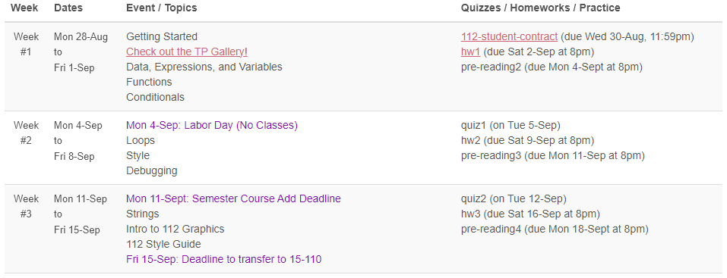
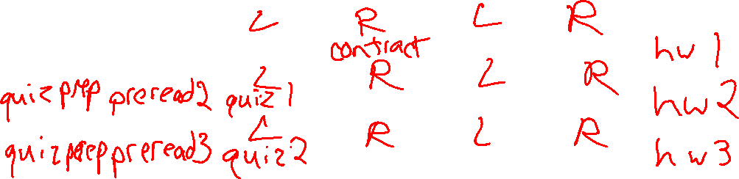
Weekly Rhythm
https://www.cs.cmu.edu/~112/schedule.html
 | Sun | Mon | Tue | Wed | Thu | Fri | Sat
Week 1
Week 2
Week 3

Slide 26
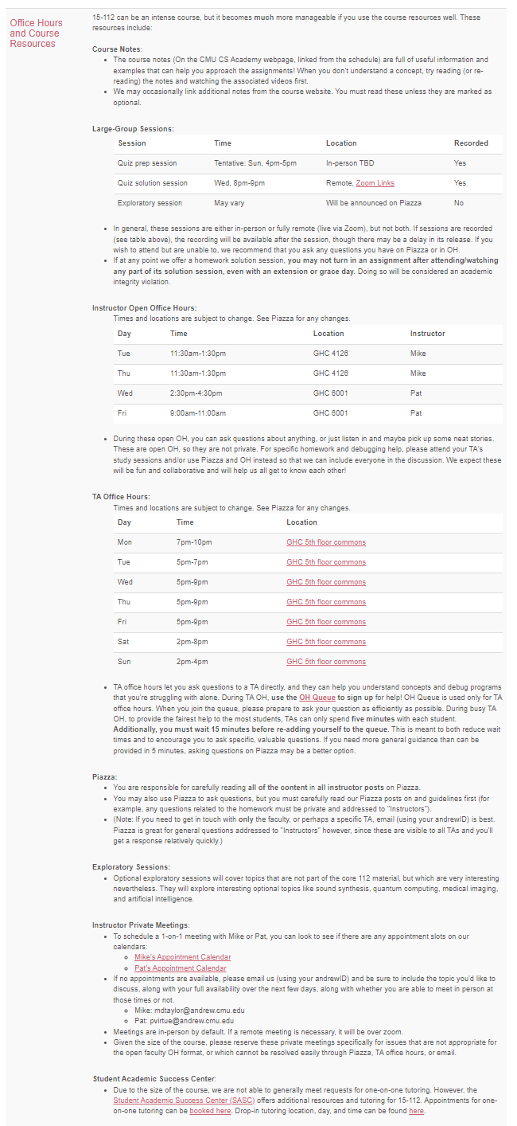
Course Resources
Use 112 resources wisely!

Slide 27
Lecture Logistics
Polls
One participation point for *each* take
Correctness of answer doesn’t count
Profs really do use this as realtime feedback on your understanding
Don’t stress
Tech issues
    One-time issue: no problem, you just need >= 80%
    Persistent issue: let us know so we can find a solution
Used for educational technique call Peer Instruction (more on this later

Slide 28

Lecture Logistics
Notes
CS Academy notes
Required reading (and viewing)
Pat’s Slides
Additional resource. Helpful for lecture notetaking and review
Preview version posted before lecture (on website Schedule)
Inked versions posted later (on website Schedule)
Taking notes
Devices in lecture

Slide 29
Thursday Logistics

Slide 30
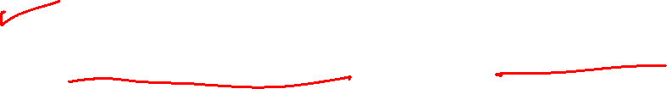
Thursday Announcements
Recitation
Friday
  Required
  GHC 5th Floor Clusters (see link to GHC 5 video on syllabus)

Slide 31
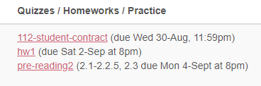
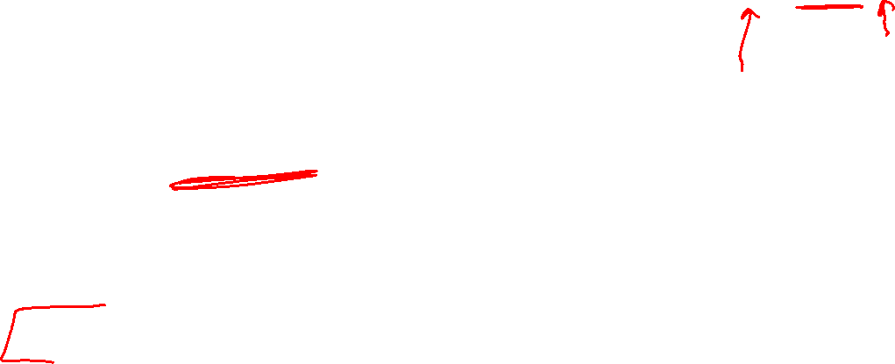
Thursday Announcements
Assignments:
https://www.cs.cmu.edu/~112/schedule.html
112 student contract
    Due YESTERDAY 8/30, 11:59 pm
HW1
    Due Saturday 9/2, 8 pm
Week 2 Pre-reading Checkpoint
    Released by Thursday
    Due Mon 9/3, 8 pm

Slide 32
Weekly Rhythm
https://www.cs.cmu.edu/~112/schedule.html
https://www.cs.cmu.edu/~112/syllabus.html
Support (see syllabus and watch Piazza)
OH
Practice Quiz
Quiz Prep Session
 | Sun | Mon | Tue | Wed | Thu | Fri | Sat
Week 1 |  |  | Lec | Rec Contract | Lec | Rec | HW due
Week 2 | Quiz prep | Pre-reading | Lec Quiz in Lec | Rec | Lec | Rec | HW due
Week 3 | Quiz prep | Pre-reading | Lec Quiz in Lec | Rec | Lec | Rec | HW due

Slide 33
Lecture Logistics
Polls
Polls this week don’t count. Just practicing Piazza.
Don’t stress
Tech issues
    One-time issue: no problem, you just need >= 80%
    Persistent issue: let us know so we can find a solution

Slide 34
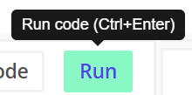
Tips!
Tips for editing code
Run code without clicking Run button
Ctrl/Cmd + Enter
Comment or uncomment block of code
Select multiple lines together
Ctrl/Cmd + /
Indent or unindent block of code
Select multiple lines together
Indent: Ctrl/Cmd + Tab
Unindent: Ctrl/Cmd + Shift + Tab

Slide 35
Getting Started with Python

Slide 36
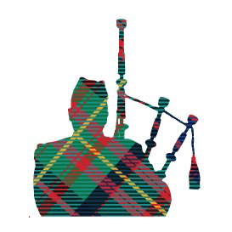
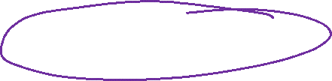
Hello World!
Classic start to new tech
print("Hello World!")
But where can we run this?

Slide 37
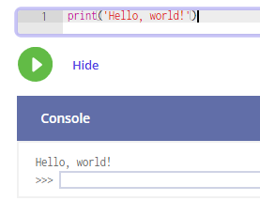
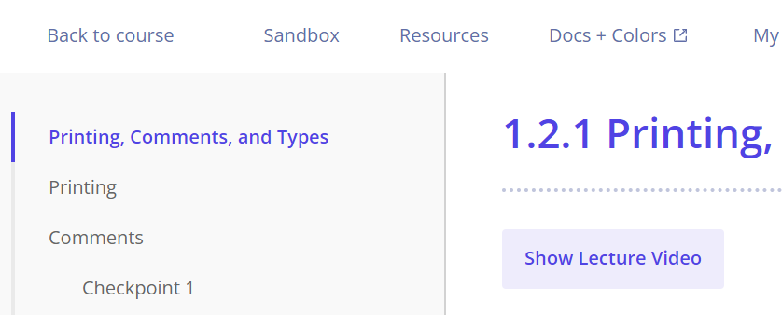
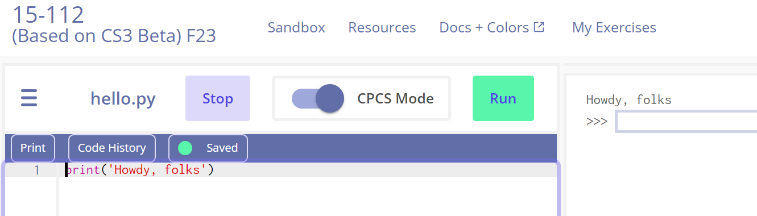
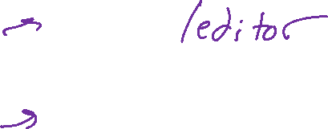
Running Python
CS Academy
Edit code boxes in notes
Exercises
Sandbox!
Python file
Python interpreter

Slide 38
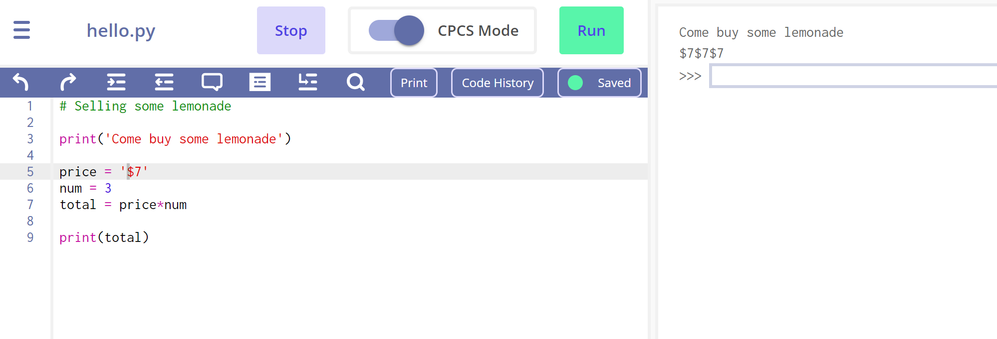
Python files/editor vs Python interpreter
Python files and editor
Write and save code
Python interpreter
Quickly test code and explore

Slide 39
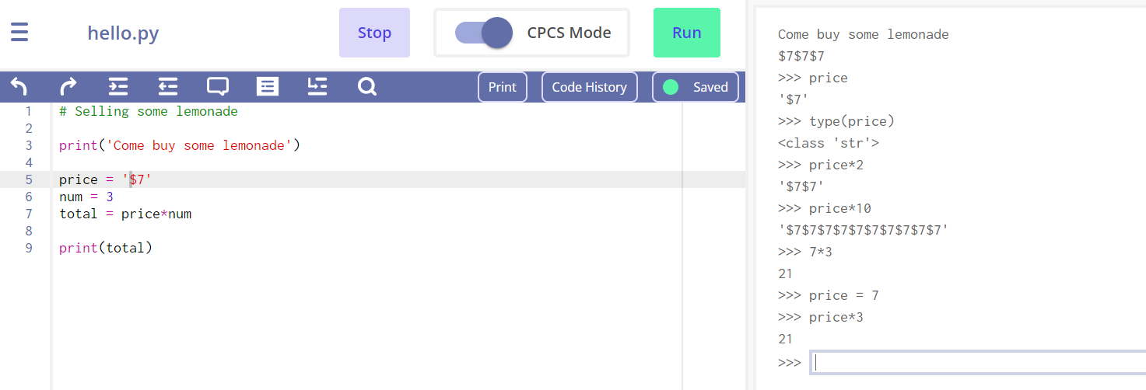
Python files/editor vs Python interpreter
Python files and editor
Write and save code
Need to explicitly run code
Python interpreter
Runs each line when you hit enter
Auto prints resulting object
Quickly test code and explore

Slide 40
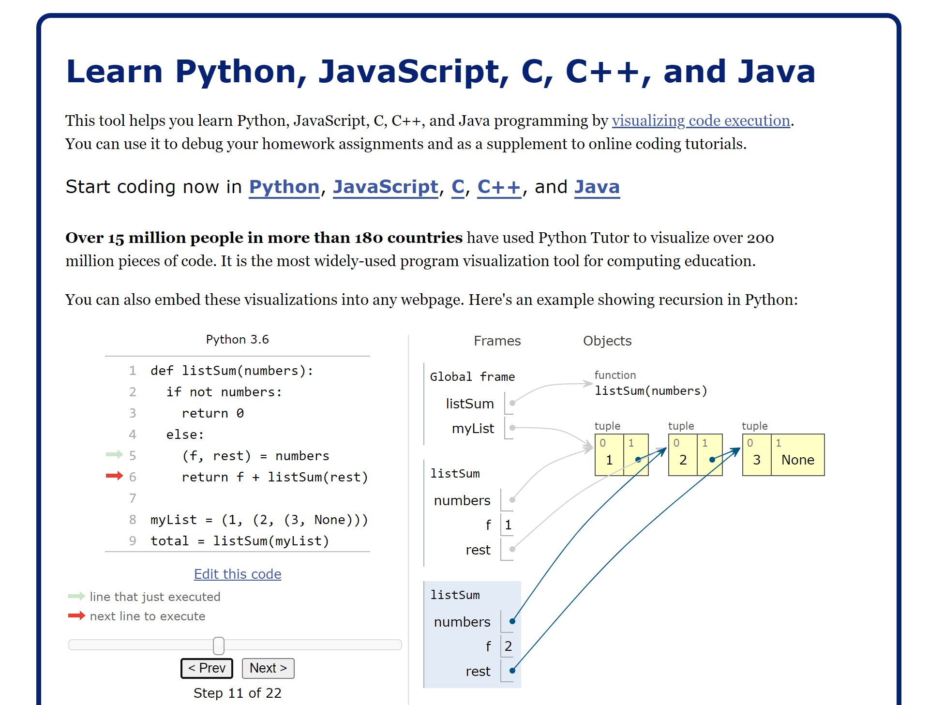

Running Python
Pythontutor
Help *see* how Python works

Slide 41
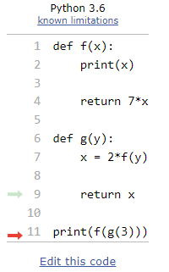
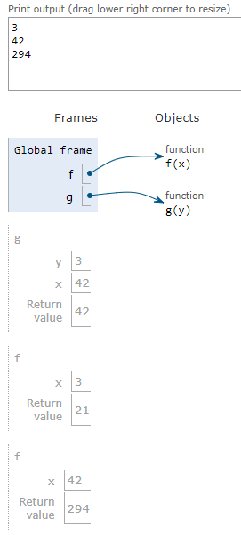
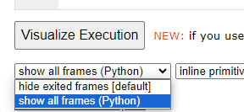
Running Python
Pythontutor
Help *see* how Python works
Helpful to learn how to write out work for code tracing
Recommended setting
(bottom-left)

Slide 42

Running Python
(more details later in course)
Terminal (a.k.a. command line) → python → Python interpreter
(Code) Editor myFile.py → Terminal: python myFile.py
IDE (Integrated development environment)
Editor connected with terminal/interpreter
VS Code (more details later in course)

Slide 43
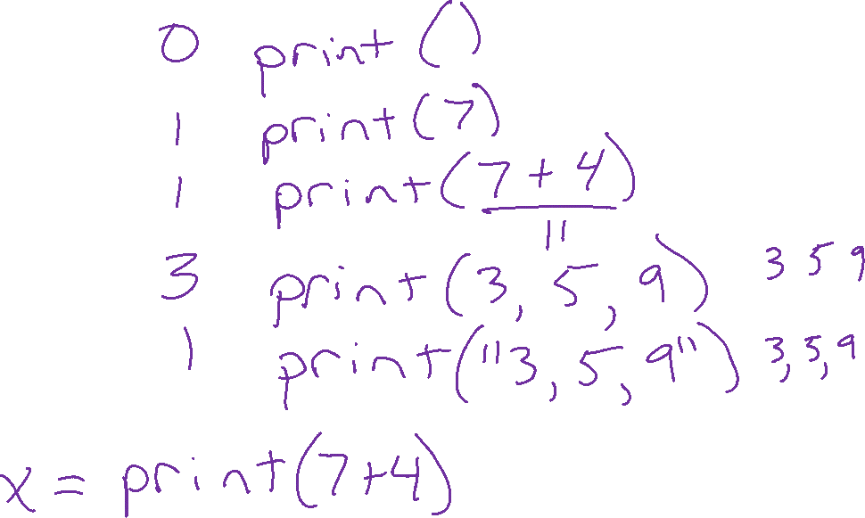

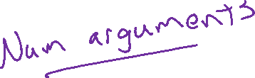

Printing

Slide 44
Printing
We can print a few different types of things in Python:
Text (which we call a "string")
print('Hello World!’)
Hello World!
Numbers (which we'll separate into integers and floating point numbers)
print(123)
print(12.3)
Expressions (which evaluate to a value before we print them)
print(12+3)
15

Slide 45
Printing Multiple Things
Call the print function with multiple arguments separated by commas
(An "argument" is a value that we pass to a function)
print('12+3:', 12+3)
12+3 = 15
This will print them separated by spaces (not commas)
print('Thing1', 'Thing2’)
Thing1 Thing2

Slide 46
Printing with f-strings (formatted strings)
By putting the letter f right before a string, you can then
place variable names in {squiggly braces} to print their values, like so:
x = 42
y = 99
print(f'Did you know that {x} + {y} is {x+y}?’)
Did you know that 42 + 99 is 141?
Since the introduction of f-strings in Python, this has become a popular way to print combinations of text and values.

Slide 47
The print function
print is a function. The print function will send text to the console output.
Like in math, Python functions return values, and we can assign those values to variables, e.g. y = abs(-7)
But, some functions, like print, just return the special Python value None
y = print('Hello World!’)
print(f'The value of y is {y}.')
Hello World!
The value of y is None.

Slide 48
Operators and expressions

Slide 49


Operators Summary
Arithmetic
  +, -, *, /, **, //, %, - (unary), + (unary)
Comparison
  <, <=, >=, >, ==, !=
Assignment
  +=, -=, *=, /=, //=, **=, %=
Logical
  and, or, not
Note: not covering the bitwise operators (for now at least)
<<, >>, &, |, ^, ~, &=, |=, ^=, <<=, >>=

Slide 50
Arithmetic Operators
print(6 + 2)
print(6 - 2)
print(6 * 2)
print(6 / 2)
8
4
12
3.0
>>>

Slide 51
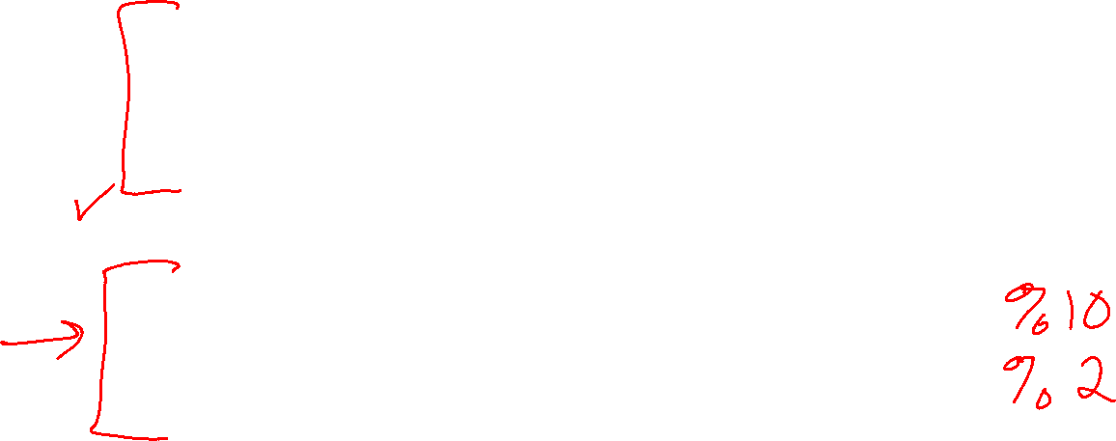

Arithmetic operators
Operator | Example Python | Example Result
Addition | 3+5 | 8
Subtraction | 3-5 | -2
Multiplication | 3*5 | 15
Division | 3/5 | 0.6
Power (Exponent) | 3**5 | 243
Negation | -3 | -3
Modulo “Mod” (remainder) | 5 % 3 | 2
“Div” (integer division) | 5 // 3 | 1

Slide 52
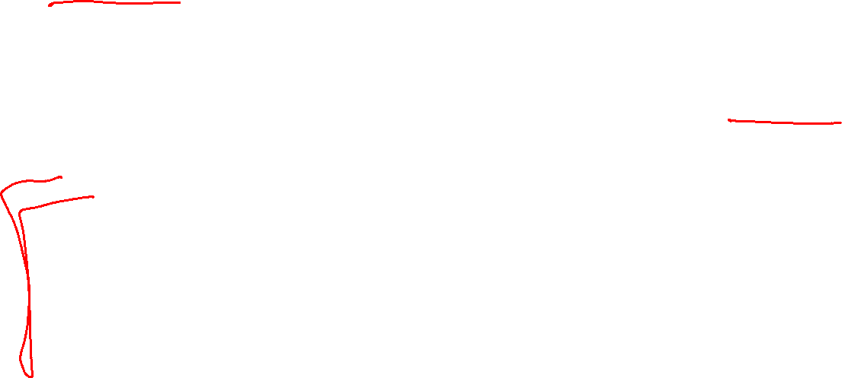
Expressions
Expression in Python are just segments of code that evaluate to a value (or more specifically an object)
For arithmetic expressions, we need to pay attention to the order of operations.
Paratheses
Can change affect the order of operations, just like in math
Can help clarify the order of operations, even when not necessary
In general, don’t add unnecessary paraentheses unless for clarity

Slide 53
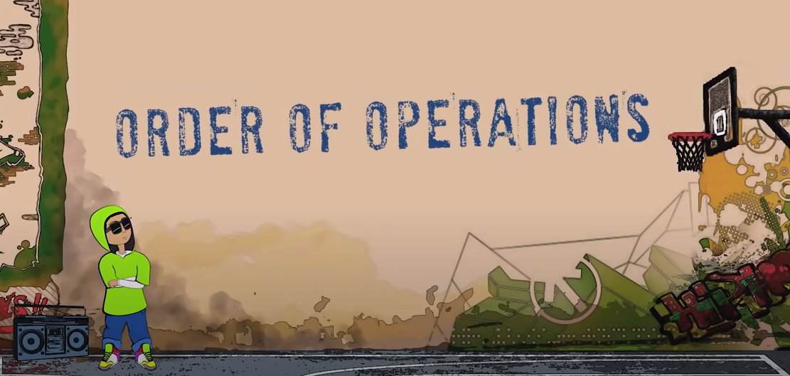
Order of operations
PEMDAS
https://www.youtube.com/watch?v=ZzeDWFhYv3E

Slide 54
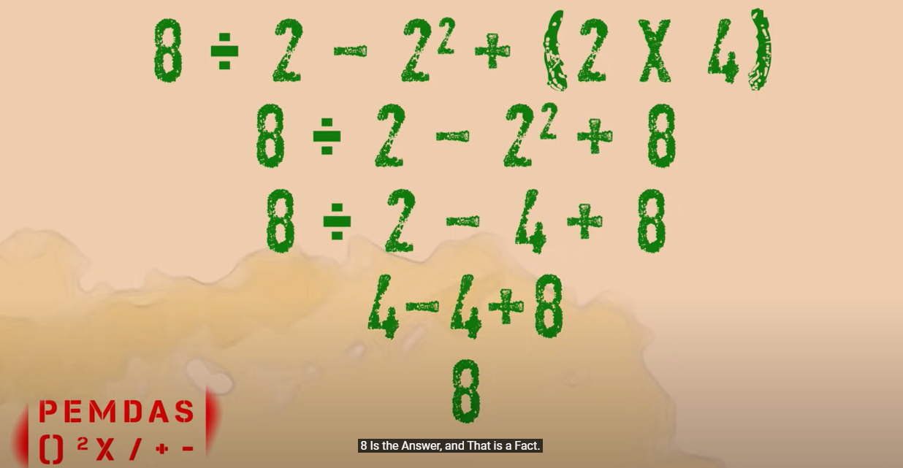
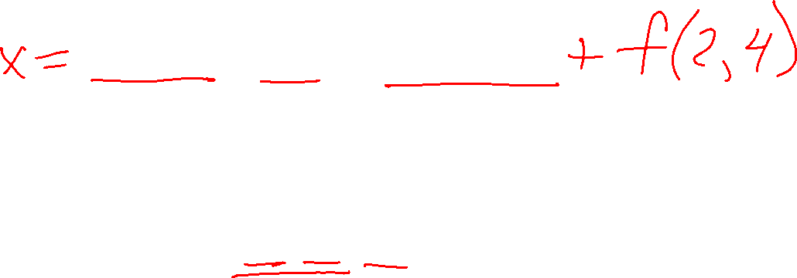
Order of operations
Tip
Be a robot!
PEMDAS
https://www.youtube.com/watch?v=ZzeDWFhYv3E

Slide 55
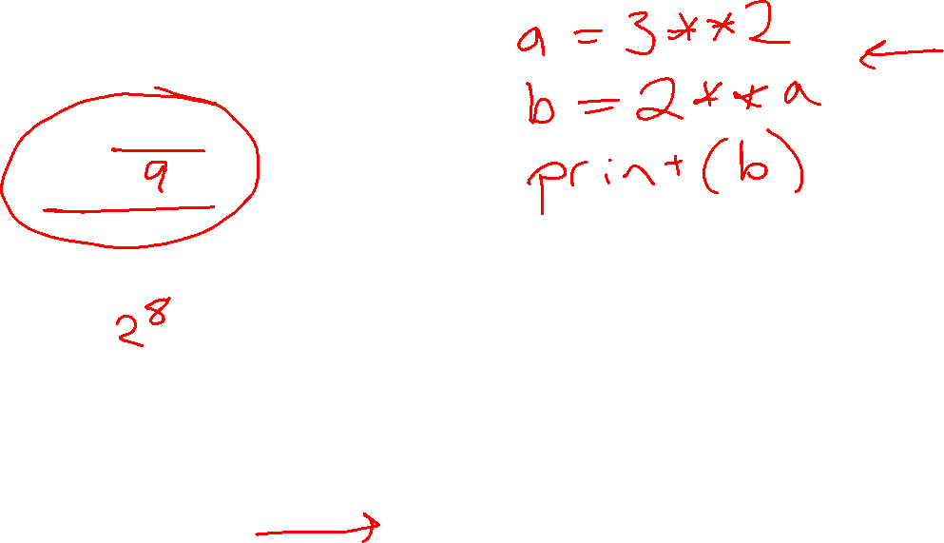
Poll 3
What does this print?
print(2**3**2)
7
64
512
Error
Debugging tip!
Expressions are things in Python that evaluate to a value
Save expressions (of all sizes) to variables
Use print(expr) to confirm values and order of operations

Slide 56
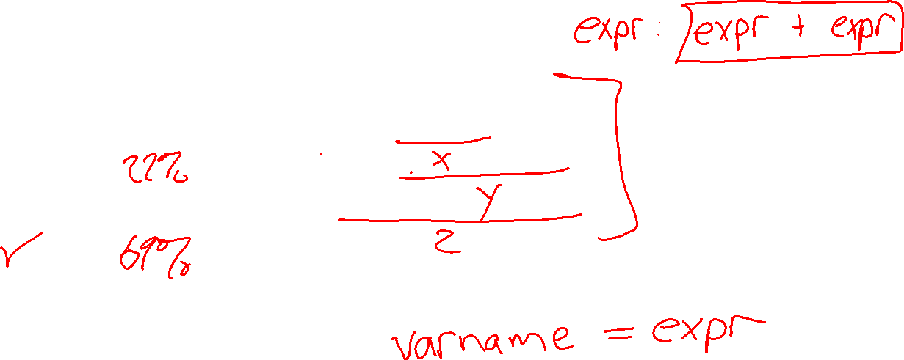
Poll 4
How many expressions are there in:
a - a // b * b
1
2
3
4
5
Other
I have no idea

Slide 57
Errors

Slide 58
Natural Language
Lessons learned
Sensitive to small things
    Like spelling, grammar, usage
    Different kinds of error
Different from language to language
Be patient while you learn
    With yourselves
    With each other
Commas save lives
Don’t consume your relatives
Which is correct?
Letss eat Grandma
Letss eat, Grandma
Lets eat Grandma
Lets eat, Grandma
Let’s eat Grandma
Let’s eat, Grandma

Slide 59
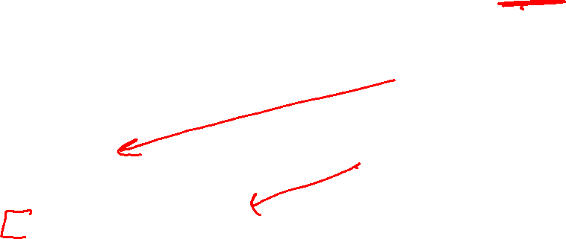
Errors
Syntax error
      print("100") # Never prints
      1 ? 0
      print("200") # Never prints
Runtime error
      print("100") # Prints!
      1 / 0
      print("200") # Never prints
Logical error
      print(f"100:, {x}") # Prints!
      if x % 2 == 1:
      print(f"{x} is even") # Prints?
      print("200") # Prints!
Debugging tip!
Use print functions to help learn where runtime errors are happening
Debugging tip!
Use print functions to see if branches of code are being entered

Slide 60
Poll 5 (Unused)
What happens when we run the following line?
x = 3(2+7)
x takes on the value 27
Syntax error
Runtime error
Logical error
I have no idea

Slide 61
Errors
Tip
Keep a list of errors that you encounter along with what they might mean
TypeError: 'int' object is not callable
Hmm, I probably have number, variable, or expression followed by a (
e.g., x = 3(2+7) should be x = 3*(2+7)
NameError: name 'total' is not defined
Hmm, I probably have variable named total that I never assigned a value
      num = 10
      mean = total/num

Slide 62
Strings and Comments

Slide 63
Poll 6 (Unused)
Which one does the right thing?
Select all that apply
print("Have you read "Pride and Prejudice" by Jane Austen?")
print("Have you read 'Pride and Prejudice' by Jane Austen?")
print('Have you read 'Pride and Prejudice" by Jane Austen?')
print('Have you read "Pride and Prejudice" by Jane Austen?')

Slide 64

Poll 6 (Unused)
Which one does the right thing?
Select all that apply
print("Have you read "Pride and Prejudice" by Jane Austen?")
print("Have you read 'Pride and Prejudice' by Jane Austen?")
print('Have you read 'Pride and Prejudice" by Jane Austen?')
print('Have you read "Pride and Prejudice" by Jane Austen?’)
print("Have you read "Pride and Prejudice" by Jane Austen?")
print("Have you read 'Pride and Prejudice' by Jane Austen?")
print('Have you read 'Pride and Prejudice" by Jane Austen?')
print('Have you read "Pride and Prejudice" by Jane Austen?')

Slide 65
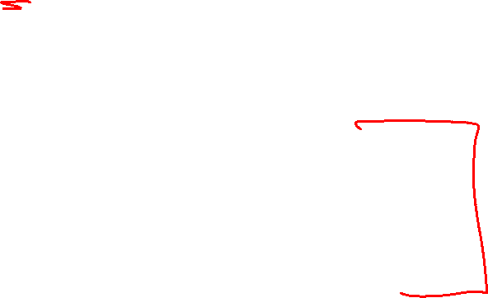
Strings
Single or double quote are fine
Can be useful for quotes withing strings (but alternated correctly)
Escape characters are needed sometimes (more on this later in the course)
print('Have you read Jane Austen\'s "Pride and Prejudice" recently?')
There are also triple quotes for multiline strings (actually, often used for comments)
f-Strings
Really useful to print a combination of strings and expressions
x = 42
y = 99
print(f'Did you know that {x} + {y} is {x+y}?')

Slide 66
Comments Summary
Notes for humans (really important!)
# Comments can go on their own line
i = 0 # Comments can go at the end of a line
def squared(x):
""" This is technically a multiline string
but is often used as a comment
"""
return x**2

Slide 67
Comments
print("Hello World!") # This is a comment
# print("What will this line do?")
Comments are for humans
Comments are sections of text that we can write in Python (and most computer languages) that provide helpful information for humans to understand the associated code.
In Python, a # symbol (also called a "pound sign" or "hash symbol") begins a comment and tells Python to ignore all of the contents from the # sign until the end of the line.
Even though Python ignores the contents of a comment, comments are an essential part of writing clear code!

Slide 68
Comments
# Comment on its own line
x = 7 # Comment after code
# Multiline comments can be useful too
# when you have more to say
# or just want to make your comments easier to read

Slide 69
Comments
"""
Long comments can be written inside triple-quotes.
Either triple-single-quotes or triple-double-quotes work.
These can save you from writing a # on every line.
(these long quotes are technially strings that are
just ignored by Python.)
"""

Slide 70
Poll 7 (Unused)
"""
print("ONE")
print("TWO")
"""
print("THREE")
print("FOUR")
# print("FIVE")
print("SIX") #
# print("SEVEN") #
# print("EIGHT") # print("NINE")
Which of the following will be printed?
Select all that apply
ONE
TWO
THREE
FOUR
FIVE
SIX
SEVEN
EIGHT
NINE

Slide 71
Poll 7 (Unused)
"""
print("ONE")
print("TWO")
"""
print("THREE")
print("FOUR")
# print("FIVE")
print("SIX") #
# print("SEVEN") #
# print("EIGHT") # print("NINE")
Which of the following will be printed?
Select all that apply
ONE
TWO
THREE
FOUR
FIVE
SIX
SEVEN
EIGHT
NINE

Slide 72
Variables

Slide 73



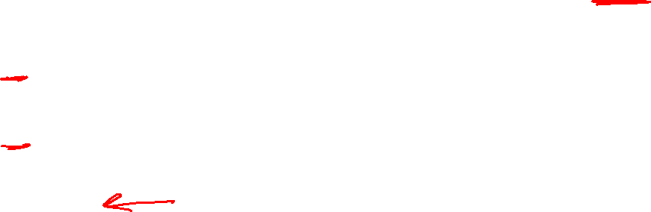
Poll 8
Which of the following will result in the variable x being 0.4?
Select all that apply
x = 0.4
0.4 = x
x = 2/5
2/5 = x
5x = 2
2 = 5x
5*x = 2
2 = 5*x
None of the above

Slide 74
Variables Summary
# The variable we are assigning has to
# be the ONLY thing on the left
# of the = sign
# 4 = x # Error
# 3*x = 4 # Error
x = 4/3
print(x)
x = 4
y = x**2
print(x)
print(y)
# Reassign x to 3
x = 3
print(x)
print(y)
# y is still 16 (not automatically y = 3**2)
# We would have to execute y = x**2 again for y to be 3**2
y = x**2
print(x)
print(y)

Slide 75
Python Objects and Variable Naming
All of the “things” in Python are objects
Python objects all have:
id More on object ids when we get to lists
value We can try to see this with print(x)
type We can see this with type(x)
Variable naming
Think of a variable name as a gift tag attached to an object
Python keeps track of variable names to allow us to use that object later
id: 103100
value: 5
type: int
x
Object
Variable name

Slide 76
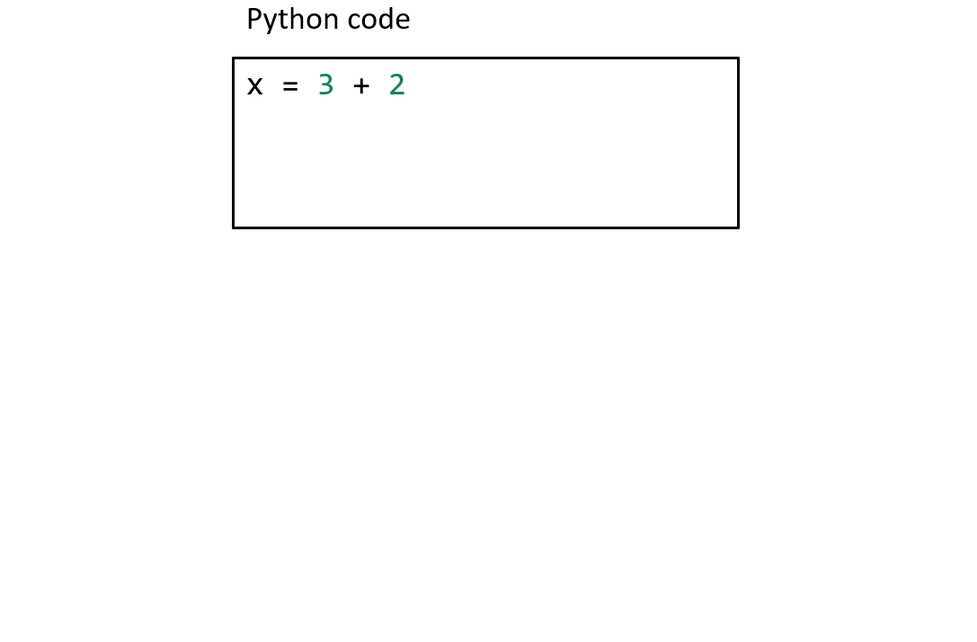
Variable Assignment
variable_name = expression
Variable name must be the ONLY thing on the LEFT of the =
Everything to the RIGHT of the = will be evaluated before the name is assigned
Python code
x = 3
Object
Variable name
value: 3
x

Slide 77
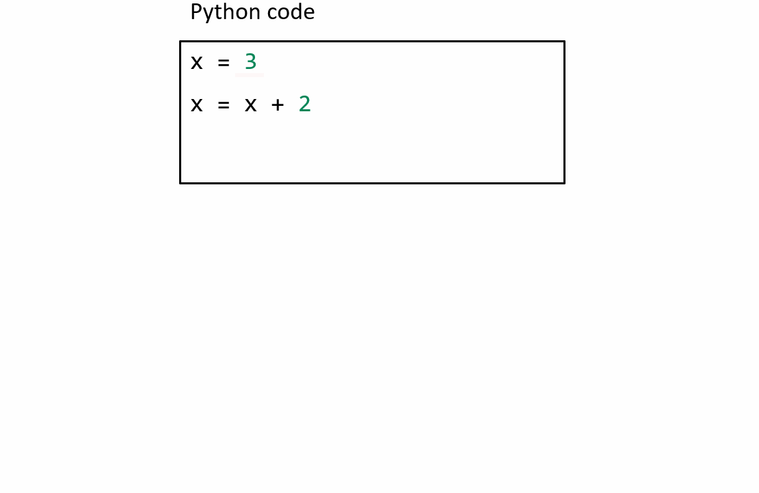
Variable Reassignment
variable_name = expression
Python evaluates the right-hand-side to create a single object and then assigns the variable name tag to that object

Slide 78
Assigning a Variable to a Variable
another_variable_name = variable_name
Multiple variables can point to the same object
For example, after running the following two lines, score and total_score will both be 10
score = 10
totalScore = score
score
Object
Variable name
value: 10
totalScore
Variable name

Slide 79

Variables
Variable names often temporarily point to the same object and are later changed to point to something else

Slide 80



Poll 9 (Unused)
Which of the are valid variable names in Python
Select all that apply
val = 4
4val = 4
val4 = 4
my4val = 4
four = 4
value? = 4
my value = 4
my_value = 4
my-value = 4
myValue = 4

Slide 81
Arithmetic assignment operators
Operator | Shortcut | Long(cut)
Addition | x += 5 | x = x + 5
Subtraction | x -= 5 | x = x - 5
Multiplication | x *= 5 | x = x * 5
Division | x /= 5 | x = x / 5
Power (Exponent) | x **= 5 | x = x**5
Modulo “Mod” (remainder) | x %= 5 | x = x % 5
“Div” (integer division) | x //= 5 | x = x // 5

Slide 82
Functions

Slide 83
Functions
def function_name(parameter):
body_including_return_statements
def myFunctionName(parameter1, parameter2, parameter3):
# Do something here
return 42
argument1 = 3
argument2 = 9
argument3 = 27
x = myFunctionName(argument1, argument2, argument3)

Slide 84
Poll 10 (Unused)
A)
def distance(x1, y1, x2, y2):
return ((x1-x2)**2 + (y1-y2)**2)**0.5
Which code is better?
B)
def distance(x1, y1, x2, y2):
xDiff = x1 - x2
yDiff = y1 - y2
xDiffSquared = xDiff**2
yDiffSquared = yDiff**2
sumOfSquares = xDiffSquared + yDiffSquared
result = sumOfSquares**0.5
return result

Slide 85

Poll 11 (Unused)
This code just started executing in pythontutor.com, to which will the red arrow move to next?

Slide 86
Types

Slide 87
Types
Types we are working with so far
int, float, str, bool, NoneType (and type)
Code
Output
print(type(3))
print(type(3.0))
print(type("3"))
print(type(True))
print(type(None))
print(type(int))
<class 'int'>
<class 'float'>
<class 'str'>
<class 'bool'>
<class 'NoneType'>
<class 'type'>

Slide 88
Types
type(value) vs isinstance(value, type)
Code
s = 'abc'
print(type(s) == str)
print(isinstance(s, str))
print(isinstance(s, int))
Output
True
True
False

Slide 89
Types
x = 4
y = 3
z = x*y
print(f'{x}*{y} = {z}')
print(f'The type of z is {type(z)}.')
Why do we care?
Types affect semantics
(i.e., depending on the type of objects involved, an expression may do different things)
4*3 = 12
The type of z is <class 'int'>.
x = 4
y = '3'
z = x*y
print(f'{x}*{y} = {z}')
print(f'The type of z is {type(z)}.')
4*3 = 3333
The type of z is <class 'str'>.
x = 4.0
y = '3'
z = x*y
print(f'{x}*{y} = {z}')
print(f'The type of z is {type(z)}.')
Traceback (most recent call last):
File "g:\My Drive\112\workspace\week1\lec\variables.py", line 41, in <module>
z = x*y
TypeError: can't multiply sequence by non-int of type 'float'

Slide 90
Types Conversions
We can convert between types when necessary
n = int('12')
print(type(n))
print(5*n)
Output
<class 'int'>
60
Example with input() function
responseStr = input('How many pears to you want to buy? ')
responseInt = int(responseStr)
pricePerPear = 1.5
totalPrice = responseInt * pricePerPear
print(f'That will cost ${totalPrice}.')

Slide 91
Comparison operators

Slide 92
Operators Summary
Arithmetic
  +, -, *, /, **, //, %, - (unary), + (unary)
Comparison
  <, <=, >=, >, ==, !=
Assignment
  +=, -=, *=, /=, //=, **=, %=
Logical
  and, or, not
Note: not covering the bitwise operators (for now at least)
<<, >>, &, |, ^, ~, &=, |=, ^=, <<=, >>=

Slide 93
Operators with Boolean values
Comparison
  <, <=, >=, >, ==, !=, is
  e.g., x <= y
  Results in Boolean value
Logical
  and, or, not
  Intended to compare two Boolean values (or negate one Boolean value in the case of not)

Slide 94
Poll 12 (Unused)
What will this print?
print(0.3 == 0.1 + 0.1 + 0.1)
True
False
I don’t know

Slide 95
Issues with floats
Equality
x = 0.1 + 0.1 + 0.1
y = 0.3
x == y # Doesn’t work well with floats
Use cmu_cpcs_utils: almostEqual(x, y)
Rounding
round(x) # Doesn’t work as you might expect
Use cmu_cpcs_utils : rounded(x)

Slide 96
Poll 13
Which of these won’t crash (i.e., produce a DivByZeroError)?
Select all that apply
print(1/0)
print(True or 1/0)
print(True and 1/0)
print(1/0 or True)
print(1/0 and False)
print(False or 1/0)
print(False and 1/0)
None of the above

Slide 97





Poll 13
Which of these won’t crash (i.e., produce a DivByZeroError)?
Select all that apply
print(1/0)
print(True or 1/0)
print(True and 1/0)
print(1/0 or True)
print(1/0 and False)
print(False or 1/0)
print(False and 1/0)
None of the above

Slide 98
Conditionals

Slide 99


Conditional statements
if boolean_expression:
body
if boolean_expression:
bodyA
else:
bodyB
if boolean_expressionA:
bodyA
elif boolean_expressionB:
bodyB
else:
bodyC
if boolean_expressionA:
bodyA
elif boolean_expressionB:
bodyB
elif boolean_expressionC:
bodyC
else:
bodyD

Slide 100


Nested Conditional Statements
if boolean_expression:
if boolean_expression:
bodyA
else:
bodyB
if boolean_expression:
body

Slide 101

Serial if statements vs. if elif elif…
if boolean_expressionA:
bodyA
if boolean_expressionB:
bodyB
if boolean_expressionC:
bodyC
if boolean_expressionD:
bodyD
if boolean_expressionA:
bodyA
elif boolean_expressionB:
bodyB
elif boolean_expressionC:
bodyC
elif boolean_expressionD:
bodyD
Potentially, all bodies execute
All four Boolean expressions will definitely be checked
At most one body executes
Could be more efficient

