Slide 1
15-112
Lecture 2
Lists
Instructor: Pat Virtue

Slide 2
Tuesday Logistics

Slide 3
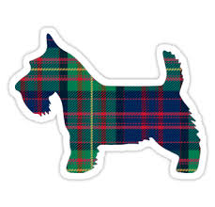
As you walk in
Quiz will start at the beginning of lecture
Have pencil/pen ready
Silence phones

Slide 4
Quiz
Before we start
Don’t open until we start
Make sure your name and Andrew ID are on the front
Read instruction page
No questions (unless clarification on English)
Additional info
25 min

Slide 5
Announcements
Logistics changes related to Midterm 1 next week
hw5 (due Sat 30-Sep at 8pm)
Optional quiz5 (ungraded, due never)
No pre-reading6
Review for midterm (in-lecture next Tuesday)
Thu 5-Oct: Midterm 1 (in-lecture next Thursday)
Stay tuned to Piazza for more details

Slide 6
Thursday Logistics

Slide 7
Announcements
Logistics changes related to Midterm 1 next week
hw5 (due Sat 30-Sep at 8pm)
Optional quiz5 (ungraded, due never)
No pre-reading6
Review for midterm (in-lecture next Tuesday)
Thu 5-Oct: Midterm 1 (in-lecture next Thursday)
Stay tuned to Piazza for more details

Slide 8
Lists

Slide 9
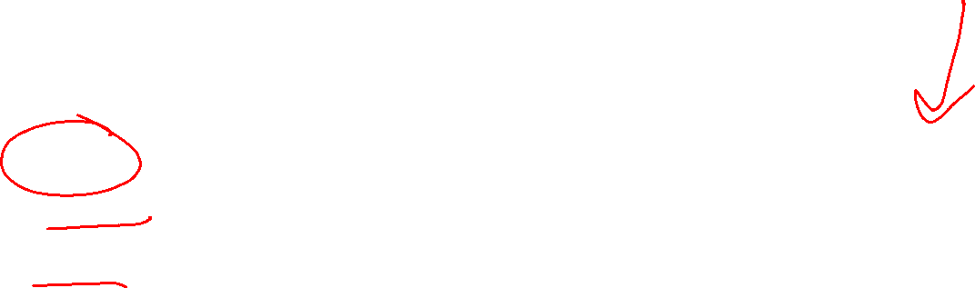
Python Objects and Variable Naming
All of the “things” in Python are objects
Python objects all have:
id More on object ids when we get to lists
value We can try to see this with print(x)
type We can see this with type(x)
Variable naming
Think of a variable name as a gift tag attached to an object
Python keeps track of variable names to allow us to use that object later
id: 103100
value: 5
type: int
x
Object
Variable name

Slide 10
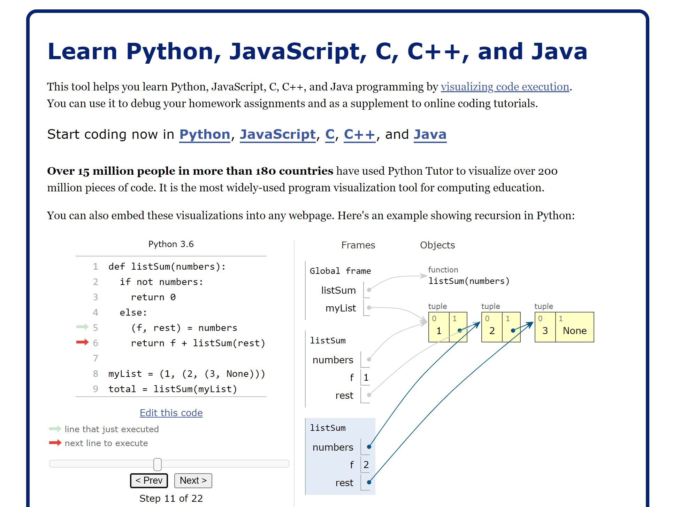
Running Python
Pythontutor
Help *see* how Python works

Slide 11
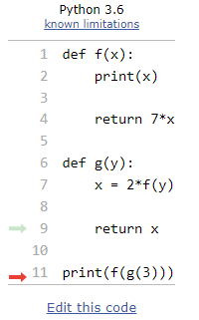
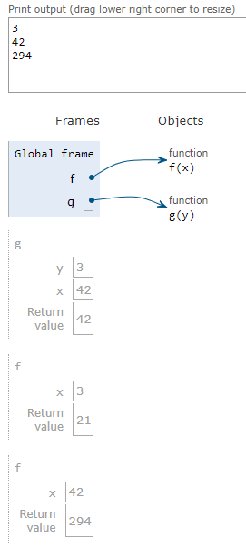
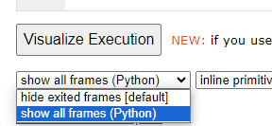
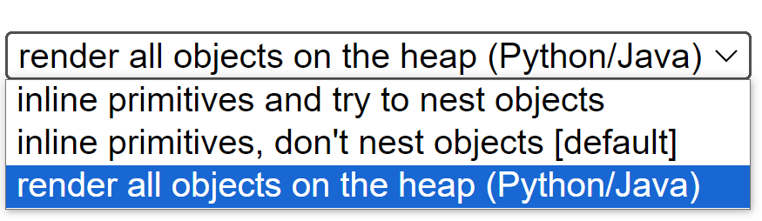
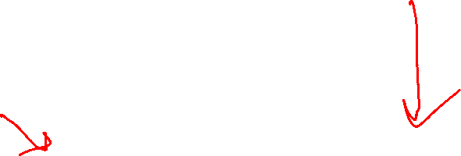
Running Python
Pythontutor
Help *see* how Python works
Helpful to learn how to write out work for code tracing
Optional settings
(bottom-left, bottom-center)

Slide 12
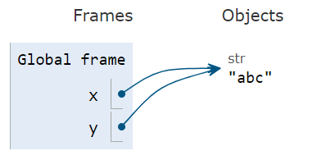
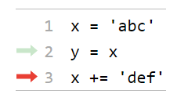
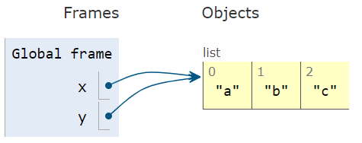
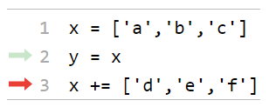
Strings vs Lists
Lists are mutable!
With strings, we always have to create a new string to modify an existing string
With lists, we can modify an existing list object

Slide 13
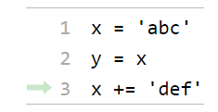
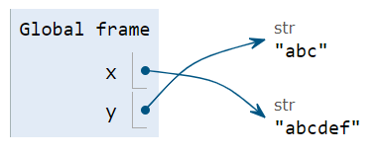
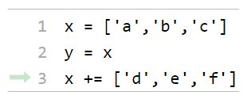
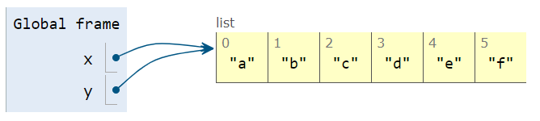
Strings vs Lists
Lists are mutable!
With strings, we always have to create a new string to modify an existing string
With lists, we can modify an existing list object

Slide 14
Reminder: Strings and aliases
Two variables are “aliases” are when they reference the exact same object
This happens when you assign a variable to another variable:
s = 'abc'
t = s
s and t are aliases referencing the same to the same exact string object 'abc’
But…strings are immutable. We can’t possibly change s without making a new string.
s += 'def' # Assigns s to a new string 'abcdef’
# The string t is referencing remains 'abc'

Slide 15
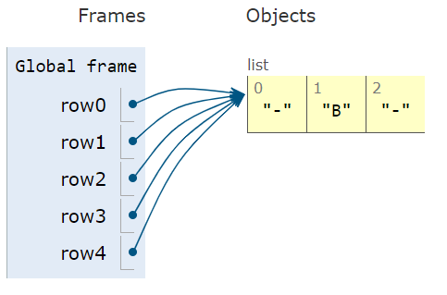
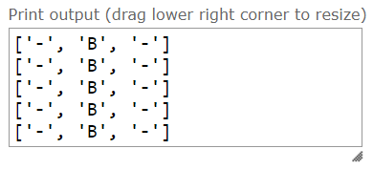
Aliasing
Two variables are “aliases” are when they reference the exact same object
row0 = ['-','-','-']
row1 = row0
row2 = row0
row3 = row0
row4 = row0
row4[1] = 'B'
print(row0)
print(row1)
print(row2)
print(row3)
print(row4)

Slide 16
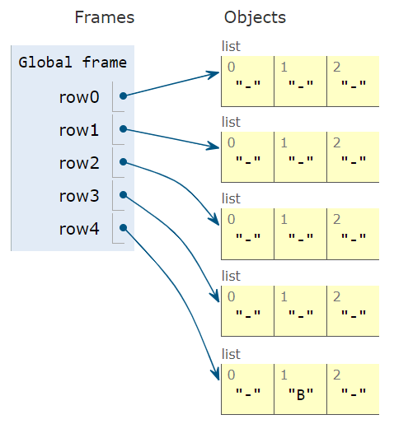
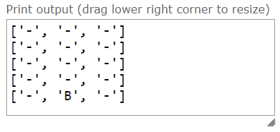
Aliasing
Two variables are “aliases” are when they reference the exact same object
row0 = ['-','-','-']
row1 = ['-','-','-']
row2 = ['-','-','-']
row3 = ['-','-','-']
row4 = ['-','-','-']
row4[1] = 'B'
print(row0)
print(row1)
print(row2)
print(row3)
print(row4)

Slide 17
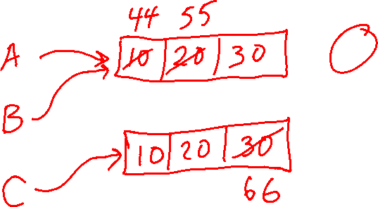
Poll 1
I. A: [44, 20, 30]
B: [10, 55, 30]
C: [10, 20, 66]
II. A: [44, 55, 30]
B: [44, 55, 30]
C: [10, 20, 66]
III. A: [44, 20, 66]
B: [10, 55, 30]
C: [44, 20, 66]
IV. A: [44, 55, 66]
B: [44, 55, 66]
C: [44, 55, 66]
What does this print?
import copy
A = [10, 20, 30]
B = A
C = copy.copy(A)
A[0] = 44
B[1] = 55
C[2] = 66
print('A:', A)
print('B:', B)
print('C:', C)

Slide 18
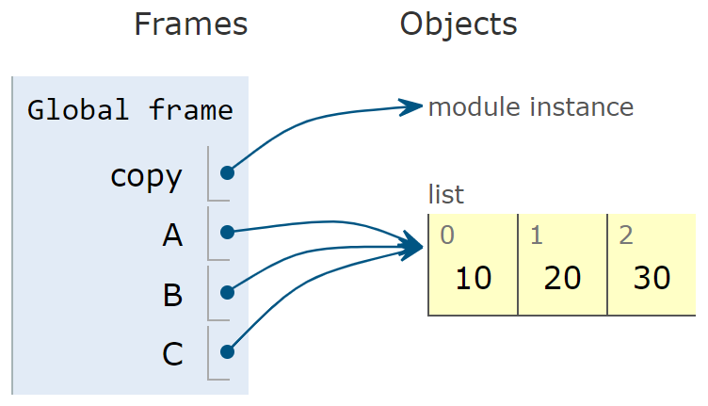
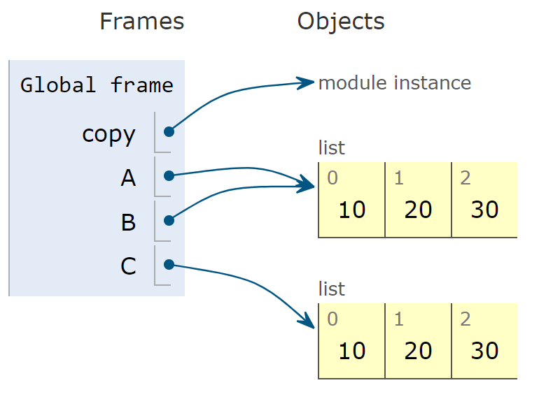
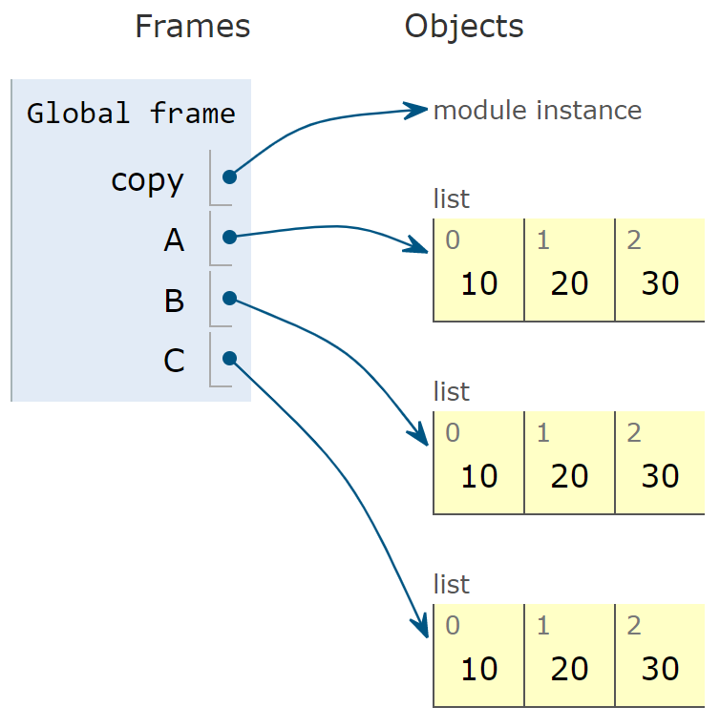
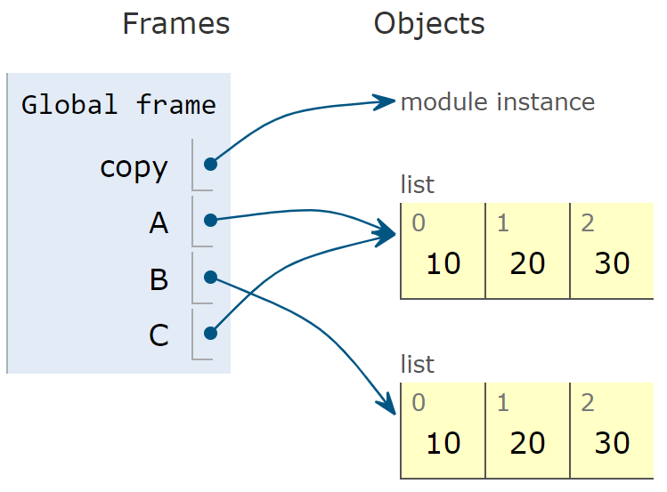

Poll 2
I.
II.
Which is the correct visualization?
import copy
A = [10, 20, 30]
B = A
C = copy.copy(A)
III.
IV.

Slide 19
List indexing and slicing
Reference slide
A = [10, 20, 30, 40, 50]
x = 99
A[1] = x
A: [10, 99, 30, 40, 50]
A = [10, 20, 30, 40, 50]
x = A[1]
A: [10, 20, 30, 40, 50]
x: 20
A = [10, 20, 30, 40, 50]
X = A[1:3]
A: [10, 20, 30, 40, 50]
X: [20, 30]
A = [10, 20, 30, 40, 50]
X = [88, 99]
A[1:3] = X
A: [10, 88, 99, 40, 50]
X: [88, 99]

Slide 20
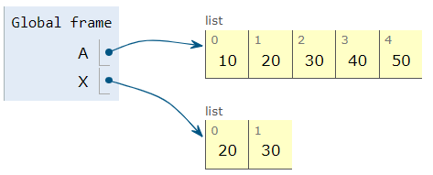
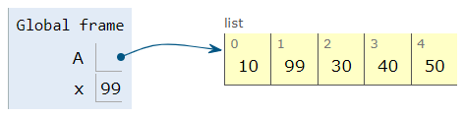
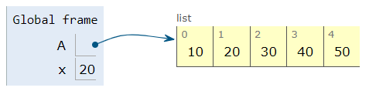
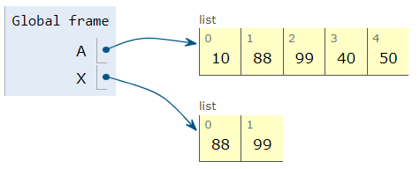
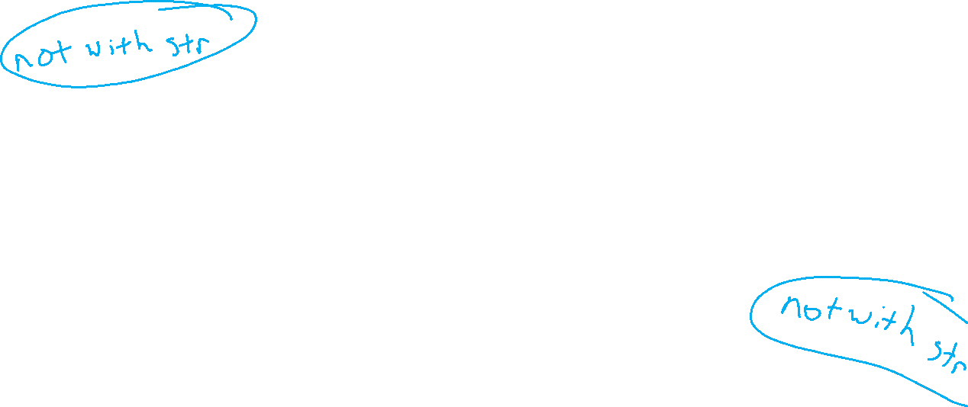
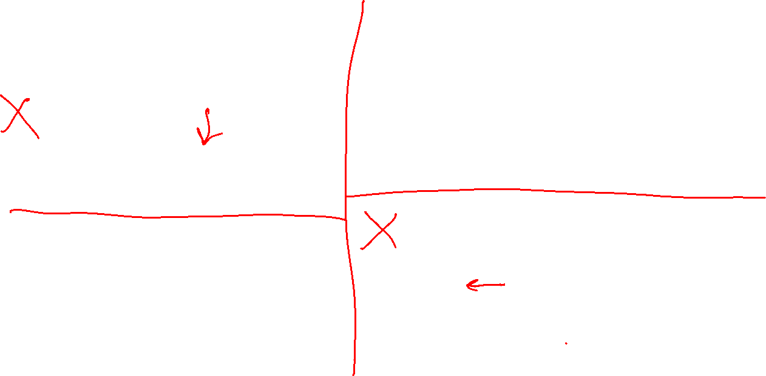
List indexing and slicing
Reference slide
A = [10, 20, 30, 40, 50]
X = A[1:3]
A = [10, 20, 30, 40, 50]
X = [88, 99]
A[1:3] = X
A = [10, 20, 30, 40, 50]
x = 99
A[1] = x
A = [10, 20, 30, 40, 50]
x = A[1]

Slide 21
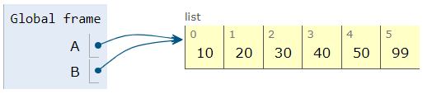
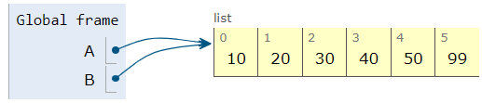
Adding elements
Reference slide
A = [10, 20, 30, 40, 50]
B = A
A.append(99)
A = [10, 20, 30, 40, 50]
B = A
A += [99]

Slide 22
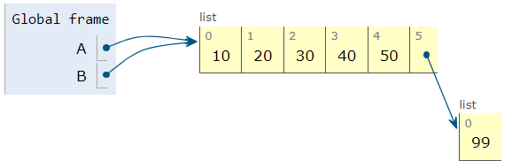
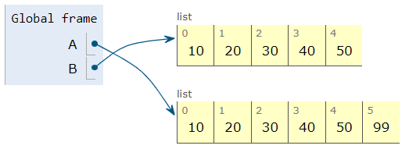
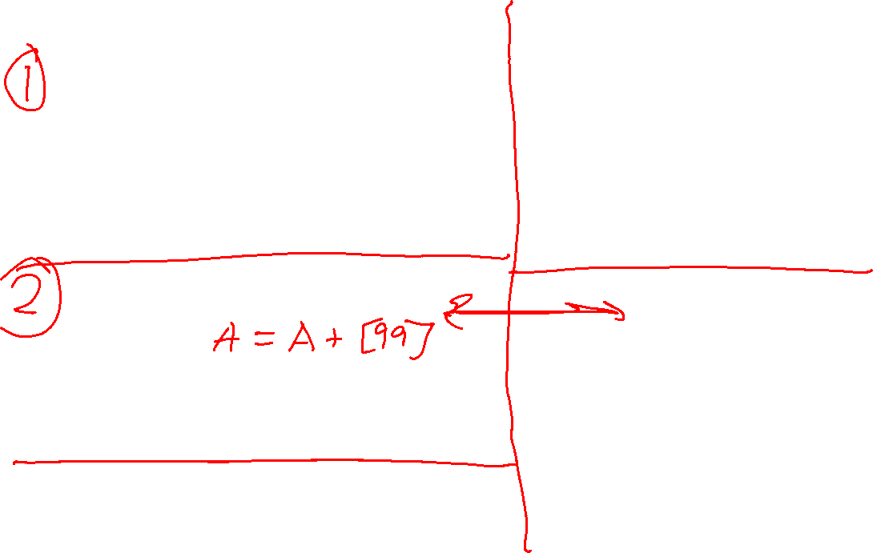
Adding elements
Reference slide
# CAUTION
A = [10, 20, 30, 40, 50]
B = A
A.append([99])
# INCONSISTENT with +=
A = [10, 20, 30, 40, 50]
B = A
A = A + [99]
A = [10, 20, 30, 40, 50]
B = A
A.append(99)
A = [10, 20, 30, 40, 50]
B = A
A += [99]
A = [10, 20, 30, 40, 50]
A += 99
TypeError: 'int' object is not iterable

Slide 23
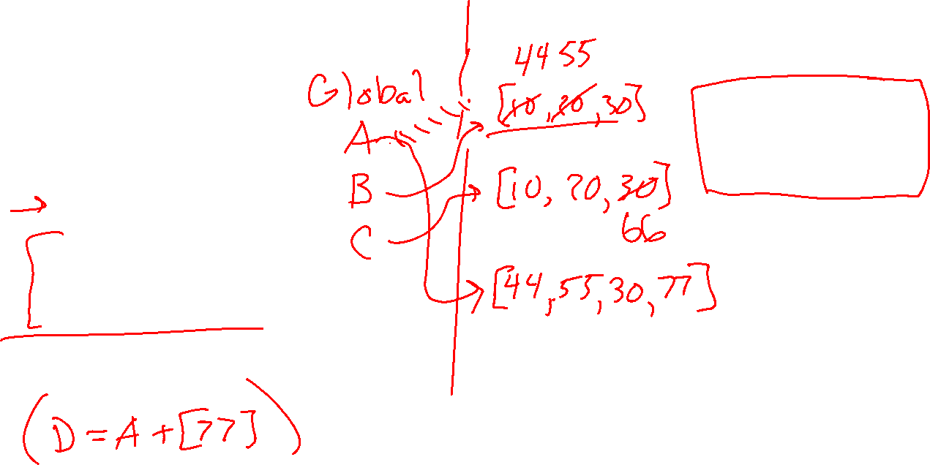
Poll 3
I. A: [44, 20, 30, 77]
B: [10, 55, 30]
C: [10, 20, 66]
II. A: [44, 55, 30, 77]
B: [44, 55, 30]
C: [10, 20, 66]
III. A: [44, 20, 66, 77]
B: [10, 55, 30]
C: [44, 20, 66]
IV. A: [44, 55, 30, 77]
B: [44, 55, 30, 77]
C: [10, 20, 66]
What are the resulting A, B, and C?
import copy
A = [10, 20, 30]
B = A
C = copy.copy(A)
A[0] = 44
B[1] = 55
C[2] = 66
A = A + [77]

Slide 24
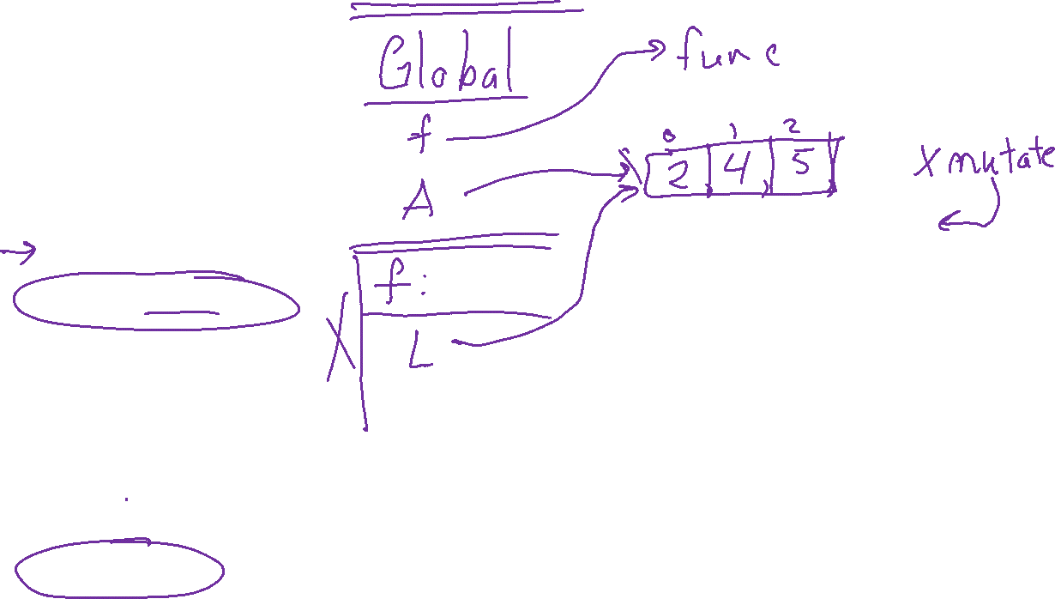
Poll 4
What does this print?
def f(L):
L.remove(3)
A = [2, 3, 4, 5]
print(f(A))
[2, 3, 4, 5]
[2, 4, 5]
[2, 3, 5]
[]
None

Slide 25
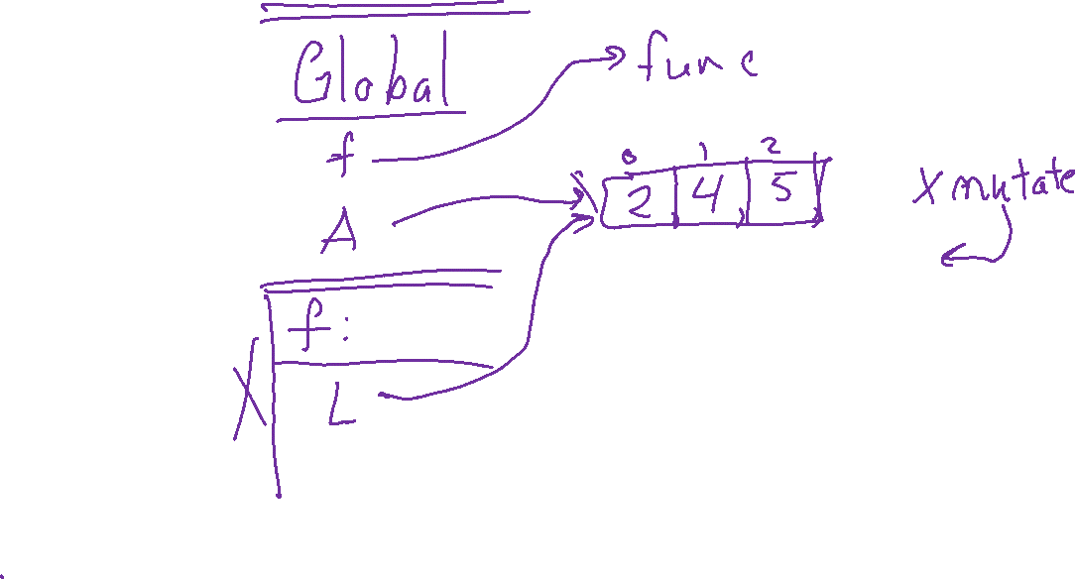
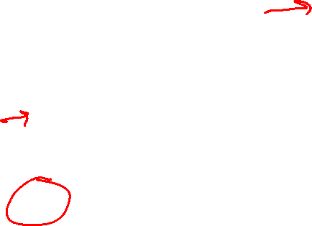
Poll 5
What does this print?
def f(L):
L.remove(3)
A = [2, 3, 4, 5]
f(A)
print(A)
[2, 3, 4, 5]
[2, 4, 5]
[2, 3, 5]
[]
None

Slide 26
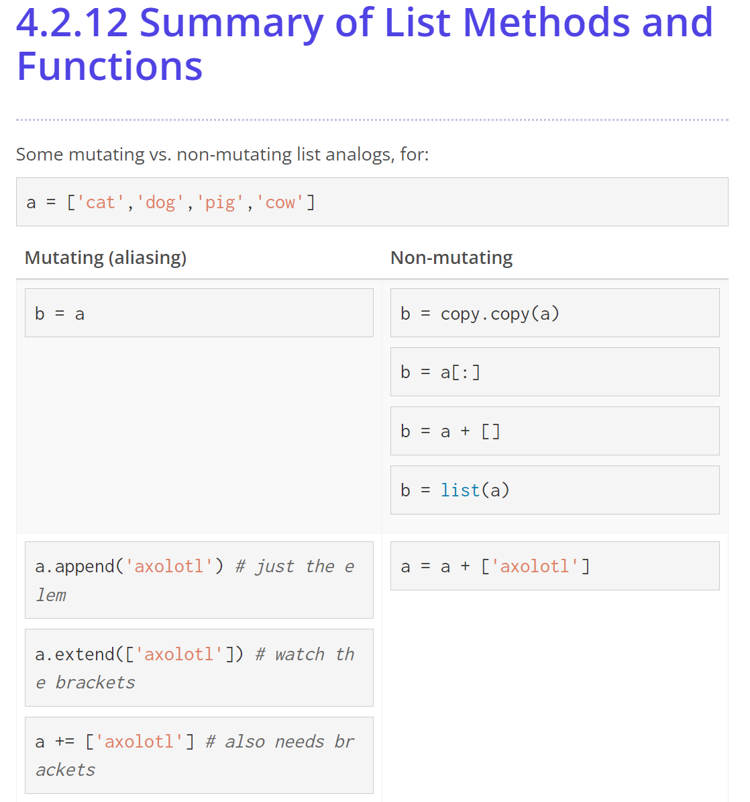
Reference slide

Slide 27
Caution: Mutating in Loops
L = [2, 4, 6, 7]
2 | 4 | 6 | 7
Guided Exercise: removeEvens
Broken version:
for i in range(len(L)):
if L[i] % 2 == 0:
L.pop(i)

Slide 28
Caution: Mutating in Loops
L = [2, 4, 6, 7]
2 | 4 | 6 | 7
Guided Exercise: removeEvens
Broken version:
i = 0
L.pop(i)
for i in range(len(L)):
if L[i] % 2 == 0:
L.pop(i)
4 | 6 | 7
i = 1
L.pop(i)
Corrected version:
i = 0
while i < len(L):
if L[i] % 2 == 0:
L.pop(i)
else:
i += 1
4 | 7
i = 2
L[i] % 2
Error: Index out of range

Slide 29
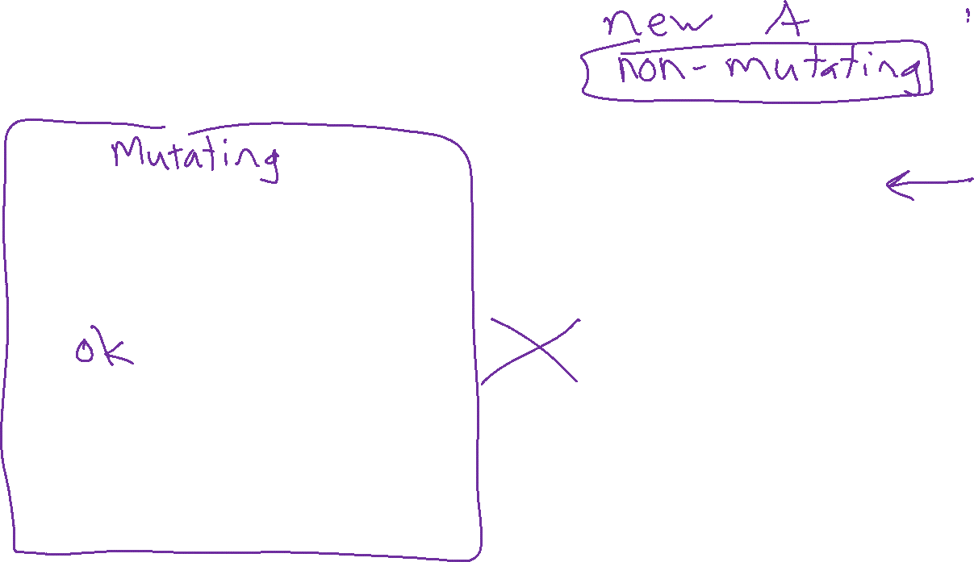

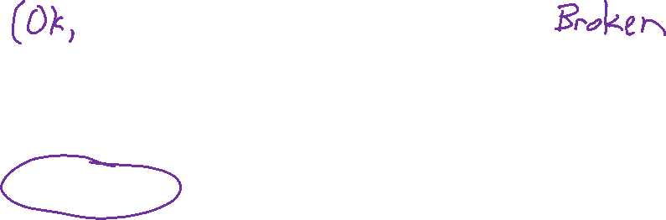
Poll 6
III.
def doubleValues(L):
A = []
for item in L:
A.append(item*2)
return A
IV.
def doubleValues(L):
A = []
for item in L:
A.append(item*2)
Which is best?
I.
def doubleValues(L):
for i in range(len(L)):
L[i] *= 2
II.
def doubleValues(L):
for i in range(len(L)):
L[i] *= 2
return L

Slide 30
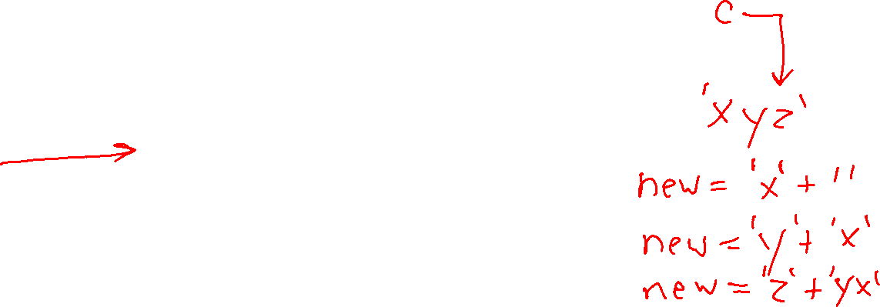
Pattern: Building up a result
From Strings Lecture
Building up a string
Sketch:
Start with empty string: result = ''
Loop
    adding to string as needed: result += nextChar
Example:
def reverseString(s):
newString = ''
for c in s:
newString = c + newString
return newString

Slide 31
Pattern: Building up a result
Building up a string
Sketch:
Start with empty string: result = []
Loop
    adding to string as needed: result.append(nextVal)
Example:
def doubleListValues(L):
newList = []
for val in L:
newList.append(2*val)
return newList

Slide 32
Poll 7
What does this print?
<class ‘int'>
<class ‘str’>
<class ‘list’>
<class 'tuple’>
(<class ‘str’>, <class ‘int’>)
ERROR
I have no idea
def f():
return 'a', 3
x = f()
print(type(x))

Slide 33
Tuples and List Comprehensions

Slide 34
Tuples
Reference slide
Like lists but immutable
FAIL: myTuple[0] = 99
Simulate multiple return values
def sumProd(x, y):
return x+y, x*y
Multiple assignment
cx, cy = width/2, height/2
Single element tuples
myTuple = (99,)
One line swapping!
y, x = x, y

Slide 35

List Comprehension
Fashionable python
Sample for loop
newList = []
for variable in sequence:
newList.append(expression)
Python shorthand
newList = [expression for variable in sequence]
Image credit: https://www.nytimes.com/2020/09/21/style/exotic-skins-fashion-covid.html

Slide 36
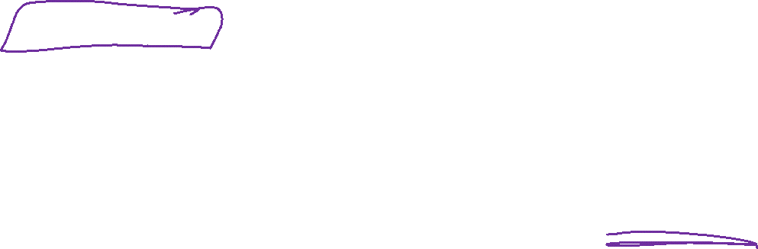
List Comprehension
Reference slide
Sample for loop (now with a filter)
newList = []
for variable in sequence:
if condition:
newList.append(expression)
Python shorthand (now with a filter)
newList = [expression for variable in sequence if condition]
Image credit: https://www.nytimes.com/2020/09/21/style/exotic-skins-fashion-covid.html

Slide 37
2D Lists

Slide 38
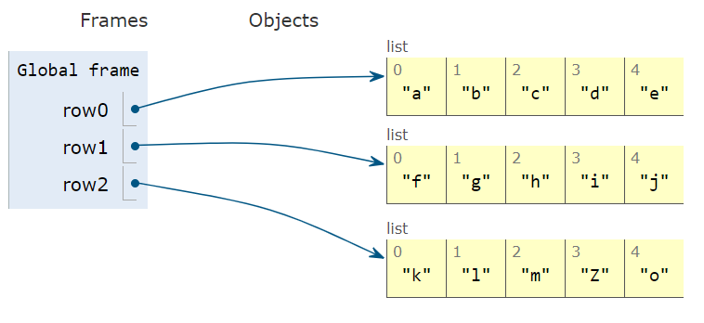
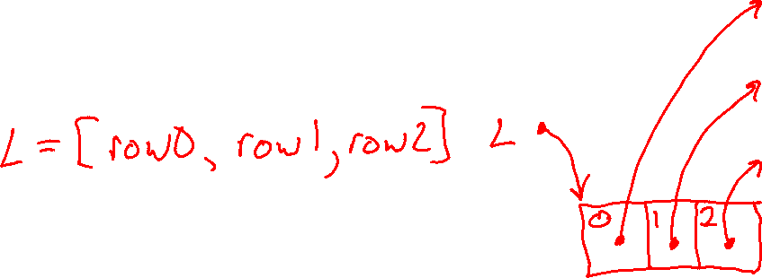
We can put lists inside elements of a list
row0 = ['a','b','c','d','e']
row1 = ['f','g','h','i','j']
row2 = ['k','l','m','n','o']
row2[3] = 'Z'

Slide 39
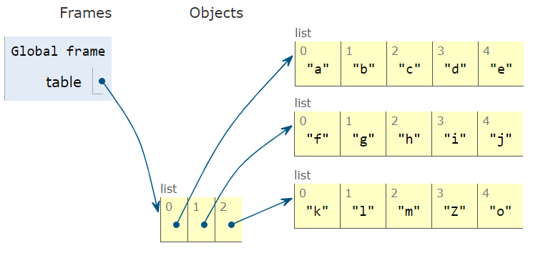

We can put lists inside elements of a list
row0 = ['a','b','c','d','e']
row1 = ['f','g','h','i','j']
row2 = ['k','l','m','n','o']
table = [row0, row1, row2]
table[2][3] = 'Z'

Slide 40
Traversing 2D Lists
Printing rectangular list
# Create rectangular 2D list
table = [[900, 901, 902],
[910, 911, 912],
[920, 921, 922]]
numRows = len(table)
numCols = len(table[0]) # Assume all rows have the same width
for i in range(numRows):
for j in range(numCols):
value = table[i][j]
print(value, end=',') # Print on same row (with commas)
print() # New line after row

Slide 41
Traversing 2D Lists
Printing non-rectangular (irregular) (ragged) list
# Create non-rectangular 2D list
table = [[900, 901],
[910, 911, 912, 913, 914],
[920, 921, 922]]
numRows = len(table)
for i in range(numRows):
numCols = len(table[i])
for j in range(numCols):
value = table[i][j]
print(value, end=',')
print() # New line after row
# Simpler if we don't need indices
for row in table:
for value in row:
print(value, end=',')
print() # New line after row

Slide 42
Creating 2D Lists

Slide 43
Creating 2D Lists
If you know the values, you can just type out the list of lists
data = [[900, 901, 902], [910, 911, 912], [920, 921, 922]]
# Same as above but code is easier to read
data = [[900, 901, 902],
[910, 911, 912],
[920, 921, 922]]

Slide 44
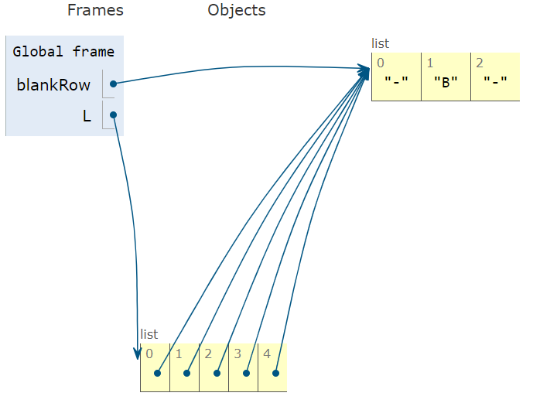
Aliasing
Two variables are “aliases” are when they reference the exact same object
blankRow = ['-','-','-']
L = []
L.append(blankRow)
L.append(blankRow)
L.append(blankRow)
L.append(blankRow)
L.append(blankRow)
L[4][1] = 'B'

Slide 45
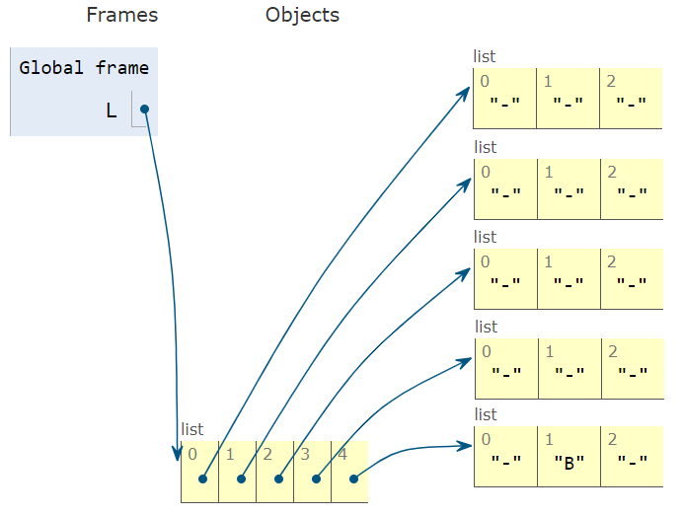
Aliasing
Two variables are “aliases” are when they reference the exact same object
L = []
L.append(['-','-','-'])
L.append(['-','-','-'])
L.append(['-','-','-'])
L.append(['-','-','-'])
L.append(['-','-','-'])
L[4][1] = 'B'

Slide 46
Poll 8
A.
board = []
for r in range(numRows):
board.append([' ']*numCols)
Which of these is the best code to create a blank word search board?
numRows, numCols = 4, 3
B.
board = []
for r in range(numRows):
cell = [' ']
row = cell*numCols
board.append(row)
C.
cell = [' ']
row = cell*numCols
rowIn2DList = [row]
board = rowIn2DList*numRows
D.
board = [[' ']*numCols]*numRows

Slide 47
Creating 2D Lists
Clearly loop through each location
grid = []
for i in range(numRows):
row = []
for j in range(numCols):
row.append(0)
grid.append(row)
Options to create a "blank" 2D list
Fashionable Python: more concise with list comprehension
Be carefull!
grid = []
for i in range(numRows):
grid.append([0]*numCols)
grid = [[0]*numCols for i in range(numRows)]
board = [[0]*numCols]*numRows # Aliased!!

Slide 48
Word Search Case Study

Slide 49


Word Search

Slide 50


Word Search Top-down Design

Slide 51


Word Search Top-down Design
def wordSearch(grid, word)
For each starting position
If start letter doesn’t match
BAIL
For each direction
For each letter in word
If out of bounds
BAIL
If letter doesn’t match
BAIL

Slide 52


Word Search Top-down Design
def wordSearch(grid, word)
For each starting position
If start letter doesn’t match
return None
searchFromPos()
def searchFromPos():
For each direction
searchFromPosInDir()
def searchFromPosInDir()
For each letter in word
if outOfBounds()
return None
if letter doesn’t match grid
return None

Slide 53


Word Search Top-down Design
def wordSearch(grid, word):
gridHeight = len(grid)
gridWidth = len(grid[0])
for i in range(gridHeight):
for j in range(gridWidth):
if grid[i][j] != word[0]:
continue
result = searchFromPos(grid, word, i, j)
if result is not None:
return result
return None

Slide 54




Word Search Top-down Design
def searchFromPos(grid, word, i, j):
for dir in getDirections():
result = searchFromPosInDir(grid, word, i, j, dir)
if result is not None:
return result
return None
def getDirections():
directions = []
for i in (-1, 0, 1):
for j in (-1, 0, 1):
if i != 0 or j != 0:
directions.append((i, j))
return directions
(-1,-1) | (-1,0) | (-1,1)
(0,-1) | (0,0) | (0,1)
(1,-1) | (1,0) | (1,1)

Slide 55





Word Search Top-down Design
(-1,-1) | (-1,0) | (-1,1)
(0,-1) | (0,0) | (0,1)
(1,-1) | (1,0) | (1,1)
def searchFromPosInDir(grid, word, iStart, jStart, dir):
gridHeight, gridWidth = len(grid), len(grid[0])
i, j = iStart, jStart
# Can skip first position
i += dir[0]
j += dir[1]
for letter in word[1:]:
if not checkBounds(i, j, gridWidth, gridHeight):
return None
if grid[i][j] != letter:
return None
i += dir[0]
j += dir[1]
return (word, iStart, jStart, dir)
def checkBounds(i, j, width, height):
return (0 <= i < height) and (0 <= j < width)

Slide 56
Copying 2D Lists

Slide 57
Code Tracing with 2D Lists

Slide 58
Code tracing with lists
x = []
for i in range(4):
y = [0]
z = y * 3
x.append(z)

Slide 59

Code tracing with lists
x = []
for i in range(4):
y = [0]
z = y * 3
x.append(z)

Slide 60

Code tracing with lists
x = [[0]*3] * 4
Step by step:
y = [0]
z = y * 3
w = [z]
x = w * 4

Slide 61

Code tracing with lists
x = [[0]*3] * 4
Step by step:
y = [0]
z = y * 3
w = [z]
x = w * 4

Slide 62
2D Lists
Things to keep in mind
Watch out for aliasing!
Think before copying
Shallow copy
Deep copy
Helper functions for printing

