Slide 1
15-112
Lecture 2
Animations with Lists
Instructor: Pat Virtue

Slide 2
Tuesday Logistics

Slide 3

Announcements
HW7
Tetris! Plan ahead
CMU Graphics Installation
Keep an eye on Piazza updates if you run into issues
Come find Pat if you bump into issues that pinned Piazza update doesn’t address
Don’t stress. You can do ALL the rest of the homework without this installation

Slide 4
Thursday Logistics

Slide 5
Announcements
HW7
Tetris!
CMU Graphics Installation
Keep an eye on Piazza updates if you run into issues
Come find Pat if you bump into issues that pinned Piazza update doesn’t address
Don’t stress. You can do ALL the rest of the homework without this installation

Slide 6
2D Lists

Slide 7
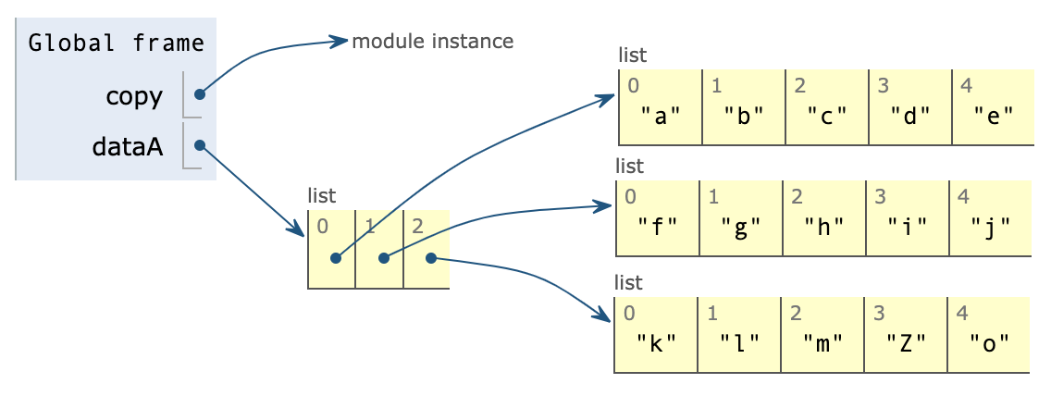
Copy vs Deepcopy
import copy
dataA = [ ['a','b','c','d','e’],
['f','g','h','i','j’],
['k','l','m','n','o'] ]
dataB = copy.copy(dataA)
dataB[2][3] = 'Z'

Slide 8
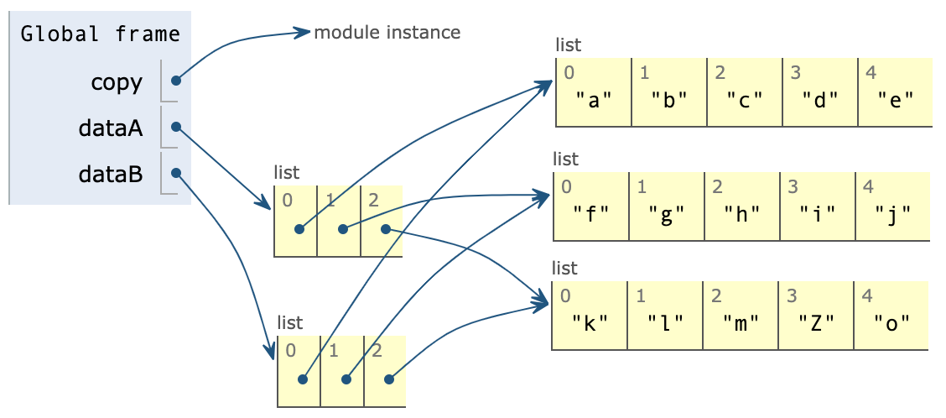
Copy vs Deepcopy
import copy
dataA = [ ['a','b','c','d','e’],
['f','g','h','i','j’],
['k','l','m','n','o'] ]
dataB = copy.copy(dataA)
dataB[2][3] = 'Z'

Slide 9
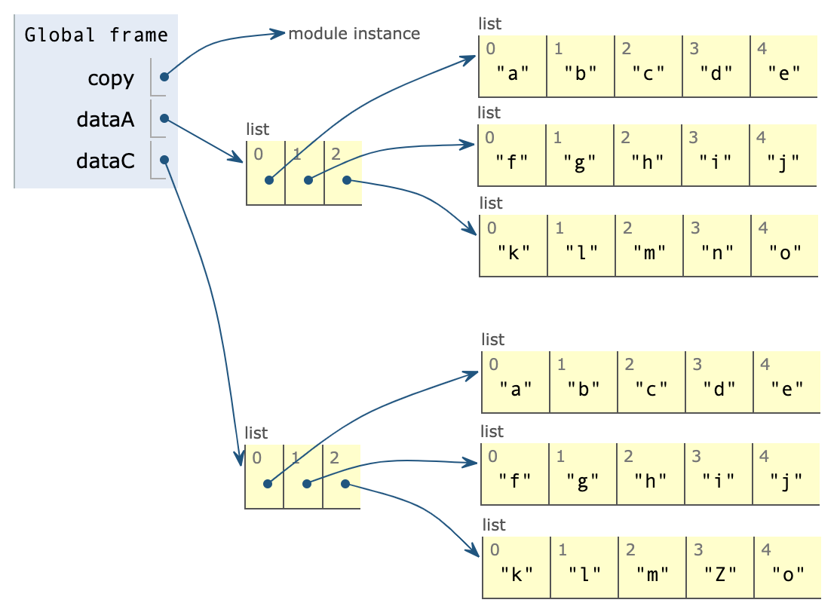
Copy vs Deepcopy
import copy
dataA = [ ['a','b','c','d','e’],
['f','g','h','i','j’],
['k','l','m','n','o'] ]
dataC = copy.deepcopy(dataA)
dataC[2][3] = 'Z'

Slide 10
Poll 1
How many total list objects exist after running this code?
import copy
dataA = [10, [200, [3000, 4000] ] ]
dataC = copy.copy(dataA)
dataD = copy.deepcopy(dataA)
3
4
5
6
7
9

Slide 11
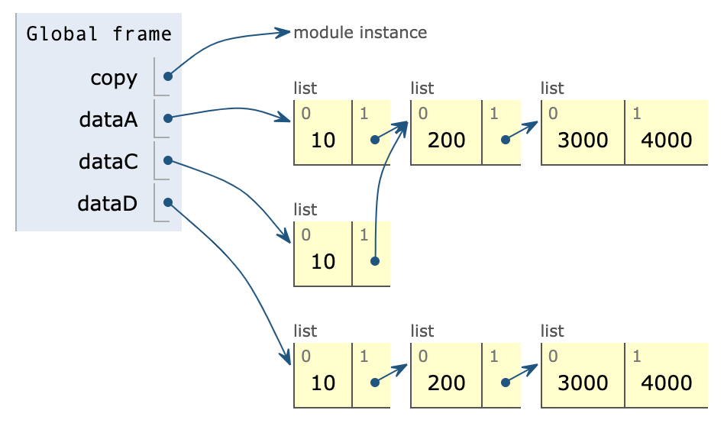
Poll 1
How many total list objects exist after running this code?
import copy
dataA = [10, [200, [3000, 4000] ] ]
dataC = copy.copy(dataA)
dataD = copy.deepcopy(dataA)

Slide 12
Code tracing with lists
x = []
for i in range(4):
y = [0]
z = y * 3
x.append(z)

Slide 13
Code tracing with lists
x = []
for i in range(4):
y = [0]
z = y * 3
x.append(z)

Slide 14
Code tracing with lists
x = [[0]*3] * 4
Step by step:
y = [0]
z = y * 3
w = [z]
x = w * 4

Slide 15
2D lists
Things to keep in mind
Watch out for aliasing!
Think before copying
Shallow copy
Deep copy
Helper functions for printing

Slide 16
2D Board Graphics

Slide 17
112 Graphics Grid Worksheet
5,5
Given:
app.width: 90
app.height: 55
app.margin: 5
Fill in the following grid with the value return for each call to:
x0, y0 = getCellLeftTop(app, r, c)
0,0 | 0,1 | 0,2 | 0,3
1,0 | 1,1 | 1,2 | 1,3
2,0 | 2,1 | 2,2 | 2,3
85,50
getCellLeftTop(app,0,0) | getCellLeftTop(app,0,1) | getCellLeftTop(app,0,2) | getCellLeftTop(app,0,3)
5, 5 | ___, ___ | ___, ___
getCellLeftTop(app,1,0) | getCellLeftTop(app,1,1) | getCellLeftTop(app,1,2) | getCellLeftTop(app,1,3)
 | ___, ___ | ___, ___
getCellLeftTop(app,2,0) | getCellLeftTop(app,2,1) | getCellLeftTop(app,2,2) | getCellLeftTop(app,2,3)
 |  |  | ___, ___

Slide 18
Building an Application!

Slide 19
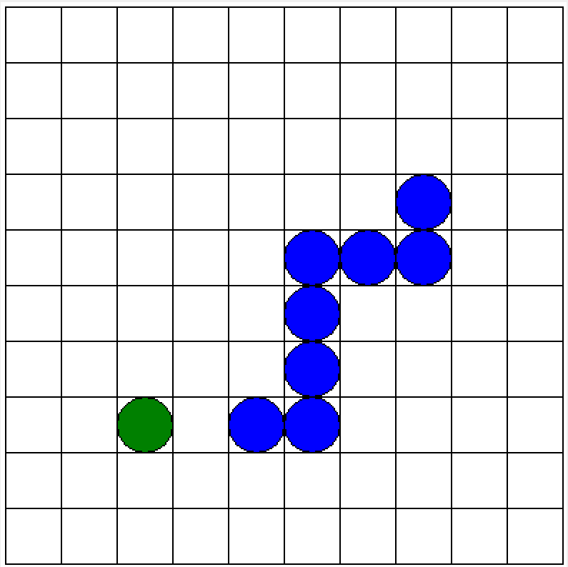
Snake Example
See Guided Exercise in notes

Slide 20
Polygons

Slide 21
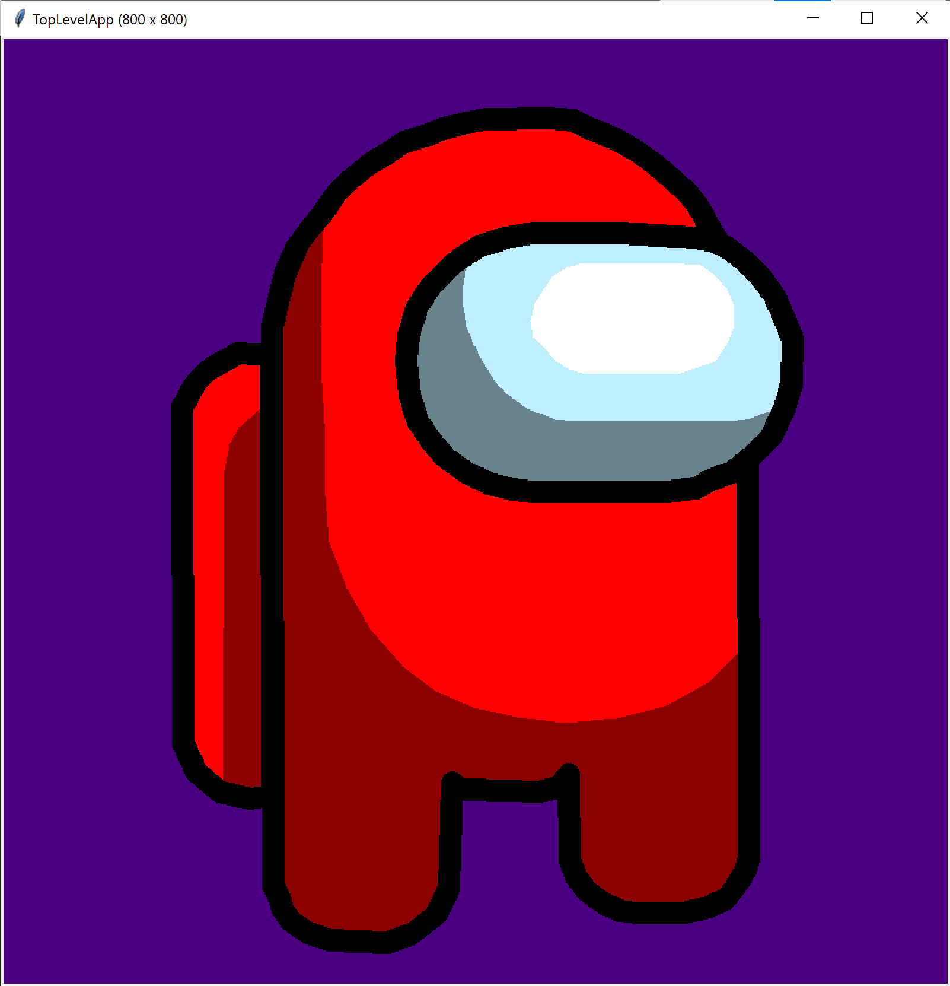
Polygon Creator Example
def amongUsShape(usColor='red', usColor2='darkRed', usLineWidth=5):
polys = [
# Pack
(usColor, None, 0, [[-0.48, -0.396], [-0.553, -0.4], [-0.616, -0.366], [-0.653, -0.33], [-0.683, -0.276], [-0.68, 0.49], [-0.65, 0.556], [-0.596, 0.6], [-0.526, 0.616], [-0.476, 0.61]]),
(usColor2, None, 0, [[-0.476, -0.28], [-0.506, -0.27], [-0.553, -0.23], [-0.573, -0.193], [-0.586, -0.133], [-0.59, 0.586], [-0.57, 0.603], [-0.536, 0.616], [-0.506, 0.613], [-0.466, 0.61]]),
(None, 'black', usLineWidth, [[-0.48, -0.396], [-0.553, -0.4], [-0.616, -0.366], [-0.653, -0.33], [-0.683, -0.276], [-0.68, 0.49], [-0.65, 0.556], [-0.596, 0.6], [-0.526, 0.616], [-0.476, 0.61]]),
# Body
(usColor2, None, 0, [[0.01, -0.933], [-0.033, -0.926], [-0.086, -0.913], [-0.12, -0.9], [-0.173, -0.883], [-0.213, -0.856], [-0.253, -0.833], [-0.296, -0.8], [-0.333, -0.76], [-0.36, -0.72], [-0.39, -0.686], [-0.42, -0.643], [-0.446, -0.583], [-0.463, -0.516], [-0.476, -0.46], [-0.476, -0.396], [-0.473, 0.816], [-0.46, 0.843], [-0.453, 0.87], [-0.433, 0.896], [-0.393, 0.923], [-0.343, 0.94], [-0.213, 0.946], [-0.16, 0.926], [-0.103, 0.883], [-0.08, 0.84], [-0.073, 0.82], [-0.066, 0.58], [-0.046, 0.596], [-0.026, 0.596], [0.133, 0.6], [0.176, 0.59], [0.2, 0.56], [0.203, 0.756], [0.216, 0.793], [0.24, 0.826], [0.276, 0.853], [0.316, 0.873], [0.356, 0.876], [0.463, 0.876], [0.52, 0.863], [0.56, 0.846], [0.586, 0.813], [0.603, 0.78], [0.613, 0.753], [0.61, -0.343], [0.61, -0.406], [0.603, -0.463], [0.58, -0.546], [0.556, -0.636], [0.526, -0.683], [0.496, -0.736], [0.47, -0.766], [0.44, -0.793], [0.416, -0.816], [0.386, -0.84], [0.353, -0.863], [0.313, -0.886], [0.283, -0.9], [0.243, -0.916], [0.21, -0.93], [0.153, -0.936]]),
(usColor, None, 0, [[-0.36, -0.686], [-0.363, -0.603], [-0.366, -0.46], [-0.363, -0.333], [-0.356, -0.193], [-0.356, -0.076], [-0.346, 0.03], [-0.306, 0.136], [-0.253, 0.23], [-0.18, 0.313], [-0.103, 0.37], [-0.016, 0.41], [0.083, 0.43], [0.193, 0.443], [0.31, 0.433], [0.42, 0.406], [0.523, 0.35], [0.593, 0.276], [0.6, -0.423], [0.573, -0.546], [0.523, -0.67], [0.496, -0.716], [0.453, -0.766], [0.413, -0.806], [0.366, -0.84], [0.316, -0.873], [0.26, -0.896], [0.206, -0.923], [0.14, -0.93], [0.086, -0.93], [0.023, -0.93], [-0.033, -0.92], [-0.1, -0.9], [-0.166, -0.866], [-0.226, -0.833], [-0.27, -0.806], [-0.306, -0.766], [-0.336, -0.736]]),
(None, 'black', usLineWidth, [[0.01, -0.933], [-0.033, -0.926], [-0.086, -0.913], [-0.12, -0.9], [-0.173, -0.883], [-0.213, -0.856], [-0.253, -0.833], [-0.296, -0.8], [-0.333, -0.76], [-0.36, -0.72], [-0.39, -0.686], [-0.42, -0.643], [-0.446, -0.583], [-0.463, -0.516], [-0.476, -0.46], [-0.476, -0.396], [-0.473, 0.816], [-0.46, 0.843], [-0.453, 0.87], [-0.433, 0.896], [-0.393, 0.923], [-0.343, 0.94], [-0.213, 0.946], [-0.16, 0.926], [-0.103, 0.883], [-0.08, 0.84], [-0.073, 0.82], [-0.066, 0.58], [-0.046, 0.596], [-0.026, 0.596], [0.133, 0.6], [0.176, 0.59], [0.2, 0.56], [0.203, 0.756], [0.216, 0.793], [0.24, 0.826], [0.276, 0.853], [0.316, 0.873], [0.356, 0.876], [0.463, 0.876], [0.52, 0.863], [0.56, 0.846], [0.586, 0.813], [0.603, 0.78], [0.613, 0.753], [0.61, -0.343], [0.61, -0.406], [0.603, -0.463], [0.58, -0.546], [0.556, -0.636], [0.526, -0.683], [0.496, -0.736], [0.47, -0.766], [0.44, -0.793], [0.416, -0.816], [0.386, -0.84], [0.353, -0.863], [0.313, -0.886], [0.283, -0.9], [0.243, -0.916], [0.21, -0.93], [0.153, -0.936]]),
# Eyes
('steelBlue', None, 0, [[0.486, -0.663], [0.316, -0.673], [0.123, -0.673], [0.056, -0.663], [-0.003, -0.643], [-0.053, -0.613], [-0.086, -0.58], [-0.12, -0.546], [-0.146, -0.503], [-0.166, -0.44], [-0.17, -0.383], [-0.163, -0.303], [-0.143, -0.243], [-0.113, -0.2], [-0.08, -0.163], [-0.033, -0.126], [0.02, -0.103], [0.073, -0.09], [0.12, -0.083], [0.423, -0.083], [0.49, -0.093], [0.526, -0.11], [0.57, -0.126], [0.616, -0.166], [0.66, -0.206], [0.693, -0.273], [0.71, -0.33], [0.713, -0.43], [0.693, -0.48], [0.67, -0.533], [0.64, -0.573], [0.603, -0.61], [0.566, -0.64], [0.533, -0.656]]),
('lightCyan', None, 0, [[0.15, -0.67], [0.096, -0.666], [0.056, -0.66], [0.016, -0.65], [-0.023, -0.626], [-0.033, -0.603], [-0.04, -0.556], [-0.04, -0.506], [-0.033, -0.46], [-0.016, -0.42], [0.006, -0.38], [0.033, -0.336], [0.066, -0.303], [0.106, -0.273], [0.17, -0.25], [0.21, -0.243], [0.57, -0.243], [0.616, -0.253], [0.666, -0.27], [0.696, -0.3], [0.7, -0.34], [0.706, -0.363], [0.706, -0.403], [0.703, -0.44], [0.686, -0.486], [0.673, -0.523], [0.643, -0.56], [0.613, -0.59], [0.57, -0.62], [0.52, -0.643], [0.47, -0.66], [0.416, -0.666]]),
(None, 'black', usLineWidth, [[0.486, -0.663], [0.316, -0.673], [0.123, -0.673], [0.056, -0.663], [-0.003, -0.643], [-0.053, -0.613], [-0.086, -0.58], [-0.12, -0.546], [-0.146, -0.503], [-0.166, -0.44], [-0.17, -0.383], [-0.163, -0.303], [-0.143, -0.243], [-0.113, -0.2], [-0.08, -0.163], [-0.033, -0.126], [0.02, -0.103], [0.073, -0.09], [0.12, -0.083], [0.423, -0.083], [0.49, -0.093], [0.526, -0.11], [0.57, -0.126], [0.616, -0.166], [0.66, -0.206], [0.693, -0.273], [0.71, -0.33], [0.713, -0.43], [0.693, -0.48], [0.67, -0.533], [0.64, -0.573], [0.603, -0.61], [0.566, -0.64], [0.533, -0.656]]),
('white', None, 0, [[0.263, -0.606], [0.226, -0.603], [0.196, -0.596], [0.163, -0.573], [0.143, -0.546], [0.123, -0.513], [0.113, -0.473], [0.12, -0.436], [0.143, -0.413], [0.17, -0.383], [0.203, -0.363], [0.24, -0.353], [0.283, -0.353], [0.446, -0.353], [0.49, -0.366], [0.536, -0.383], [0.563, -0.423], [0.58, -0.463], [0.58, -0.506], [0.563, -0.543], [0.54, -0.573], [0.503, -0.6], [0.466, -0.603]]),
]
return polys

Slide 22
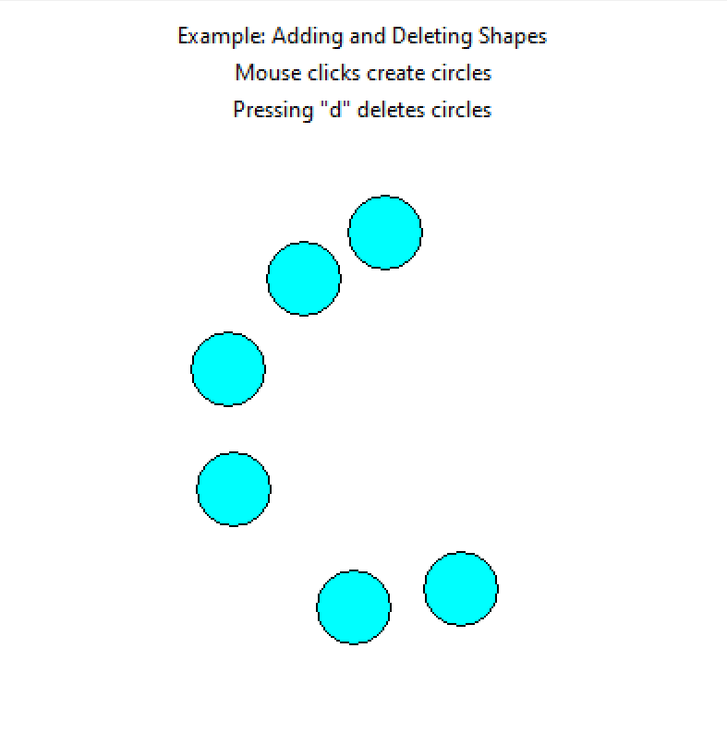
Polygon Creator Example

Slide 23
Tetris Hints

Slide 24
Draw Piece
app.pieceLeftCol
app.pieceTopRow

Slide 25
Draw Piece
Example
app.pieceLeftCol
app.pieceTopRow
app.piece
 | 0 | 1 | 2
0 | F | T | F
1 | T | T | T

Slide 26
Rotate 2D List
app.pieceLeftCol
app.pieceTopRow

Slide 27
Term Project!

