Slide 1
15-112 Lecture 2 Animations with Lists
Instructor: Pat Virtue

Slide 2
Tuesday Logistics

Slide 3
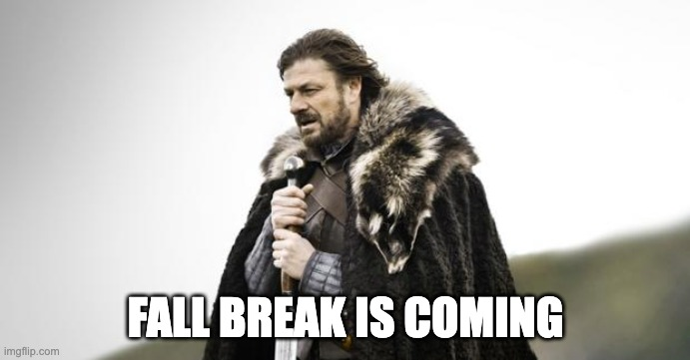
Announcements
HW7
Tetris! Plan ahead
CMU Graphics Installation
Keep an eye on Piazza updates if you run into issues
Come find Pat if you bump into issues that pinned Piazza update doesn’t address
Don’t stress. You can do ALL the rest of the homework without this installation

Slide 4
Thursday Logistics

Slide 5
Announcements
HW7
Tetris!
CMU Graphics Installation
Keep an eye on Piazza updates if you run into issues
Come find Pat if you bump into issues that pinned Piazza update doesn’t address
Don’t stress. You can do ALL the rest of the homework without this installation

