Slide 1
15-112
Lecture 2
Sets, Dictionaries, and Efficiency
Instructor: Pat Virtue

Slide 2
Tuesday Logistics

Slide 3

www.cs.cmu.edu/~112/gallery.html

Slide 4
Announcements
Term Project
Ideation Meetings
Special Topic Sessions
Hack112
Sat-Sun Nov 4-5
Just for us!
HW8
Little Alchemy!

Slide 5
Poll 1
Would you attend a TP ideation meeting with a TA?
Definitely yes
Probably yes
Probably not
Definitely not

Slide 6
Thursday Logistics

Slide 7
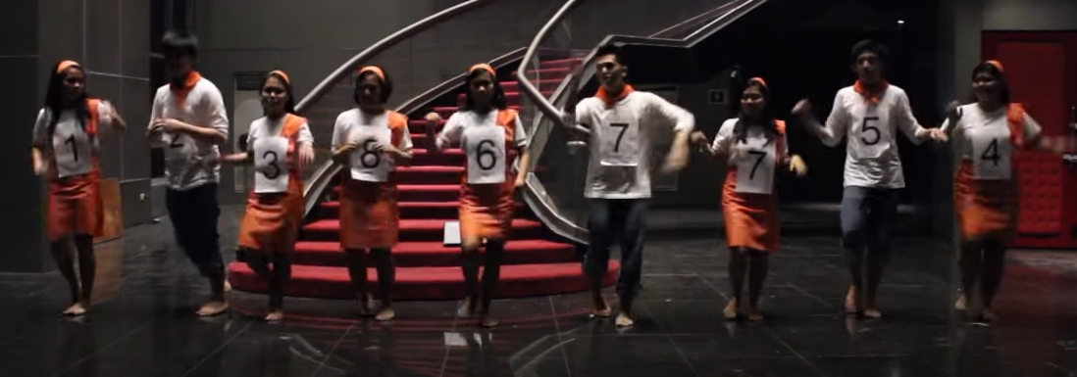
Warm-up as you walk in
Dancing is optional :-p
https://www.youtube.com/watch?v=LriMvv9qDrk

Slide 8
Announcements
Term Project
Preview

Slide 9
Sets

Slide 10

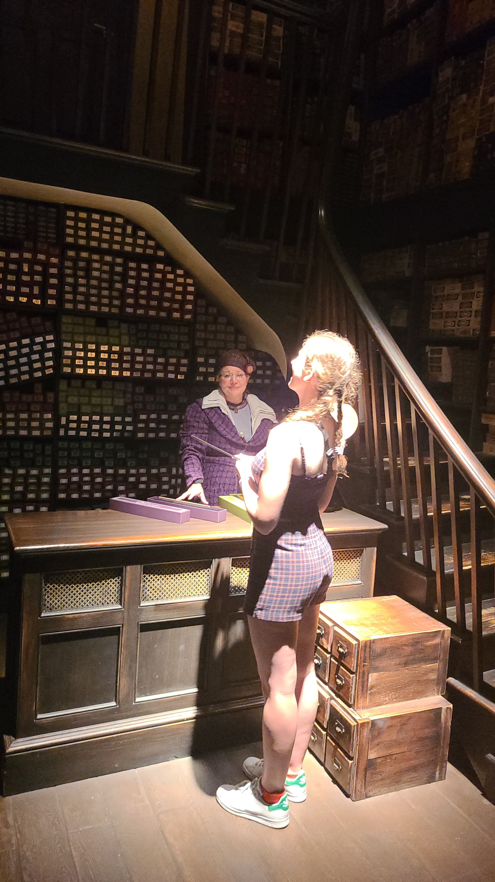
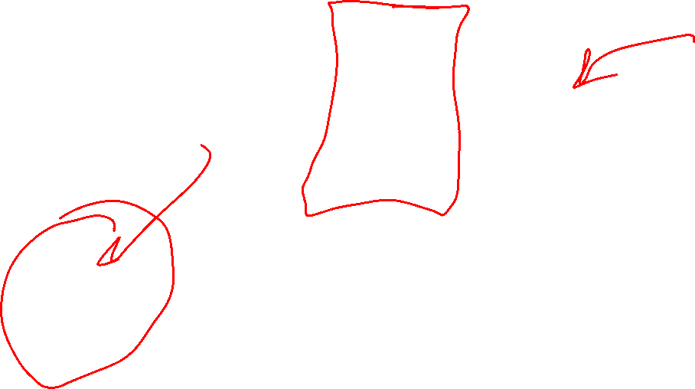
Debate
Which are better sets or lists?

Slide 11
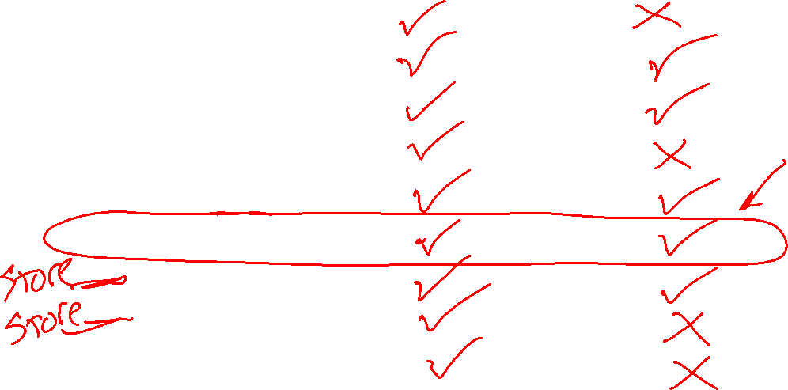
Lists vs Sets
Property
Indexing
Iterate over
Mutable
Mutable elements
Get length
Check contents
Sort different types
Sort repeated elements
Stored in order added
Lists
Sets

Slide 12

“I feel the need, the need for speed”
-- Top Gun

Slide 13
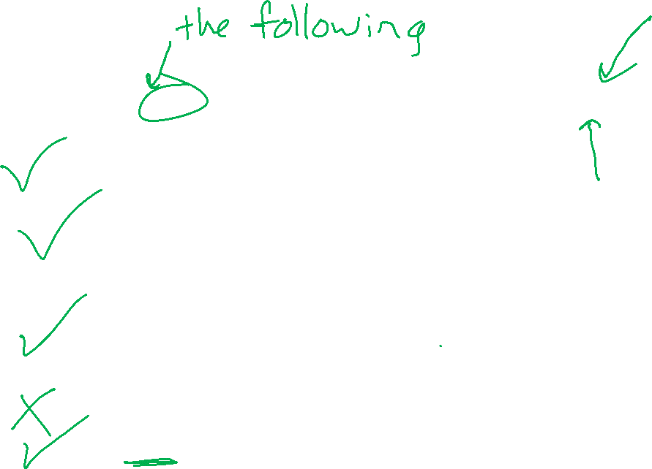
Poll 2
Which of may need to visit all N elements in the list data, assuming N = len(data)? Select ALL that apply.
for x in data:
print(x)
for i in range(len(data)):
x = data[i]
print(x)
if x in data:
print(“Found it”)
x = data[-1]
x = max(data)
None of the above

Slide 14
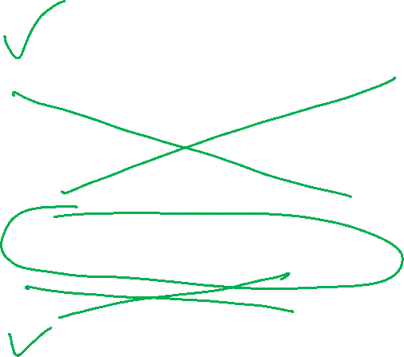
Poll 3
Which of may need to visit all N elements in the set data, assuming N = len(data)? Select ALL that apply.
for x in data:
print(x)
for i in range(len(data)):
x = data[i]
print(x)
if x in data:
print(“Found it”)
x = data[-1]
x = max(data)
None of the above

Slide 15
Discussion
Brainstorm: How can I make finding a specific student’s exam more efficient?

Slide 16
Set lookup is *way* faster

Slide 17
Hashing

Slide 18
Discussion
Brainstorm: How can I make finding a specific student’s exam more efficient?

Slide 19
How do sets work? In-class exercise
Hashtables
Simple example
def myHash(s):
val = 0
for c in s:
val += ord(c)
return val
s = "cat"
numBuckets = 10
hVal = myHash(s)
bucketIndex = hVal % numBuckets
print(s, hVal, bucketIndex)

Slide 20
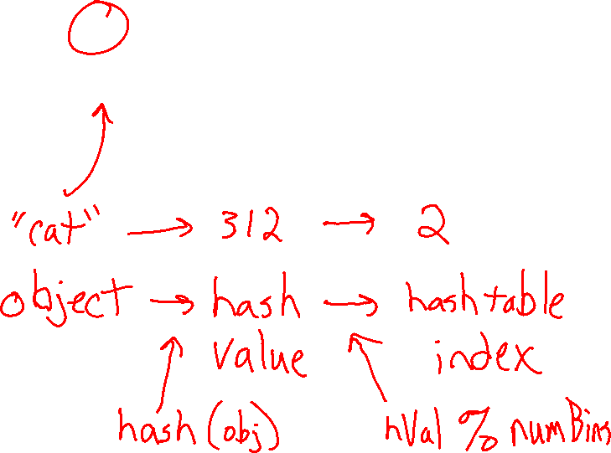
How do sets work?
Hashtable (a list of length numBuckets)
Hashtables
Simple example
0 | 1 | 2 | 3 | 4 | 5 | 6 | 7 | 8 | 9
def myHash(s):
val = 0
for c in s:
val += ord(c)
return val
s = "cat"
numBuckets = 10
hVal = myHash(s)
bucketIndex = hVal % numBuckets
print(s, hVal, bucketIndex)

Slide 21
Dictionaries

Slide 22
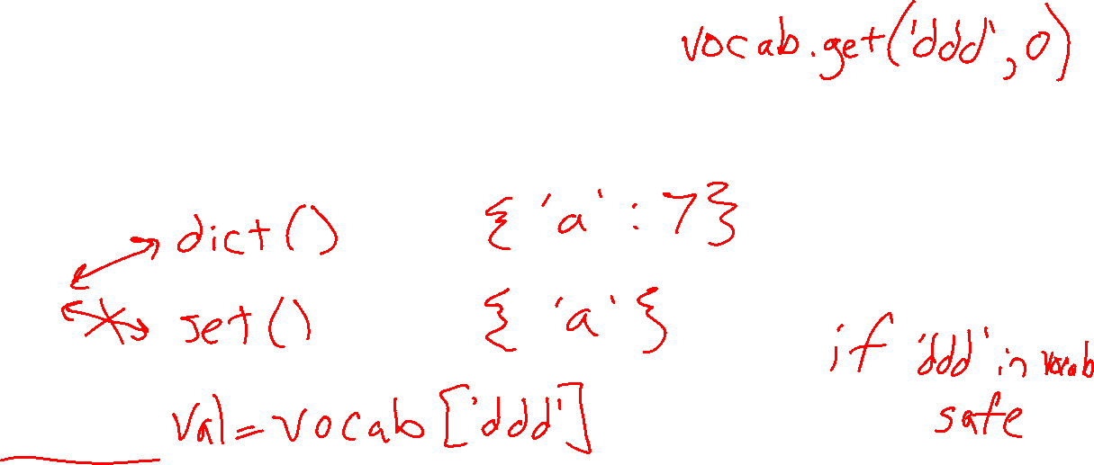
Dictionaries
Map keys to values
Keys are stored like sets
{}
Key Error

Slide 23
Sets and Dictionaries Example
Vocab

Slide 24
Efficiency

Slide 25
Counting operations
Worksheet

Slide 26
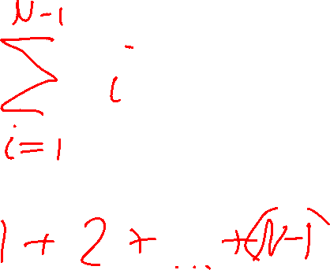
Counting operations
Worksheet

Slide 27
Counting operations
N is the size of the input data
e.g. the length of an input list
The function f(N) is a measurement or count of resources used based on N
Often based on computation time needed, but can be related to other resources like space (memory) needed
Measured in number of operations rather than time
    Lots of reasons, e.g. easier to compare algorithms despite changes in computer speed
Small details either ignored or estimated (because of big-O)

Slide 28
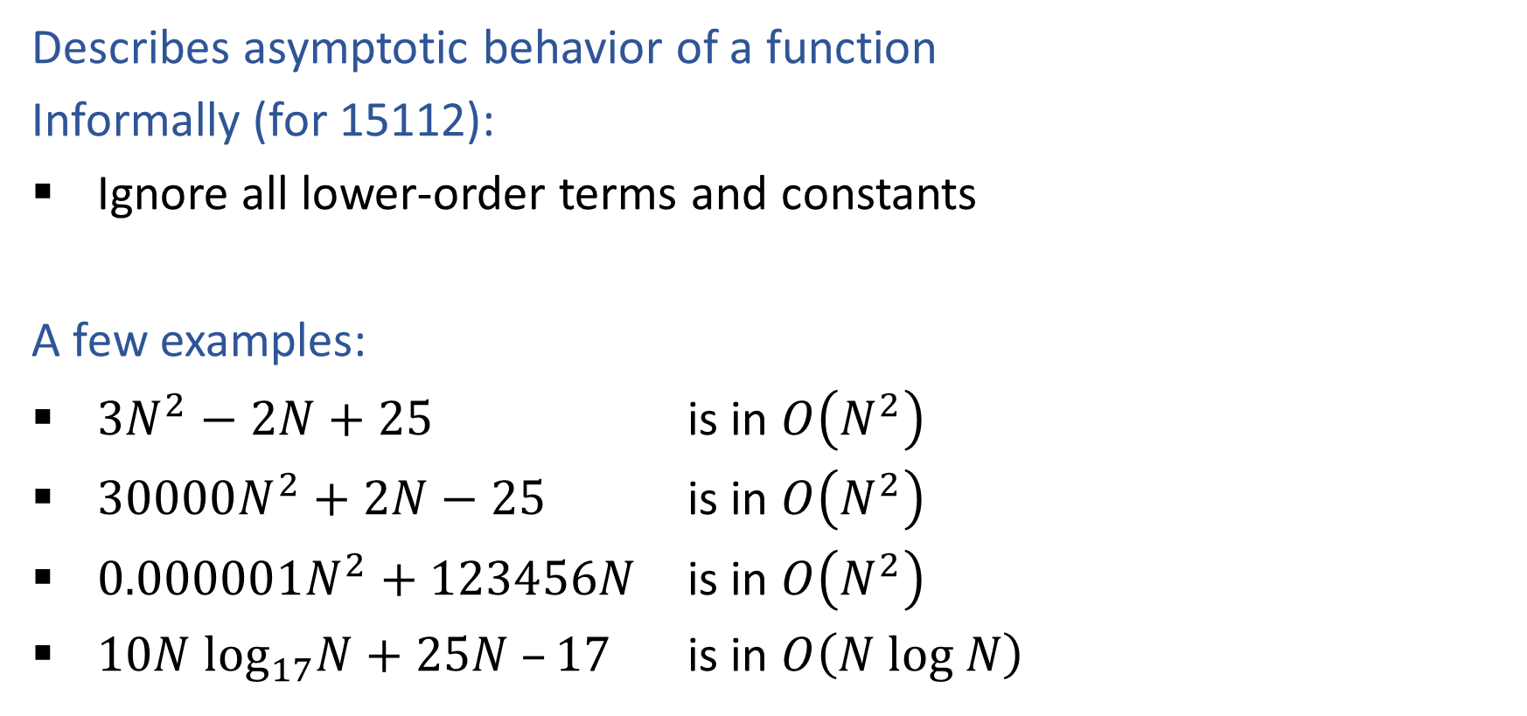
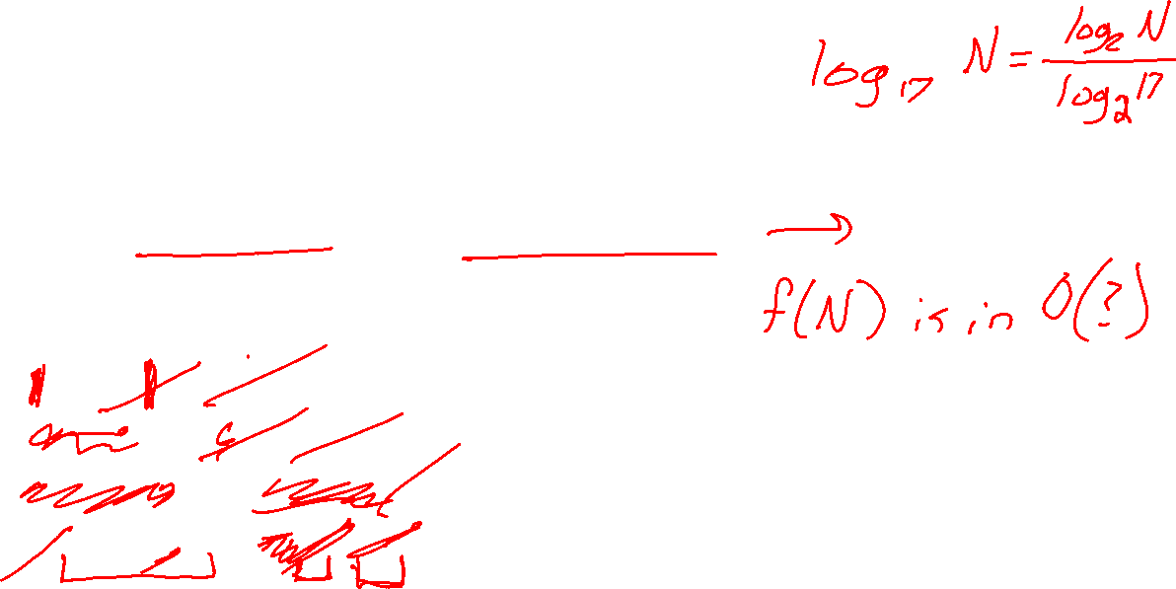
Big O
Describes asymptotic behavior of a function
Informally (for 15112):
Ignore all lower-order terms and constants
A few examples:
$3N^{2}−2N+25$ is in $O\left(N^{2}\right)$
$30000N^{2}+2N−25$ is in $O\left(N^{2}\right)$
$0.000001N^{2}+123456N$ is in $O\left(N^{2}\right)$
$10N \log_{17}N+25N –17$ is in $O\left(N log N\right)$

Slide 29
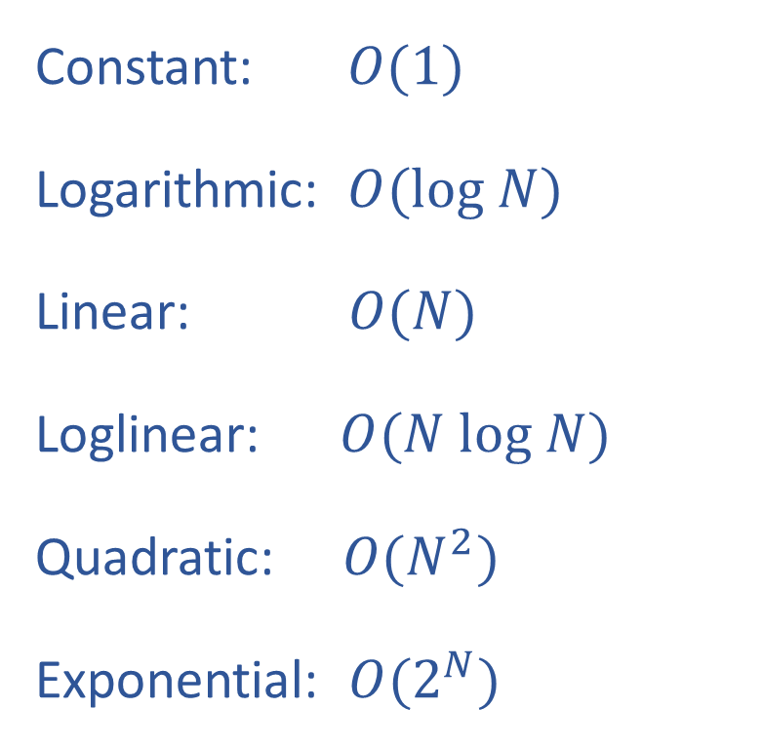
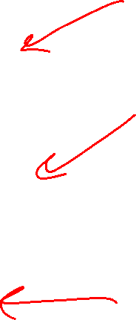
Common Function Families
Constant: $O(1)$
Logarithmic: $O(log N)$
Linear: $O(N)$
Loglinear: $O(N log N)$
Quadratic: $O(N^{2})$
Exponential: $O(2^{N})$

Slide 30
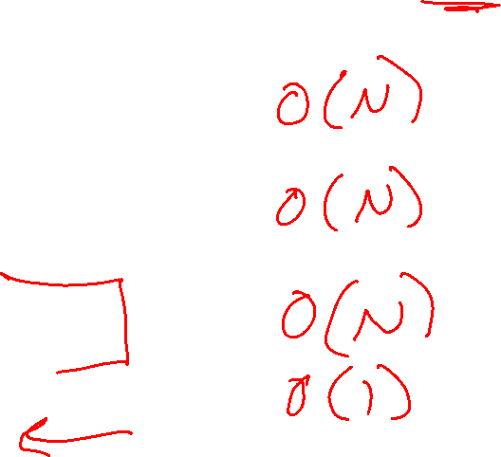
Previous Poll 2
Which of these needs to visit all N elements in the list data, assuming N = len(data)?
Select ALL that apply.
for x in data:
print(x)
for i in range(len(data)):
print(x)
if x in data:
print(“Found it”)
x = data[i]
x = max(data)
None of the above

Slide 31
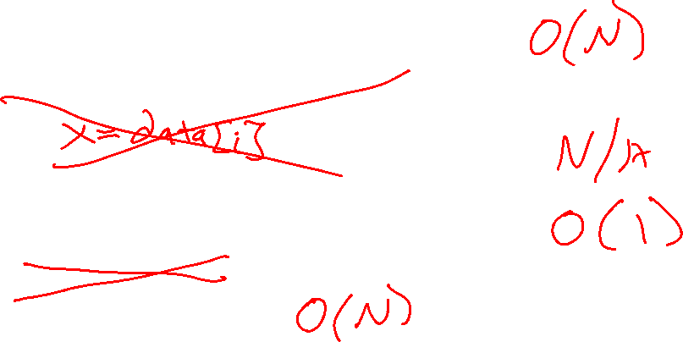
Previous Poll 3
Which of these needs to visit all N elements in the set data, assuming N = len(data)?
Select ALL that apply.
for x in data:
print(x)
for i in range(len(data)):
print(x)
if x in data:
print(“Found it”)
x = data[i]
x = max(data)
None of the above

Slide 32
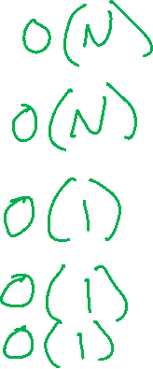
Poll 4
Which of these is O(N) for the dictionary d, assuming N = len(d)? Note: all of these are either O(1) or O(N)
Select ALL that apply.
for key in d:
print(d[key])
for i in range(len(d)):
print(d[i])
if key in d:
print(“Found it”)
x = d[key]
d[key] = x
None of the above

Slide 33
Efficiency of Search and Sort

Slide 34
Example Lame Wordle

Slide 35
Poll 5
I’m thinking of a number between 1 and 64. After each guess, I’ll tell you if you’re correct or if my number is higher or lower.
$100 if you win. $0 if you lose.
How many guesses do you want to buy, $1 each?
A: 6
B: 7
C: 32
D: 64

Slide 36
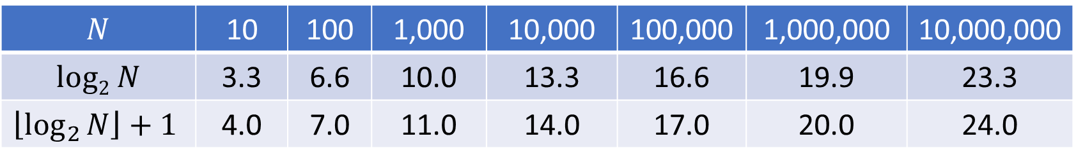
Guess a Number: Binary Search
I’m thinking of a number between 1 and N. After each guess, I’ll tell you if you’re correct or if my number is higher or lower.
What is the maximum number of guesses you’ll need to play this game?
$$N$$ | 10 | 100 | 1,000 | 10,000 | 100,000 | 1,000,000 | 10,000,000
$$log2 N$$ | 3.3 | 6.6 | 10.0 | 13.3 | 16.6 | 19.9 | 23.3
$$\left\lfloor \log_{2}{N}\right\rfloor +1$$ | 4.0 | 7.0 | 11.0 | 14.0 | 17.0 | 20.0 | 24.0

Slide 37
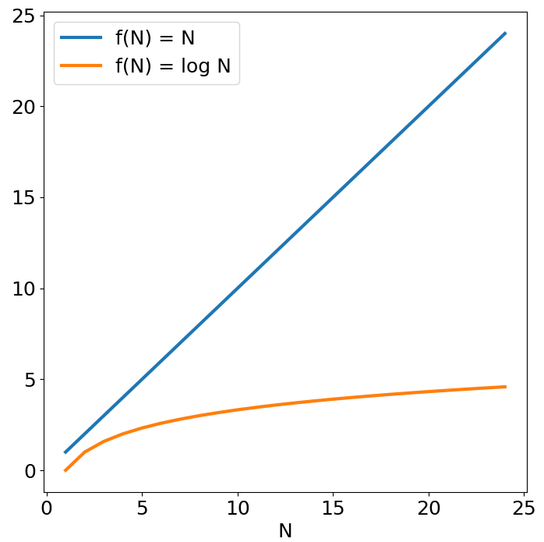
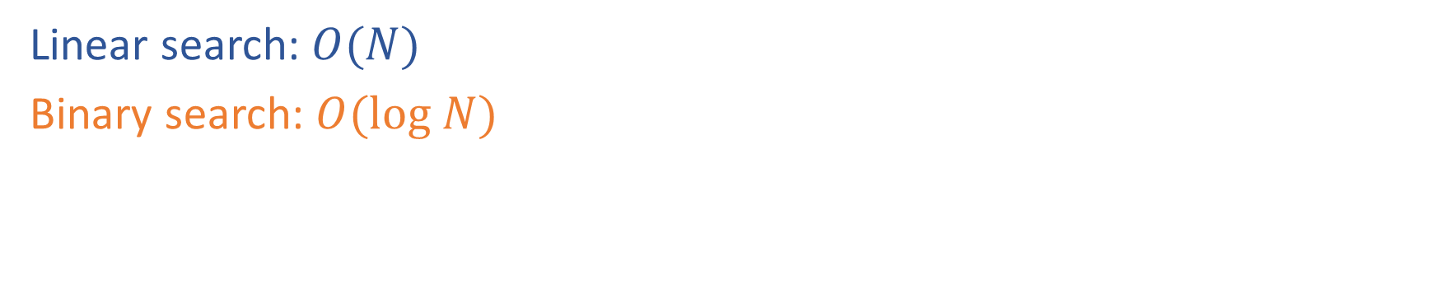
Linear vs Binary Search
Linear search: $O(N)$
Binary search: $O(log N)$

Slide 38
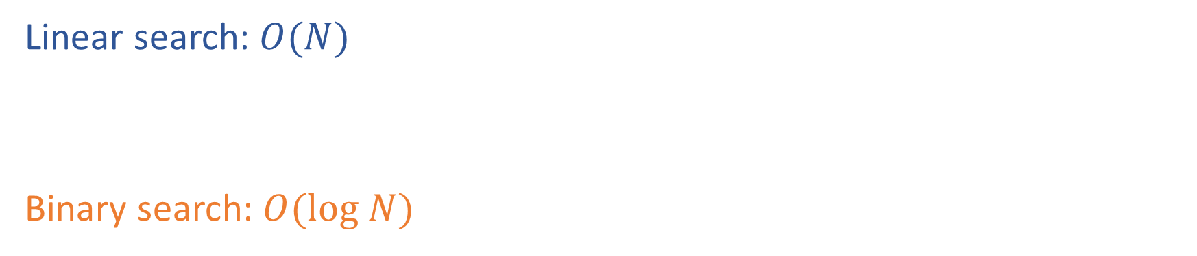
Linear vs Binary Search
Linear search: $O(N)$
Binary search: $O(log N)$

Slide 39
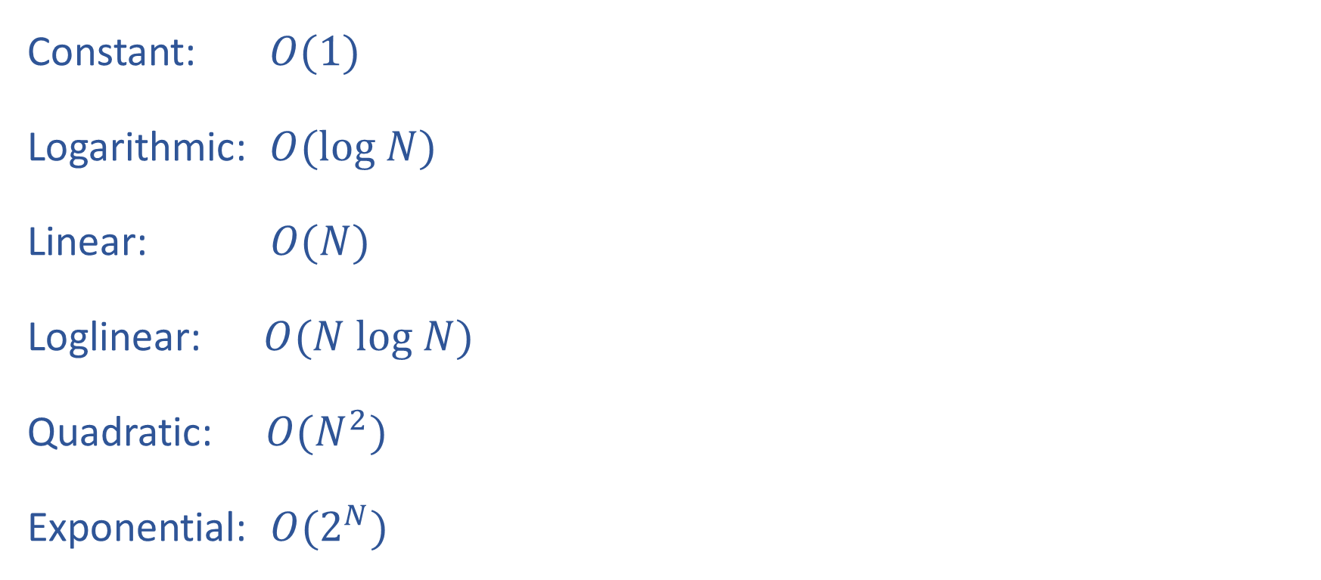
Common Function Families
Constant: $O(1)$
Logarithmic: $O(log N)$
Linear: $O(N)$
Loglinear: $O(N log N)$
Quadratic: $O(N^{2})$
Exponential: $O(2^{N})$

Slide 40
Complexity Classes

Slide 41
Efficiency of Sorting Algorithms

Slide 42
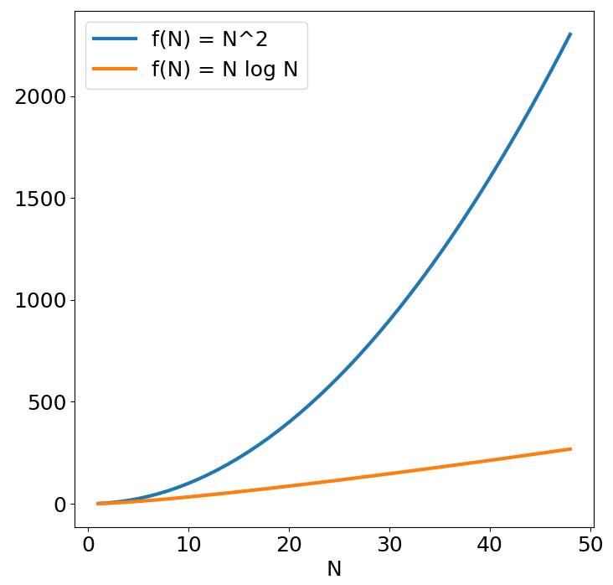
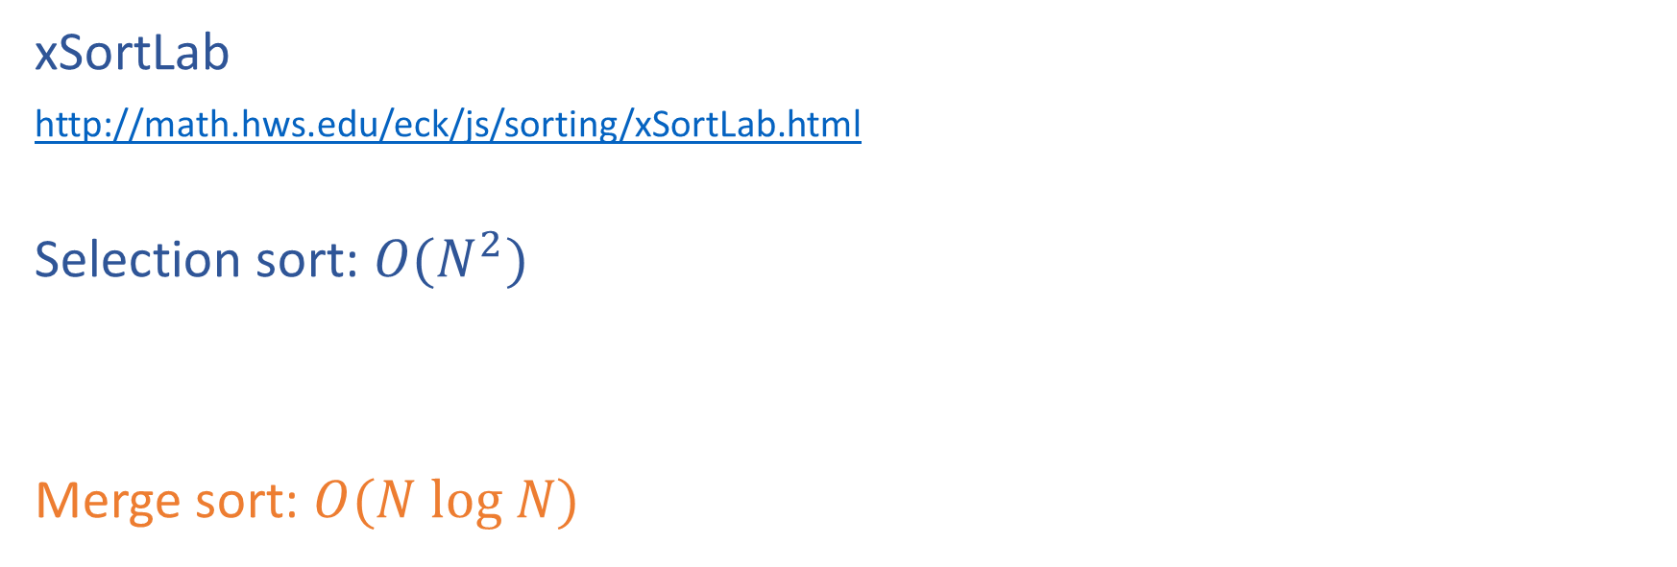
Sorting algorithms
xSortLab
http://math.hws.edu/eck/js/sorting/xSortLab.html
Selection sort: $O(N^{2})$
Merge sort: $O(N log N)$

Slide 43
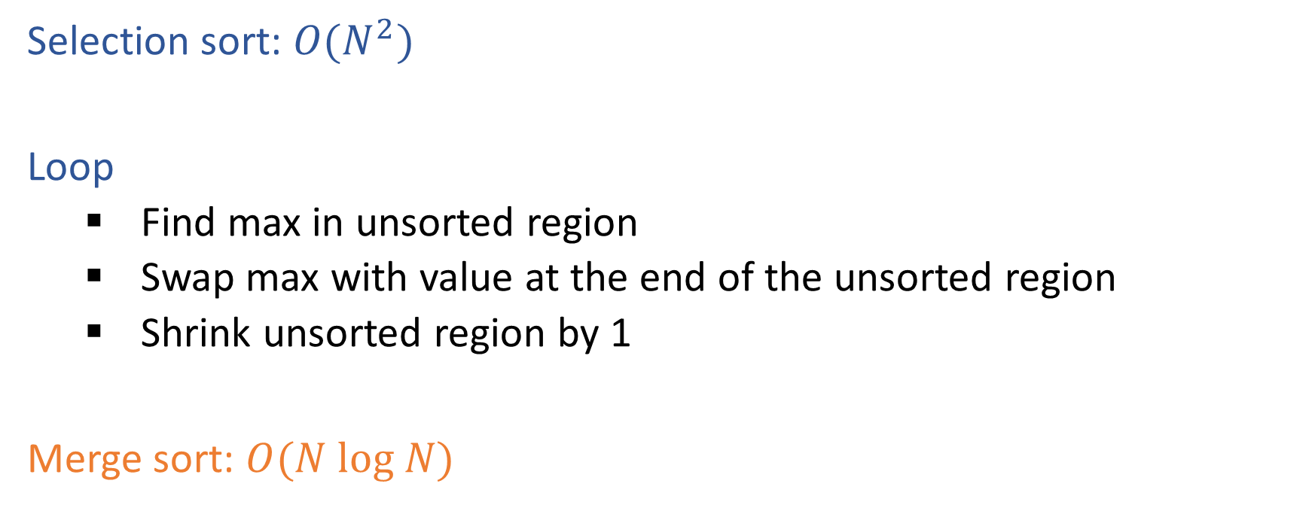
Sorting algorithms
Selection sort: $O(N^{2})$
Loop
    Find max in unsorted region
    Swap max with value at the end of the unsorted region
    Shrink unsorted region by 1
Merge sort: $O(N log N)$

Slide 44
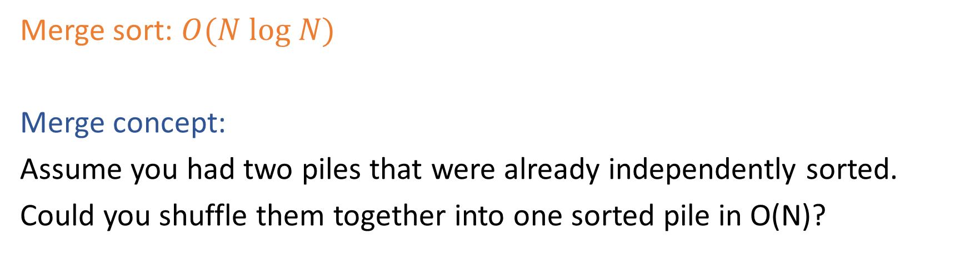
Sorting algorithms
Merge sort: $O(N log N)$
Merge concept:
Assume you had two piles that were already independently sorted.
Could you shuffle them together into one sorted pile in O(N)?

