Slide 1
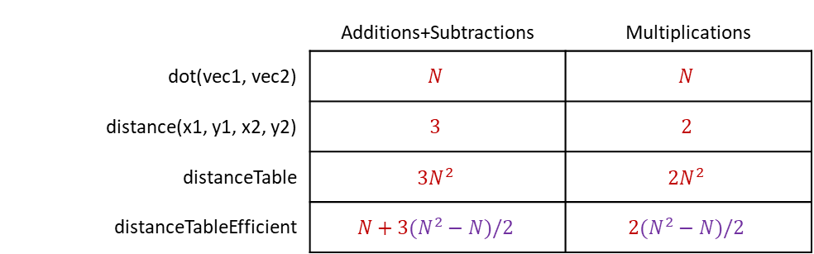
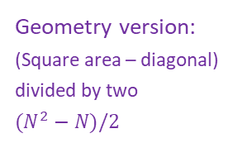
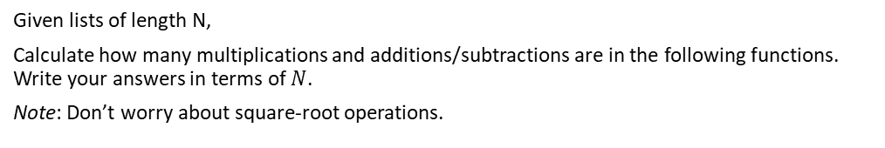
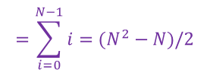


Exercise: Counting operations
Given lists of length N,
Calculate how many multiplications and additions/subtractions are in the following functions. Write your answers in terms of $N$.
Note: Don’t worry about square-root operations.
 | Additions+Subtractions | Multiplications
dot(vec1, vec2) | $$N$$ | $$N$$
distance(x1, y1, x2, y2) | $$3$$ | $$2$$
distanceTable | $$3N^{2}$$ | $$2N^{2}$$
distanceTableEfficient | $$N+3(N^{2}−N)/2$$ | $$2(N^{2}−N)/2$$
$$N+3(1+2+…+N−1)$$
def dot(vec1, vec2):
N = len(vec1)
result = 0
for i in range(N):
val1 = vec1[i]
val2 = vec2[i]
result = result + val1*val2
return result
Arithmetic sequence:
$1+2+3+…+\left(N−2\right)+\left(N−1\right)$
$$=\sum_{i=0}^{N−1}{i}=(N^{2}−N)/2$$
Geometry version:
(Square area – diagonal) divided by two
$(N^{2}−N)/2$
def distance(x1, y1, x2, y2):
dx = x1-x2
dy = y1-y2
return math.sqrt(dx*dx + dy*dy)
def distanceTable(pointList):
# Distance between all pairs of
# points
N = len(pointList)
for i in range(N):
for j in range(N):
p1 = pointList[i]
p2 = pointList[j]
d = distance(p1[0], p1[1],
p2[0], p2[1])
print(d, end='\t')
print()
def distanceTableEfficient(pointList):
# Distance between all pairs of
# points (without repeats)
N = len(pointList)
for i in range(N):
start = i+1
for j in range(start, N):
p1 = pointList[i]
p2 = pointList[j]
d = distance(p1[0], p1[1],
p2[0], p2[1])
print(d, end='\t')
print()

