Slide 1

Play Rock Paper Scissors with the people around you
What are the rules?
What is the best action to take if the other player plays Rock?
What is the best overall strategy?

Slide 2
Announcements
Assignments:
HW10 due Tuesday
P5 due Thursday (week from today)
Review Session:
Sunday Dec 10 2-4pm
Final Exam:
Thursday Dec 14 1-4pm
All material is fair game, will focus disproportionately on material not yet covered on midterm exams
Other:
Come to office hours for conceptual questions!

Slide 3
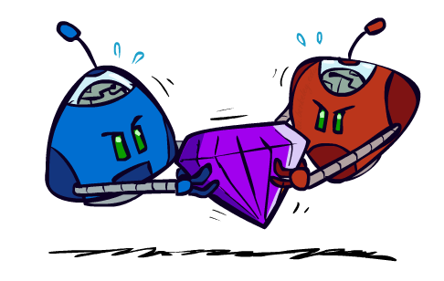
AI: Representation and Problem Solving
Game Theory: Equilibrium
Instructors: Vincent Conitzer and Aditi Raghunathan
Slide credits: CMU AI
Image credit: ai.berkeley.edu

Slide 4
Learning Objectives
Formulate a problem as a game
Describe and compare the basic concepts in game theory
  Normal-form game, extensive-form game
  Zero-sum game, general-sum game
  Pure strategy, mixed strategy, support, best response, dominance
  Dominant strategy equilibrium, Nash equilibrium, (Minimax strategy), (maximin strategy), Stackelberg equilibrium
Describe iterative removal algorithm
(Describe minimax theorem)
Compute equilibria for bimatrix games
  Pure strategy Nash equilibrium
  Mixed strategy Nash equilibrium (including using LP for zero-sum games)
  Stackelberg equilibrium (only pure strategy equilibrium is required)

Slide 5

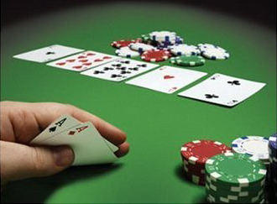


From Games to Game Theory
The study of mathematical models of conflict and cooperation between intelligent decision makers
Used in economics, political science, biology, computer science, …
John Nash
Winner of Nobel Memorial Prize in Economic Sciences
Notes:
We all play games, from … to … to party boardgames such as werewolf.
In most of the games, we have to play in a very strategic way to win.
Game theory is the study of strategic decision making.
More specifically, game theory is the study of mathematical models of conflict and cooperation between intelligent decision-makers. The games studied in game theory must have elements including the players, information, actions and payoffs.
Although the first known discussion of game theory is for a two-player card game, game theory is not only designed for entertaining games. Modern game theory has been used in economics and political science. Nobel Prize winner John Nash

Slide 6
Recall: Adversarial Search
Zero-sum, perfect information, two player games with turn-taking moves
3
12
8
2
4
6
14
5
2

Slide 7
Simultaneous-Move Games and Payoff Matrices
Rock-Paper-Scissors (RPS)
  Rock beats Scissors
  Scissors beats Paper
  Paper beats Rock
  2-player normal-form game with finite set of actions taken simultaneously
  represented in a (bi)matrix
  Player 1 is row player (typically first number)
  Player 2 is column player (typically second number)
Player 2
 | Rock | Paper | Scissors
Rock | 0, 0 | -1, 1 | 1, -1
Paper | 1, -1 | 0, 0 | -1, 1
Scissors | -1, 1 | 1, -1 | 0, 0
Player 1
Notes:
A two-player normal-form game with finite actions can be represented by a (bi)matrix
Player 1: Row player, Player 2: Column player
Often first number is for row player, second for column player

Slide 8

Rock, Paper, Scissors, Lizard, Spock
CBS, Big Bang Theory
https://www.youtube.com/watch?v=iSHPVCBsnLw
Image credit: https://www.snorgtees.com/rock-paper-scissors-lizard-spock

Slide 9
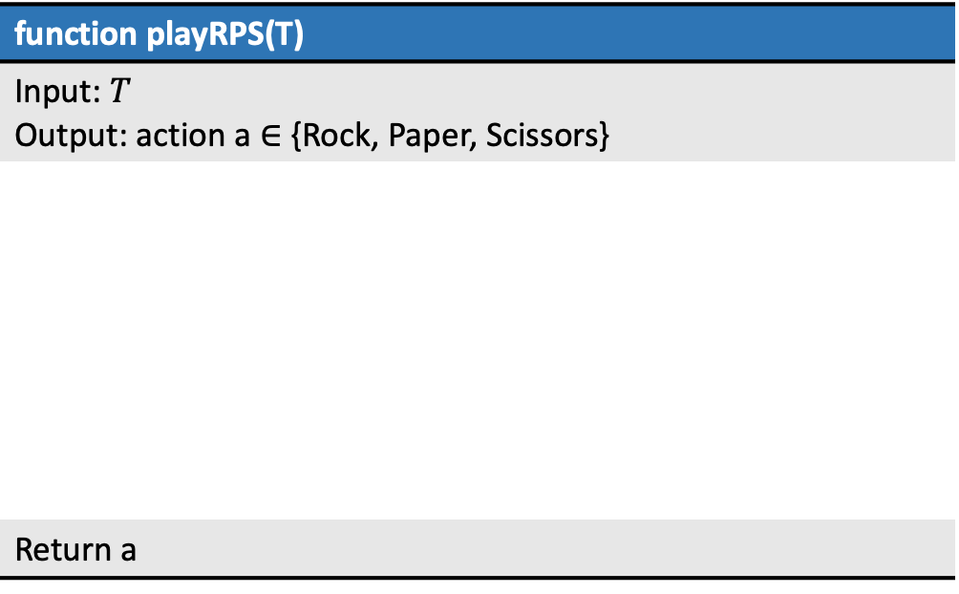
Strategy: Rock, Paper, Scissors
Design an AI to play Rock-Paper-Scissors for T rounds
If T=1, what action does your AI choose?
function playRPS(T)
Input: $T$ Output: action a $∈$ {Rock, Paper, Scissors}
Return a

Slide 10

Simultaneous-Move Games and Payoff Matrices
Football vs Concert (FvsC)
  Historically known as Battle of Sexes
  If football together: Alex ☺☺, Berry ☺
  If concert together: Alex ☺, Berry ☺☺
  If not together: Alex ☹, Berry ☹
Fill in the payoff matrix, row payoff first then column!
Berry
 | Football | Concert
Football
Concert
Alex

Slide 11
Normal-Form Games
A game in normal form consists of the following elements
  Set of players
  Set of actions for each player
  Payoffs / Utility functions
    Determines the utility for each player given the actions chosen by all players (referred to as action profile)
  Bimatrix game is special case: two players, finite action sets
Players move simultaneously and the game ends immediately afterwards
What are the players, set of actions and utility functions of Football vs Concert (FvsC) game?
Notes:
A normal-form game is a representation of a game in game theory. It directly specifies the set of players' strategies where a strategy is a complete plan of action for every stage of the game, regardless of whether that stage actually arises in play.

Slide 12
Classical Games and Payoff Matrices
Prisoner’s Dilemma (PD)
  If both Cooperate with each other: 1 year in jail each
  If one Defect to police, one Cooperate: 0 year for (D), 3 years for (C)
  If both Defect to police: 2 years in jail each
  Let’s play!
Player 2
 | Cooperate | Defect
Cooperate | -1,-1 | -3,0
Defect | 0,-3 | -2,-2
Player 1
Notes:
Two members of a criminal gang are arrested and imprisoned. Each prisoner is in solitary confinement with no means of communicating with the other. The prosecutors lack sufficient evidence to convict the pair on the principal charge, but they have enough to convict both on a lesser charge. Simultaneously, the prosecutors offer each prisoner a bargain. Each prisoner is given the opportunity either to betray the other by testifying that the other committed the crime, or to cooperate with the other by remaining silent. The possible outcomes are:
If A and B each betray the other, each of them serves two years in prison
If A and B each cooperate with each other (not with police), each serves on the lesser crime
If A betrays B but B remains silent, A will be set free and B will serve three years in prison (and vice versa)
If A and B both remain silent, both of them will serve only one year in prison (on the lesser charge).

Slide 13

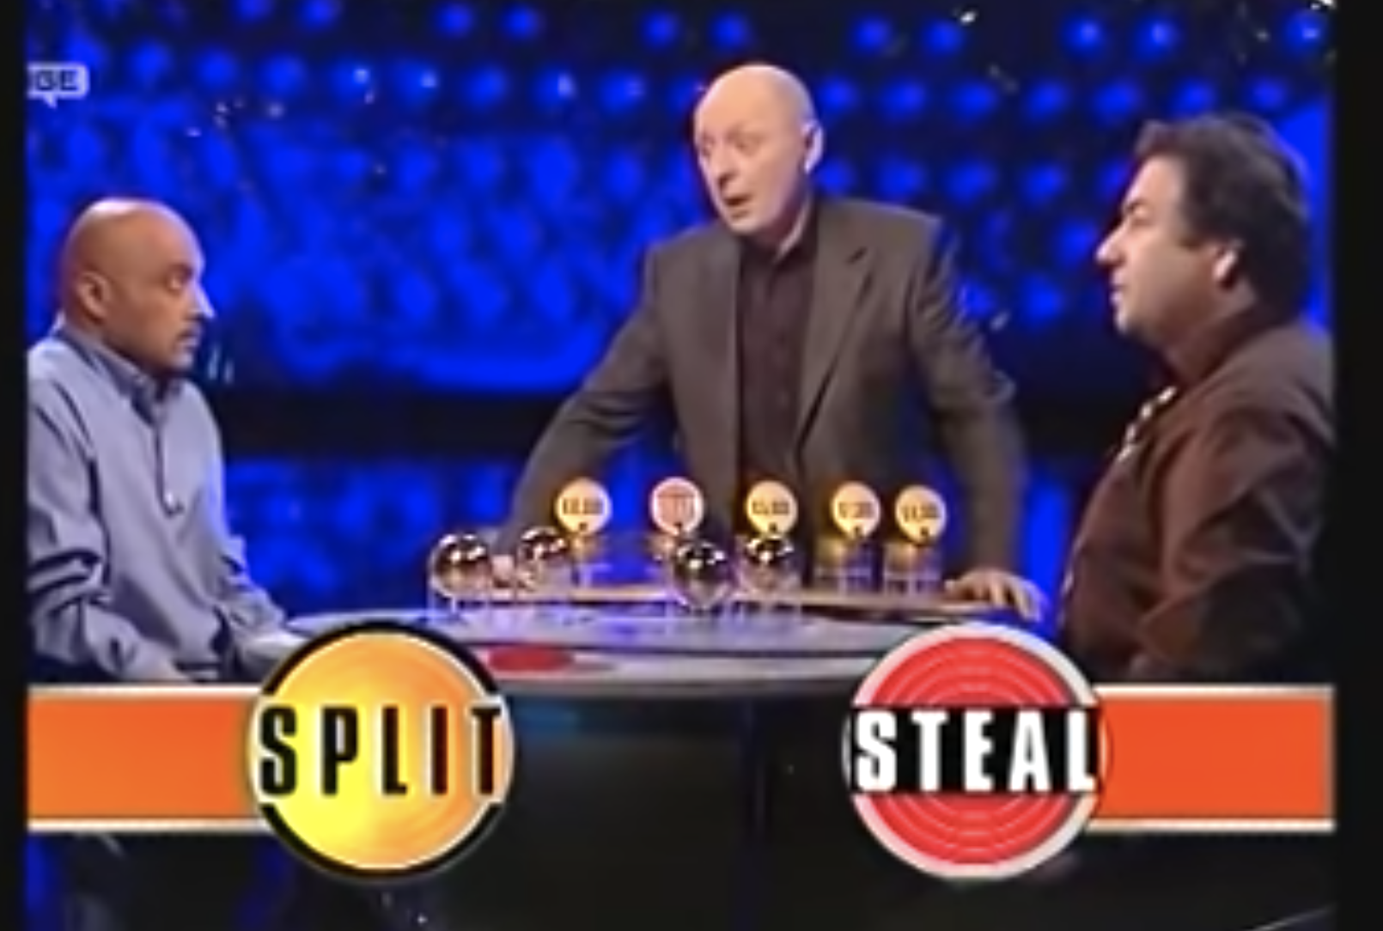
Variation: Split or Steal
https://youtu.be/p3Uos2fzIJ0
https://www.wnycstudios.org/podcasts/radiolab/segments/golden-rule

Slide 14
Zero-sum vs General-sum
Zero-sum Game
  No matter what actions are chosen by the players, the utilities for all the players sum up to zero or a constant
General-sum Game
  The sum of utilities of all the players need not be a constant
  Which ones are general-sum games?
Player 2
 | Cooperate | Defect
Cooperate | -1,-1 | -3,0
Defect | 0,-3 | -2,-2
Player 1
Player 2
 | Rock | Paper | Scissors
Rock | 0,0 | -1,1 | 1,-1
Paper | 1,-1 | 0,0 | -1,1
Scissor | -1,1 | 1,-1 | 0,0
Berry
Alex
 | Football | Concert
Football | 2,1 | 0,0
Concert | 0,0 | 1,2
Player 1

Slide 15
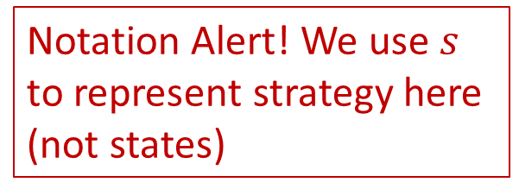
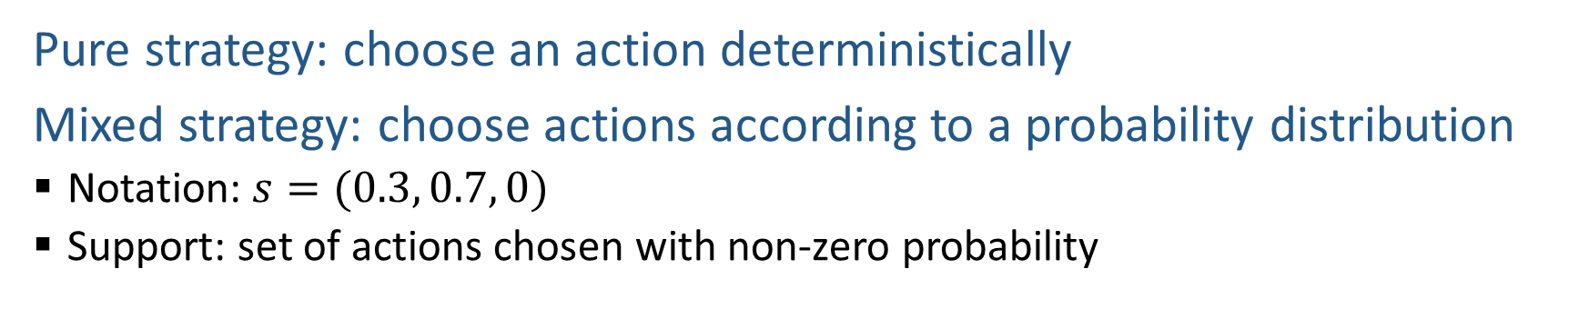
Strategy
Pure strategy: choose an action deterministically
Mixed strategy: choose actions according to a probability distribution
  Notation: $s=(0.3, 0.7, 0)$
  Support: set of actions chosen with non-zero probability
Notation Alert! We use $s$ to represent strategy here (not states)
Does your AI play a deterministic strategy or a mixed strategy?
What is the support size of your AI’s strategy?
Player 2
 | Rock | Paper | Scissors
Rock | 0, 0 | -1, 1 | 1, -1
Paper | 1, -1 | 0, 0 | -1, 1
Scissors | -1, 1 | 1, -1 | 0, 0
Player 1

Slide 16
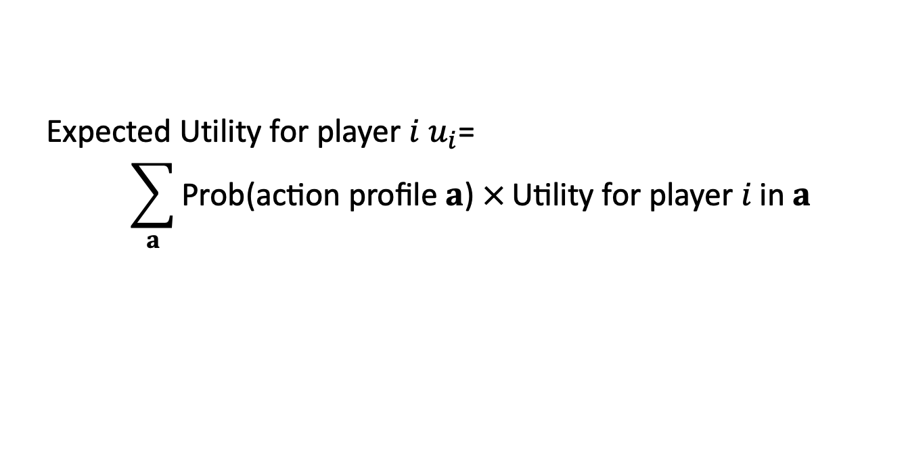
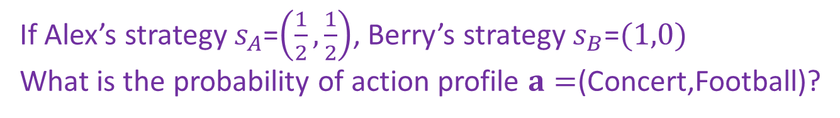
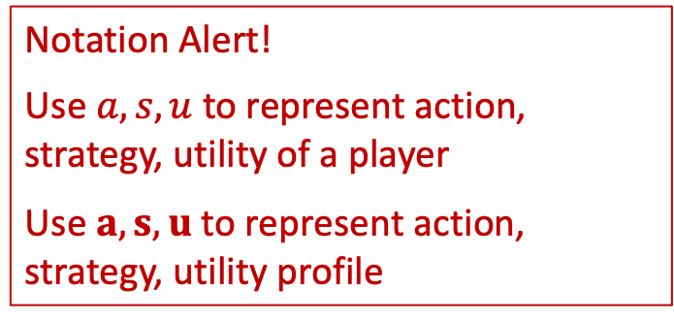
Expected Utility
Notation Alert!
Use $a, s,u$ to represent action, strategy, utility of a player
Use $a,s,u$ to represent action, strategy, utility profile
Given the strategies of all players,
Expected Utility for player $i$ $u_{i}$=
$$\sum_{a}{\text{Prob}\text{(}\text{action} \text{profile} a\text{) }×}\text{Utility} \text{for} \text{player} i \text{in} a$$
Can skip action profiles with probability $0$ or utility $0$
If Alex’s strategy $s_{A}$=$\left(\frac{1}{2},\frac{1}{2}\right)$, Berry’s strategy $s_{B}$=$(1,0)$
What is the probability of action profile $a=$(Concert,Football)?
Berry
What is Alex’s expected utility overall?
 | Football | Concert
Football | 2,1 | 0,0
Concert | 0,0 | 1,2
Alex

Slide 17
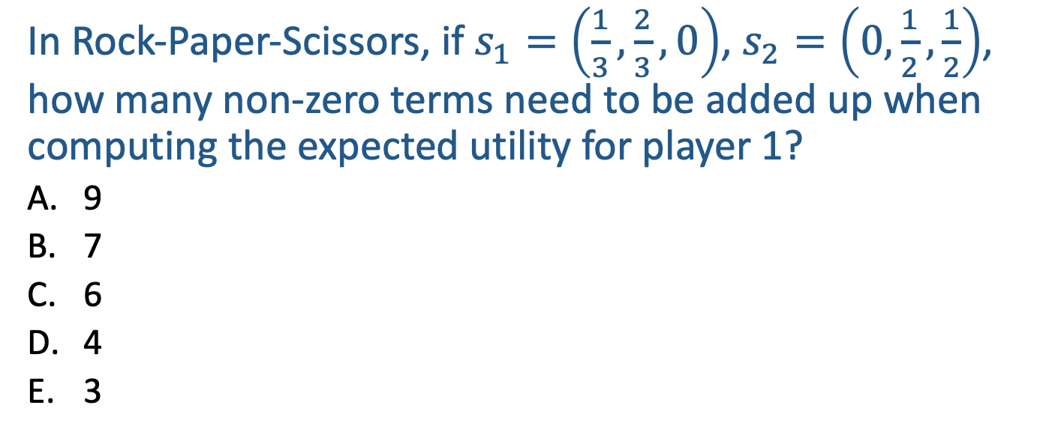
Poll 1
In Rock-Paper-Scissors, if $s_{1}=\left(\frac{1}{3},\frac{2}{3},0\right)$, $s_{2}=\left(0,\frac{1}{2},\frac{1}{2}\right)$, how many non-zero terms need to be added up when computing the expected utility for player 1?
  9
  7
  6
  4
  3
Player 2
 | Rock | Paper | Scissors
Rock | 0, 0 | -1, 1 | 1, -1
Paper | 1, -1 | 0, 0 | -1, 1
Scissors | -1, 1 | 1, -1 | 0, 0
Player 1

Slide 18
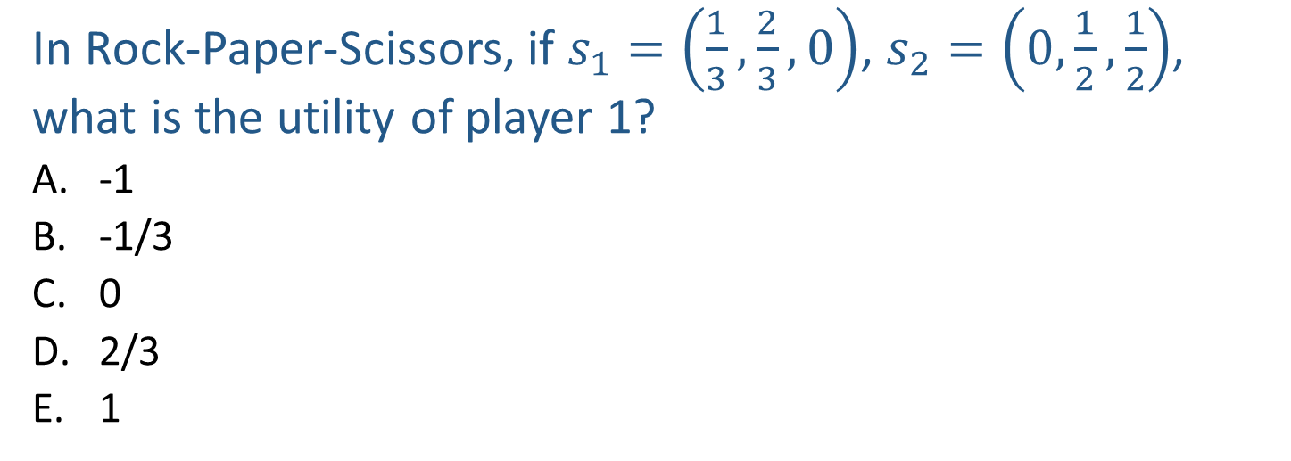
Poll 2
In Rock-Paper-Scissors, if $s_{1}=\left(\frac{1}{3},\frac{2}{3},0\right)$, $s_{2}=\left(0,\frac{1}{2},\frac{1}{2}\right)$, what is the utility of player 1?
  -1
  -1/3
  0
  2/3
  1
Player 2
 | Rock | Paper | Scissors
Rock | 0, 0 | -1, 1 | 1, -1
Paper | 1, -1 | 0, 0 | -1, 1
Scissors | -1, 1 | 1, -1 | 0, 0
Player 1

Slide 19
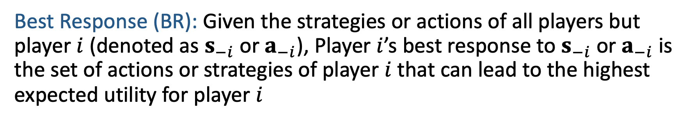
Best Response
Best Response (BR): Given the strategies or actions of all players but player $i$ (denoted as $s_{−i}$ or $a_{−i}$), Player $i$’s best response to $s_{−i}$ or $a_{−i}$ is the set of actions or strategies of player $i$ that can lead to the highest expected utility for player $i$
In RPS, what is Player 1’s best response to Rock (i.e., assuming Player 2 plays Rock)? What about to (.5 Rock, .5 Paper, 0 Scissors)?
In Prisoner’s Dilemma, what is Player 1’s best response to Cooperate? What is Player 1’s best response to Defect? What about to (.5 Cooperate, .5 Defect)?
Player 2
 | Cooperate | Defect
Cooperate | -1,-1 | -3,0
Defect | 0,-3 | -2,-2
Player 1

Slide 20
Best Response
Best Response (BR): Given the strategies or actions of all players but player $i$ (denoted as $s_{−i}$ or $a_{−i}$), Player $i$’s best response to $s_{−i}$ or $a_{−i}$ is the set of actions or strategies of player $i$ that can lead to the highest expected utility for player $i$
In RPS, what is Player 1’s best response to Rock (i.e., assuming Player 2 plays Rock)?
Paper
In Prisoner’s Dilemma, what is Player 1’s best response to Cooperate? What is Player 1’s best response to Defect?
Defect, Defect
Player 2
 | Cooperate | Defect
Cooperate | -1,-1 | -3,0
Defect | 0,-3 | -2,-2
Player 1

Slide 21
Best Response
Best Response (BR): Given the strategies or actions of all players but player $i$ (denoted as $s_{−i}$ or $a_{−i}$), Player $i$’s best response to $s_{−i}$ or $a_{−i}$ is the set of actions or strategies of player $i$ that can lead to the highest expected utility for player $i$
What is Alex’s best response to Berry’s mixed strategy $s_{B}=\left(\frac{1}{2},\frac{1}{2}\right)$?
Berry
 | Football | Concert
Football | 2,1 | 0,0
Concert | 0,0 | 1,2
Alex
Notes:
U_A (Football,S_B) = ½*2 + ½*0 = 1
U_A(Concert,S_B) = ½*0+ ½ *1 = ½
Is it ever better to choose Concert?

Slide 22
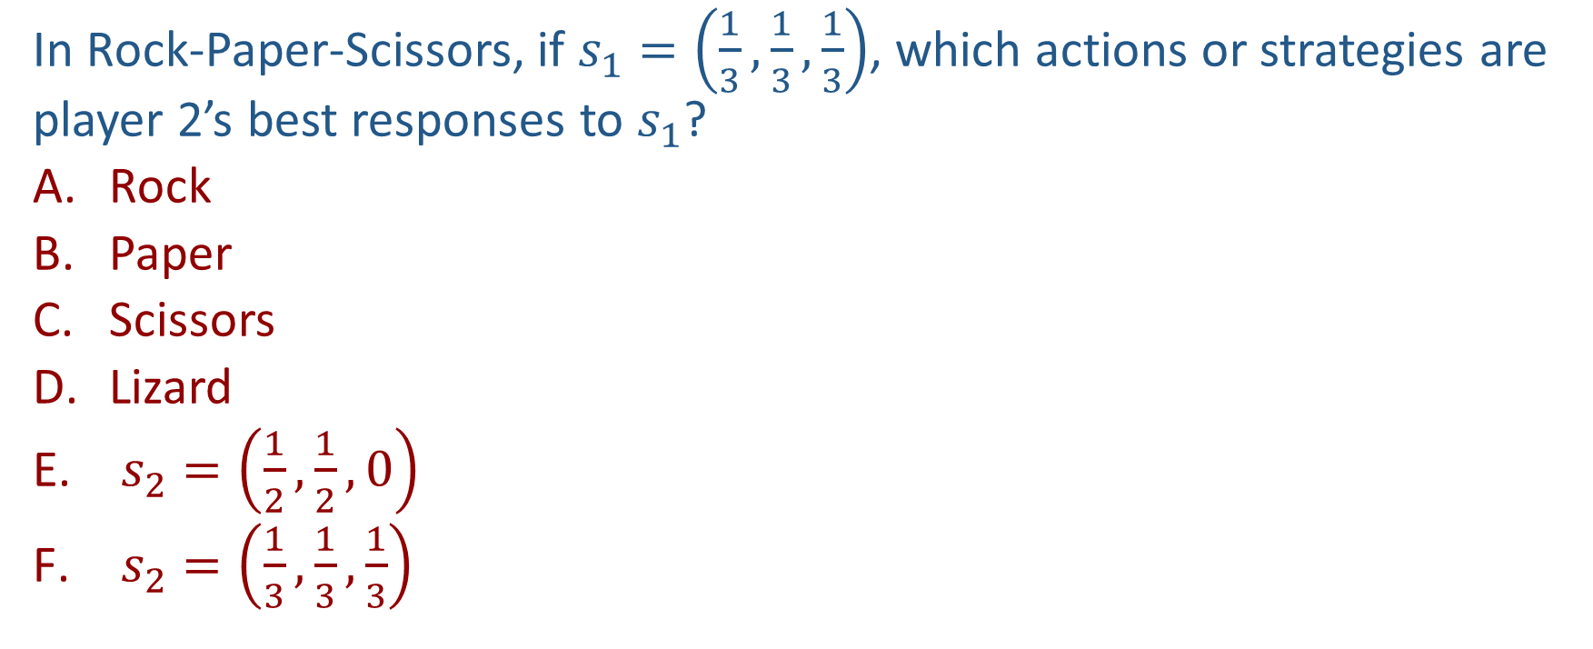
Poll 3
In Rock-Paper-Scissors, if $s_{1}=\left(\frac{1}{3},\frac{1}{3},\frac{1}{3}\right)$, which actions or strategies are player 2’s best responses to $s_{1}$?
  Rock
  Paper
  Scissors
  Lizard
  $s_{2}=\left(\frac{1}{2},\frac{1}{2},0\right)$
  $s_{2}=\left(\frac{1}{3},\frac{1}{3},\frac{1}{3}\right)$
Player 2
 | Rock | Paper | Scissors
Rock | 0, 0 | -1, 1 | 1, -1
Paper | 1, -1 | 0, 0 | -1, 1
Scissors | -1, 1 | 1, -1 | 0, 0
Player 1

Slide 23
Best Response
Proposition: A mixed strategy is BR iff all actions in the support are BR
Player 2
 | Rock | Paper | Scissors
Rock | 0, 0 | -1, 1 | 1, -1
Paper | 1, -1 | 0, 0 | -1, 1
Scissors | -1, 1 | 1, -1 | 0, 0
Player 1

Slide 24
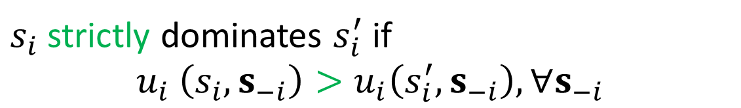

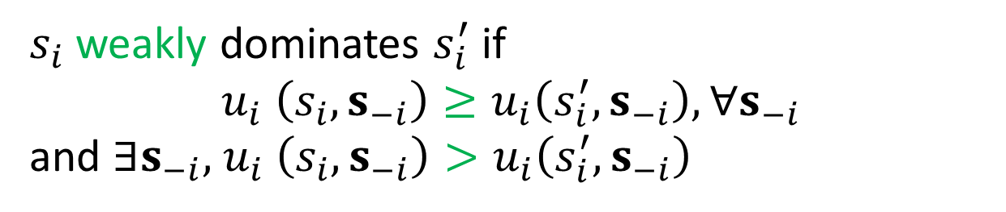
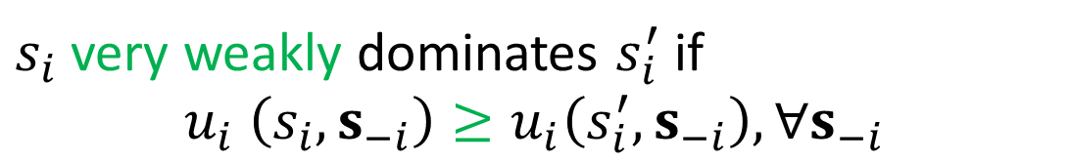
Dominance
$s_{i}$ and $s_{i}′$ are two strategies for player $i$
$s_{i}$ strictly dominates $s_{i}′$if $s_{i}$ is always better than $s_{i}′$, no matter what strategies are chosen by other players
$s_{i}$ strictly dominates $s_{i}^{′}$ if
$$u_{i} \left(s_{i},s_{−i}\right)>u_{i}\left(s_{i}^{′},s_{−i}\right),∀s_{−i}$$
always better
$s_{i}$ very weakly dominates $s_{i}^{′}$ if
$$u_{i} \left(s_{i},s_{−i}\right)≥u_{i}\left(s_{i}^{′},s_{−i}\right),∀s_{−i}$$
never worse
$s_{i}$ weakly dominates $s_{i}^{′}$ if
$$u_{i} \left(s_{i},s_{−i}\right)≥u_{i}\left(s_{i}^{′},s_{−i}\right),∀s_{−i}$$
and $∃s_{−i}\text{, }u_{i} \left(s_{i},s_{−i}\right)>u_{i}\left(s_{i}^{′},s_{−i}\right)$
never worse and sometimes better

Slide 25
Dominance
Can you find any dominance relationships between the pure strategies in these games?
Player 2
 | Cooperate | Defect
Cooperate | -1,-1 | -3,0
Defect | 0,-3 | -2,-2
Player 2
Player 1
 | Rock | Paper | Scissors
Rock | 0,0 | -1,1 | 1,-1
Paper | 1,-1 | 0,0 | -1,1
Scissor | -1,1 | 1,-1 | 0,0
Berry
Player 1
 | Football | Concert
Football | 2,1 | 0,0
Concert | 0,0 | 1,2
Alex

Slide 26
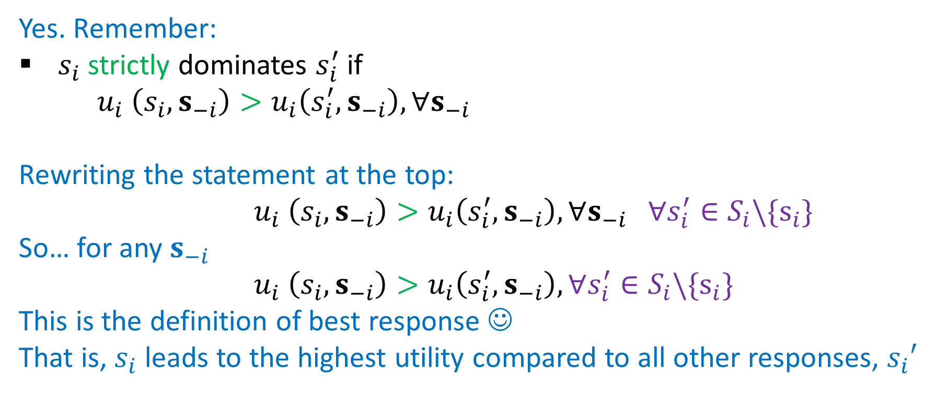
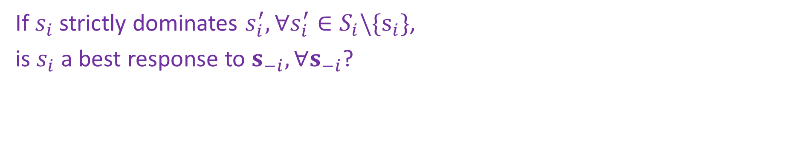
Dominance
If $s_{i}$ strictly dominates $s_{i}^{′},∀s_{i}^{′}∈S_{i}\backslash \{s_{i}\}$,
is $s_{i}$ a best response to $s_{−i},∀s_{−i}$?
Yes. Remember:
$s_{i}$ strictly dominates $s_{i}^{′}$ if
$u_{i} \left(s_{i},s_{−i}\right)>u_{i}\left(s_{i}^{′},s_{−i}\right),∀s_{−i}$
Rewriting the statement at the top:
$u_{i} \left(s_{i},s_{−i}\right)>u_{i}\left(s_{i}^{′},s_{−i}\right),∀s_{−i} ∀s_{i}^{′}∈S_{i}\backslash \{s_{i}\}$
So… for any $s_{−i}$
$u_{i} \left(s_{i},s_{−i}\right)>u_{i}\left(s_{i}^{′},s_{−i}\right),∀s_{i}^{′}∈S_{i}\backslash \{s_{i}\}$
This is the definition of best response ☺
That is, $s_{i}$ leads to the highest utility compared to all other responses, $s_{i}′$

Slide 27
Solution Concepts in Games
How should one player play and what should we expect all the players to play?
  Dominant strategy and dominant strategy equilibrium
  Nash Equilibrium
  (Minimax strategy)
  (Maximin strategy)
  Stackelberg Equilibrium

Slide 28
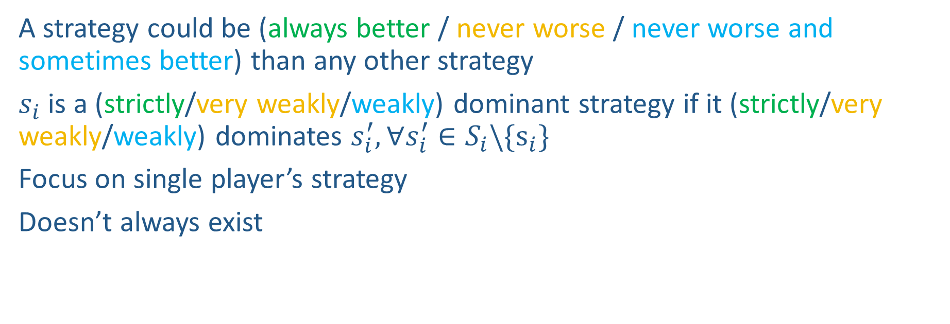
Dominant Strategy
A strategy could be (always better / never worse / never worse and sometimes better) than any other strategy
$s_{i}$ is a (strictly/very weakly/weakly) dominant strategy if it (strictly/very weakly/weakly) dominates $s_{i}^{′}, ∀s_{i}^{′}∈S_{i}\backslash \{s_{i}\}$
Focus on single player’s strategy
Doesn’t always exist
Is there a strictly dominant strategy for player 1 in PD?
Player 2
 | Cooperate | Defect
Cooperate | -1,-1 | -3,0
Defect | 0,-3 | -2,-2
Player 1

Slide 29
Dominant Strategy Equilibrium
Sometimes called dominant strategy solution
Every player plays a dominant strategy
Focus on strategy profile for all players
Note: Doesn’t always exist
What is the dominant strategy equilibrium for PD?
Player 2
 | Cooperate | Defect
Cooperate | -1,-1 | -3,0
Defect | 0,-3 | -2,-2
Player 1

Slide 30
Solution Concepts in Games
How should one player play and what should we expect all the players to play?
  Dominant strategy and dominant strategy equilibrium
  Nash Equilibrium
  (Minimax strategy)
  (Maximin strategy)
  Stackelberg Equilibrium

Slide 31
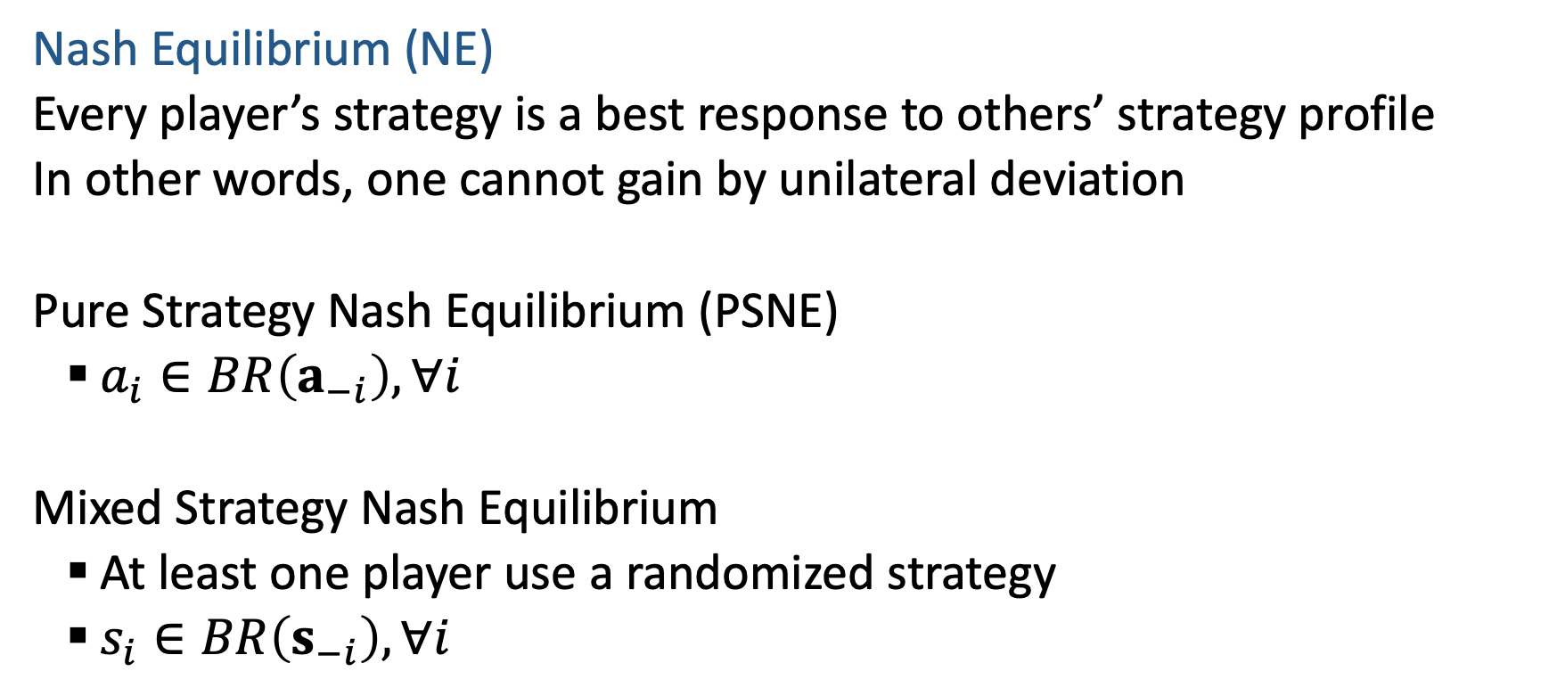
Nash Equilibrium
Nash Equilibrium (NE)
  Every player’s strategy is a best response to others’ strategy profile
  In other words, one cannot gain by unilateral deviation
  Pure Strategy Nash Equilibrium (PSNE)
    $a_{i}∈BR\left(a_{−i}\right),∀i$
  Mixed Strategy Nash Equilibrium
    At least one player use a randomized strategy
    $s_{i}∈BR\left(s_{−i}\right),∀i$

Slide 32
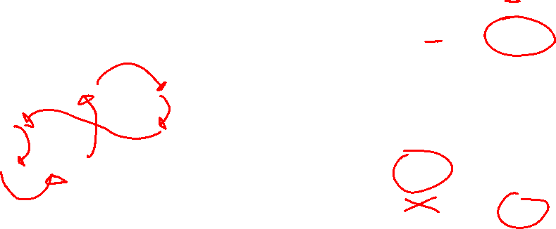
Nash Equilibrium
What are the PSNEs in these games?
What is the mixed strategy NE in RPS?
Player 2
 | Cooperate | Defect
Cooperate | -1,-1 | -3,0
Defect | 0,-3 | -2,-2
Player 1
Player 2
 | Rock | Paper | Scissors
Rock | 0,0 | -1,1 | 1,-1
Paper | 1,-1 | 0,0 | -1,1
Scissor | -1,1 | 1,-1 | 0,0
Berry
Player 1
Alex
 | Football | Concert
Football | 2,1 | 0,0
Concert | 0,0 | 1,2

Slide 33
Nash Equilibrium
What are the PSNEs in these games?
RPS: None. Prisoner’s Dilemma: (D,D). Football vs Concert: (F,F),(C,C)
What is the mixed strategy NE in RPS?
Player 2
 | Cooperate | Defect
Cooperate | -1,-1 | -3,0
Defect | 0,-3 | -2,-2
(1/3,1/3,1/3) for both players
Player 1
Player 2
 | Rock | Paper | Scissors
Rock | 0,0 | -1,1 | 1,-1
Paper | 1,-1 | 0,0 | -1,1
Scissor | -1,1 | 1,-1 | 0,0
Berry
Player 1
Alex
 | Football | Concert
Football | 2,1 | 0,0
Concert | 0,0 | 1,2

Slide 34
Nash Equilibrium
Theorem (Nash 1951): NE always exists in finite games
  Finite number of players, finite number of actions
  NE: can be pure or mixed
  Proof: Through Brouwer's fixed point theorem

Slide 35
Find PSNE
Find pure strategy Nash Equilibrium (PSNE)
  Enumerate all action profiles
  For each action profile, check if it is NE
    For each player, check other available actions to see if he should deviate
  Other approaches?
Player 2
 | L | C | R
U | 10, 3 | 1, 5 | 5, 4
M | 3, 1 | 2, 4 | 5, 2
D | 0, 10 | 1, 8 | 7, 0
Player 1
Notes:
for each player to see if there is no incentive for this player to deviate, i.e., there exists another action of this player that lead to higher payoff, given the actions of other players

Slide 36
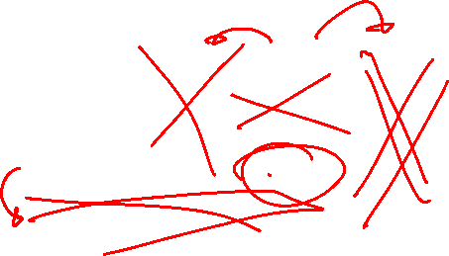
Find PSNE
A strictly dominated strategy is one that is always worse than some other strategy
Strictly dominated strategies cannot be part of an NE
Why?
Which are the strictly dominated strategies for player 1?
How about player 2?
Player 2
 | L | C | R
U | 10, 3 | 1, 5 | 5, 4
M | 3, 1 | 2, 4 | 5, 2
D | 0, 10 | 1, 8 | 7, 0
Player 1

Slide 37
Find PSNE through Iterative Removal
Remove strictly dominated actions (pure strategies) and then find PSNE in the remaining game
Can have new strictly dominated actions in the remaining game!
Repeat the process until no actions can be removed
This is the Iterative Removal algorithm (also known as Iterative Elimination of Strictly Dominated Strategies)
Find PSNE in this game using iterative removal
Player 2
 | L | C | R
U | 10, 3 | 1, 5 | 5, 4
M | 3, 1 | 2, 4 | 5, 2
D | 0, 10 | 1, 8 | 7, 0
Player 1

Slide 38
Find Mixed Strategy Nash Equilibrium
Big idea:
A NE occurs when there’s no incentive to change actions
Ensure that the expected utility of other player’s actions is equal
Can we still apply iterative removal?
  Yes! The removed strategies cannot be part of any NE
  You can always apply iterative removal first
Berry
 | Football | Concert
Football | 2,1 | 0,0
Concert | 0,0 | 1,2
Alex
Notes:
, i.e., no strictly dominated strategies in the remaining game
Now assume you are given a 2 by 2 bimatrix game after iterative removal. Further, you are told that in a NE, all the actions are chosen with non-zero probability. What are the necessary conditions for a mixed strategy NE?
Check the FvsC game, in addition to PSNEs (F,F) and (C,C), there is a mixed strategy NE shown below.
If I am player B and I want player A’s utilities to be the same, what can I change about my own strategy to make that true?

Slide 39
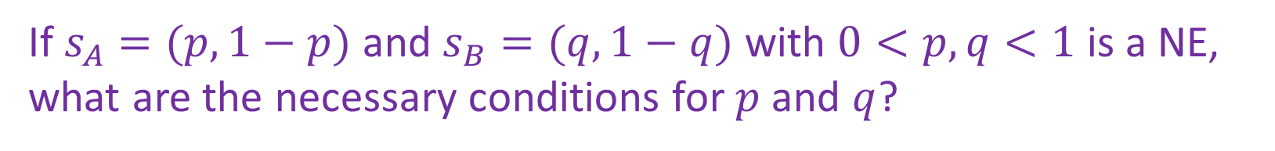
Find Mixed Strategy Nash Equilibrium
How to find mixed strategy NE (after iterative removal)?
Berry
 | Football | Concert
Football | 2,1 | 0,0
Concert | 0,0 | 1,2
Alex
If $s_{A}=(p,1−p)$ and $s_{B}=(q,1−q)$ with $0<p,q<1$ is a NE, what are the necessary conditions for $p$ and $q$?
Notes:
, i.e., no strictly dominated strategies in the remaining game
Now assume you are given a 2 by 2 bimatrix game after iterative removal. Further, you are told that in a NE, all the actions are chosen with non-zero probability. What are the necessary conditions for a mixed strategy NE?
Check the FvsC game, in addition to PSNEs (F,F) and (C,C), there is a mixed strategy NE shown below.

Slide 40


Find Mixed Strategy Nash Equilibrium
How to find mixed strategy NE (after iterative removal)?
Berry
 | Football | Concert
Football | 2,1 | 0,0
Concert | 0,0 | 1,2
Alex
If $s_{A}=(p,1−p)$ and $s_{B}=(q,1−q)$ with $0<p,q<1$ is a NE, what are the necessary conditions for $p$ and $q$?
$$u_{A}\left(F,s_{B}\right)=u_{A}\left(C,s_{B}\right)$$
$$u_{B}\left(s_{A},F\right)=u_{B}\left(s_{A},C\right)$$

Slide 41
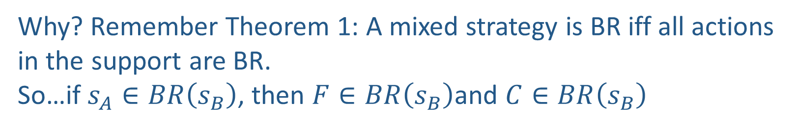


Find Mixed Strategy Nash Equilibrium
How to find mixed strategy NE (after iterative removal)?
Berry
 | Football | Concert
Football | 2,1 | 0,0
Concert | 0,0 | 1,2
Alex
If $s_{A}=(p,1−p)$ and $s_{B}=(q,1−q)$ with $0<p,q<1$ is a NE, what are the necessary conditions for $p$ and $q$?
$$u_{A}\left(F,s_{B}\right)=u_{A}\left(C,s_{B}\right)$$
$$u_{B}\left(s_{A},F\right)=u_{B}\left(s_{A},C\right)$$
Why? Remember Theorem 1: A mixed strategy is BR iff all actions in the support are BR.
So…if $s_{A}∈BR\left(s_{B}\right)$, then $F∈BR\left(s_{B}\right)$and $C∈BR\left(s_{B}\right)$
Notes:
, i.e., no strictly dominated strategies in the remaining game
Now assume you are given a 2 by 2 bimatrix game after iterative removal. Further, you are told that in a NE, all the actions are chosen with non-zero probability. What are the necessary conditions for a mixed strategy NE?
Check the FvsC game, in addition to PSNEs (F,F) and (C,C), there is a mixed strategy NE shown below.

Slide 42
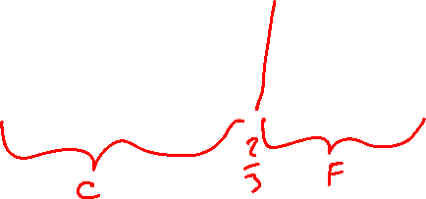
Visualizing
Utility of Berry
Alex wants to choose p such that Berry doesn’t want to deviate from his strategy
Berry wants the most reward he can get, so he will deviate if one strategy has more utility than another
The only way these two conditions is met is if we choose the p such that any strategy Berry picks will yield equal utility for Berry
2
Berry chooses Concert
Berry chooses Football
1
Berry
p
 | Football | Concert
Football | 2,1 | 0,0
Concert | 0,0 | 3,2
0
1
p
1-p
Alex

Slide 43
Visualizing
Utility of Alex
Concert
Berry wants to choose q such that Alex doesn’t want to deviate from his strategy
Alex wants the most reward he can get, so he will deviate if one strategy has more utility than another
The only way these two conditions is met is if we choose the q such that any strategy Alex picks will yield equal utility for Alex
2
Football
1
Berry
q
 | Football | Concert
Football | 2,1 | 0,0
Concert | 0,0 | 3,2
0
1
Alex

Slide 44
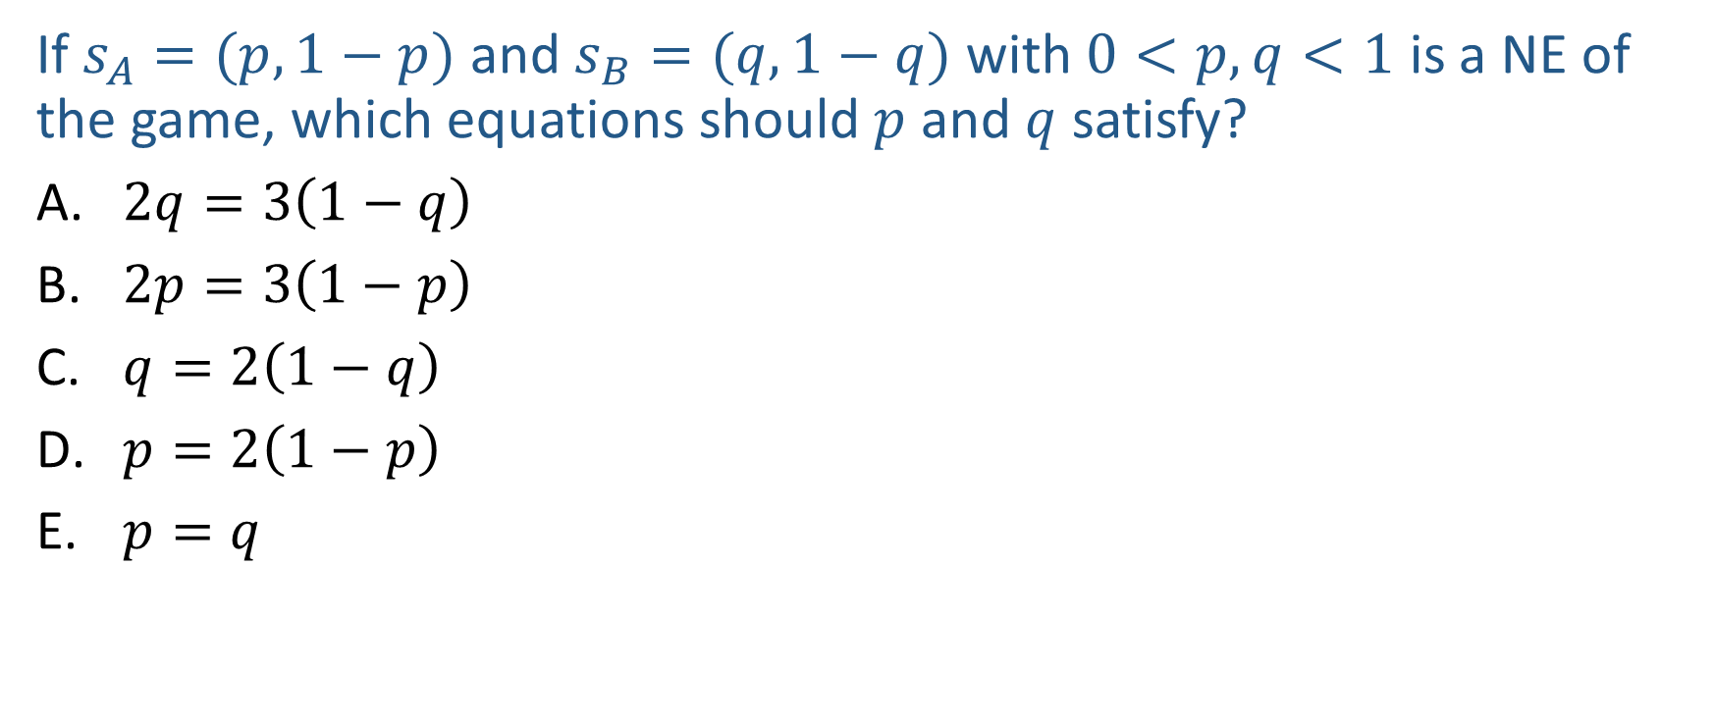
Poll 4
If $s_{A}=(p,1−p)$ and $s_{B}=(q,1−q)$ with $0<p,q<1$ is a NE of the game, which equations should $p$ and $q$ satisfy?
$2q=3\left(1−q\right)$
$2p=3\left(1−p\right)$
$q=2\left(1−q\right)$
$p=2\left(1−p\right)$
$p=q$
Berry
 | Football | Concert
Football | 2,1 | 0,0
Concert | 0,0 | 3,2
Alex
Notes:
2/3

Slide 45
Solution Concepts in Games
How should one player play and what should we expect all the players to play?
  Dominant strategy and dominant strategy equilibrium
  Nash Equilibrium
  Minimax strategy
  Maximin strategy
  Stackelberg Equilibrium

Slide 46
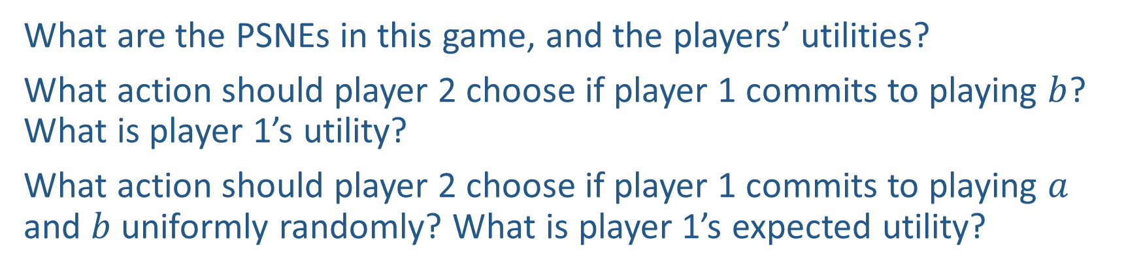
Power of Commitment
What are the PSNEs in this game, and the players’ utilities?
What action should player 2 choose if player 1 commits to playing $b$? What is player 1’s utility?
What action should player 2 choose if player 1 commits to playing $a$ and $b$ uniformly randomly? What is player 1’s expected utility?
Player 2
 | c | d
a | 2,1 | 4,0
b | 1,0 | 3,2
Player 1

Slide 47
Stackelberg Equilibrium
Stackelberg Game
  Leader commits to a strategy first
  Follower responds after observing the leader’s strategy
Stackelberg Equilibrium
  Follower best responds to leader’s strategy
  Leader commits to a strategy that maximizes her utility assuming follower best responds
Player 2
 | c | d
a | 2,1 | 4,0
b | 1,0 | 3,2
Player 1

Slide 48
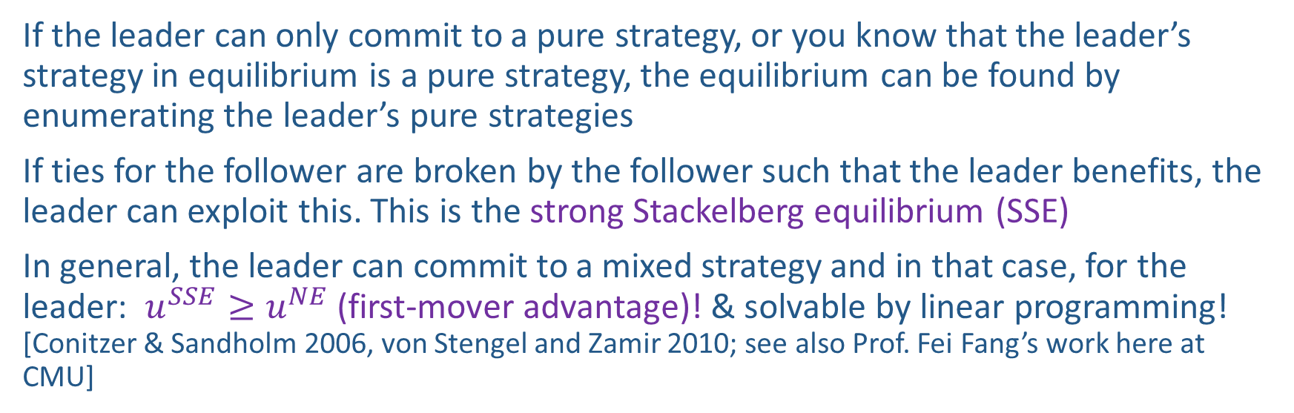
Stackelberg Equilibrium
If the leader can only commit to a pure strategy, or you know that the leader’s strategy in equilibrium is a pure strategy, the equilibrium can be found by enumerating the leader’s pure strategies
If ties for the follower are broken by the follower such that the leader benefits, the leader can exploit this. This is the strong Stackelberg equilibrium (SSE)
In general, the leader can commit to a mixed strategy and in that case, for the leader: $u^{SSE}≥u^{NE}$ (first-mover advantage)! & solvable by linear programming! [Conitzer & Sandholm 2006, von Stengel and Zamir 2010; see also Prof. Fei Fang’s work here at CMU]
Berry
Player 2
 | Football | Concert
Football | 2,1 | 0,0
Concert | 0,0 | 1,2
 | c | d
a | 2,1 | 4,0
b | 1,0 | 3,2
Alex
Player 1

Slide 49
In-Class Activity
What is the Mixed Strategy Nash Equilibrium for this new problem?
Berry
 | Football | Concert
Football | 4,1 | 0,0
Concert | 0,0 | 3,3
Alex
Notes:
4q + 0(1-q) = 0q + 3(1-q)
Q = 3/7
1p + 0(1-p) = 0p + 3(1-p)
P = 3/4

