Slide 1
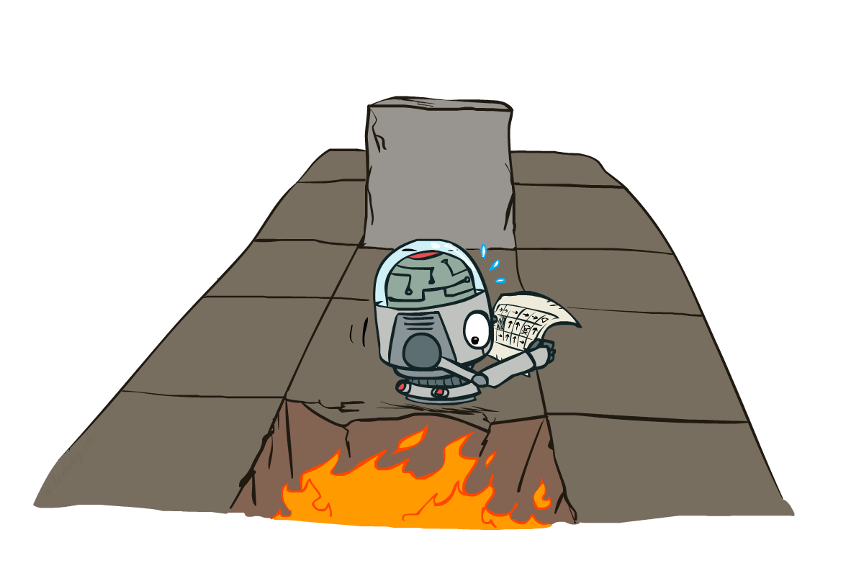
15-281 AI: Representation and Problem Solving
Markov Decision Processes II
Instructors: Aditi Raghunathan and Vince Conitzer
University of California, Berkeley
[These slides adapted from Dan Klein and Pieter Abbeel]
Notes:
Please retain proper attribution, including the reference to ai.berkeley.edu. Thanks!

Slide 2
Logistics
P3 checkpoint due on this Friday Oct 13 10PM
HW6 online due Oct 24 10PM (the Tuesday after fall break)
Mid-semester feedback forms on Piazza

Slide 3
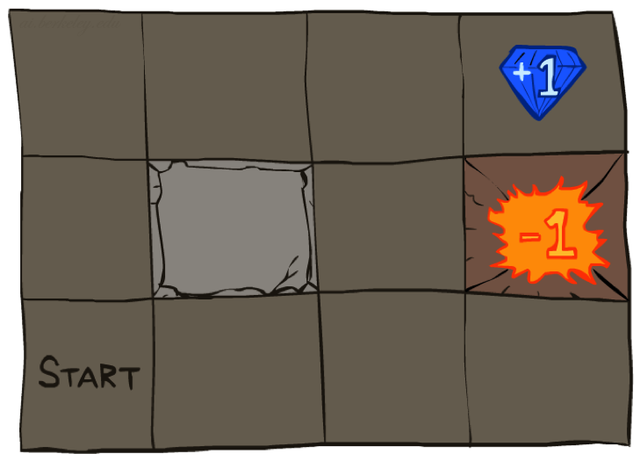




Example: Grid World
A maze-like problem
  The agent lives in a grid
  Walls block the agent’s path
Noisy movement: actions do not always go as planned
  80% of the time, the action North takes the agent North (if there is no wall there)
  10% of the time, North takes the agent West; 10% East
  If there is a wall in the direction the agent would have been taken, the agent stays put
The agent receives rewards
  Small “living” reward each step (can be negative)
  Big rewards come at the end (good or bad)
Goal: maximize sum of rewards

Slide 4
Recap: Defining MDPs
Markov decision processes:
  Set of states S
  Start state s₀
  Set of actions A
  Transitions P(s’|s,a) (or T(s,a,s’))
  Rewards R(s,a,s’) (and discount γ)
MDP quantities so far:
  Policy = Choice of action for each state
  Utility = sum of (discounted) rewards
  V-Values = expected future utility from a state (max node)
  Q-values = expected future utility from state-action (expecti node)
s
a
s, a
s,a,s’
s’

Slide 5
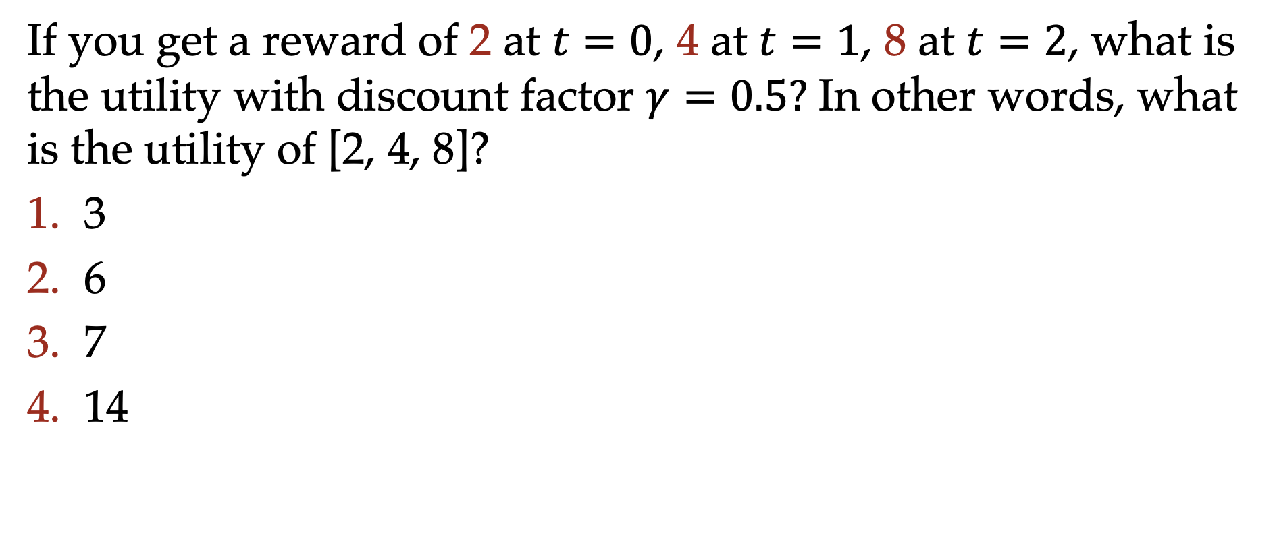
Poll: Utility
If you get a reward of 2 at $t=0$, 4 at $t=1$, 8 at $t=2$, what is the utility with discount factor $γ=0.5?$ In other words, what is the utility of [2, 4, 8]?
3
6
7
14

Slide 6
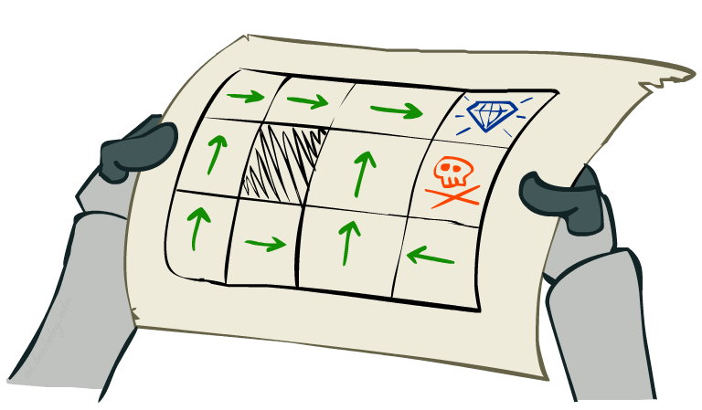
Solving MDPs

Slide 7
Optimal Quantities
The value (utility) of a state s:
  V*(s) = expected utility starting in s and acting optimally
The value (utility) of a q-state (s,a):
  Q*(s,a) = expected utility starting out having taken action a from state s and (thereafter) acting optimally
The optimal policy:
  π*(s) = optimal action from state s
s
s is a state
a
(s, a) is a q-state
s, a
s,a,s’
(s,a,s’) is a
transition
s’
Notes:
Demo just shows V and Q values, snapshots on next slides.

Slide 8
Value Iteration
Start with V₀(s) = 0: no time steps left means an expected reward sum of zero
Given vector of V_{k}(s) values, do one play of expectimax from each state:
Repeat until convergence, which yields V*
Complexity of each iteration: O(S²A)
Theorem: will converge to unique optimal values
  Basic idea: approximations get refined towards optimal values
  Policy may converge long before values do
V_{k+1}(s)
a
s, a
s,a,s’
V_{k}(s’)
Notes:
Discuss computational complexity: S * A * S times number of iterations
Note: updates not in place [if in place, it means something else and not even clear what it means]

Slide 9
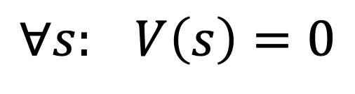
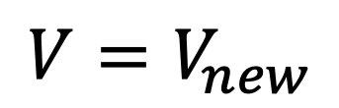
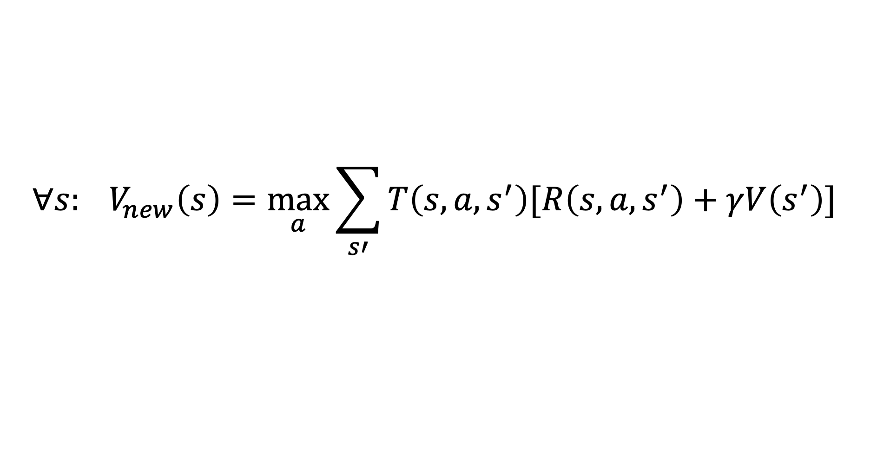
Value Iteration (again ☺ )
s
a
Init:
Iterate:
s, a
$$∀s: V\left(s\right)=0$$
s,a,s’
s’
$$∀s: V_{new}\left(s\right)=\max_{a}{\sum_{s′}{T\left(s,a,s^{′}\right)[R\left(s,a,s^{′}\right)+γV\left(s^{′}\right)] }}$$
$$V=V_{new}$$
Note: can even directly assign to V(s), which will not compute the sequence of V_{k} but will still converge to V*

Slide 10
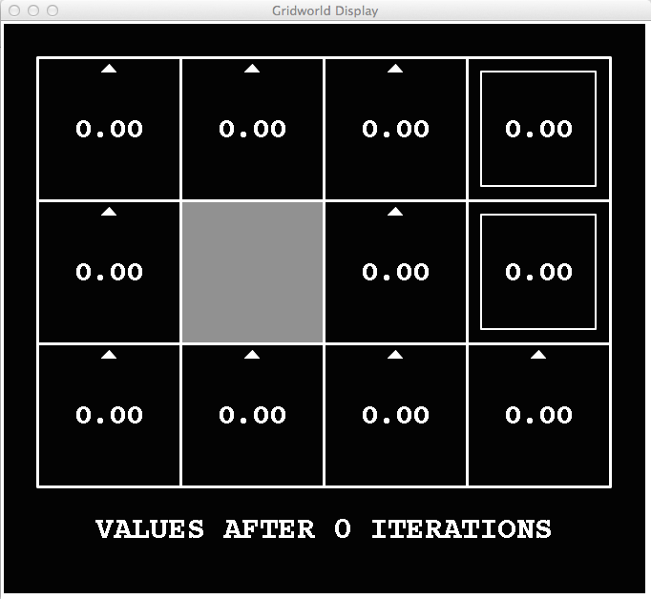
k=0
Noise = 0.2
Discount = 0.9
Living reward = 0
Notes:
Assuming zero living reward

Slide 11
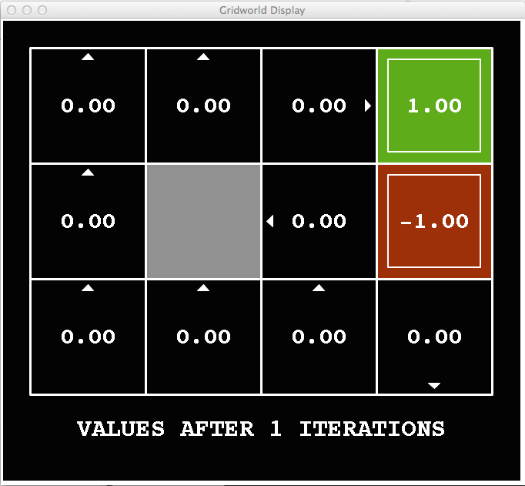
k=1
Noise = 0.2
Discount = 0.9
Living reward = 0
Notes:
Assuming zero living reward
Next: .8*.9=.72

Slide 12
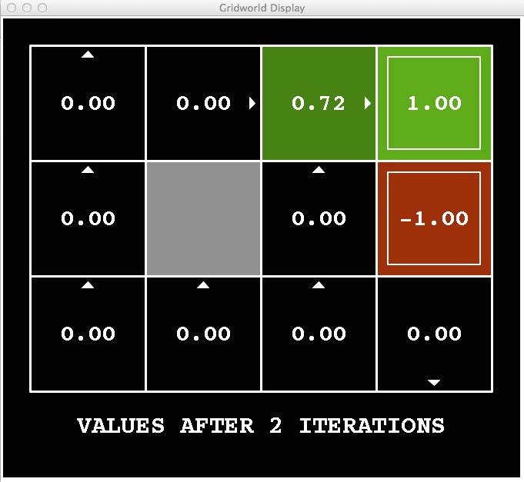
k=2
Noise = 0.2
Discount = 0.9
Living reward = 0
Notes:
Assuming zero living reward

Slide 13
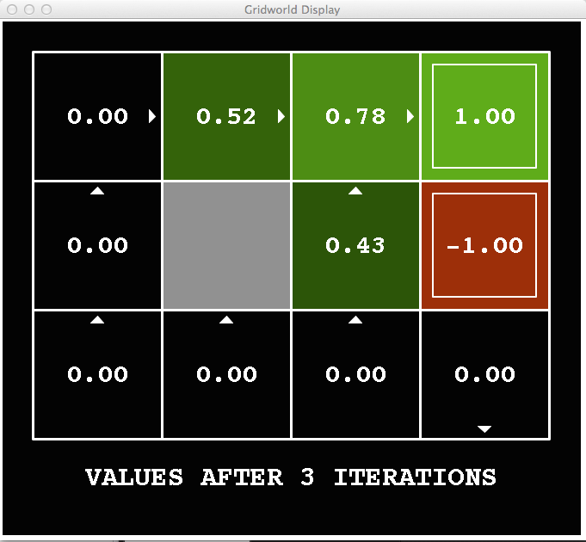
k=3
Noise = 0.2
Discount = 0.9
Living reward = 0
Notes:
Assuming zero living reward
Just went up – because you can try to get back now if you get carried out by the noise

Slide 14
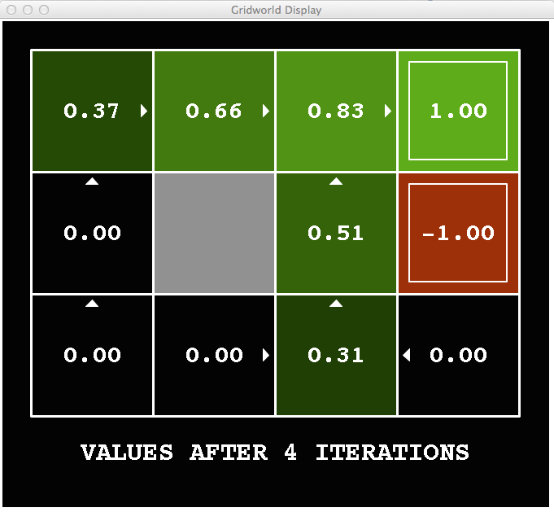
k=4
Noise = 0.2
Discount = 0.9
Living reward = 0
Notes:
Assuming zero living reward

Slide 15
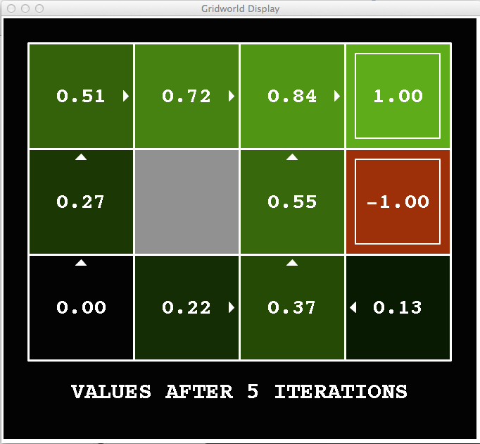
k=5
Noise = 0.2
Discount = 0.9
Living reward = 0
Notes:
Assuming zero living reward

Slide 16
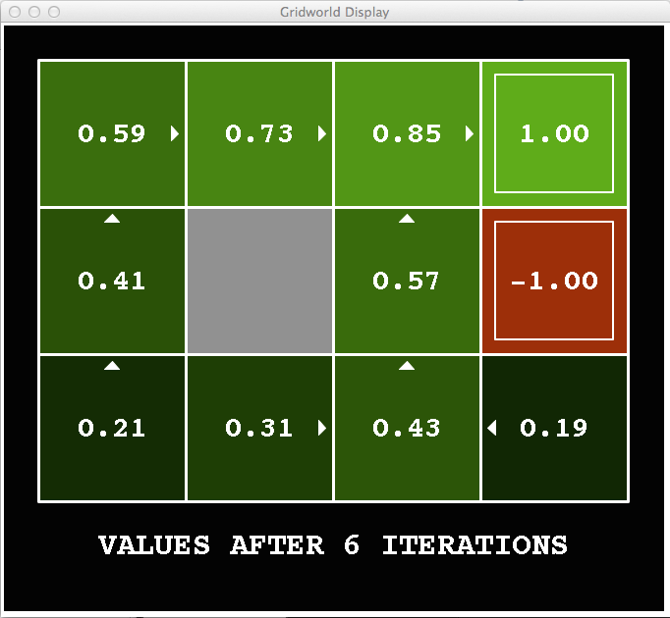
k=6
Noise = 0.2
Discount = 0.9
Living reward = 0
Notes:
Assuming zero living reward

Slide 17
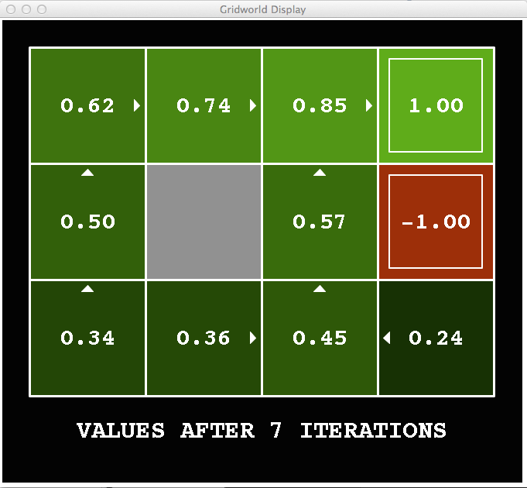
k=7
Noise = 0.2
Discount = 0.9
Living reward = 0
Notes:
Assuming zero living reward

Slide 18
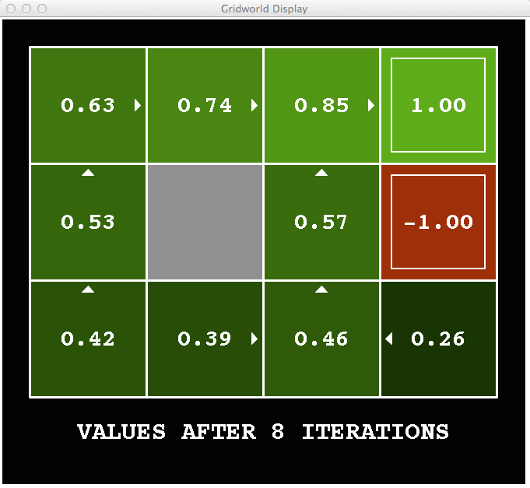
k=8
Noise = 0.2
Discount = 0.9
Living reward = 0
Notes:
Assuming zero living reward

Slide 19
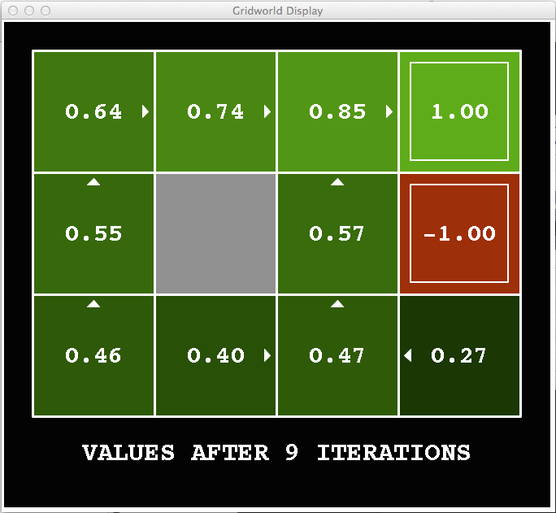
k=9
Noise = 0.2
Discount = 0.9
Living reward = 0
Notes:
Assuming zero living reward

Slide 20

k=10
Noise = 0.2
Discount = 0.9
Living reward = 0
Notes:
Assuming zero living reward

Slide 21

k=11
Noise = 0.2
Discount = 0.9
Living reward = 0
Notes:
Assuming zero living reward

Slide 22
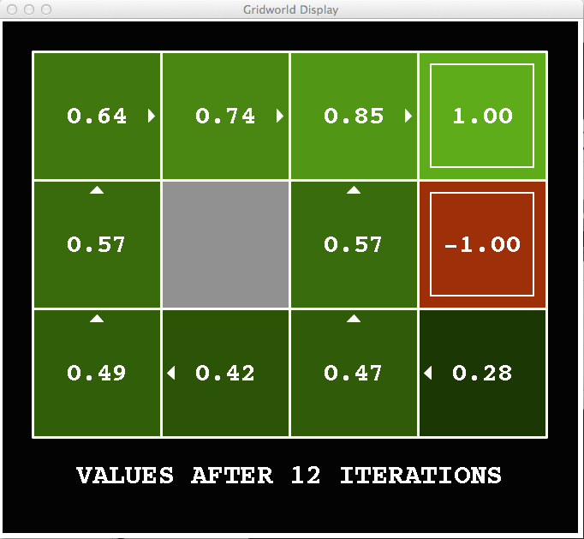
k=12
Noise = 0.2
Discount = 0.9
Living reward = 0
Notes:
Assuming zero living reward

Slide 23

k=100
Noise = 0.2
Discount = 0.9
Living reward = 0
Notes:
Assuming zero living reward

Slide 24

The Bellman Equations
How to be optimal:
Step 1: Take correct first action
Step 2: Keep being optimal

Slide 25
Value Iteration
Bellman equations characterize the optimal values:
Value iteration computes them:
Value iteration is just a fixed point solution method
  … though the V_{k} vectors are also interpretable as time-limited values
V(s)
a
s, a
s,a,s’
V(s’)
Notes:
Discuss computational complexity: S * A * S times number of iterations
Note: updates not in place [if in place, it means something else and not even clear what it means]

Slide 26
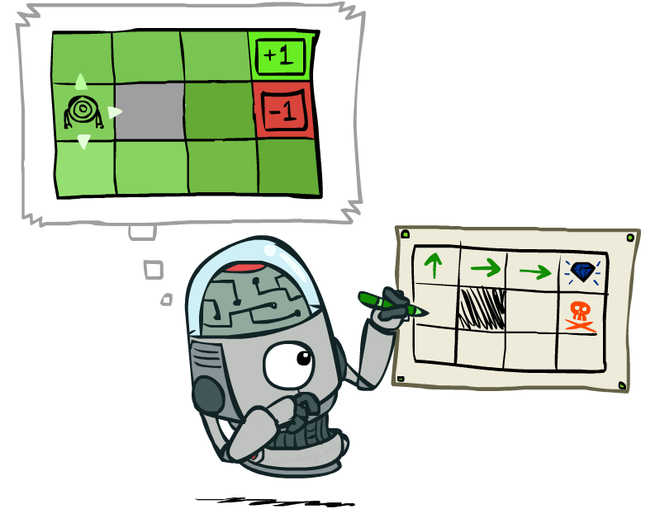
Policy Extraction

Slide 27
Poll 2: policy extraction
What is the optimal action to take from the blue state (living reward = 0, discount = 0.9, noise = 0.2)
East
West
North
South
Notes:
East (0.133)
West (-0.667)
North (0.58)
South (0.284)

Slide 28
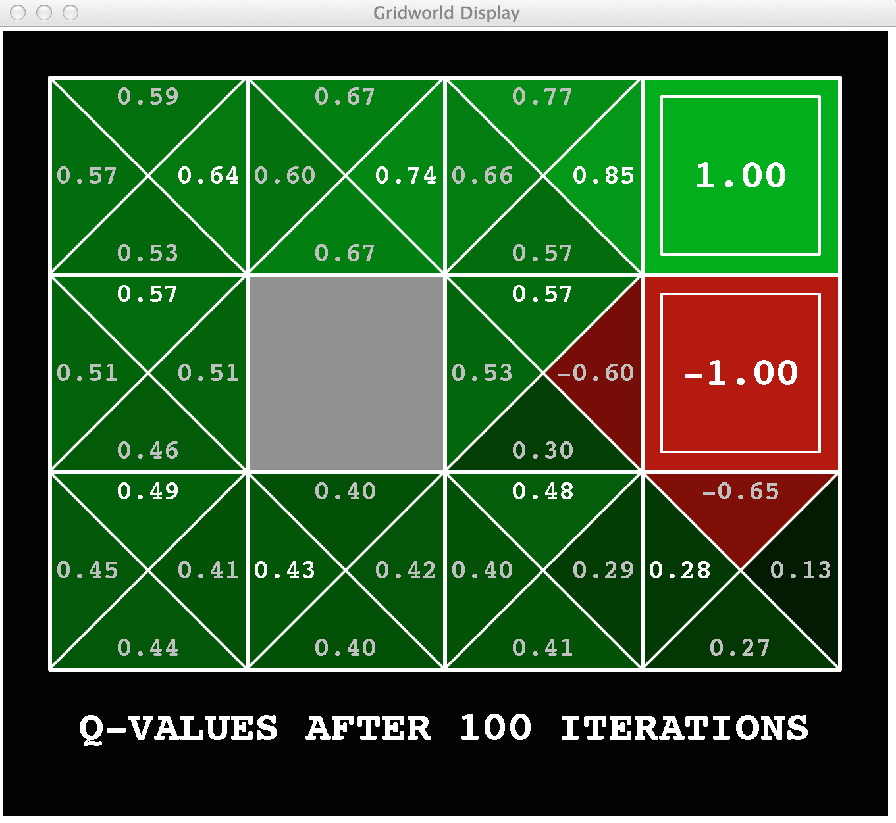
Poll 3: policy extraction
What is the optimal action to take from the blue state (living reward = 0, discount = 0.9, noise = 0.2)
East
West
North
South
Notes:
East (0.133)
West (-0.667)
North (0.58)
South (0.284)

Slide 29

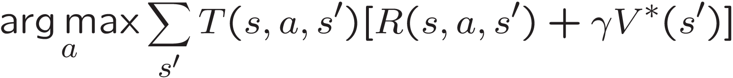
Computing Actions from Values
Let’s imagine we have the optimal values V*(s)
How should we act?
  It’s not obvious!
We need to do a mini-expectimax (one step)
This is called policy extraction, since it gets the policy implied by the values

Slide 30
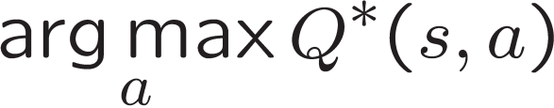
Computing Actions from Q-Values
Let’s imagine we have the optimal
q-values:
How should we act?
  Completely trivial to decide!
Important lesson: actions are easier to select from q-values than values!

Slide 31
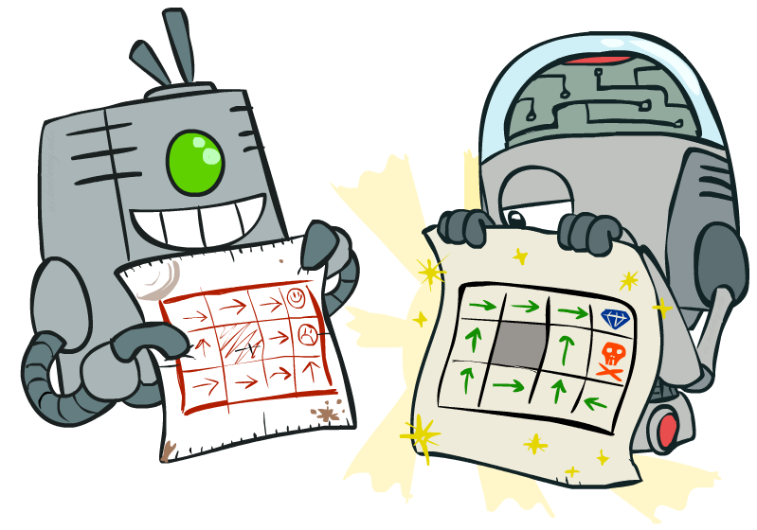
Policy Methods

Slide 32
Problems with Value Iteration
Value iteration repeats the Bellman updates:
Problem 1: It’s slow – O(S²A) per iteration
Problem 2: The “max” at each state rarely changes
Problem 3: The policy often converges long before the values
s
a
s, a
s,a,s’
s’
Notes:
Demo steps through value iteration; snapshots of values shown on next slides.

Slide 33
k=12
Noise = 0.2
Discount = 0.9
Living reward = 0
Notes:
Assuming zero living reward

Slide 34
k=100
Noise = 0.2
Discount = 0.9
Living reward = 0
Notes:
Assuming zero living reward

Slide 35
Policy Iteration
Alternative approach for optimal values:
  Step 1: Policy Evaluation: calculate utilities for some fixed policy (not optimal utilities!) until convergence
  Step 2: Policy Improvement: update policy using one-step look-ahead with resulting converged (but not optimal!) utilities as future values
  Repeat steps until policy converges
This is Policy Iteration
  It’s still optimal!
  Can converge (much) faster under some conditions

Slide 36
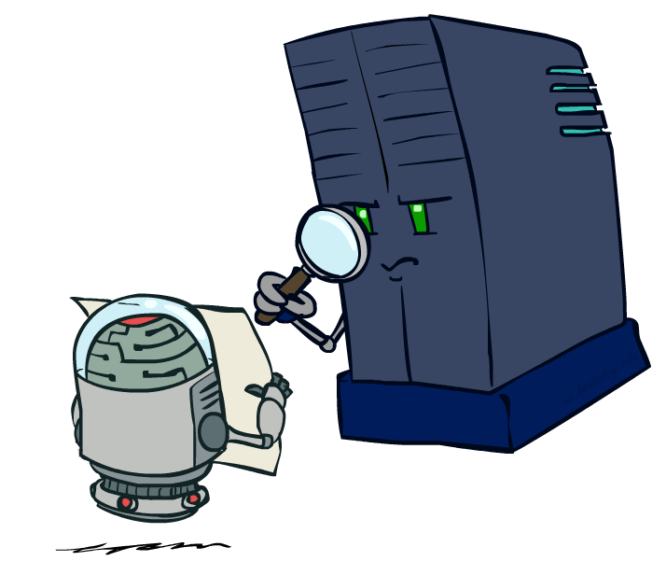
Policy Evaluation

Slide 37
Fixed Policies
Do the optimal action
Do what π says to do
s
s
a
π(s)
s, a
s, π(s)
s,a,s’
s, π(s),s’
s’
s’
Expectimax trees max over all actions to compute the optimal values
If we fixed some policy π(s), then the tree would be simpler – only one action per state
  … though the tree’s value would depend on which policy we fixed

Slide 38
Utilities for a Fixed Policy
Another basic operation: compute the utility of a state s under a fixed (generally non-optimal) policy
Define the utility of a state s, under a fixed policy π:
  V^{π}(s) = expected total discounted rewards starting in s and following π
Recursive relation (one-step look-ahead / Bellman equation):
s
π(s)
s, π(s)
s, π(s),s’
s’

Slide 39

Policy Evaluation
s
How do we calculate the V’s for a fixed policy π?
Idea 1: Turn recursive Bellman equations into updates
(like value iteration)
Efficiency: O(S²) per iteration
Idea 2: Without the maxes, the Bellman equations are just a linear system
  Solve with Matlab (or your favorite linear system solver)
π(s)
s, π(s)
s, π(s),s’
s’

Slide 40
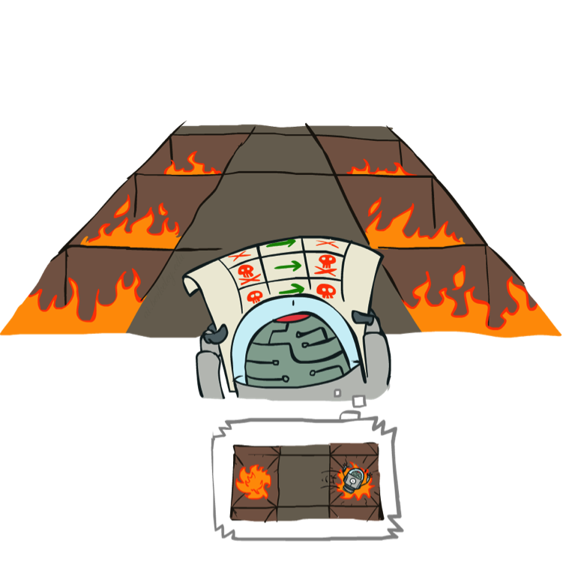
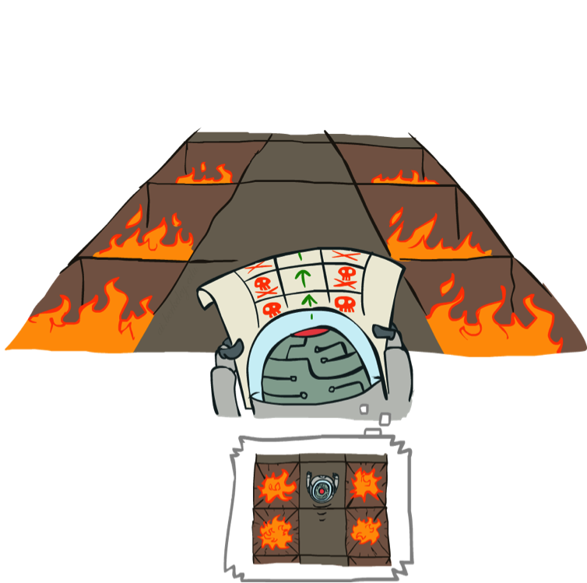
Example: Policy Evaluation
Always Go Right
Always Go Forward

Slide 41
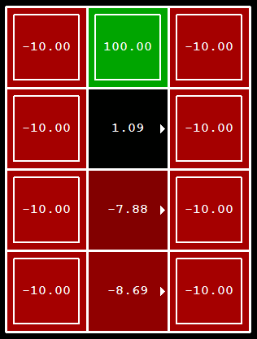
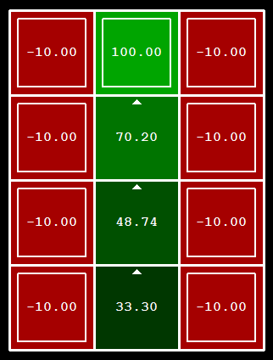
Example: Policy Evaluation
Always Go Right
Always Go Forward

Slide 42

Policy Iteration

Slide 43
Policy Iteration
Evaluation: For fixed current policy π, find values with policy evaluation:
  Iterate until values converge:
Improvement: For fixed values, get a better policy using policy extraction
  One-step look-ahead:

Slide 44
Comparison
Both value iteration and policy iteration compute the same thing (all optimal values)
In value iteration:
  Every iteration updates both the values and (implicitly) the policy
  We don’t track the policy, but taking the max over actions implicitly recomputes it
In policy iteration:
  We do several passes that update utilities with fixed policy (each pass is fast because we consider only one action, not all of them)
  After the policy is evaluated, a new policy is chosen (slow like a value iteration pass)
  The new policy will be better (or we’re done)

Slide 45
Poll: Policy Improvement
After one step of policy improvement, what’s the policy? Discount factor = 0.5
First do policy evaluation
(A) Exit, East, West, East, Exit
(B) Exit, West, West, East, Exit
(C) Exit, West, East, East, Exit
(D) Exit, East, East, East, Exit
T (Terminal)
R(A, Exit, T) = 10
R(E, Exit, T) = 1
A | B | C | D | E
Exit East West East Exit

Slide 46
Summary: MDP Algorithms
So you want to….
  Compute optimal values: use value iteration or policy iteration
  Compute values for a particular policy: use policy evaluation
  Turn your values into a policy: use policy extraction (one-step lookahead)
These all look the same!
  They basically are – they are all variations of Bellman updates
  They all use one-step lookahead expectimax fragments
  They differ only in whether we plug in a fixed policy or max over actions

Slide 47
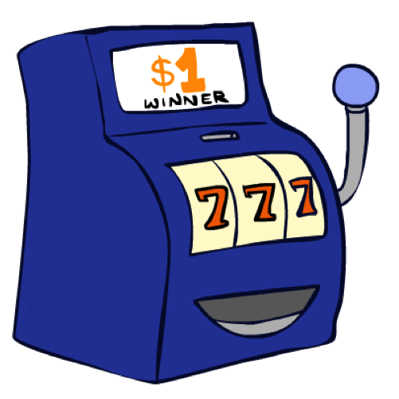
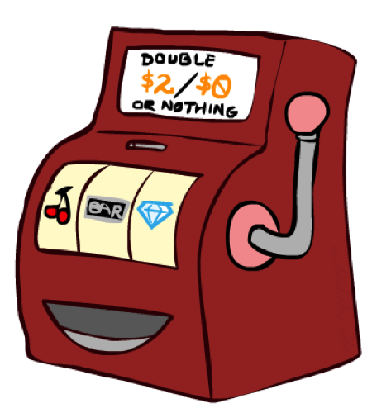

Double Bandits

Slide 48
Double-Bandit MDP
Actions: Blue, Red
States: Win, Lose
No discount
100 time steps
Both states have the same value
0.25 $0
0.75
$2
W
L
0.25
$0
$1
1.0
$1
1.0
0.75 $2
Notes:
What’s the expected value for pull blue?
How about pull red?
So what shall we do?

Slide 49
Offline Planning
Solving MDPs is offline planning
  You determine all quantities through computation
  You need to know the details of the MDP
  You do not actually play the game!
No discount
100 time steps
Both states have the same value
0.25 $0
Value
0.75
$2
W
0.25
$0
Play Red
150
L
$1
1.0
$1
1.0
0.75 $2
Play Blue
100

Slide 50
Let’s Play!
$2
$2
$0
$2
$2
$2
$2
$0
$0
$0
Notes:
What shall we play?
How did we do?

Slide 51
Online Planning
Rules changed! Red’s win chance is different.
?? $0
??
$2
W
L
??
$0
$1
1.0
$1
1.0
?? $2

Slide 52
Let’s Play!
$0
$0
$0
$2
$0
$2
$0
$0
$0
$0
Notes:
What shall we play?
How did we do?

Slide 53
What Just Happened?
That wasn’t planning, it was learning!
  Specifically, reinforcement learning
  There was an MDP, but you couldn’t solve it with just computation
  You needed to actually act to figure it out
Important ideas in reinforcement learning that came up
  Exploration: you have to try unknown actions to get information
  Exploitation: eventually, you have to use what you know
  Regret: even if you learn intelligently, you make mistakes
  Sampling: because of chance, you have to try things repeatedly
  Difficulty: learning can be much harder than solving a known MDP

Slide 54
Next Time: Reinforcement Learning!

Slide 55

Asynchronous Value Iteration*
In value iteration, we update every state in each iteration
  Actually, any sequences of Bellman updates will converge if every state is visited infinitely often
In fact, we can update the policy as seldom or often as we like, and we will still converge
Idea: Update states whose value we expect to change:
If is large then update predecessors of s

