Slide 1
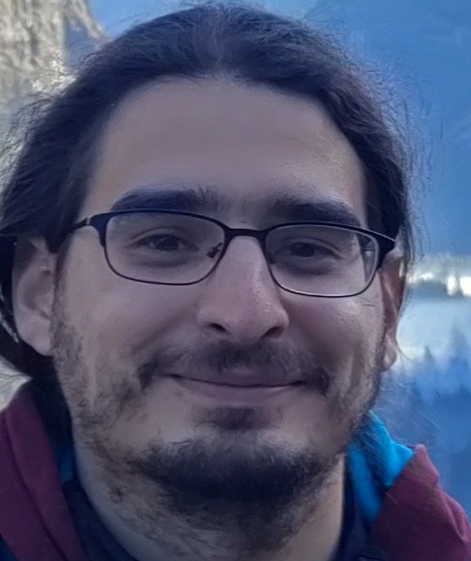
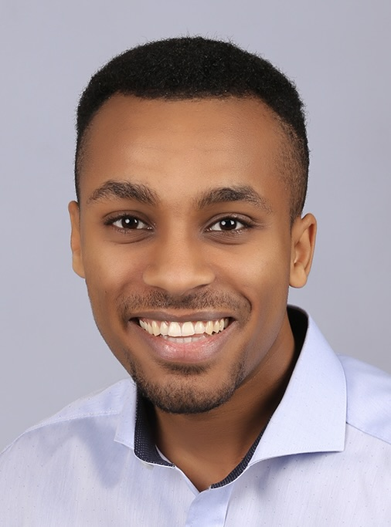
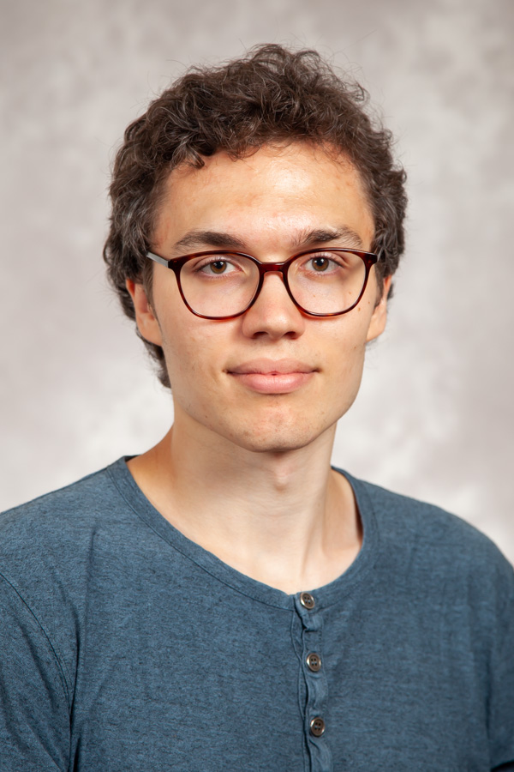
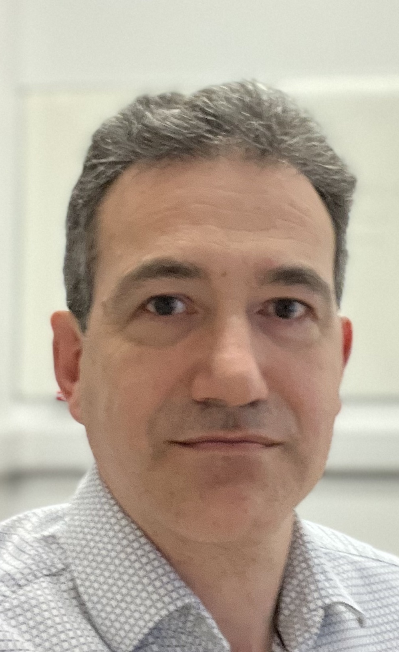
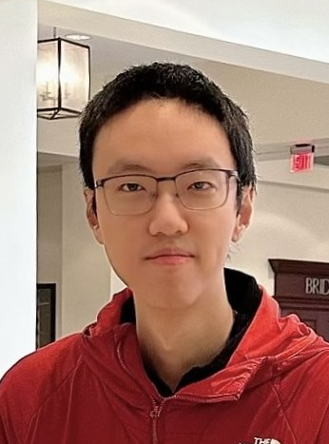
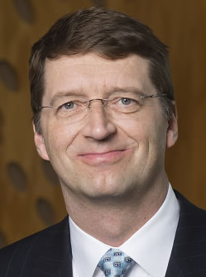
Complexity of imperfect-recall equilibrium concepts
Emanuel Tewolde, Caspar Oesterheld, Vincent Conitzer, and Paul Goldberg. The Computational Complexity of Single-Player Imperfect-Recall Games. IJCAI’23
Emanuel Tewolde, Brian Zhang, Caspar Oesterheld, Manolis Zampetakis, Tuomas Sandholm, Paul Goldberg, and Vincent Conitzer. Imperfect-Recall Games: Equilibrium Concepts and Their Complexity. IJCAI’24
Manolis Zampetakis
Emanuel Tewolde
Caspar Oesterheld
Paul Goldberg
CDT+Thirding
EDT+Halfing
Ex ante optimal
Brian Zhang
CLS-complete*
PLS-complete*
NP-hard*
*under conditions / greatly oversimplifying
Tuomas Sandholm

Slide 2
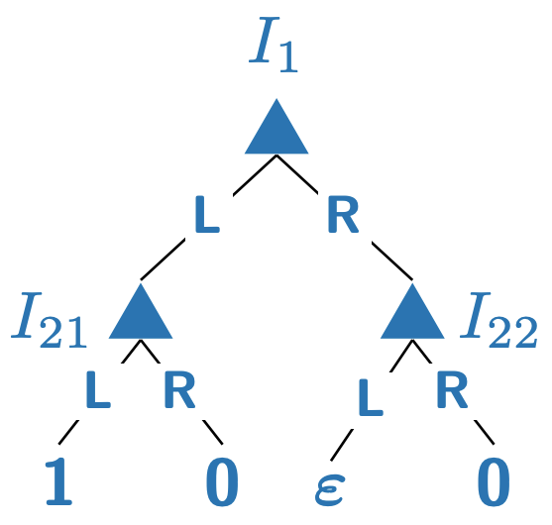
Equilibrium Refinement for Imperfect Recall
Task: Study our fix of issues arising with some equilibrium concepts
Theory project
with a significant component in nonlinear optimization
Ratip Emin Berker, Emanuel Tewolde, Ioannis Anagnostides, Tuomas Sandholm, and Vincent Conitzer. The Value of Recall in Extensive-Form Games. AAAI’25

Slide 3
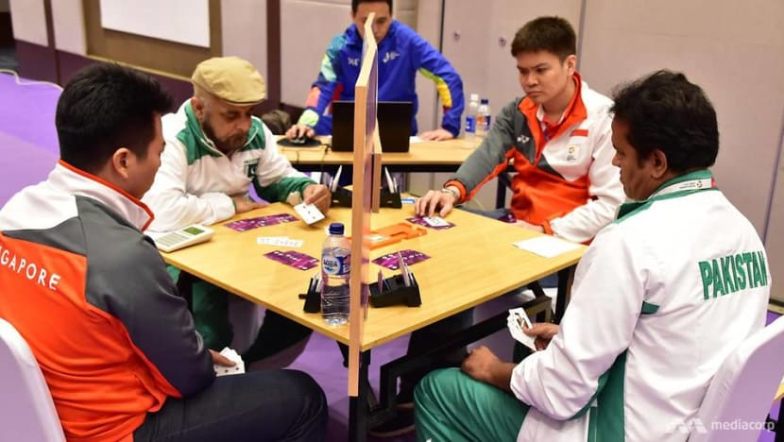
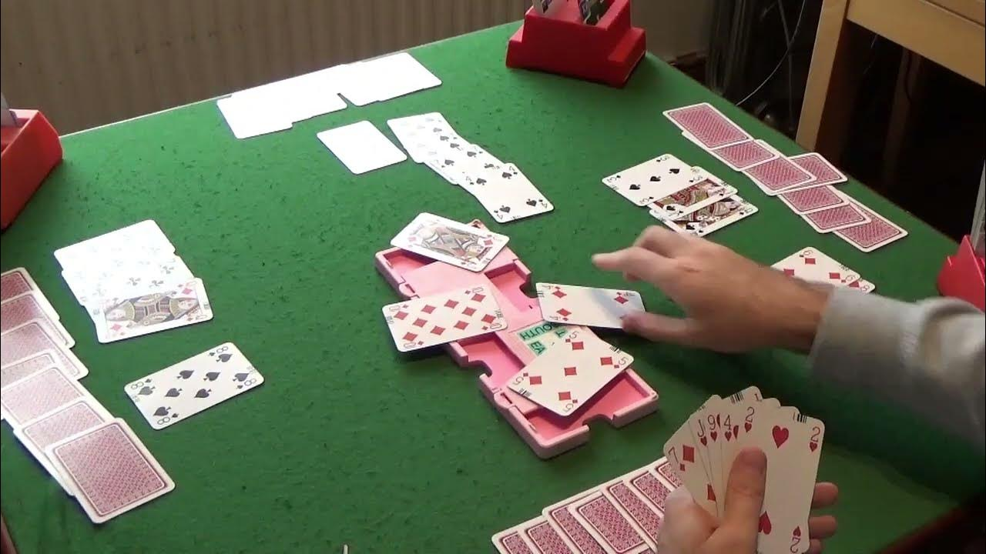
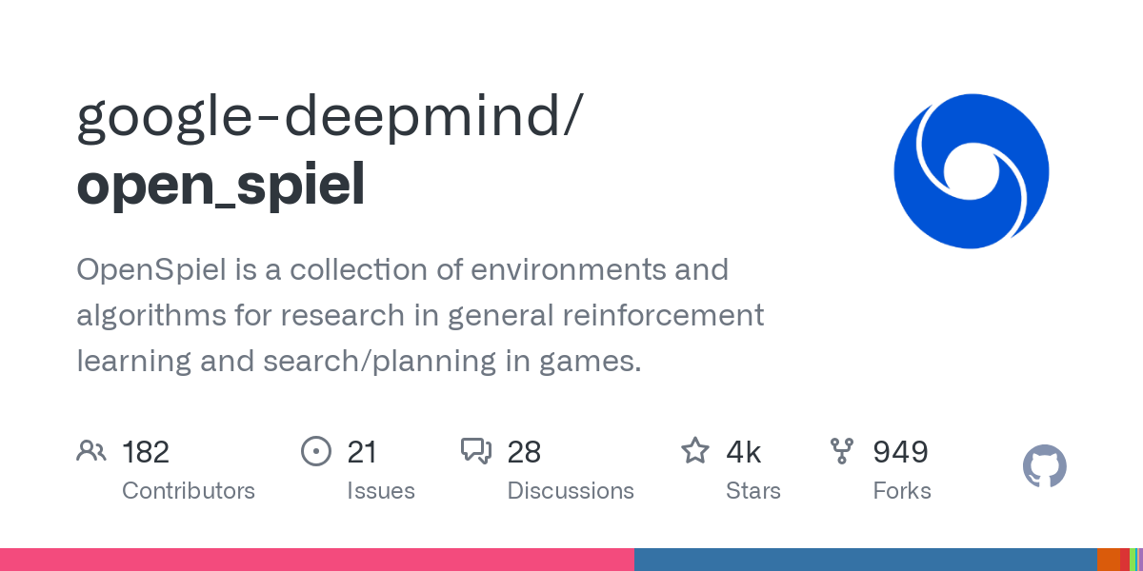
Bridge
https://www.channelnewsasia.com/sport/what-is-contract-bridge-skill-not-luck-singapore-asian-games-806306
https://www.youtube.com/watch?v=W8O-TD0rs1I&ab_channel=LearnModernBridge
2-player vs 2-player card game
Classical, but yet unsolved testbed for game-playing AI
Coding project using optimization and/or reinforcement learning
https://github.com/google-deepmind/open_spiel

Slide 4

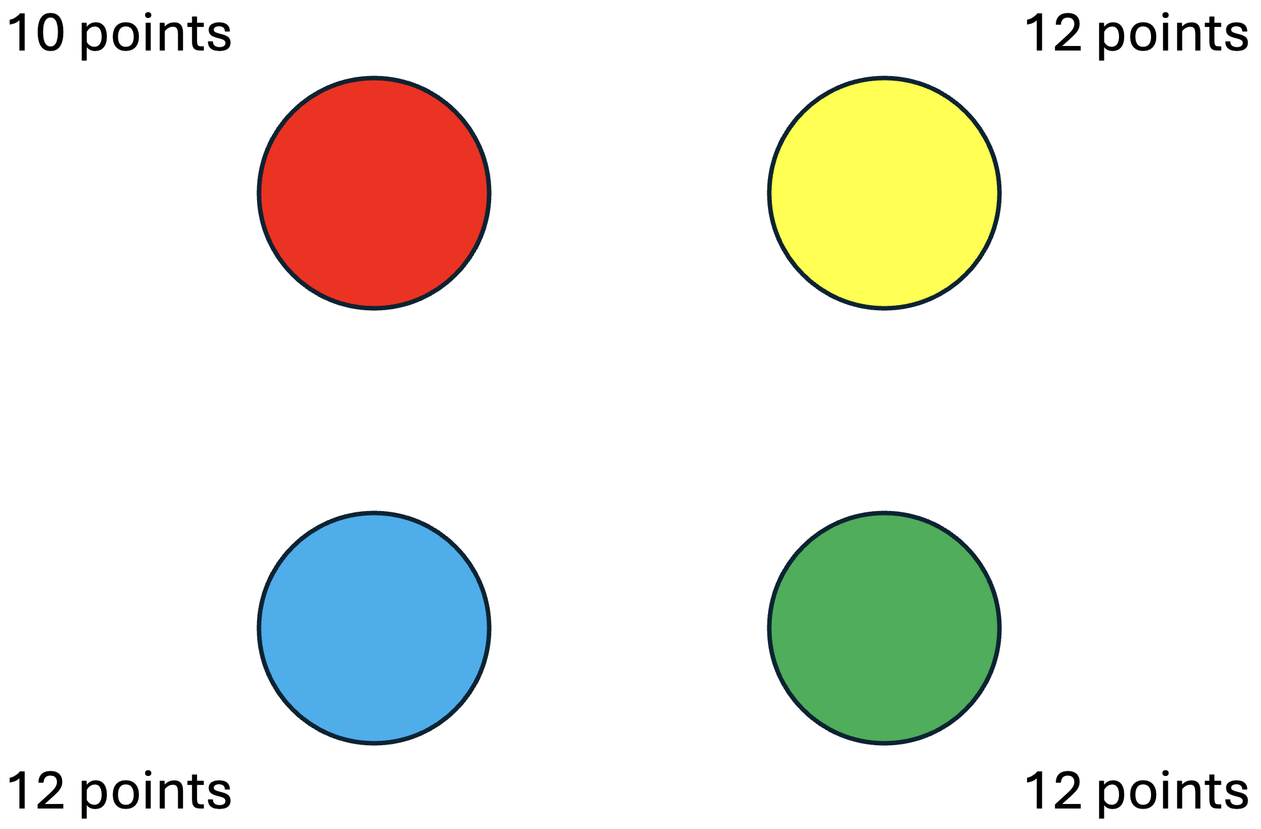
Symmetries in Sequential Games
https://www.walmart.com/ip/Hanabi-The-Collaborative-Classic-Card-Game-by-R-R-Games/40478451
Theory and Coding project in reinforcement learning
Emanuel Tewolde, Brian Hu Zhang, Caspar Oesterheld, Tuomas Sandholm, and Vincent Conitzer. Computing Game Symmetries and Equilibria That Respect Them AAAI’25
Notes:
We have to also think about conceptual questions as to how to implement our theory paper well into algorithms

Slide 5
Project Topics: Theory
Decision Making under Imperfect Recall
  Nonlinear Optimization, Equilibrium Refinements
Game Theory with Simulated Agents
Notes:
Emin: Vojta and I had thought about simulation games with boundedly powerful simulations (ie one agent can pay to simulate, but the other can pay to detect being similated, and had achieved some (very) preliminary but interesting results. I can ask him if he kept working on it, but it may be a good fit for a course project!
Do we also want to mention a repeated games project, or regret learning in team games?

Slide 6
Project Topics: Theory and Applications
Decision Making under Imperfect Recall
  Equilibrium Refinements
  Bot for the Card Game Bridge
Symmetries in Games,
Game Theory with Simulated Agents
Notes:
Equilibrium Refinements need background in Nonlinear Optimization
Emin: Vojta and I had thought about simulation games with boundedly powerful simulations (ie one agent can pay to simulate, but the other can pay to detect being similated, and had achieved some (very) preliminary but interesting results. I can ask him if he kept working on it, but it may be a good fit for a course project!
Do we also want to mention a repeated games project, or regret learning in team games?

