Slide 1
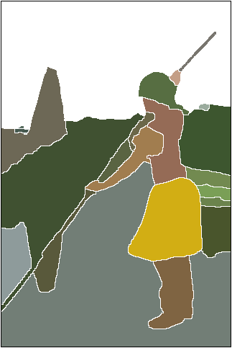
Segmentation
16-385 Computer Vision
Spring 2018, Lecture 27
http://www.cs.cmu.edu/~16385/

Slide 2
Course announcements
Homework 7 is due on Sunday 6th.
- Any questions about homework 7?
- How many of you have looked at/started/finished homework 7?
Yannis will have extra office hours Tuesday 4-6 pm.
How many of you went to Vladlen Koltun’s talk?

Slide 3
Overview of today’s lecture
Graph-cuts and GrabCut.
Normalized cuts.
Boundaries.
Clustering for segmentation.

Slide 4
Slide credits
Most of these slides were adapted from:
Srinivasa Narasimhan (16-385, Spring 2015).
James Hays (Brown University).

Slide 5
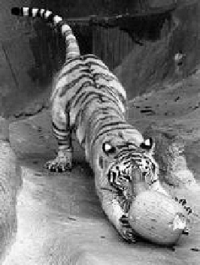
Image segmentation by pairwise similarities
Image = { pixels }
Segmentation = partition of image into segments
Similarity between pixels i and j
S_{ij} = S_{ji} ≥ 0
S_{ij}
Objective: “similar pixels, with large value of S_{ij}, should be in the same segment, dissimilar pixels should be in different segments”

Slide 6
Relational Graphs
G=(V, E, S)
V: each node denotes a pixel
E: each edge denotes a pixel-pixel relationship
S: each edge weight measures pairwise similarity
Segmentation = node partitioning
break V into disjoint sets V₁ , V₂

Slide 7
Solving MRF by Graph Partitioning
Some simple MRF models can be translated into graph partitioning
pair relationships
data measures
L1
L2

Slide 8
Weighted graph partitioning
i
Pixels i I = vertices of graph G
Edges ij = pixel pairs with S_{ij} > 0
Similarity matrix S = [ S_{ij} ]
d_{i} = Σ_{j Є G} S_{ij} degree of I
deg A = Σ_{i Є A} d_{i} degree of A G
Assoc(A,B) = Σ_{i Є A} Σ_{j Є B} S_{ij}
S_{ij}
j
i
A
A
B

Slide 9
Cuts in a Graph
(edge) cut = set of edges whose removal makes a graph disconnected
weight of a cut: cut( A, B ) = Σ_{i Є A,} Σ_{j Є B} S_{ij} =Assoc(A,B)
the normalized cut
Normalized Cut criteria: minimum cut(A,Ā)
NCut( A,B ) = cut(A, B)( + )
1
deg A
1
deg B

Slide 10
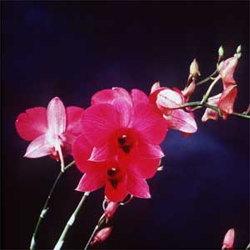
Grouping with Spectral Graph Partitioning
SGP: data structure = a weighted graph, weights describing data affinity
Segmentation is to find a node partitioning of a relational graph, with minimum total cut-off affinity.
Discriminative models are used to evaluate the weights between nodes.
The solution sought is the cuts of the minimum energy.

NP-Hard!

Slide 11
Matrix representation of the graph problem:
0.1
5
4
1
6
2
3
4
2
3
9
7
5
2
1
2
1
7
1
8
2
2
0.1
affinity matrix

Slide 12
Eigenvector approach to segmentation
Represent a connected component (or cluster C)
By a weight vector w such that (indicator vector):
w^{t}Mw is the association of C because:
If C is a good cluster, then the average association between features
In C should be large. Therefore, we want:
w^{t}Mw is large
Suggests algorithm:
Build matrix M
Find w such that w^{t}Mw is maximum.
Problem: w is a binary vector

Slide 13
Replace binary vector with continuous weight vector. Interpretation:
w_{i} large if i belongs to C.
Problem becomes:
Find w such that w^{t}Mw is maximum
Construct the corresponding component C by:
i belongs to C if w_{i} is large.
Problem with scale:
The relative values of the w_{i}’s are important, the total magnitude of w is not.
Normalization:

Slide 14
Replace binary vector with continuous weight vector. Interpretation:
w_{i} large if i belongs to C.
Problem becomes:
Find w such that w^{t}Mw is maximum
Construct the corresponding component C by:
i belongs to C if w_{i} is large.
Problem with scale:
The relative values of the w_{i}’s are important, the total magnitude of w is not.
Normalization:
Rayleigh’s ratio theorem:
Given a symmetric matrix M, the maximum of the ratio
is obtained for the eigenvector w_{max} corresponding to the largest eigenvalue λ_{max} of M.

Slide 15
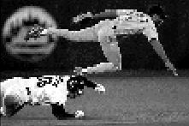
Brightness Image Segmentation

Slide 16
Brightness Image Segmentation

Slide 17
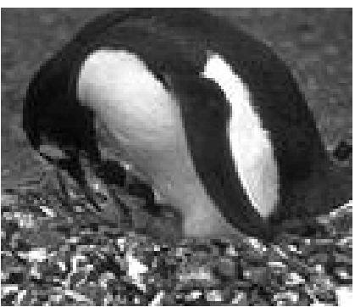
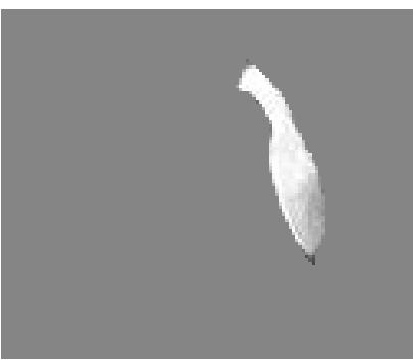
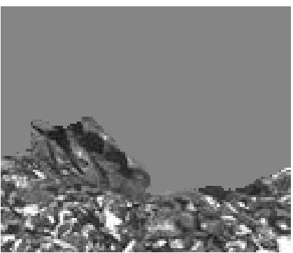
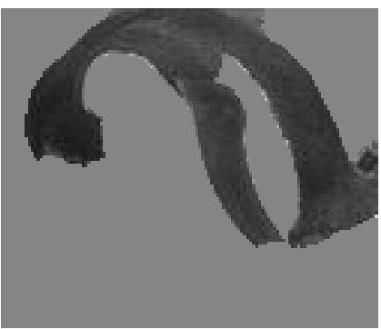
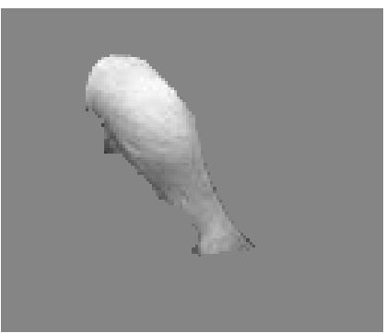

Slide 18
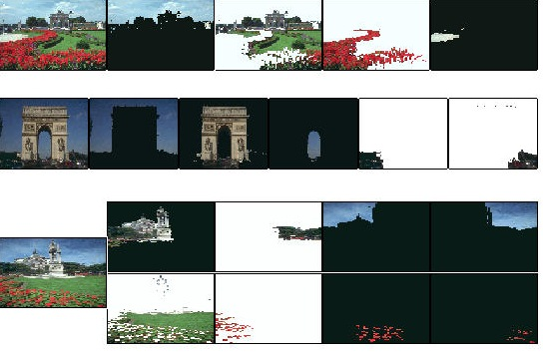
Results on color segmentation

Slide 19
Segmentation from boundaries

Slide 20
Prob. of boundary
Intuition:
Duality between regions and boundaries
Maybe “easier” to estimate boundaries first
Then use the boundaries to generate segmentations at different levels of granularity
Fine resolution
Coarse resolution
All examples from: P. Arbelaez, M. Maire, C. Fowlkes and J. Malik. Contour Detection and Hierarchical Image Segmentation. IEEE TPAMI, Vol. 33, No. 5, pp. 898-916, May 2011.
Complete package: http://www.eecs.berkeley.edu/Research/Projects/CS/vision/grouping/resources.html

Slide 21
Finding boundaries
Pb

Slide 22
Brightness
Color 1
Combining multiple cues
Color 2
Texton

Slide 24
gPb (global Pb)
Idea: We could use the Pb contours to generate an affinity matrix and then use Ncuts
j and i have lower affinity because they cross higher Pb values

Slide 25
gPb (global Pb)
Not good: generate segmentation from the eigenvectors
Good: Combine the gradients of the eigenvectors!!

Slide 26
Final step: Convert closed boundary (UCM = Ultrametric Contour Map)
Different thresholds on contours yield segmentations at different levels of granularity
Guaranteed to produce a hierarchical segmentation

Slide 27
Prob. of boundary
Intuition:
Duality between regions and boundaries
Maybe “easier” to estimate boundaries first
Then use the boundaries to generate segmentations at different levels of granularity
Fine resolution
Coarse resolution
Complete package: http://www.eecs.berkeley.edu/Research/Projects/CS/vision/grouping/resources.html

Slide 28
Clustering: group together similar points and represent them with a single token
Key Challenges:
1) What makes two points/images/patches similar?
2) How do we compute an overall grouping from pairwise similarities?

Slide 29
Why do we cluster?
Summarizing data
Look at large amounts of data
Patch-based compression or denoising
Represent a large continuous vector with the cluster number
Counting
Histograms of texture, color, SIFT vectors
Segmentation
Separate the image into different regions
Prediction
Images in the same cluster may have the same labels

Slide 30
How do we cluster?
K-means
Iteratively re-assign points to the nearest cluster center
Agglomerative clustering
Start with each point as its own cluster and iteratively merge the closest clusters
Mean-shift clustering
Estimate modes of pdf

Slide 31
K-means clustering

Slide 32
1. Select initial centroids at random

Slide 33
1. Select initial centroids at random
2. Assign each object to the cluster with the nearest centroid.

Slide 34
1. Select initial centroids at random
2. Assign each object to the cluster with the nearest centroid.
3. Compute each centroid as the mean of the objects assigned to it (go to 2)

Slide 35
1. Select initial centroids at random
2. Assign each object to the cluster with the nearest centroid.
3. Compute each centroid as the mean of the objects assigned to it (go to 2)
2. Assign each object to the cluster with the nearest centroid.

Slide 36
1. Select initial centroids at random
2. Assign each object to the cluster with the nearest centroid.
3. Compute each centroid as the mean of the objects assigned to it (go to 2)
2. Assign each object to the cluster with the nearest centroid.
Repeat previous 2 steps until no change

Slide 37
K-means Clustering
Given k:
Select initial centroids at random.
Assign each object to the cluster with the nearest centroid.
Compute each centroid as the mean of the objects assigned to it.
Repeat previous 2 steps until no change.

Slide 38
K-means: design choices
Initialization
Randomly select K points as initial cluster center
Or greedily choose K points to minimize residual
Distance measures
Traditionally Euclidean, could be others
Optimization
Will converge to a local minimum
May want to perform multiple restarts

Slide 39
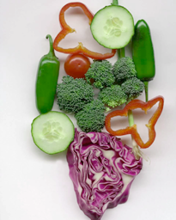
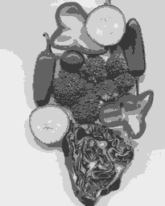
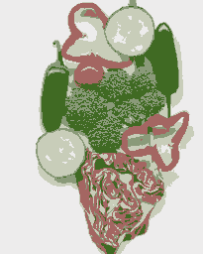
K-means clustering using intensity or color
Image
Clusters on intensity
Clusters on color
Notes:
I gave each pixel the mean intensity or mean color of its cluster --- this is basically just vector quantizing the image intensities/colors. Notice that there is no requirement that clusters be spatially localized and they’re not.

Slide 40
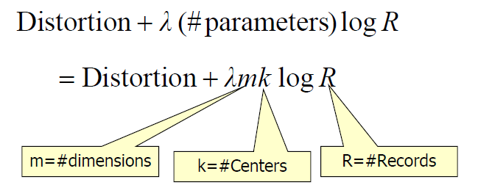
How to choose the number of clusters?
Minimum Description Length (MDL) principal for model comparison
Minimize Schwarz Criterion
also called Bayes Information Criteria (BIC)

Slide 41
K-Means pros and cons
Pros
Finds cluster centers that minimize conditional variance (good representation of data)
Simple and fast*
Easy to implement
Cons
Need to choose K
Sensitive to outliers
Prone to local minima
All clusters have the same parameters (e.g., distance measure is non-adaptive)
*Can be slow: each iteration is O(KNd) for N d-dimensional points
Usage
Rarely used for pixel segmentation

Slide 42
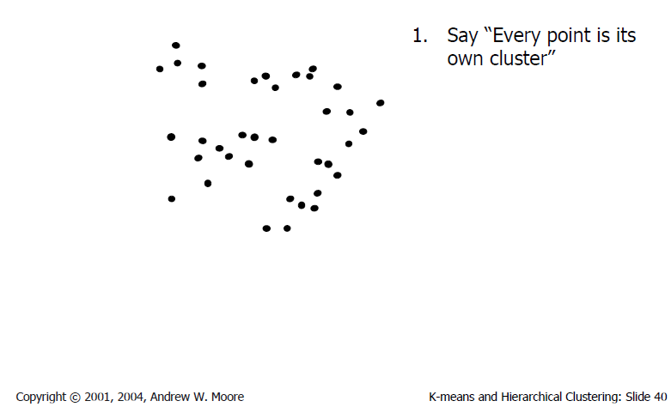
Agglomerative clustering

Slide 43
Agglomerative clustering

Slide 44
Agglomerative clustering

Slide 45
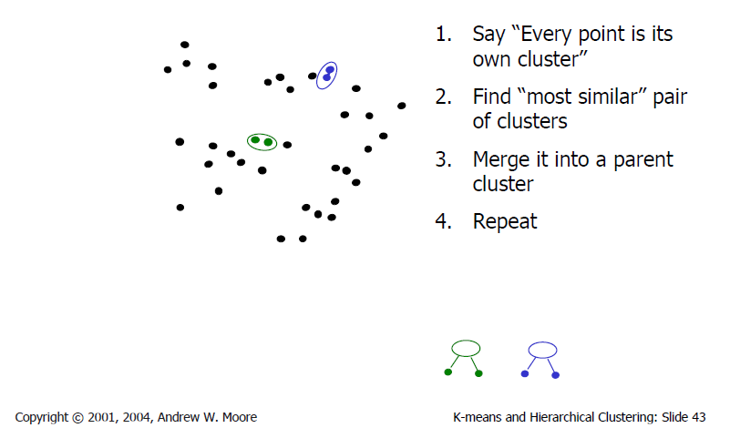
Agglomerative clustering

Slide 46
Agglomerative clustering

Slide 47
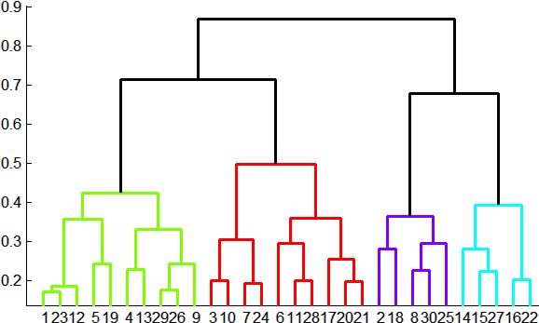
Agglomerative clustering
How to define cluster similarity?
Average distance between points, maximum distance, minimum distance
Distance between means or medoids
How many clusters?
Clustering creates a dendrogram (a tree)
Threshold based on max number of clusters or based on distance between merges
distance

Slide 48
Conclusions: Agglomerative Clustering
Good
Simple to implement, widespread application
Clusters have adaptive shapes
Provides a hierarchy of clusters
Bad
May have imbalanced clusters
Still have to choose number of clusters or threshold
Need to use an “ultrametric” to get a meaningful hierarchy

Slide 49
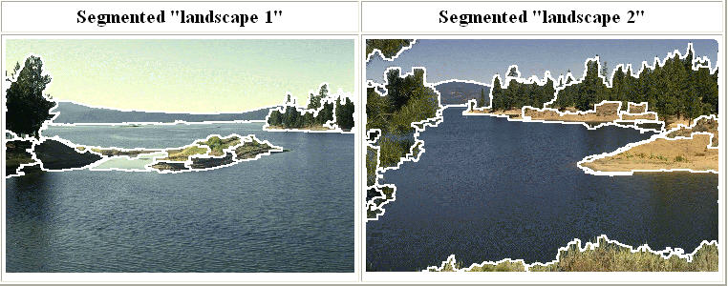
Mean shift segmentation
D. Comaniciu and P. Meer, Mean Shift: A Robust Approach toward Feature Space Analysis, PAMI 2002.
Versatile technique for clustering-based segmentation

Slide 50
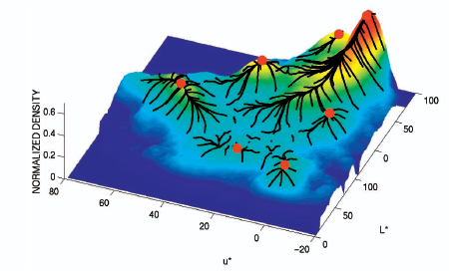
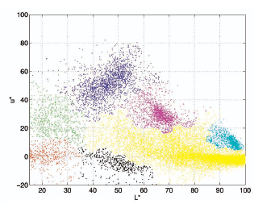
Mean shift algorithm
Try to find modes of this non-parametric density

Slide 51
Mean Shift Algorithm
A ‘mode seeking’ algorithm
Fukunaga & Hostetler (1975)

Slide 52
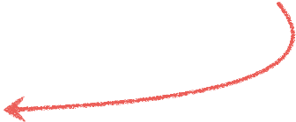
Mean Shift Algorithm
A ‘mode seeking’ algorithm
Fukunaga & Hostetler (1975)
Find the region of highest density

Slide 53
Mean Shift Algorithm
A ‘mode seeking’ algorithm
Fukunaga & Hostetler (1975)
Pick a point

Slide 54
Mean Shift Algorithm
A ‘mode seeking’ algorithm
Fukunaga & Hostetler (1975)
Draw a window

Slide 55
Mean Shift Algorithm
A ‘mode seeking’ algorithm
Fukunaga & Hostetler (1975)
Compute the (weighted) mean

Slide 56
Mean Shift Algorithm
A ‘mode seeking’ algorithm
Fukunaga & Hostetler (1975)
Shift the window

Slide 57
Mean Shift Algorithm
A ‘mode seeking’ algorithm
Fukunaga & Hostetler (1975)
Compute the mean

Slide 58
Mean Shift Algorithm
A ‘mode seeking’ algorithm
Fukunaga & Hostetler (1975)
Shift the window

Slide 59
Mean Shift Algorithm
A ‘mode seeking’ algorithm
Fukunaga & Hostetler (1975)
Compute the mean

Slide 60
Mean Shift Algorithm
A ‘mode seeking’ algorithm
Fukunaga & Hostetler (1975)
Shift the window

Slide 61
Mean Shift Algorithm
A ‘mode seeking’ algorithm
Fukunaga & Hostetler (1975)
Compute the mean

Slide 62
Mean Shift Algorithm
A ‘mode seeking’ algorithm
Fukunaga & Hostetler (1975)
Shift the window

Slide 63
Mean Shift Algorithm
A ‘mode seeking’ algorithm
Fukunaga & Hostetler (1975)
Compute the mean

Slide 64
Mean Shift Algorithm
A ‘mode seeking’ algorithm
Fukunaga & Hostetler (1975)
Shift the window

Slide 65
Mean Shift Algorithm
A ‘mode seeking’ algorithm
Fukunaga & Hostetler (1975)
Compute the mean

Slide 66
Mean Shift Algorithm
A ‘mode seeking’ algorithm
Fukunaga & Hostetler (1975)
Shift the window

Slide 67
Mean Shift Algorithm
A ‘mode seeking’ algorithm
Fukunaga & Hostetler (1975)
Compute the mean

Slide 68
Mean Shift Algorithm
A ‘mode seeking’ algorithm
Fukunaga & Hostetler (1975)
Shift the window

Slide 69
Mean Shift Algorithm
A ‘mode seeking’ algorithm
Fukunaga & Hostetler (1975)
Compute the mean

Slide 70
Mean Shift Algorithm
A ‘mode seeking’ algorithm
Fukunaga & Hostetler (1975)
Shift the window
To understand the theory behind this we need to understand…

Slide 71
Real Modality Analysis

Slide 72
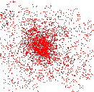
Attraction basin
Attraction basin: the region for which all trajectories lead to the same mode
Cluster: all data points in the attraction basin of a mode
Slide by Y. Ukrainitz & B. Sarel

Slide 73
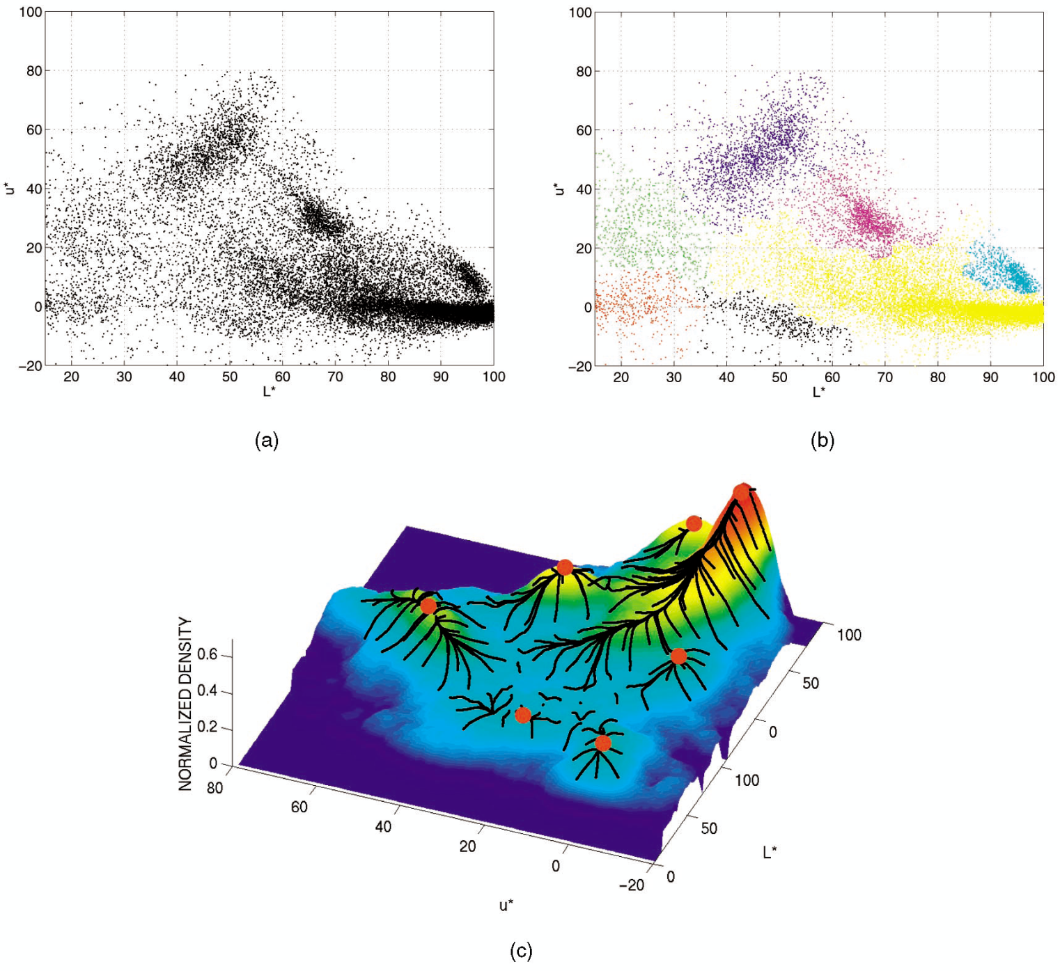
Attraction basin

Slide 74
Mean shift clustering
The mean shift algorithm seeks modes of the given set of points
Choose kernel and bandwidth
For each point:
Center a window on that point
Compute the mean of the data in the search window
Center the search window at the new mean location
Repeat (b,c) until convergence
Assign points that lead to nearby modes to the same cluster

Slide 75
Segmentation by Mean Shift
Compute features for each pixel (color, gradients, texture, etc)
Set kernel size for features K_{f} and position K_{s}
Initialize windows at individual pixel locations
Perform mean shift for each window until convergence
Merge windows that are within width of K_{f} and K_{s}

Slide 76
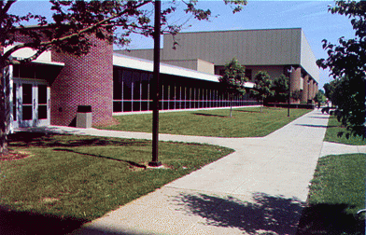
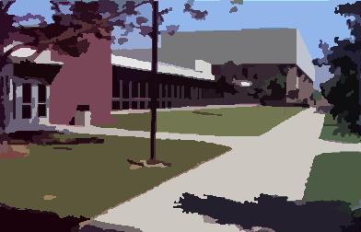
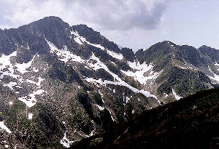
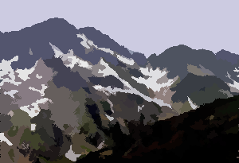
Mean shift segmentation results
http://www.caip.rutgers.edu/~comanici/MSPAMI/msPamiResults.html

Slide 77
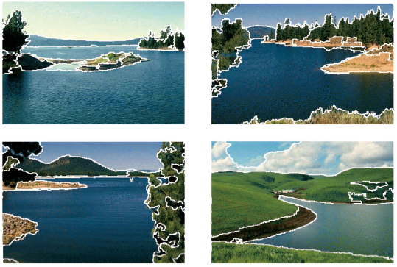
http://www.caip.rutgers.edu/~comanici/MSPAMI/msPamiResults.html

Slide 78
Mean-shift: other issues
Speedups
Binned estimation
Fast search of neighbors
Update each window in each iteration (faster convergence)
Other tricks
Use kNN to determine window sizes adaptively
Lots of theoretical support
D. Comaniciu and P. Meer, Mean Shift: A Robust Approach toward Feature Space Analysis, PAMI 2002.

Slide 79
References
Basic reading:
Szeliski, Sections 5.2, 5.3, 5.4, 5.5.
Notes:
Ch

