Slide 1
Virtual Memory: Details
15-213/15-513/14-513: Introduction to Computer Systems
17th Lecture, Oct 3, 2024
Instructors:
Brian Railing

Slide 2
Announcements
Written #5: “Midterm” Written
  Available on Gradescope (not canvas)
  Covers first half of course, with questions similar to the final exam
  Due Wednesday Oct 9
  No peer grading. Instead, graded by TAs before Fall break
  Counts twice in final grades as a normal Written (can be 2 of your 2 dropped Writtens)
    For mid-semester grades, we will temporarily count it as 20%
Cache Lab
  Due Thursday Oct 10
  You will need to sign up for a code review appointment soon
Fall Break
  Saturday Oct 12 to Sunday Oct 20: limited TA support

Slide 3
Review: Virtual Addressing
Each process has its own virtual address space
Page tables map virtual to physical addresses
Physical memory can be shared among processes
0
Address
translation
0
Virtual Address Space for Process 1:
Physical
Address
Space (DRAM)
VP 1
VP 2
PP 2
...
N-1
PP 6
(e.g., read-only
library code)
Virtual Address Space for Process 2:
0
PP 8
VP 1
...
...
N-1
VP k
M-1

Slide 4
Review: Memory Accesses without VM
CPU sends physical address to cache
Cache sends data to CPU

Slide 5
Review: Memory Accesses with VM
CPU sends virtual address to MMU
MMU looks up physical address in page table
MMU sends physical address to cache
Cache sends data to CPU

Slide 6
Review: Memory Accesses with VM
CPU sends virtual address to MMU
MMU looks up physical address in page table
Present?
No
MMU triggers page fault
OS takes control and does stuff we’ll discuss later
Yes
MMU sends physical address to cache
Cache sends data to CPU

Slide 7
Review: Memory Accesses with VM
CPU sends virtual address to MMU
MMU looks up physical address in page table
OS recovers, tells
MMU to retry
Present?
No
MMU triggers page fault
OS takes control and tries to recover
Yes
MMU sends physical address to cache
OS cannot recover
OS terminates malfunctioning process
Cache sends data to CPU

Slide 8
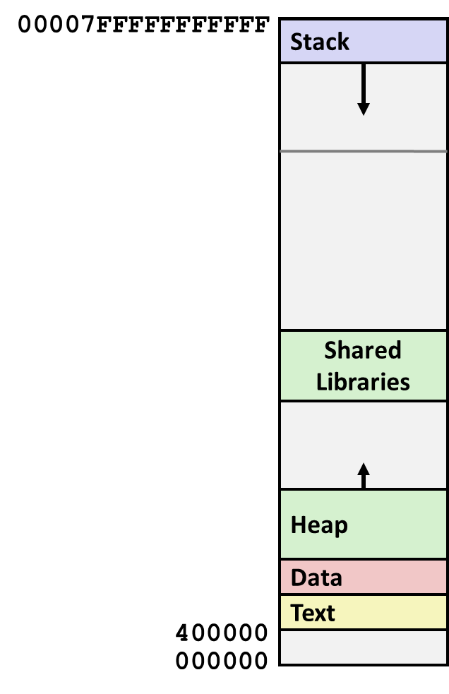
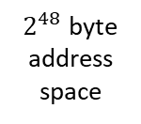
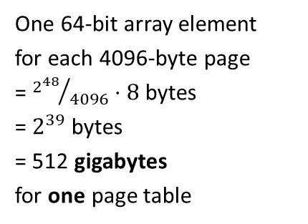
Review: The problem
One 64-bit array element
for each 4096-byte page
= ${2^{48}}/{4096}⋅8$ bytes
= $2^{39}$ bytes
= 512 gigabytes
for one page table
$2^{48}$ byte address space

Slide 9
Review: the problem
(with k-level page tables)
Page table
base register
(PTBR)
n-1
VIRTUAL ADDRESS
p-1
0
VPN 1
VPN 2
...
VPN k
VPO
the Level 1
page table
a Level 2
page table
a Level k
page table
...
...
PPN
Cache miss!
Cache miss!
Cache miss!
Cache miss!
Cache miss!
PPN
PPO

Slide 10
Today
Page Faults
Conceptual Quiz
Concrete examples of virtual memory systems
  “Simple memory system” from CSAPP 9.6.4
  Intel Core i7
Nifty things virtual memory makes possible
  Paging/swapping (disk as extra RAM)
  Memory-mapped files (RAM as cache for disk)
  Copy-on-write sharing

Slide 11
What happens on a page fault?
What is a page fault?
Why can they happen? How does the OS know?

Slide 12
OS tracks VM “areas”
Each area has permissions / purpose / etc

Slide 13
Types of Faults
This is a legal address
  Hard / Major faults – “normal” page faults
  Soft / minor faults – the OS took the page away, but has not reused it
The address is legal, but …
  The type of access is wrong, so “protection exception”
The address is not legal
  Segmentation fault or bus error

Slide 14
Today
Page Faults
Conceptual Quiz
Concrete examples of virtual memory systems
  “Simple memory system” from CSAPP 9.6.4
  Intel Core i7
Nifty things virtual memory makes possible
  Paging/swapping (disk as extra RAM)
  Memory-mapped files (RAM as cache for disk)
  Copy-on-write sharing

Slide 15
Conceptual Quiz: 1
For a simple system with a one-level page table, what must the MMU do before fetching the PTE?
Before fetching the Page Table Entry (PTE) from a one-level page table in a simple system, the Memory Management Unit (MMU) performs the following sub-steps:
Virtual Address Splitting: The MMU splits the virtual address into two parts:
  Virtual Page Number (VPN): The leftmost bits of the address represent the VPN.
  Virtual Page Offset (VPO): The remaining bits indicate the offset within the page.
Indexing into Page Table: The VPN is used directly as an array index in the page table. The MMU looks up the corresponding PTE using the VPN.
Feel free to ask if you need further clarification! 😊
For additional context and details, you can refer to the lecture materials from Carnegie Mellon University¹²

Slide 16
Conceptual Quiz: 2
The MMU must know the physical address of the page table in order to read page table entries from memory. Why does it need a physical address?
The Memory Management Unit (MMU) requires the physical address of the page table for several reasons:
Address Translation: The MMU translates virtual addresses (used by the CPU) to physical addresses (used by RAM). To do this, it needs to access the page table.
Page Table Lookup: When a virtual address is accessed, the MMU uses the VPN (Virtual Page Number) to index into the page table. The resulting PTE (Page Table Entry) contains the physical address of the corresponding page frame in RAM.
Hardware Interaction: The MMU interacts directly with RAM and other hardware components. It needs the physical address to perform memory accesses efficiently.
Protection and Permissions: The page table entries also store information about page permissions (read-only, read-write, etc.) and protection flags. The MMU checks these flags to enforce memory protection.
In summary, the physical address of the page table allows the MMU to perform address translation, look up PTEs, and manage memory efficiently. If you have further questions, feel free to ask!

Slide 17
Today
Page Faults
Conceptual Quiz
Concrete examples of virtual memory systems
  “Simple memory system” from CSAPP 9.6.4
  Intel Core i7
Nifty things virtual memory makes possible
  Paging/swapping (disk as extra RAM)
  Memory-mapped files (RAM as cache for disk)
  Copy-on-write sharing

Slide 18
Simple Memory System Example
Addressing
  14-bit virtual addresses
  12-bit physical address
  Page size = 64 bytes
13
12
11
10
9
8
7
6
5
4
3
2
1
0
VPN
VPO
Virtual Page Number
Virtual Page Offset
11
10
9
8
7
6
5
4
3
2
1
0
PPN
PPO
Physical Page Number
Physical Page Offset

Slide 19
Simple Memory System TLB
16 entries
4-way associative
TLBT
TLBI
13
12
11
10
9
8
7
6
5
4
3
2
1
0
0
0
0
0
1
1
0
1
VPN
VPO
VPN = 0b1101 = 0x0D
Translation Lookaside Buffer (TLB)
Set
Tag
PPN
Valid
Tag
PPN
Valid
Tag
PPN
Valid
Tag
PPN
Valid
Set
Tag
PPN
Valid
Tag
PPN
Valid
Tag
PPN
Valid
Tag
PPN
Valid
0
03
–
0
09
0D
1
00
–
0
07
02
1
0
03
–
0
09
0D
1
00
–
0
07
02
1
1
03
2D
1
02
–
0
04
–
0
0A
–
0
1
03
2D
1
02
–
0
04
–
0
0A
–
0
2
02
–
0
08
–
0
06
–
0
03
–
0
2
02
–
0
08
–
0
06
–
0
03
–
0
3
07
–
0
03
0D
1
0A
34
1
02
–
0
3
07
–
0
03
0D
1
0A
34
1
02
–
0

Slide 20
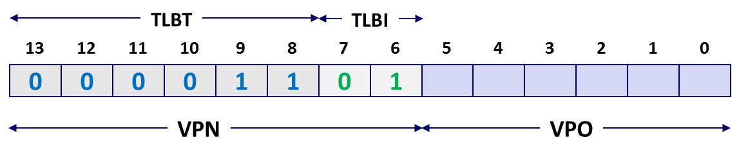
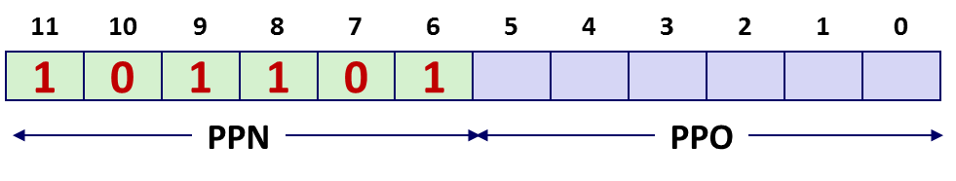
Simple Memory System Page Table
Only showing the first 16 entries (out of 256)
VPN
PPN
Valid
VPN
PPN
Valid
00
28
1
08
13
1
01
–
0
09
17
1
02
33
1
0A
09
1
03
02
1
0B
–
0
04
–
0
0C
–
0
05
16
1
0D
2D
1
0x0D → 0x2D
06
–
0
0E
11
1
07
–
0
0F
0D
1

Slide 21
Simple Memory System Cache
16 lines, 4-byte cache line size
Physically addressed
Direct mapped
V[0b00001101101001] = V[0x369]
P[0b101101101001] = P[0xB69] = 0x15
CT
CI
CO
11
10
9
8
7
6
5
4
3
2
1
0
1
0
1
1
0
1
1
0
1
0
0
1
PPN
PPO
Idx
Tag
Valid
B0
B1
B2
B3
Idx
Tag
Valid
B0
B1
B2
B3
Idx
Tag
Valid
B0
B1
B2
B3
Idx
Tag
Valid
B0
B1
B2
B3
0
19
1
99
11
23
11
8
24
1
3A
00
51
89
0
19
1
99
11
23
11
8
24
1
3A
00
51
89
1
15
0
–
–
–
–
9
2D
0
–
–
–
–
1
15
0
–
–
–
–
9
2D
0
–
–
–
–
2
1B
1
00
02
04
08
A
2D
1
93
15
DA
3B
2
1B
1
00
02
04
08
A
2D
1
93
15
DA
3B
3
36
0
–
–
–
–
B
0B
0
–
–
–
–
3
36
0
–
–
–
–
B
0B
0
–
–
–
–
4
32
1
43
6D
8F
09
C
12
0
–
–
–
–
4
32
1
43
6D
8F
09
C
12
0
–
–
–
–
5
0D
1
36
72
F0
1D
D
16
1
04
96
34
15
5
0D
1
36
72
F0
1D
D
16
1
04
96
34
15
6
31
0
–
–
–
–
E
13
1
83
77
1B
D3
6
31
0
–
–
–
–
E
13
1
83
77
1B
D3
7
16
1
11
C2
DF
03
F
14
0
–
–
–
–
7
16
1
11
C2
DF
03
F
14
0
–
–
–
–

Slide 22
Intel Core i7 Memory System
Processor package
Core x4
Registers
Instruction
fetch
MMU
(addr translation)
L1 d-cache
32 KB, 8-way
L1 i-cache
32 KB, 8-way
L1 d-TLB
64 entries, 4-way
L1 i-TLB
128 entries, 4-way
L2 unified cache
256 KB, 8-way
L2 unified TLB
512 entries, 4-way
QuickPath interconnect
4 links @ 25.6 GB/s each
To other
cores
To I/O
bridge
L3 unified cache
8 MB, 16-way
(shared by all cores)
DDR3 Memory controller
3 x 64 bit @ 10.66 GB/s
32 GB/s total (shared by all cores)
Main memory

Slide 23
End-to-end Core i7 Address Translation
CPU
32/64
L2, L3, and
main memory
Result
Virtual address (VA)
36
12
VPN
VPO
L1
hit
L1
miss
32
4
TLBT
TLBI
L1 d-cache
(64 sets, 8 lines/set)
TLB
hit
TLB
miss
...
...
L1 TLB (16 sets, 4 entries/set)
9
9
9
9
40
12
40
6
6
VPN1
VPN2
VPN3
VPN4
PPN
PPO
CT
CI
CO
Physical
address
(PA)
CR3
PTE
PTE
PTE
PTE
Page tables

Slide 24
Core i7 Level 1-3 Page Table Entries
63
62
52
51
12
11
9
8
7
6
5
4
3
2
1
0
XD
Unused
Page table physical base address
Unused
G
PS
A
CD
WT
U/S
R/W
P=1
Available for OS (page table location on disk)
P=0
Each entry references a 4K child page table. Significant fields:
P: Child page table present in physical memory (1) or not (0).
R/W: Read-only or read-write access access permission for all reachable pages.
U/S: user or supervisor (kernel) mode access permission for all reachable pages.
WT: Write-through or write-back cache policy for the child page table.
A: Reference bit (set by MMU on reads and writes, cleared by software).
PS: Page size either 4 KB or 4 MB (defined for Level 1 PTEs only).
Page table physical base address: 40 most significant bits of physical page table address (forces page tables to be 4KB aligned)
XD: Disable or enable instruction fetches from all pages reachable from this PTE.
Notes:
Reference bit – used in LRU

Slide 25
Core i7 Level 4 Page Table Entries
63
62
52
51
12
11
9
8
7
6
5
4
3
2
1
0
XD
Unused
Page physical base address
Unused
G
D
A
CD
WT
U/S
R/W
P=1
Available for OS (page location on disk)
P=0
Each entry references a 4K child page. Significant fields:
P: Child page is present in memory (1) or not (0)
R/W: Read-only or read-write access permission for child page
U/S: User or supervisor mode access
WT: Write-through or write-back cache policy for this page
A: Reference bit (set by MMU on reads and writes, cleared by software)
D: Dirty bit (set by MMU on writes, cleared by software)
G: Global page (don’t evict from TLB on task switch)
Page physical base address: 40 most significant bits of physical page address (forces pages to be 4KB aligned)
XD: Disable or enable instruction fetches from this page.

Slide 26
Core i7 Page Table Translation
9
9
9
9
12
Virtual
address
VPN 1
VPN 2
VPN 3
VPN 4
VPO
L1 PT
Page global
directory
L2 PT
Page upper
directory
L3 PT
Page middle
directory
L4 PT
Page
table
40
40
40
40
CR3
/
/
/
/
Physical
address
of L1 PT
Offset into
physical and
virtual page
/
L4 PTE
12
L1 PTE
L2 PTE
L3 PTE
Physical
address
of page
512 GB
region
per entry
1 GB
region
per entry
2 MB
region
per entry
4 KB
region
per entry
40
/
40
12
Physical
address
PPN
PPO

Slide 27
Cute Trick for Speeding Up L1 Access
CT
Tag Check
40
6
6
Physical
address
(PA)
CT
CI
CO
PPN
PPO
Address
Translation
No
Change
Virtual
address
(VA)
CI
VPN
VPO
L1 Cache
36
12
Observation
  Bits that determine CI identical in virtual and physical address
  Can index into cache while address translation taking place
  Generally we hit in TLB, so PPN bits (CT bits) available quickly
  “Virtually indexed, physically tagged”
  Cache carefully sized to make this possible
Notes:
This is taught in further detail in 15-346

Slide 28
Quiz
https://canvas.cmu.edu/courses/42532/quizzes/127212

Slide 29
Today
Page Faults
Conceptual Quiz
Concrete examples of virtual memory systems
  “Simple memory system” from CSAPP 9.6.4
  Intel Core i7
Nifty things virtual memory makes possible
  Memory-mapped files (RAM as cache for disk)
  Copy-on-write sharing

Slide 30
Memory-Mapped Files
Paging = every page of a program’s physical RAM is backed by some page of disk*
Normally, those pages belong to swap space
But what if some pages were backed by … files?
* This is how it used to work 20 years ago.
Nowadays, not always true.

Slide 31
Memory-Mapped Files
Process
virtual memory
Physical
memory
Swap space
File on disk

Slide 32
Memory-Mapped Files
Process 2
virtual memory
Process 1
virtual memory
Physical
memory
Swap space
File on disk

Slide 33
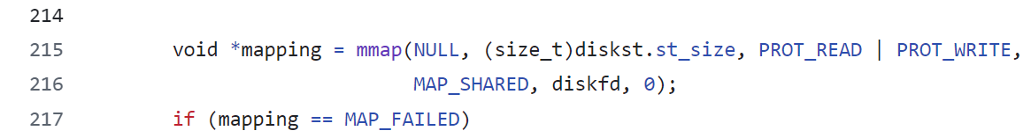
SFS Uses MMap
In sfs_mount, it uses mmap to read the entire “disk” into memory

Slide 34
Copy-on-write sharing
fork creates a new process by copying the entire address space
of the parent process
  That sounds slow
  It is slow
Parent
virtual memory
Physical
memory
Swap space
File on disk
Clever trick:
  Just duplicate the page tables
  Mark everything read only
  Copy only on write faults

Slide 35
Copy-on-write sharing
Child
virtual memory
Parent
virtual memory
Physical
memory
Swap space
File on disk
Clever trick:
  Just duplicate the page tables
  Mark everything read only
  Copy only on write faults

Slide 36
Copy-on-write sharing
Child
virtual memory
Parent
virtual memory
Physical
memory
Child wrote to this page
Swap space
File on disk
Clever trick:
  Just duplicate the page tables
  Mark everything read only
  Copy only on write faults

Slide 37
Summary
Multi-level page tables reduce total memory consumption of page tables
Translation lookaside buffers reduce time cost of translation
Real systems have 3 to 5 levels of page table
Virtual memory makes nifty things possible
  Memory protection and process isolation
  Paging/swapping (disk as extra RAM)
  Memory-mapped files (RAM as cache for disk)
  Copy-on-write sharing

Slide 38
Conceptual Quiz: 3
Why are one-level page tables impractical and how do multi-level page tables fix this problem?
A single-level page table covering the entire address space of a typical system would be much too large. For instance, with 4kB pages, a 48-bit address space, and a 8-byte PTE, a single-level page table would occupy 512 gigabytes, which is more RAM than most computers have.

Slide 39
Conceptual Quiz: 4
Why is memory access slower with a multi-level page table than with a single-level page table?
A k-level page table requires k memory loads in order to determine the physical address. There is no spatial locality to these loads.

Slide 40
Conceptual Quiz: 5
What is the Translation Lookaside Buffer (TLB), what problem does it solve, and when is it used?
The TLB is a small cache dedicated to storing mappings from virtual to physical addresses. It avoids the cost of lookups in a multi-level page table.
The MMU consults the TLB for each address as its first action; if there is a TLB hit, it does not need to fetch anything from the page table.

Slide 41
Conceptual Quiz: 6
How does virtual memory interact with the memory cache(s)?
The cache’s function is to speed up access to whatever data is most frequently used. The MMU sits “in between” the CPU and the cache; the cache works only with physical addresses. This means data from multiple processes may coexist in the cache (or compete for cache space).

