Slide 1

14-513
18-613

Slide 2
Processes and Multitasking
15-213/15-513/14-513: Introduction to Computer Systems
17th Lecture, October 29, 2024

Slide 3
Today
Processes
System Calls
Process Control
Shells

Slide 4
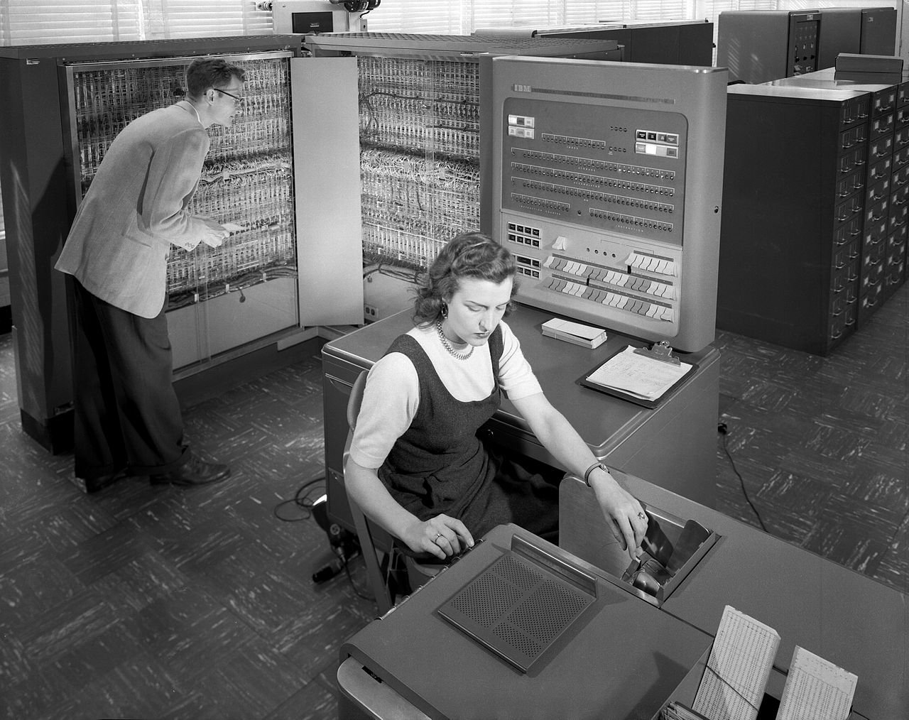
Earliest days: One batch job at a time
IBM 704 at Langley Research Center (NASA), 1957
https://commons.wikimedia.org/w/index.php?curid=6455009
Notes:
The earliest digital computers could only run one program at a time, start to finish. You couldn’t work directly with them. You had to give the “operator” – that’s this lady in the picture – a stack of punch cards with your program and your data, and when it was your program’s turn they’d put it into the computer and let it run. Hours later, maybe days later, you’d get back another stack of punch cards with the output. Or the compile errors. Nobody liked this.

Slide 5


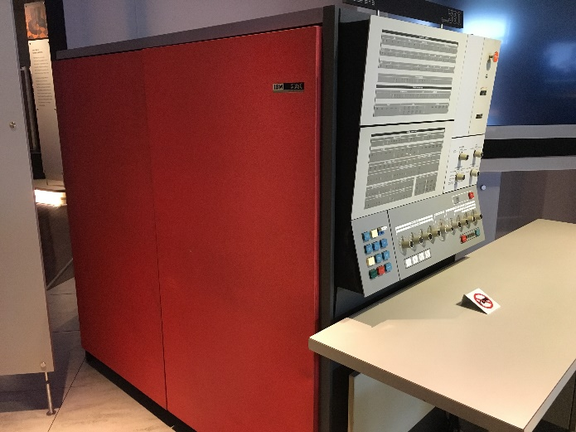
How can many people share one computer efficiently?
Notes:
It would be better if we could debug our programs interactively. But, if only one person at a time can interact with the computer, everyone else has to wait until they’re done… What if lots of people could use it at the same time, somehow?

Slide 6
Multiprocessing
Memory
Memory
Memory
Stack
Stack
Stack
Heap
Heap
…
Heap
Data
Data
Data
Code
Code
Code
CPU
CPU
CPU
Registers
Registers
Registers
Computer runs many processes simultaneously
  Applications for one or more users
    Web browsers, email clients, editors, …
  Background tasks
    Monitoring network & I/O devices
Notes:
Suppose we wrap a container around all the computer’s state that relates to a particular program it’s running. That container is called a process.
[advance animation] Then we could make room for more than one container on the same hardware. This is what virtual memory was originally invented for. In the physical RAM, each program takes up a different region, but the code running in each process sees only its own data, at virtual addresses that are chosen for the program’s convenience.
Now lots of people can run programs at once and it’s not a problem if some programs are waiting for people to type at them, the computer can do something else in the meantime. This is called time sharing.

Slide 7
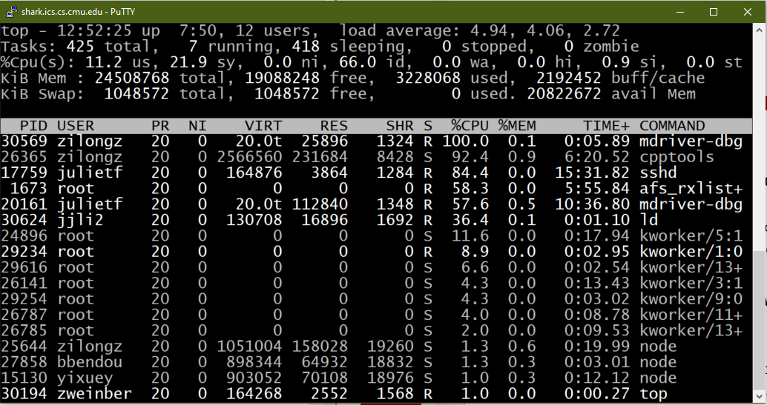
Multiprocessing Example
Running program “top” on hammerheadshark
  System has 425 “tasks”, 7 of which are active
  Identified by Process ID (PID), user account, command name
Notes:
We do time sharing all the time in this class. Every shark has at least two people logged into it 24x7, every semester.
This is a screen shot of the “top” program, from yesterday, on hammerheadshark. It gives you an interactive list of every process a Unix style computer is running. Windows has the same display, but they call it the Task Manager.

Slide 8
Processes
Definition: A process is an instance of a running program.
  One of the most profound ideas in computer science
  Not the same as “program” or “processor”
Process provides each program with two key abstractions:
  Private address space
    Each program seems to have exclusive use of main memory.
    Provided by kernel mechanism called virtual memory
  Logical control flow
    Each program seems to have exclusive use of the CPU
    Provided by kernel mechanism called context switching
Memory
Stack
Heap
Data
Code
CPU
Registers
Notes:
Let me emphasize that a process is not the same thing as a program. A program is a collection of code that does something useful. A process is a container that you “load” a program into in order to run it. You can have more than one process executing the same program – if you’ve ever opened up two terminal windows on the same shark that’s what you were doing.
The two key abstractions that the process – the container – gives us are the private virtual address space, like we keep saying, each program only sees its own RAM. But also, it gives us a private view of the CPU. Each program sees the CPU executing only its own code. This is called logical control flow.

Slide 9
Control Flow
Processors do only one thing:
  From startup to shutdown, each CPU core simply reads and executes
  a sequence of machine instructions, one at a time *
  This sequence is the CPU’s control flow (or flow of control)
Physical control flow
<startup>
inst₁
inst₂
inst₃
…
inst_{n}
<shutdown>
Time
* many modern CPUs execute several instructions at once and/or out of program order, but this is invisible to the programmer
Notes:
Even today, it’s still true that one CPU core runs one program at a time…
But it doesn’t have to run one program start to finish.

Slide 10
Context Switching
Processes are managed by a shared chunk of memory-resident OS code called the kernel
  Important: the kernel is not a separate process, but rather runs as part of some existing process.
Control flow passes from one process to another via a context switch
Process A
Process B
user code
kernel code
context switch
Time
user code
kernel code
context switch
user code
Notes:
There’s a special program called the kernel that takes control of the computer every so often and changes what process is running.

Slide 11
Context Switching (Uniprocessor)
Memory
Stack
Stack
Stack
Heap
Heap
…
Heap
Data
Data
Data
Code
Code
Code
Saved registers
Saved registers
CPU
Registers
Single processor executes multiple processes concurrently
  Process executions interleaved (multitasking)
  Address spaces managed by virtual memory system (recall VM lectures)
  Register values for nonexecuting processes saved in memory
Notes:
And here’s how that works. There’s only one CPU, so only one set of CPU registers, so every process that’s not running has its registers saved to memory.

Slide 12
Context Switching (Uniprocessor)
Memory
Stack
Stack
Stack
Heap
Heap
…
Heap
Data
Data
Data
Code
Code
Code
Saved registers
Saved registers
Saved registers
CPU
Registers
Save current registers in memory
Notes:
To switch away from A, we save process A’s registers in memory…

Slide 13
Context Switching (Uniprocessor)
Memory
Stack
Stack
Stack
Heap
Heap
…
Heap
Data
Data
Data
Code
Code
Code
Saved registers
Saved registers
Saved registers
CPU
Registers
Schedule next process for execution
Notes:
And then we select B as the process to run next. The algorithm for selecting B (as opposed to C or any other process) is called the scheduler.

Slide 14
Context Switching (Uniprocessor)
Memory
Stack
Stack
Stack
Heap
Heap
…
Heap
Data
Data
Data
Code
Code
Code
Saved registers
Saved registers
Saved registers
CPU
Registers
Load saved registers and switch address space (context switch)
How?
Notes:
And we load in process B’s registers from memory.
Ask: how change address space? (kernel uses new page tables for this process, PTBR value stored with context)

Slide 15
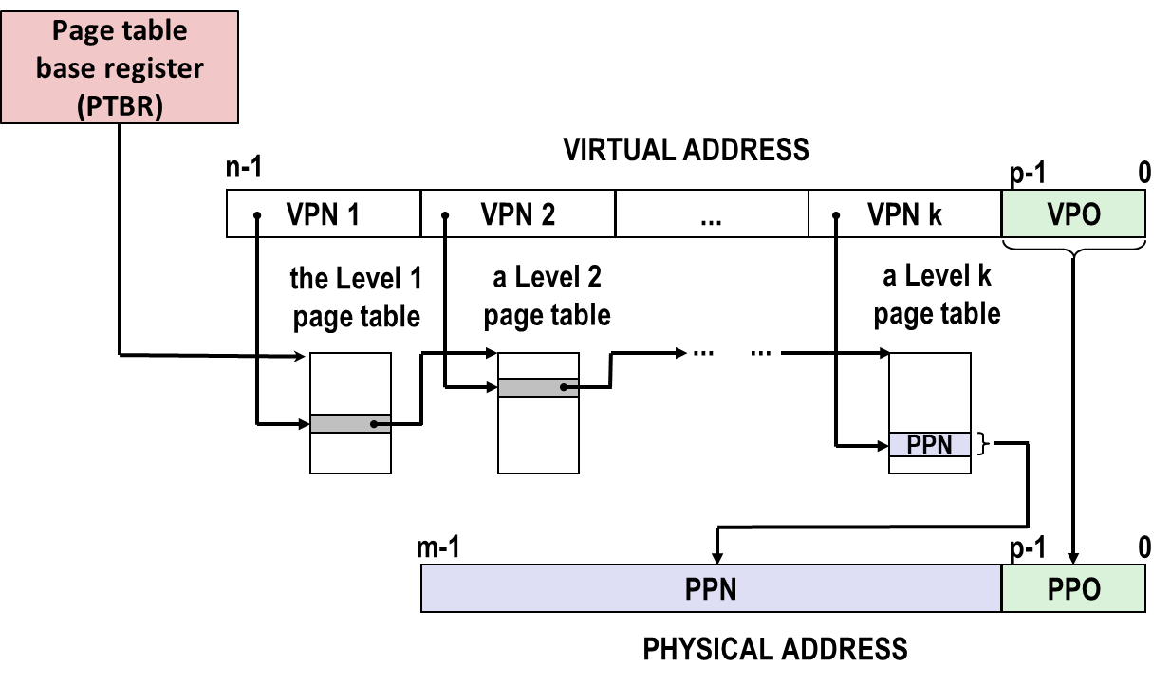
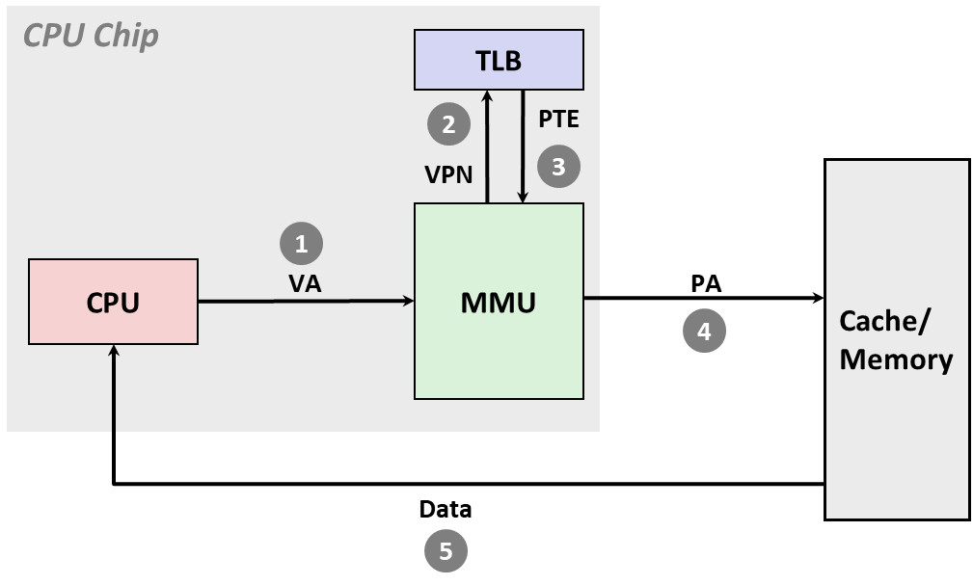
Recall: How to Switch the Address Space
update
this
invalidate
entries
What about caches?
Do nothing: caches
use physical addresses
Notes:
To swap OLD address space for NEW address space: Swap in the PTBR for NEW: Ensures entire page table is for NEW.
Invalidate the TLB entries, since they have page translations for OLD. NEW ones are reloaded into TLB as accessed. (Some machines tag TLB entries with PIDs to avoid this step.)
Nothing to be done for caches, since all cache tags are based on physical addresses.

Slide 16
Context Switching (Multicore)
Memory
Stack
Stack
Stack
Heap
Heap
…
Heap
Data
Data
Data
Code
Code
Code
Saved registers
CPU
CPU
Multicore processors
  Multiple CPUs on single chip
  Share main memory (and some caches)
  Each can execute a separate process
    Scheduling of processes onto cores done by kernel
Registers
Registers
Notes:
Nowadays computers have more than one CPU so they really can run more than one process simultaneously, but usually there are many more processes than there are CPUs so we still use context switching. The kernel picks the next process to run on each CPU more or less independently of the others.

Slide 17
User View of Concurrent Processes
Two processes run concurrently (are concurrent) if their execution overlaps in time
Otherwise, they are sequential
Appears as if concurrent processes run in parallel with each other
  This means they can interfere with each other
  (more on that in a couple weeks)
A and B concurrent
Process A
Process B
Process C
A and C concurrent
Time
B and C sequential
Notes:
Whether we have one or many CPU cores, human users perceive the computer to be running many processes simultaneously, because context switches can happen many times a second.
Unfortunately, we’ve created a new problem for ourselves. Programs that are running at the same time can interfere with each other. We’ll talk a lot more about this in a couple weeks, but for now you should know how to tell when this can happen.
[next] Process A and B are concurrent: the whole time that B is running, A is also running.
[next] A and C are also concurrent, even though there’s only a little overlap.
[next] But B and C don’t overlap at all, so we call them sequential.

Slide 18
Traditional (Uniprocessor) Reality
Only one process runs at a time
A and B execution is interleaved, not truly concurrent
Similarly for A and C
Still possible for A and B / A and C to interfere with each other
Process A
Process B
Process C
Time
Notes:
If there’s only one CPU, then A, B, and C can’t truly run at the same time, but their execution is interleaved, so they can still mess each other up.

Slide 19
How does the kernel take control?
The CPU executes instructions in sequence
We don’t write “now run kernel code” in our programs…
  Or do we??
Physical control flow
<startup>
inst₁
inst₂
inst₃
…
inst_{n}
<shutdown>
<kernel entry>
inst_{a}
inst_{b}
inst_{c}
…
<kernel exit>
Time
syscall
Notes:
I said the kernel takes control of the CPU every so often and picks another process to run. How is that possible?
[next] Very often it takes control because the program asked it to do something. There’s a special CPU instruction – on the x86 it’s “syscall” – that makes a function call into the kernel. Any time you do that, the kernel might switch to some other program for a while.
There are several other ways the kernel can take control. You heard about one of them last time – page faults. We’ll talk more about these other ways on Tuesday.

Slide 20
Today
Processes
System Calls
Process Control
Shells

Slide 21
System Calls
Whenever a program wants to cause an effect outside its own process, it must ask the kernel for help
Examples:
  Read/write files
  Get current time
  Allocate RAM (sbrk)
  Create new processes
// fopen.c
FILE *fopen(const char *fname,
const char *mode) {
int flags = mode2flags(mode);
if (!flags) return NULL;
int fd = open(fname, flags,
DEFPERMS);
if (fd == -1) return NULL;
return fdopen(fd, mode);
}
// open.S
.global open
open:
mov $SYS_open, %eax
syscall
cmp $SYS_error_thresh, %rax
ja __syscall_error
ret
Notes:
If you dug into the code of the C library, you might see that fopen uses another function called just “open” to do most of its work, but “open” is defined in assembly language and it doesn’t seem to do very much, it just puts a constant in EAX and uses this special “syscall” instruction and then compares RAX with another constant and either returns or jumps to error handling code.
Well, like I said, “syscall” makes a function call into the kernel. The kernel will do all the real work. It gets the arguments to open from the usual argument registers, and the value it returns in RAX is either the return value or an error code.
We have to use a special instruction to call the kernel because the kernel has special privileges. It can do things like change the page tables and talk directly to I/O devices. So you can’t just jump into its code anywhere.

Slide 22
All the system calls
accept
accept4
acct
add_key
adjtimex
bind
bpf
brk
capget
capset
chdir
chroot
clock_adjtime
clock_getres
clock_gettime
clock_nanosleep
clock_settime
clone
clone3
close
close_range
connect
copy_file_range
delete_module
dup
dup3
epoll_create1
epoll_ctl
epoll_pwait
epoll_pwait2
eventfd2
execve
execveat
exit
exit_group
faccessat
faccessat2
fallocate
fanotify_init
fanotify_mark
fchdir
fchmod
fchmodat
fchown
fchownat
fdatasync
fgetxattr
finit_module
flistxattr
flock
fremovexattr
fsconfig
fsetxattr
fsmount
fsopen
fspick
fsync
futex
futex_waitv
get_mempolicy
get_robust_list
getcpu
getcwd
getdents64
getegid
geteuid
getgid
getgroups
getitimer
getpeername
getpgid
getpid
getppid
getpriority
getrandom
getresgid
getresuid
getrlimit
getrusage
getsid
getsockname
getsockopt
gettid
gettimeofday
getuid
getxattr
init_module
inotify_add_watch
inotify_init1
inotify_rm_watch
io_cancel
io_destroy
io_getevents
io_pgetevents
io_setup
io_submit
io_uring_enter
io_uring_register
io_uring_setup
ioctl
ioprio_get
ioprio_set
kcmp
kexec_file_load
kexec_load
keyctl
kill
landlock_add_rule
landlock_create_ruleset
landlock_restrict_self
lgetxattr
linkat
listen
listxattr
llistxattr
lookup_dcookie
lremovexattr
lsetxattr
madvise
mbind
membarrier
memfd_create
memfd_secret
migrate_pages
mincore
mkdirat
mknodat
mlock
mlock2
mlockall
mount
mount_setattr
move_mount
move_pages
mprotect
mq_getsetattr
mq_notify
mq_open
mq_timedreceive
mq_timedsend
mq_unlink
mremap
msgctl
msgget
msgrcv
msgsnd
msync
munlock
munlockall
munmap
name_to_handle_at
nanosleep
nfsservctl
open_by_handle_at
open_tree
openat
openat2
perf_event_open
personality
pidfd_getfd
pidfd_open
pidfd_send_signal
pipe2
pivot_root
pkey_alloc
pkey_free
pkey_mprotect
ppoll
prctl
pread64
preadv
preadv2
prlimit64
process_madvise
process_mrelease
process_vm_readv
process_vm_writev
pselect6
ptrace
pwrite64
pwritev
pwritev2
quotactl
quotactl_fd
read
readahead
readlinkat
readv
reboot
recvfrom
recvmmsg
recvmsg
remap_file_pages
removexattr
renameat
renameat2
request_key
restart_syscall
rseq
rt_sigaction
rt_sigpending
rt_sigprocmask
rt_sigqueueinfo
rt_sigreturn
rt_sigsuspend
rt_sigtimedwait
rt_tgsigqueueinfo
sched_get_priority_max
sched_get_priority_min
sched_getaffinity
sched_getattr
sched_getparam
sched_getscheduler
sched_rr_get_interval
sched_setaffinity
sched_setattr
sched_setparam
sched_setscheduler
sched_yield
seccomp
semctl
semget
semop
semtimedop
sendmmsg
sendmsg
sendto
set_mempolicy
set_mempolicy_home_node
set_robust_list
set_tid_address
setdomainname
setfsgid
setfsuid
setgid
setgroups
sethostname
setitimer
setns
setpgid
setpriority
setregid
setresgid
setresuid
setreuid
setrlimit
setsid
setsockopt
settimeofday
setuid
setxattr
shmat
shmctl
shmdt
shmget
shutdown
sigaltstack
signalfd4
socket
socketpair
splice
statx
swapoff
swapon
symlinkat
sync
sync_file_range
sync_file_range2
syncfs
sysinfo
syslog
tee
tgkill
timer_create
timer_delete
timer_getoverrun
timer_gettime
timer_settime
timerfd_create
timerfd_gettime
timerfd_settime
times
tkill
umask
umount2
uname
unlinkat
unshare
userfaultfd
utimensat
vhangup
vmsplice
wait4
waitid
write
writev
Linux kernel 6.0
Notes:
There’s almost 400 different system calls on current Unixes – this is the list from Linux kernel 6.0. Many are only useful in very specific circumstances – for instance, there’s one that adjusts the system’s idea of how long one second is. In case the quartz oscillator built into the computer isn’t accurate enough. You’re probably never going to write code that uses that one.
By way of comparison there are something like twenty thousand documented functions in the C library.

Slide 23
System Call Error Handling
Almost all system-level operations can fail
  Only exception is the handful of functions that return void
  You must explicitly check for failure
On error, most system-level functions return −1 and set global variable errno to indicate cause.
Example:
pid_t pid = fork();
if (pid == -1) {
fprintf(stderr, "fork error: %s\n", strerror(errno));
exit(1);
}
Notes:
Almost all system calls can fail, and it’s your responsibility to check. Usually they return minus 1 when they fail, but there are exceptions, always check the manpage. When they fail, they set a global variable errno to a code that tells you why they failed. You can use the strerror function to turn that code into a string for an error message.
What do you do when something fails? It depends on the program. Often you should just stop. Write an error message to stderr – include strerror of errno – and then exit the program. Note: exit 1. Exit code 0 means your program succeeded in doing what it was meant to do. If a system call failed, that didn’t happen.

Slide 24
Error-reporting functions
Can simplify somewhat using an error-reporting function:
Not always appropriate to exit when something goes wrong.
void unix_error(char *msg) /* Unix-style error */
{
fprintf(stderr, "%s: %s\n", msg, strerror(errno));
exit(1);
}
pid_t pid = fork();
if (pid == -1)
unix_error("fork error");
Note: csapp.c exits with 0,
which is a bug.
Notes:
It gets repetitive writing fprintf stderr blah blah strerror errno blah exit 1, so some people like to define a helper function that encapsulates it. You’ll see this in the starter code for shell and proxy. But this is only the Right Thing if exiting is the Right Thing.
[next] The textbook’s sample code has bugs in some of its error reporting functions. If you see exit 0 in an error reporting function, change it to 1.

Slide 25
Error-handling Wrappers
We simplify the code we present to you even further by using Stevens¹-style error-handling wrappers:
NOT what you generally want to do in a real application
¹e.g., in “UNIX Network Programming: The sockets networking API“ W. Richard Stevens
pid_t Fork(void)
{
pid_t pid = fork();
if (pid == -1)
unix_error("Fork error");
return pid;
}
pid = Fork(); // Only returns if successful
Notes:
The textbook, and these slides, compact things even further with “Stevens wrappers” that encapsulate both the error handling and the actual system call. Whenever you see a system call spelled with an uppercase first letter, it’s one of these wrappers. It takes the same arguments as the bare system call and it returns only if it succeeds.
We like this for the slides because it gets the error handling out of the way and makes the slides easier to read, but it’s almost never the right thing to do in a real program, because, again, exiting isn’t always the right thing.

Slide 26
Today
Processes
System Calls
Process Control
Shells
Notes:
How do we create new processes, load programs into them, set them running, wait for them to be done? With system calls.

Slide 27
Obtaining Process IDs
pid_t getpid(void)
  Returns PID of current process
pid_t getppid(void)
  Returns PID of parent process
Notes:
Every process has a process ID, a code number that identifies it. PIDs don’t change over the lifetime of a process, but they might get reused after a process terminates.
Every process also has a parent process – the process that started it, and will be notified when it terminates. (Unlike in biology, computer processes tend to outlive their children.) (If a parent process does terminate first, its children will all be reassigned to have special process number 1 as their parent. Process 1 never terminates.)

Slide 28
Process States
At any time, each process is either:
Running
  Process is either executing instructions, or it could be executing instructions if there were enough CPU cores.
Blocked / Sleeping
  Process cannot execute any more instructions until some external event happens (usually I/O).
Stopped
  Process has been prevented from executing by user action (control-Z).
Terminated / Zombie
  Process is finished. Parent process has not yet been notified.

Slide 29
Terminating Processes
Process becomes terminated for one of three reasons:
  Receiving a signal whose default action is to terminate (next lecture)
  Returning from the main routine
  Calling the exit function
void exit(int status)
  Terminates with an exit status of status
  Convention: normal return status is 0, nonzero on error
  Another way to explicitly set the exit status is to return an integer value from the main routine
exit is called once but never returns.
Notes:
Exit is another of those rare system calls that can’t fail.

Slide 30
Creating Processes
Parent process creates a new running child process by calling fork
int fork(void)
  Returns 0 to the child process, child’s PID to parent process
  Child is almost identical to parent:
    Child get an identical (but separate) copy of the parent’s virtual address space.
    Child gets identical copies of the parent’s open file descriptors
    Child has a different PID than the parent
fork is interesting (and often confusing) because
it is called once but returns twice

Slide 31
Conceptual View of fork
Memory
Memory
parent
child
Stack
➔
Stack
Stack
Heap
Heap
Heap
Data
Data
Data
Code
Code
Code
Saved registers
Saved registers
Saved registers
CPU
CPU
Registers
Registers
Make complete copy of execution state
  Designate one as parent and one as child
  Resume execution of parent or child
  (Optimization: Use copy-on-write to avoid copying RAM)

Slide 32
fork Example
Call once, return twice
Concurrent execution
  Can’t predict execution order of parent and child
int main(int argc, char** argv)
{
pid_t pid;
int x = 1;
pid = Fork();
if (pid == 0) { /* Child */
printf("child : x=%d\n", ++x);
return 0;
}
/* Parent */
printf("parent: x=%d\n", --x);
return 0;
}
fork.c
linux> ./fork
parent: x=0
child : x=2
linux> ./fork
child : x=2
parent: x=0
linux> ./fork
parent: x=0
child : x=2
linux> ./fork
parent: x=0
child : x=2

Slide 33
fork Example
Call once, return twice
Concurrent execution
  Can’t predict execution order of parent and child
Duplicate but separate address space
  x has a value of 1 when fork returns in parent and child
  Subsequent changes to x are independent
Shared open files
  stdout is the same in both parent and child
int main(int argc, char** argv)
{
pid_t pid;
int x = 1;
pid = Fork();
if (pid == 0) { /* Child */
printf("child : x=%d\n", ++x);
return 0;
}
/* Parent */
printf("parent: x=%d\n", --x);
return 0;
}
linux> ./fork
parent: x=0
child : x=2

Slide 34
Modeling fork with Process Graphs
A process graph is a useful tool for capturing the partial ordering of statements in a concurrent program:
  Each vertex is the execution of a statement
  a -> b means a happens before b
  Edges can be labeled with current value of variables
  printf vertices can be labeled with output
  Each graph begins with a vertex with no inedges
Any topological sort of the graph corresponds to a feasible total ordering.
  Total ordering of vertices where all edges point from left to right

Slide 35
Process Graph Example
int main(int argc, char** argv)
{
pid_t pid;
int x = 1;
pid = Fork();
if (pid == 0) { /* Child */
printf("child : x=%d\n", ++x);
return 0;
}
/* Parent */
printf("parent: x=%d\n", --x);
return 0;
}
child: x=2
Child
printf
exit
x==1
parent: x=0
Parent
main
fork
printf
exit
fork.c

Slide 36
Interpreting Process Graphs
Original graph:
Relabled graph:
child: x=2
printf
exit
x==1
parent: x=0
main
fork
printf
exit
Feasible total ordering:
e
f
a
b
e
c
f
d
a
b
c
d
Feasible or Infeasible?
a
b
f
c
e
d
Infeasible: not a topological sort

Slide 37
fork Example: Two consecutive forks
Bye
void fork2()
{
printf("L0\n");
fork();
printf("L1\n");
fork();
printf("Bye\n");
}
printf
L1
Bye
printf
fork
printf
Bye
printf
L0
L1
Bye
forks.c
printf
fork
printf
fork
printf
Feasible output:
L0
L1
Bye
Bye
L1
Bye
Bye
Infeasible output:
L0
Bye
L1
Bye
L1
Bye
Bye
Notes:
Run ./forks 2
(Similarly for other examples)

Slide 38
fork Example: Nested forks in parent
void fork4()
{
printf("L0\n");
if (fork() != 0) {
printf("L1\n");
if (fork() != 0) {
printf("L2\n");
}
}
printf("Bye\n");
}
Bye
Bye
printf
printf
L0
L1
L2
Bye
printf
fork
printf
fork
printf
printf
forks.c
Feasible or Infeasible?
L0
Bye
L1
Bye
Bye
L2
Feasible or Infeasible?
L0
L1
Bye
Bye
L2
Bye
Infeasible
Feasible

Slide 39
fork Example: Nested forks in children
void fork5()
{
printf("L0\n");
if (fork() == 0) {
printf("L1\n");
if (fork() == 0) {
printf("L2\n");
}
}
printf("Bye\n");
}
L2
Bye
printf
printf
L1
Bye
printf
fork
printf
L0
Bye
printf
fork
printf
forks.c
Feasible or Infeasible?
L0
Bye
L1
Bye
Bye
L2
Feasible or Infeasible?
L0
Bye
L1
L2
Bye
Bye
Infeasible
Feasible

Slide 40
Reaping Child Processes
Idea
  When process terminates, it still consumes system resources
    Examples: Exit status, various OS tables
  Called a “zombie”
    Living corpse, half alive and half dead
Reaping
  Performed by parent on terminated child (using wait or waitpid)
  Parent is given exit status information
  Kernel then deletes zombie child process
What if parent doesn’t reap?
  If any parent terminates without reaping a child, then the orphaned child should be reaped by init process (pid == 1)
    Unless it was init that terminated! Then need to reboot…
  So, only need explicit reaping in long-running processes
    e.g., shells and servers

Slide 41
Zombie
Example
void fork7() {
if (fork() == 0) {
/* Child */
printf("Terminating Child, PID = %d\n", getpid());
exit(0);
} else {
printf("Running Parent, PID = %d\n", getpid());
while (1)
; /* Infinite loop */
}
}
linux> ./forks 7 &
[1] 6639
Running Parent, PID = 6639
Terminating Child, PID = 6640
linux> ps
PID TTY TIME CMD
6585 ttyp9 00:00:00 tcsh
6639 ttyp9 00:00:03 forks
6640 ttyp9 00:00:00 forks <defunct>
6641 ttyp9 00:00:00 ps
linux> ./forks 7 &
[1] 6639
Running Parent, PID = 6639
Terminating Child, PID = 6640
linux> ./forks 7 &
[1] 6639
Running Parent, PID = 6639
Terminating Child, PID = 6640
linux> ps
PID TTY TIME CMD
6585 ttyp9 00:00:00 tcsh
6639 ttyp9 00:00:03 forks
6640 ttyp9 00:00:00 forks <defunct>
6641 ttyp9 00:00:00 ps
linux> kill 6639
[1] Terminated
linux> ps
PID TTY TIME CMD
6585 ttyp9 00:00:00 tcsh
6642 ttyp9 00:00:00 ps
forks.c
ps shows child process as “defunct” (i.e., a zombie)
Killing parent allows child to be reaped by init

Slide 42
Non- terminating
Child Example
void fork8()
{
if (fork() == 0) {
/* Child */
printf("Running Child, PID = %d\n",
getpid());
while (1)
; /* Infinite loop */
} else {
printf("Terminating Parent, PID = %d\n",
getpid());
exit(0);
}
}
linux> ./forks 8
Terminating Parent, PID = 6675
Running Child, PID = 6676
forks.c
linux> ./forks 8
Terminating Parent, PID = 6675
Running Child, PID = 6676
linux> ps
PID TTY TIME CMD
6585 ttyp9 00:00:00 tcsh
6676 ttyp9 00:00:06 forks
6677 ttyp9 00:00:00 ps
linux> ./forks 8
Terminating Parent, PID = 6675
Running Child, PID = 6676
linux> ps
PID TTY TIME CMD
6585 ttyp9 00:00:00 tcsh
6676 ttyp9 00:00:06 forks
6677 ttyp9 00:00:00 ps
linux> kill 6676
linux> ps
PID TTY TIME CMD
6585 ttyp9 00:00:00 tcsh
6678 ttyp9 00:00:00 ps
Child process still active even though parent has terminated
Must kill child explicitly, or else will keep running indefinitely

Slide 43
wait: Synchronizing with Children
Parent reaps a child with one of these system calls:
pid_t wait(int *status)
  Suspends current process until one of its children terminates
  Returns PID of child, records exit status in status
pid_t waitpid(pid_t pid, int *status,
int options)
  More flexible version of wait:
  Can wait for a specific child or group of children
  Can be told to return immediately if there are no children to reap

Slide 44
wait: Synchronizing with Children
void fork9() {
int child_status;
if (fork() == 0) {
printf("HC: hello from child\n");
exit(0);
} else {
printf("HP: hello from parent\n");
wait(&child_status);
printf("CT: child has terminated\n");
}
printf("Bye\n");
}
HC
exit
printf
CT
Bye
HP
fork
printf
wait
printf
forks.c
Feasible output:
HC
HP
CT
Bye
Feasible output(s):
HC HP
HP HC
CT CT
Bye Bye
Infeasible output:
HP
CT
Bye
HC

Slide 45
wait: Status codes
Return value of wait is the pid of the child process that terminated
If status != NULL, then the integer it points to will be set to a value that indicates the exit status
  More information than the value passed to exit
  Must be decoded, using macros defined in sys/wait.h
    WIFEXITED, WEXITSTATUS, WIFSIGNALED, WTERMSIG, WIFSTOPPED, WSTOPSIG, WIFCONTINUED
    See textbook for details

Slide 46
Another wait Example
If multiple children completed, will take in arbitrary order
Can use macros WIFEXITED and WEXITSTATUS to get information about exit status
void fork10() {
pid_t pid[N];
int i, child_status;
for (i = 0; i < N; i++)
if ((pid[i] = fork()) == 0) {
exit(100+i); /* Child */
}
for (i = 0; i < N; i++) { /* Parent */
pid_t wpid = wait(&child_status);
if (WIFEXITED(child_status))
printf("Child %d terminated with exit status %d\n",
wpid, WEXITSTATUS(child_status));
else
printf("Child %d terminate abnormally\n", wpid);
}
}
forks.c
Notes:
Will consistently terminate in order, even with random delays.
But, can turn off delays on parent with
setenv PARENT 0
Then see variations in termination order

Slide 47
waitpid: Waiting for a Specific Process
pid_t waitpid(pid_t pid, int *status, int options)
  Suspends current process until specific process terminates
  Various options (see textbook)
void fork11() {
pid_t pid[N];
int i;
int child_status;
for (i = 0; i < N; i++)
if ((pid[i] = fork()) == 0)
exit(100+i); /* Child */
for (i = N-1; i >= 0; i--) {
pid_t wpid = waitpid(pid[i], &child_status, 0);
if (WIFEXITED(child_status))
printf("Child %d terminated with exit status %d\n",
wpid, WEXITSTATUS(child_status));
else
printf("Child %d terminate abnormally\n", wpid);
}
}
forks.c
Notes:
Will always terminate in reverse order

Slide 48
execve: Loading and Running Programs
int execve(char *filename, char *argv[], char *envp[])
Loads and runs in the current process:
  Executable file filename
    Can be object file or script file beginning with #!interpreter (e.g., #!/bin/bash)
  …with argument list argv
    By convention argv[0]==filename
  …and environment variable list envp
    “name=value” strings (e.g., USER=droh)
    getenv, putenv, printenv
Overwrites code, data, and stack
  Retains PID, open files and signal context
Called once and never returns
  …except if there is an error

Slide 49
execve Example
Execute "/bin/ls –lt /usr/include" in child process using current environment:
envp[n] = NULL
envp[n-1]
"PWD=/usr/droh"
…
envp[0]
"USER=droh"
environ
myargv[argc] = NULL
(argc == 3)
myargv[2]
"/usr/include"
myargv[1]
"-lt"
myargv
myargv[0]
"/bin/ls"
if ((pid = Fork()) == 0) { /* Child runs program */
if (execve(myargv[0], myargv, environ) < 0) {
printf("%s: %s\n", myargv[0], strerror(errno));
exit(1);
}
}

Slide 50
Structure of the stack when a new program starts
Null-terminated
environment variable strings
Bottom of stack
Null-terminated
command-line arg strings
envp[n] == NULL
envp[n-1]
environ
(global var)
...
envp[0]
argv[argc] = NULL
envp
(in %rdx)
argv[argc-1]
...
argv
(in %rsi)
argv[0]
argc
(in %rdi)
Stack frame for
libc_start_main
Top of stack
Future stack frame for
main

Slide 51
execve and process memory layout
User stack
Private, demand-zero
To load and run a new program a.out in the current process using execve:
Free vm_area_struct’s and page tables for old areas
Create vm_area_struct’s and page tables for new areas
  Programs and initialized data backed by object files.
  .bss and stack backed by anonymous files.
Set PC to entry point in .text
  Linux will fault in code and data pages as needed.
libc.so
.data
Memory mapped region
for shared libraries
Shared, file-backed
.text
Runtime heap (via malloc)
Private, demand-zero
Uninitialized data (.bss)
Private, demand-zero
a.out
Initialized data (.data)
.data
Private, file-backed
.text
Program text (.text)
0

Slide 52
Quiz
https://canvas.cmu.edu/courses/42532/quizzes/127192

Slide 53
Today
Processes
System Calls
Process Control
Shells

Slide 54
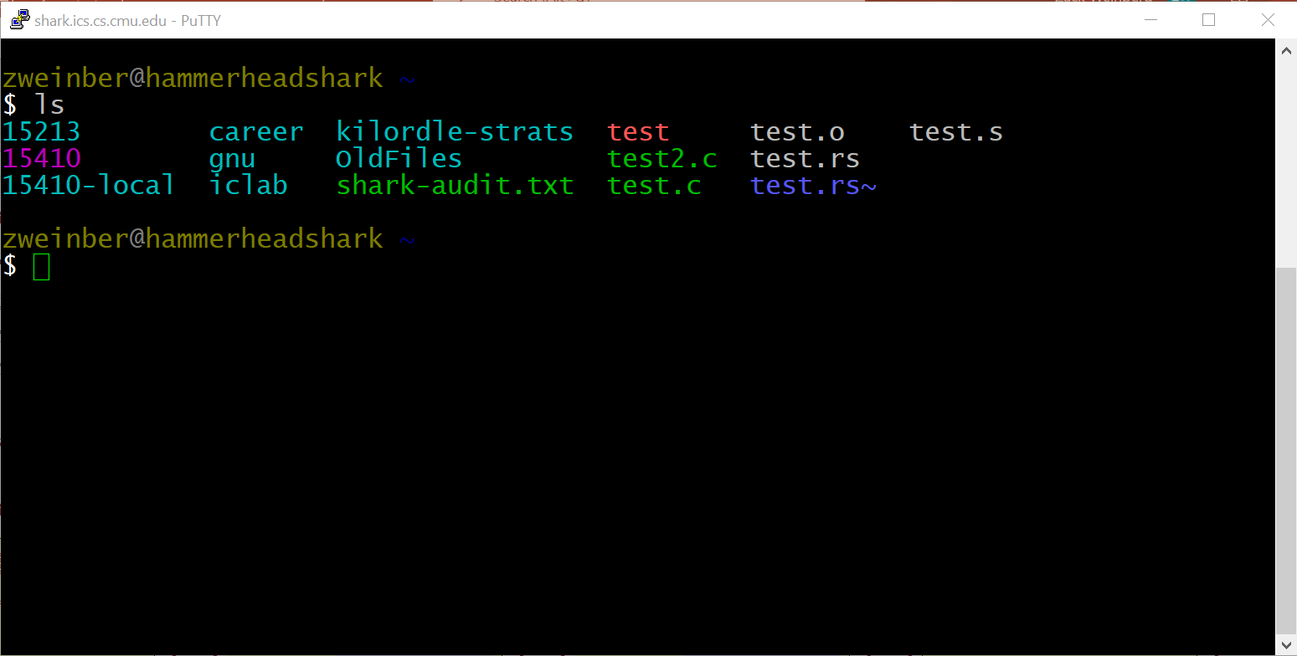
Shell Programs
A shell is an application program that runs programs on behalf of the user
  sh Original Unix shell (Stephen Bourne, AT&T Bell Labs, 1977)
  csh/tcsh BSD Unix C shell
  bash “Bourne-Again” Shell (default Linux shell)
Notes:
Thinking back to the 1960s again, for people to be able to share a computer, it’s not enough for the computer to have processes. We need a way for each user to communicate with the computer directly, and tell it to start up processes and run programs. We need a user interface.
The specific kind of user interface we need is called a shell. A shell is a program that runs other programs, as instructed by the user. When you log into the sharks and type commands, the program that receives and executes those commands is a shell program.
I’m showing an example of a command line shell, but they don’t have to work that way. The desktop interface on Windows and Mac is also a shell, because its primary purpose is to start other programs for you. It might even be called a shell internally.

Slide 55
Shell Programs
Simple shell
  Described in the textbook, starting at p. 753
  Implementation of a very elementary shell
  Purpose
    Understand what happens when you type commands
    Understand use and operation of process control operations
Notes:
In the next several slides I’m going to go over the internals of a very simple command line shell, taken directly from the textbook. It’s missing a lot of features that a real shell would have, but it’s enough to give you the idea of how they work.

Slide 56
Simple Shell Example
linux> ./shellex
> /bin/ls -l csapp.c
-rw-r--r-- 1 bryant users 23053 Jun 15 2015 csapp.c
> /bin/ps
PID TTY TIME CMD
31542 pts/2 00:00:01 tcsh
32017 pts/2 00:00:00 shellex
32019 pts/2 00:00:00 ps
> /bin/sleep 10 &
32031 /bin/sleep 10 &
> /bin/ps
PID TTY TIME CMD
31542 pts/2 00:00:01 tcsh
32024 pts/2 00:00:00 emacs
32030 pts/2 00:00:00 shellex
32031 pts/2 00:00:00 sleep
32033 pts/2 00:00:00 ps
> quit
Must give full pathnames for programs
Run program in background
Sleep is running
in background
Notes:
Try:
./shellx
>/bin/ls –l csapp.c
>./delay 5
>./delay 5 &
>/bin/ls csapp.c
>quit

Slide 57
Simple Shell Implementation
Basic loop
  Read line from command line
  Execute the requested operation
    Built-in command (only one implemented is quit)
    Load and execute program from file
int main(int argc, char** argv)
{
char cmdline[MAXLINE]; /* command line */
while (1) {
/* read */
printf("> ");
fgets(cmdline, MAXLINE, stdin);
if (feof(stdin))
exit(0);
/* evaluate */
eval(cmdline);
}
...
Execution is a sequence of read/evaluate steps
shellex.c
Notes:
Try:
./shellx
>/bin/ls –l csapp.c
>./delay 5
>./delay 5 &
>/bin/ls csapp.c
>quit

Slide 58
Simple Shell eval Function
void eval(char *cmdline)
{
char *argv[MAXARGS]; /* Argument list execve() */
char buf[MAXLINE]; /* Holds modified command line */
int bg; /* Should the job run in bg or fg? */
pid_t pid; /* Process id */
strcpy(buf, cmdline);
bg = parseline(buf, argv);
if (argv[0] == NULL)
return; /* Ignore empty lines */
if (!builtin_command(argv)) {
if ((pid = Fork()) == 0) { /* Child runs user job */
if (execve(argv[0], argv, environ) < 0) {
printf("%s: Command not found.\n", argv[0]);
exit(0);
}
}
/* Parent waits for foreground job to terminate */
if (!bg) {
int status;
if (waitpid(pid, &status, 0) < 0)
unix_error("waitfg: waitpid error");
}
else
printf("%d %s", pid, cmdline);
}
return;
}
parseline will parse ‘buf’ into ‘argv’ and return whether or not input line ended in ‘&’
shellex.c
shellex.c

Slide 59
Simple Shell eval Function
void eval(char *cmdline)
{
char *argv[MAXARGS]; /* Argument list execve() */
char buf[MAXLINE]; /* Holds modified command line */
int bg; /* Should the job run in bg or fg? */
pid_t pid; /* Process id */
strcpy(buf, cmdline);
bg = parseline(buf, argv);
if (argv[0] == NULL)
return; /* Ignore empty lines */
if (!builtin_command(argv)) {
if ((pid = Fork()) == 0) { /* Child runs user job */
if (execve(argv[0], argv, environ) < 0) {
printf("%s: Command not found.\n", argv[0]);
exit(0);
}
}
/* Parent waits for foreground job to terminate */
if (!bg) {
int status;
if (waitpid(pid, &status, 0) < 0)
unix_error("waitfg: waitpid error");
}
else
printf("%d %s", pid, cmdline);
}
return;
}
Ignore empty lines.
shellex.c
shellex.c

Slide 60
Simple Shell eval Function
void eval(char *cmdline)
{
char *argv[MAXARGS]; /* Argument list execve() */
char buf[MAXLINE]; /* Holds modified command line */
int bg; /* Should the job run in bg or fg? */
pid_t pid; /* Process id */
strcpy(buf, cmdline);
bg = parseline(buf, argv);
if (argv[0] == NULL)
return; /* Ignore empty lines */
if (!builtin_command(argv)) {
if ((pid = Fork()) == 0) { /* Child runs user job */
if (execve(argv[0], argv, environ) < 0) {
printf("%s: Command not found.\n", argv[0]);
exit(0);
}
}
/* Parent waits for foreground job to terminate */
if (!bg) {
int status;
if (waitpid(pid, &status, 0) < 0)
unix_error("waitfg: waitpid error");
}
else
printf("%d %s", pid, cmdline);
}
return;
}
If it is a ‘built in’ command, then handle it here in this program. Otherwise fork/exec the program specified in argv[0]
shellex.c
shellex.c

Slide 61
Simple Shell eval Function
void eval(char *cmdline)
{
char *argv[MAXARGS]; /* Argument list execve() */
char buf[MAXLINE]; /* Holds modified command line */
int bg; /* Should the job run in bg or fg? */
pid_t pid; /* Process id */
strcpy(buf, cmdline);
bg = parseline(buf, argv);
if (argv[0] == NULL)
return; /* Ignore empty lines */
if (!builtin_command(argv)) {
if ((pid = fork()) == 0) { /* Child runs user job */
if (execve(argv[0], argv, environ) < 0) {
printf("%s: Command not found.\n", argv[0]);
exit(0);
}
}
/* Parent waits for foreground job to terminate */
if (!bg) {
int status;
if (waitpid(pid, &status, 0) < 0)
unix_error("waitfg: waitpid error");
}
else
printf("%d %s", pid, cmdline);
}
return;
}
Create child
shellex.c
shellex.c

Slide 62
Simple Shell eval Function
void eval(char *cmdline)
{
char *argv[MAXARGS]; /* Argument list execve() */
char buf[MAXLINE]; /* Holds modified command line */
int bg; /* Should the job run in bg or fg? */
pid_t pid; /* Process id */
strcpy(buf, cmdline);
bg = parseline(buf, argv);
if (argv[0] == NULL)
return; /* Ignore empty lines */
if (!builtin_command(argv)) {
if ((pid = fork()) == 0) { /* Child runs user job */
execve(argv[0], argv, environ);
// If we get here, execve failed.
printf("%s: %s\n", argv[0], strerror(errno));
exit(127);
}
/* Parent waits for foreground job to terminate */
if (!bg) {
int status;
if (waitpid(pid, &status, 0) < 0)
unix_error("waitfg: waitpid error");
}
else
printf("%d %s", pid, cmdline);
}
return;
}
Start argv[0].
execve only returns on error.
shellex.c
shellex.c
Notes:
The special exit code 127 means “execve failed”.

Slide 63
Simple Shell eval Function
void eval(char *cmdline)
{
char *argv[MAXARGS]; /* Argument list execve() */
char buf[MAXLINE]; /* Holds modified command line */
int bg; /* Should the job run in bg or fg? */
pid_t pid; /* Process id */
strcpy(buf, cmdline);
bg = parseline(buf, argv);
if (argv[0] == NULL)
return; /* Ignore empty lines */
if (!builtin_command(argv)) {
if ((pid = fork()) == 0) { /* Child runs user job */
execve(argv[0], argv, environ);
// If we get here, execve failed.
printf("%s: %s\n", argv[0], strerror(errno));
exit(127);
}
/* Parent waits for foreground job to terminate */
if (!bg) {
int status;
if (waitpid(pid, &status, 0) < 0)
unix_error("waitfg: waitpid error");
}
else
printf("%d %s", pid, cmdline);
}
return;
}
If running child in foreground, wait until it is done.
shellex.c
shellex.c

Slide 64
Simple Shell eval Function
void eval(char *cmdline)
{
char *argv[MAXARGS]; /* Argument list execve() */
char buf[MAXLINE]; /* Holds modified command line */
int bg; /* Should the job run in bg or fg? */
pid_t pid; /* Process id */
strcpy(buf, cmdline);
bg = parseline(buf, argv);
if (argv[0] == NULL)
return; /* Ignore empty lines */
if (!builtin_command(argv)) {
if ((pid = fork()) == 0) { /* Child runs user job */
execve(argv[0], argv, environ);
// If we get here, execve failed.
printf("%s: %s\n", argv[0], strerror(errno));
exit(127);
}
/* Parent waits for foreground job to terminate */
if (!bg) {
int status;
if (waitpid(pid, &status, 0) < 0)
unix_error("waitfg: waitpid error");
}
else
printf("%d %s\n", pid, cmdline);
}
return;
}
If running child in background, print pid and continue doing other stuff.
shellex.c
shellex.c
shellex.c

Slide 65
Simple Shell eval Function
void eval(char *cmdline)
{
char *argv[MAXARGS]; /* Argument list execve() */
char buf[MAXLINE]; /* Holds modified command line */
int bg; /* Should the job run in bg or fg? */
pid_t pid; /* Process id */
strcpy(buf, cmdline);
bg = parseline(buf, argv);
if (argv[0] == NULL)
return; /* Ignore empty lines */
if (!builtin_command(argv)) {
if ((pid = fork()) == 0) { /* Child runs user job */
execve(argv[0], argv, environ);
// If we get here, execve failed.
printf("%s: %s\n", argv[0], strerror(errno));
exit(127);
}
/* Parent waits for foreground job to terminate */
if (!bg) {
int status;
if (waitpid(pid, &status, 0) < 0)
unix_error("waitfg: waitpid error");
}
else
printf("%d %s\n", pid, cmdline);
}
return;
}
Oops. There is a problem with this code.
shellex.c
Notes:
Not reaping background jobs, only fg ones via waitpid

Slide 66
Problem with Simple Shell Example
Shell designed to run indefinitely
  Should not accumulate unneeded resources
    Memory
    Child processes
    File descriptors
Our example shell correctly waits for and reaps foreground jobs
But what about background jobs?
  Will become zombies when they terminate
  Will never be reaped because shell (typically) will not terminate
  Could run the entire computer out of memory
    More likely, run out of PIDs
Notes:
./shellex
>./delay 10 &
>/bin/ps
...
>/bin/ps

Slide 67
Summary
Processes
  At any given time, system has multiple active processes
  Only one can execute at a time on any single core
  Each process appears to have total control of
  processor + private memory space

Slide 68
Summary (cont.)
Spawning processes
  Call fork
  One call, two returns
Process completion
  Call exit
  One call, no return
Reaping and waiting for processes
  Call wait or waitpid
Loading and running programs
  Call execve (or variant)
  One call, (if no error) no return

