Slide 1
Bits, Bytes, and Integers – Part 2
15-213: Introduction to Computer Systems
3rd Lecture, May 19, 2022
Instructors:
Zack Weinberg

Slide 2
Autolab/Canvas/Piazza accounts
Everyone who is enrolled should have an account
We add students to Autolab and Piazza every morning
If you are on waitlist, just keep on hanging in there
  Send all waitlist questions to Amy Weis alweis@andrew.cmu.edu
  Not to the instructors
If you were recently added to the course, read https://piazza.com/class/l2qjkx0vcikb7?cid=8
to learn how to get started on the labs

Slide 3
Reminder about labs 0 and 1
Lab 0 is due Monday the 23rd
  No late days, no grace days
  Email instructors if you need an extension
  It’s supposed to be easy—if it takes you more than a couple hours’ effort, you may not be prepared for this course
Lab 1 (data lab) comes out tomorrow (the 20th)
  Will be due June 3 (two weeks)
  However, lab 2 (bomb lab) comes out the 27th and is also
  due on June 3
  Start early!

Slide 4
Reminder about in-person attendance
This room is full.
In-person classes are primarily for undergraduate students who are enrolled in 15-213.
If I told you in email to enroll in 513 for a reason other than “you’re a graduate student,” you are also entitled to be in this room.
If you’re enrolled in 15-513 because you are a graduate student, however, you may attend only if there is space.

Slide 5
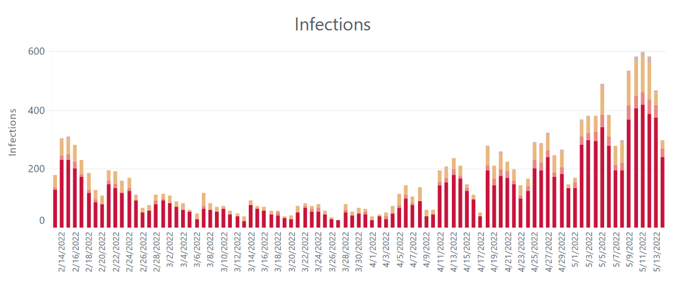
Reminder about masks
COVID-19 infections, Allegheny County, last three months
CMU relaxes mask requirements
The pandemic is not over
I think it would be a really good idea if we all continued to wear masks in this classroom

Slide 6
Today: Bits, Bytes, and Integers
Representing information as bits
Bit-level manipulations
Integers
  Representation: unsigned and signed; negation
  Conversion, casting
  Extension, truncation, shifting
  Addition, multiplication
Representations in memory, pointers, strings

Slide 7



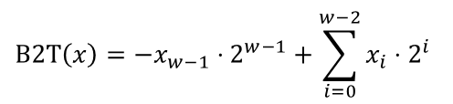
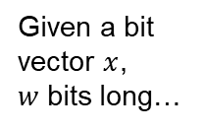
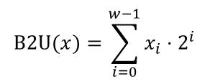
Encoding “Integers”
Unsigned
Signed (twos complement)
Given a bit
vector $x$,
$w$ bits long…
$$\text{B}\text{2}U(x)=\sum_{i=0}^{w−1}{x_{i}⋅2^{i}}$$
$$\text{B}\text{2}\text{T}\left(x\right)=−x_{w−1}⋅2^{w−1}+\sum_{i=0}^{w−2}{x_{i}⋅2^{i}}$$
Sign Bit
Examples (w = 5)
-16 | 8 | 4 | 2 | 1
0 | 1 | 0 | 1 | 0
$$0+8+0+2+0=$$
10
16 | 8 | 4 | 2 | 1
1 | 0 | 1 | 1 | 0
-16 | 8 | 4 | 2 | 1
$$16+8+0+2+0=$$
26
$$−16+8+0+2+0=$$
−10

Slide 8
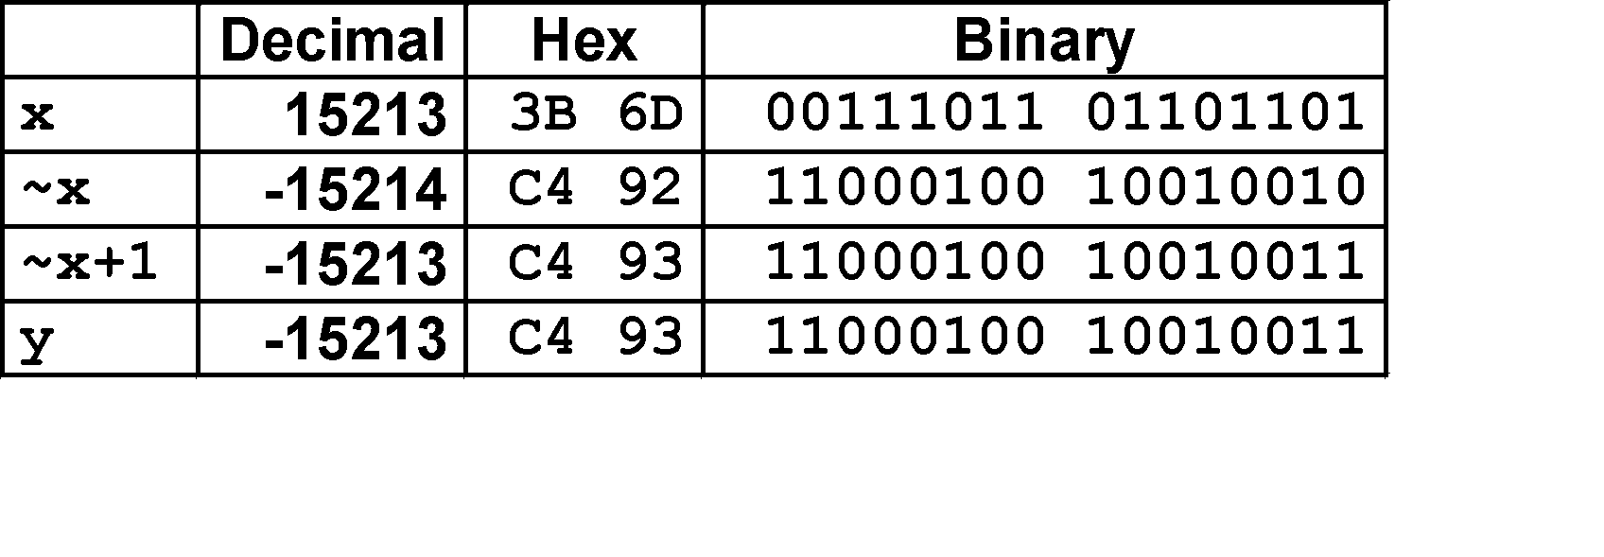
Negation: Complement & Increment
Negate through complement and increase
~x + 1 == -x
Why?
  -x + x == 0 (by definition)
  ~x + x == 1111…111 == -1
  ~x + x + 1 == 0
  (~x+1) + x == 0
  ~x+1 == -x
x
1
0
0
1
1
1
0
1
+
~x
0
1
1
0
0
0
1
0
−1
1
1
1
1
1
1
1
1
Example: x = 15213

Slide 9
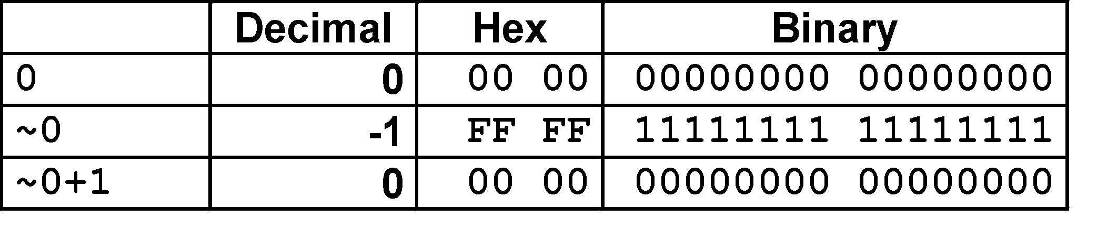
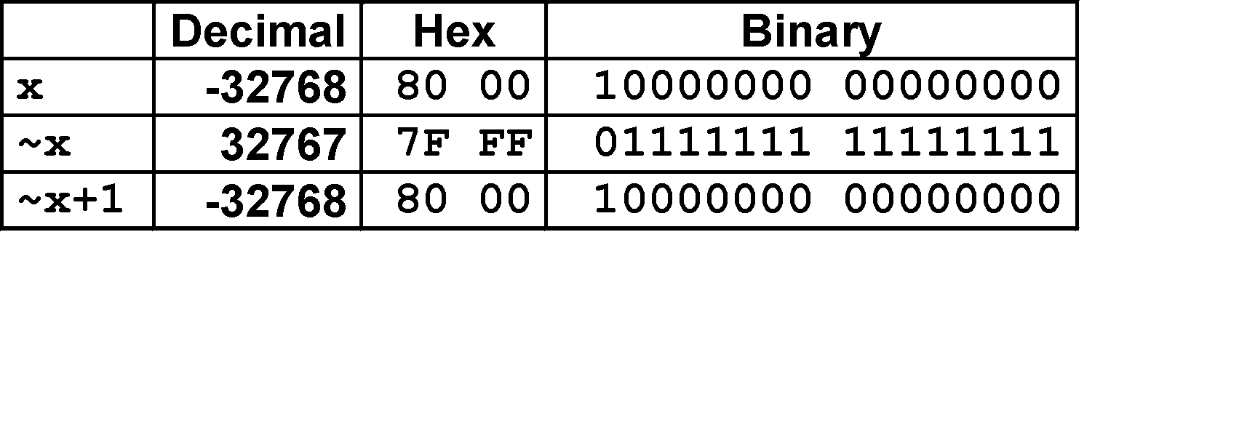
Complement & Increment Examples
x = 0
x = TMin
Oops!
It’s still negative!

Slide 10
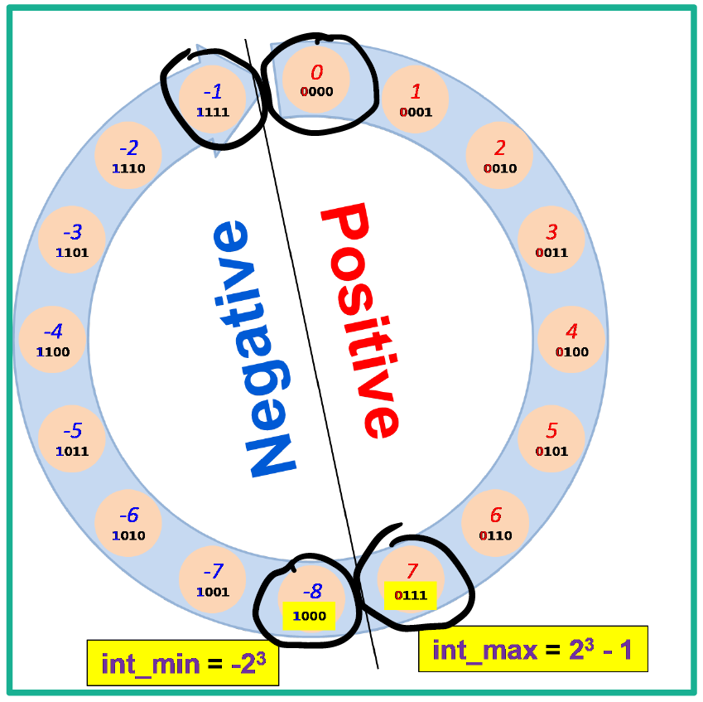
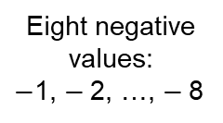
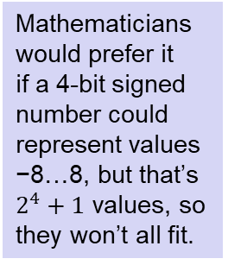
Eight negative values:
$−$1, $−$2, …, $−$8
Eight non-negative values:
0, 1, …, 7
Mathematicians would prefer it
if a 4-bit signed number could represent values −8…8, but that’s $2^{4}+1$ values, so they won’t all fit.
What if we made a 4-bit signed number only represent values −7…7? Then we wouldn’t be using bit pattern 1000…

Slide 11
Activity: https://www.cs.cmu.edu/afs/cs/academic/class/15213-m22/www/activities/213_lecture3.pdf
Do “model 0” and “model −1”, then stop.

Slide 12
Today: Bits, Bytes, and Integers
Representing information as bits
Bit-level manipulations
Integers
  Representation: unsigned and signed; negation
  Conversion, casting
  Extension, truncation, shifting
  Addition, multiplication
Representations in memory, pointers, strings

Slide 13
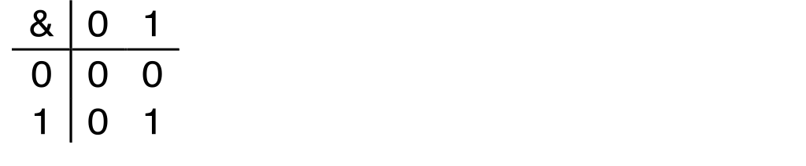
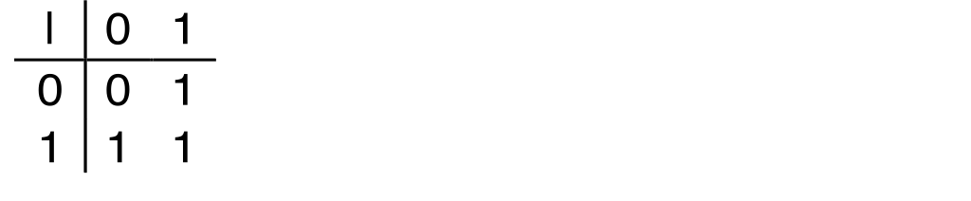
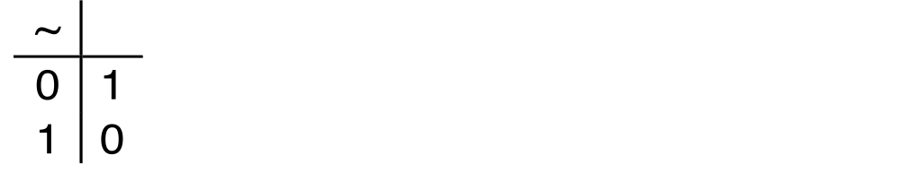
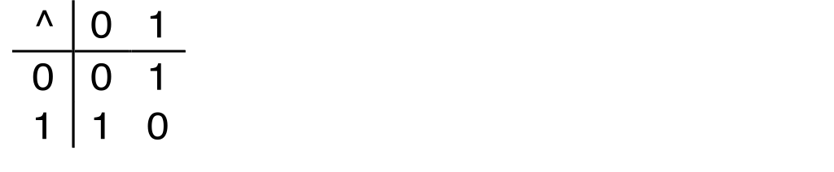
Boolean Algebra
Developed by George Boole in 19th Century
  Algebraic representation of logic
    Encode “True” as 1 and “False” as 0
And
A&B = 1 when both A=1 and B=1
Or
A|B = 1 when either A=1 or B=1
Not
~A = 1 when A=0
Exclusive-Or (Xor)
A^B = 1 when either A=1 or B=1, but not both

Slide 14
General Boolean Algebras
Operate on Bit Vectors
  Operations applied bitwise
All of the Properties of Boolean Algebra Apply
01101001
& 01010101
01000001
01101001
| 01010101
01111101
01101001
^ 01010101
00111100
~ 01010101
10101010
01000001
01111101
00111100
10101010

Slide 15
Example: Representing & Manipulating Sets
Representation
  Width w bit vector represents subsets of {0, …, w–1}
  a_{j} = 1 if j ∈ A
    01101001 { 0, 3, 5, 6 }
    76543210
    01010101 { 0, 2, 4, 6 }
    76543210
Operations
  & Intersection 01000001 { 0, 6 }
  | Union 01111101 { 0, 2, 3, 4, 5, 6 }
  ^ Symmetric difference 00111100 { 2, 3, 4, 5 }
  ~ Complement 10101010 { 1, 3, 5, 7 }

Slide 16
Bit-Level Operations in C
Decimal
Hex
Binary
Operations &, |, ~, ^ Available in C
  Apply to any “integral” data type
    long, int, short, char, unsigned
  View arguments as bit vectors
  Arguments applied bit-wise
Examples (Char data type)
  ~0x41 → 0xBE
    ~01000001₂ → 10111110₂
  ~0x00 → 0xFF
    ~00000000₂ → 11111111₂
  0x69 & 0x55 → 0x41
    01101001₂ & 01010101₂ → 01000001₂
  0x69 | 0x55 → 0x7D
    01101001₂ | 01010101₂ → 01111101₂
0
0
0000
1
1
0001
2
2
0010
3
3
0011
4
4
0100
5
5
0101
6
6
0110
7
7
0111
8
8
1000
9
9
1001
A
10
1010
B
11
1011
C
12
1100
D
13
1101
E
14
1110
F
15
1111

Slide 17
Bit-Level Operations in C
Decimal
Hex
Binary
Operations &, |, ~, ^ Available in C
  Apply to any “integral” data type
    long, int, short, char, unsigned
  View arguments as bit vectors
  Arguments applied bit-wise
Examples (Char data type)
  ~0x41 → 0xBE
    ~01000001₂ → 10111110₂
  ~0x00 → 0xFF
    ~00000000₂ → 11111111₂
  0x69 & 0x55 → 0x41
    01101001₂ & 01010101₂ → 01000001₂
  0x69 | 0x55 → 0x7D
    01101001₂ | 01010101₂ → 01111101₂
Operations &, |, ~, ^ Available in C
  Apply to any “integral” data type
    long, int, short, char, unsigned
  View arguments as bit vectors
  Arguments applied bit-wise
Examples (Char data type)
  ~0x41 → 0xBE
    ~0100 0001₂ → 1011 1110₂
  ~0x00 → 0xFF
    ~0000 0000₂ → 1111 1111₂
  0x69 & 0x55 → 0x41
    0110 1001₂ & 0101 0101₂ → 0100 0001₂
  0x69 | 0x55 → 0x7D
    0110 1001₂ | 0101 0101₂ → 0111 1101₂
0
0
0000
1
1
0001
2
2
0010
3
3
0011
4
4
0100
5
5
0101
6
6
0110
7
7
0111
8
8
1000
9
9
1001
A
10
1010
B
11
1011
C
12
1100
D
13
1101
E
14
1110
F
15
1111

Slide 18
Contrast: Logic Operations in C
Contrast to Bit-Level Operators
  Logic Operations: &&, ||, !
    View 0 as “False”
    Anything nonzero as “True”
    Always return 0 or 1
    Early termination
Examples (char data type)
  !0x41 → 0x00
  !0x00 → 0x01
  !!0x41→ 0x01
  0x69 && 0x55 → 0x01
  0x69 || 0x55 → 0x01
  p && *p (avoids null pointer access)
Watch out for && vs. & (and || vs. |)…
one of the more common oopsies in
C programming

Slide 19
Activity: https://www.cs.cmu.edu/afs/cs/academic/class/15213-m22/www/activities/213_lecture3.pdf
Do “model 1” and “model 2”, then stop.

Slide 20
Today: Bits, Bytes, and Integers
Representing information as bits
Bit-level manipulations
Integers
  Representation: unsigned and signed; negation
  Conversion, casting
  Extension, truncation, shifting
  Addition, multiplication
Representations in memory, pointers, strings

Slide 21
Mapping Between Signed & Unsigned
Two’s Complement
Unsigned
T2U
s
T2B
B2U
u
X
Maintain Same Bit Pattern
Unsigned
U2T
Two’s Complement
u
U2B
B2T
s
X
Maintain Same Bit Pattern
Mappings between unsigned and two’s complement numbers:
Keep bit representations and reinterpret

Slide 22
Relation between Signed & Unsigned
Unsigned
U2T
Two’s Complement
u
U2B
B2T
s
X
Maintain Same Bit Pattern
w–1
0
u
+
+
+
• • •
+
+
+
s
-
+
+
• • •
+
+
+
Large positive weight
becomes
Large negative weight

Slide 23

Mapping Signed ↔ Unsigned
Bits
0000
0001
0010
0011
0100
0101
0110
0111
1000
1001
1010
1011
1100
1101
1110
1111
Signed
0
1
2
3
4
5
6
7
-8
-7
-6
-5
-4
-3
-2
-1
Unsigned
0
1
2
3
4
5
6
7
8
9
10
11
12
13
14
15
=
$$±16$$

Slide 24
Conversion Visualized
2’s Comp. → Unsigned
  Ordering Inversion
  Negative → Big Positive
UMax
UMax – 1
TMax + 1
Unsigned
Range
TMax
TMax
2’s Complement Range
0
0
–1
–2
TMin

Slide 25
Signed vs. Unsigned in C
Constants
  By default are considered to be signed integers
  Unsigned if have “U” as suffix
    0U, 4294967259U
Casting
  Explicit casting between signed & unsigned same as U2T and T2U
    int tx, ty;
    unsigned ux, uy;
    tx = (int) ux;
    uy = (unsigned) ty;
  Implicit casting also occurs via assignments and procedure calls
    tx = ux; int fun(unsigned u);
    uy = ty; uy = fun(tx);

Slide 26
Casting Surprises
Expression Evaluation
  If there is a mix of unsigned and signed in single expression,
  signed values implicitly cast to unsigned
  Including comparison operations <, >, ==, <=, >=
  Examples:
Constant 1 | Constant 2 | Relation | Evaluation
0 | 0U | == | Unsigned
-1 | 0 | < | Signed
-1 | 0U | > | Unsigned
INT_MAX | INT_MIN | > | Signed
(unsigned)INT_MAX | INT_MIN | < | Unsigned
-1 | -2 | > | Signed
(unsigned)-1 | -2 | > | Unsigned
INT_MAX | ((unsigned)INT_MAX) + 1 | < | Unsigned
INT_MAX | (int)(((unsigned)INT_MAX) + 1) | > | Signed

Slide 27
Summary
Casting Signed ↔ Unsigned: Basic Rules
Bit pattern is maintained
But reinterpreted
Can have unexpected effects: adding or subtracting 2^{w}
Expression containing signed and unsigned int
  int is cast to unsigned!!

Slide 28
Today: Bits, Bytes, and Integers
Representing information as bits
Bit-level manipulations
Integers
  Representation: unsigned and signed; negation
  Conversion, casting
  Extension, truncation, shifting
  Addition, multiplication
Representations in memory, pointers, strings

Slide 29
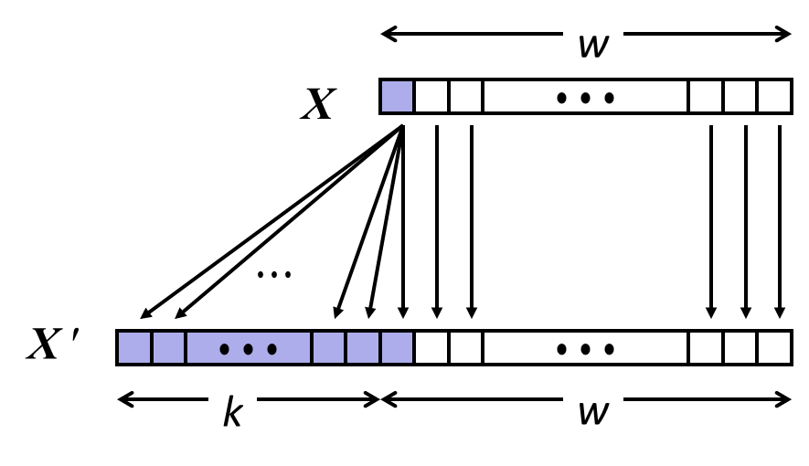
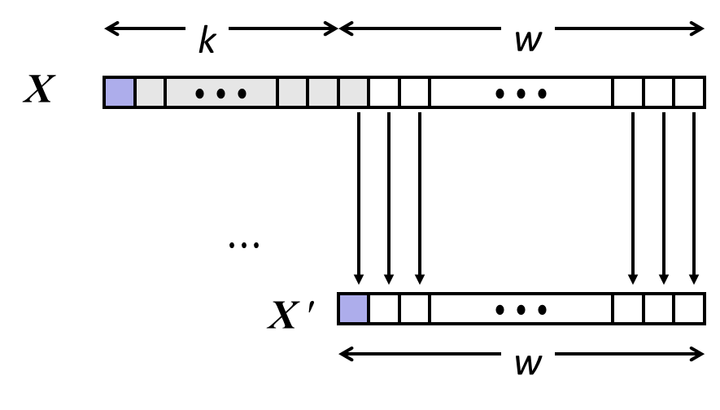
Sign Extension and Truncation
Sign Extension
Truncation
Make k copies of sign bit
Chop off k highest bits

Slide 30
Sign Extension: Simple Example
Positive number
Negative number
-16 | 8 | 4 | 2 | 1
0 | 1 | 0 | 1 | 0
-16 | 8 | 4 | 2 | 1
1 | 0 | 1 | 1 | 0
10 =
-10 =
-32 | 16 | 8 | 4 | 2 | 1
0 | 0 | 1 | 0 | 1 | 0
-32 | 16 | 8 | 4 | 2 | 1
1 | 1 | 0 | 1 | 1 | 0
10 =
-10 =

Slide 31
Truncation: Simple Example
No sign change
Sign change
-16 | 8 | 4 | 2 | 1
0 | 0 | 0 | 1 | 0
-16 | 8 | 4 | 2 | 1
0 | 1 | 0 | 1 | 0
2 =
10 =
 | -8 | 4 | 2 | 1
 | 0 | 0 | 1 | 0
 | -8 | 4 | 2 | 1
 | 1 | 0 | 1 | 0
2 =
-6 =
2 mod 16 = 2
10 mod 16 = 10U mod 16 = 10U = -6
-16 | 8 | 4 | 2 | 1
1 | 1 | 0 | 1 | 0
-16 | 8 | 4 | 2 | 1
1 | 0 | 1 | 1 | 0
-6 =
-10 =
 | -8 | 4 | 2 | 1
 | 1 | 0 | 1 | 0
 | -8 | 4 | 2 | 1
 | 0 | 1 | 1 | 0
-6 =
6 =
-6 mod 16 = 26U mod 16 = 10U = -6
-10 mod 16 = 22U mod 16 = 6U = 6

Slide 32
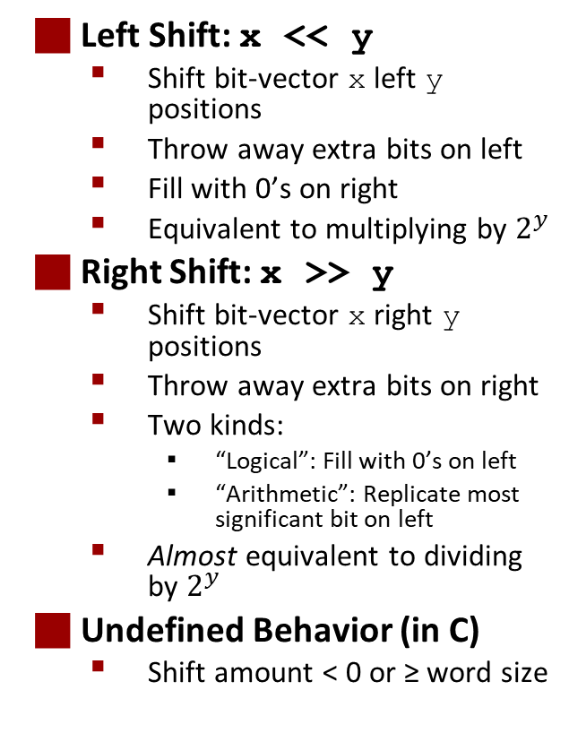
Shifting
Left Shift: x << y
  Shift bit-vector x left y positions
  Throw away extra bits on left
  Fill with 0’s on right
  Equivalent to multiplying by $2^{y}$
Right Shift: x >> y
  Shift bit-vector x right y positions
  Throw away extra bits on right
  Two kinds:
    “Logical”: Fill with 0’s on left
    “Arithmetic”: Replicate most significant bit on left
  Almost equivalent to dividing by $2^{y}$
Undefined Behavior (in C)
  Shift amount < 0 or ≥ word size
Argument x | 01100010
<< 3 | 00010000
Logical >> 2 | 00011000
Arithmetic >> 2 | 00011000
Argument x | 10100010
<< 3 | 00010000
Logical >> 2 | 00101000
Arithmetic >> 2 | 11101000

Slide 33
Today: Bits, Bytes, and Integers
Representing information as bits
Bit-level manipulations
Integers
  Representation: unsigned and signed; negation
  Conversion, casting
  Extension, truncation, shifting
  Addition, multiplication
Representations in memory, pointers, strings

Slide 34
Unsigned Addition
u
Operands: w bits
• • •
+
v
• • •
True Sum: w+1 bits
u + v
• • •
Discard Carry: w bits
UAdd_{w}(u , v)
• • •
Decimal
Hex
Binary
Standard Addition Function
  Ignores carry output
Implements Modular Arithmetic
  s = UAdd_{w}(u , v) = u + v mod 2^{w}
0
0
0000
1
1
0001
2
2
0010
3
3
0011
4
4
0100
5
5
0101
6
6
0110
7
7
0111
unsigned char
1110 1001
+ 1101 0101
E9
+ D5
233
+ 213
8
8
1000
9
9
1001
A
10
1010
B
11
1011
C
12
1100
D
13
1101
E
14
1110
F
15
1111

Slide 35
Unsigned Addition
u
Operands: w bits
• • •
+
v
• • •
True Sum: w+1 bits
u + v
• • •
Discard Carry: w bits
UAdd_{w}(u , v)
• • •
Decimal
Hex
Binary
Standard Addition Function
  Ignores carry output
Implements Modular Arithmetic
  s = UAdd_{w}(u , v) = u + v mod 2^{w}
0
0
0000
1
1
0001
2
2
0010
3
3
0011
4
4
0100
5
5
0101
6
6
0110
7
7
0111
unsigned char
1110 1001
+ 1101 0101
E9
+ D5
233
+ 213
8
8
1000
9
9
1001
A
10
1010
1 1011 1110
1BE
446
B
11
1011
C
12
1100
1011 1110
BE
190
D
13
1101
E
14
1110
F
15
1111

Slide 36
Visualizing (Mathematical) Integer Addition
Integer Addition
  4-bit integers u, v
  Compute true sum Add₄(u , v)
  Values increase linearly with u and v
  Forms planar surface
Add₄(u , v)
v
u

Slide 37
Visualizing Unsigned Addition
Wraps Around
  If true sum ≥ 2^{w}
  At most once
Overflow
UAdd₄(u , v)
True Sum
2^{w+1}
Overflow
2^{w}
v
0
Modular Sum
u

Slide 38
Two’s Complement Addition
Operands: w bits
u
• • •
+
v
• • •
True Sum: w+1 bits
u + v
• • •
Discard Carry: w bits
TAdd_{w}(u , v)
• • •
TAdd and UAdd have Identical Bit-Level Behavior
  Signed vs. unsigned addition in C:
  int s, t, u, v;
  s = (int) ((unsigned) u + (unsigned) v);
  t = u + v
  Will give s == t
1110 1001
+ 1101 0101
E9
+ D5
-23
+ -43
1 1011 1110
1BE
-66
1011 1110
BE
-66

Slide 39
Visualizing 2’s Complement Addition
NegOver
Values
  4-bit two’s comp.
  Range from -8 to +7
Wraps Around
  If sum ≥ 2^{w–1}
    Becomes negative
    At most once
  If sum < –2^{w–1}
    Becomes positive
    At most once
TAdd₄(u , v)
v
u
PosOver

Slide 40
TAdd Overflow
Functionality
  True sum requires w+1 bits
  Drop off MSB
  Treat remaining bits as 2’s comp. integer
True Sum
0 111…1
2^{w}–1
PosOver
TAdd Result
0 100…0
2^{w –1}–1
011…1
0 000…0
0
000…0
1 011…1
–2^{w –1}
100…0
1 000…0
–2^{w}
NegOver

Slide 41
Multiplication
Goal: Computing Product of w-bit numbers x, y
  Either signed or unsigned
But, exact results can be bigger than w bits
  Unsigned: up to 2w bits
    Result range: 0 ≤ x * y ≤ (2^{w} – 1) ² = 2^{2w} – 2^{w+1} + 1
  Two’s complement min (negative): Up to 2w-1 bits
    Result range: x * y ≥ (–2^{w–1})*(2^{w–1}–1) = –2^{2w–2} + 2^{w–1}
  Two’s complement max (positive): Up to 2w bits, but only for (TMin_{w})²
    Result range: x * y ≤ (–2^{w–1}) ² = 2^{2w–2}
So, maintaining exact results…
  would need to keep expanding word size with each product computed
  is done in software, if needed
    e.g., by “arbitrary precision” arithmetic packages

Slide 42
Unsigned Multiplication in C
u
• • •
Operands: w bits
*
v
• • •
True Product: 2*w bits
u · v
• • •
• • •
UMult_{w}(u , v)
Discard w bits: w bits
• • •
Standard Multiplication Function
  Ignores high order w bits
Implements Modular Arithmetic
  UMult_{w}(u , v) = u · v mod 2^{w}
1110 1001
* 1101 0101
E9
* D5
233
* 213
1100 0001 1101 1101
C1DD
49629
1101 1101
DD
221

Slide 43
Signed Multiplication in C
u
• • •
Operands: w bits
*
v
• • •
True Product: 2*w bits
u · v
• • •
• • •
TMult_{w}(u , v)
Discard w bits: w bits
• • •
Standard Multiplication Function
  Ignores high order w bits
  Some of which are different for signed vs. unsigned multiplication
  Lower bits are the same
1110 1001
* 1101 0101
E9
* D5
-23
* -43
0000 0011 1101 1101
03DD
989
1101 1101
DD
-35

Slide 44
Power-of-2 Multiply with Shift
Operation
  u << k gives u * 2^{k}
  Both signed and unsigned
Examples
  u << 3 == u * 8
  (u << 5) – (u << 3) == u * 24
  Most machines shift and add faster than multiply
    Compiler generates this code automatically
k
u
• • •
Operands: w bits
*
2^{k}
0
•••
0
1
0
•••
0
0
True Product: w+k bits
u · 2^{k}
• • •
0
•••
0
0
Discard k bits: w bits
UMult_{w}(u , 2^{k})
•••
0
•••
0
0
TMult_{w}(u , 2^{k})

Slide 45
Activity: https://www.cs.cmu.edu/afs/cs/academic/class/15213-m22/www/activities/213_lecture3.pdf
Do “model 3”, then stop.

Slide 46
Today: Bits, Bytes, and Integers
Representing information as bits
Bit-level manipulations
Integers
  Representation: unsigned and signed; negation
  Conversion, casting
  Extension, truncation, shifting
  Addition, multiplication
Representations in memory, pointers, strings

Slide 47
Byte-Oriented Memory Organization
00•••0
FF•••F
• • •
Programs refer to data by address
  Imagine all of RAM as an enormous array of bytes
  An address is an index into that array
    A pointer variable stores an address
System provides a private address space to each “process”
  A process is an instance of a program, being executed
  An address space is one of those enormous arrays of bytes
  Each program can see only its own code and data within its enormous array
  We’ll come back to this later (“virtual memory” classes)

Slide 48
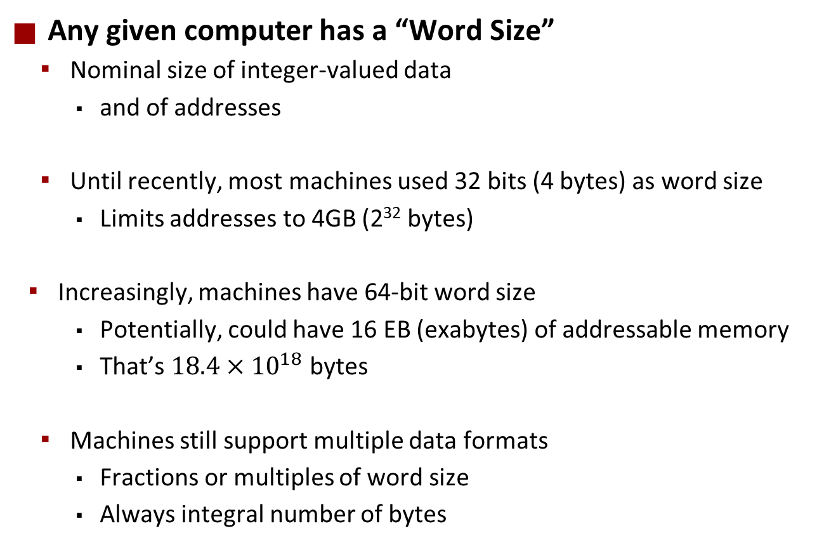
Machine Words
Any given computer has a “Word Size”
  Nominal size of integer-valued data
    and of addresses
  Until recently, most machines used 32 bits (4 bytes) as word size
    Limits addresses to 4GB (2³² bytes)
  Increasingly, machines have 64-bit word size
    Potentially, could have 16 EB (exabytes) of addressable memory
    That’s $18.4×{10}^{18}$ bytes
  Machines still support multiple data formats
    Fractions or multiples of word size
    Always integral number of bytes
Yes, both of these numbers are correct.
This discrepancy is known as the Great Storage Industry Marketing Lie. Ask me about it after class if you really want to know.

Slide 49
Addresses Always Specify Byte Locations
32-bit
Words
64-bit
Words
Bytes
Addr.
Address of a word is address of the first byte in the word
Addresses of successive words differ by 4 (32-bit) or 8 (64-bit)
0000
Addr
=
??
0001
0000
0002
Addr
=
??
0003
0000
0004
Addr
=
??
0005
0004
0006
0007
0008
Addr
=
??
0009
0008
0010
Addr
=
??
0011
0008
0012
Addr
=
??
0013
0012
0014
0015

Slide 50
Example Data Representations
C Data Type | Typical 32-bit | Typical 64-bit | x86-64
char | 1 | 1 | 1
short | 2 | 2 | 2
int | 4 | 4 | 4
long | 4 | 8 | 8
float | 4 | 4 | 4
double | 8 | 8 | 8
pointer | 4 | 8 | 8

Slide 51
Byte Ordering
So, how are the bytes within a multi-byte word ordered in memory?
Conventions
  Big Endian: Sun, PPC Mac, network packet headers
    Least significant byte has highest address
  Little Endian: x86, ARM processors running Android, iOS, and Windows
    Least significant byte has lowest address

Slide 52
Byte Ordering Example
Example
  Variable x has 4-byte value of 0x01234567
  Address given by &x is 0x100
Big Endian
0x100
0x101
0x102
0x103
01
01
23
23
45
45
67
67
Little Endian
0x100
0x101
0x102
0x103
67
67
45
45
23
23
01
01

Slide 53
Representing Integers
Decimal: 15213
Binary: 0011 1011 0110 1101
Hex: 3 B 6 D
int A = 15213;
long int C = 15213;
IA32, x86-64
Sun
IA32
x86-64
Sun
6D
00
Increasing addresses
3B
00
6D
6D
00
00
3B
3B
3B
00
00
6D
00
00
3B
00
00
6D
00
int B = -15213;
00
IA32, x86-64
Sun
00
00
93
FF
C4
FF
FF
C4
FF
93
Two’s complement representation

Slide 54
Examining Data Representations
Code to Print Byte Representation of Data
  Casting pointer to unsigned char * allows treatment as a byte array
typedef unsigned char *pointer;
void show_bytes(pointer start, size_t len){
size_t i;
for (i = 0; i < len; i++)
printf(”%p\t0x%.2x\n",start+i, start[i]);
printf("\n");
}
Printf directives:
%p: Print pointer
%x: Print Hexadecimal

Slide 55
show_bytes Execution Example
int a = 15213;
printf("int a = 15213;\n");
show_bytes((pointer) &a, sizeof(int));
Result (Linux x86-64):
int a = 15213;
0x7fffb7f71dbc 6d
0x7fffb7f71dbd 3b
0x7fffb7f71dbe 00
0x7fffb7f71dbf 00

Slide 56
Representing Pointers
int B = -15213;
int *P = &B;
Sun
IA32
x86-64
EF
FF
FB
2C
AC
28
F5
FF
3C
1B
FE
82
FD
7F
00
00
Different compilers & machines assign different locations to objects
Even get different results each time run program

Slide 57
Representing Strings
char S[6] = "18213";
Strings in C
  Represented by array of characters
  Each character encoded in ASCII format
    Standard 7-bit encoding of character set
    Character “0” has code 0x30
      Digit i has code 0x30+i
  String should be null-terminated
    Final character = 0
Compatibility
  Byte ordering not an issue
IA32
Sun
31
38
32
31
33
00
31
38
32
31
33
00

Slide 58
A note about x86 machine code
x86 machine code is a sequence of bytes
  Grouped into variable-length instructions, which look like strings…
  But they contain embedded little-endian numbers…
Example Fragment
Deciphering Numbers
  Value: 0x12ab
  Pad to 32 bits: 0x000012ab
  Split into bytes: 00 00 12 ab
  Reverse: ab 12 00 00
Address Instruction Code Assembly Rendition
8048365: 5b pop %ebx
8048366: 81 c3 ab 12 00 00 add $0x12ab,%ebx
804836c: 83 bb 28 00 00 00 00 cmpl $0x0,0x28(%ebx)

