Slide 1
Machine-Level Programming I: Basics 15-213/18-213: Introduction to Computer Systems 5th Lecture, May 25, 2022
Instructor:
Kyle Liang

Slide 2
Announcements
Lab 2 (bomb lab) will be available via Autolab on May 27
Due Friday June 3
Lab 1 is due Friday June 3 (handin via Autolab)
Written Assignment 1 is due Wednesday June 1
GDB bootcamp will be this Friday, May 27
Exceptionally useful for labs–you’ll really want it for Lab 2.

Slide 3
Today: Machine Programming I: Basics
History of Intel processors and architectures
Assembly Basics: Registers, operands, move
Arithmetic & logical operations
C, assembly, machine code

Slide 4
Intel x86 Processors
Dominate laptop/desktop/server market
ARM architecture is a promising newcomer
Evolutionary design
Backwards compatible up until 8086, introduced in 1978
Added more features as time goes on
Now 3 volumes, about 5,000 pages of documentation
Complex instruction set computer (CISC)
Many different instructions with many different formats
But, only small subset encountered with Linux programs
Hard to match performance of Reduced Instruction Set Computers (RISC)
But, Intel has done just that!
In terms of speed. Less so for low power.

Slide 5
Intel x86 Evolution: Milestones
Name Date Transistors MHz
8086 1978 29K 5-10
First 16-bit Intel processor. Basis for IBM PC & DOS
1MB address space
386 1985 275K 16-33
First 32 bit Intel processor , referred to as IA32
Added “flat addressing”, capable of running Unix
Pentium 4E 2004 125M 2800-3800
First 64-bit Intel x86 processor, referred to as x86-64
Core 2 2006 291M 1060-3333
First multi-core Intel processor
Core i7 2008 731M 1600-4400
Four cores (our shark machines)

Slide 6
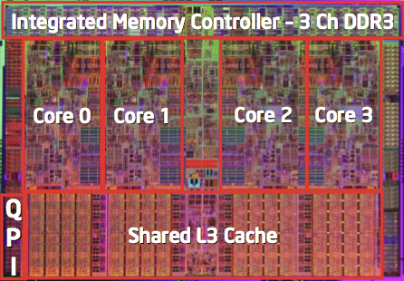
Intel x86 Processors, cont.
Machine Evolution
386 1985 0.3M
Pentium 1993 3.1M
Pentium/MMX 1997 4.5M
PentiumPro 1995 6.5M
Pentium III 1999 8.2M
Pentium 4 2000 42M
Core 2 Duo 2006 291M
Core i7 2008 731M
Core i7 Skylake 2015 1.9B
Added Features
Instructions to support multimedia operations
Instructions to enable more efficient conditional operations
Transition from 32 bits to 64 bits
More cores

Slide 7
Intel x86 Processors, cont.
Past Generations
1st Pentium Pro 1995 600 nm
1st Pentium III 1999 250 nm
1st Pentium 4 2000 180 nm
1st Core 2 Duo 2006 65 nm
Recent & Upcoming Generations
Nehalem 2008 45 nm
Sandy Bridge 2011 32 nm
Ivy Bridge 2012 22 nm
Haswell 2013 22 nm
Broadwell 2014 14 nm
Skylake 2015 14 nm
Kaby Lake 2016 14 nm
Coffee Lake 2017 14 nm
Cannon Lake 2018 10 nm
Ice Lake 2019 10 nm
Tiger Lake 2020 10 nm
Alder Lake 2022 “intel 7” (10nm+++)
Process technology
Process technology dimension = width of narrowest wires
(10 nm ≈ 100 atoms wide)
(But this is changing now.)

Slide 8
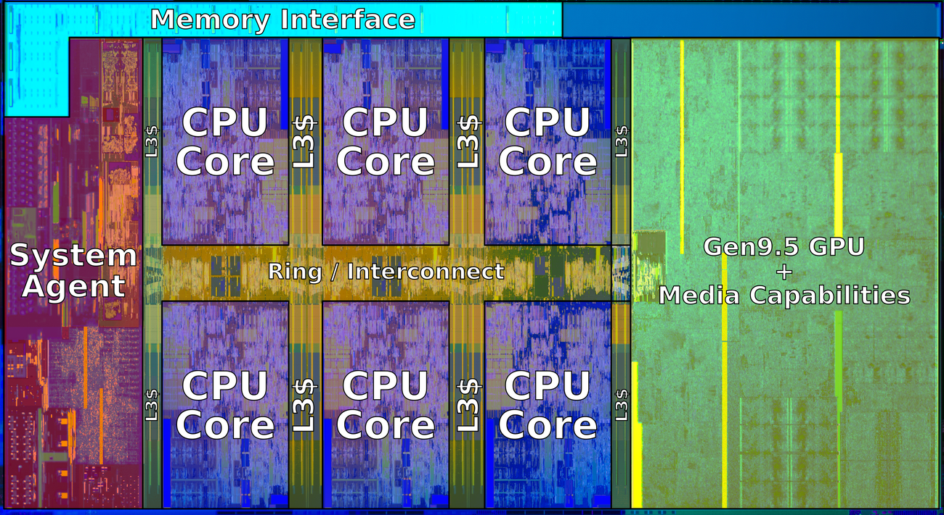
2018 State of the Art: Coffee Lake
Mobile Model: Core i7
2.2-3.2 GHz
45 W
Server Model: Xeon E
Integrated graphics
Multi-socket enabled
3.3-3.8 GHz
80-95 W
Desktop Model: Core i7
Integrated graphics
2.4-4.0 GHz
35-95 W

Slide 9
x86 Clones: Advanced Micro Devices (AMD)
Historically
AMD has followed just behind Intel
A little bit slower, a lot cheaper
Then
Recruited top circuit designers from Digital Equipment Corp. and other downward trending companies
Built Opteron: tough competitor to Pentium 4
Developed x86-64, their own extension to 64 bits
Recent Years
Intel got its act together
1995-2011: Lead semiconductor “fab” in world
2018: #2 largest by $$ (#1 is Samsung)
2019: reclaimed #1
AMD fell behind: Spun off GlobalFoundaries
2019-20: Pulled ahead! Used TSMC for part of fab
2022: Intel re-took the lead

Slide 10
Intel’s 64-Bit History
2001: Intel Attempts Radical Shift from IA32 to IA64
Totally different architecture (Itanium)
Executes IA32 code only as legacy
Performance disappointing
2003: AMD Steps in with Evolutionary Solution
x86-64 (now called “AMD64”)
Intel Felt Obligated to Focus on IA64
Hard to admit mistake or that AMD is better
2004: Intel Announces EM64T extension to IA32
Extended Memory 64-bit Technology
Almost identical to x86-64!
All but low-end x86 processors support x86-64
But, lots of code still runs in 32-bit mode

Slide 11
Our Coverage
IA32
The traditional x86
For 15/18-213: RIP, Summer 2015
x86-64
The standard
shark> gcc hello.c
shark> gcc –m64 hello.c
Presentation
Book covers x86-64
Web aside on IA32
We will only cover x86-64

Slide 12
Today: Machine Programming I: Basics
History of Intel processors and architectures
Assembly Basics: Registers, operands, move
Arithmetic & logical operations
C, assembly, machine code

Slide 13
How Does a Computer Understand Code?
Short answer: Bits!
Not the complete picture, let’s take it bit by bit

Slide 14
How Does a Person Understand English?
Let’s see how humans understand English
English uses an alphabet
A, B, C …
Examine a sentence:
Subject: (I) core noun of the sentence
Object: (15213) supporting noun
Verbs: (love) actions associating subject and object
I love 15213!

Slide 15
How Does a CPU Understand Code (cont)?
1 + 2
What’s the language of the CPU?
Basic building block is bits
A sentence in English is like a program
Subject and Object?
Data Types: Integers, Floats, …
Verb?
Arithmetic Operations: +, -, /, *, <<, >>, …
CPU: Take data, apply action, use result
Let’s encode: 1 + 2
(+, 1, 2)
Notes:
Ask students on verbs.

Slide 16
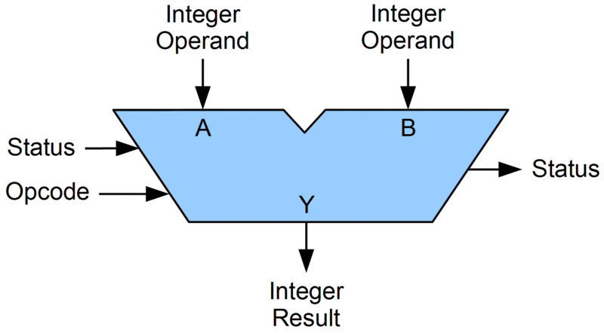
Generalize Our Encoding
1 + 2
1 + 2 -> (+, 1, 2)
3 + 4 -> (+, 3, 4)
Let’s make specialized hardware in our CPU for +, -, …
Separate operations from data
p = 1
q = 2
(+, p, q)
p
q
+

Slide 17
Generalize Our Data Pipeline
p
q
+
CPU needs to supply p, q to our arithmetic unit
CPU uses registers to store information for the ALU
(+, %p, %q)
But where do the registers get information?
From the program, and in memory
(Load, 0x1, %p)
(Load, &0x7FFFF7AFCBA0, %q)

Slide 18
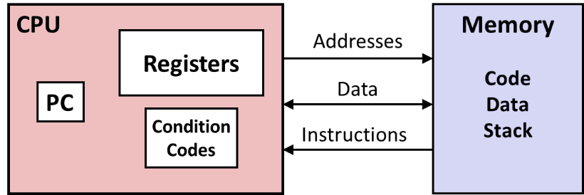
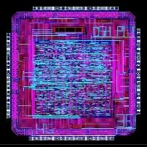
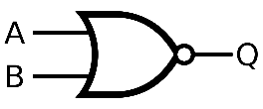
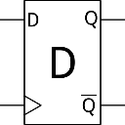
Levels of Abstraction
#include <stdio.h>
int main(){
int i, n = 10, t1 = 0, t2 = 1, nxt;
for (i = 1; i <= n; ++i){
printf("%d, ", t1);
nxt = t1 + t2;
t1 = t2;
t2 = nxt; }
return 0; }
C programmer
Assembly programmer
Computer Designer
Gates, clocks, circuit layout, …

Slide 19
Definitions
Architecture: (also ISA: instruction set architecture) The parts of a processor design that one needs to understand for writing assembly/machine code.
Examples: instruction set specification, registers
Microarchitecture: Implementation of the architecture
Examples: cache sizes and core frequency
Code Forms:
Machine Code: The byte-level programs that a processor executes
Assembly Code: A text representation of machine code
Example ISAs:
Intel: x86, IA32, Itanium, x86-64
ARM: Used in almost all mobile phones
RISC V: New open-source ISA

Slide 20
Assembly/Machine Code View
CPU
Memory
Registers
Addresses
Data
Code
Data
Stack
PC
Condition
Codes
Instructions
Programmer-Visible State
PC: Program counter
Address of next instruction
Called “RIP” (x86-64)
Register file
Heavily used program data
Condition codes
Store status information about most recent arithmetic or logical operation
Used for conditional branching
Memory
Byte addressable array
Code and user data
Stack to support procedures
Rest in
Instruction Pointer
Notes:
IP: instruction pointer

Slide 21
Assembly Characteristics: Data Types
“Integer” data of 1, 2, 4, or 8 bytes
Data values
Addresses (untyped pointers)
Floating point data of 4, 8, or 10 bytes
Code: Byte sequences encoding series of instructions
No aggregate types such as arrays or structures
Just contiguously allocated bytes in memory
Notes:
10 bytes: extended precision, allows better calculation of double-precision

Slide 22
Class Activity
Form teams of 2
One person should take notes / advise / etc
One person should ssh to a shark machine
wget http://www.cs.cmu.edu/~213/activities/lec5.tar
tar xf lec5.tar
cd lec5
./act1

Slide 23
x86-64 Integer Registers
%rax
%r8
%eax
%r8d
%rbx
%r9
%ebx
%r9d
%rcx
%r10
%ecx
%r10d
%rdx
%r11
%edx
%r11d
%rsi
%r12
%esi
%r12d
%rdi
%r13
%edi
%r13d
%rsp
%r14
%esp
%r14d
%rbp
%r15
%ebp
%r15d
Can reference low-order 4 bytes (also low-order 1 & 2 bytes)
Not part of memory (or cache)

Slide 24
Some History: IA32 Registers
Origin
(mostly obsolete)
%eax
%ax
%ah
%al
accumulate
%ecx
%cx
%ch
%cl
counter
%edx
%dx
%dh
%dl
data
general purpose
%ebx
%bx
%bh
%bl
base
%esi
source
index
%si
%edi
destination
index
%di
%esp
stack
pointer
%sp
%ebp
base
pointer
%bp
16-bit virtual registers
(backwards compatibility)

Slide 25
Assembly Characteristics: Operations
Transfer data between memory and register
Load data from memory into register
Store register data into memory
Perform arithmetic function on register or memory data
Transfer control
Unconditional jumps to/from procedures
Conditional branches
Indirect branches

Slide 26
Moving Data
%rax
%rcx
Moving Data
movq Source, Dest
Operand Types
Immediate: Constant integer data
Example: $0x400, $-533
Like C constant, but prefixed with ‘$’
Encoded with 1, 2, or 4 bytes
Register: One of 16 integer registers
Example: %rax, %r13
But %rsp reserved for special use
Others have special uses for particular instructions
Memory: 8 consecutive bytes of memory at address given by register
Simplest example: (%rax)
Various other “addressing modes”
%rdx
%rbx
%rsi
%rdi
%rsp
%rbp
%rN
Warning: Intel docs use mov Dest, Source

Slide 27
movq Operand Combinations
Source
Dest
Src,Dest
C Analog
Reg
movq $0x4,%rax
temp = 0x4;
Imm
Mem
movq $-147,(%rax)
*p = -147;
Reg
movq %rax,%rdx
temp2 = temp1;
movq
Reg
Mem
movq %rax,(%rdx)
*p = temp;
Mem
Reg
movq (%rax),%rdx
temp = *p;
Cannot do memory-memory transfer with a single instruction

Slide 28
Simple Memory Addressing Modes
Normal (R) Mem[Reg[R]]
Register R specifies memory address
Aha! Pointer dereferencing in C movq (%rcx),%rax
Displacement D(R) Mem[Reg[R]+D]
Register R specifies start of memory region
Constant displacement D specifies offset movq 8(%rbp),%rdx

Slide 29
Example of Simple Addressing Modes
void
whatAmI(<type> a, <type> b)
{
????
}
whatAmI:
movq (%rdi), %rax
movq (%rsi), %rdx
movq %rdx, (%rdi)
movq %rax, (%rsi)
ret
%rsi
%rdi

Slide 30
Example of Simple Addressing Modes
void swap
(long *xp, long *yp)
{
long t0 = *xp;
long t1 = *yp;
*xp = t1;
*yp = t0;
}
swap:
movq (%rdi), %rax
movq (%rsi), %rdx
movq %rdx, (%rdi)
movq %rax, (%rsi)
ret

Slide 31
Understanding Swap()
Memory
void swap
(long *xp, long *yp)
{
long t0 = *xp;
long t1 = *yp;
*xp = t1;
*yp = t0;
}
Registers
%rdi
%rsi
%rax
%rdx
Register Value
%rdi xp
%rsi yp
%rax t0
%rdx t1
swap:
movq (%rdi), %rax # t0 = *xp
movq (%rsi), %rdx # t1 = *yp
movq %rdx, (%rdi) # *xp = t1
movq %rax, (%rsi) # *yp = t0
ret

Slide 32
Understanding Swap()
Memory
Registers
Address
123
0x120
%rdi
0x120
0x118
%rsi
0x100
0x110
%rax
0x108
%rdx
456
0x100
swap:
movq (%rdi), %rax # t0 = *xp
movq (%rsi), %rdx # t1 = *yp
movq %rdx, (%rdi) # *xp = t1
movq %rax, (%rsi) # *yp = t0
ret

Slide 33
Understanding Swap()
Memory
Registers
Address
123
0x120
%rdi
0x120
0x118
%rsi
0x100
0x110
%rax
123
0x108
%rdx
456
0x100
swap:
movq (%rdi), %rax # t0 = *xp
movq (%rsi), %rdx # t1 = *yp
movq %rdx, (%rdi) # *xp = t1
movq %rax, (%rsi) # *yp = t0
ret

Slide 34
Understanding Swap()
Memory
Registers
Address
123
0x120
%rdi
0x120
0x118
%rsi
0x100
0x110
%rax
123
0x108
%rdx
456
456
0x100
swap:
movq (%rdi), %rax # t0 = *xp
movq (%rsi), %rdx # t1 = *yp
movq %rdx, (%rdi) # *xp = t1
movq %rax, (%rsi) # *yp = t0
ret

Slide 35
Understanding Swap()
Memory
Registers
Address
456
0x120
%rdi
0x120
0x118
%rsi
0x100
0x110
%rax
123
0x108
%rdx
456
456
0x100
swap:
movq (%rdi), %rax # t0 = *xp
movq (%rsi), %rdx # t1 = *yp
movq %rdx, (%rdi) # *xp = t1
movq %rax, (%rsi) # *yp = t0
ret

Slide 36
Understanding Swap()
Memory
Registers
Address
456
0x120
%rdi
0x120
0x118
%rsi
0x100
0x110
%rax
123
0x108
%rdx
456
123
0x100
swap:
movq (%rdi), %rax # t0 = *xp
movq (%rsi), %rdx # t1 = *yp
movq %rdx, (%rdi) # *xp = t1
movq %rax, (%rsi) # *yp = t0
ret

Slide 37
Simple Memory Addressing Modes
Normal (R) Mem[Reg[R]]
Register R specifies memory address
Aha! Pointer dereferencing in C movq (%rcx),%rax
Displacement D(R) Mem[Reg[R]+D]
Register R specifies start of memory region
Constant displacement D specifies offset movq 8(%rbp),%rdx

Slide 38
Complete Memory Addressing Modes
Most General Form
D(Rb,Ri,S) Mem[Reg[Rb]+S*Reg[Ri]+ D]
D: Constant “displacement” 1, 2, or 4 bytes
Rb: Base register: Any of 16 integer registers
Ri: Index register: Any, except for %rsp
S: Scale: 1, 2, 4, or 8 (why these numbers?)
Special Cases
(Rb,Ri) Mem[Reg[Rb]+Reg[Ri]]
D(Rb,Ri) Mem[Reg[Rb]+Reg[Ri]+D]
(Rb,Ri,S) Mem[Reg[Rb]+S*Reg[Ri]]
Notes:
Scale by byte, short, int, or long

Slide 39
Address Computation Examples
%rdx | 0xf000
%rcx | 0x0100
Expression | Address Computation | Address
0x8(%rdx)
(%rdx,%rcx)
(%rdx,%rcx,4)
0x80(,%rdx,2)
Expression | Address Computation | Address
0x8(%rdx) | 0xf000 + 0x8 | 0xf008
(%rdx,%rcx) | 0xf000 + 0x100 | 0xf100
(%rdx,%rcx,4) | 0xf000 + 4*0x100 | 0xf400
0x80(,%rdx,2) | 2*0xf000 + 0x80 | 0x1e080
Notes:
0xf000 + 0x8 = 0xf008
0xf000 + 0x0100 = 0xf100
0xf000 + 4*0x0100 = 0xf400
2*0xf000 + 0x80 = 0x1d080

Slide 40
Address Computation Examples
%rdx | 0xf000
%rcx | 0x0100
Expression | Address Computation | Address
0x8(%rdx)
(%rdx,%rcx)
(%rdx,%rcx,4)
0x80(,%rdx,2)
Expression | Address Computation | Address
0x8(%rdx) | 0xf000 + 0x8 | 0xf008
(%rdx,%rcx) | 0xf000 + 0x100 | 0xf100
(%rdx,%rcx,4) | 0xf000 + 4*0x100 | 0xf400
0x80(,%rdx,2) | 2*0xf000 + 0x80 | 0x1e080
Notes:
0xf000 + 0x8 = 0xf008
0xf000 + 0x0100 = 0xf100
0xf000 + 4*0x0100 = 0xf400
2*0xf000 + 0x80 = 0x1d080

Slide 41
Today: Machine Programming I: Basics
History of Intel processors and architectures
Assembly Basics: Registers, operands, move
Arithmetic & logical operations
C, assembly, machine code

Slide 42
Address Computation Instruction
leaq Src, Dst
Src is address mode expression
Set Dst to address denoted by expression
Uses
Computing addresses without a memory reference
E.g., translation of p = &x[i];
Computing arithmetic expressions of the form x + k*y
k = 1, 2, 4, or 8
Example
long m12(long x)
{
return x*12;
}
Converted to ASM by compiler:
leaq (%rdi,%rdi,2), %rax # t = x+2*x
salq $2, %rax # return t<<2

Slide 43
Some Arithmetic Operations
Two Operand Instructions:
Format Computation
addq Src,Dest Dest = Dest + Src
subq Src,Dest Dest = Dest − Src
imulq Src,Dest Dest = Dest * Src
salq Src,Dest Dest = Dest << Src Also called shlq
sarq Src,Dest Dest = Dest >> Src Arithmetic
shrq Src,Dest Dest = Dest >> Src Logical
xorq Src,Dest Dest = Dest ^ Src
andq Src,Dest Dest = Dest & Src
orq Src,Dest Dest = Dest | Src
Watch out for argument order! Src,Dest (Warning: Intel docs use “op Dest,Src”)
No distinction between signed and unsigned int (why?)

Slide 44
Some Arithmetic Operations
One Operand Instructions
incq Dest Dest = Dest + 1
decq Dest Dest = Dest − 1
negq Dest Dest = − Dest
notq Dest Dest = ~Dest
See book for more instructions

Slide 45
Arithmetic Expression Example
arith:
leaq (%rdi,%rsi), %rax
addq %rdx, %rax
leaq (%rsi,%rsi,2), %rdx
salq $4, %rdx
leaq 4(%rdi,%rdx), %rcx
imulq %rcx, %rax
ret
long arith
(long x, long y, long z)
{
long t1 = x+y;
long t2 = z+t1;
long t3 = x+4;
long t4 = y * 48;
long t5 = t3 + t4;
long rval = t2 * t5;
return rval;
}
Interesting Instructions
leaq: address computation
salq: shift
imulq: multiplication
But, only used once

Slide 46
Understanding Arithmetic Expression Example
arith:
leaq (%rdi,%rsi), %rax # t1
addq %rdx, %rax # t2
leaq (%rsi,%rsi,2), %rdx
salq $4, %rdx # t4
leaq 4(%rdi,%rdx), %rcx # t5
imulq %rcx, %rax # rval
ret
long arith
(long x, long y, long z)
{
long t1 = x+y;
long t2 = z+t1;
long t3 = x+4;
long t4 = y * 48;
long t5 = t3 + t4;
long rval = t2 * t5;
return rval;
}
Register | Use(s)
%rdi | Argument x
%rsi | Argument y
%rdx | Argument z, t4
%rax | t1, t2, rval
%rcx | t5

Slide 47
Recap: Floating Point
Background: Fractional binary numbers
IEEE floating point standard: Definition
Rounding, addition, multiplication
Example and properties
Floating point in C
Summary

Slide 48
Recap: Floating Point Representation
Example: 15213₁₀ = (-1)⁰ x 1.1101101101101₂ x 2¹³
Numerical Form: (–1)^{s} M 2E
Sign bit s determines whether number is negative or positive
Significand M normally a fractional value in range [1.0,2.0).
Exponent E weights value by power of two
Encoding
MSB s is sign bit s
exp field encodes E (but is not equal to E)
frac field encodes M (but is not equal to M)
s | exp | frac
Notes:
M stands for mantissa

Slide 49
Floating Point Operations: Basic Idea
x +_{f} y = Round(x + y)
x ×_{f} y = Round(x × y)
Basic idea
First compute exact result
Make it fit into desired precision
Possibly overflow if exponent too large
Possibly round to fit into frac

Slide 50
Rounding
Rounding Modes (illustrate with $ rounding)
$1.40 $1.60 $1.50 $2.50 –$1.50
Towards zero $1 $1 $1 $2 –$1
Round down (−∞) $1 $1 $1 $2 –$2
Round up (+∞) $2 $2 $2 $3 –$1
Nearest Even (default) $1 $2 $2 $2 –$2

Slide 51
Closer Look at Round-To-Even
Default Rounding Mode
Hard to get any other kind without dropping into assembly
C99 has support for rounding mode management
All others are statistically biased
Sum of set of positive numbers will consistently be over- or under- estimated
Applying to Other Decimal Places / Bit Positions
When exactly halfway between two possible values
Round so that least significant digit is even
E.g., round to nearest hundredth
7.8949999 7.89 (Less than half way)
7.8950001 7.90 (Greater than half way)
7.8950000 7.90 (Half way—round up)
7.8850000 7.88 (Half way—round down)

Slide 52
Rounding Binary Numbers
Binary Fractional Numbers
“Even” when least significant bit is 0
“Half way” when bits to right of rounding position = 100…₂
Examples
Round to nearest 1/4 (2 bits right of binary point)
Value Binary Rounded Action Rounded Value
2 3/32 10.00011₂ 10.00₂ (<1/2—down) 2
2 3/16 10.00110₂ 10.01₂ (>1/2—up) 2 1/4
2 7/8 10.11100₂ 11.00₂ ( 1/2—up) 3
2 5/8 10.10100₂ 10.10₂ ( 1/2—down) 2 1/2

Slide 53
FP Multiplication
(–1)^{s1} M1 2^{E1} x (–1)^{s2} M2 2^{E2}
Exact Result: (–1)^{s} M 2E
Sign s: s1 ^ s2
Significand M: M1 x M2
Exponent E: E1 + E2
Fixing
If M ≥ 2, shift M right, increment E
If E out of range, overflow
Round M to fit frac precision
Implementation
Biggest chore is multiplying significands
4 bit mantissa: 1.010*2² x 1.110*2³ = 10.0011*2⁵
= 1.00011*2⁶ = 1.001*2⁶

Slide 54
Floating Point Addition
(–1)^{s1} M1 2^{E1} + (-1)^{s2} M2 2^{E2}
Assume E1 > E2
Exact Result: (–1)^{s} M 2E
Sign s, significand M:
Result of signed align & add
Exponent E: E1
Fixing
If M ≥ 2, shift M right, increment E
if M < 1, shift M left k positions, decrement E by k
Overflow if E out of range
Round M to fit frac precision
Get binary points lined up
E1–E2
(–1)^{s1} M1
+
(–1)^{s2} M2
(–1)^{s} M
1.010*2² + 1.110*2³ = (1.010 + 11.100)*2²
= 100.110 * 2² = 1.0011 * 2⁴ = 1.010 * 2⁴

Slide 55
Mathematical Properties of FP Add
Compare to those of Abelian Group
Closed under addition?
But may generate infinity or NaN
Commutative?
Associative?
Overflow and inexactness of rounding
(3.14+1e10)-1e10 = 0, 3.14+(1e10-1e10) = 3.14
0 is additive identity?
Every element has additive inverse?
Yes, except for infinities & NaNs
Monotonicity
a ≥ b ⇒ a+c ≥ b+c?
Except for infinities & NaNs
Yes
Yes
No
Yes
Almost
Almost

Slide 56
Mathematical Properties of FP Mult
Compare to Commutative Ring
Closed under multiplication?
But may generate infinity or NaN
Multiplication Commutative?
Multiplication is Associative?
Possibility of overflow, inexactness of rounding
Ex: (1e20*1e20)*1e-20= inf, 1e20*(1e20*1e-20)= 1e20
1 is multiplicative identity?
Multiplication distributes over addition?
Possibility of overflow, inexactness of rounding
1e20*(1e20-1e20)= 0.0, 1e20*1e20 – 1e20*1e20 = NaN
Monotonicity
a ≥ b & c ≥ 0 ⇒ a * c ≥ b *c?
Except for infinities & NaNs
Yes
Yes
No
Yes
No
Almost

Slide 57
Recap: Floating Point
Background: Fractional binary numbers
IEEE floating point standard: Definition
Rounding, addition, multiplication
Example and properties
Floating point in C
Summary

Slide 58
Tiny Floating Point Example
s | exp | frac
1 | 4-bits | 3-bits
8-bit Floating Point Representation
the sign bit is in the most significant bit
the next four bits are the exponent, with a bias of 7
the last three bits are the frac
Same general form as IEEE Format
normalized, denormalized
representation of 0, NaN, infinity

Slide 59
Dynamic Range (Positive Only)
v = (–1)^{s} M 2E
n: E = Exp – Bias
d: E = 1 – Bias
s exp frac E Value
0 0000 000 -6 0
0 0000 001 -6 1/8*1/64 = 1/512
0 0000 010 -6 2/8*1/64 = 2/512
…
0 0000 110 -6 6/8*1/64 = 6/512
0 0000 111 -6 7/8*1/64 = 7/512
0 0001 000 -6 8/8*1/64 = 8/512
0 0001 001 -6 9/8*1/64 = 9/512
…
0 0110 110 -1 14/8*1/2 = 14/16
0 0110 111 -1 15/8*1/2 = 15/16
0 0111 000 0 8/8*1 = 1
0 0111 001 0 9/8*1 = 9/8
0 0111 010 0 10/8*1 = 10/8
…
0 1110 110 7 14/8*128 = 224
0 1110 111 7 15/8*128 = 240
0 1111 000 n/a inf
closest to zero
Denormalized
numbers
(-1)⁰(0+1/4)*2⁻⁶
largest denorm
smallest norm
(-1)⁰(1+1/8)*2⁻⁶
closest to 1 below
Normalized
numbers
closest to 1 above
largest norm

Slide 60
Distribution of Values
6-bit IEEE-like format
e = 3 exponent bits
f = 2 fraction bits
Bias is 2³⁻¹-1 = 3
Notice how the distribution gets denser toward zero.
s | exp | frac
1 | 3-bits | 2-bits
8 values

Slide 61
Distribution of Values (close-up view)
6-bit IEEE-like format
e = 3 exponent bits
f = 2 fraction bits
Bias is 3
s | exp | frac
1 | 3-bits | 2-bits

Slide 62
Special Properties of the IEEE Encoding
FP Zero Same as Integer Zero
All bits = 0
Can (Almost) Use Unsigned Integer Comparison
Must first compare sign bits
Must consider −0 = 0
NaNs problematic
Will be greater than any other values
What should comparison yield? The answer is complicated.
Otherwise OK
Denorm vs. normalized
Normalized vs. infinity

Slide 63
Today: Floating Point
Background: Fractional binary numbers
IEEE floating point standard: Definition
Rounding, addition, multiplication
Example and properties
Floating point in C
Summary

Slide 64
Floating Point in C
C Guarantees Two Levels
float single precision
double double precision
Conversions/Casting
Casting between int, float, and double changes bit representation
double/float → int
Truncates fractional part
Like rounding toward zero
Not defined when out of range or NaN: Generally sets to TMin
int → double
Exact conversion, as long as int has ≤ 53 bit word size
int → float
Will round according to rounding mode

Slide 65
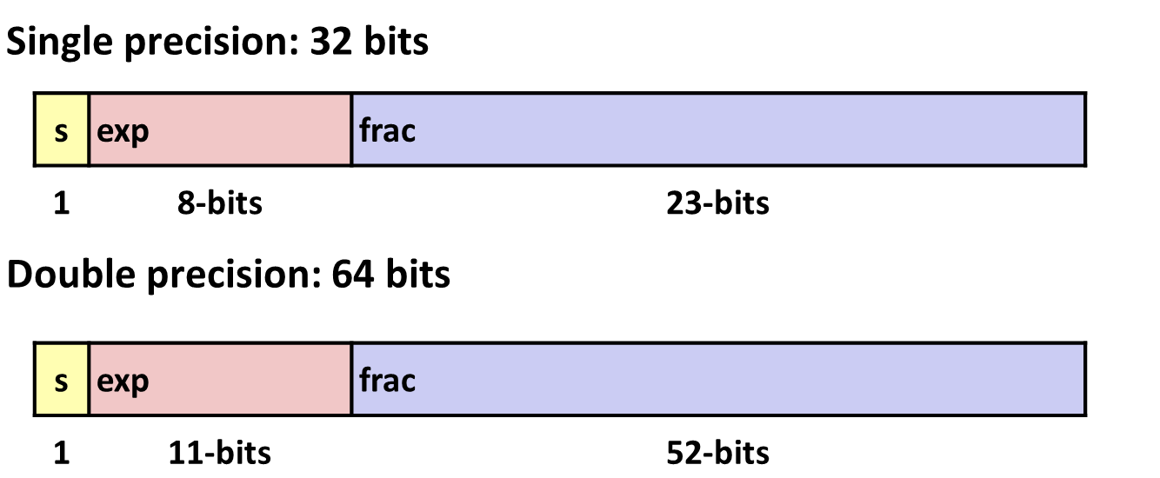
Floating Point Puzzles
For each of the following C expressions, either:
Argue that it is true for all argument values
Explain why not true
x == (int)(float) x
x == (int)(double) x
f == (float)(double) f
d == (double)(float) d
f == -(-f);
2/3 == 2/3.0
d < 0.0 ⇒ ((d*2) < 0.0)
d > f ⇒ -f > -d
d * d >= 0.0
(d+f)-d == f
int x = …;
float f = …;
double d = …;
Assume neither
d nor f is NaN
Notes:
Floats cannot represent all ints: only 25 bits in the

Slide 66
Summary
IEEE Floating Point has clear mathematical properties
Represents numbers of form M x 2E
One can reason about operations independent of implementation
As if computed with perfect precision and then rounded
Not the same as real arithmetic
Violates associativity/distributivity
Makes life difficult for compilers & serious numerical applications programmers

Slide 67
Today: Machine Programming I: Basics
History of Intel processors and architectures
Assembly Basics: Registers, operands, move
Arithmetic & logical operations
C, assembly, machine code

Slide 68
Turning C into Object Code
Code in files p1.c p2.c
Compile with command: gcc –Og p1.c p2.c -o p
Use debugging-friendly optimizations (-Og)
Put resulting binary in file p
text
C program (p1.c p2.c)
Compiler (gcc –Og -S)
text
Asm program (p1.s p2.s)
Assembler (gcc –c or as)
binary
Object program (p1.o p2.o)
Static libraries (.a)
Linker (gcc or ld)
binary
Executable program (p)

Slide 69
Compiling Into Assembly
C Code (sum.c)
Generated x86-64 Assembly
long plus(long x, long y);
void sumstore(long x, long y,
long *dest)
{
long t = plus(x, y);
*dest = t;
}
sumstore:
pushq %rbx
movq %rdx, %rbx
call plus
movq %rax, (%rbx)
popq %rbx
ret
Obtain (on shark machine) with command
gcc –Og –S sum.c
Produces file sum.s
Warning: Will get very different results on non-Shark machines (Andrew Linux, Mac OS-X, …) due to different versions of gcc and different compiler settings.

Slide 70
What it really looks like
.globl sumstore
.type sumstore, @function
sumstore:
.LFB35:
.cfi_startproc
pushq %rbx
.cfi_def_cfa_offset 16
.cfi_offset 3, -16
movq %rdx, %rbx
call plus
movq %rax, (%rbx)
popq %rbx
.cfi_def_cfa_offset 8
ret
.cfi_endproc
.LFE35:
.size sumstore, .-sumstore

Slide 71
What it really looks like
Things that look weird and are preceded by a ‘.’ are generally directives.
.globl sumstore
.type sumstore, @function
sumstore:
.LFB35:
.cfi_startproc
pushq %rbx
.cfi_def_cfa_offset 16
.cfi_offset 3, -16
movq %rdx, %rbx
call plus
movq %rax, (%rbx)
popq %rbx
.cfi_def_cfa_offset 8
ret
.cfi_endproc
.LFE35:
.size sumstore, .-sumstore
sumstore:
pushq %rbx
movq %rdx, %rbx
call plus
movq %rax, (%rbx)
popq %rbx
ret
Notes:
Directives are notes to the assembler. They do not represent instructions are not translated to machine code.

Slide 72
Object Code
Code for sumstore
Assembler
Translates .s into .o
Binary encoding of each instruction
Nearly-complete image of executable code
Missing linkages between code in different files
Linker
Resolves references between files
Combines with static run-time libraries
E.g., code for malloc, printf
Some libraries are dynamically linked
Linking occurs when program begins execution
0x0400595:
0x53
0x48
0x89
0xd3
0xe8
0xf2
0xff
0xff
0xff
0x48
0x89
0x03
0x5b
0xc3
Total of 14 bytes
Each instruction 1, 3, or 5 bytes
Starts at address 0x0400595
Notes:
Object code is almost executable but lacks certain references across files. Linker resolves this.

Slide 73
Machine Instruction Example
C Code
Store value t where designated by dest
Assembly
Move 8-byte value to memory
Quad words in x86-64 parlance
Operands:
t: Register %rax
dest: Register %rbx
*dest: Memory M[%rbx]
Object Code
3-byte instruction
Stored at address 0x40059e
*dest = t;
movq %rax, (%rbx)
0x40059e: 48 89 03

Slide 74
Disassembling Object Code
Disassembled
0000000000400595 <sumstore>:
400595: 53 push %rbx
400596: 48 89 d3 mov %rdx,%rbx
400599: e8 f2 ff ff ff callq 400590 <plus>
40059e: 48 89 03 mov %rax,(%rbx)
4005a1: 5b pop %rbx
4005a2: c3 retq
Disassembler
objdump –d sum
Useful tool for examining object code
Analyzes bit pattern of series of instructions
Produces approximate rendition of assembly code
Can be run on either a.out (complete executable) or .o file

Slide 75
Alternate Disassembly
Disassembled
Dump of assembler code for function sumstore:
0x0000000000400595 <+0>: push %rbx
0x0000000000400596 <+1>: mov %rdx,%rbx
0x0000000000400599 <+4>: callq 0x400590 <plus>
0x000000000040059e <+9>: mov %rax,(%rbx)
0x00000000004005a1 <+12>:pop %rbx
0x00000000004005a2 <+13>:retq
Within gdb Debugger
Disassemble procedure
gdb sum
disassemble sumstore

Slide 76
Alternate Disassembly
Disassembled
Object Code
Dump of assembler code for function sumstore:
0x0000000000400595 <+0>: push %rbx
0x0000000000400596 <+1>: mov %rdx,%rbx
0x0000000000400599 <+4>: callq 0x400590 <plus>
0x000000000040059e <+9>: mov %rax,(%rbx)
0x00000000004005a1 <+12>:pop %rbx
0x00000000004005a2 <+13>:retq
0x0400595:
0x53
0x48
0x89
0xd3
0xe8
0xf2
0xff
0xff
0xff
0x48
0x89
0x03
0x5b
0xc3
Within gdb Debugger
Disassemble procedure
gdb sum
disassemble sumstore
Examine the 14 bytes starting at sumstore
x/14xb sumstore

Slide 77
What Can be Disassembled?
% objdump -d WINWORD.EXE
WINWORD.EXE: file format pei-i386
No symbols in "WINWORD.EXE".
Disassembly of section .text:
30001000 <.text>:
30001000: 55 push %ebp
30001001: 8b ec mov %esp,%ebp
30001003: 6a ff push $0xffffffff
30001005: 68 90 10 00 30 push $0x30001090
3000100a: 68 91 dc 4c 30 push $0x304cdc91
Reverse engineering forbidden by
Microsoft End User License Agreement
Anything that can be interpreted as executable code
Disassembler examines bytes and reconstructs assembly source
Notes:
EULA’s are particularly harmful: disassembly is a US federal right for educational purposes.

Slide 78
Machine Programming I: Summary
History of Intel processors and architectures
Evolutionary design leads to many quirks and artifacts
C, assembly, machine code
New forms of visible state: program counter, registers, ...
Compiler must transform statements, expressions, procedures into low-level instruction sequences
Assembly Basics: Registers, operands, move
The x86-64 move instructions cover wide range of data movement forms
Arithmetic
C compiler will figure out different instruction combinations to carry out computation

