Slide 1
Dynamic Memory Allocation:
Advanced Concepts
15-213/14-513/15-513: Introduction to Computer Systems
14th Lecture, June 21, 2022

Slide 2
Reminders
Cache lab is due Friday
  2 grace days, 1 penalty late day
Midterm is Friday
  Logistics details: https://piazza.com/class/l2qjkx0vcikb7?cid=1004
  Fill out the form (linked from that post) if you cannot take the exam at the normal time for any reason
  It’s OK to request a make-up at the last minute
After Friday, next class is July 5
  Enjoy your mid-summer break!

Slide 3
Review: Dynamic Memory Allocation
Memory
invisible to
user code
Application
Kernel virtual memory
Dynamic Memory Allocator
User stack
(created at runtime)
Heap
%rsp
(stack
pointer)
Programmers use dynamic memory allocators (such as malloc) to acquire virtual memory (VM) at runtime
  For data structures whose size is only known at runtime
Dynamic memory allocators manage an area of process VM known as the heap
Memory-mapped region for
shared libraries
brk
Run-time heap
(created by malloc)
Read/write segment
(.data, .bss)
Loaded
from
the
executable
file
Read-only segment
(.init, .text, .rodata)
0x400000
Unused
0

Slide 4
Review: Keeping Track of Free Blocks
Method 1: Implicit list using length—links all blocks
Method 2: Explicit list among the free blocks using pointers
Method 3: Segregated free list
  Different free lists for different size classes
Method 4: Blocks sorted by size
  Can use a balanced tree (e.g., Red-Black tree) with pointers within each free block, and the length used as a key
Need to tag
each block as
allocated/free
Unused
32
48
32
16
Need space
for pointers
32
48
32
16

Slide 5
Review: Implicit Lists Summary
Implementation: very simple
Allocate cost:
  linear time worst case
Free cost:
  constant time worst case
  even with coalescing
Memory Overhead:
  Depends on placement policy
  Strategies include first fit, next fit, and best fit
Not used in practice for malloc/free because of linear-time allocation
  used in many special purpose applications
However, the concepts of splitting and boundary tag coalescing are general to all allocators

Slide 6
Today
Explicit free lists
Segregated free lists
Memory-related perils and pitfalls

Slide 7
Keeping Track of Free Blocks
Method 1: Implicit list using length—links all blocks
Method 2: Explicit list among the free blocks using pointers
Method 3: Segregated free list
  Different free lists for different size classes
Method 4: Blocks sorted by size
  Can use a balanced tree (e.g. Red-Black tree) with pointers within each free block, and the length used as a key
Unused
32
48
32
16
32
48
32
16

Slide 8
Explicit Free Lists
Allocated (as before)
Free
Size
a
Size
a
Payload and
padding
Next
Prev
Optional
Size
a
Size
a
Maintain list(s) of free blocks, not all blocks
  Luckily we track only free blocks, so we can use payload area
  The “next” free block could be anywhere
    So we need to store forward/back pointers, not just sizes
  Still need boundary tags for coalescing
    To find adjacent blocks according to memory order

Slide 9
Explicit Free Lists
Logically:
Physically: blocks can be in any order
A
B
C
Forward (next) links
A
B
32
32
32
32
48
48
32
32
32
32
C
Back (prev) links

Slide 10
Allocating From Explicit Free Lists
conceptual graphic
Before
After
(with splitting)
= malloc(…)

Slide 11
Freeing With Explicit Free Lists
Insertion policy: Where in the free list do you put a newly freed block?
Unordered
  LIFO (last-in-first-out) policy
    Insert freed block at the beginning of the free list
  FIFO (first-in-first-out) policy
    Insert freed block at the end of the free list
  Pro: simple and constant time
  Con: studies suggest fragmentation is worse than address ordered
Address-ordered policy
  Insert freed blocks so that free list blocks are always in address order:
  addr(prev) < addr(curr) < addr(next)
  Con: requires search
  Pro: studies suggest fragmentation is lower than LIFO/FIFO

Slide 12
Freeing With a LIFO Policy (Case 1)
Allocated
Allocated
conceptual graphic
Before
free( )
Root
Insert the freed block at the root of the list
After
Root

Slide 13
Freeing With a LIFO Policy (Case 2)
Allocated
Free
conceptual graphic
Before
free( )
Root
Splice out adjacent successor block, coalesce both memory blocks, and insert the new block at the root of the list
After
Root

Slide 14
Freeing With a LIFO Policy (Case 3)
Free
Allocated
conceptual graphic
Before
free( )
Root
Splice out adjacent predecessor block, coalesce both memory blocks, and insert the new block at the root of the list
After
Root

Slide 15
Freeing With a LIFO Policy (Case 4)
Free
Free
conceptual graphic
Before
free( )
Root
Splice out adjacent predecessor and successor blocks, coalesce all 3 blocks, and insert the new block at the root of the list
After
Root

Slide 16
Some Advice: An Implementation Trick
LIFO Insertion
Point
FIFO Insertion
Point
A
B
C
D
Free
Pointer
Next fit
Use circular, doubly-linked list
Support multiple approaches with single data structure
First-fit vs. next-fit
  Either keep free pointer fixed or move as search list
LIFO vs. FIFO
  Insert as next block (LIFO), or previous block (FIFO)

Slide 17
Explicit List Summary
Comparison to implicit list:
  Allocate is linear time in number of free blocks instead of all blocks
    Much faster when most of the memory is full
  Slightly more complicated allocate and free because need to splice blocks in and out of the list
  Some extra space for the links (2 extra words needed for each block)
    Does this increase internal fragmentation?

Slide 18
Today
Explicit free lists
Segregated free lists
Memory-related perils and pitfalls

Slide 19
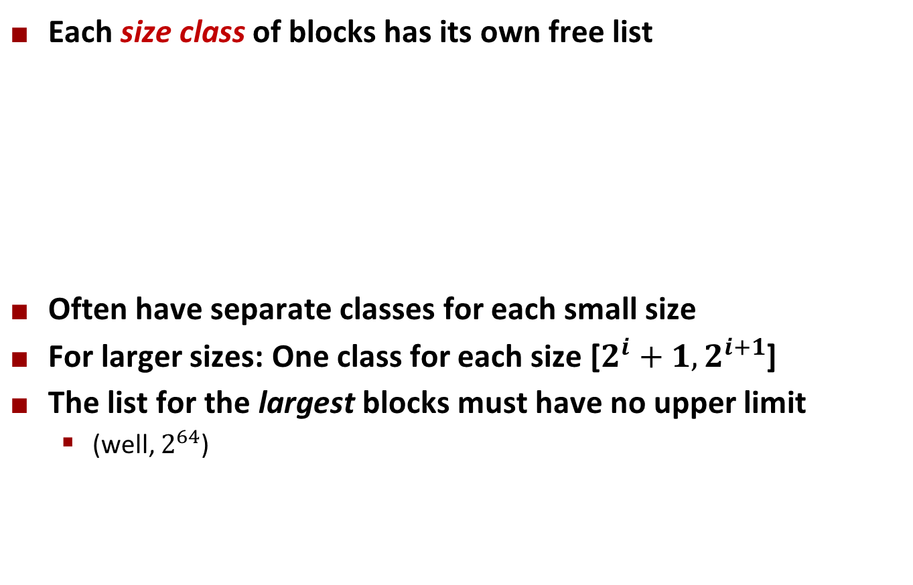
Segregated List (Seglist) Allocators
Each size class of blocks has its own free list
Often have separate classes for each small size
For larger sizes: One class for each size [$2^{i}+1,2^{i+1}$]
The list for the largest blocks must have no upper limit
  (well, $2^{64}$)
16
32-48
64–inf

Slide 20
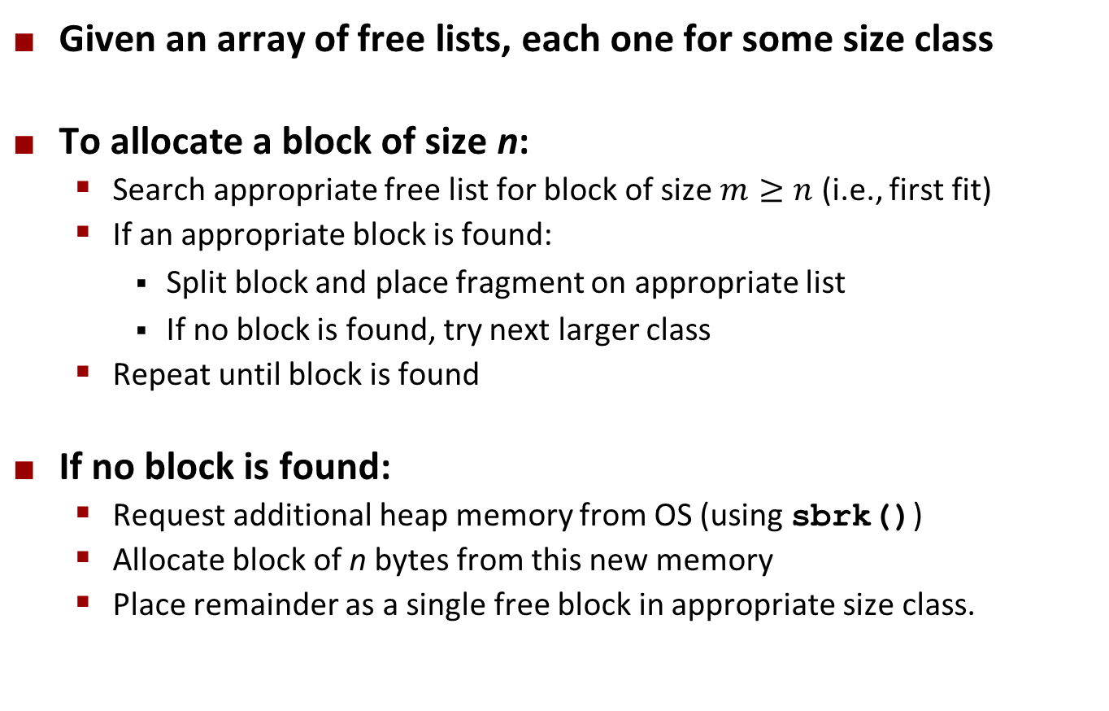
Seglist Allocator
Given an array of free lists, each one for some size class
To allocate a block of size n:
  Search appropriate free list for block of size $m≥n$ (i.e., first fit)
  If an appropriate block is found:
    Split block and place fragment on appropriate list
    If no block is found, try next larger class
  Repeat until block is found
If no block is found:
  Request additional heap memory from OS (using sbrk())
  Allocate block of n bytes from this new memory
  Place remainder as a single free block in appropriate size class.

Slide 21
Seglist Allocator (cont.)
To free a block:
  Coalesce and place on appropriate list
Advantages of seglist allocators vs. non-seglist allocators (both with first-fit)
  Higher throughput
    log time for power-of-two size classes vs. linear time
  Better memory utilization
    First-fit search of segregated free list approximates a best-fit search of entire heap.
    Extreme case: Giving each block its own size class is equivalent to best-fit.

Slide 22
More Info on Allocators
D. Knuth, The Art of Computer Programming, vol 1, 3rd edition, Addison Wesley, 1997
  The classic reference on dynamic storage allocation
Wilson et al, “Dynamic Storage Allocation: A Survey and Critical Review”, Proc. 1995 Int’l Workshop on Memory Management, Kinross, Scotland, Sept, 1995.
  Comprehensive survey
  Available from CS:APP student site (csapp.cs.cmu.edu)

Slide 23
Quiz Time!
Check out:
https://canvas.cmu.edu/courses/28989/quizzes/83211

Slide 24
Today
Explicit free lists
Segregated free lists
Memory-related perils and pitfalls

Slide 25
Memory-Related Perils and Pitfalls
Dereferencing bad pointers
Reading uninitialized memory
Overwriting memory
Referencing nonexistent variables
Freeing blocks multiple times
Referencing freed blocks
Failing to free blocks

Slide 26
Dereferencing Bad Pointers
The classic scanf bug
int val;
...
scanf("%d", val);
case 'd': {
int *valp = va_arg(ap, int *);
*valp = (int)strtol(valbuf, &endp, 10);
}
Crash here …
if you’re lucky

Slide 27
Reading Uninitialized Memory
Assuming that heap data is initialized to zero
Can avoid by using calloc
/* return y = Ax */
int *matvec(int **A, int *x) {
int *y = malloc(N*sizeof(int));
int i, j;
for (i=0; i<N; i++)
for (j=0; j<N; j++)
y[i] += A[i][j]*x[j];
return y;
}

Slide 28
Overwriting Memory
Allocating the (possibly) wrong sized object
Can you spot the bug?
int **p;
p = malloc(N*sizeof(int));
for (i=0; i<N; i++) {
p[i] = malloc(M*sizeof(int));
}

Slide 29
Overwriting Memory
Off-by-one errors
char **p;
p = malloc(N*sizeof(int *));
for (i=0; i<=N; i++) {
p[i] = malloc(M*sizeof(int));
}
char *p;
p = malloc(strlen(s));
strcpy(p,s);

Slide 30
Overwriting Memory
Not checking the max string size
Basis for classic buffer overflow attacks
char s[8];
int i;
gets(s); /* reads “123456789” from stdin */

Slide 31
Overwriting Memory
Misunderstanding pointer arithmetic
int *search(int *p, int val) {
while (p && *p != val)
p += sizeof(int);
return p;
}

Slide 32
Overwriting Memory
Referencing a pointer instead of the object it points to
What gets decremented?
  (See next slide)
int *BinheapDelete(int **binheap, int *size) {
int *packet;
packet = binheap[0];
binheap[0] = binheap[*size - 1];
*size--;
Heapify(binheap, *size, 0);
return(packet);
}

Slide 33
C operators
Postfix
Operators Associativity
() [] -> . ++ -- left to right
! ~ ++ -- + - * & (type) sizeof right to left
* / % left to right
+ - left to right
<< >> left to right
< <= > >= left to right
== != left to right
& left to right
^ left to right
| left to right
&& left to right
|| left to right
?: right to left
= += -= *= /= %= &= ^= != <<= >>= right to left
, left to right
Unary
Unary
Binary
Prefix
Binary
->, (), and [] have high precedence, with * and & just below
Unary +, -, and * have higher precedence than binary forms
Source: K&R page 53, updated

Slide 34
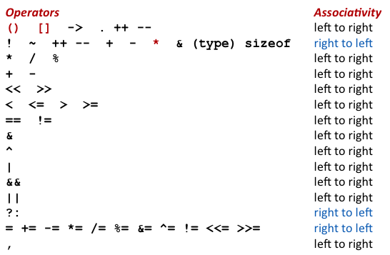
Overwriting Memory
Referencing a pointer instead of the object it points to
Same effect as
  size--;
Rewrite as
  (*size)--;
int *BinheapDelete(int **binheap, int *size) {
int *packet;
packet = binheap[0];
binheap[0] = binheap[*size - 1];
*size--;
Heapify(binheap, *size, 0);
return(packet);
}

Slide 35
Referencing Nonexistent Variables
Forgetting that local variables disappear when a function returns
int *foo () {
int val;
return &val;
}

Slide 36
Freeing Blocks Multiple Times
Nasty!
x = malloc(N*sizeof(int));
<manipulate x>
free(x);
y = malloc(M*sizeof(int));
<manipulate y>
free(x);

Slide 37
Referencing Freed Blocks
Evil!
x = malloc(N*sizeof(int));
<manipulate x>
free(x);
...
y = malloc(M*sizeof(int));
for (i=0; i<M; i++)
y[i] = x[i]++;

Slide 38
Failing to Free Blocks (Memory Leaks)
Slow, long-term killer!
foo() {
int *x = malloc(N*sizeof(int));
...
return;
}

Slide 39
Failing to Free Blocks (Memory Leaks)
Freeing only part of a data structure
struct list {
int val;
struct list *next;
};
foo() {
struct list *head = malloc(sizeof(struct list));
head->val = 0;
head->next = NULL;
<create and manipulate the rest of the list>
...
free(head);
return;
}

Slide 40
Dealing With Memory Bugs
Debugger: gdb
  Good for finding bad pointer dereferences
  Hard to detect the other memory bugs
Data structure consistency checker
  Runs silently, prints message only on error
  Use as a probe to zero in on error
Binary translator: valgrind
  Powerful debugging and analysis technique
  Rewrites text section of executable object file
  Checks each individual reference at runtime
    Bad pointers, overwrites, refs outside of allocated block
glibc malloc contains checking code
  setenv MALLOC_CHECK_ 3

