Slide 1
Code Optimization
15-213/15-513/14-513: Introduction to Computer Systems
12th Lecture, February 24, 2022

Slide 2
Today
Principles and goals of compiler optimization
Local optimization
  Constant folding, strength reduction, dead code elimination, common subexpression elimination
Global optimization
  Inlining, code motion, loop transformations
Obstacles to optimization
  Memory aliasing, procedure calls, non-associative arithmetic
Quiz
Machine-dependent optimization
  Branch predictability, loop unrolling, scheduling, vectorization

Slide 3
Back in the Good Old Days,
when the term "software" sounded funny
and Real Computers were made out of drums
and vacuum tubes,
Real Programmers wrote in machine code.
Not FORTRAN. Not RATFOR. Not, even,
assembly language.
Machine Code.
Raw, unadorned, inscrutable hexadecimal numbers. Directly.
— “The Story of Mel, a Real Programmer”
Ed Nather, 1983
Notes:
Forty years ago, Ed Nather wrote a story about a fellow named Mel, whom he’d known twenty years before that, back when computers were made out of drums and vacuum tubes.
(Drums, by the way, were what we used for stable storage before disks and after paper tape. Big metal cylinder with magnetic media wrapped around the outside.)
Mel wrote his programs in machine code. Raw, unadorned, inscrutable hexadecimal numbers. Directly.
Ed was impressed. Ed thought, of the two of them, Mel was the real programmer. But this is machismo. Programming in machine code is the bad kind of difficult. I’ve done it a couple times, for tiny little things, and you spend all your time triple-checking that individual inscrutable hexadecimals mean what you want them to mean, and you have no brain left over to think about what your program actually does.
Since the very beginning of computers, people have been trying to make the computer do the tedious, inscrutable parts of programming, so they, the humans, could concentrate on the fun, creative parts.

Slide 4

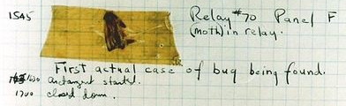
Rear Admiral Grace Hopper
  First person to find an actual bug (a moth)
  Invented first compiler in 1951 (precursor to COBOL)
  “I decided data processors ought to be able to write their programs in English, and the computers would translate them into machine code”
Notes:
People like Admiral Grace Hopper, here, who found the very first bug. A moth, stuck in one of ENIAC’s relays.
But more importantly, she thought up the idea of compiling.
She said, “I decided data processors ought to be able to write their programs in English, and the computers would translate them into machine code.”
“data processors” was what they called “computer users” back in 1951. The people, trying to get the computer to crunch data for them.

Slide 5

John Backus
  Developed FORTRAN in 1957 for the IBM 704
  Oldest machine-independent programming language still in use today
  “Much of my work has come from being lazy. I didn't like writing programs, and so, when I was working on the IBM 701, I started work on a programming system to make it easier to write programs”
Notes:
And people like John Backus, who designed FORTRAN, the oldest machine-independent programming language that’s still used today.
“I was lazy, I didn’t like writing programs, I wanted to make it easier”, he said.

Slide 6

Fran Allen
  Pioneer of many optimizing compilation techniques
  Wrote a paper in 1966 that introduced the concept of the control flow graph, which is still central to compiler theory today
  First woman to win the ACM Turing Award
Notes:
And Fran Allen, who realized that a compiler shouldn’t just directly translate the FORTRAN or Algol or whatever to machine code, it should optimize.
It should produce a machine code program that computes the same results as the source code, but does this as efficiently as possible, even if that means changing up how it works.

Slide 7
Goals of compiler optimization
Minimize number of instructions
  Don’t do calculations more than once
  Don’t do unnecessary calculations at all
  Avoid slow instructions (multiplication, division)
Avoid waiting for memory
  Keep everything in registers whenever possible
  Access memory in cache-friendly patterns
  Load data from memory early, and only once
Avoid branching
  Don’t make unnecessary decisions at all
  Make it easier for the CPU to predict branch destinations
  “Unroll” loops to spread cost of branches over more instructions
Notes:
How do we define “make this as efficient as possible” in a way that a computer can carry out?
One obvious goal is to minimize the number of instructions we execute. Don’t do the same calculation over and over again. Don’t do unnecessary calculations at all.
Another obvious goal, as you’re seeing right now in cache lab, is to avoid waiting for memory. That means making the best possible use of the registers, and accessing memory in a pattern that maximizes locality, and stuff like that.
And another important goal, for reasons we’ll talk about later today, is to avoid branching, especially unpredictable branching.

Slide 8
Limits to compiler optimization
Generally cannot improve algorithmic complexity
  Only constant factors, but those can be worth 10x or more…
Must not cause any change in program behavior
  Programmer may not care about “edge case” behavior,
  but compiler does not know that
  Exception: language may declare some changes acceptable
Often only analyze one function at a time
  Whole-program analysis (“LTO”) expensive but gaining popularity
  Exception: inlining merges many functions into one
Tricky to anticipate run-time inputs
  Profile-guided optimization can help with common case, but…
  “Worst case” performance can be just as important as “normal”
  Especially for code exposed to malicious input
  (e.g. network servers)
Notes:
Compilers aren’t magic and they aren’t creative. This means they can’t do everything for you.
In most cases they can’t make your algorithm better. They can edit all the unnecessary instructions out of your bubble sort, but it will still be bubble sort, not quicksort.
They don’t know what’s in or out of scope of your design, so they can’t change any behavior, not even edge-case behavior you never cared about… unless the language says it’s OK. A language spec might allow its compilers to apply the associative law to floating-point calculations even though floating point arithmetic isn’t associative.
They usually only look at one function at a time, just to keep compilation time down—except that inlining merges many functions into one.
And they typically have no information about what will happen when the program is run.

Slide 9
Performance Realities
There’s more to performance than asymptotic complexity
Constant factors matter too!
  Easily see 10:1 performance range depending on how code is written
  Must optimize at multiple levels:
    algorithm, data representations, procedures, and loops
Must understand system to optimize performance
  How programs are compiled and executed
  How modern processors + memory systems operate
  How to measure program performance and identify bottlenecks
  How to improve performance without destroying code modularity
  and generality
Notes:
Hopper and Backus and Allen, and everyone who’s worked on compilers after them, gave us a world where we don’t have to write machine code. But, to get good performance, we have to understand what the compiler is doing when it writes the machine code for us. What it’s capable of, and what we still have to do ourselves.

Slide 10
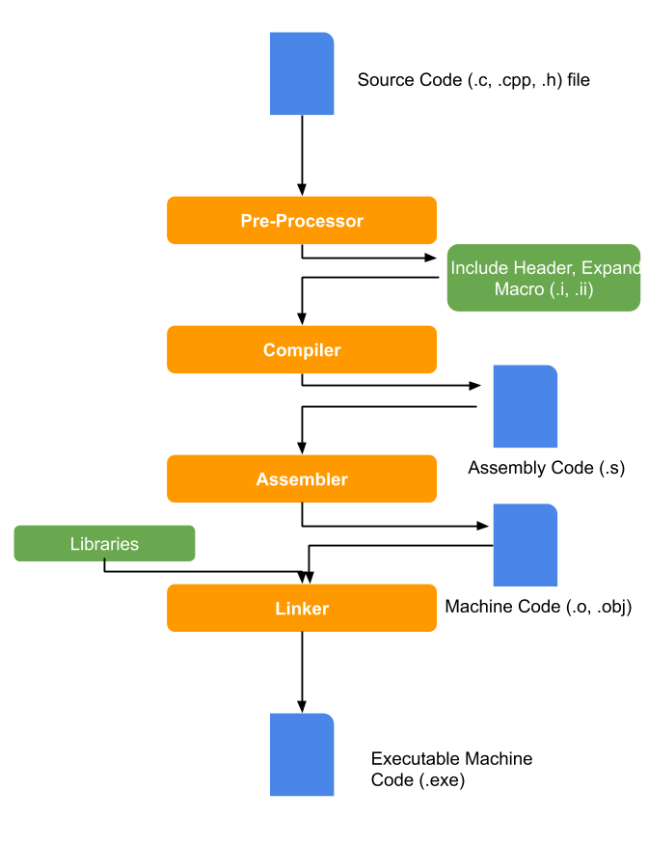
What does it mean to compile code?
The CPU only understands machine code directly
All other languages must be either
  interpreted: executed
  by software
  compiled: translated
  to machine code
  by software
Notes:
You may remember this slide from the GCC bootcamp. The four stages of translation between the C program you write, and an equivalent in machine code that the computer can actually run.
Most of the optimization work happens in the second stage – usually called compilation “proper” – so let’s zoom in on it.

Slide 11
Compilation is a pipeline
Preprocessing
Compilation
Assembling
Fold constants
Eliminate common subexpressions
Inline functions
Reduce operation strength
Select instructions
Schedule instructions
Allocate registers
Emit assembly language
Reduce control flow to gotos
Move code out of loops
Eliminate dead code
Restructure loops
Hundreds! Many repeated.
Notes:
Compilation happens in stages, often called “passes” -- each makes a change to the ‘intermediate representation’ of the program. Not all of these make it faster; some of them are instead just a thing you have to do to get closer to assembly language. I’ve given those “lowering” passes an orange box, and the passes that are purely about optimization a green box.
A production compiler like GCC or LLVM or MSVC will have hundreds of these passes, because there are hundreds of possible optimizations.
I don’t even have time to talk about all twelve of the passes on this slide, so what I’m going to concentrate on is what you should know when reading assembly. When you’re scratching your head, wondering how on earth the assembly you’re looking at can be the same computation as what you wrote -- think about this lecture.

Slide 12
Two kinds of optimizations
entry
Local optimizations work inside a single basic block
  Constant folding, strength reduction, dead code elimination, (local) CSE, …
Global optimizations process the entire control flow graph of a function
  Loop transformations, code motion, (global) CSE, …
setup
Easy?
easy
complex
loop
Done?
exit
Notes:
A fundamental idea in compiler theory is the control flow graph. That was Fran Allen’s insight: draw a flowchart of all the decisions that the program makes, and use mathematical graph theory to analyze it. It’s a directed graph and it can have cycles – those are the loops.
We can divide optimizations into two classes based on how they interact with the control flow graph. Local optimizations work on one basic block at a time – that’s a chunk of “straight line” code, containing neither gotos nor labels. They have limited impact but they’re reliable. Doing local optimizations is just about always a win.
Global optimizations, on the other hand, process an entire function at once. They can move code between basic blocks and rearrange the graph. They can be very powerful but they’re not always a good idea.

Slide 13
Today
Principles and goals of compiler optimization
Local optimization
  Constant folding, strength reduction, dead code elimination, common subexpression elimination
Global optimization
  Inlining, code motion, loop transformations
Obstacles to optimization
  Memory aliasing, procedure calls, non-associative arithmetic
Quiz
Machine-dependent optimization
  Branch predictability, loop unrolling, scheduling, vectorization

Slide 14
Constant Folding
Do arithmetic in the compiler
long mask = 0xFF << 8; →
long mask = 0xFF00;
Any expression with constant inputs can be folded
Might even be able to remove library calls…
size_t namelen = strlen("Harry Bovik"); →
size_t namelen = 11;
Notes:
Probably the most obvious local optimization there is: if you can have the compiler do some math, instead of doing it when the program is run, that’s a win. For example, you remember all those wacky expressions you had to write in data lab to get big constants? If you go back and disassemble your solutions you’ll probably see hex FF00 instead of hex FF shift left 8, and so on.
Really clever compilers might be able to fold through C library functions with constant arguments.

Slide 15
Strength reduction
Replace expensive operations with cheaper ones
long a = b * 5; →
long a = (b << 2) + b;
Multiplication and division are the usual targets
Multiplication is often hiding in memory access expressions
Notes:
Another easy, reliable local optimization is to replace expensive machine instructions with cheap ones. This is the optimizer that likes to turn mul into lea.

Slide 16
Dead code elimination
Don’t emit code that will never be executed
if (0) { puts("Kilroy was here"); }
if (1) { puts("Only bozos on this bus"); }
Don’t emit code whose result is overwritten
x = 23;
x = 42;
These may look silly, but...
  Can be produced by other optimizations
  Assignments to x might be far apart
Notes:
If code is never going to be executed, don’t write it out! And don’t do any calculations that would only be used by code that’s never executed, or that has its result overwritten before it’s used.
You might be thinking “why would anyone write that in the first place?” but other optimizations often make code be dead. Maybe that “if zero” was “if some arithmetic that the constant folder evaluated to zero” in the source code.
This is arguably a global optimization – it changes the control flow graph -- but it’s so easy and reliable it usually gets lumped with the local ones.

Slide 17
Common Subexpression Elimination
Factor out repeated calculations, only do them once
  norm[i] = v[i].x*v[i].x + v[i].y*v[i].y;
  →
  elt = &v[i];
  x = elt->x;
  y = elt->y;
  norm[i] = x*x + y*y;
Notes:
If you’ve got to do a calculation, only do it once, and remember the result. This complex expression reads from memory four times, but we can calculate the address of v[i] just once…
… and we can load dot x and dot y from memory once each
… and finally we can do all the arithmetic in registers.
This can be a local or a global optimization and there are at least five different algorithms for it.

Slide 18
Today
Principles and goals of compiler optimization
Local optimization
  Constant folding, strength reduction, dead code elimination, common subexpression elimination
Global optimization
  Inlining, code motion, loop transformations
Obstacles to optimization
  Memory aliasing, procedure calls, non-associative arithmetic
Quiz
Machine-dependent optimization
  Branch predictability, loop unrolling, scheduling, vectorization
Notes:
Moving on to more complicated global optimizations…

Slide 19
Inlining
Copy body of a function into its caller(s)
  Can create opportunities for many other optimizations
  Can make code much bigger and therefore slower (size; i-cache)
int pred(int x) {
if (x == 0)
return 0;
else
return x - 1;
}
int func(int y) {
return pred(y)
+ pred(0)
+ pred(y+1);
}
int func(int y) {
int tmp;
if (y == 0) tmp = 0; else tmp = y - 1;
if (0 == 0) tmp += 0; else tmp += 0 - 1;
if (y+1 == 0) tmp += 0; else tmp += (y + 1) - 1;
return tmp;
}
Notes:
One of the most important global optimizations is inlining. Take a short function and copy its body in place of all calls to it. Obviously this cuts out the function call overhead, but it also gets around that one-function-at-a-time restriction and gives the compiler opportunities to do more other optimizations. Here we have two simple functions and there’s not much to do to either one by itself, but if we combine them…

Slide 20
Inlining
Copy body of a function into its caller(s)
  Can create opportunities for many other optimizations
  Can make code much bigger and therefore slower
int pred(int x) {
if (x == 0)
return 0;
else
return x - 1;
}
int func(int y) {
return pred(y)
+ pred(0)
+ pred(y+1);
}
int func(int y) {
int tmp;
if (y == 0) tmp = 0; else tmp = y - 1;
if (0 == 0) tmp += 0; else tmp += 0 - 1;
if (y+1 == 0) tmp += 0; else tmp += (y + 1) - 1;
return tmp;
}
Always true
Does nothing
Can constant fold
Notes:
Now each of the function calls is an expression that we can optimize based on the value of x at each call site.

Slide 21
Inlining
Copy body of a function into its caller(s)
  Can create opportunities for many other optimizations
  Can make code much bigger and therefore slower
int func(int y) {
int tmp;
if (y == 0) tmp = 0; else tmp = y - 1;
if (0 == 0) tmp += 0; else tmp += 0 - 1;
if (y+1 == 0) tmp += 0; else tmp += (y + 1) - 1;
return tmp;
}
int func(int y) {
int tmp = 0;
if (y != 0) tmp = y - 1;
if (y != -1) tmp += y;
return tmp;
}
Notes:
And so inlining plus local optimizations produces this much simpler function.
This kind of opportunity to simplify the code after inlining, comes up a whole lot in C++ with template functions. If you ever wondered why almost the entire implementation of std::string and std::map is in the header files? It’s so the compiler can inline all of it and then simplify it down to the cases that matter for the actual program.
The catch to inlining is that if you do it too much, the program can become really big. Too big for the instruction cache. That makes it slow no matter what.

Slide 22
Code Motion
Move calculations out of a loop
Only valid if every iteration would produce same result
long j;
for (j = 0; j < n; j++)
a[n*i+j] = b[j];
→
long j;
int ni = n*i;
for (j = 0; j < n; j++)
a[ni+j] = b[j];
Notes:
Sometimes a program computes the same value over and over because the expression is inside a loop. If every iteration of the loop computes the same result, we say the calculation is a ‘loop invariant’ and we move it to above the loop. It’s CSE in time instead of space. In the example, n times I is invariant so we make a temp variable for it.

Slide 23
Loop Transformations
Rearrange entire loop nests for maximum efficiency
/* Two stages of some calculation */
void compute(double *a, double *b, long n) {
for (long i = 0; i < n; i++)
for (long j = 0, j < n; j++)
a[j*n + i] = atan2(i, j);
for (long i = 0; i < n; i++)
for (long j = 0, j < n; j++)
b[i*n + j] = a[i*n + j]
+ (i >= 1 && j >= 1)
? a[(i-1)*n + (j-1)]
: 0;
}
Notes:
Also called “loop nest optimization.”
Here’s a messy calculation with two stages, each of which is a two-deep loop nest. Compilers put scary amounts of algebra into making this kind of code go fast because guess what: most of a computer’s CPU time is spent in loops.

Slide 24
Loop Transformations
Loop interchange: do iterations in cache-friendly order
/* Two stages of some calculation */
void compute(double *a, double *b, long n) {
for (long i = 0; i < n; i++)
for (long j = 0, j < n; j++)
a[i*n + j] = atan2(j, i);
for (long i = 0; i < n; i++)
for (long j = 0, j < n; j++)
b[i*n + j] = a[i*n + j]
+ (i >= 1 && j >= 1)
? a[(i-1)*n + (j-1)]
: 0;
}
Notes:
It doesn’t matter what order the first loop nest is done in, so – assuming the compiler knows that, which it probably does for atan2 – it can swap the roles of I and J so that the A matrix is written in cache-friendly order. This is called loop interchange because it’s logically the same as swapping the two loops. I wrote it this way because …

Slide 25
Loop Transformations
Loop fusion: combine adjacent loops with the same limits
/* Two stages of some calculation */
void compute(double *a, double *b, long n) {
for (long i = 0; i < n; i++) {
for (long j = 0, j < n; j++) {
a[i*n + j] = atan2(j, i);
for (long i = 0; i < n; i++)
for (long j = 0, j < n; j++)
b[i*n + j] = a[i*n + j]
+ (i >= 1 && j >= 1)
? a[(i-1)*n + (j-1)]
: 0;
}
}
}
Notes:
… the next optimization, loop fusion, is going to notice that the two loop nests have the exact same limits and no conflicting side effects, and so we can do them at the same time. This reduces the amount of branching and bookkeeping and also makes better use of memory cache – now we are using a[i*n+j] right after we set it.

Slide 26
Loop Transformations
Induction variable elimination: replace loop indices with algebra
/* Two stages of some calculation */
void compute(double *a, double *b, long n) {
for (long i = 0; i < n*n; i++) {
for (long j = 0, j < n; j++) {
a[i] = atan2(i%n, i/n);
b[i] = a[i]
+ (i >= n && i%n >= 1)
? a[i – n - 1]
: 0;
}
}
}
Notes:
The inner loop always runs from zero to N-1, and we’re always working with array element i*n+j, and that means we can combine the inner and outer loops and get rid of j by doing math on I instead.
This is mainly valuable if it frees up registers that we need for something else. It also means fewer, more predictable branches.
The compiler might not do it in this case because it introduces a division, yuck, slow. Of course, we’re calling a trig function on every iteration, that’s even slower.

Slide 27
Today
Principles and goals of compiler optimization
Local optimization
  Constant folding, strength reduction, dead code elimination, common subexpression elimination
Global optimization
  Inlining, code motion, loop transformations
Obstacles to optimization
  Memory aliasing, procedure calls, non-associative arithmetic
Quiz
Machine-dependent optimization
  Branch predictability, loop unrolling, scheduling, vectorization
Notes:
Now let’s look at reasons why the compiler might not do the optimizations you want.

Slide 28
Memory Aliasing
/* Sum rows of n X n matrix a and store in vector b. */
void sum_rows1(double *a, double *b, long n) {
long i, j;
for (i = 0; i < n; i++) {
b[i] = 0;
for (j = 0; j < n; j++)
b[i] += a[i*n + j];
}
}
# sum_rows1 inner loop
.L4:
movsd (%rsi,%rax,8), %xmm0 # FP load
addsd (%rdi), %xmm0 # FP add
movsd %xmm0, (%rsi,%rax,8) # FP store
addq $8, %rdi
cmpq %rcx, %rdi
jne .L4
  Code updates b[i] on every iteration
  Why couldn’t compiler optimize this away?
Notes:
A is N-by-N square matrix and we want to sum up the values in each row and put the sums in another array B.
The compiler loads b[i] from memory, adds a[i][j], and writes it back, on each cycle. Why?

Slide 29
Memory Aliasing
/* Sum rows of n X n matrix a and store in vector b. */
void sum_rows1(double *a, double *b, long n) {
long i, j;
for (i = 0; i < n; i++) {
b[i] = 0;
for (j = 0; j < n; j++)
b[i] += a[i*n + j];
}
}
Value of B:
double A[9] =
{ 0, 1, 2,
4, 8, 16},
32, 64, 128};
double B[3] = A+3;
sum_rows1(A, B, 3);
double A[9] =
{ 0, 1, 2,
0, 8, 16},
32, 64, 128};
double A[9] =
{ 0, 1, 2,
0, 8, 16},
32, 64, 128};
double A[9] =
{ 0, 1, 2,
1, 8, 16},
32, 64, 128};
double A[9] =
{ 0, 1, 2,
3, 8, 16},
32, 64, 128};
double A[9] =
{ 0, 1, 2,
3, 0, 16},
32, 64, 128};
double A[9] =
{ 0, 1, 2,
3, 3, 16},
32, 64, 128};
double A[9] =
{ 0, 1, 2,
3, 6, 16},
32, 64, 128};
double A[9] =
{ 0, 1, 2,
3, 22, 16},
32, 64, 128};
double A[9] =
{ 0, 1, 2,
3, 22, 0},
32, 64, 128};
double A[9] =
{ 0, 1, 2,
3, 22, 32},
32, 64, 128};
double A[9] =
{ 0, 1, 2,
3, 22, 96},
32, 64, 128};
double A[9] =
{ 0, 1, 2,
3, 22, 224},
32, 64, 128};
init: [4, 8, 16]
i = 0: [3, 8, 16]
i = 1: [3, 22, 16]
i = 2: [3, 22, 224]
  Code updates b[i] on every iteration
  Must consider possibility that these updates will affect program behavior
Notes:
Well, what if B is inside A? Then, every time we modify B, we change the values in A and that might change what the next addition produces. Watch what happens to the values in A as I step through the loop.
Remember I said the compiler can’t change any program behavior? That it doesn’t know what the programmer wanted? This could have been what the programmer wanted, even though what you get in B is not the sum of each row in A as it was before the call.
This is called pointer aliasing, or memory aliasing.

Slide 30
Avoiding Aliasing Penalties
/* Sum rows of n X n matrix a and store in vector b. */
void sum_rows2(double *a, double *b, long n) {
long i, j;
for (i = 0; i < n; i++) {
double val = 0;
for (j = 0; j < n; j++)
val += a[i*n + j];
b[i] = val;
}
}
# sum_rows2 inner loop
.Loop:
addsd (%rdi), %xmm0 # FP load + add
addq $8, %rdi
cmpq %rax, %rdi
jne .Loop
  Use a local variable for intermediate results
Notes:
What can we do about it? The simplest thing is to do the code motion by hand. We use a local variable to hold the sum, and write to b[i] only once per outer loop.

Slide 31
Avoiding Aliasing Penalties
/* Sum rows of n X n matrix a and store in vector b. */
void sum_rows2(double *a, double *b, long n) {
long i, j;
for (i = 0; i < n; i++) {
double val = 0;
for (j = 0; j < n; j++)
val += a[i*n + j];
b[i] = val;
}
}
Value of B:
double A[9] =
{ 0, 1, 2,
4, 8, 16},
32, 64, 128};
double B[3] = A+3;
sum_rows1(A, B, 3);
double A[9] =
{ 0, 1, 2,
4, 8, 16},
32, 64, 128};
double A[9] =
{ 0, 1, 2,
4, 8, 16},
32, 64, 128};
double A[9] =
{ 0, 1, 2,
4, 8, 16},
32, 64, 128};
double A[9] =
{ 0, 1, 2,
3, 8, 16},
32, 64, 128};
double A[9] =
{ 0, 1, 2,
3, 8, 16},
32, 64, 128};
double A[9] =
{ 0, 1, 2,
3, 8, 16},
32, 64, 128};
double A[9] =
{ 0, 1, 2,
3, 8, 16},
32, 64, 128};
double A[9] =
{ 0, 1, 2,
3, 27, 16},
32, 64, 128};
double A[9] =
{ 0, 1, 2,
3, 27, 16},
32, 64, 128};
double A[9] =
{ 0, 1, 2,
3, 27, 16},
32, 64, 128};
double A[9] =
{ 0, 1, 2,
3, 27, 16},
32, 64, 128};
double A[9] =
{ 0, 1, 2,
3, 27, 224},
32, 64, 128};
init: [4, 8, 16]
i = 0: [3, 8, 16]
i = 1: [3, 27, 16]
i = 2: [3, 27, 224]
  Still changes A in the middle of the operation
  Different results
Notes:
If we call this version of the function with B pointing into the middle of A, we get different results from the original, but still not the same as if B was separate from A. Let’s step through the loop again and see how the values change.

Slide 32
Avoiding Aliasing Penalties
/* Sum rows of n X n matrix a and store in vector b. */
void sum_rows3(double *restrict a, double *restrict b, long n) {
long i, j;
for (i = 0; i < n; i++) {
b[i] = 0;
for (j = 0; j < n; j++)
b[i] += a[i*n + j];
}
}
# sum_rows3 inner loop
.Loop:
addsd (%rdi), %xmm0 # FP load + add
addq $8, %rdi
cmpq %rax, %rdi
jne .Loop
  Use restrict qualifier to tell compiler that a and b cannot alias
  Less reliable than using local variables
Notes:
We can get the same effect by annotating the program to tell the compiler that A and B can’t overlap. This is the meaning of the C99 restrict qualifier. Note that it goes on the right of the star, because it modifies the pointer type, not the pointed-to type.
You might think you could get the same effect by declaring A as “const double” but that just means this function promises not to write through the A pointer. It’s still allowed to write through the B pointer, and the B pointer is still allowed to point into the same space as A.

Slide 33
Avoiding Aliasing Penalties
subroutine sum_rows4(a, b, n)
implicit none
integer, parameter :: dp = kind(1.d0)
real(kind=dp), dimension(:), intent(in) :: a
real(kind=dp), dimension(:), intent(out) :: b
integer, intent(in) :: n
integer :: i, j
do i = 1,n
b(i) = 0
do j = 1,n
b(i) = b(i) + a(i*n + j)
end
end
end
# sum_rows4 inner loop
.Loop:
addsd (%rdi), %xmm0 # FP load + add
addq $8, %rdi
cmpq %rax, %rdi
jne .Loop
  Use Fortran
  Array parameters in Fortran are assumed not to alias
Notes:
Or you could write the function in Fortran, because the language spec for Fortran says array parameters are assumed not to alias.
This is not a joke. This is one of the big reasons why people still use Fortran for heavy number crunching.

Slide 34
Function calls are opaque
Compiler examines one function at a time
  Some exceptions for code in a single file
Must assume a function call could do anything
Cannot usually
  move function calls
  change number of times a function is called
  cache data from memory in registers across function calls
size_t strlen(const char *s) {
size_t len = 0;
while (*s++ != '\0') {
len++;
}
return len;
}
O(n) execution time
Return value depends on:
  value of s
  contents of memory at address s
    Only cares about whether individual bytes are zero
    Does not modify memory
Compiler might know some of that (but probably not)
Notes:
Another big blocker for optimization is function calls.
The compiler only looks at one function at a time – there are exceptions, like inlining, but even then usually only within a single file – and it mostly doesn’t know what any other function does while it’s working on each one. It has to assume function calls could do almost anything.
That means it can’t optimize function calls very much. It can’t move them around, it can’t change the number of times a function is called, and it can’t assume data it loaded from memory before a function call is unchanged afterward.
For example, here’s strlen from the standard library. It loops over every character in the string, so it has order-of-N execution time. It doesn’t modify memory, and the return value only depends on the argument and the data in memory pointed to by the argument. It’s a standard library function so the compiler might know some of that, but probably not.

Slide 35
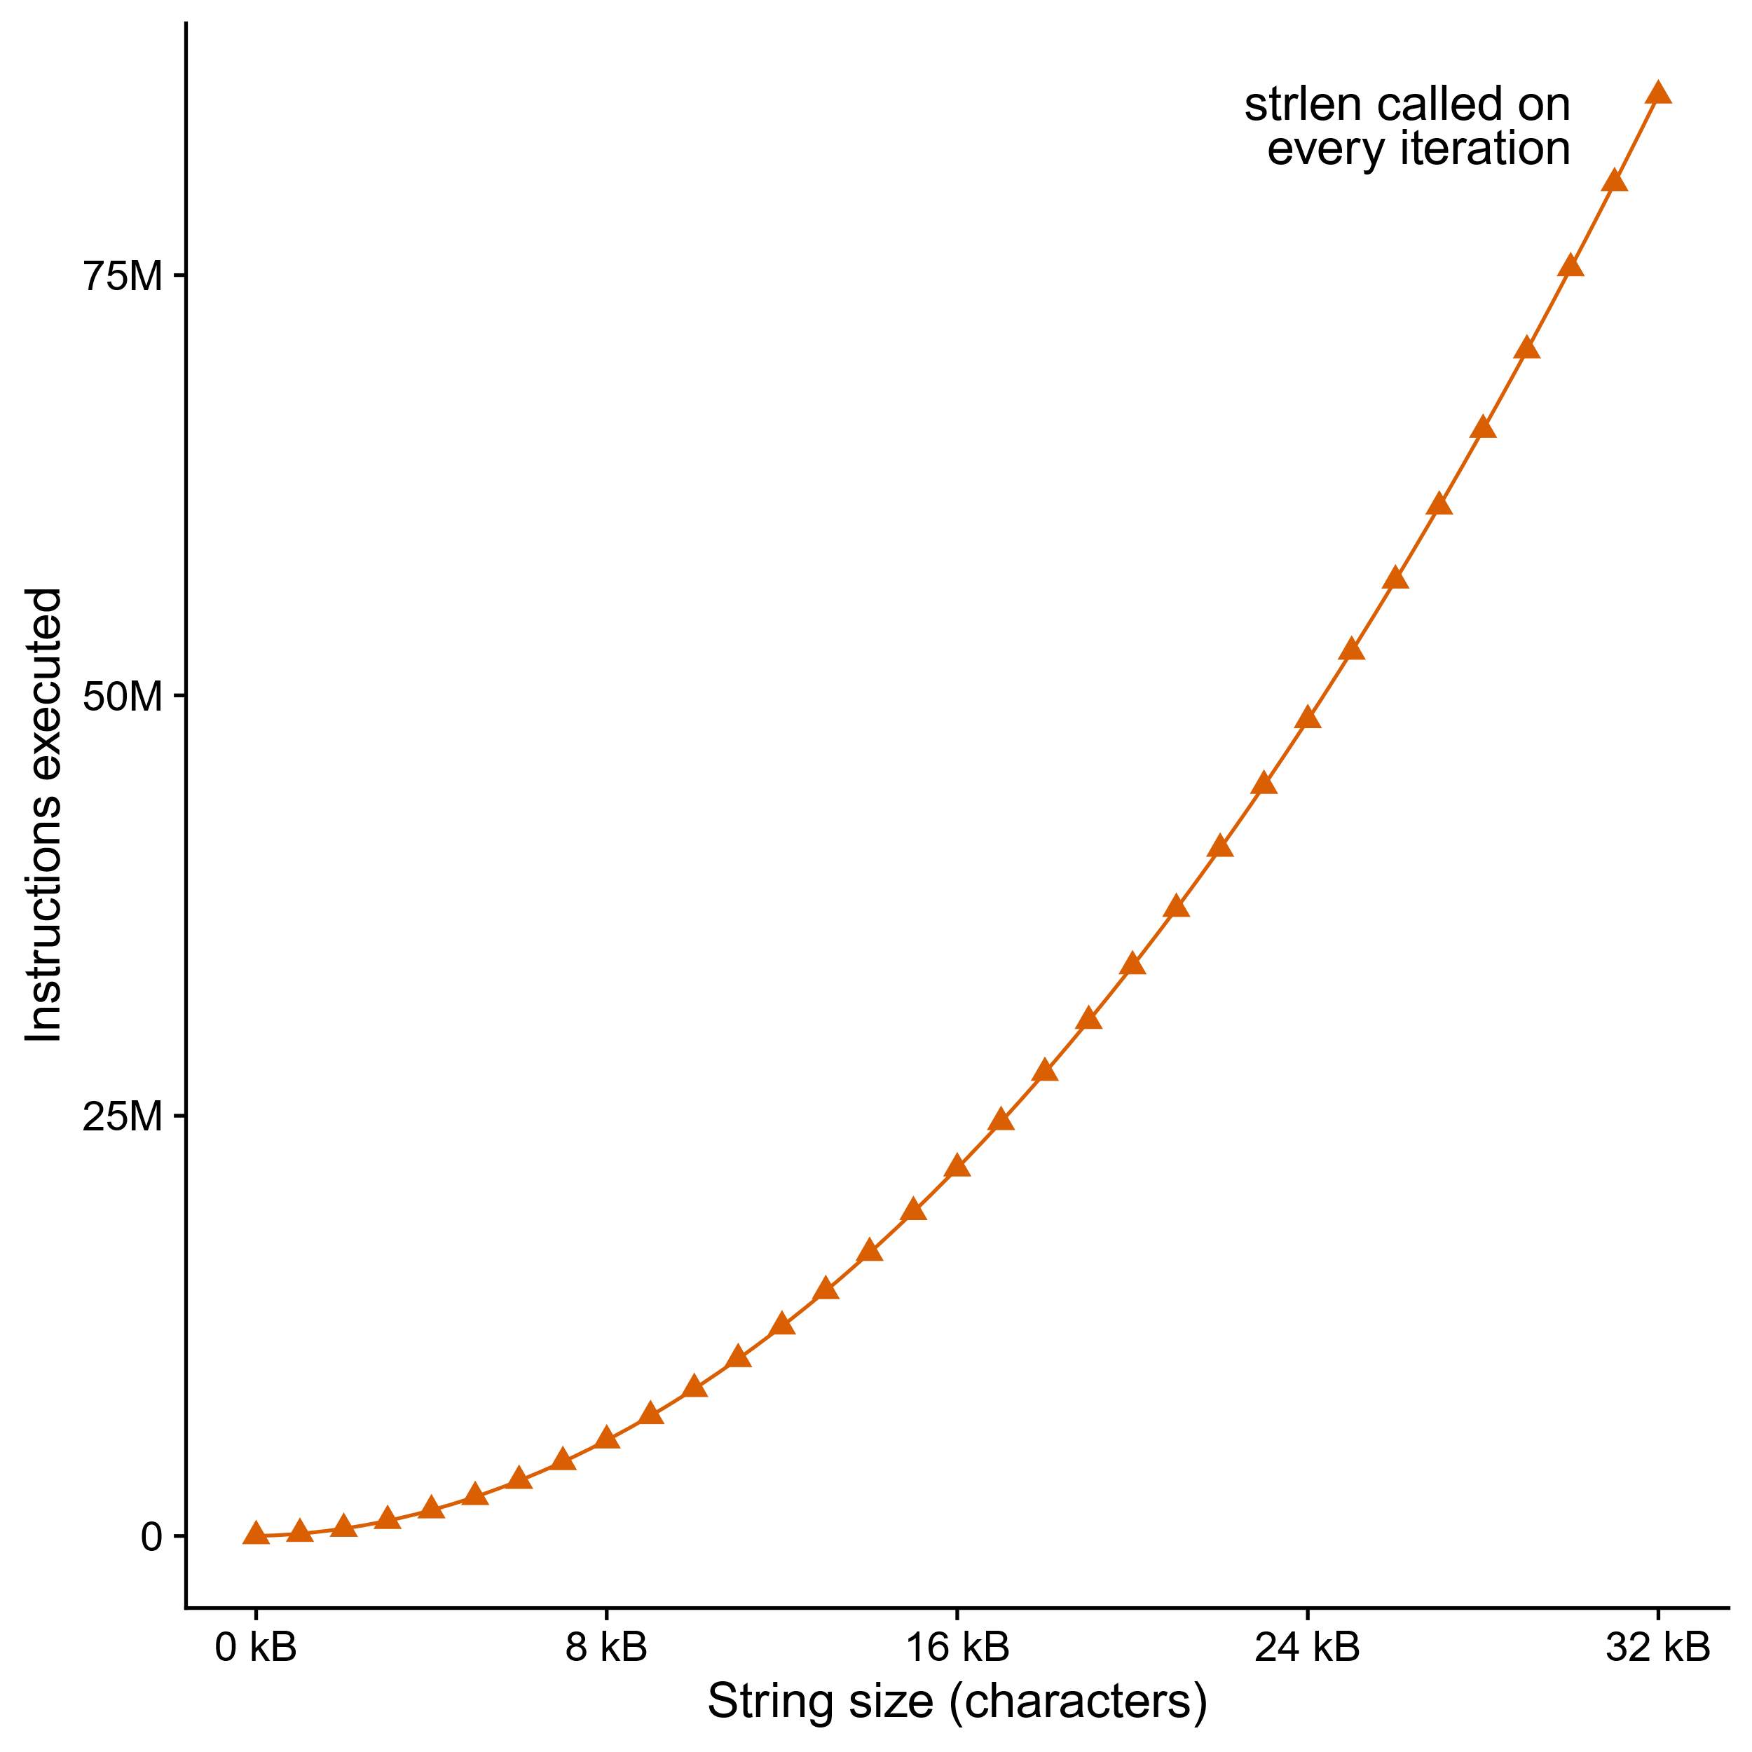
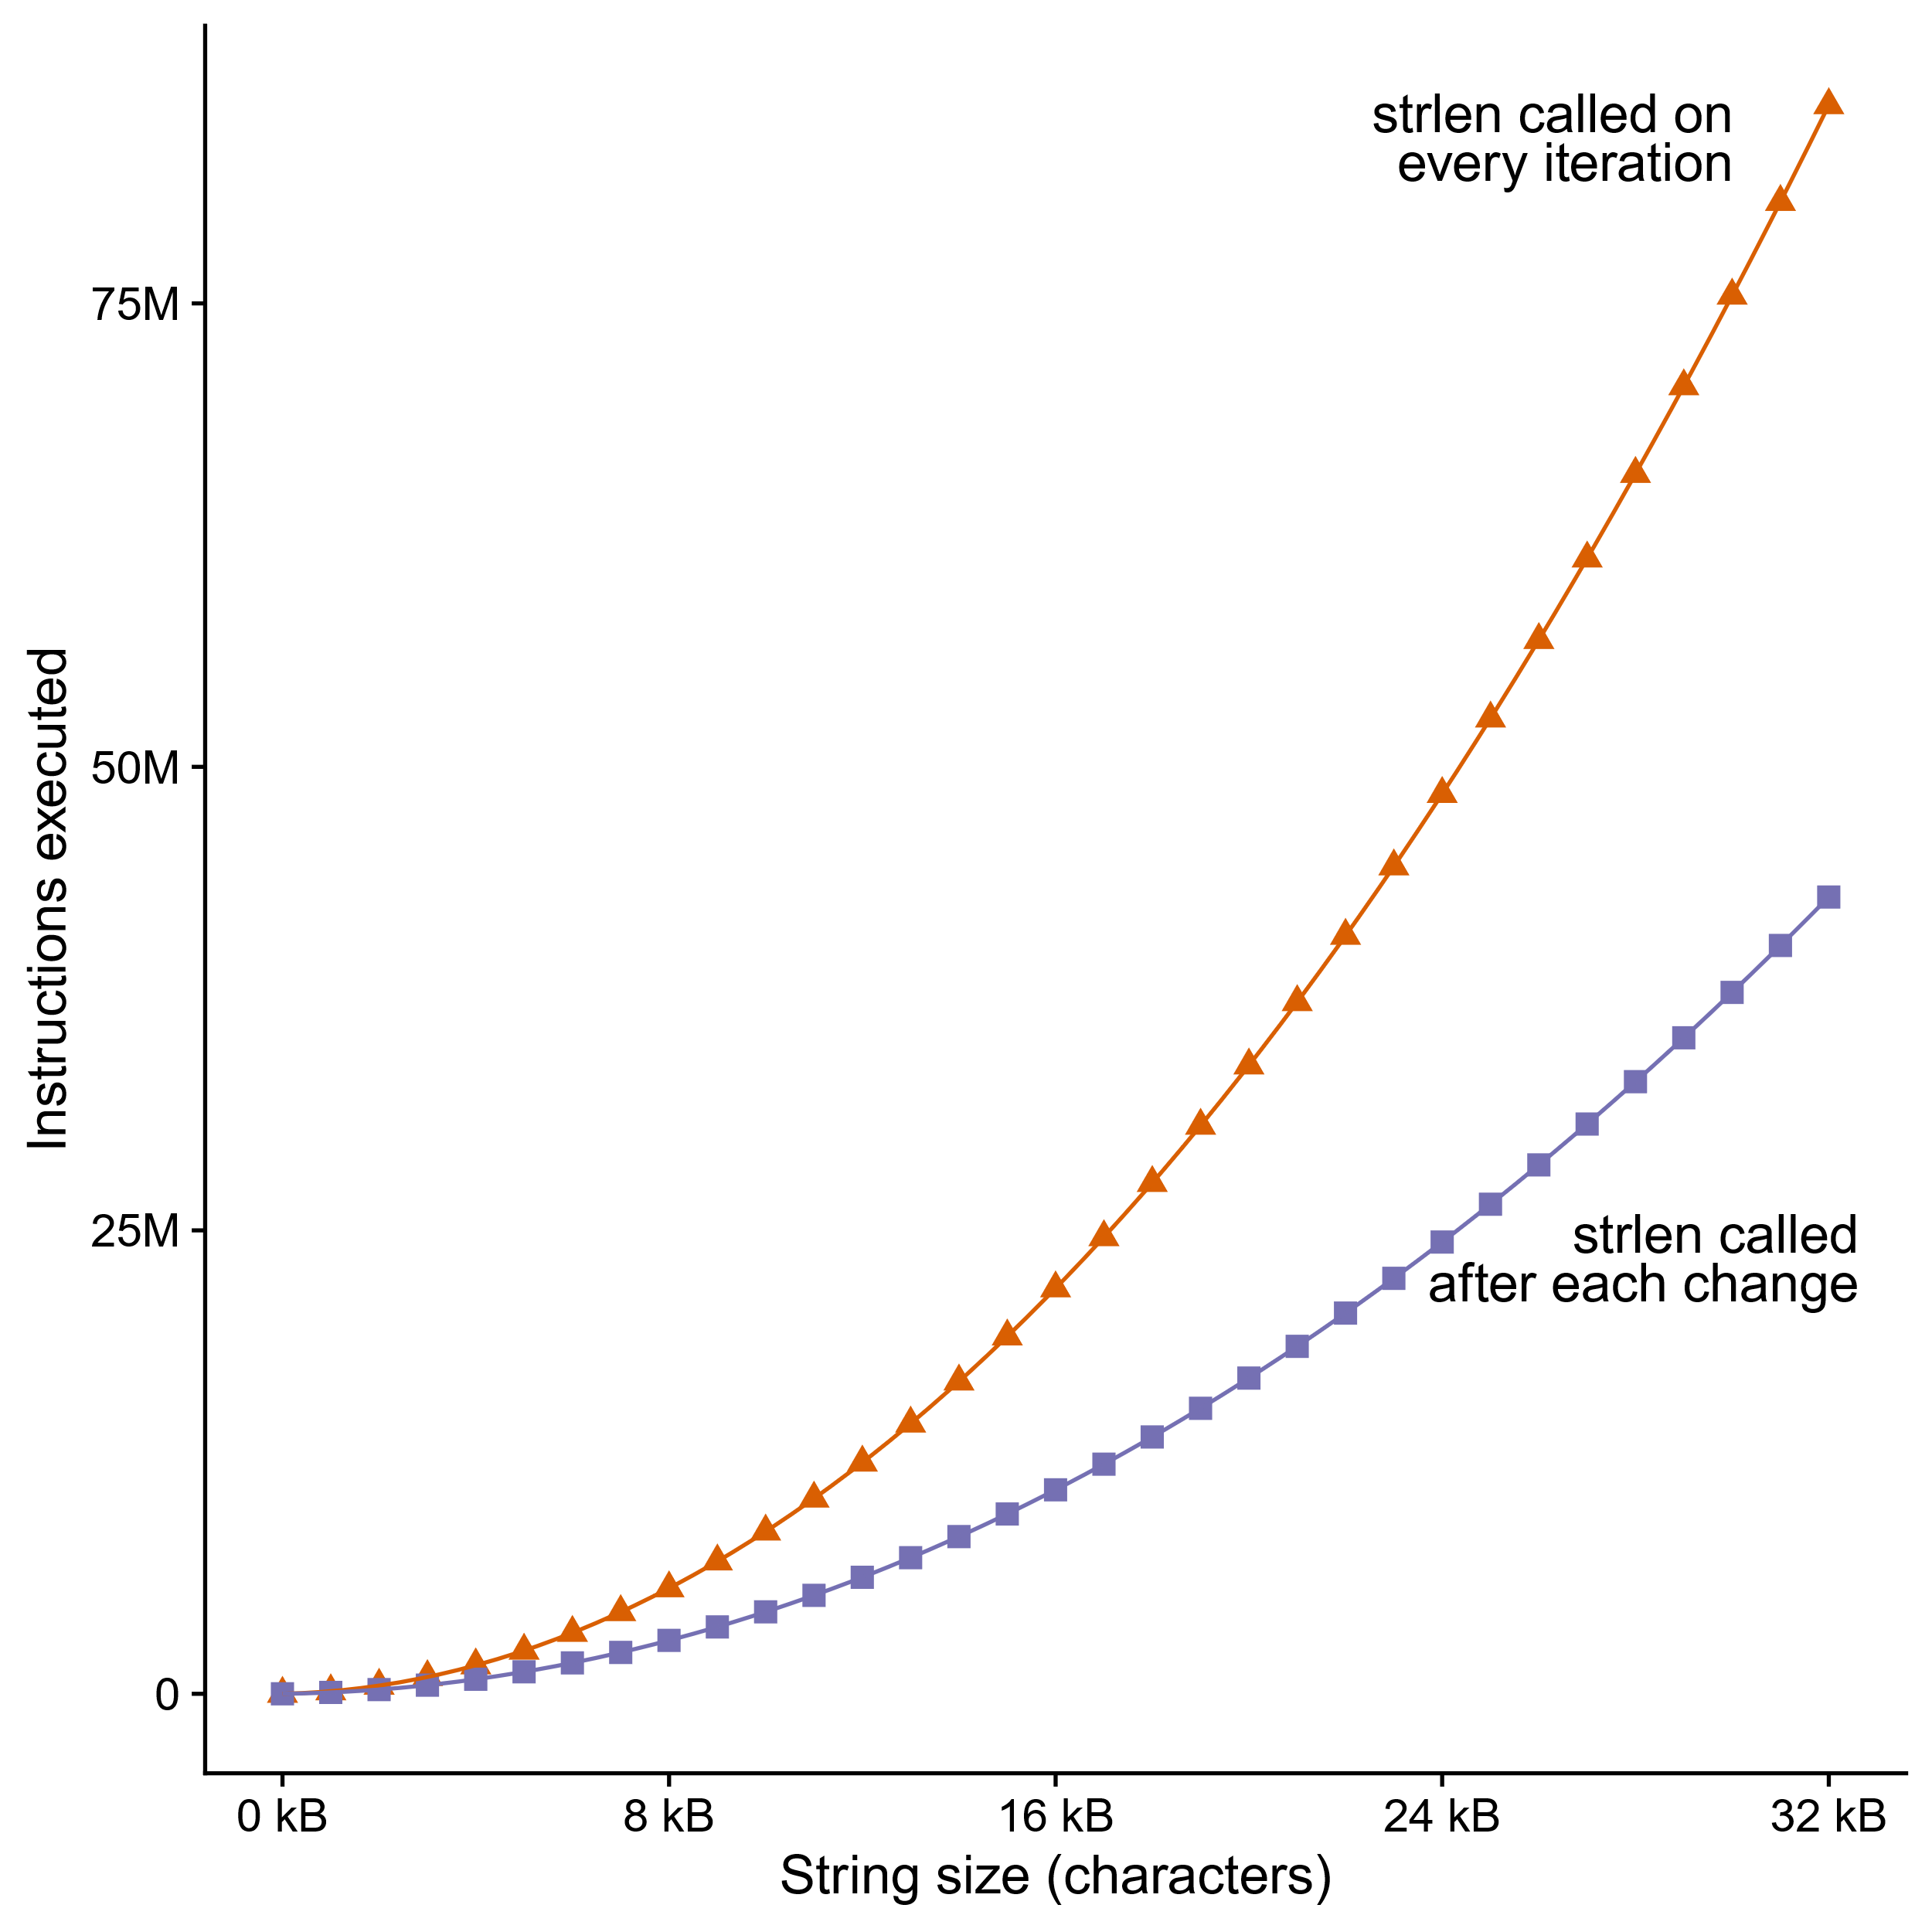
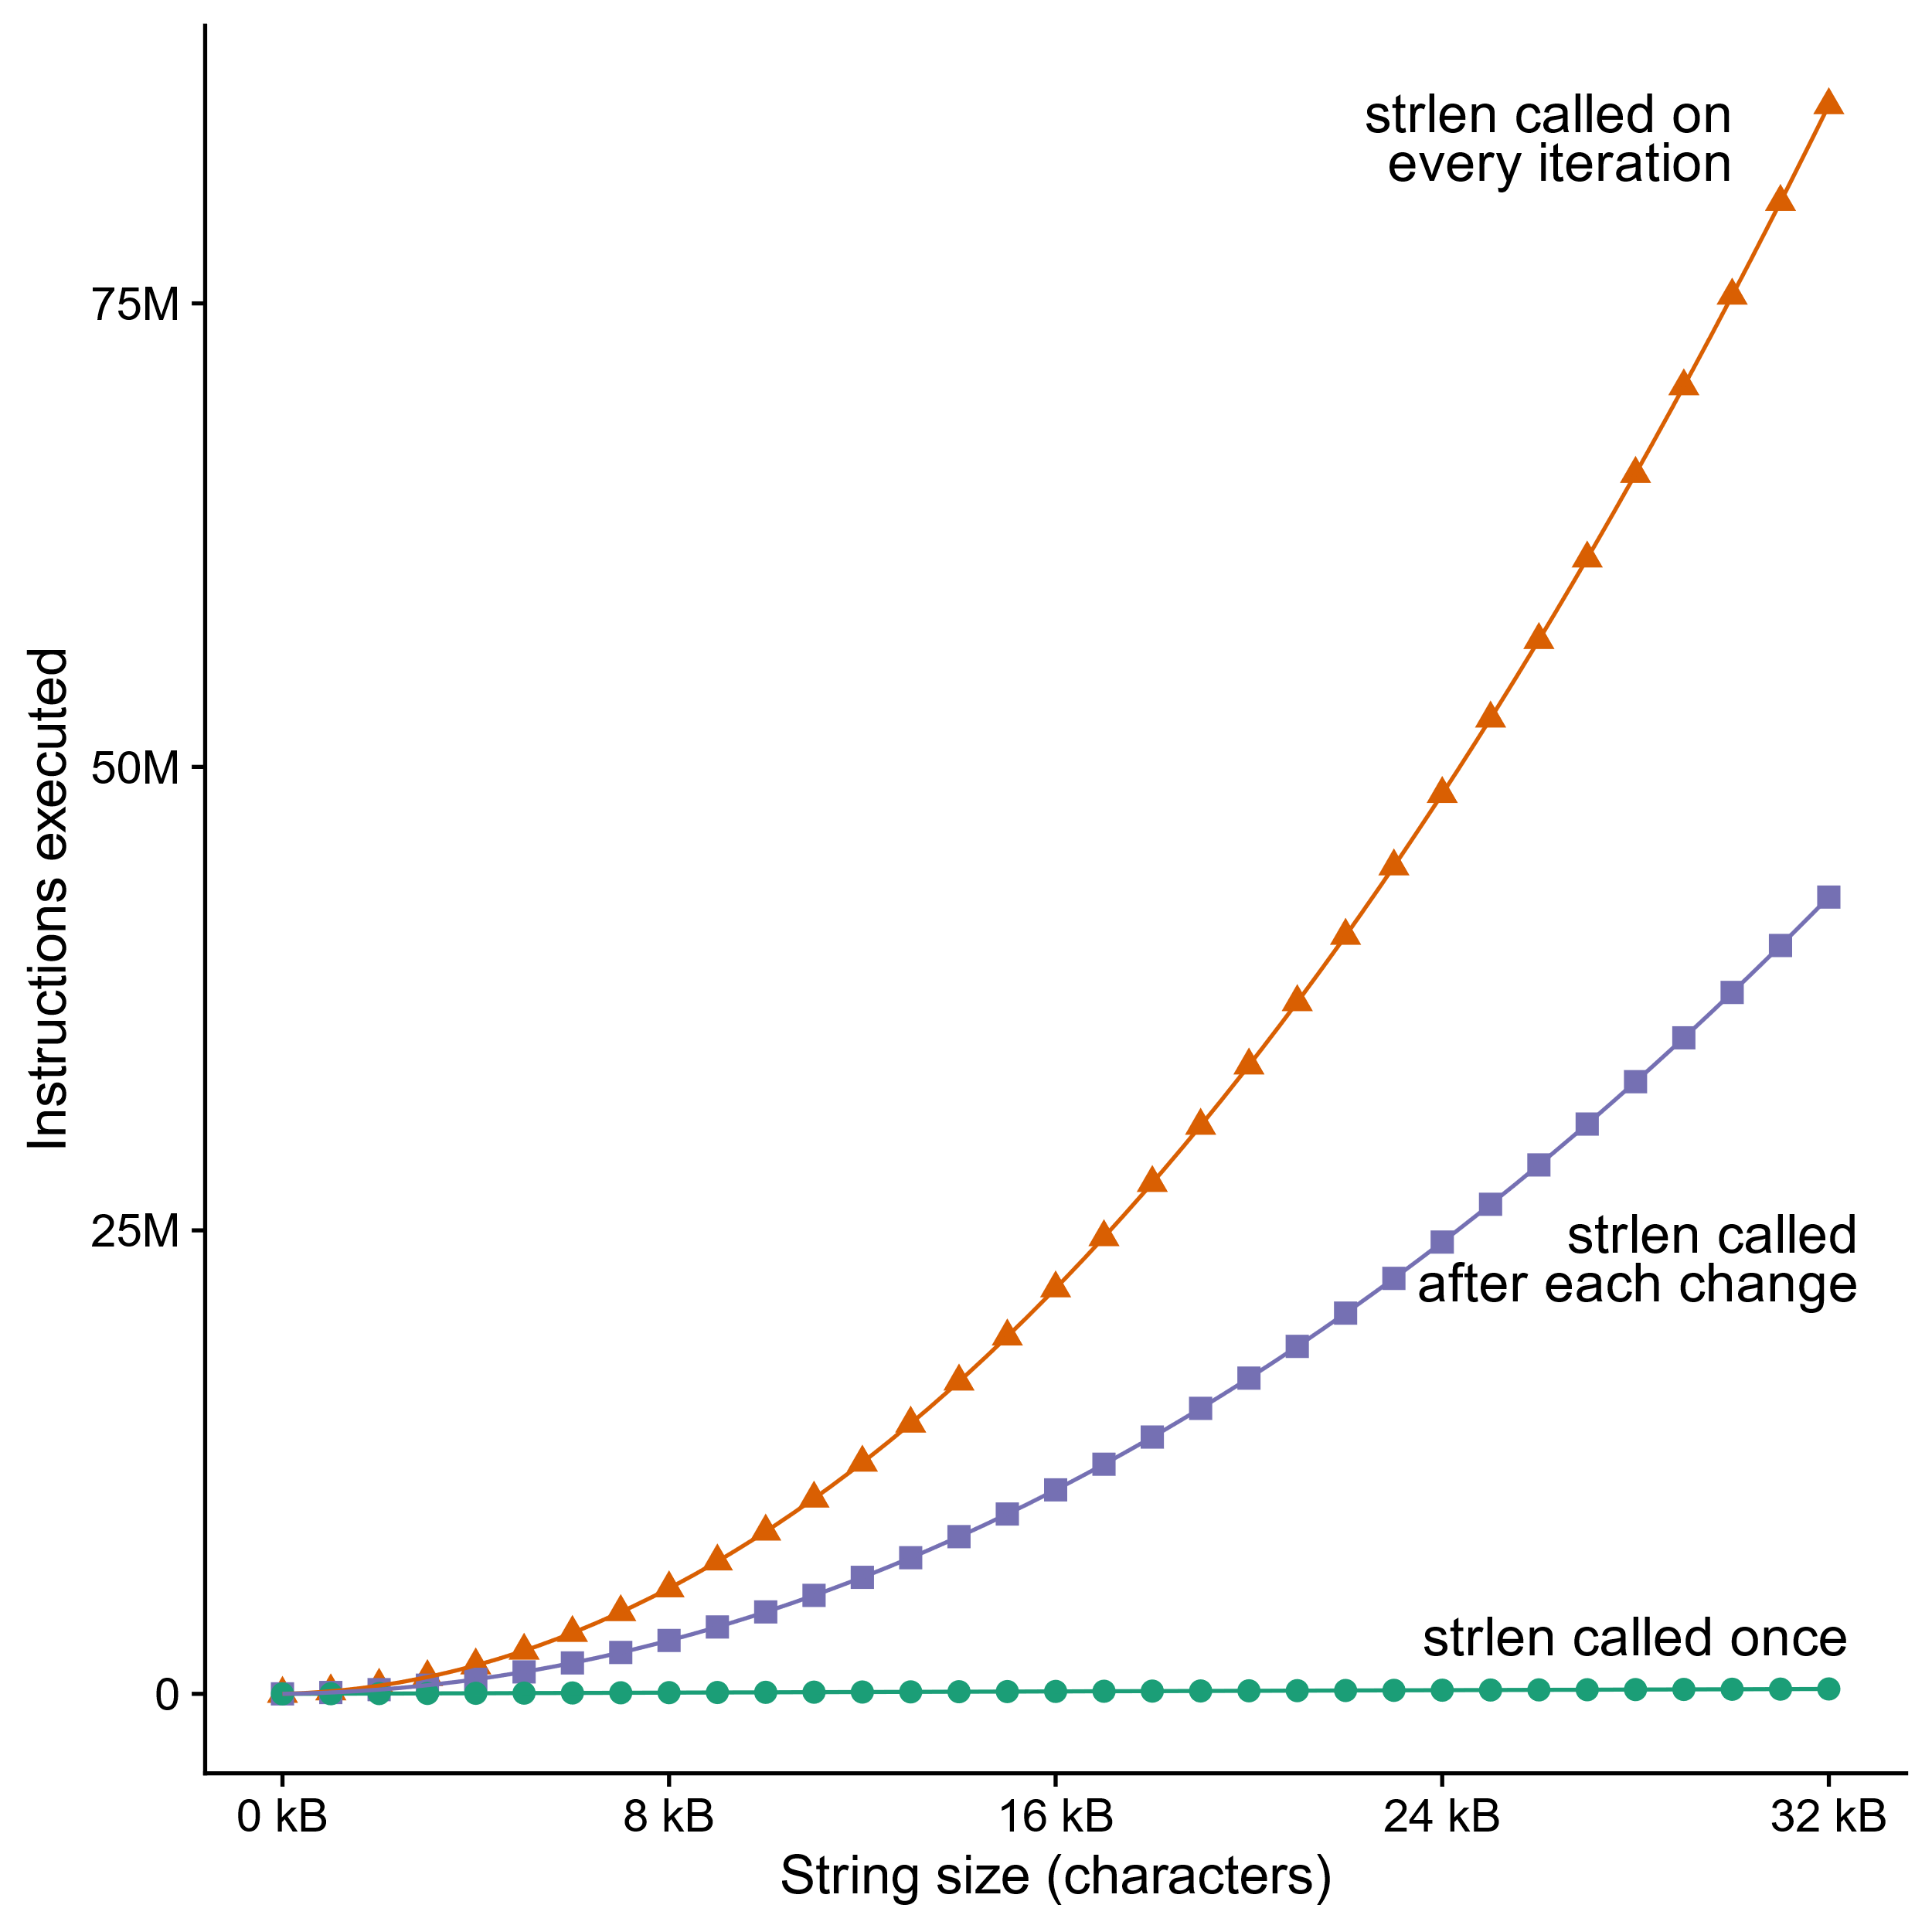
Can’t move function calls out of loops
void lower_quadratic(char *s) {
size_t i;
for (i = 0; i < strlen(s); i++)
if (s[i] >= 'A' && s[i] <= 'Z')
s[i] += 'a' - 'A';
}
void lower_still_quadratic(char *s) {
size_t i, n = strlen(s);
for (i = 0; i < n; i++)
if (s[i] >= 'A' && s[i] <= 'Z') {
s[i] += 'a' - 'A’;
n = strlen(s);
}
}
void lower_linear(char *s) {
size_t i, n = strlen(s);
for (i = 0; i < n; i++)
if (s[i] >= 'A' && s[i] <= 'Z')
s[i] += 'a' - 'A';
}
Lots more examples of this kind of bug: accidentallyquadratic.tumblr.com
Notes:
And because the compiler doesn’t know most of that, if you call strlen in a loop, it has to assume the result could change evey time.
In the function at the top, we have “for (I = 0, I < strlen(s), I++)”, we’re calling strlen, which scans the whole string, for every character in the string, and that’s O(n squared) time complexity. 75 million instructions executed to lowercase 32k of text.
[space] GCC on the sharks does know that strlen is a “pure function”, meaning it doesn’t have any side effects and its return value only depends on its argument and the data pointed to by its argument. That means it can assume strlen will return the same thing on each iteration UNLESS the loop changes the string. So it only calls strlen right after each change. I generated the data for the graph with strings that were exactly 50 percent uppercase, so, the middle function is twice as fast, but it’s still quadratic.
[space] If we manually move the strlen call out of the loop and only call it once, now we get linear time complexity.
[space] This is called “accidentally quadratic” complexity because the programmer probably didn’t intend for lower to be this slow, but it is anyway.
Complexity theorists make a huge deal about the difference between polynomial and exponential time, but for practical purposes,
Quadratic is already too slow.
Even n log n can be too slow – database wranglers spend a lot of time avoiding sorting.

Slide 36
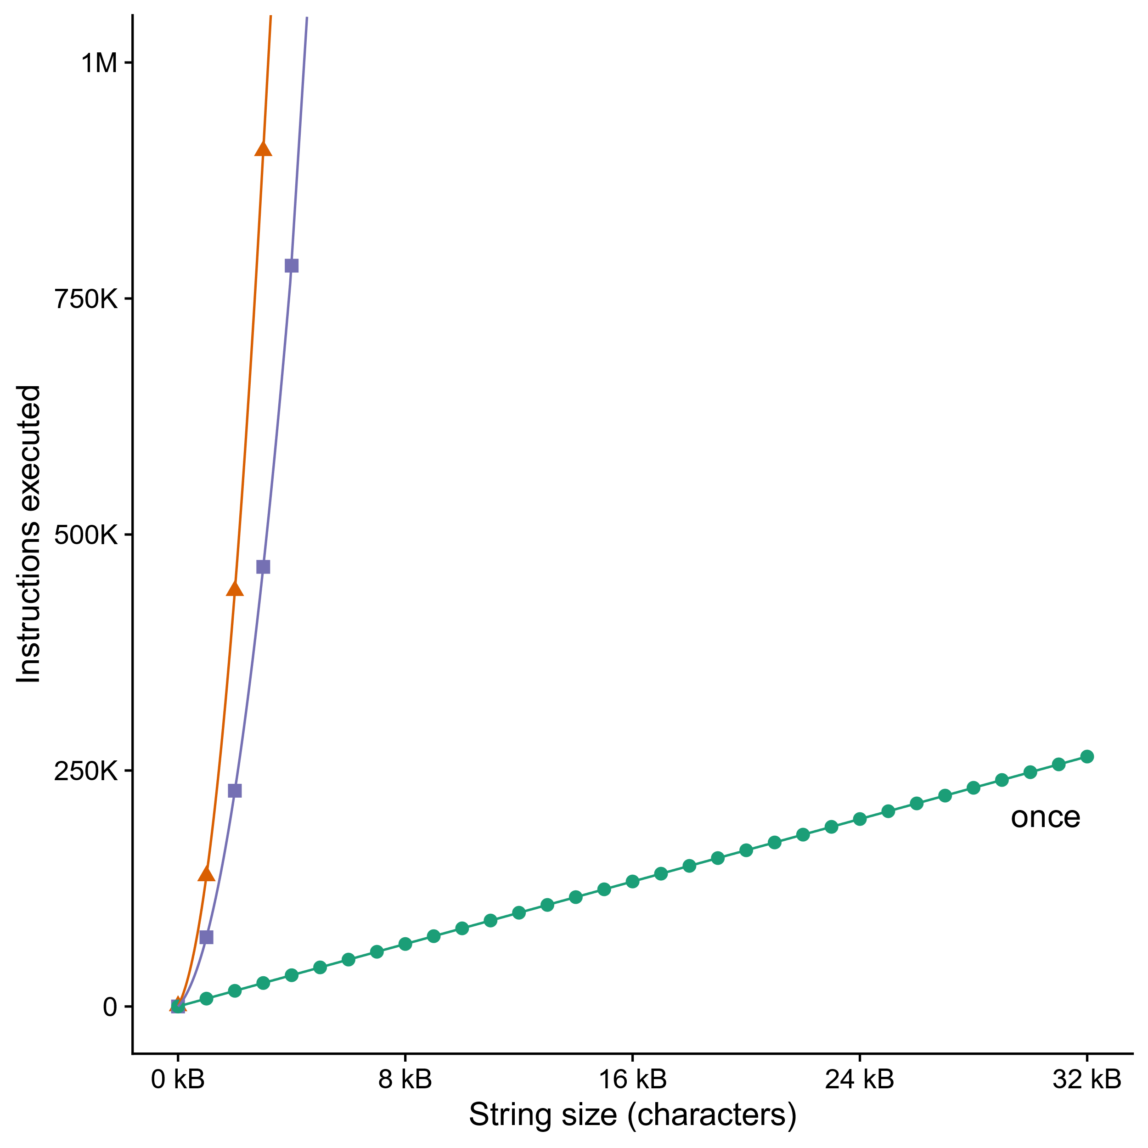
Can’t move function calls out of loops
void lower_quadratic(char *s) {
size_t i;
for (i = 0; i < strlen(s); i++)
if (s[i] >= 'A' && s[i] <= 'Z')
s[i] += 'a' - 'A';
}
void lower_still_quadratic(char *s) {
size_t i, n = strlen(s);
for (i = 0; i < n; i++)
if (s[i] >= 'A' && s[i] <= 'Z') {
s[i] += 'a' - 'A’;
n = strlen(s);
}
}
void lower_linear(char *s) {
size_t i, n = strlen(s);
for (i = 0; i < n; i++)
if (s[i] >= 'A' && s[i] <= 'Z')
s[i] += 'a' - 'A';
}
every iteration
after each change
Notes:
I zoomed in on the bottom of the graph so you can see that “lower_linear” really is linear and not O(1). But look how much of a difference it makes to call strlen only once.
We can lowercase 32kB of text in the same number of CPU cycles that it takes lower_still_quadratic to do two kilobytes.

Slide 37
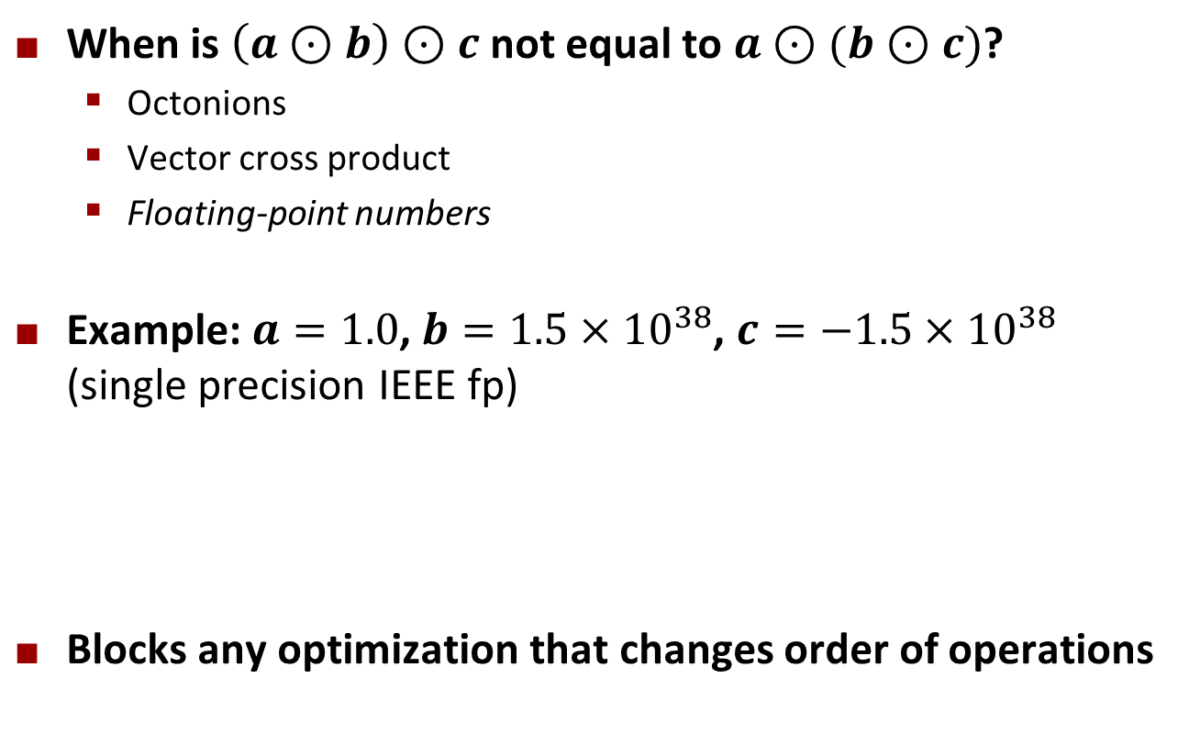
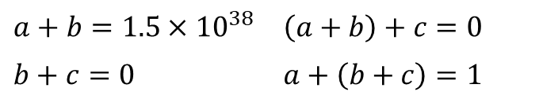
Non-associative arithmetic
When is $\left(a⊙b\right)⊙c$ not equal to $a⊙(b⊙c)$?
  Octonions
  Vector cross product
  Floating-point numbers
Example: $a=1.0$, $b=1.5×{10}^{38}$, $c=−1.5×{10}^{38}$ (single precision IEEE fp)
Blocks any optimization that changes order of operations
$$a+b=1.5×{10}^{38}$$ | $$\left(a+b\right)+c=0$$
$$b+c=0$$ | $$a+\left(b+c\right)=1$$
Notes:
Who can think of a mathematical operator – like addition, or matrix product, or whatever – that isn’t associative? Paren A op B, close paren, op C is not the same as A op paren B op C, close paren? [Demand at least two examples from class, then reveal next part of slide.]
These are my top three examples: octonions, which are like complex numbers, but with eight dimensions instead of two; vector cross product (unlike vector exterior product); and … floating point numbers.
[reveal] Floating point numbers aren’t associative because of rounding error. If you add 1.0 to 1.5x10^38 in single precision IEEE float, it gets rounded back to 1.5x10^38, so if you then subtract 1.5x10^38 again you get zero. But if you do it in the other order, 1.5x10^38 minus 1.5x10^38 is zero, plus one is one.
[reveal] In C the compiler is only allowed to change order of operations if it gives the same result, so it has to be very cautious about reordering floating point math.

Slide 38
Non-associative arithmetic
void mmm(double *a, double *b,
double *c, int n) {
memset(c, 0, n*n*sizeof(double));
int i, j, k;
for (i = 0; i < n; i++)
for (j = 0; j < n; j++)
for (k = 0; k < n; k++)
c[i*n + j] += a[i*n + k]
* b[k*n + j];
}
void mmm(double *a, double *b,
double *c, int n) {
memset(c, 0, n*n*sizeof(double));
int i, j, k, i1, j1, k1;
for (i = 0; i < n; i+=B)
for (j = 0; j < n; j+=B)
for (k = 0; k < n; k+=B)
for (i1 = i; i1 < i+B; i1++)
for (j1 = j; j1 < j+B; j1++)
for (k1 = k; k1 < k+B; k1++)
c[i1*n+j1] += a[i1*n + k1]
* b[k1*n + j1];
}
j
j1
c
a
b
c
a
b
=
x
=
x
i
i1
Block size B x B
Compiler cannot do this transformation automatically
Notes:
For example, remember last week we talked about how much matrix multiply speeds up if you do it in blocks for better cache use?
The compiler can’t do that transformation for you.
Unless maybe there’s a special option, like GCC’s –ffast-math, to tell it not to worry about getting the numbers right.

Slide 39
Quiz Time!
Check out:
https://canvas.cmu.edu/courses/24383/quizzes/67220

Slide 40
Today
Principles and goals of compiler optimization
Local optimization
  Constant folding, strength reduction, dead code elimination, common subexpression elimination
Global optimization
  Inlining, code motion, loop transformations
Obstacles to optimization
  Memory aliasing, procedure calls, non-associative arithmetic
Quiz
Machine-dependent optimization
  Branch predictability, loop unrolling, scheduling, vectorization
Notes:
Up till this point we’ve only been talking about “high level” or “machine independent” optimizations. Improvements that basically always make sense, and don’t need detailed information about the structure of the CPU that’s going to run the program.
Machine independent optimizations are great, but they’re only part of a compiler’s job. It’s also important to tailor the assembly language to the capabilities of the CPU. In the time we have left, let’s look at how compilers can do that.

Slide 41
Modern CPU Design
Instruction Control
Fetch
Control
Address
Instruction
Cache
Retirement
Unit
Register
File
Instruction
Decode
Instructions
Operations
Register Updates
Prediction OK?
Execution
Functional
Units
Branch
Arith
Arith
Arith
Load
Store
Operation Results
Addr.
Addr.
Data
Data
Data
Cache
Notes:
To understand the goals of machine-dependent optimizations you have to understand what a modern CPU is like. In the bottom part of the slide are the “functional units” that are actually doing the work. Each is specialized for a type of instruction – such as arithmetic, memory, and branching – and notice there are several arithmetic units, so it can do several arithmetic instructions at the same time. There’s a bus that feeds data from the registers to the functional units, and another bus that takes the data back to the registers, and yet a third bus going from the load and store units out to the data cache.
Meanwhile, at the top of the slide, we have the control circuitry, whose job is to read instructions from memory and dispatch them to appropriate functional units. It will try to keep all of them busy, even if that means executing instructions “out of order” – as soon as all the inputs to an instruction are available, and there’s a free functional unit that can process it, it goes, even if it was later in the machine code than other instructions that are still waiting.
This is just a taste – Professor Railing has an entire course about how these boxes are put together. 418.

Slide 42
Branches Are A Challenge
Instruction Control Unit must work well ahead of Execution Unit
to generate enough operations to keep EU busy
If the CPU has to wait for the result of the cmp before continuing to fetch instructions, may waste tens of cycles doing nothing!
404663: mov $0x0,%eax
404668: cmp (%rdi),%rsi
40466b: jge 404685
40466d: mov 0x8(%rdi),%rax
. . .
404685: repz retq
Executing
Need to know
which way to
branch …
Notes:
In order to keep all of those functional units busy, the control unit has to be fetching instructions well in advance of what’s currently being executed. But that means code like this poses a problem. Suppose the control unit has just fetched the jge instruction. It needs to know, right now, what to fetch next. But that depends on the result of the cmp, and the cmp is ten instructions back in the queue, so it’s going to be at least a half-dozen cycles before we know its result. More if that paren-rdi memory access misses the cache.
Nobody knows how to make a wire that sends data backwards in time, not even a little, so what do we do?
Anyone know?

Slide 43
Branch Prediction
Guess which way branch will go
  Begin executing instructions at predicted position
  But don’t actually modify register or memory data
404663: mov $0x0,%eax
404668: cmp (%rdi),%rsi
40466b: jge 404685
40466d: mov 0x8(%rdi),%rax
. . .
404685: repz retq
Predict Taken
Continue
Fetching
Here
Notes:
The control unit makes a guess. It starts fetching from the destination it guessed, and dispatching instructions, but the results of all those instructions are marked “speculative”. They are held in the “retirement unit” until the result of the cmp is known. If the guess was correct, then the CPU can commit all those results and keep going.
But if it guessed wrong, what’s it got to do?
It has to throw away all that speculative work and start over, fetching from the correct path through the code.

Slide 44
Branch Prediction Through Loop
401029: mulsd (%rdx),%xmm0,%xmm0
40102d: add $0x8,%rdx
401031: cmp %rax,%rdx
401034: jne 401029
Assume
array length = 100
i = 98
Predict Taken (OK)
401029: mulsd (%rdx),%xmm0,%xmm0
40102d: add $0x8,%rdx
401031: cmp %rax,%rdx
401034: jne 401029
i = 99
Predict Taken
(Oops)
401029: mulsd (%rdx),%xmm0,%xmm0
40102d: add $0x8,%rdx
401031: cmp %rax,%rdx
401034: jne 401029
Read invalid location
Executed
i = 100
401029: mulsd (%rdx),%xmm0,%xmm0
40102d: add $0x8,%rdx
401031: cmp %rax,%rdx
401034: jne 401029
Fetched
i = 101
Notes:
So for instance here’s a little loop – walking through the elements of an array of doubles and multiplying register xmm0 by each one – suppose there are 100 elements in the array, and the control unit is guessing that the jne instruction will jump. That’s a good guess the first 99 times through the loop. But when we get to element 100, oops! Jne fell through, but we guessed it would jump, and we executed another four instructions and fetched four more beyond that before we noticed.

Slide 45
Branch Misprediction Invalidation
401029: mulsd (%rdx),%xmm0,%xmm0
40102d: add $0x8,%rdx
401031: cmp %rax,%rdx
401034: jne 401029
Assume
array length = 100
i = 98
Predict Taken (OK)
401029: mulsd (%rdx),%xmm0,%xmm0
40102d: add $0x8,%rdx
401031: cmp %rax,%rdx
401034: jne 401029
i = 99
Predict Taken
(Oops)
401029: mulsd (%rdx),%xmm0,%xmm0
40102d: add $0x8,%rdx
401031: cmp %rax,%rdx
401034: jne 401029
i = 100
Invalidate
401029: mulsd (%rdx),%xmm0,%xmm0
40102d: add $0x8,%rdx
401031: cmp %rax,%rdx
401034: jne 401029
i = 101
Notes:
So now we have to throw out four instructions’ worth of calculations, and four more fetches, and back up the visible processor state to what it should have been at the point of the mis-predicted branch, and start over.

Slide 46
Branch Misprediction Recovery
401029: mulsd (%rdx),%xmm0,%xmm0
40102d: add $0x8,%rdx
401031: cmp %rax,%rdx
401034: jne 401029
401036: jmp 401040
. . .
401040: movsd %xmm0,(%r12)
i = 99
Definitely not taken
Reload
Pipeline
Performance Cost
  Multiple clock cycles on modern processor
  Can be a major performance limiter
Notes:
We roll the register state back to loop cycle 99 and the instruction fetcher starts over, fetching from 401036 instead of 401029. The instruction at 401036 is an unconditional jump – those don’t require guessing. It just does it. Fetch from 401040 next. And we go on.
As you might imagine, this is expensive. We just wasted a bunch of time and electricity. On a real CPU it wouldn’t be a measly four to eight instructions’ worth of wasted work, either, it would be more like fifty instructions. Tens to hundreds of clock cycles.
This is also one of the most troublesome parts of a modern CPU to implement correctly. You’ve probably heard about the “Spectre” hardware security bugs –the root cause of those is that Intel and AMD and ARM and IBM, they all got the “back up and start over” process wrong.

Slide 47
Branch Prediction Numbers
A simple heuristic:
  Backwards branches are often loops, so predict taken
  Forwards branches are often ifs, so predict not taken
  >95% prediction accuracy just with this!
Fancier algorithms track behavior of each branch
  Subject of ongoing research
  2011 record (https://www.jilp.org/jwac-2/program/JWAC-2-program.htm): 34.1 mispredictions per 1000 instructions
  Current research focuses on the remaining handful of
  “impossible to predict” branches (strongly data-dependent,
  no correlation with history)
    e.g. https://hps.ece.utexas.edu/pub/PruettPatt_BranchRunahead.pdf

Slide 48
Optimizing for Branch Prediction
Reduce # of branches
  Transform loops
  Unroll loops
  Use conditional moves
    Not always a good idea
Make branches predictable
  Sort data https://stackoverflow.com/questions/11227809
  Avoid indirect branches
    function pointers
    virtual methods
.Loop:
movzbl 0(%rbp,%rbx), %edx
leal -65(%rdx), %ecx
cmpb $25, %cl
ja .Lskip
addl $32, %edx
movb %dl, 0(%rbp,%rbx)
.Lskip:
addl $1, %rbx
cmpq %rax, %rbx
jb .Loop
.Loop:
movzbl 0(%rbp,%rbx), %edx
movl %edx, %esi
leal -65(%rdx), %ecx
addl $32, %edx
cmpb $25, %cl
cmova %esi, %edx
movb %dl, 0(%rbp,%rbx)
addl $1, %rbx
cmpq %rax, %rbx
jb .Loop
Memory write now unconditional!
Notes:
What can the compiler do to make the branch predictor’s job easier? Well, it can reduce the number of branches. Several of the loop transformations I showed you earlier can do this, and remember that most CPU time is spent in a loop, so that’s the place to target. Unrolling loops, which we’re about to see, also does this, although it’s not the main reason for unrolling.
The compiler can also turn branches into conditional moves. On the right, that’s the assembly language for the lowercase-a-string function from earlier, in two versions: with a branch, at the top; with a conditional move, at the bottom. This particular branch is liable to be hard to predict because it depends entirely on the string, so it’s a good target for converting to conditional moves – but watch out! [reveal] We are now writing each character back to memory whether or not it changed! Probably not a big deal, unless you have a write-through cache, but still a potential reason not to do this.
If we can’t get rid of branches, maybe we can make them more predictable. Processing data in sorted order often makes branches more predictable – click that stack overflow link for a fun story about that. Another thing that really helps is to avoid using indirect branches – function pointers, virtual method calls, jump tables – because processors haven’t put as much effort into optimizing those. Microsoft’s C++ compiler will try to guess which concrete implementation of a virtual method is most likely to be in use, and inline that one, wrapped in an if-I-guessed-right conditional.

Slide 49
Loop Unrolling
Amortize cost of loop condition by duplicating body
Creates opportunities for CSE, code motion, scheduling
Prepares code for vectorization
Can hurt performance by increasing code size
for (size_t i = 0; i < nelts; i++) {
A[i] = B[i]*k + C[i];
}
for (size_t i = 0; i < nelts - 4; i += 4) {
A[i ] = B[i ]*k + C[i ];
A[i+1] = B[i+1]*k + C[i+1];
A[i+2] = B[i+2]*k + C[i+2];
A[i+3] = B[i+3]*k + C[i+3];
}
When would this change be incorrect?
Notes:
Why would it make the code faster if you duplicate the loop body four times?
The most elemental reason is that it means you execute the loop condition and branch four times less often. That probably doesn’t make a huge difference for this code, but suppose the value of “nelts” is super unpredictable except it’s always a multiple of four – then we just reduced the frequency of branch misprediction stalls by a factor of four.
It also creates opportunities for a bunch of other optimizations, which we’ll look at next.
You do have to watch out for increasing code size, though, like with inlining. And you also have to watch out for running out of registers. If there’s not enough registers to hold all of the variables and intermediates, this probably won’t be faster.
Also, I want to ask: [reveal] When is this change incorrect?
This change is incorrect when the number of elements is not a multiple of 4. Sometimes the compiler can emit code to do the last few array elements separately from the loop, but that takes up even more space.

Slide 50
Scheduling
Rearrange instructions to make it easier for the CPU
to keep all functional units busy
For instance, move all the loads to the top of an
unrolled loop
  Now maybe it’s more obvious why we need lots of registers
for (size_t i = 0; i < nelts - 4; i += 4) {
A[i ] = B[i ]*k + C[i ];
A[i+1] = B[i+1]*k + C[i+1];
A[i+2] = B[i+2]*k + C[i+2];
A[i+3] = B[i+3]*k + C[i+3];
}
for (size_t i = 0; i < nelts - 4; i += 4) {
B0 = B[i]; B1 = B[i+1]; B2 = B[i+2]; B3 = B[i+3];
C0 = C[i]; C1 = C[i+1]; C2 = C[i+2]; C3 = B[i+3];
A[i ] = B0*k + C0;
A[i+1] = B1*k + C1;
A[i+2] = B2*k + C2;
A[i+3] = B3*k + C3;
}
When would this change be incorrect?
Notes:
If we have a lot of work to do within a basic block, maybe it doesn’t have to be done all in a straight line. [reveal] Maybe, for instance, we can take that unrolled loop and move all the memory loads to the beginning, so they can all issue at once and then the math can happen in whatever order the data comes back. The CPU’s control unit might be able to do this itself, but then again it might not, and either way it works better if the compiler helps.
[reveal] When is this change incorrect?
This change is incorrect when A overlaps B or C, so the writes to A change the values being read from B or C. Like with the vector row sums from earlier.

Slide 51
Vectorization
Use special instructions that operate on several array elements at once
  Often called “SIMD” for “Single Instruction Multiple Data”
  Invented in 1966 for ILLIAC IV supercomputer
  Valuable for audio and video processing; has become ubiquitous
for (size_t i = 0; i < nelts - 4; i += 4) {
B0 = B[i]; B1 = B[i+1]; B2 = B[i+2]; B3 = B[i+3];
C0 = C[i]; C1 = C[i+1]; C2 = C[i+2]; C3 = B[i+3];
A[i ] = B0*k + C0;
A[i+1] = B1*k + C1;
A[i+2] = B2*k + C2;
A[i+3] = B3*k + C3;
}
kkkk = _mm_set_ps1(k);
for (size_t i = 0; i < nelts - 4; i += 4) {
B0123 = _mm_load_ps(&B[i]);
C0123 = _mm_load_ps(&C[i]);
A0123 = _mm_fmadd_ps(B0123, kkkk, C0123);
_mm_store_ps(&A[i], A0123);
}
Notes:
And the last optimization we’re going to talk about today is when you use special “vector instructions” or “SIMD instructions” that do the same arithmetic on a bunch of array elements at once. The loop on the left is ideal for this. It’s calculating a = b*k + c for every element of arrays b and c, four elements at a time. [reveal] Assuming these are single precision floats, the CPU has a single instruction that can do four loads at once, another instruction that can do four stores at once, and a third that can do four multiplications and additions at once.
I wrote the code on the right by hand, but compilers can do this for you – if the preconditions are all just so.
How much vectorization helps, depends a _lot_ on exactly what you need to calculate and exactly what CPU you have. It happens to be very good at things like decoding compressed music and video, and that’s why it’s usually available on modern CPUs, but for many tasks it’s more trouble than it’s worth.

Slide 52
Summary: Getting High Performance
Good compiler and flags
Don’t do anything sub-optimal
  Watch out for hidden algorithmic inefficiencies
  Write compiler-friendly code
    Watch out for optimization blockers:
    procedure calls & memory references
  Look carefully at innermost loops (where most work is done)
Tune code for machine
  Exploit instruction-level parallelism
  Avoid unpredictable branches
  Make code cache friendly

