Slide 1
Future of Computing:
Moore’s Law,
The End of Frequency Scaling,
Domain-specific accelerators
15-213: Introduction to Computer Systems
27th Lecture, Apr. 28, 2022
Instructor:
David Andersen

Slide 2
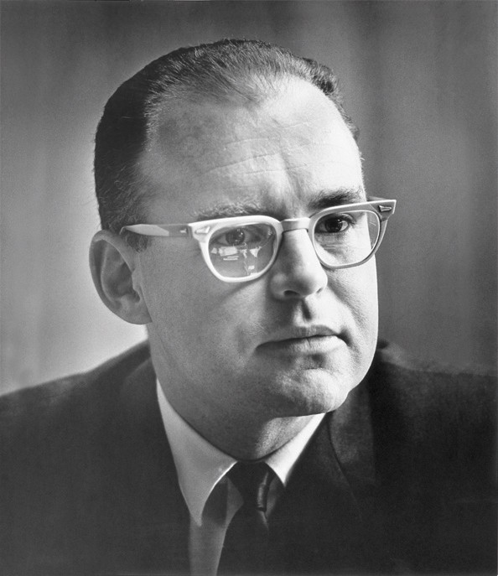
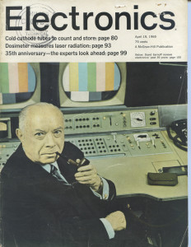
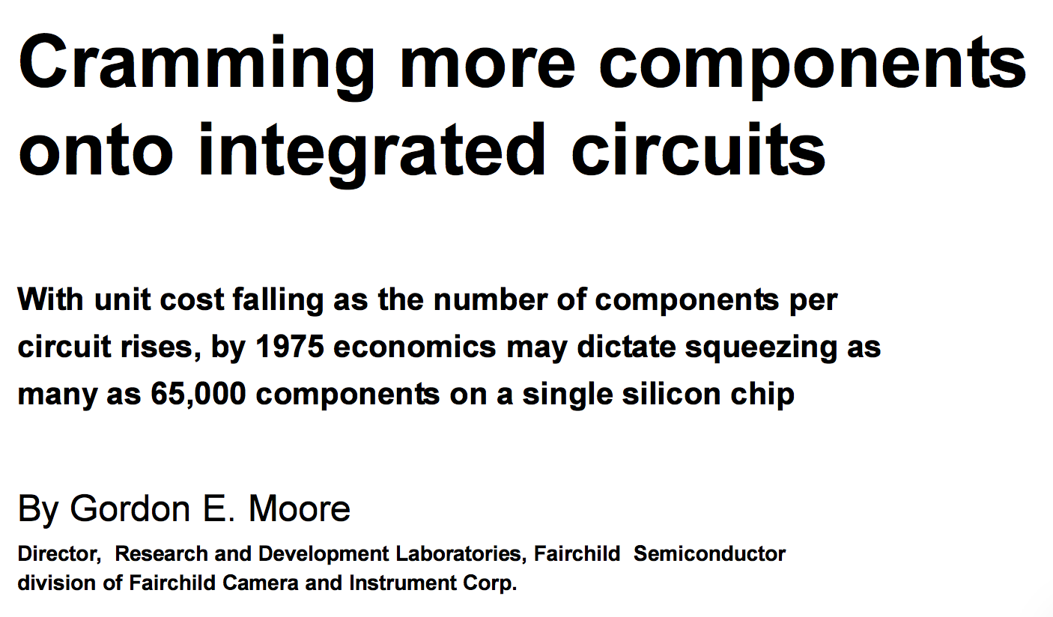
Moore’s Law Origins
April 19, 1965

Slide 3
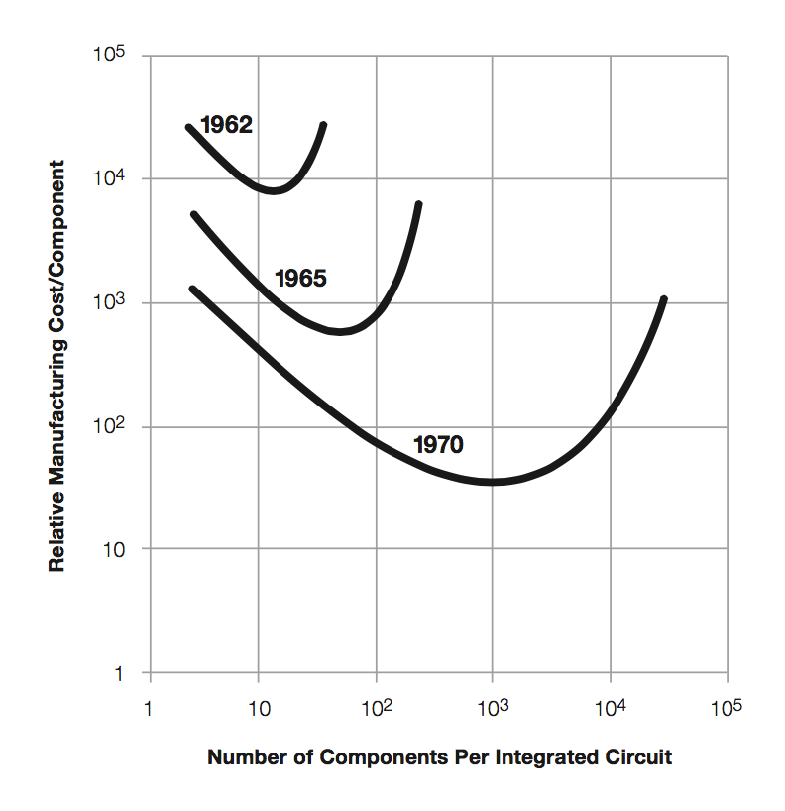
Moore’s Law Origins
Moore’s Thesis
  Minimize price per device
  Optimum number of devices / chip increasing 2x / year
Later
  2x / 2 years
  “Moore’s Prediction”
1965: 50
1970: 1000

Slide 4
Moore’s Law: 50 Years
Sample of
117 processor chips

Slide 5
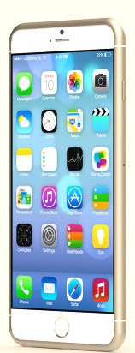
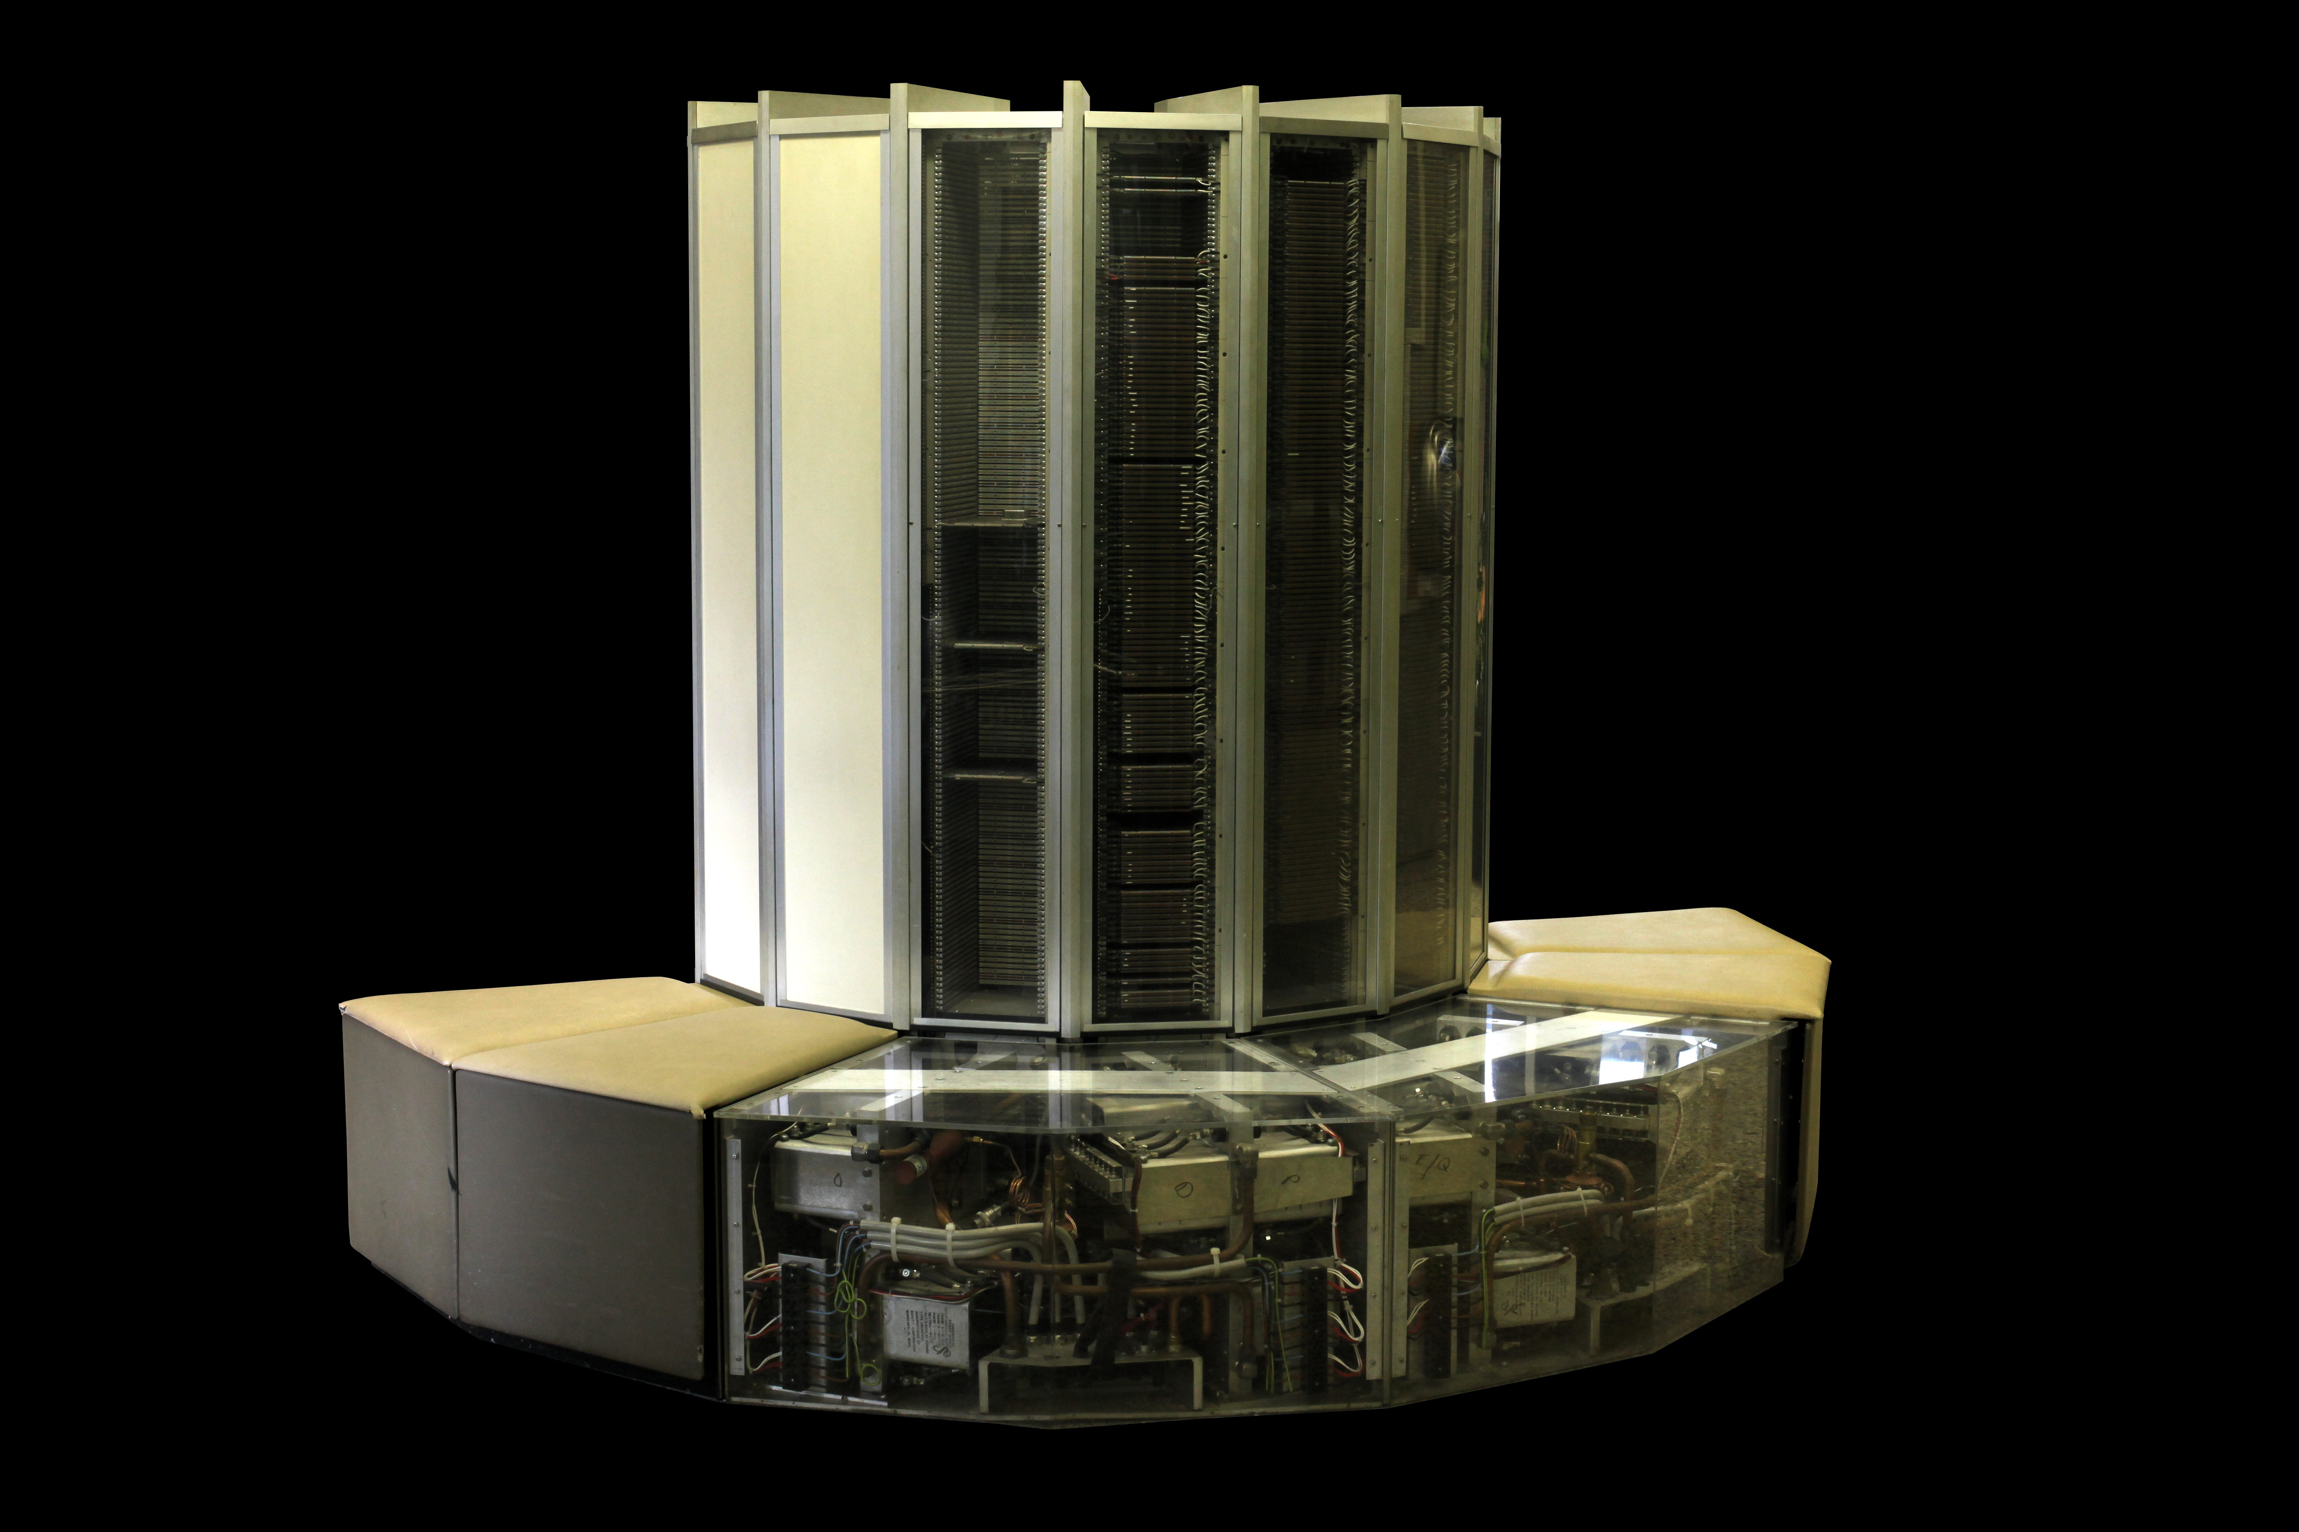
What Moore’s Law Has Meant
1976 Cray 1
  250 M Ops/second
  ~170,000 chips
  0.5B transistors
  5,000 kg, 115 KW
  $9M
  80 manufactured
2014 iPhone 6
  > 4 B Ops/second
  ~10 chips
  > 3B transistors
  120 g, < 5 W
  $649
  10 million sold in first 3 days

Slide 6
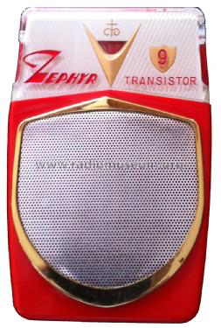
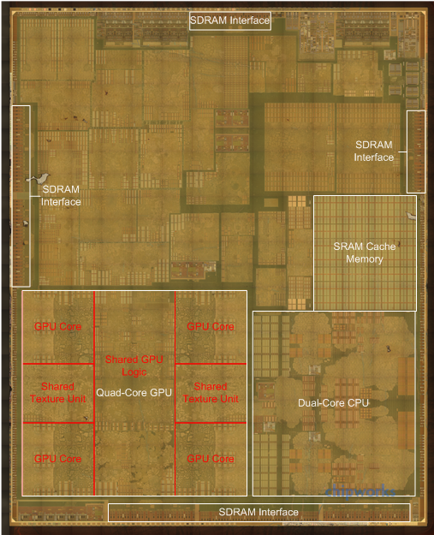
What Moore’s Law Has Meant
1965 Consumer Product
2015 Consumer Product
Apple A8 Processor
2 B transistors

Slide 7
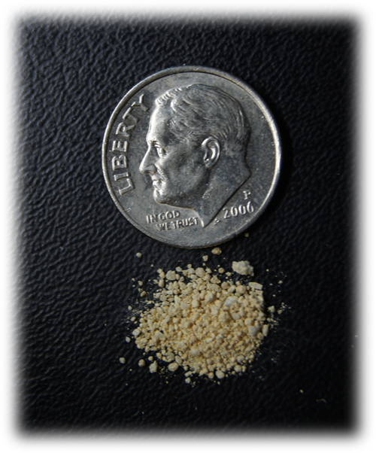
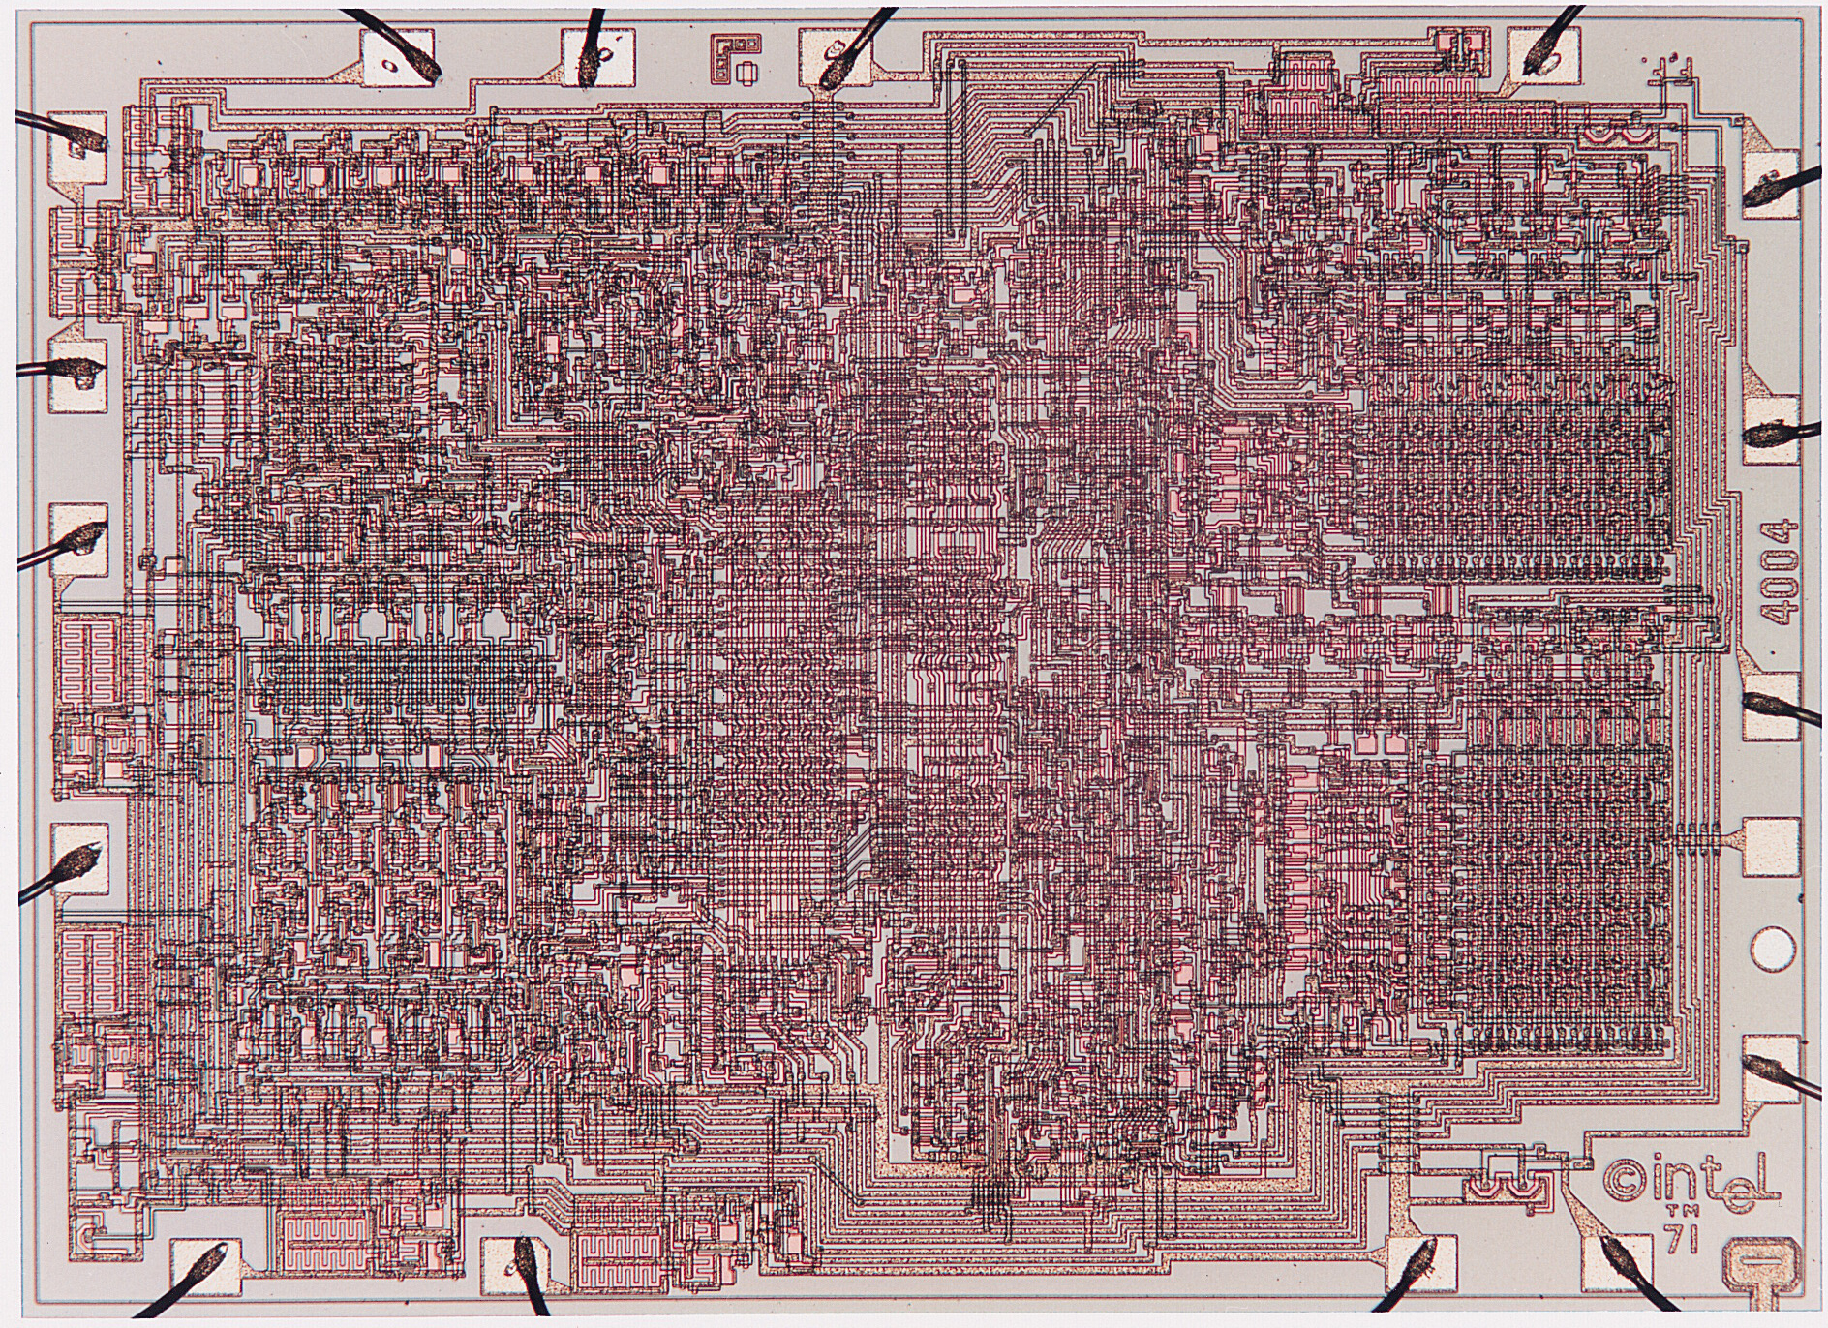
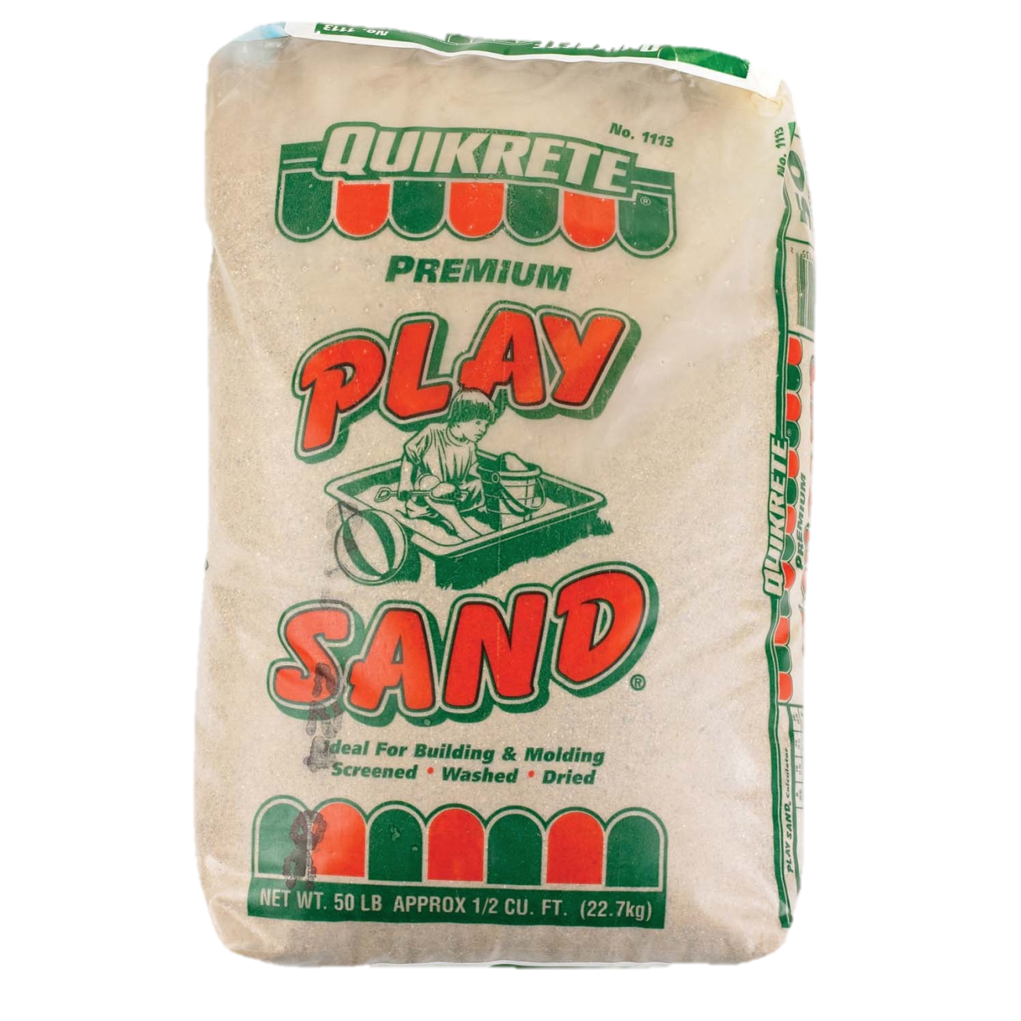
Visualizing Moore’s Law to Date
If transistors were the size of a grain of sand
Intel 4004
1970
2,300 transistors
0.1 g
Apple A8
2014
2 B transistors
88 kg

Slide 8
Moore’s ”Law” drove itself
Better
Products
Sales $$
Capital +
R&D Investment
Product
Design
New Technology
Consumer products sustain the
$300B semiconductor industry

Slide 9
What Moore’s Law Could Mean
2015 Consumer Product
2065 Consumer Product
  Portable
  Low power
  Will drive markets & innovation
?

Slide 10
Requirements for Future Technology
Must be suitable for portable, low-power operation
  Consumer products
  Internet of Things components
  Not cryogenic, not quantum
Must be inexpensive to manufacture
  Comparable to current semiconductor technology
    O(1) cost to make chip with O(N) devices
Need not be based on transistors
  Memristors, carbon nanotubes, DNA transcription, ...
  Possibly new models of computation
  But, still want lots of devices in an integrated system

Slide 11
Increasing Transistor Counts
Chips have gotten bigger
  1 area doubling / 10 years
Transistors have gotten smaller
  4 density doublings / 10 years
Will these trends continue?

Slide 12
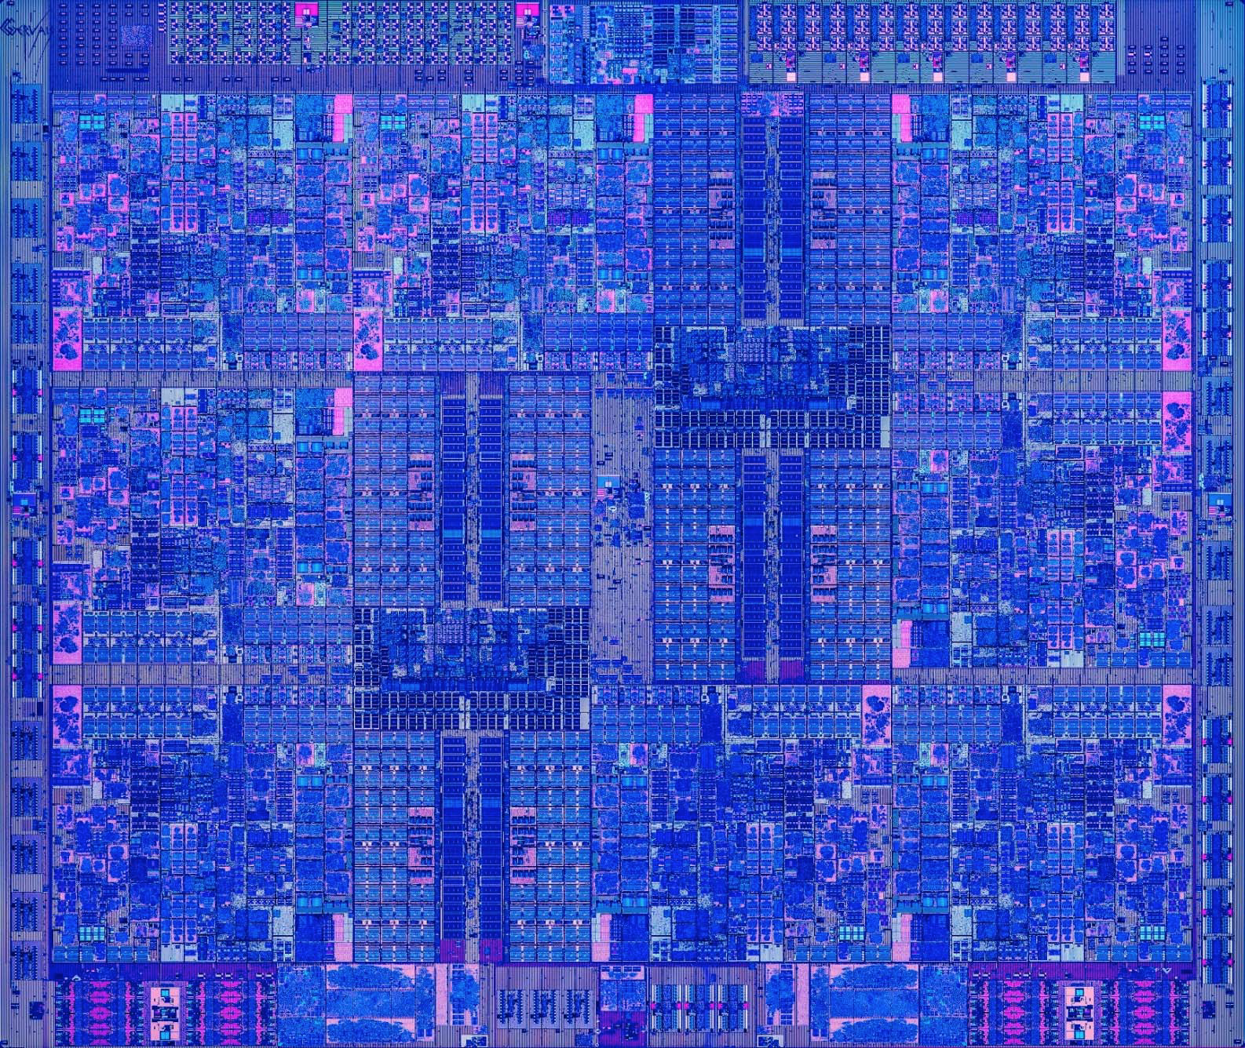
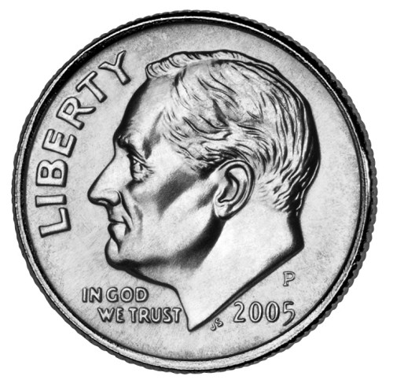
Chips Have Gotten Bigger
Intel 4004
1970
2,300 transistors
12 mm²
Apple A8
2014
2 B transistors
89 mm²
IBM z13
205
4 B transistors
678 mm²

Slide 13
Chip Size Trend
2x every 9.5 years

Slide 14
Chip Size Extrapolation
173 cm²

Slide 15
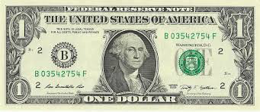
Extrapolation: The iPhone 31s
Apple A59
2065
10¹⁷ transistors
173 cm²

Slide 16
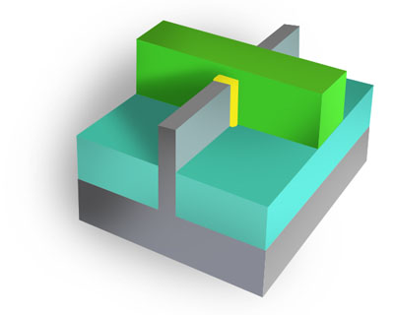
Transistors Have Gotten Smaller
  Area A
  N devices
  Linear Scale L
L

Slide 17
Linear Scaling Trend
1/2x every 5 years ➔
2x transistor density every 2.5 years

Slide 18
Decreasing Feature Sizes
Apple A8
2014
2 B transistors
L = 211 nm
Intel 4004
1970
2,300 transistors
L = 72,000 nm

Slide 19
Linear Scaling Trend
Submillimeter
Submicrometer

Slide 20
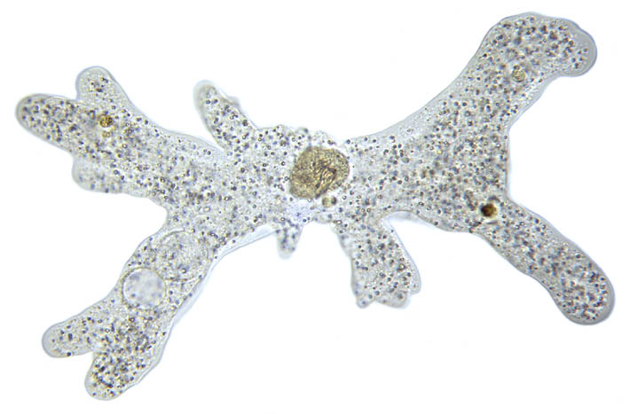
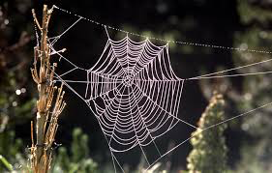
Submillimeter Dimensions
10⁻³
1 millimeter (mm)
500μm: Length of amoeba
10⁻⁴
72μm: Intel 4004 linear scale
50μm: Average size of cell in human body
10⁻⁵
10μm: Thickness of sheet of plastic food wrap
5μm: Spider silk thickness
2μm: E coli bacterium length
1 micrometer (μm)
10⁻⁶

Slide 21

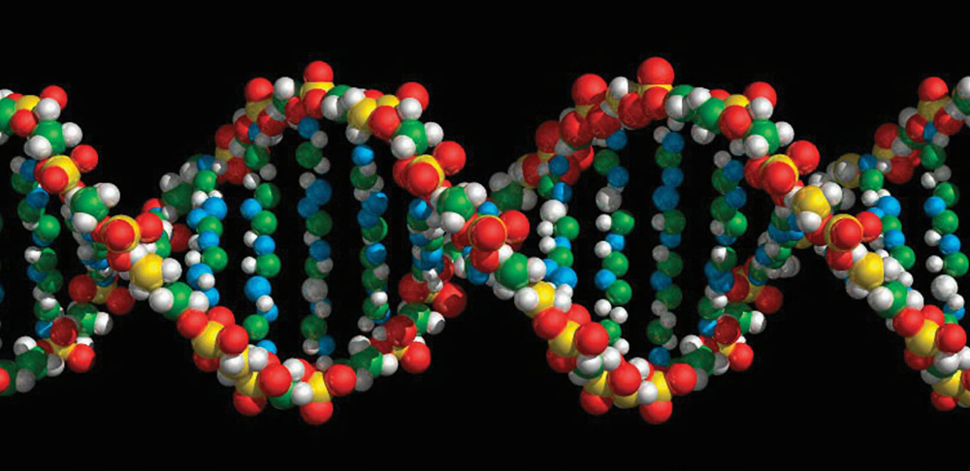
Submicrometer Dimensions
10⁻⁶
1 micrometer (μm)
400-700nm: Visible light wavelengths
211nm: Apple A8 linear scale
10⁻⁷
30nm: Minimum cooking oil smoke particle diameter
10⁻⁸
9nm: Cell membrane thickness
2nm: DNA helix diameter
10⁻⁹
1 nanometer (nm)
1nm: Carbon nanotube diameter

Slide 22
Linear Scaling Extrapolation
230 pm

Slide 23
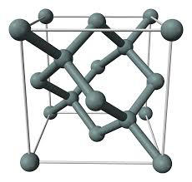
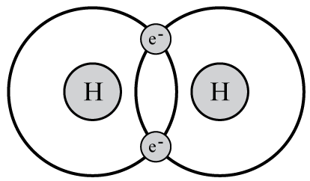
Subnanometer Dimensions
1 nanometer (nm)
10⁻⁹
1nm: Carbon nanotube diameter
543pm: Silicon crystal lattice spacing
230pm: 2065 linear scale projection
10⁻¹⁰
74pm: Spacing between atoms in hydrogen molecule
53pm: Electron-proton spacing in hydrogen (Bohr radius)
10⁻¹¹
2.4pm: Electron wavelength (Compton wavelength)
1 picometer
(pm)
10⁻¹²

Slide 24
Reaching 2065 Goal
Target
  10¹⁷ devices
  400 mm²
  L = 63 pm
Is this possible?
No!
Not with 2-d
fabrication

Slide 25
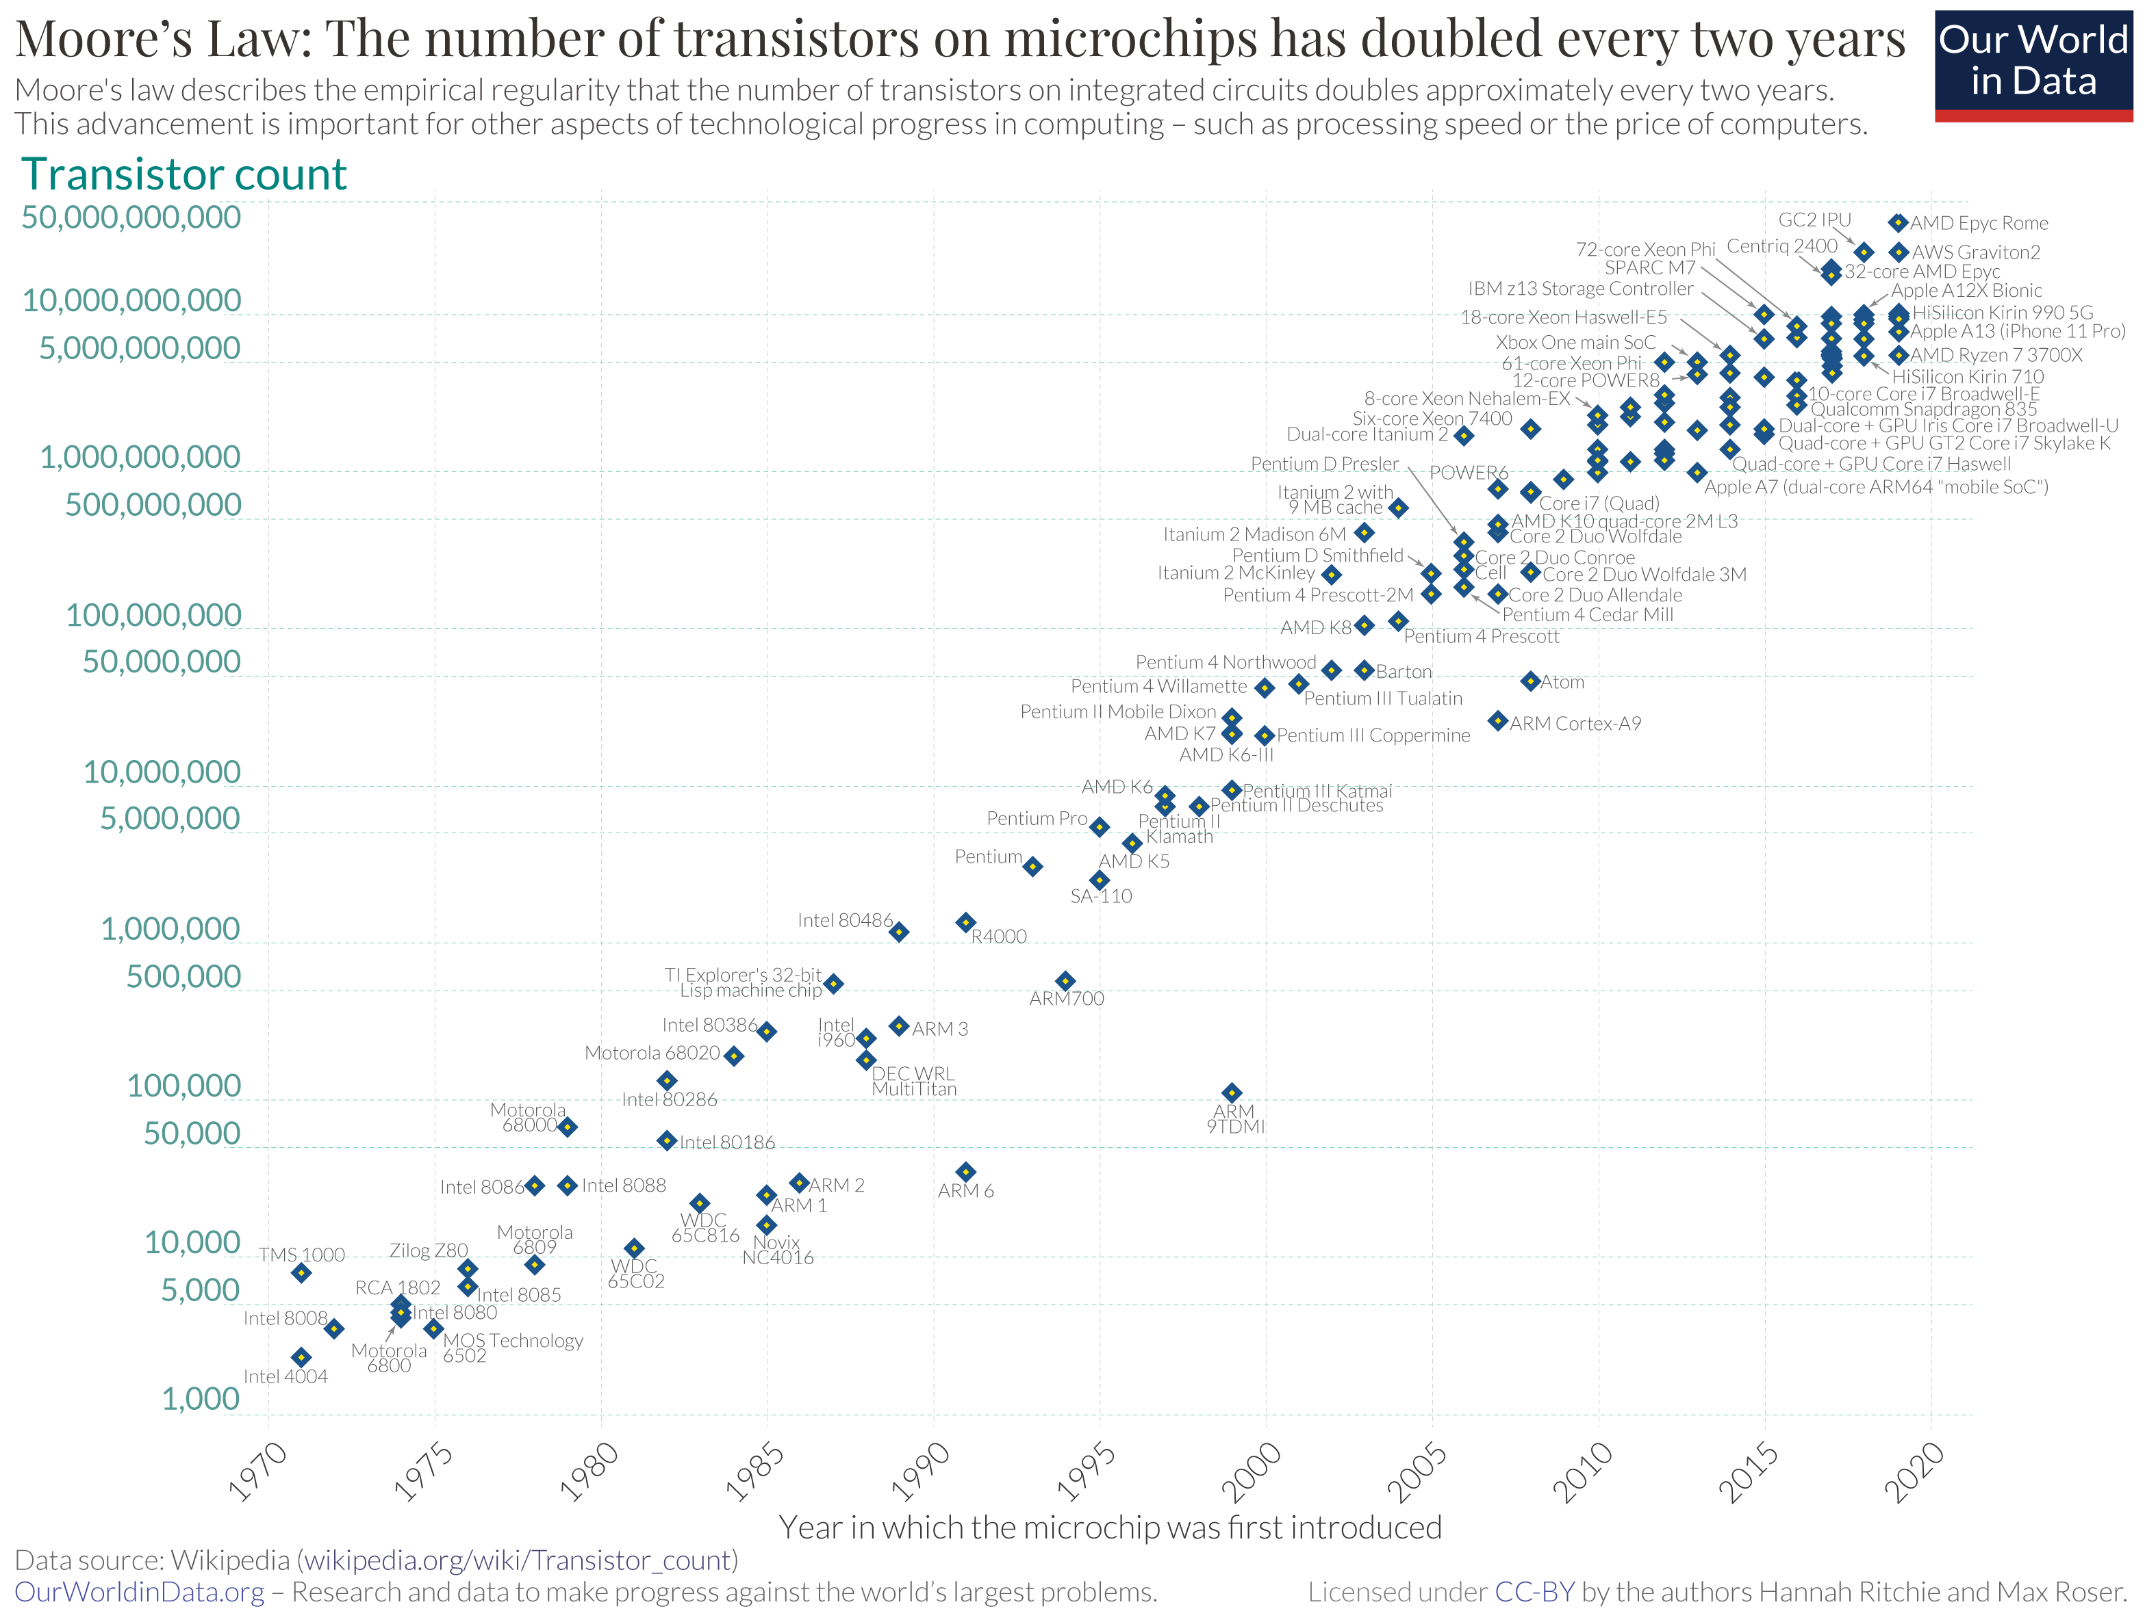

Slide 26
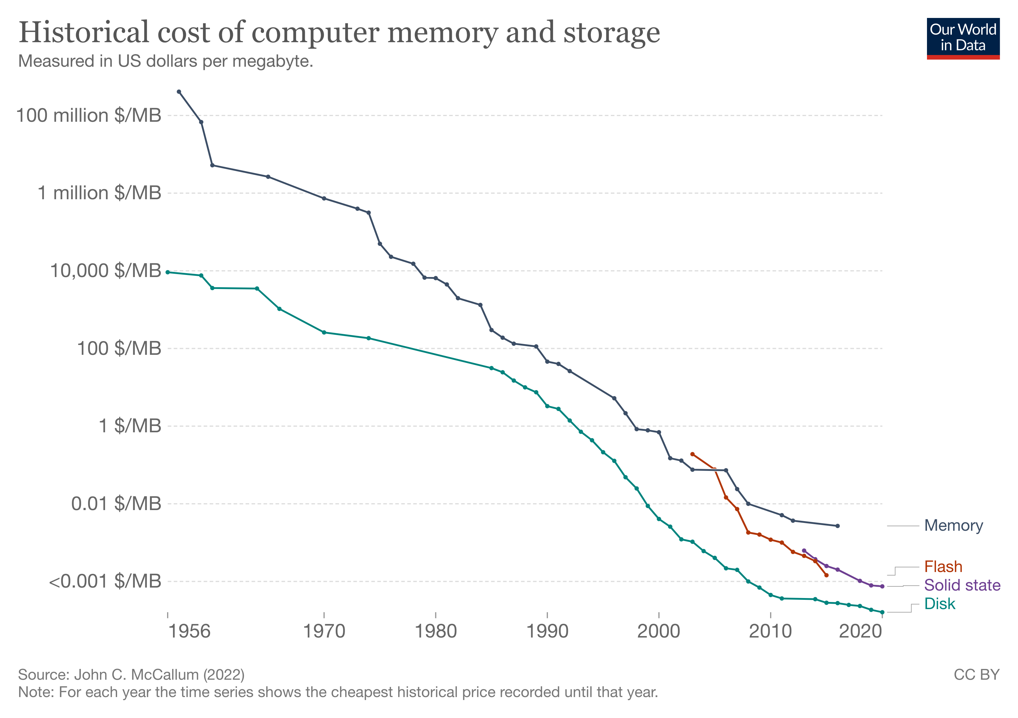

Slide 27
Fabrication Economics
Currently
  Fixed number of lithography steps
  Manufacturing cost $10–$20 / chip
    Including amortization of facility
Fabricating 1,000,000 physical layers
  Cannot do lithography on every step
Options
  Chemical self assembly
    Devices generate themselves via chemical processes
  Pattern multiple layers at once

Slide 28
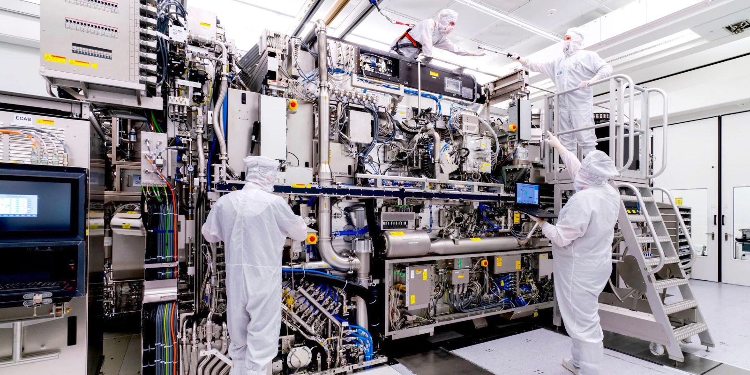

Slide 30
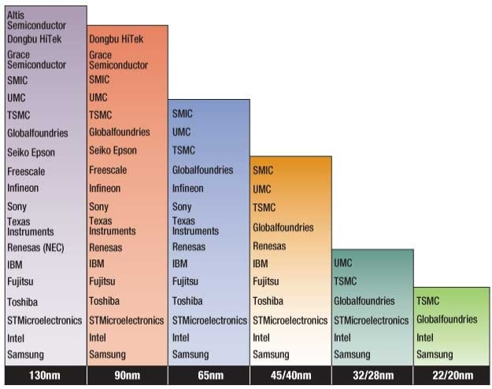
Challenges to Moore’s Law: Economic
Growing Capital Costs
  State of art fab line ~$20B
  Must have very high volumes to amortize investment
  Has led to major consolidations

Slide 31
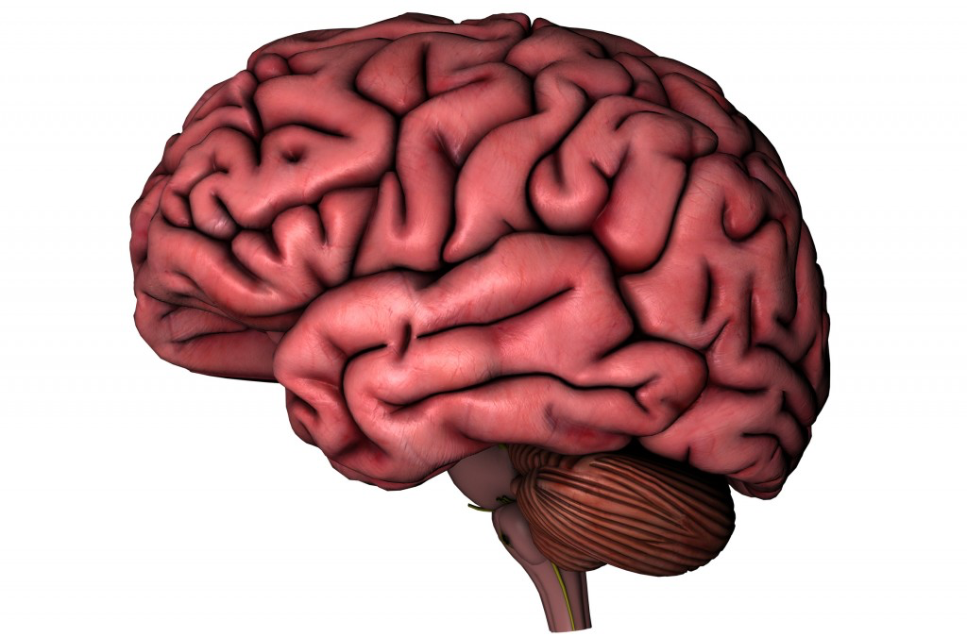
Meeting Power Constraints
  2 B transistors
  2 GHz operation
  1—5 W
  64 B neurons
  100 Hz operation
  15—25 W
    Liquid cooling
    Up to 25% body’s total energy consumption
Can we increase number of devices by 500,000x without increasing power requirement?

Slide 32
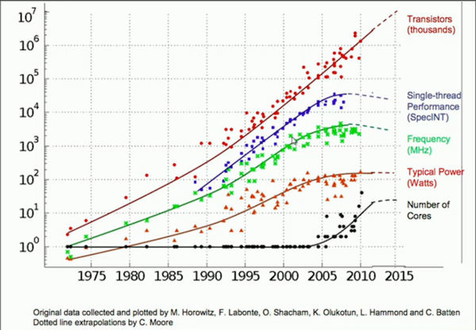
End of Dennard Scaling
What Happened?
  Old: Reduce voltage as we reduced transistor size
  New: Can’t drop voltage below ~1V
  Reached limit of power / chip in 2004
  More logic on chip (Moore’s Law), but can’t make them run faster
    Response has been to increase cores / chip

Slide 33
End of Easy Gains – Fun Times Ahead
We can’t just crank up the clock
We won’t be able to infinitely add cores
We want to keep improving perf/$, perf/W, etc.
But we’re going to have to be even more clever at all layers of the computation stack…

Slide 34
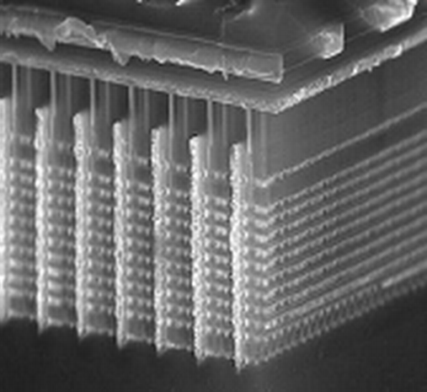
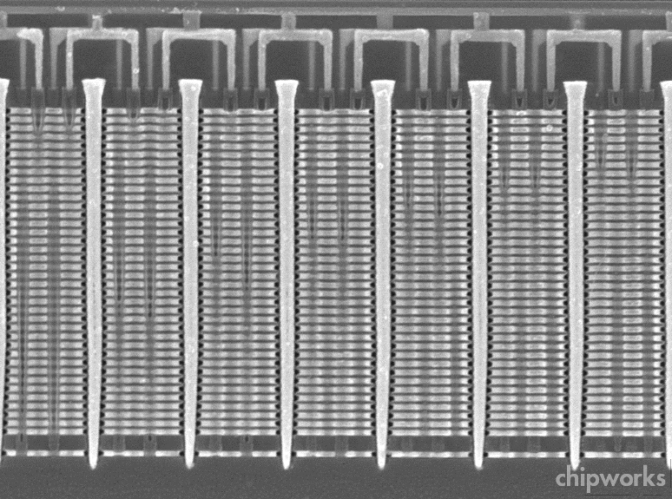
Samsung V-Nand Flash Example
  Build up layers of unpatterned material
  Then use lithography to slice, drill, etch, and deposit material across all layers
  ~30 total masking steps
  Up to 48 layers of memory cells
  Exploits particular structure of flash memory circuits

Slide 35
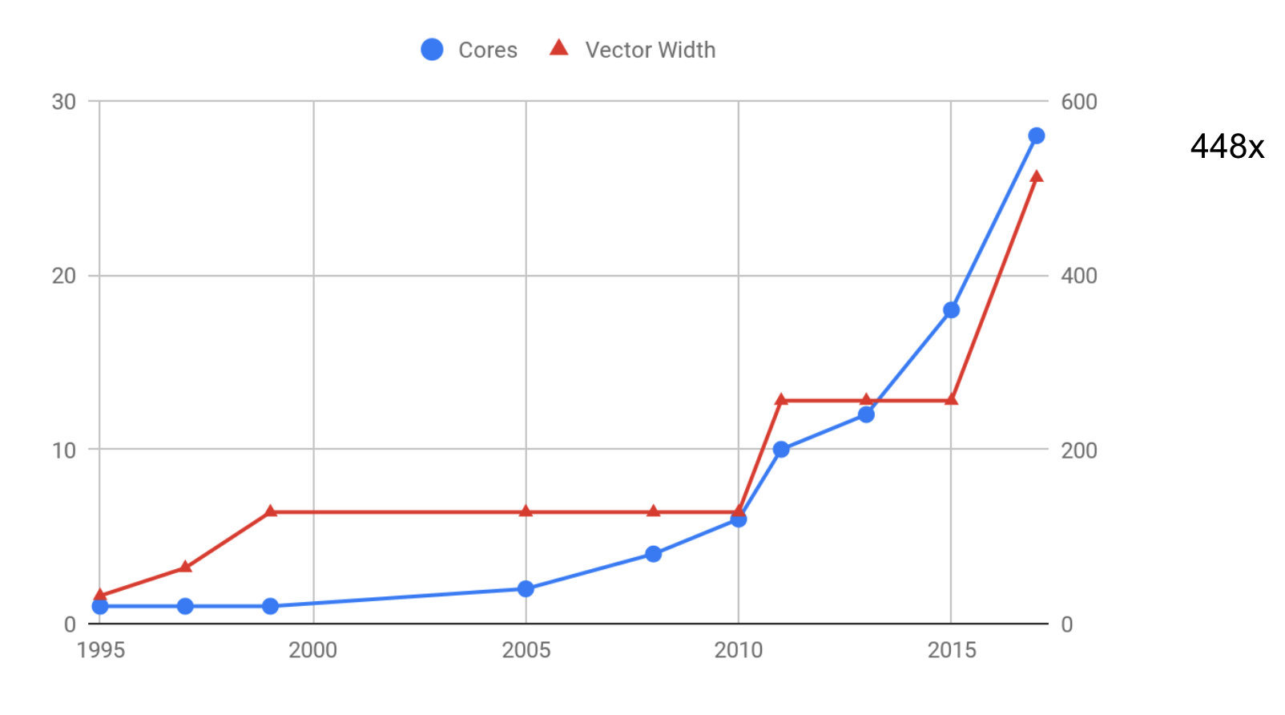
Putting Parallelism on the Programmer

Slide 36
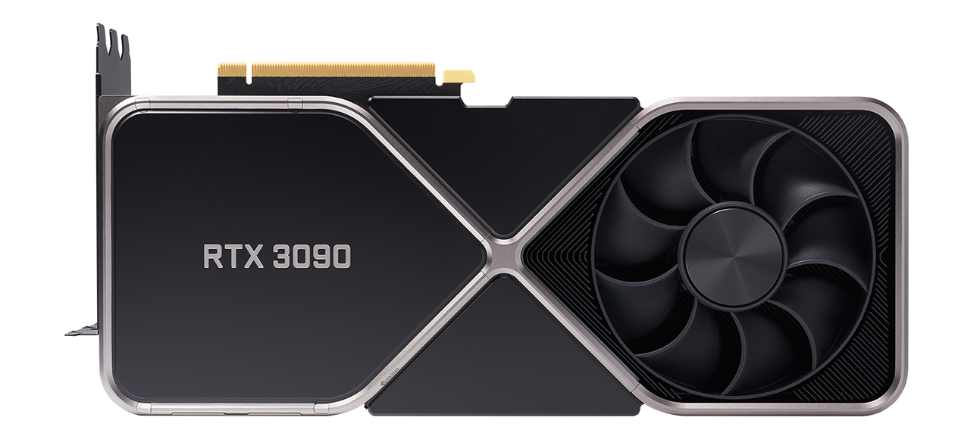
A lot of parallelism…
At 350W, a lot of power, too

Slide 37
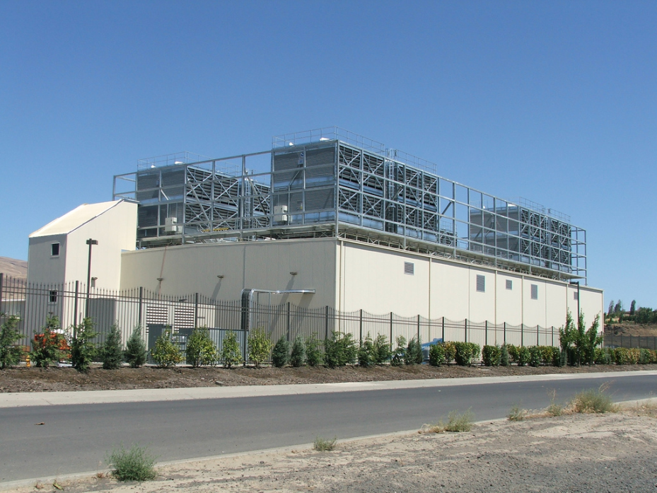
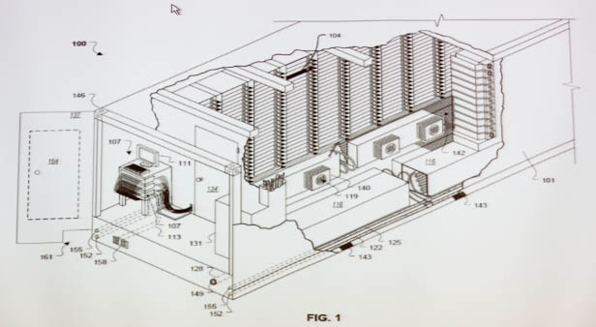
Google Data Centers
Dalles, Oregon
  Hydroelectric power @ 2¢ / KW Hr
  50 Megawatts
    Enough to power 60,000 homes
  Engineered for low cost, modularity & power efficiency
  Container: 1160 server nodes, 250KW
Notes:
One of the biggest users of cluster computing is Google. They have set up dozens of data centers around the world, containing more computer power than just about anyone else.
Here’s a picture of their data center in Dalles, Oregon. It cost them $600M and requires around 50 megawatts of power. (For reference, that much power would supply the residential electricity needs of 6,000 households in the U.S.). They located the data center near the Columbia River to take advantage of low-cost electricity.
Imagine what our intelligence sources could do if they had facilities on this scale to store and process satellite imagery, voice signals, and feeds from media outlets.

Slide 38
Cluster Programming Model
  Application programs written in terms of high-level operations on data
  Runtime system controls scheduling, load balancing, …
Scaling Challenges
  Centralized scheduler forms bottleneck
  Copying to/from disk very costly
  Hard to limit data movement
    Significant performance factor
Application
Programs
Machine-Independent
Programming Model
Runtime
System
Hardware

Slide 39
Computing Landscape Trends
Google Data Center
Data Intensity
Sophisticated
data analysis
Internet-Scale
Computing
Computational Intensity

Slide 40
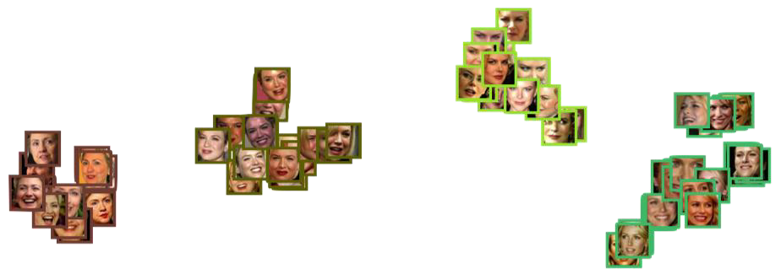
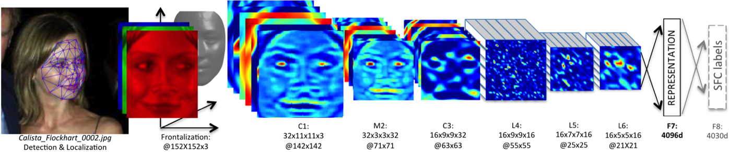
DNN Application Example
Facebook DeepFace Architecture

Slide 41

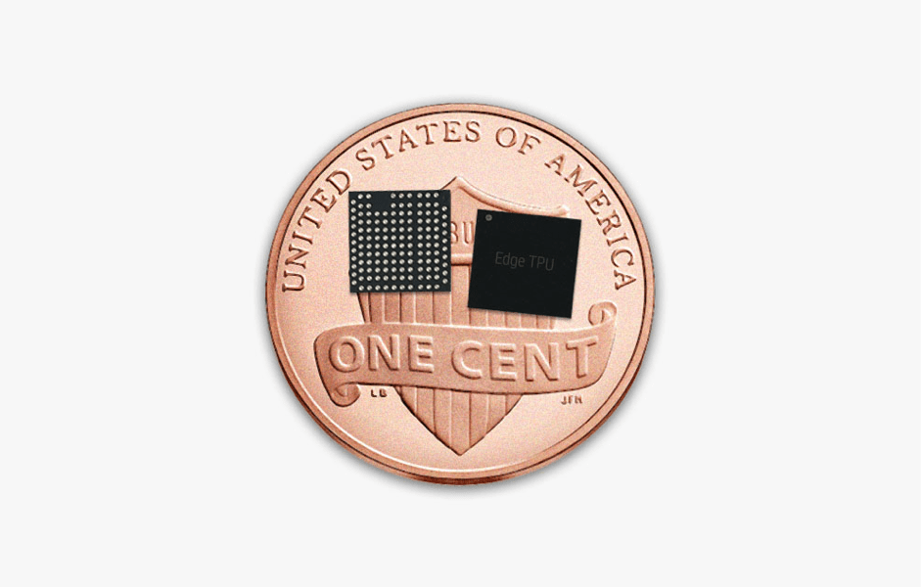
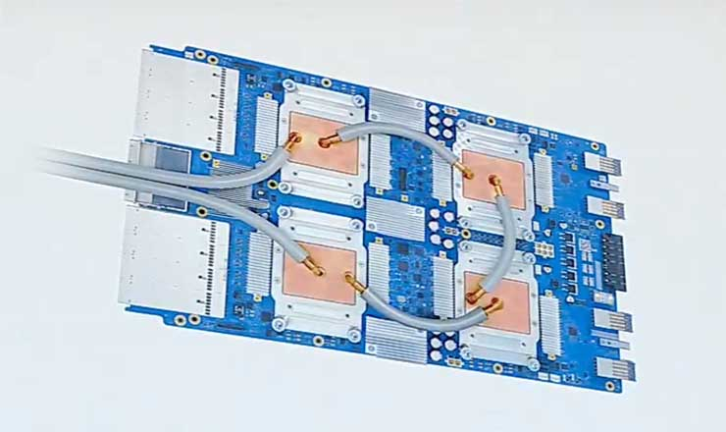
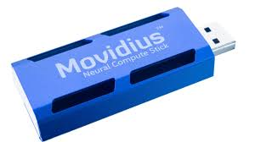
The “More than Moore” approach
“Functional diversification of semiconductor-based devices”
  Integration of sensors, RF, MEMS, quantum?, storage
Flowering of application-specific chips

Slide 42
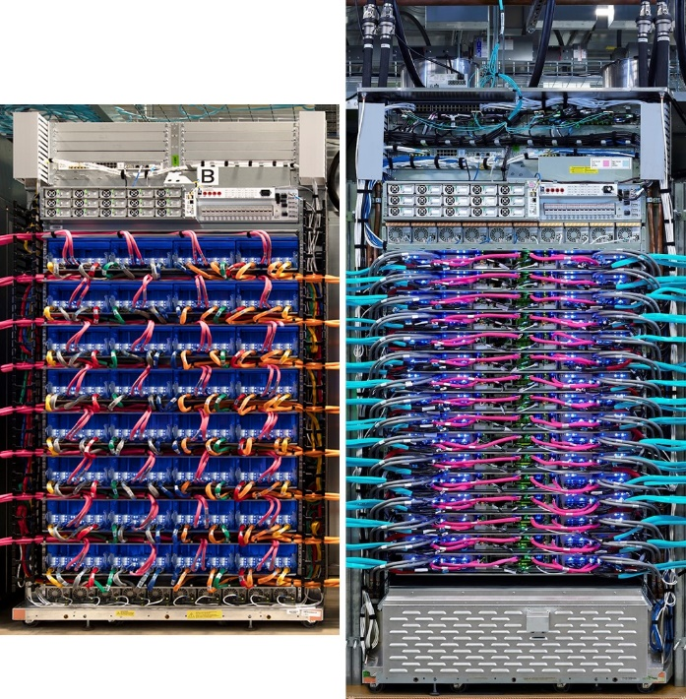
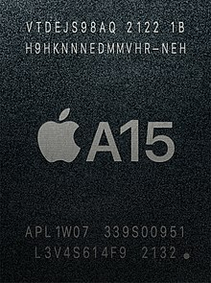
ASICs in the wild at gigacorps
Google: TPUv1, v2, v3,
custom network interface card,
video transcoder,
Amazon: AI chip, custom VM
controller, custom switching chip
Apple: Its own ARM chips, M1,
custom AI chip
6 core CPU,
5 core GPU,
16 core Neural Engine,
ISP image processor,
Hardware video codec

Slide 43
We will have more advances
But they’re bumpy!
Optical interconnects give us a one time big bump
Persistent memory might still – but bumpy
We have more lithographic advances – but really hard
We have yield improvements for EUV – but slowing over time…

Slide 44
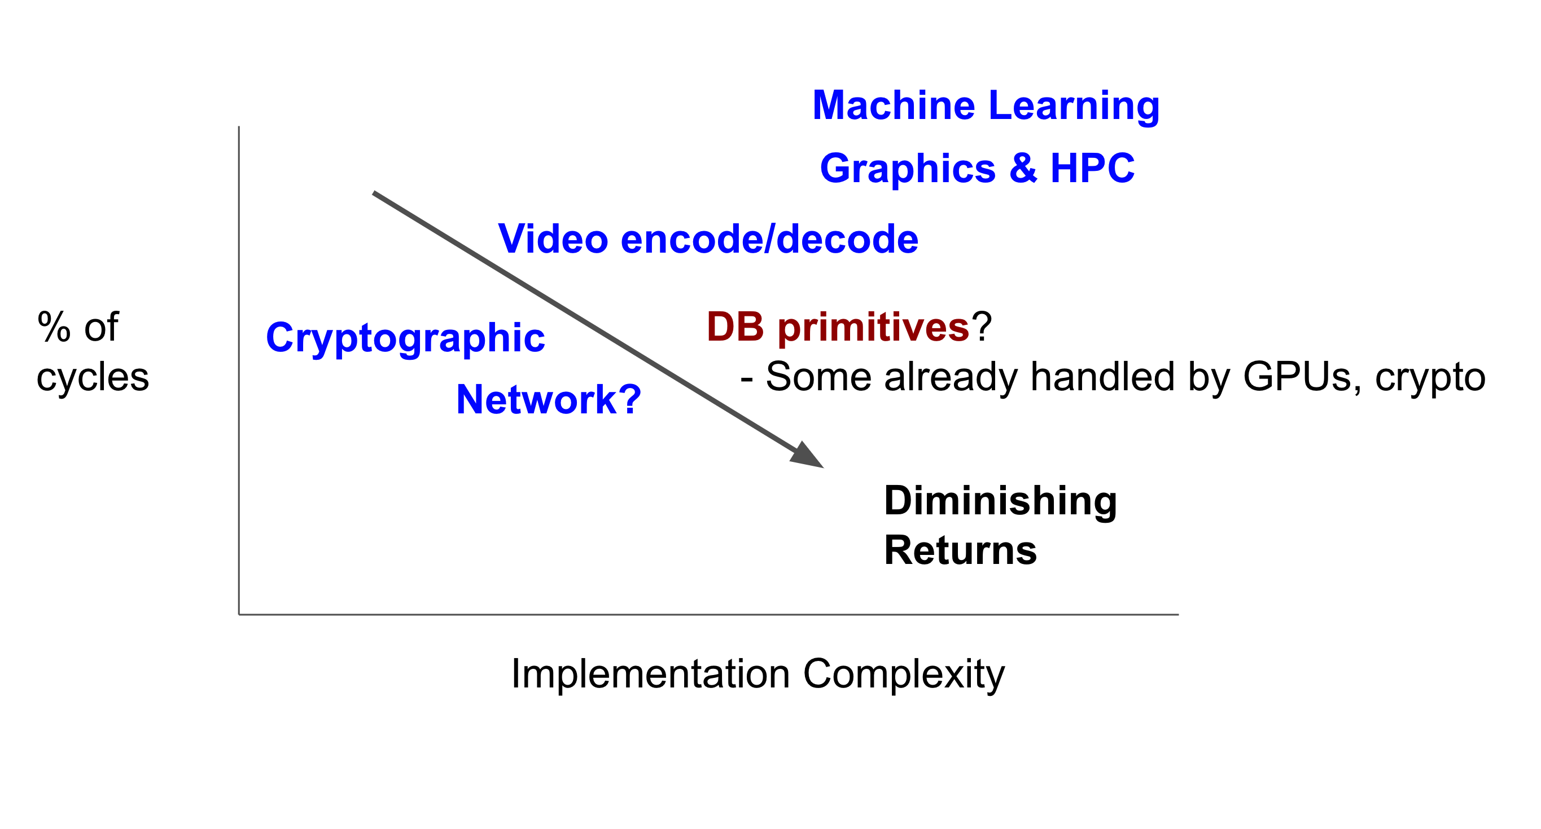
Adding accelerators

Slide 45
Can’t outrun Amdahl
Moore:
  Most CPU functions got faster simultaneously
  Memory density scaled too!
  I/O (& mem latency) was the primary bottleneck to work around
Multicore:
  Parallelization bottleneck
GPUs / SIMD
  Vectorization & parallelization
Post-Moore:
  Specialization bottleneck

Slide 46
Future speedups will need it all…
Hardware improvements
Specialized hardware/software co-design
Software implementation improvements
Algorithmic improvements

Slide 47
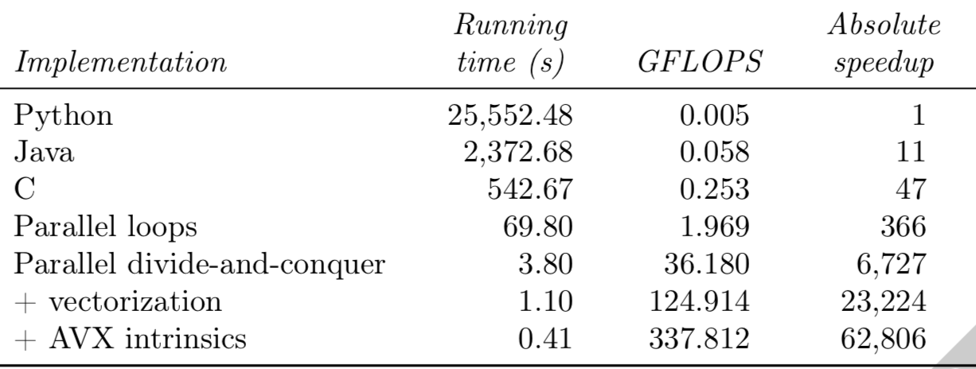
4096 x 4096 Matrix Multiply
(Leiserson et al., “There’s Plenty of Room At The Top”)

Slide 48
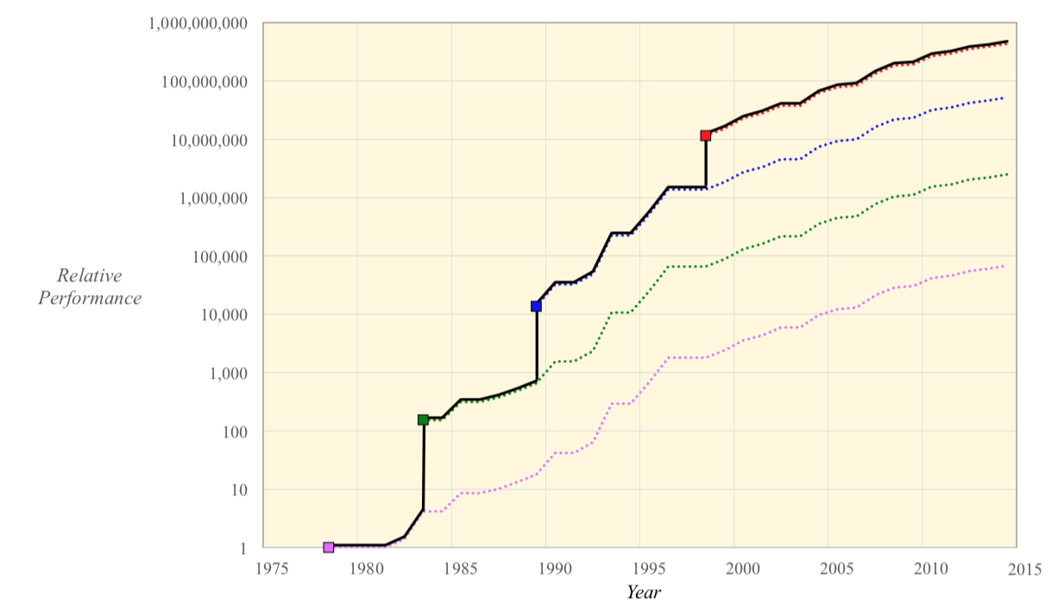
MaxFlow over time (Leiserson et al)

Slide 49
2018--?: Putting Heterogeneity on the programmer
Trend in architecture over last decade: Increasingly shift pain to the programmer
  Parallelization, vectorization, massive concurrency, etc.
This will get worse. (No alternative yet)

Slide 50
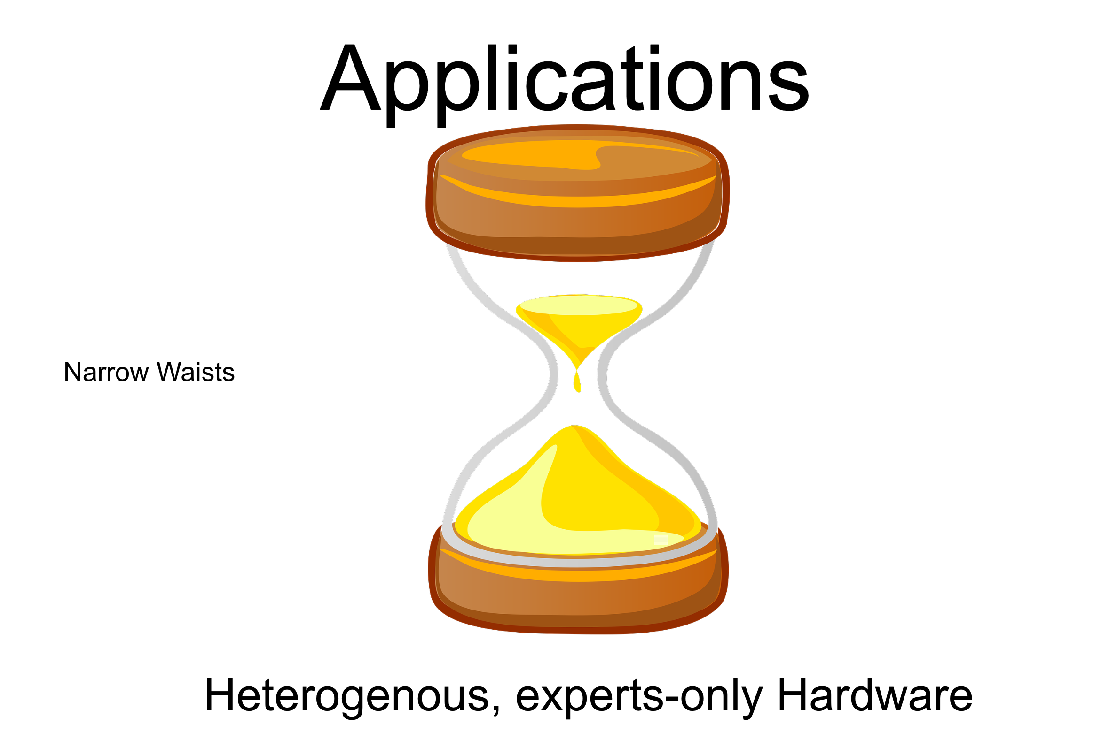

Slide 51
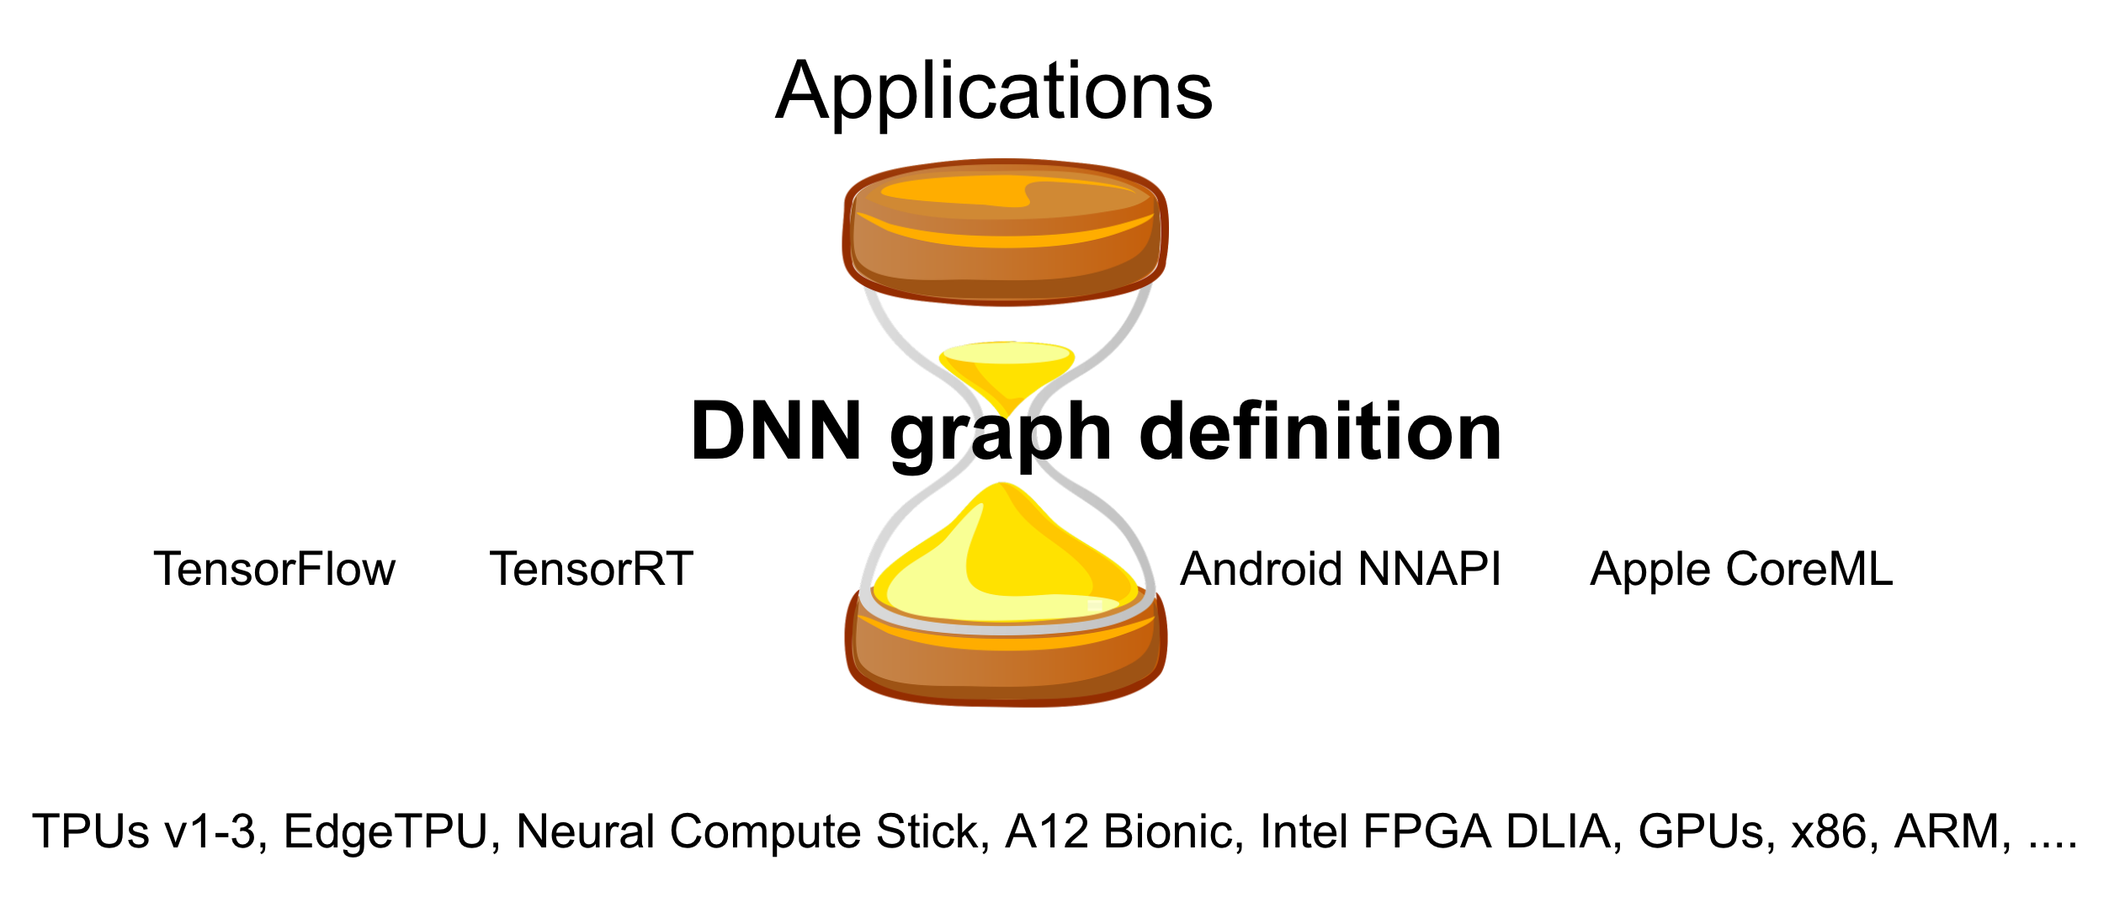
Waists are emerging: ML example

Slide 52
How do we manage?
By making sure we combine systems knowledge + domain knowledge to craft frameworks that help programmers get things done in this increasingly complex hardware world
Go forth and build awesome systems!

