Slide 1
Compressive sensing
Motivation, theory, recovery
Linear inverse problems
Compressive sensing
  Theory
  Hallmark
  Recovery algorithms
Examples

Slide 2
Linear inverse problems
Many classic problems in computer can be posed as linear inverse problems
Notation
  Signal of interest
  Observations
  Measurement model
Problem definition: given , recover
measurement matrix
measurement noise

Slide 3
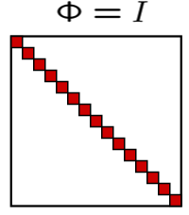
Linear inverse problems
Problem definition: given , recover
Scenario 1
We can invert the
system of equations

Slide 4
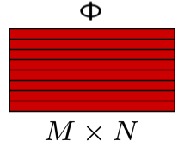
Linear inverse problems
Problem definition: given , recover
Scenario 2

Slide 5

Credit: Rob Fergus and Antonio Torralba

Slide 6
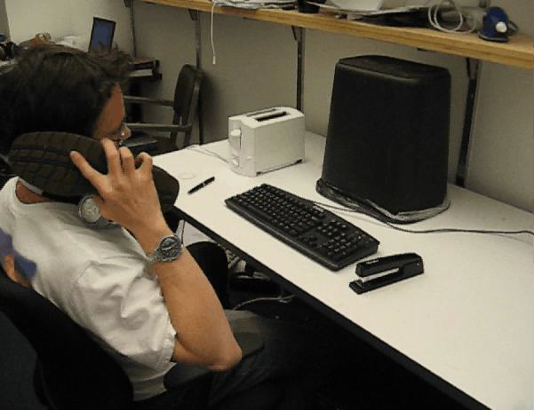
Credit: Rob Fergus and Antonio Torralba

Slide 7
Linear inverse problems
Problem definition: given , recover
Scenario 2
Measurement matrix has a
(N-M) dimensional null-space
Solution is no longer unique
Many interesting vision problem fall under this scenario

Slide 8
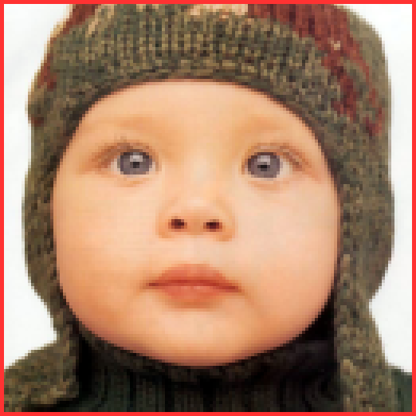

Image super-resolution
Low resolution input/observation
128x128 pixels

Slide 9
Image super-resolution
2x super-resolution

Slide 10
Image super-resolution
4x super-resolution

Slide 11
Image super-resolution
Super-resolution factor D
Under-sampling factor M/N = 1/D²
General rule:
The smaller the under-sampling, the more the unknowns and hence, the harder the super-resolution problem

Slide 12
Many other vision problems…
Affine rank minimizaiton, Matrix completion, deconvolution, Robust PCA
Image synthesis
  Infilling, denoising, etc.
Light transport
  Reflectance fields, BRDFs, Direct global separation, Light transport matrices
Sensing

Slide 13
Compressive sensing

Slide 14



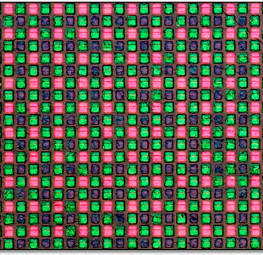

Sense by Sampling
sample
Notes:
Example: Large Hadron Collider will produce 10 peta bytes of data per second; need to triage that down to 100/sec “potentially interesting events” in real time

Slide 15
Sense by Sampling
too
much
data!
sample
Notes:
Example: Large Hadron Collider will produce 10 peta bytes of data per second; need to triage that down to 100/sec “potentially interesting events” in real time

Slide 16
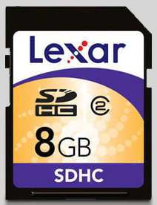




Sense then Compress
sample
compress
JPEG
JPEG2000
…
decompress

Slide 17
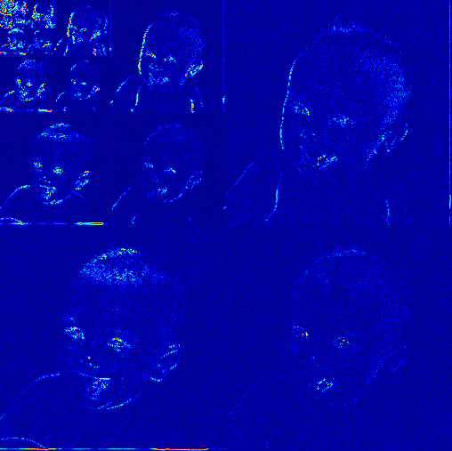

Sparsity
large
wavelet
coefficients
(blue = 0)
pixels

Slide 18
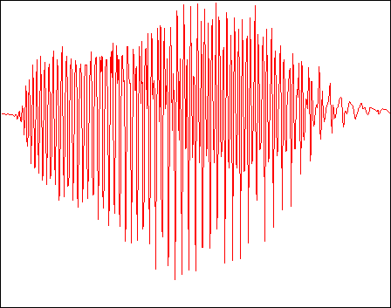
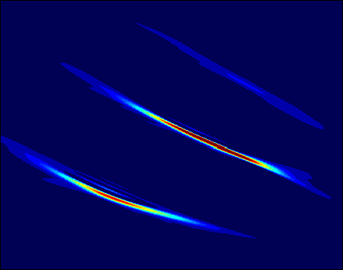

Sparsity
large
wavelet
coefficients
(blue = 0)
pixels
wideband
signal
samples
large
Gabor (TF)
coefficients
frequency
time

Slide 19


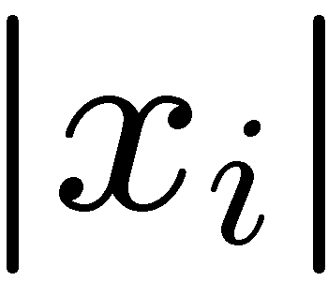


Concise Signal Structure
Sparse signal: only K out of N
coordinates nonzero
sorted index

Slide 20

Concise Signal Structure
Sparse signal: only K out of N
coordinates nonzero
  model: union of K-dimensional subspaces
  aligned w/ coordinate axes
sorted index

Slide 21
Concise Signal Structure
Sparse signal: only K out of N
coordinates nonzero
  model: union of K-dimensional subspaces
Compressible signal: sorted coordinates decay rapidly with power-law
power-law
decay
sorted index

Slide 22


Concise Signal Structure
Sparse signal: only K out of N
coordinates nonzero
  model: union of K-dimensional subspaces
Compressible signal: sorted coordinates decay rapidly with power-law
  model: ball:
power-law
decay
sorted index

Slide 23
What’s Wrong with this Picture?
Why go to all the work to acquire
N samples only to discard all but
K pieces of data?
sample
compress
decompress

Slide 24
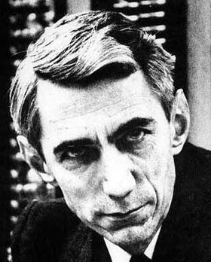
What’s Wrong with this Picture?
  linear processing
  linear signal model
  (bandlimited subspace)
  nonlinear processing
  nonlinear signal model
  (union of subspaces)
sample
compress
decompress

Slide 25

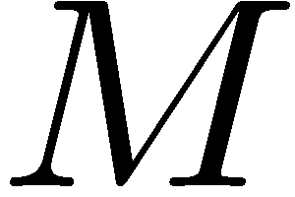

Compressive Sensing
Directly acquire “compressed” data
via dimensionality reduction
Replace samples by more general “measurements”
compressive sensing
recover

Slide 26








Sampling
Signal is -sparse in basis/dictionary
  WLOG assume sparse in space domain
Sampling
sparse
signal
measurements
nonzero
entries

Slide 27
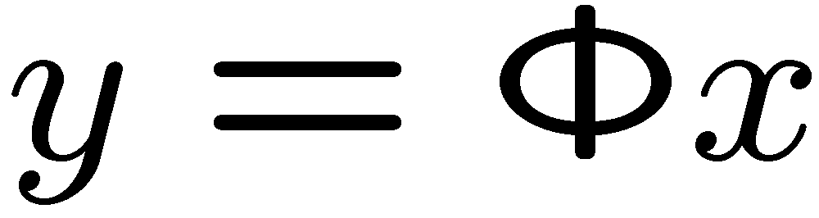




Compressive Sampling
When data is sparse/compressible, can directly acquire a condensed representation with
no/little information loss through
linear dimensionality reduction
measurements
sparse
signal
nonzero
entries

Slide 28

How Can It Work?
Projection
not full rank…
… and so
loses information in general
Ex: Infinitely many ’s map to the same
(null space)

Slide 29
How Can It Work?
Projection
not full rank…
… and so
loses information in general
But we are only interested in sparse vectors
columns

Slide 30
How Can It Work?
Projection
not full rank…
… and so
loses information in general
But we are only interested in sparse vectors
is effectively MxK
columns

Slide 31


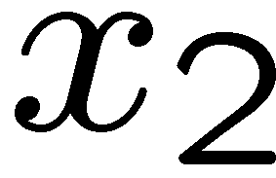

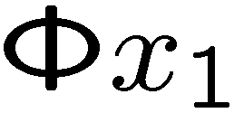
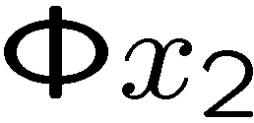
Criterion for no information loss
No two points can map to the same point under action of
K-dim subspaces
Notes:
31

Slide 32
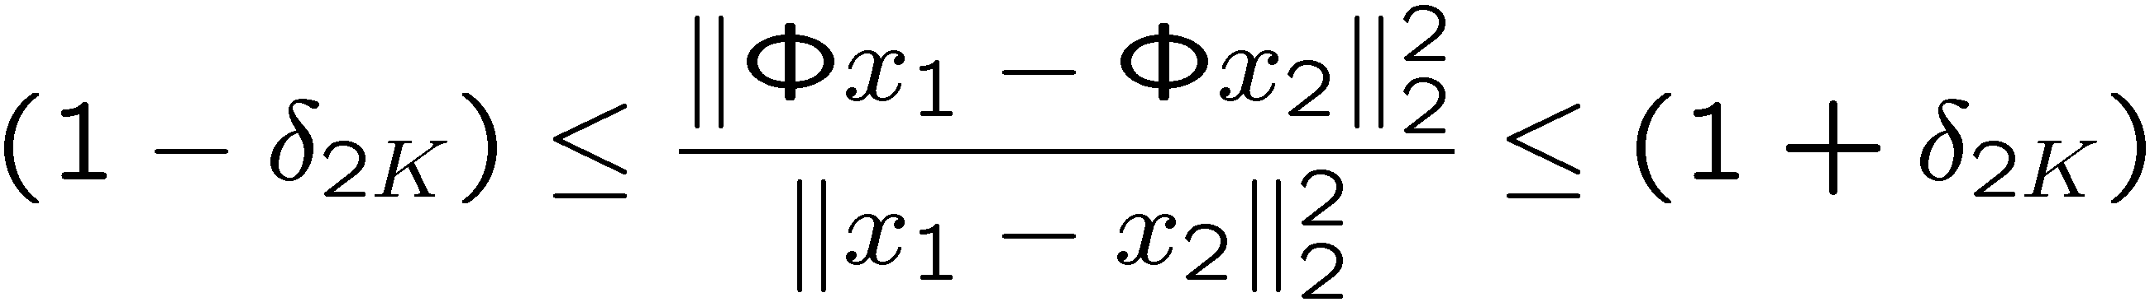
Restricted Isometry Property (RIP)
“Stable embedding”
RIP of order 2K implies: for all K-sparse x₁ and x₂
K-dim subspaces

Slide 33
RIP = Stable Embedding
An information preserving projection preserves the geometry of the set of sparse signals
RIP ensures that
Notes:
33

Slide 34
How Can It Work?
Projection
not full rank…
… and so
loses information in general
Design so that each of its Mx2K submatrices
are full rank (RIP)
Unfortunately, a combinatorial,
NP-complete design problem
columns

Slide 35
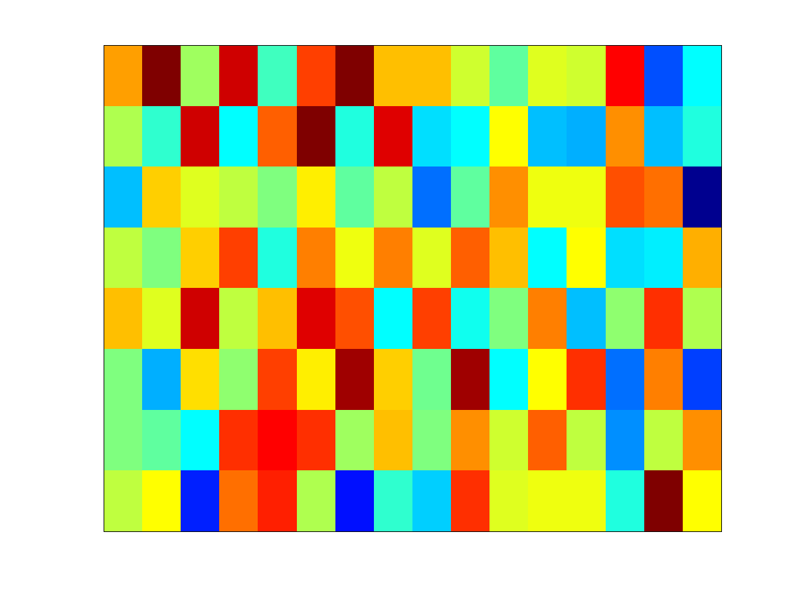
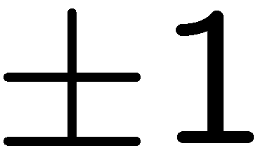
Insight from the 70’s [Kashin, Gluskin]
Draw at random
  iid Gaussian
  iid Bernoulli
  …
Then has the RIP with high probability
provided
columns

Slide 36
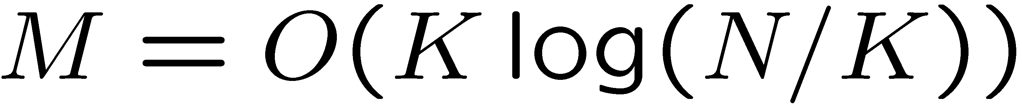
Randomized Sensing
Measurements = random linear combinations of the entries of the signal
No information loss for sparse vectors whp
measurements
sparse
signal
nonzero
entries

Slide 37
CS Signal Recovery
Goal: Recover signal
from measurements
Problem: Random
projection not full rank
(ill-posed inverse problem)
Solution: Exploit the sparse/compressible
geometry of acquired signal

Slide 38

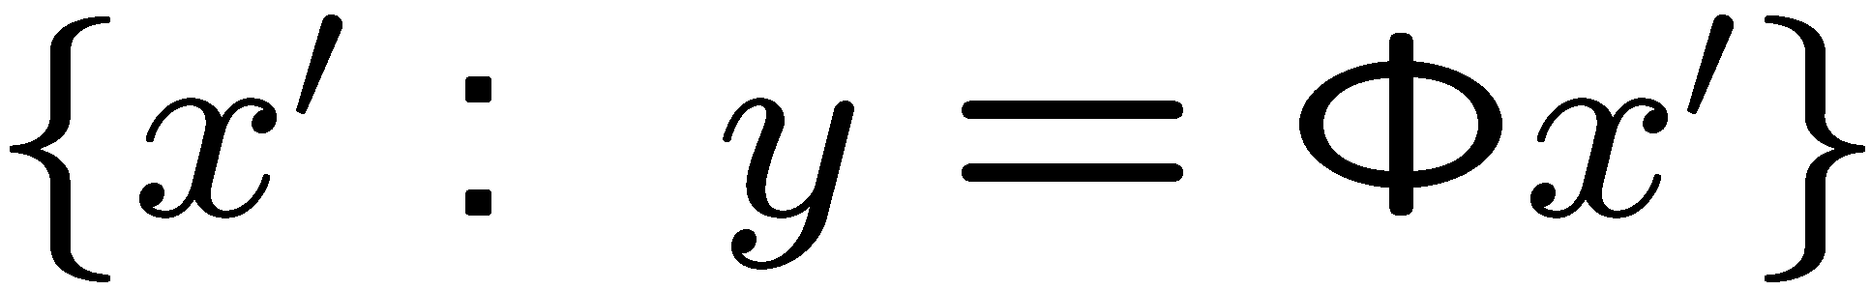
CS Signal Recovery
Random projection
not full rank
Recovery problem:
given
find
Null space
Search in null space
for the “best”
according to some
criterion
  ex: least squares
(N-M)-dim hyperplane
at random angle

Slide 39
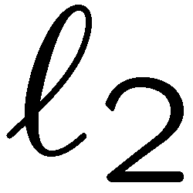
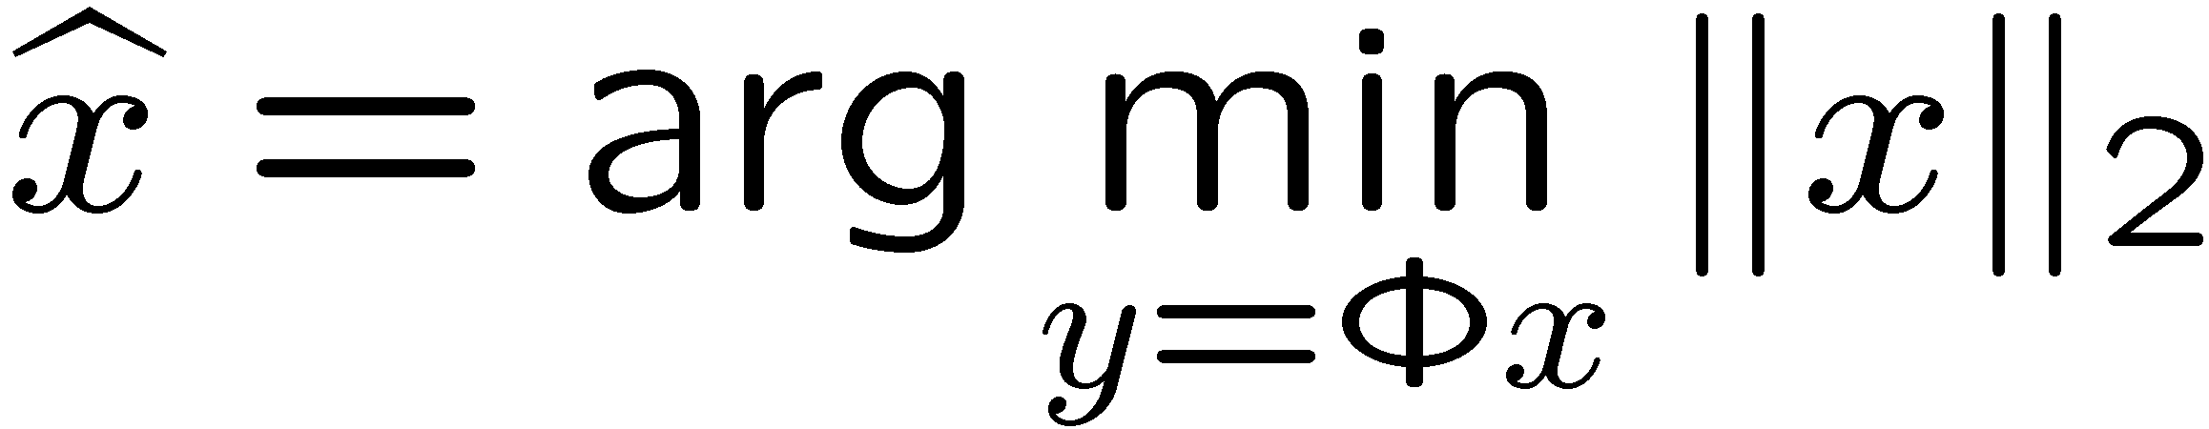
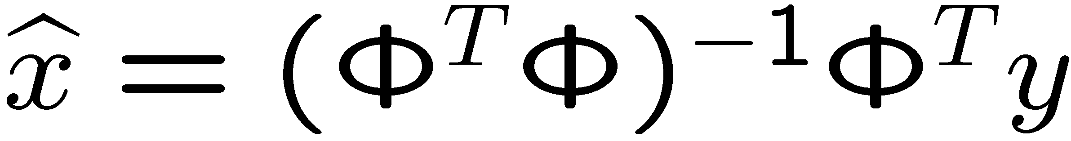
Signal Recovery
Recovery: given
(ill-posed inverse problem) find (sparse)
Optimization:
Closed-form solution:

Slide 40
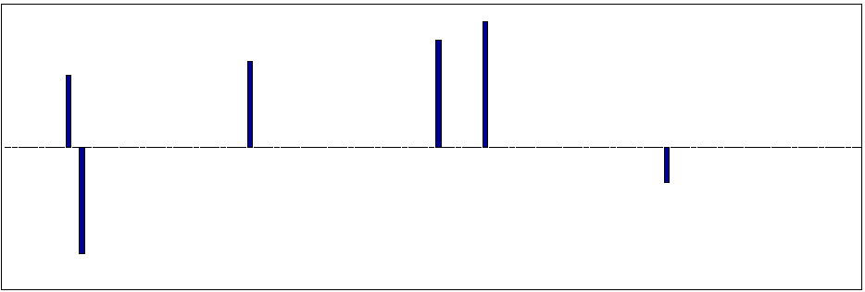
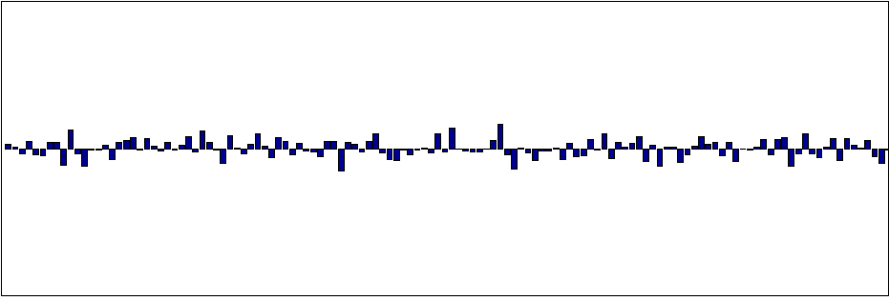

Signal Recovery
Recovery: given
(ill-posed inverse problem) find (sparse)
Optimization:
Closed-form solution:
Wrong answer!
Notes:
40

Slide 41

Signal Recovery
Recovery: given
(ill-posed inverse problem) find (sparse)
Optimization:
Closed-form solution:
Wrong answer!
Notes:
41

Slide 42

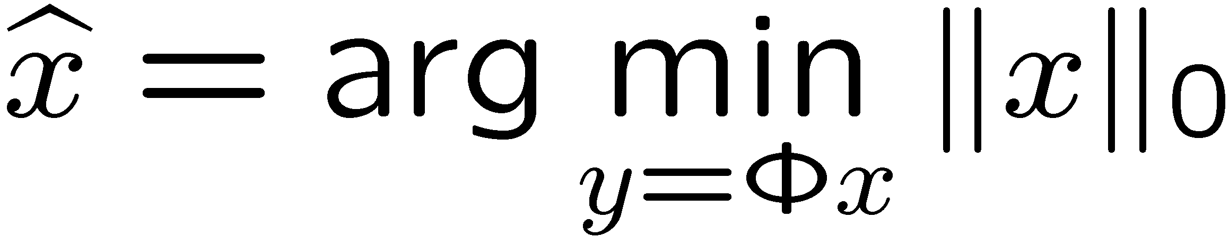
Signal Recovery
Recovery: given
(ill-posed inverse problem) find (sparse)
Optimization:
“find sparsest vector
in translated nullspace”
Notes:
42

Slide 43
Signal Recovery
Recovery: given
(ill-posed inverse problem) find (sparse)
Optimization:
Correct!
But NP-Complete alg
“find sparsest vector
in translated nullspace”
Notes:
43

Slide 44

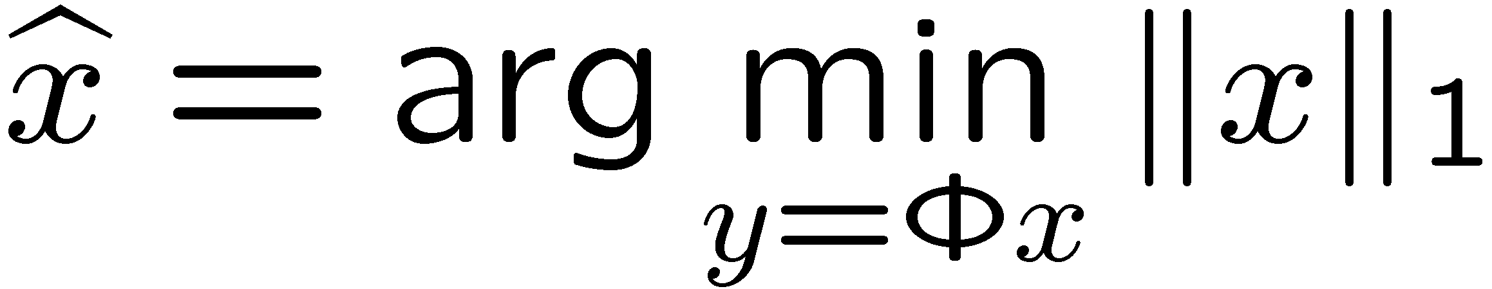
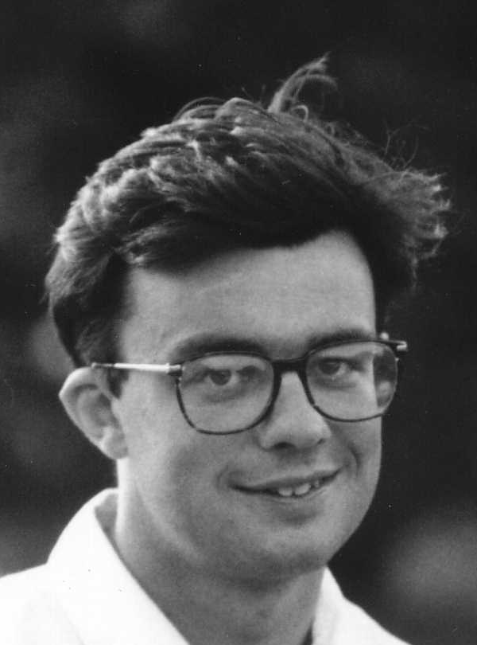
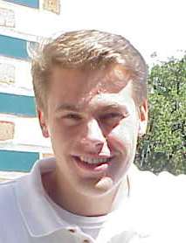
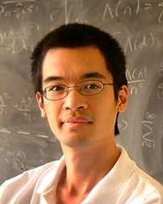
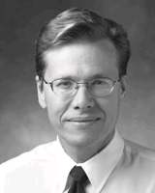
Signal Recovery
Recovery: given
(ill-posed inverse problem) find (sparse)
Optimization:
Convexify the optimization
Candes Romberg Tao
Donoho
Notes:
44

Slide 45
Signal Recovery
Recovery: given
(ill-posed inverse problem) find (sparse)
Optimization:
Convexify the optimization
Correct!
Polynomial time alg
(linear programming)
Notes:
45

Slide 46


Compressive Sensing
random
measurements
sparse
signal
nonzero
entries
Signal recovery via optimization
[Candes, Romberg, Tao; Donoho]
Notes:
46

Slide 47
Compressive Sensing
random
measurements
sparse
signal
nonzero
entries
Signal recovery via iterative greedy algorithm
  (orthogonal) matching pursuit [Gilbert, Tropp]
  iterated thresholding
  [Nowak, Figueiredo; Kingsbury, Reeves; Daubechies, Defrise, De Mol;
  Blumensath, Davies; …]
  CoSaMP [Needell and Tropp]
Notes:
47

Slide 48
CS Hallmarks
Stable
  acquisition/recovery process is numerically stable
Asymmetrical (most processing at decoder)
  conventional: smart encoder, dumb decoder
  CS: dumb encoder, smart decoder
Democratic
  each measurement carries the same amount of information
  robust to measurement loss and quantization
  “digital fountain” property
Random measurements encrypted
Universal
  same random projections / hardware can be used for
  any sparse signal class (generic)
Notes:
48

Slide 49
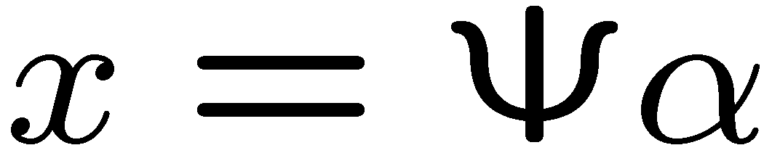



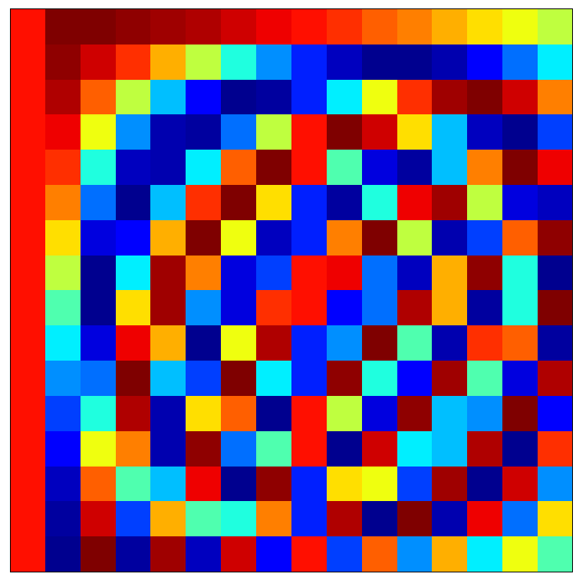
Universality
Random measurements can be used for signals sparse in any basis

Slide 50
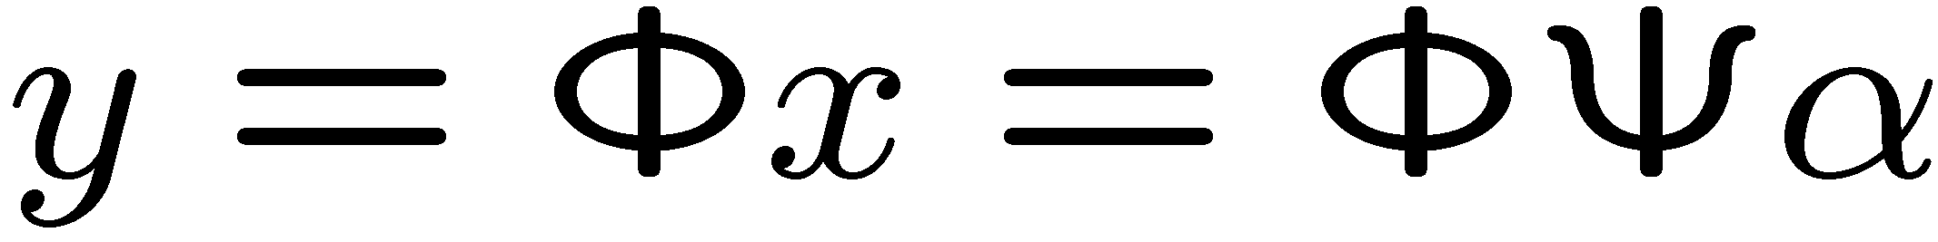

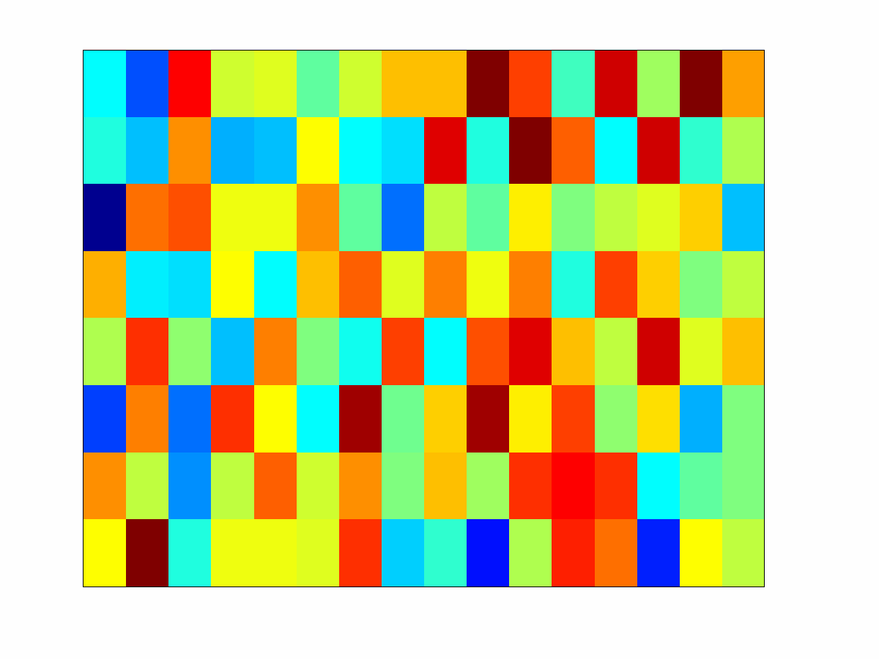
Universality
Random measurements can be used for signals sparse in any basis

Slide 51

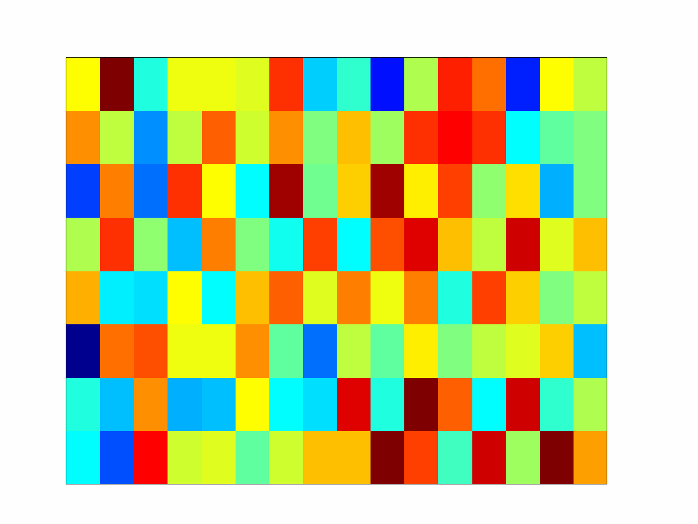
Universality
Random measurements can be used for signals sparse in any basis
sparse
coefficient
vector
nonzero
entries

Slide 52
Examples

Slide 53
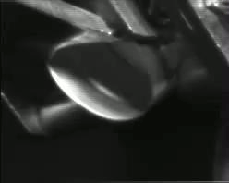
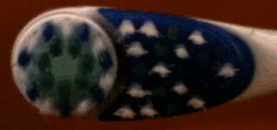
Case Study 1: Periodic signals
Bottling line
Toothbrush
Credit: Veeraraghavan et al, 2011

Slide 54
High-speed Camera
Nyquist Sampling of x(t) – When each period of x has high frequency variations, Nyquist sampling rate is high.
P = 10ms
T_{s} = 1/(2 f_{Max})
Periodic signal has regularly spaced, sparse Fourier coefficients.
Is it necessary to use a high-speed video camera? Why waste bandwidth?
- f_{Max}
-4f_{P}
-3f_{P}
-2f_{P}
-f_{P}
0
f_{P}=1/P
2f_{P}
3f_{P}
4f_{P}
f_{Max}

Slide 55
Solving for the video
Camera observations at a pixel
N unknowns
Frame 1
Coded Strobing
Frame M
t
Frame Integration Period T_{S}
y
=
A
x

Slide 56
Solving for the video
Fourier Basis
t
Non-zero elements
b1
b2
bN
Basis Coeff
x = F s

Slide 57
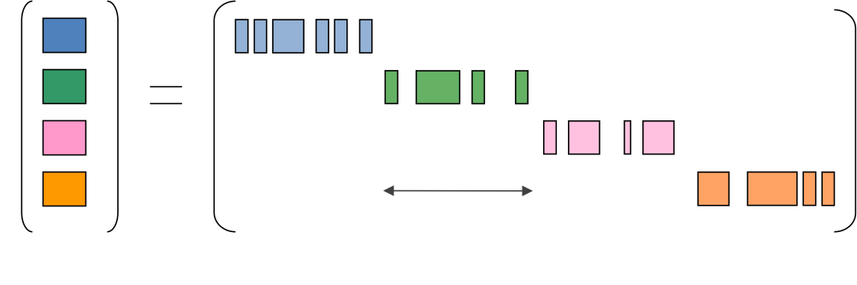
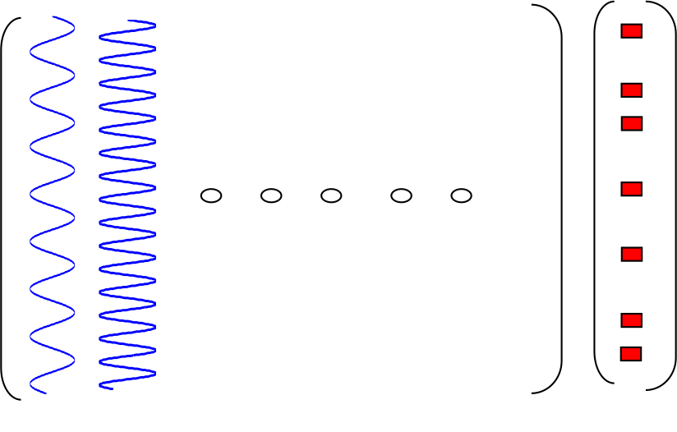
Solving for the video
y
=
A
F
s

Slide 58
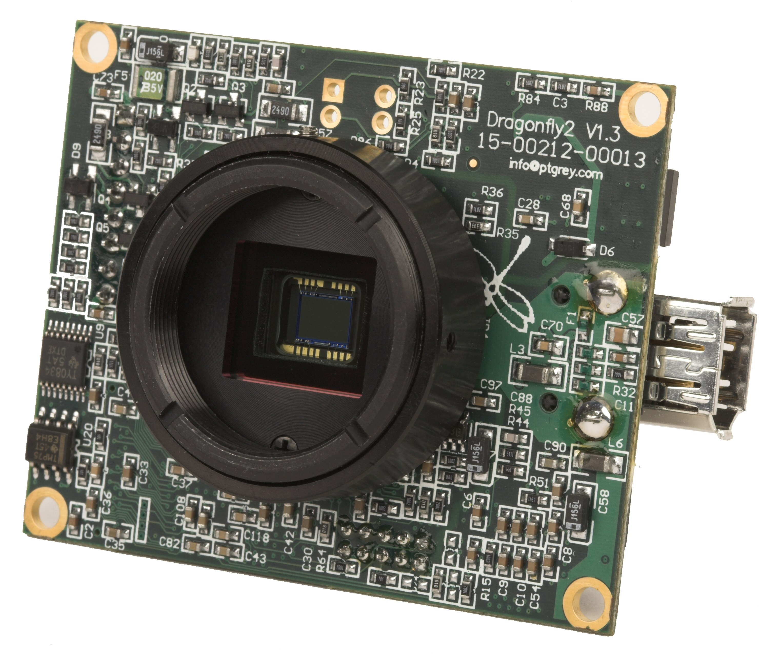
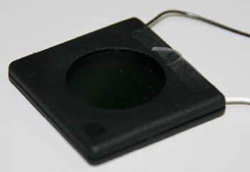
Implementation
PGR Dragonfly2
(25 fps)
FLC Shutter
Can flutter at 250us

Slide 59
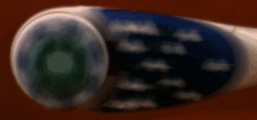
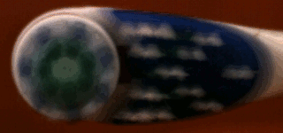
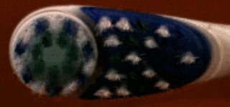
Toothbrush (simulation)
20fps normal camera
20fps coded strobing camera
Reconstructed frames
1000fps hi-speed camera

Slide 60



Mill Tool
Mill tool rotating at 50Hz
Normal Video: 25fps
Mill tool rotating at 50Hz
Coded Strobing Video: 25fps
Mill tool rotating at 50Hz
Reconstructed Video at 2000fps

Slide 61
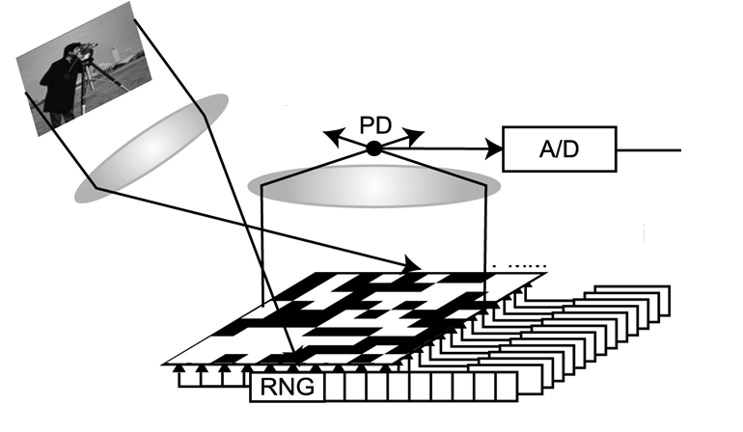
Case Study 2: Spatial Multiplexing
Photo-detector
Digital
micro-mirror device

Slide 62
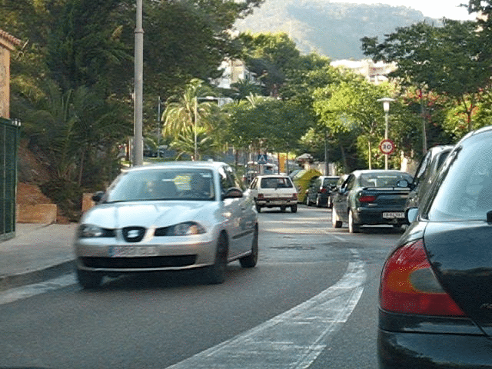
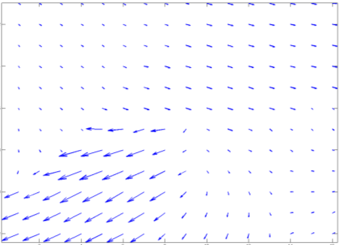
Signal model
Motion flow
Two images I₁ and I₂
Optical flow from I₁ to I₂
Credit: Ce Liu

Slide 63
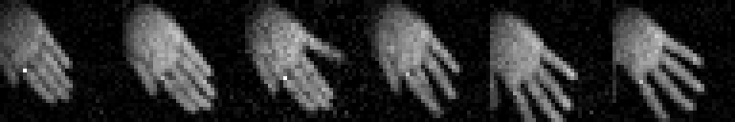



Results
Single pixel camera with short-wave infrared detector
Sampling rate: 10,000 Hz
Number of compressive measurements: 65536
Total duration of data acquisition: 6 seconds
Reconstructed video resolution: 128x128x256
Initial estimate (6 different videos) *animated gifs*
Final estimate (6 different videos)

Slide 64

Example 3: MRI
MRI obtains samples in Fourier space
Taking lesser samples == higher speed of operation, less time etc.
Lustig et al., 2008

Slide 65

MRI
Least squares recovery
From 10 times lesser number of measurements
Lustig et al., 2008

Slide 66

MRI
l1-recovery
From 10 times lesser number of measurements
The recovery is exact, provided some conditions are satisfied
Lustig et al., 2008

Slide 67
Summary: CS
Compressive sensing
  randomized dimensionality reduction
  exploits signal sparsity information
  integrates sensing, compression, processing
Why it works: with high probability, random projections preserve information
in signals with concise geometric structures
  sparse signals
  compressible signals

Slide 68
Summary: CS
Encoding: = random linear combinations
of the entries of
Decoding: Recover from via optimization
measurements
sparse
signal
nonzero
entries
Notes:
68

