Slide 1
Lessons from 1K rejected research papers
Christos Faloutsos
CMU
https://www.cs.cmu.edu/~christos/TMP/faloutsos_1KR.pptx
Notes:
Hello everybody and welcome to the ‘lessons learned’ presentation.

Slide 2
Disclaimer – meta-advice
Mainly, for ML / Data Science / DB venues
For other venues:
Some of the suggestions may still hold, but:
👉 Team up with seasoned authors from those venues
Notes:
Let’s start with 3 preliminaries: first, the intended audience:
this would be researchers in ML, DB, Data Science.
For other venues, like computer networks, operating systems, computer vision,
some of these ‘lessons’ will carry over.
But it is best to follow the meta-advice, and ask for advice from authors in those fields.

Slide 3
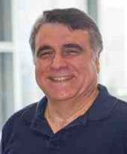
Self-introduction
Qualifications: https://www.cs.cmu.edu/~christos/
Over 30+ years of research-paper submissions from CMU (and UofT, UMD, AT&T, IBM, MSR, etc)
3-digit acceptances
4-digit (~1K) rejections
…
Notes:
Second preliminary: may I introduce myself:
I’ve been submitting research papers for the past 30+ years;
Triple-digits of acceptances, but about 1K rejections …

Slide 4
Self-introduction
Qualifications: https://www.cs.cmu.edu/~christos/
Over 30+ years of research-paper submissions from CMU (and UofT, UMD, AT&T, IBM, MSR, etc)
3-digit acceptances
4-digit (~1K) rejections
… and counting (sigh!)
Notes:
… and counting (unfortunately)

Slide 5
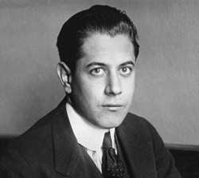
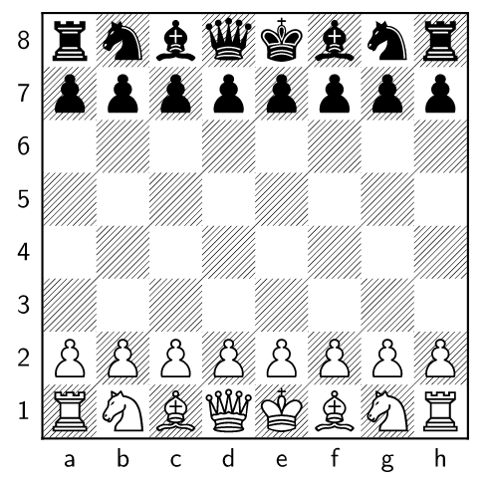
On the bright side:
You may learn much more from a game you lose than from a game you win.
wikipedia.org
José Raúl Capablanca
World chess champion 1921-27
(‘the Cuban chess machine’)
Notes:
Last preliminary: some thoughts on rejections:
Chess champion J.R. Capablanca said the above encouraging quote.
The question is, can we do better than learning from our ‘lost-games’/rejected-papers?

Slide 6
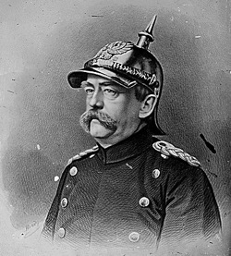
On the bright side:
You may learn much more from a game you lose than from a game you win.
wikipedia.org
Only a fool learns from his own mistakes. The wise man learns from the mistakes of others.
(attr. to Bismarck (‘Iron Chancellor’) - wikiquote.org)
germanculture.com.ua
Notes:
The answer is ‘yes’, by none other than the ‘iron Chancellor’,
Otto von Bismarck – the unifier of Germany in the 19th century:
yes, the smart way is to learn from *other* people’s mistakes.

Slide 7
(fool?)
?
Only a fool learns from his own mistakes. The wise man learns from the mistakes of others.
(attr. to Bismarck (‘Iron Chancellor’) - wikiquote.org)
germanculture.com.ua
Notes:
Great idea – but where can we find such a ‘fool’ to learn from? I couldn’t find one, 30 years ago…

Slide 8
(ouch!)
Only a fool learns from his own mistakes. The wise man learns from the mistakes of others.
(attr. to Bismarck (‘Iron Chancellor’) - wikiquote.org)
germanculture.com.ua
Notes:
But I guess you found one… Which leads us to the main outline of this presentation:

Slide 9
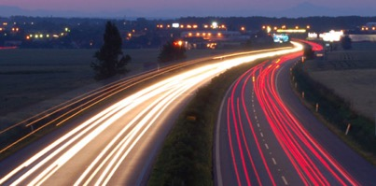
Outline
Top 3 lessons: ‘F.A.N.’
Figure (‘crown jewel’ figure)
Ask (ask a rhetorical question)
Name (give a name to your method/system)
A step back: ‘think like a reviewer’
More battle scars; and ~10 remedies
Conclusions
Notes:
We’ll spend most of the time in the top 3 mistakes, and their remedies.
The remedies form the acronym ‘FAN’

Slide 10
Outline
Top 3 lessons: ‘F.A.N.’
Figure (‘crown jewel’ figure)
Ask (ask a rhetorical question)
Name (give a name to your method/system)
A step back: ‘think like a reviewer’
More battle scars; and ~10 remedies
Conclusions
your
paper
🤞
Notes:
… like a fan that will push our paper towards the top of the paper list, and hopefully above the threshold.
In the last few minutes, we’ll do a deep dive:
we’ll go ‘behind enemy lines’ to see how reviewers think,
and finally we’ll see a list of about 10 more lessons and remedies. So, let’s start with the ‘F’ remedy.

Slide 11
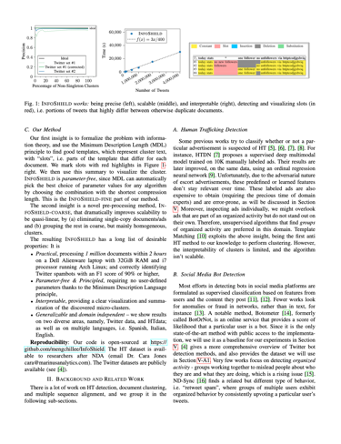
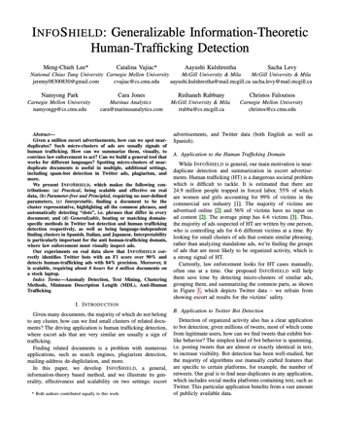
‘F’ – which one?
Pick one to review
Q1) Which one?
Q2) Why?
(a)
(b)
(c)
Notes:
Suppose that you volunteered to be a reviewer, and the bad news is that it is due tomorrow.
The worse news is that you are pressed for time
(also due tomorrow is a progress report / a project launch/ a proposal etc).
The good news is that you are allowed to pick only one of the 3 papers below –
you see their front page. Which one would you pick, and why?

Slide 12
‘F’ – which one?
II
Pick one to review
Q1) Which one?
Q2) Why?
(a)
(b)
(c)
Notes:
In general, the ‘pause’ sign means ‘pause and vote’ –
our on-line participants, will actually have a vote – for our off-line ones, feel free to pause and choose.
Case (a) has nice formatted text, with some bold font for emphasis.
Case (b) wastes some space with a table – it has a few bullet items, but very little bold font.
Case ( c ) is like case (b), with a figure instead of a table. Feel free to pause or vote.

Slide 13
‘F’ – which one?
Pick one to review
Q1) Which one? -> ‘c’
Q2) Why?
(a)
(b)
(c)
Notes:
I presume most of you voted for the figure. Why?

Slide 14
‘F’ – which one?
Pick one to review
Q1) Which one? -> ‘c’
Q2) Why?
(c)
A2.1: ‘an image is worth a thousand words’
A2.2: the author respects reviewer’s time
Notes:
If you allow me to play arm-chair psychologist,
I would conjecture two reasons:
the obvious reason is that images are easier to understand than text.
The more subtle reason is that the author exhibits maturity,
respect for the reviewers’ time, and spends *his/her* time to make the paper easy to follow.
Most probably, this author has a clear problem definition,
a clear list of contributions, careful experiments, and thus the paper will be easy and enjoyable to read.

Slide 15
Outline
Top 3 lessons: ‘F.A.N.’
Figure (‘crown jewel’ figure)
Ask (ask a rhetorical question)
Name (give a name to your method/system)
A step back: ‘think like a reviewer’
More battle scars; and ~10 remedies
Conclusions
Notes:
Let’s elaborate on the ‘F’ recipe – the ‘crown jewel figure’ –
that is, the best, most informative, most convincing figure we can create.

Slide 16
'F': What makes a good ‘crown jewel’ figure?
[Consider a paper that tries to find near-duplicate escort ads -> human trafficking ]
…
Notes:
What makes a good such ‘crown jewel’ figure?
Let’s have a concrete example –
suppose we have a paper that tries to spot human trafficking activity,
by looking for near-duplicate escort ads.
This is actually a real paper (follow the link,
or check the resources at the end of this presentation).
So, suppose you have an algorithm that …

Slide 17
'F': What makes a good ‘crown jewel’ figure?
[Consider a paper that tries to find near-duplicate escort ads -> human trafficking ]
…
Notes:
… processes millions of escort ads (text documents), spots micro-clusters …

Slide 18
'F': What makes a good ‘crown jewel’ figure?
[Consider a paper that tries to find near-duplicate escort ads -> human trafficking ]
…

Slide 19
'F': What makes a good ‘crown jewel’ figure?
[Consider a paper that tries to find near-duplicate escort ads -> human trafficking ]
If interested
call 123456
email: xyzw@
If interested
call 987654
email: xyzw@
…
If interested
call 456789
email: xyzw@
Notes:
… and highlights the similarities and differences in each micro-cluster.
The reason this works is that criminals write the same ad text for their several victims,
and they only change a few details (like name, phone number).
Suppose that your paper is ready, complete with algorithm, experiments, and nice results.

Slide 20
'F': What makes a good ‘crown jewel’ figure?
[Consider a paper that tries to find near-duplicate escort ads -> human trafficking ]
If interested
call 123456
email: xyzw@
Mock-up text,
for victims’ safety
If interested
call 987654
email: xyzw@
…
If interested
call 456789
email: xyzw@
Notes:
Of course, the text shown is a mock-up, for the victims’ safety.

Slide 21
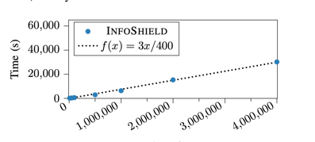
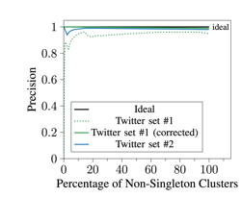
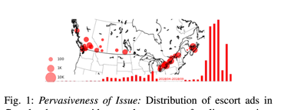
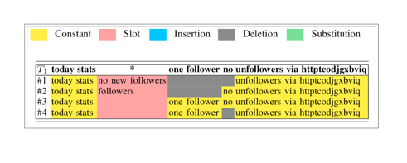
'F': What makes a good ‘crown jewel’ figure?
Which one a reviewer will find most impressive?
A)
B)
C)
# ads
D)
E)
Notes:
Which of these figures will you choose for ‘F’ (crown jewel figure)?
Let’s guess what will be the reviewers’ response to each of these figures.

Slide 22
'F': What makes a good ‘crown jewel’ figure?
Which one a reviewer will find most impressive?
Message??
(A)
# ads
Notes:
Run time versus input size – what will a reviewer conclude?

Slide 23
'F': What makes a good ‘crown jewel’ figure?
Which one a reviewer will find most impressive?
scalable
(A)
# ads
Notes:
Yes, the method is linear and thus scalable.

Slide 24
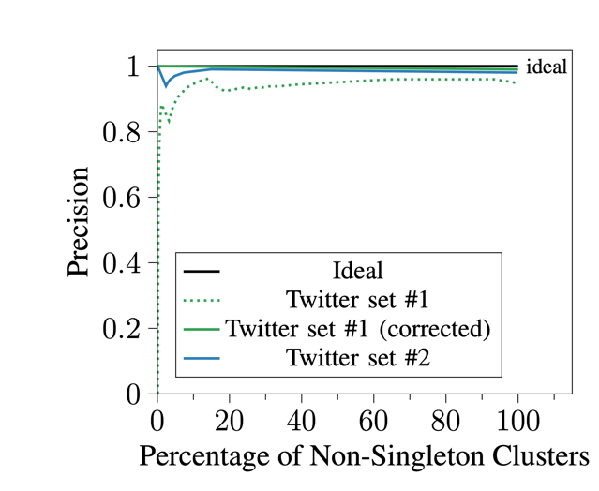
'F': What makes a good ‘crown jewel’ figure?
Which one a reviewer will find most impressive?
Message?
(B)
Notes:
Precision versus some-not-so-important quantity:
the blue/green curves are close to 100% precision (black line). Message to reviewer?

Slide 25
'F': What makes a good ‘crown jewel’ figure?
Which one a reviewer will find most impressive?
accurate
(B)
Notes:
“The method is accurate”

Slide 26
'F': What makes a good ‘crown jewel’ figure?
Which one a reviewer will find most impressive?
Message?
(C)
Notes:
Choice ( C ): large circles mean ‘many escort ads’;
the histogram is number of ads vs time. What is the reviewers’ impression?

Slide 27
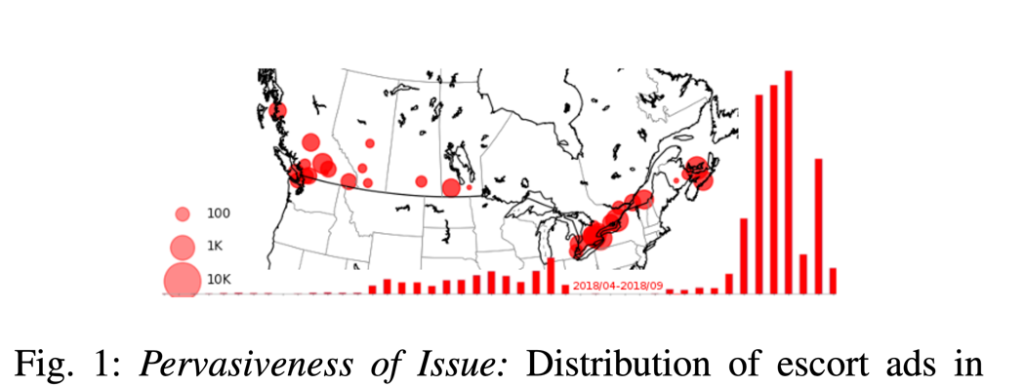
'F': What makes a good ‘crown jewel’ figure?
Which one a reviewer will find most impressive?
Important
problem
(C)
Notes:
“The problem is pervasive, with increasing importance"

Slide 28
'F': What makes a good ‘crown jewel’ figure?
Which one a reviewer will find most impressive?
Message?
(D)
System Overview
Notes:
The proposed system reads in the ads;
forces each ad into an $n$-dimensional embedding;
then it finds micro-clusters;
ranks them according to importance;
and finally finds similarities to convince the investigators.
What is the take-home message?

Slide 29
'F': What makes a good ‘crown jewel’ figure?
Which one a reviewer will find most impressive?
Elaborate
method
(D)
System Overview
Notes:
“it is an elaborate method”

Slide 30
'F': What makes a good ‘crown jewel’ figure?
Which one a reviewer will find most impressive?
(E)
Message?
Result, on real ‘tweets’
Notes:
Last choice: it shows the members of a micro-cluster from real data (public tweets) –
yellow stands for the common substrings;
red stands for the slots (‘names’/’phones’ for the trafficking case).
Take-home message?

Slide 31
'F': What makes a good ‘crown jewel’ figure?
Which one a reviewer will find most impressive?
(E)
It works.
Result, on real ‘tweets’
Notes:
“It works”

Slide 32
'F': What makes a good ‘crown jewel’ figure?
Which one a reviewer will find most impressive?
A) scalable
B) accurate
C) important
# ads
D) elaborate
E) It works
Notes:
OK – which one (or ones) would you use for ‘crown jewel figure’?

Slide 33
'F': What makes a good ‘crown jewel’ figure?
II
Which one a reviewer will find most impressive?
A) scalable
B) accurate
C) important
# ads
D) elaborate
E) It works
Notes:
… Voting time …

Slide 34
'F': What makes a good ‘crown jewel’ figure?
Q: Which one to choose?
✓
✓
A) scalable
B) accurate
C) important
# ads
✓
D) elaborate
E) It works
Notes:
I would argue that A-B-E are the most convincing,
because they show compelling properties of our system.
Which of the 3 to choose for the final winner?

Slide 35
'F': What makes a good ‘crown jewel’ figure?
A: all 3 - it’s OK to have >1 figures
✓
✓
✓
A) scalable
B) accurate
E) It works
# ads
Notes:
That was a trick question – we could concatenate all 3 (as long as the font-size is still readable)

Slide 36
'F': What makes a good ‘crown jewel’ figure?
Emphasize ‘what’ we can achieve – not ‘how’
‘How’
‘What’
✓
D) elaborate
E) It works
Notes:
Let me elaborate on a subtle, but *extremely* important point:
In our crown-jewel (and all the other high-visibility places: title, abstract, intro, conclusions)
we want to emphasize *what* our method is achieving
(what treasures will our work lead to) – and NOT – I repeat, NOT *how* we achieve that
(not the detailed steps of the treasure map).
The best place for ‘how’ is in the 3rd section of our paper (‘proposed method’).

Slide 37
'F': What makes a good ‘crown jewel’ figure?
Emphasize ‘what’ we can achieve – not ‘how’
‘How’
‘What’
“Embed -> cluster -> rank”
“*anybody* could do that – what’s so novel?”
✓
D) elaborate
E) It works
Notes:
The reason for staying away from ‘how’ is the reviewers’ reaction:
‘your method does embedding (standard stuff),
followed by clustering (also textbook stuff),
and then ranking – all steps are known – no novelty’.

Slide 38
'F': What makes a good ‘crown jewel’ figure?
Emphasize ‘what’ we can achieve – not ‘how’
‘How’
‘What’
“Embed -> cluster -> rank”
“*anybody* could do that – what’s so novel?”
✓
D) elaborate
E) It works
Notes:
Thus, we want to push the ‘how’ into section 3 –
and never in the title/abstract/intro/conclusions.

Slide 39
'F': What makes a good ‘crown jewel’ figure?
Emphasize ‘what’ we can achieve – not ‘how’
‘How’
‘What’
“Embed -> cluster -> rank”
“*anybody* could do that – what’s so novel?”
✓
D) elaborate
E) It works
Notes:
Apologies for the repetition –
but I really want to emphasize how dangerous is to mention the ‘how’ outside section 3.
And we’ll repeat this message 6-7 times later on – it is *that* important.

Slide 40
Outline
Top 3 lessons: ‘F.A.N.’
Figure (‘crown jewel’ figure)
Ask (ask a rhetorical question)
Name (give a name to your method/system)
A step back: ‘think like a reviewer’
More battle scars; and ~10 remedies
Conclusions
Notes:
So, we are done with ‘F’ / crown-jewel figure, and we are ready for the ‘A’ recipe.

Slide 41
'A': Best way to start the abstract?
[Consider a paper that tries to find near-duplicate escort ads -> human trafficking ]
If interested
call 123456
email: xyzw@
If interested
call 987654
email: xyzw@
…
If interested
call 456789
email: xyzw@
Notes:
What is the best way to start your abstract?
For concreteness, let’s say we have the human-trafficking-detection paper,
that finds micro-clusters of near-duplicate escort ads.

Slide 42
'A': Best way to start the abstract?
A)
B)
Human trafficking is an age old problem that continues to affect 25 million people worldwide.
…..
Given a million escort advertisements, how can we spot near- duplicates?
…..
Notes:
I’ll give you a few seconds to read choice (A)

Slide 43
'A': Best way to start the abstract?
A)
B)
Human trafficking is an age old problem that continues to affect 25 million people worldwide.
…..
Given a million escort advertisements, how can we spot near- duplicates?
…..
Notes:
… and a few more to read (B)

Slide 44
'A': Best way to start the abstract?
A)
II
B)
Human trafficking is an age old problem that continues to affect 25 million people worldwide.
…..
Given a million escort advertisements, how can we spot near- duplicates?
…..
Notes:
Voting time: (A) or (B)? Off-line viewers please decide if you want to pause, while the on-line viewers cast their votes ….

Slide 45
'A': Best way to start the abstract?
✓
✓
✓
A)
B)
Human trafficking is an age old problem that continues to affect 25 million people worldwide.
…..
Given a million escort advertisements, how can we spot near- duplicates?
…..
Notes:
Both are good – but I would argue that (B) is a little better, because it asks a question

Slide 46
Outline
Top 3 lessons: ‘F.A.N.’
Figure (‘crown jewel’ figure)
Ask (ask a rhetorical question)
Name (give a name to your method/system)
A step back: ‘think like a reviewer’
More battle scars; and ~10 remedies
Conclusions
Notes:
’A’ stands for ‘ask a rhetorical question’. For those of us who don’t speak ancient Greek nor Latin, ‘rhetorical question’ means …

Slide 47
'A': Best way to start the abstract?
A)
B)
Human trafficking is an age old problem that continues to affect 25 million people worldwide.
…..
Given a million escort advertisements, how can we spot near- duplicates?
…..
‘Rhetorical question’:
= you know the answer
Notes:
… that we know the answer.

Slide 48
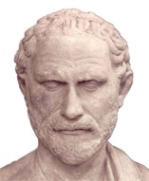
'A': Best way to start the abstract?
A)
B)
Human trafficking is an age old problem that continues to affect 25 million people worldwide.
…..
Given a million escort advertisements, how can we spot near- duplicates?
…..
rhetor
orator
‘Rhetorical question’:
= you know the answer
Notes:
This is a 2 thousand year trick, heavily used by public speakers in ancient Rome and Greece –
can’t go wrong with such a time-tested tool!
Questions appeal to the general audience (making them start thinking) –
and, judging from myself, it is even more effective to problem-solvers like all of us.
The question in (B) would have problem-solving reviewers think:
“hm, I could do an N-square algorithm comparing everything with everything – no – 1M – it won’t work –
how about cosine similarity and k-means clustering –
but this will find large clusters – not micro-clusters – hm – let me read on”)

Slide 49
'A': Best ‘rhetorical question’:
II
C)
B)
How can we help law enforcement fight human trafficking?
…..
Given a million escort advertisements, how can we spot near- duplicates?
…..
‘Rhetorical question’:
= you know the answer
Notes:
Is (B) the best rhetorical question we can ask? Are there better (or worse) questions? How about ( C )? Voting time, again…

Slide 50
'A': Best ‘rhetorical question’:
C)
B)
How can we help law enforcement fight human trafficking?
…..
Given a million escort advertisements, how can we spot near- duplicates?
…..
Wrong question.
(‘call your congressperson’,
‘deploy face recognition s/w’,
…)
‘Rhetorical question’:
= you know the answer
Notes:
I would argue that ( C ) is not a good choice –
too general and unfocused, and it’s answer is not *our algorithm*.

Slide 51
Outline
Top 3 lessons: ‘F.A.N.’
Figure (‘crown jewel’ figure)
Ask (ask a rhetorical question)
Name (give a name to your method/system)
A step back: ‘think like a reviewer’
More battle scars; and ~10 remedies
Conclusions
Notes:
Let’s proceed to the ‘N’ recipe.

Slide 52
Reminder: our sample problem
[Consider a paper that tries to find near-duplicate escort ads -> human trafficking ]
If interested
call 123456
email: xyzw@
If interested
call 987654
email: xyzw@
…
If interested
call 456789
email: xyzw@
Notes:
Before we reveal what ‘N’ stands for, let’s decide which title is better.
Remember, you have written a paper that finds micro-clusters in escort ads,
which are often an indication of human trafficking.

Slide 53
'N': Which title is best?
On human trafficking detection
Embedding and clustering for human trafficking detection
Fast and accurate human trafficking detection
TrafficSpot: Fast and accurate human trafficking detection
Notes:
For that paper, which title would you like to give?

Slide 54
'N': Which title is best?
On human trafficking detection
Embedding and clustering for human trafficking detection
Fast and accurate human trafficking detection
TrafficSpot: Fast and accurate human trafficking detection
Notes:
How about this one? It is on topic. Any pros or cons, from the on-line audience?

Slide 55
'N': Which title is best?
On human trafficking detection
Embedding and clustering for human trafficking detection
Fast and accurate human trafficking detection
TrafficSpot: Fast and accurate human trafficking detection
~
Too general
Notes:
It’s OK – but we can do better. It is too general (are we talking about the legal aspects of detection? The privacy aspects? The law-enforcement aspects?)

Slide 56
'N': Which title is best?
On human trafficking detection
Embedding and clustering for human trafficking detection
Fast and accurate human trafficking detection
TrafficSpot: Fast and accurate human trafficking detection
Notes:
How about this one?

Slide 57
'N': Which title is best?
NO-NO
‘What’ – not ‘How’
On human trafficking detection
Embedding and clustering for human trafficking detection
Fast and accurate human trafficking detection
TrafficSpot: Fast and accurate human trafficking detection
Notes:
No – never – please, no: violates the ” ‘what’ – not ‘how’ “ rule of thumb.

Slide 58
'N': Which title is best?
On human trafficking detection
Embedding and clustering for human trafficking detection
Fast and accurate human trafficking detection
TrafficSpot: Fast and accurate human trafficking detection
Notes:
This one? Pros / cons?

Slide 59
'N': Which title is best?
On human trafficking detection
Embedding and clustering for human trafficking detection
Fast and accurate human trafficking detection
TrafficSpot: Fast and accurate human trafficking detection
✓
Notes:
It is very good – short, to the point, emphasizing the ‘what’.

Slide 60
'N': Which title is best?
On human trafficking detection
Embedding and clustering for human trafficking detection
Fast and accurate human trafficking detection
TrafficSpot: Fast and accurate human trafficking detection
Notes:
Exactly as ‘C’, but it has a method-name. Pros / cons?

Slide 61
'N': Which title is best?
On human trafficking detection
Embedding and clustering for human trafficking detection
Fast and accurate human trafficking detection
TrafficSpot: Fast and accurate human trafficking detection
✓
✓
Notes:
Yes, this is probably one of the best titles. The reason is it gives a *name* (hence the ‘N’ recipe).

Slide 62
'N': Which title is best?
On human trafficking detection
Embedding and clustering for human trafficking detection
Fast and accurate human trafficking detection
TrafficSpot: Fast and accurate human trafficking detection
Q: Benefits of a name?
✓
✓
Notes:
What are the benefits of giving a name to our method?

Slide 63
'N': Which title is best?
On human trafficking detection
Embedding and clustering for human trafficking detection
Fast and accurate human trafficking detection
TrafficSpot: Fast and accurate human trafficking detection
Q: Benefits of a name?
Easy reference
.
✓
✓
Notes:
Yes, it makes our paper-writing easier (‘our TraffickSpot algorithm does this and that’, as opposed to ‘ the algorithm in page 4 … ‘ ).
The second advantage is more subtle (but more important…) – any guesses?

Slide 64
'N': Which title is best?
On human trafficking detection
Embedding and clustering for human trafficking detection
Fast and accurate human trafficking detection
TrafficSpot: Fast and accurate human trafficking detection
Q: Benefits of a name?
Easy reference
‘novelty’
✓
✓
Notes:
It highlights the novelty of our method: it has a new name, and thus a reviewer will assume that it is a novel algorithm (despite the fact that it consists of a sequence of textbook steps – all algorithms are eventually additions and if-then-else statements…)
The same way that all of us are made of quarks…

Slide 65
Outline
Top 3 lessons: ‘F.A.N.’
Figure (‘crown jewel’ figure)
Ask (ask a rhetorical question)
Name (give a name to your method/system)
A step back: ‘think like a reviewer’
More battle scars; and ~10 remedies
Conclusions
Notes:
‘N’ stands for ‘Name’ – but picking a good name is not that easy! Let me elaborate:

Slide 66
'N': How to pick good names?
CAE (-> Cluster And Embed)
CUBE (-> ClUster and emBEd)
Spot
TrafficSpot
InfoShield
Notes:
Again, consider the sample paper (micro-cluster detection in escort ads). Pros and cons of the first choice?

Slide 67
'N': How to pick good names?
Meaningless
‘how’
CAE (-> Cluster And Embed)
CUBE (-> ClUster and emBEd)
Spot
TrafficSpot
InfoShield
Notes:
No – never – please, no! the violation of ‘ what – not how’ is already bad enough –
a minor con is that CAE has no meaning, nor relation to human trafficking or anything else.

Slide 68
'N': How to pick good names?
CAE (-> Cluster And Embed)
CUBE (-> ClUster and emBEd)
Spot
TrafficSpot
InfoShield
Notes:
How about choice ‘b’? A lot of authors try to create a nice acronym like that.
Pros and cons of ‘b’?

Slide 69
'N': How to pick good names?
English word
irrelevant
‘how’
CAE (-> Cluster And Embed)
CUBE (-> ClUster and emBEd)
Spot
TrafficSpot
InfoShield
Notes:
‘what – not how’ is a show stopper – but the specific choice has additional,
minor, drawbacks: the paper has nothing to do with cubes, cubic powers or anything related;
and it is an English word – we’ll describe later why vocabulary words are not a good idea.

Slide 70
'N': How to pick good names?
CAE (-> Cluster And Embed)
CUBE (-> ClUster and emBEd)
Spot
TrafficSpot
InfoShield
Notes:
How about ‘c’? Pros/cons?

Slide 71
'N': How to pick good names?
CAE (-> Cluster And Embed)
CUBE (-> ClUster and emBEd)
Spot
TrafficSpot
InfoShield
English word
~
Notes:
It’s OK – minor disadvantage is that it is a vocabulary word – and thus we can do better.

Slide 72
'N': How to pick good names?
CAE (-> Cluster And Embed)
CUBE (-> ClUster and emBEd)
Spot
TrafficSpot
InfoShield
~
Notes:
How about ‘d’?

Slide 73
'N': How to pick good names?
CAE (-> Cluster And Embed)
CUBE (-> ClUster and emBEd)
Spot
TrafficSpot
InfoShield
~
✓
Notes:
It is very good – clearly ‘what – not how’, easy to remember, not a vocabulary word.

Slide 74
'N': How to pick good names?
CAE (-> Cluster And Embed)
CUBE (-> ClUster and emBEd)
Spot
TrafficSpot
InfoShield
~
✓
Notes:
How about ‘e’?

Slide 75
'N': How to pick good names?
CAE (-> Cluster And Embed)
CUBE (-> ClUster and emBEd)
Spot
TrafficSpot
InfoShield
~
✓
✓
Notes:
Also very good, like ‘d’: “Shielding trafficking victims using information technology”. In fact, that was the choice for the actual paper on human trafficking detection.

Slide 76
Recipes for ‘good names’ – part1/4
1) ‘What’ – not ‘how’
clusterEmbed TrafficLight
Notes:
Choosing good names is non-trivial, but *well worth* the time.
Next we’ll see 4 rules-of-thumb for picking good names.
We’ll use ‘red’ and ‘green’ for ‘bad’ and ‘good’ names respectively.
For the two choices, what should be ‘red’ and what should be ‘green’, and why?

Slide 77
Recipes for ‘good names’ – part1/4
1) ‘What’ – not ‘how’
clusterEmbed TrafficLight
Notes:
I hope we all agree on the labels – and this is the first, and most important of the four rules of thumb: ‘what – not how’

Slide 78
Recipes for ‘good names’ – part1/4
1) ‘What’ – not ‘how’
clusterEmbed TrafficLight
Notes:
Let me emphasize this rule with two ‘danger’ signs – it is *that* important.

Slide 79
Recipes for ‘good names’ – part2/4
2) Easy to pronounce/remember
Heraclitus
TripWire
WireShark
ZX23-S
Notes:
The rest of the rules are ‘nice to have’ – but let’s go over them anyway:
Suppose you have another algorithm, on cybersecurity and computer network traffic monitoring.
First choice: that name (an ancient philosopher).
Next choice: has to do with wire (ethernet?) and implies that your algorithm wants to trip the intruders or so
Next: similarly, with a shark guarding your wires
Next: some alphanumeric string

Slide 80
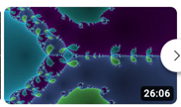
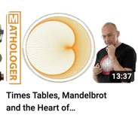
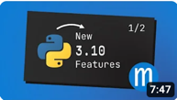
Let’s take a small break
youtube channels for math/physics, with *superb* presentations/animations:
3blue1brown
Mathologer
… ditto, for python+ coding
mCoding
Declaration: I am not being funded
nor any other way related to the above channels
Notes:
Let’s take a small break – and may I recommend these cites,
for their *superb* presentation of difficult concepts,
like fourier transform, Ramanujan’s proofs, Mandelbrot fractal;
and coding tips with examples – and none of them is related to me in any way.
And the main reason for this break is to illustrate the weakness of human memory
and the importance of choosing memorable names!

Slide 81
Recipes for ‘good names’ – part2/4
2) Easy to pronounce/remember
Heraclitus
TripWire
WireShark
ZX23-S
II
Notes:
Do you remember any of the four names (for the hypothetical cybersecurity algorithm)?
The first one was some philosopher - do you remember it? Voting time!
people without a degree in philosophy, won’t remember the name.

Slide 82
Recipes for ‘good names’ – part2/4
2) Easy to pronounce/remember
Heraclitus
TripWire
WireShark
ZX23-S
Notes:
Yeap, that’s him - who remembers the second choice? Something with wires (wire-tap or so). Voting time!

Slide 83
Recipes for ‘good names’ – part2/4
2) Easy to pronounce/remember
Heraclitus
TripWire
WireShark
ZX23-S
Notes:
Yes, trip-wire – I guess several of you may have gotten it, or gotten close.
And similarly for the 3rd choice. How about the last one?
We won’t even vote – the last one is not for mere mortals!

Slide 84
Recipes for ‘good names’ – part2/4
2) Easy to pronounce/remember
Heraclitus
TripWire
WireShark
ZX23-S
Notes:
… only robots, or humans with photographic memory.

Slide 85
Recipes for ‘good names’ – part2/4
2) Easy to pronounce/remember
Heraclitus
TripWire
WireShark
ZX23-S
Notes:
This leads us to the second rule of thumb for names: easy to remember …

Slide 86
Recipes for ‘good names’ – part2/4
2) Easy to pronounce/remember
Heraclitus TripWire
ZX23-S WireShark
Notes:
… and easy to pronounce.

Slide 87
Recipes for ‘good names’ – part3/4
3) But NOT an English word (google collisions..)
SOAR
SkySoar
Notes:
Third rule: suppose you have an algorithm for drone navigation – which of the two would you pick?

Slide 88
Recipes for ‘good names’ – part3/4
3) But NOT an English word (google collisions..)
SOAR
SkySoar
Notes:
We want to avoid vocabulary words …

Slide 89
Recipes for ‘good names’ – part3/4
3) But NOT an English word (google collisions..)
SOAR SkySoar
Notes:
… because, after our paper is published,
people will google its name to find the pdf –
and instead they will get material about eagles and fighter jets.
Not the kiss of death, but why make it difficult for people to read and cite our work?

Slide 90
Recipes for ‘good names’ – part4/4
4) Positive connotation
EaglesEye
MAFIA
Poltergeist
Sherlock
II
Notes:
Last ‘soft’ rule: which would you choose (ignore the ‘English word’ rule for the moment).
Voting time – pause, or vote!
How about the first? The second? Third? Fourth?

Slide 91
Recipes for ‘good names’ – part4/4
4) Positive connotation
EaglesEye
MAFIA
Poltergeist
Sherlock
Notes:
Slight preference for the green ones.

Slide 92
Recipes for ‘good names’ – part4/4
4) Positive connotation
MAFIA EaglesEye
Poltergeist Sherlock

Slide 93
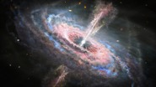
Recipes for ‘good names’ – part4/4
4) Positive connotation
MAFIA EaglesEye
Poltergeist Sherlock
Notes:
Again, this is a ‘soft’ rule – but it is epsilon better to have a name that reminds the reviewer of strength (lion, tiger), toughness (diamond), beauty (‘sandyBeach’), awesomeness (‘super-nova’), brilliancy (Sherlock, Einstein).

Slide 94
Recipes for ‘good names’
1) ‘What’ – not ‘how’
clusterEmbed TrafficLight
2) Easy to pronounce/remember
Heraclitus TripWire
ZX23 WireShark
3) But NOT an English word (google collisions..)
SOAR SkySoar
4) Positive connotation
MAFIA EaglesEye
Poltergeist Sherlock
Notes:
Here are all the rules, combined, for your easy reference.
Again, only the first is a ‘must’

Slide 95
Recipes for ‘good names’
1) ‘What’ – not ‘how’
clusterEmbed TrafficLight
2) Easy to pronounce/remember
Heraclitus TripWire
ZX23 WireShark
3) But NOT an English word (google collisions..)
SOAR SkySoar
4) Positive connotation
MAFIA EaglesEye
Poltergeist Sherlock
Notes:
Here are all the rules, combined, for your easy reference.
Again, only the first is a ‘must’ – there are published papers that broke the other 3 rules (red stars and underline) – but why would we want our name associated to a serial killer, or organized crime.

Slide 96
Drill: pick a name!
Suppose that you have developed a method that detects Twitter users that exhibit similar behavior. You use random seeds, and belief propagation, to spot such groups.
SSTU (‘spotting similar twitter users’)
BPSim (Belief Propagation for similar user detection)
TwinSpot
II
Notes:
(If there is time….)
*you* pick a name: suppose you have a method that spot twitter users
that have too similar behavior (and thus they may be sock-puppets).
Voting time – pause or vote:
How about SSTU:
BPSim
TwinSpot

Slide 97
Drill: pick a name!
Suppose that you have developed a method that detects Twitter users that exhibit similar behavior. You use random seeds, and belief propagation, to spot such groups.
SSTU (‘spotting similar twitter users’)
BPSim (Belief Propagation for similar user detection)
TwinSpot
❌
❌
✓
✓
Notes:
TwinSpot is probably the best (satisfying all 4 rules of thumb)
Can we do even better?

Slide 98
Drill: pick a name!
✓
✓
CopyCatch (!!) [Alex Beutel+, WWW13]
Notes:
This is a real paper, by Alex Beutel, during his internship at FaceBook.

Slide 99
Drill: pick a name!
✓
✓
CopyCatch (!!) [Alex Beutel+, WWW13]
Lesson learned:
team up with a native speaker ☺
Notes:
Suggestion: team up with a native speaker – especially one with a degree in English, and/or creative, and/or sense of humor (think outside the box).
We often got naming advice from the admin in our department (English major, with a great sense of humor).

Slide 100
Summary of summary: F.A.N.
Figure (one or more; ‘what’, not ‘how’)
Ask a ‘rhetorical’ question (and answer it!)
Name your method
CopyCatch ClusterEmbed
Notes:
We are done with the lessons/recipes part of the talk. Here is the summary for F.A.N.

Slide 101
Outline
Top 3 lessons: ‘F.A.N.’
Figure (‘crown jewel’ figure)
Ask (ask a rhetorical question)
Name (give a name to your method/system)
A step back: ‘think like a reviewer’
More battle scars; and ~10 remedies
Conclusions
Notes:
… Let’s do a deep dive – and go behind enemy lines

Slide 102
Think like a reviewer
Papers are graded on:
Relevance
Novelty
Technical quality
Presentation
Reviewers:
Pressed for time
Un-paid
Notes:
It is public knowledge that reviewers have to judge a paper on those four aspects
(and may be a few more).
The first and third are outside the scope of this lecture.
This lecture mostly focuses on the ‘red’: presentation.
But let me remind you that the remedies we covered, also help with ‘novelty’:

Slide 103
Think like a reviewer
Papers are graded on:
Relevance
Novelty
‘what’, not ‘how’
name
Technical quality
Presentation
Reviewers:
Pressed for time
Un-paid
Notes:
Emphasizing the ‘how’ kills the novelty in the reviewers’ mind;
giving a good name does the opposite.

Slide 104
Think like a reviewer
Papers are graded on:
Relevance
Novelty
Technical quality
Presentation
Reviewers:
Pressed for time
Un-paid
Notes:
What is not so public is the fact that reviewers are pressed for time:
they are unpaid; nobody thanks them
(at best they get a ‘thanks to the anonymous reviewers’).

Slide 105
Think like a reviewer
Papers are graded on:
Relevance
Novelty
Technical quality
Presentation
Reviewers:
Pressed for time
Un-paid
Q: what should authors do?
Notes:
And you may ask – ‘so how can we, as authors, help with this time shortage’

Slide 106
Think like a reviewer
Papers are graded on:
Relevance
Novelty
Technical quality
Presentation
Reviewers:
Pressed for time
Un-paid
Q: what should authors do?
A1: save their time (using figures, tables, emphasis)
A2: attention routing
Notes:
The answer is: Respect their time!
Clear figures and tables help;
carefully chosen emphasis (bold/italic) also helps;
a few well-chosen bullet items also help.
In short, we want to draw the reviewers’ attention to the (few) things that matter:
the accuracy / speed / effectiveness of our algorithm;
or the explainability,
or the fact that this is the first algorithm that solves an important problem.

Slide 107
Think like a reviewer
Papers are graded on:
Relevance
Novelty
Technical quality
Presentation
Reviewers:
Pressed for time
Un-paid
Q: what should authors do?
A1: save their time (using figures, tables, emphasis)
A2: attention routing
All F.A.N. recipes do that
Notes:
… and, as you may have noticed, all the F.A.N. recipes do exactly attention routing.

Slide 108
Outline
Top 3 lessons: ‘F.A.N.’
Figure (‘crown jewel’ figure)
Ask (ask a rhetorical question)
Name (give a name to your method/system)
A step back: ‘think like a reviewer’
More battle scars; and ~10 remedies
Conclusions
Notes:
We are almost done…

Slide 109
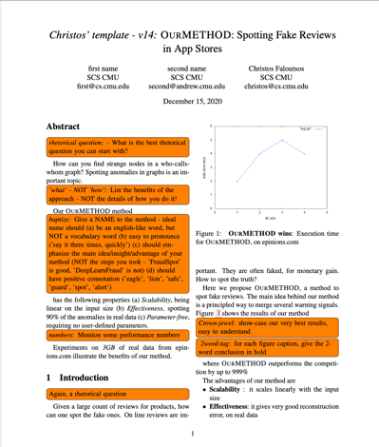
More recipes
Check template with ‘orange suggestions’: https://www.cs.cmu.edu/~christos/TMP/samplePaper_v14.tar.gz
tar xfv; make
Notes:
There are several more lessons-learned/recipes, encapsulated in the above tar-file (available on the web)

Slide 110
More recipes
Check template with ‘orange suggestions’: https://www.cs.cmu.edu/~christos/TMP/samplePaper_v14.tar.gz
tar xfv; make
Notes:
The resulting pdf has ‘orange suggestions’,
the first few of which are exactly the F.A.N. recipes.

Slide 111
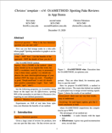
More recipes – part 1 of 4
Title:
Name your method (‘what’, not ‘how’)
Abstract
Ask a rhetorical question
Give performance numbers
✓
✓
Notes:
I won’t go over all the 10+ recipes / orange-suggestions – hopefully, I’ll cover them in a future lecture.

Slide 112
More recipes - part 2 of 4
3. Intro:
Again, rhetorical question
‘crown jewel’ figure
List (bullets) 2-4 contributions
(Informal) problem definition
Give two-word summary for each contribution
4. Literature survey
‘salesman matrix’: rows are features; columns are baselines
✓
✓
Notes:
… suggestions about intro and survey section …

Slide 113
More recipes - part 3 of 4
5. Proposed method
No citations from now on
Clear problem definition
Add theorems/lemmas and proofs (‘QED’)
6. Experiments
Each sub-section should confirm each of the contributions
Notes:
… proposed method section; and experiments section …

Slide 114
More recipes - part 3 of 4
7. Conclusions
Repeat the contributions from the intro
8. Globally:
‘two-word tag’, for every figure/table caption
Notes:
… and conclusions and global suggestions.

Slide 115
F.A.Q.
Are these guidelines mandatory/necessary?
Are they enough/sufficient?
Notes:
Some of you may be wondering: are the FAN (+10) recipes necessary and sufficient?

Slide 116
F.A.Q.
Are these guidelines mandatory/necessary?
NO (but help: + epsilon)
Are they enough/sufficient?
Notes:
No

Slide 117
F.A.Q.
Are these guidelines mandatory/necessary?
NO (but help: + epsilon)
Are they enough/sufficient?
NO (more, every year)
Notes:
… and ‘no’: they help by a little
But we may – no, we will, discover new rules as time goes by (‘learning from our mistakes’, Capablanca style)

Slide 118
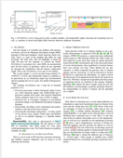
Resources
Human-trafficking detection paper:
http://catvajiac.me/files/infoshield.pdf
INFOSHIELD: Generalizable Information-Theoretic
Human-Trafficking Detection, Meng-Chieh Lee, Catalina Vajiac, et al, ICDE 2021, Chania, Greece
Check ‘orange suggestions’ at:
https://www.cs.cmu.edu/~christos/TMP/samplePaper_v14.tar.gz
Notes:
Here are all the resources: the ‘InfoShield’ paper that we used as example; and the tar-file with the ‘orange suggestions’

Slide 119
Conclusions – high level
1) Respect
reviewers’
time
2) ‘what’, not
‘how’
Notes:
The over-arching messages are two:
Respect to reviewers’ time (emphasis, attention-routing, clarity, etc)
‘what – not how’ – ‘how’ is only for section 3 – nowhere else.

Slide 120
Conclusions - detailed
F.A.N. (Figure; Ask question; Name your method)
(check orange suggestions)
Notes:
Here is the list of detailed F.A.N. recipes

Slide 121
Conclusions - detailed
F.A.N. (Figure; Ask question; Name your method)
‘ACK: … we would like to thank CF …’
christos@cs.cmu.edu
https://www.cs.cmu.edu/~christos/TMP/samplePaper_v14.tar.gz
https://www.cs.cmu.edu/~christos/TMP/faloutsos_1KR.pptx
Notes:
Here are my co-ordinates and pointers to the related material – if you find these recipes useful, I would very much appreciate if you mention it in the acknowledgements.

Slide 122
Conclusions - detailed
F.A.N. (Figure; Ask question; Name your method)
your
paper
🤞
Notes:
… and I wish that FAN will push your submissions over the acceptance threshold.

Slide 123
Conclusions - detailed
Questions?
F.A.N. (Figure; Ask question; Name your method)
your
paper
🤞

