Slide 1
Sequential imperfect-information games
Case study: Poker
Tuomas Sandholm
Carnegie Mellon University
Computer Science Department

Slide 2
Sequential imperfect information games
Players face uncertainty about the state of the world
Most real-world games are like this
  A robot facing adversaries in an uncertain, stochastic environment
  Almost any card game in which the other players’ cards are hidden
  Almost any economic situation in which the other participants possess private information (e.g. valuations, quality information)
    Negotiation
    Multi-stage auctions (e.g., English)
    Sequential auctions of multiple items
  …
This class of games presents several challenges for AI
  Imperfect information
  Risk assessment and management
  Speculation and counter-speculation
Techniques for solving sequential complete-information games (like chess) don’t apply
Our techniques are domain-independent

Slide 3
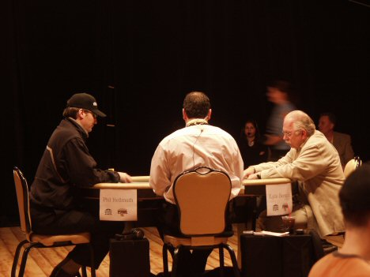
Poker
Recognized challenge problem in AI
  Hidden information (other players’ cards)
  Uncertainty about future events
  Deceptive strategies needed in a good player
Very large game trees
Texas Hold’em: most popular variant
On NBC:
Notes:
Heads-Up is highly complex & difficult to play well.
Picture is a Heads-Up competition televised by NBC.

Slide 4
Finding equilibria
In 2-person 0-sum games,
  Nash equilibria are minimax equilibria => no equilibrium selection problem
  If opponent plays a non-equilibrium strategy, that only helps me
Any finite sequential game (satisfying perfect recall) can be converted into a matrix game
  Exponential blowup in #strategies (even in reduced normal form)
Sequence form: More compact representation based on sequences of moves rather than pure strategies [Romanovskii 62, Koller & Megiddo 92, von Stengel 96]
  2-person 0-sum games with perfect recall can be solved in time polynomial in size of game tree using LP
  Cannot solve Rhode Island Hold’em (3.1 billion nodes) or Texas Hold’em (10¹⁸ nodes)

Slide 5
Our approach [Gilpin & Sandholm EC’06, JACM’07]
Now used by all competitive Texas Hold’em programs
Original game
Abstracted game
Automated abstraction
Compute Nash
Nash equilibrium
Reverse model
Nash equilibrium
Notes:
Reverse model is straightforward if only signals are abstracted, but an interesting problem if also actions are abstracted, as in No-Limit Texas Hold’em.

Slide 6
Outline
Automated abstraction
  Lossless
  Lossy
New equilibrium-finding algorithms
Stochastic games with >2 players, e.g., poker tournaments
Current & future research

Slide 7
Lossless abstraction
[Gilpin & Sandholm EC’06, JACM’07]

Slide 8
Information filters
Observation: We can make games smaller by filtering the information a player receives
Instead of observing a specific signal exactly, a player instead observes a filtered set of signals
  E.g. receiving signal {A♠,A♣,A♥,A♦} instead of A♥
Notes:
Information filters isolate signal history from action history

Slide 9
Signal tree
Each edge corresponds to the revelation of some signal by nature to at least one player
Our abstraction algorithms operate on it
  Don’t load full game into memory

Slide 10
Isomorphic relation
Captures the notion of strategic symmetry between nodes
Defined recursively:
  Two leaves in signal tree are isomorphic if for each action history in the game, the payoff vectors (one payoff per player) are the same
  Two internal nodes in signal tree are isomorphic if they are siblings and there is a bijection between their children such that only ordered game isomorphic nodes are matched
We compute this relationship for all nodes using a DP plus custom perfect matching in a bipartite graph
  Answer is stored

Slide 11
Abstraction transformation
Merges two isomorphic nodes
Theorem. If a strategy profile is a Nash equilibrium in the abstracted (smaller) game, then its interpretation in the original game is a Nash equilibrium
Assumptions
  Observable player actions
  Players’ utility functions rank the signals in the same order
Notes:
Interpretation into the original game is straightforward.

Slide 12
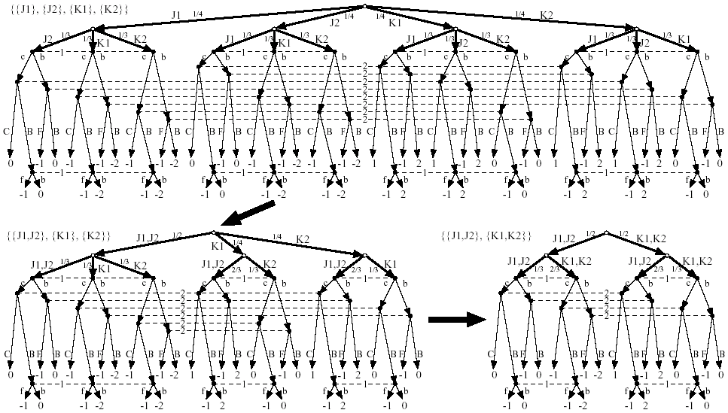

Slide 15
GameShrink algorithm
Bottom-up pass: Run DP to mark isomorphic pairs of nodes in signal tree
Top-down pass: Starting from top of signal tree, perform the transformation where applicable
Theorem. Conducts all these transformations
  Õ(n²), where n is #nodes in signal tree
  Usually highly sublinear in game tree size
One approximation algorithm: instead of requiring perfect matching, require a matching with a penalty below threshold

Slide 16
Algorithmic techniques for making GameShrink faster
Union-Find data structure for efficient representation of the information filter (unioning finer signals into coarser signals)
  Linear memory and almost linear time
Eliminate some perfect matching computations using easy-to-check necessary conditions
  Compact histogram databases for storing win/loss frequencies to speed up the checks
Notes:
E.g., unioning ace of spades and ace of clubs into{ace of spades or ace of clubs.

Slide 17
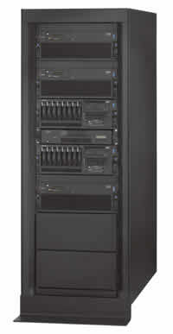
Solving Rhode Island Hold’em poker
AI challenge problem [Shi & Littman 01]
  3.1 billion nodes in game tree
Without abstraction, LP has 91,224,226 rows and columns => unsolvable
GameShrink runs in one second
After that, LP has 1,237,238 rows and columns
Solved the LP
  CPLEX barrier method took 8 days & 25 GB RAM
Exact Nash equilibrium
Largest incomplete-info (poker) game solved to date by over 4 orders of magnitude

Slide 18
Lossy abstraction

Slide 19
Texas Hold’em poker
2-player Limit Texas Hold’em has ~10¹⁸ leaves in game tree
Losslessly abstracted game too big to solve => abstract more => lossy
Nature deals 2 cards to each player
Round of betting
Nature deals 3 shared cards
Round of betting
Nature deals 1 shared card
Round of betting
Nature deals 1 shared card
Round of betting

Slide 20
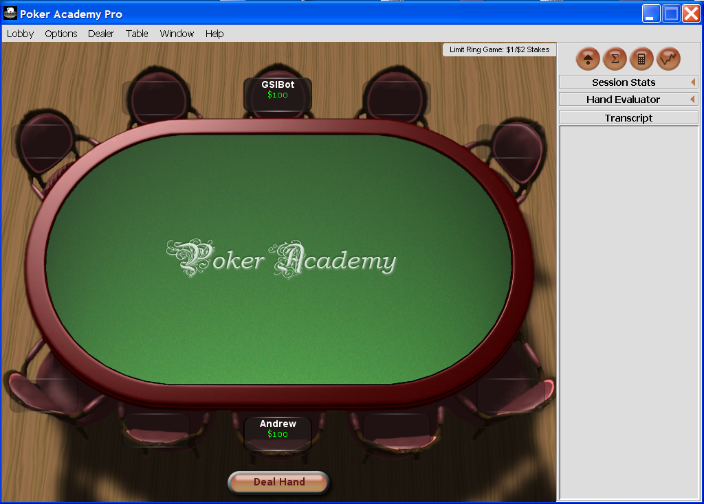

Slide 21
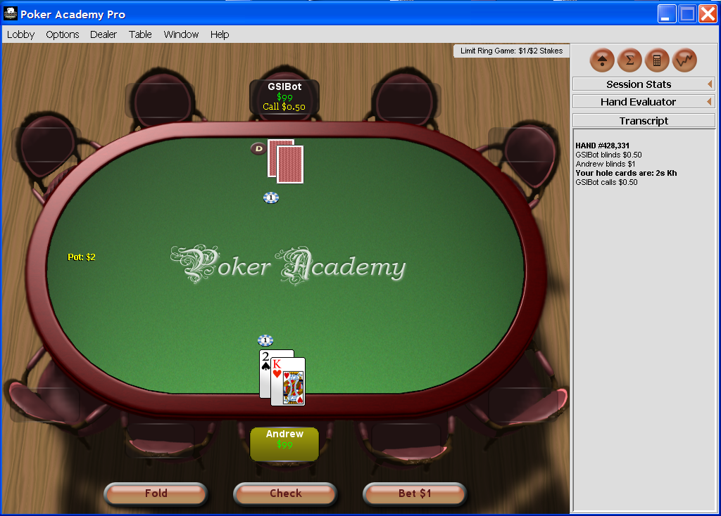

Slide 22
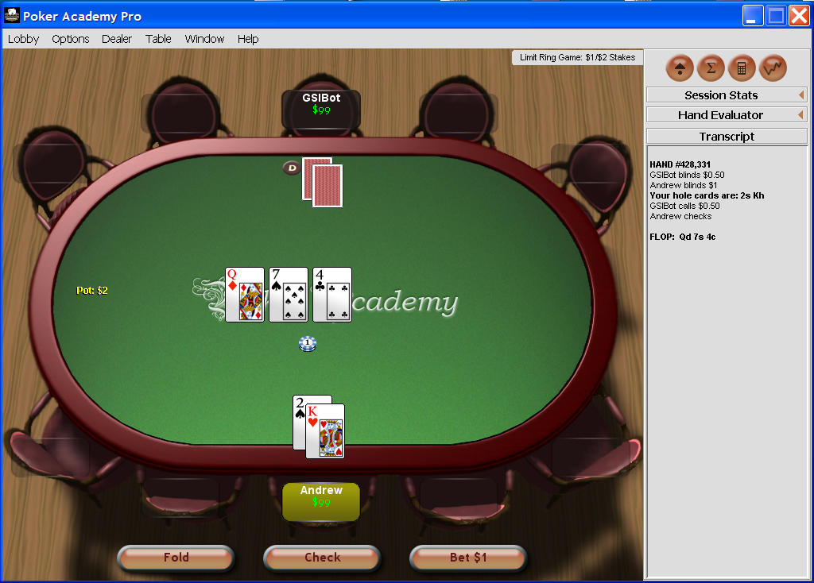

Slide 23
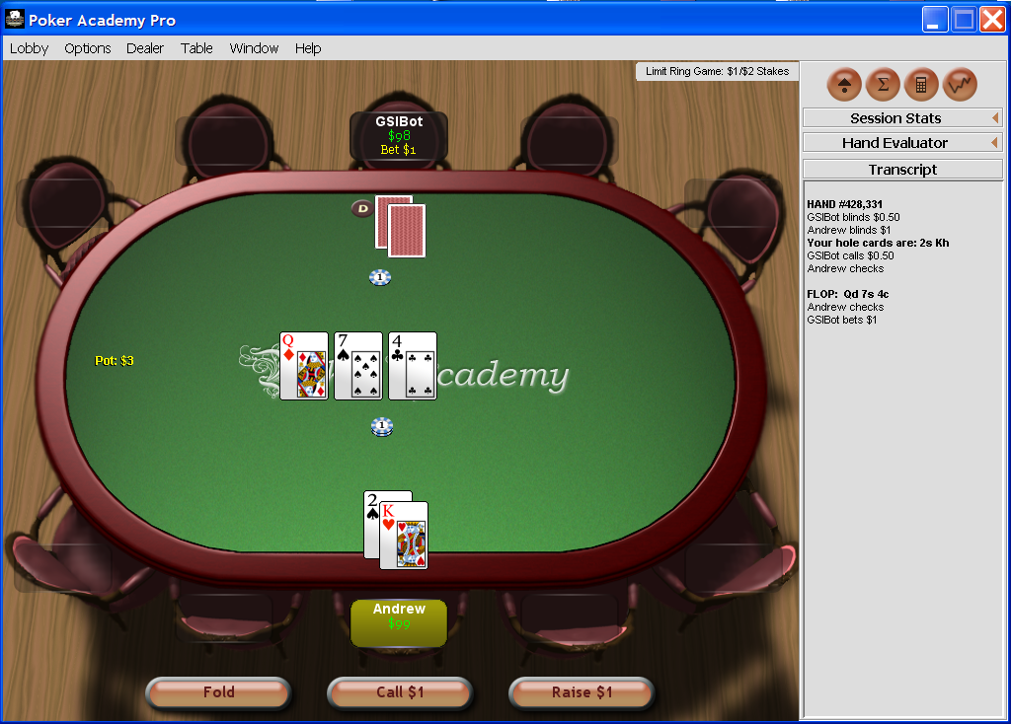

Slide 24
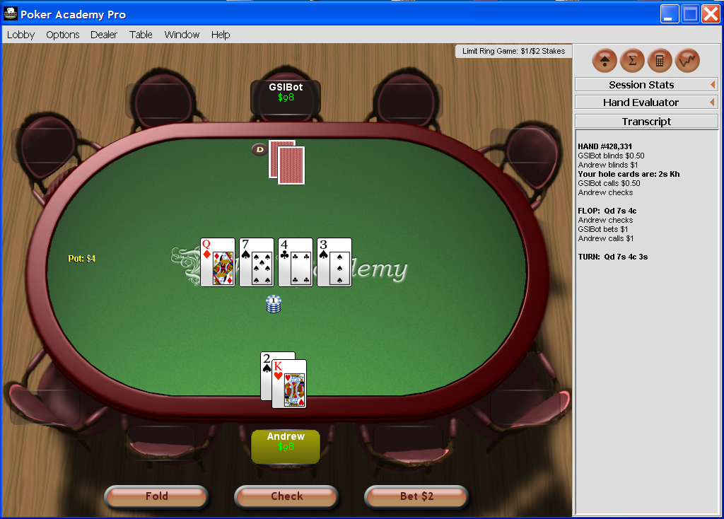

Slide 25
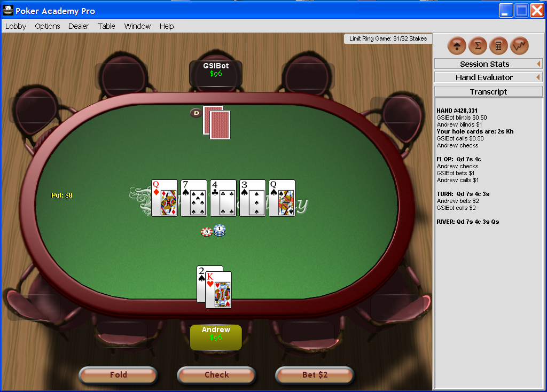

Slide 26
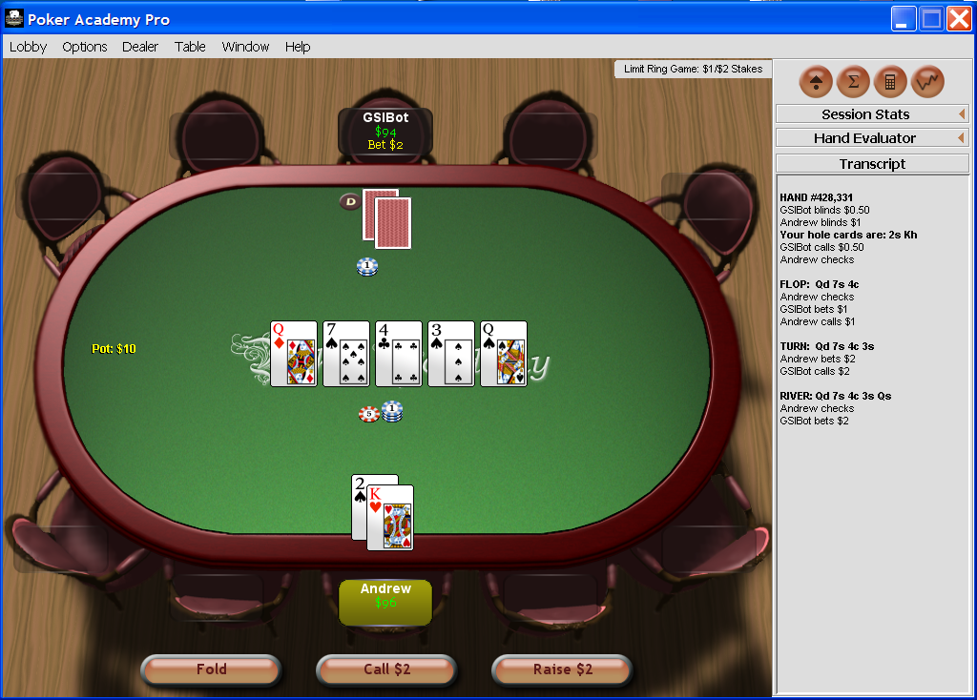

Slide 27
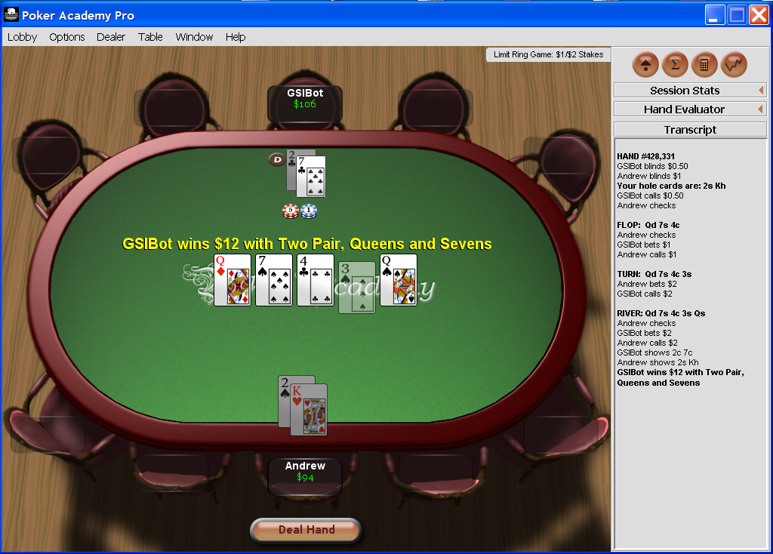

Slide 28
GS1
1/2005 - 1/2006

Slide 29
GS1 [Gilpin & Sandholm AAAI’06]
Our first program for 2-person Limit Texas Hold’em
1/2005 - 1/2006
First Texas Hold’em program to use automated abstraction
  Lossy version of Gameshrink

Slide 30
GS1
We split the 4 betting rounds into two phases
  Phase I (first 2 rounds) solved offline using approximate version of GameShrink followed by LP
    Assuming rollout
  Phase II (last 2 rounds):
    abstractions computed offline
      betting history doesn’t matter & suit isomorphisms
    real-time equilibrium computation using anytime LP
      updated hand probabilities from Phase I equilibrium (using betting histories and community card history):
      s_{i} is player i’s strategy, h is an information set

Slide 31
Some additional techniques used
Precompute several databases
Conditional choice of primal vs. dual simplex for real-time equilibrium computation
  Achieve anytime capability for the player that is us
Dealing with running off the equilibrium path

Slide 32
GS1 results
Sparbot: Game-theory-based player, manual abstraction
Vexbot: Opponent modeling, miximax search with statistical sampling
GS1 performs well, despite using very little domain-knowledge and no adaptive techniques
  No statistical significance

Slide 33
GS2 [Gilpin & Sandholm AAMAS’07]
2/2006-7/2006
Original version of GameShrink is “greedy” when used as an approximation algorithm => lopsided abstractions
GS2 instead finds abstraction via clustering & IP
  Round by round starting from round 1
Other ideas in GS2:
  Overlapping phases so Phase I would be less myopic
    Phase I = round 1, 2, and 3; Phase II = rounds 3 and 4
  Instead of assuming rollout at leaves of Phase I (as was done in SparBot and GS1), use statistics to get a more accurate estimate of how play will go
    Statistics from 100,000’s hands of SparBot in self-play

Slide 34
GS2
2/2006 – 7/2006
[Gilpin & Sandholm AAMAS’07]

Slide 35
Optimized approximate abstractions
Original version of GameShrink is “greedy” when used as an approximation algorithm => lopsided abstractions
GS2 instead finds an abstraction via clustering & IP
For round 1 in signal tree, use 1D k-means clustering
  Similarity metric is win probability (ties count as half a win)
For each round 2..3 of signal tree:
  For each group i of hands (children of a parent at round – 1):
    use 1D k-means clustering to split group i into k_{i} abstract “states”
    for each value of k_{i}, compute expected error (considering hand probs)
  IP decides how many children different parents (from round – 1) may have: Decide k_{i}’s to minimize total expected error, subject to ∑_{i} k_{i} ≤ K_{round}
    K_{round} is set based on acceptable size of abstracted game
    Solving this IP is fast in practice
Notes:
Solves generalized knapsack problem, though computationally difficult it is solved quickly in practice

Slide 36
Phase I (first three rounds)
Optimized abstraction
  Round 1
    There are 1,326 hands, of which 169 are strategically different
    We allowed 15 abstract states
  Round 2
    There are 25,989,600 distinct possible hands
      GameShrink (in lossless mode for Phase I) determined there are ~10⁶ strategically different hands
    Allowed 225 abstract states
  Round 3
    There are 1,221,511,200 distinct possible hands
    Allowed 900 abstract states
Optimizing the approximate abstraction took 3 days on 4 CPUs
LP took 7 days and 80 GB using CPLEX’s barrier method

Slide 37
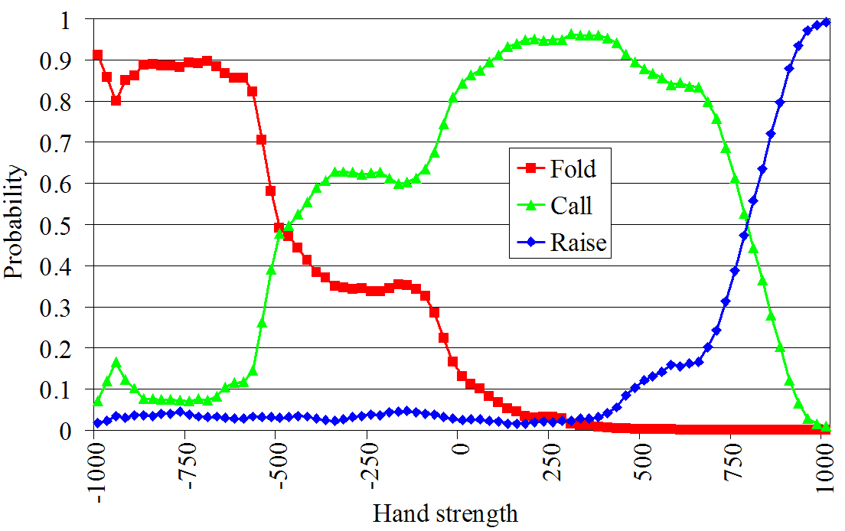
Mitigating effect of round-based abstraction (i.e., having 2 phases)
For leaves of Phase I, GS1 & SparBot assumed rollout
Can do better by estimating the actions from later in the game (betting) using statistics
For each possible hand strength and in each possible betting situation, we stored the probability of each possible action
  Mine history of how betting has gone in later rounds from 100,000’s of hands that SparBot played
  E.g. of betting in 4th round
    Player 1 has bet. Player 2’s turn

Slide 38
Phase II (rounds 3 and 4)
Abstraction computed using the same optimized abstraction algorithm as in Phase I
Equilibrium solved in real time (as in GS1)
  Beliefs for the beginning of Phase II determined using Bayes rule based on observations and the computed equilibrium strategies from Phase I

Slide 39
Precompute several databases
db5: possible wins and losses (for a single player) for every combination of two hole cards and three community cards (25,989,600 entries)
  Used by GameShrink for quickly comparing the similarity of two hands
db223: possible wins and losses (for both players) for every combination of pairs of two hole cards and three community cards based on a roll-out of the remaining cards (14,047,378,800 entries)
  Used for computing payoffs of the Phase I game to speed up the LP creation
handval: concise encoding of a 7-card hand rank used for fast comparisons of hands (133,784,560 entries)
  Used in several places, including in the construction of db5 and db223
Colexicographical ordering used to compute indices into the databases allowing for very fast lookups

Slide 40
GS2 experiments
Opponent | Series won by GS2 | Win rate (small bets per hand)
GS1 | 38 of 50 p=.00031 | +0.031
Sparbot | 28 of 50 p=.48 | +0.0043
Vexbot | 32 of 50 p=.065 | -0.0062

Slide 41
GS3
8/2006 – 3/2007
[Gilpin, Sandholm & Sørensen AAAI’07]
GS4 is similar

Slide 42
Entire game solved holistically
We no longer break game into phases
  Because our new equilibrium-finding algorithms can solve games of the size that stem from reasonably fine-grained abstractions of the entire game
=> better strategies & no need for real-time computation

Slide 43
Potential-aware automated abstraction
All prior abstraction algorithms (including ours) had myopic probability of winning as the similarity metric
  Does not address potential, e.g., hands like flush draws where although the probability of winning is small, the payoff could be high
Potential not only positive or negative, but also “multidimensional”
GS3’s abstraction algorithm takes potential into account…

Slide 44
Idea: similarity metric between hands at round R should be based on the vector of probabilities of transitions to abstracted states at round R+1
  E.g., L₁ norm
In the last round, the similarity metric is simply probability of winning (assuming rollout)
This enables a bottom

Slide 45
Bottom-up pass to determine abstraction for round 1
Round r-1
.3
.2
0
.5
Round r
Clustering using L₁ norm
  Predetermined number of clusters, depending on size of abstraction we are shooting for
In the last (4th) round, there is no more potential => we use probability of winning (assuming rollout) as similarity metric

Slide 46
Determining abstraction for round 2
For each 1st-round bucket i:
  Make a bottom-up pass to determine 3rd-round buckets, considering only hands compatible with i
  For k_{i}  {1, 2, …, max}
    Cluster the 2nd-round hands into k_{i} clusters
      based on each hand’s histogram over 3rd-round buckets
IP to decide how many children each 1st-round bucket may have, subject to ∑_{i} k_{i} ≤ K₂
  Error metric for each bucket is the sum of L₂ distances of the hands from the bucket’s centroid
  Total error to minimize is the sum of the buckets’ errors
    weighted by the probability of reaching the bucket

Slide 47
Determining abstraction for round 3
Done analogously to how we did round 2

Slide 48
Determining abstraction for round 4
Done analogously, except that now there is no potential left, so clustering is done based on probability of winning (assuming rollout)
Now we have finished the abstraction!

Slide 49
Potential-aware vs win-probability-based abstraction
[Gilpin & Sandholm AAAI-08]
Both use clustering and IP
Experiment conducted on Heads-Up Rhode Island Hold’em
  Abstracted game solved exactly
Finer-grained
abstraction
13 buckets in first round is lossless
Potential-aware becomes lossless,
win-probability-based is as good as it gets, never lossless

Slide 50
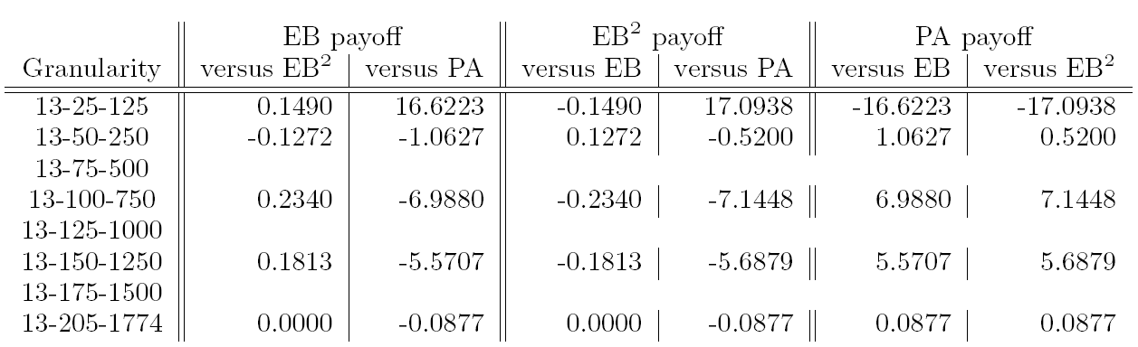
Potential-aware vs win-probability-based abstraction
[Gilpin & Sandholm AAAI-08 & new]
13 buckets in first round is lossless
Potential-aware becomes lossless,
win-probability-based is as good as it gets, never lossless

Slide 51
Equilibrium-finding algorithms
Solving the (abstracted) game
Now we move from discussing general-sum n-player games to discussing 2-player 0-sum games

Slide 52
Scalability of (near-)equilibrium finding in 2-person 0-sum games
Manual approaches can only solve games with a handful of nodes
AAAI poker competition announced
Gilpin, Sandholm
& Sørensen
Scalable EGT
Zinkevich et al.
Counterfactual regret
Gilpin, Hoda,
Peña & Sandholm
Scalable EGT
Koller & Pfeffer
Using sequence form
& LP (simplex)
Billings et al.
LP (CPLEX interior point method)
Gilpin & Sandholm
LP (CPLEX interior point method)

Slide 53
(Un)scalability of LP solvers
Rhode Island Hold’em LP
  91,000,000 rows and columns
  After GameShrink,1,200,000 rows and columns, and 50,000,000 non-zeros
  CPLEX’s barrier method uses 25 GB RAM and 8 days
Texas Hold’em poker much larger
  => would need to use extremely coarse abstraction
Instead of LP, can we solve the equilibrium-finding problem in some other way?

Slide 54
Excessive gap technique (EGT)
LP solvers only scale to ~10⁷ nodes. Can we do better than use LP?
Usually, gradient-based algorithms have poor convergence, but…
Theorem [Nesterov 05]. There is a gradient-based algorithm (for a class of minmax problems) that finds an ε-equilibrium in O(1/ ε) iterations
In general, work per iteration is as hard as solving the original problem, but…
Can make each iteration faster by considering problem structure:
Theorem [Hoda et al. 06]. In sequential games, each iteration can be solved in time linear in the size of the game tree

Slide 55
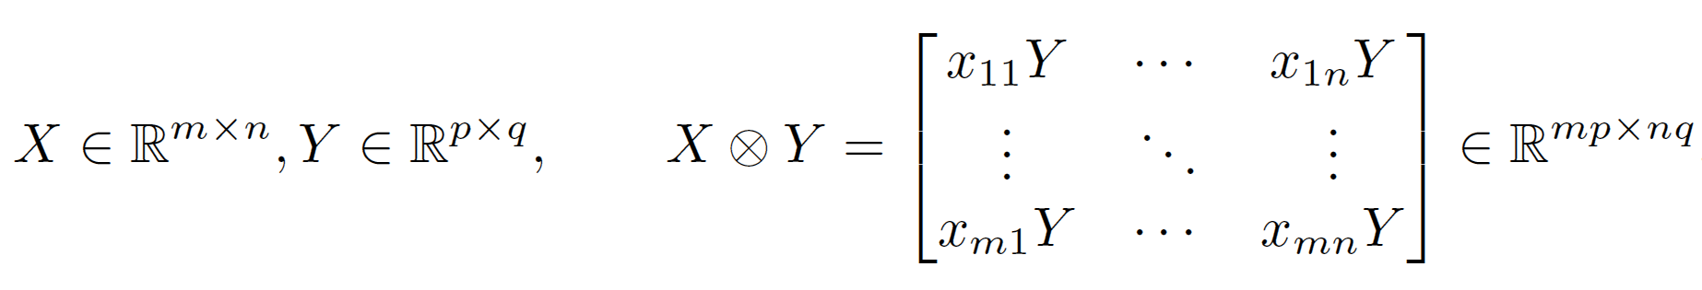
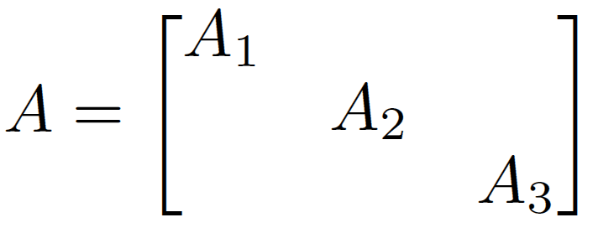
Scalable EGT [Gilpin, Hoda, Peña, Sandholm WINE’07]
Memory saving in poker & many other games
Main space bottleneck is storing the game’s payoff matrix A
Definition. Kronecker product
In Rhode Island Hold’em:
Using independence of card deals and betting options, can represent this as A₁ = F₁  B₁ A₂ = F₂  B₂ A₃ = F₃  B₃ + S  W
F_{r} corresponds to sequences of moves in round r that end in a fold
S corresponds to sequences of moves in round 3 that end in a showdown
B_{r} encodes card buckets in round r
W encodes win/loss/draw probabilities of the buckets

Slide 56
Memory usage
Instance | CPLEX barrier | CPLEX simplex | Our method
Losslessly abstracted Rhode Island Hold’em | 25.2 GB | >3.45 GB | 0.15 GB
Lossily abstracted Texas Hold’em | >458 GB | >458 GB | 2.49 GB
Notes:
Space usage drops to about a square root of the original space use.

Slide 57
Memory usage
Instance | CPLEX barrier | CPLEX simplex | Our method
10k | 0.082 GB | >0.051 GB | 0.012 GB
160k | 2.25 GB | >0.664 GB | 0.035 GB
Losslessly abstracted RI Hold’em | 25.2 GB | >3.45 GB | 0.15 GB
Lossily abstracted TX Hold’em | >458 GB | >458 GB | 2.49 GB
Notes:
Space usage drops to about a square root of the original space use.

Slide 58
Scalable EGT [Gilpin, Hoda, Peña, Sandholm WINE’07]
Speed
Fewer iterations
  With Euclidean prox fn, gap was reduced by an order of magnitude more (at given time allocation) compared to entropy-based prox fn
  Heuristics
    Less conservative shrinking of ₁ and ₂
      Sometimes need to reduce (halve) t
    Balancing ₁ and ₂ periodically
      Often allows reduction in the values
    Gap was reduced by an order of magnitude (for given time allocation)
Faster iterations
  Parallelization in each of the 3 matrix-vector products in each iteration => near-linear speedup

Slide 59
Iterated smoothing [Gilpin, Peña & Sandholm AAAI-08]
Input: Game and ε_{target}
Initialize strategies x and y arbitrarily
ε  ε_{target}
repeat
  ε  gap(x, y) / e
  (x, y)  SmoothedGradientDescent(f, ε, x, y)
  until gap(x, y) < ε_{target}
O(1/ε)
→ O(log(1/ε))

Slide 60
Solving GS3’s four-round model
[Gilpin, Sandholm & Sørensen AAAI’07]
Computed abstraction with
  20 buckets in round 1
  800 buckets in round 2
  4,800 buckets in round 3
  28,800 buckets in round 4
Our version of excessive gap technique used 30 GB RAM
  (Simply representing as an LP would require 32 TB)
  Outputs new, improved solution every 2.5 days
  4 1.65GHz CPUs: 6 months to gap 0.028 small bets per hand

Slide 61
Results (for GS4)
AAAI-08 Computer Poker Competition
  GS4 won the Limit Texas Hold’em bankroll category
    Played 4-4 in the pairwise comparisons. 4th of 9 in elimination category
  Tartanian did the best in terms of bankroll in No-Limit Texas Hold’em
    3rd out of 4 in elimination category

Slide 62
Comparison to prior poker AI
Rule-based
  Limited success in even small poker games
Simulation/Learning
  Do not take multi-agent aspect into account
Game-theoretic
  Small games
  Manual abstraction + LP for equilibrium finding [Billings et al. IJCAI-03]
  Ours
    Automated abstraction
    Custom solver for finding Nash equilibrium
    Domain independent

Slide 63
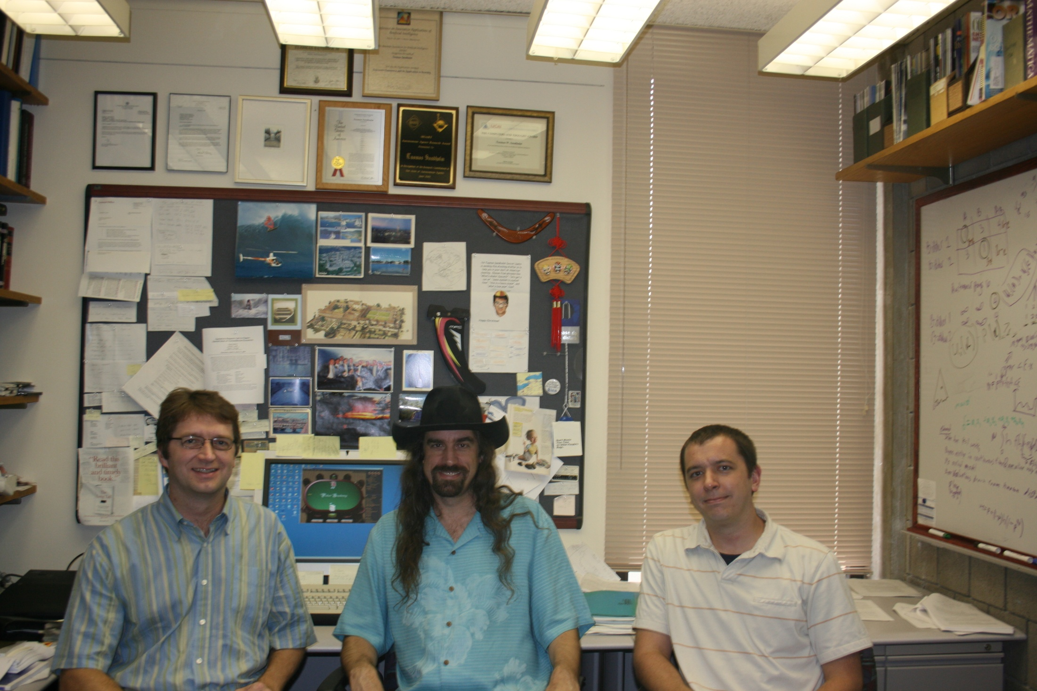

Slide 64
>2 players
(Actually, our abstraction algorithms, presented earlier in this talk, apply to >2 players)

Slide 65
Games with >2 players
Matrix games:
  2-player zero-sum: solvable in polytime
  >2 players zero-sum: PPAD-complete [Chen & Deng, 2006]
  No previously known algorithms scale beyond tiny games with >2 players
Stochastic games (undiscounted):
  2-player zero-sum: Nash equilibria exist
  3-player zero-sum: Existence of Nash equilibria still open

Slide 66
Poker tournaments
Players buy in with cash (e.g., $10) and are given chips (e.g., 1500) that have no monetary value
Lose all you chips => eliminated from tournament
Payoffs depend on finishing order (e.g., $50 for 1st, $30 for 2nd, $20 for 3rd)
Computational issues:
  >2 players
  Tournaments are stochastic games (potentially infinite duration): each game state is a vector of stack sizes (and also encodes who has the button)
Notes:
Blinds usually escalate quickly. We assume constant blinds.

Slide 67
Jam/fold strategies
Jam/fold strategy: in the first betting round, go all-in or fold
In 2-player poker tournaments, when blinds become high compared to stacks, provably near-optimal to play jam/fold strategies [Miltersen & Sørensen 2007]
Solving a 3-player tournament [Ganzfried & Sandholm AAMAS-08]
  Compute an approximate equilibrium in jam/fold strategies
  Strategy spaces 2¹⁶⁹, 2 • 2¹⁶⁹, 3 • 2¹⁶⁹
  Algorithm combines
    an extension of fictitious play to imperfect-information games
    with a variant of value iteration
  Our solution challenges Independent Chip Model (ICM) accepted by poker community
  Unlike in 2-player case, tournament and cash game strategies differ substantially
Notes:
946 non-terminal states

Slide 68
Our first algorithm
Initialize payoffs for all game states using heuristic from poker community (ICM)
Repeat until “outer loop” converges
  “Inner loop”:
    Assuming current payoffs, compute an approximate equilibrium at each state using fictitious play
    Can be done efficiently by iterating over each player’s information sets
  “Outer loop”:
    Update the values with the values obtained by new strategy profile
    Similar to value iteration in MDPs

Slide 69
Ex-post check
Our algorithm is not guaranteed to converge, and can converge to a non-equilibrium (we constructed example)
We developed an ex-post check to verify how much any player could gain by deviating [Ganzfried & Sandholm IJCAI-09]
  Constructs an undiscounted MDP from the strategy profile, and solves it using variant of policy iteration
  Showed that no player could gain more than 0.1% of highest possible payoff by deviating from our profile

Slide 70
New algorithms [Ganzfried & Sandholm IJCAI-09]
Developed 3 new algorithms for solving multiplayer stochastic games of imperfect information
  Unlike first algorithm, if these algorithms converge, they converge to an equilibrium
  First known algorithms with this guarantee
  They also perform competitively with the first algorithm
The algorithms combine fictitious play variant from first algorithm with techniques for solving undiscounted MDPs (i.e., maximizing expected total reward)

Slide 71
Best one of the new algorithms
Initialize payoffs using ICM as before
Repeat until “outer loop” converges
  “Inner loop”:
    Assuming current payoffs, compute an approximate equilibrium at each state using our variant of fictitious play as before
  “Outer loop”: update the values with the values obtained by new strategy profile S_{t} using a modified version of policy iteration:
    Create the MDP M induced by others’ strategies in S_{t} (and initialize using own strategy in S_{t}):
    Run modified policy iteration on M
      In the matrix inversion step, always choose the minimal solution
      If there are multiple optimal actions at a state, prefer the action chosen last period if possible
Notes:
This is the first new algorithm in AAAI-08 submission.
Each non-terminal state of M corresponds to non-terminal state of the tournament and a table position: so 946 • 3 = 2838 non-terminal states of M.

Slide 72
Second new algorithm
Interchanging roles of fictitious play and policy iteration:
  Policy iteration used as inner loop to compute best response
  Fictitious play used as outer loop to combine BR with old strategy
Initialize strategies using ICM
Inner loop:
  Create MDP M induced from strategy profile
  Solve M using policy iteration variant (from previous slide)
Outer loop:
  Combine optimal policy of M with previous strategy using fictitious play updating rule

Slide 73
Third new algorithm
Using value iteration variant as the inner loop
Again we use MDP solving as inner loop and fictitious play as outer loop
Same as previous algorithm except different inner loop
New inner loop:
  Value iteration, but make sure initializations are pessimistic (underestimates of optimal values in the MDP)
  Pessimistic initialization can be accomplished by matrix inversion using outer loop strategy as initialization in induced MDP

Slide 74
Summary
Domain-independent techniques
Automated lossless abstraction
  Solved Rhode Island Hold’em exactly
    3.1 billion nodes in game tree, biggest solved before had 140,000
Automated lossy abstraction
  k-means clustering & integer programming
  Potential-aware
Novel scalable equilibrium-finding algorithms
  Scalable EGT & iterated smoothing
DBs, data structures, …
Won AAAI-08 Computer Poker Competition Limit Texas Hold’em bankroll category (and did best in bankroll in No-Limit also)
  Competitive with world’s best professional poker players?
First algorithms for solving large stochastic games with >2 players (3-player jam/fold poker tournaments)

Slide 75
Current & future research
Abstraction
  Provable approximation (ex ante / ex post)
  Action abstraction (requires reverse model) -> Tartanian for No-Limit Texas Hold’em [Gilpin, Sandholm & Sørensen AAMAS-08]
  Other types of abstraction
Equilibrium-finding algorithms with even better scalability
Other solution concepts: sequential equilibrium, coalitional deviations,…
Even larger #players (cash game & tournament)
Opponent modeling
Actions beyond the ones discussed in the rules:
  Explicit information-revelation actions
  Timing, …
Trying these techniques in other games
Notes:
Ex ante & ex post

