Slide 1
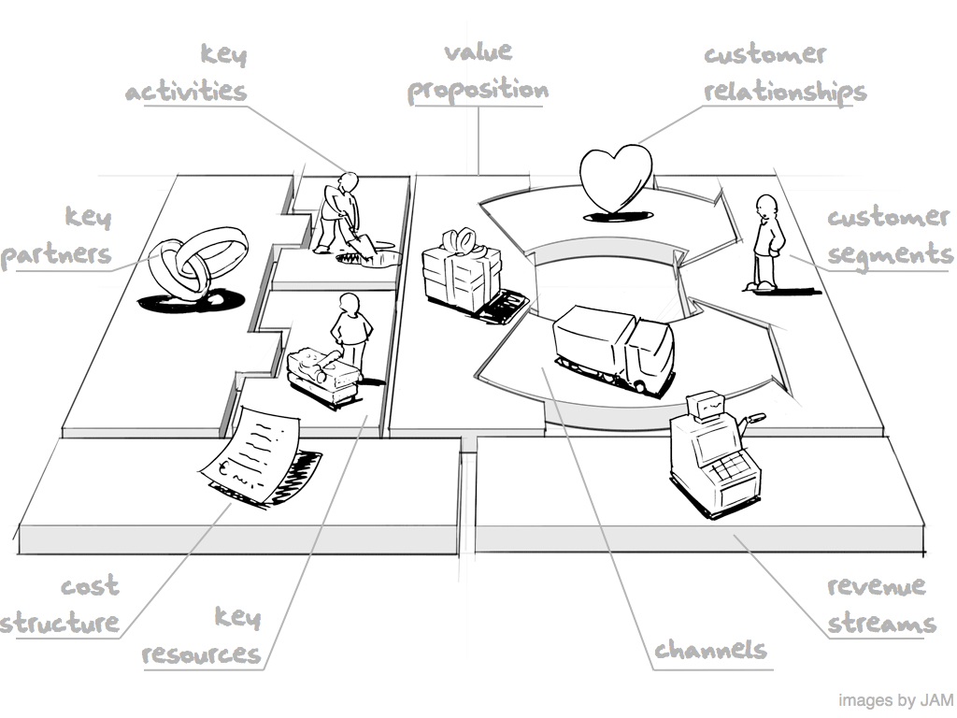
Business Models
What’s new?
Dave Mawhinney
Donald H. Jones Center for Entrepreneurship
Managing Director, Open Field Entrepreneurs Fund
October 10, 2011

Slide 2
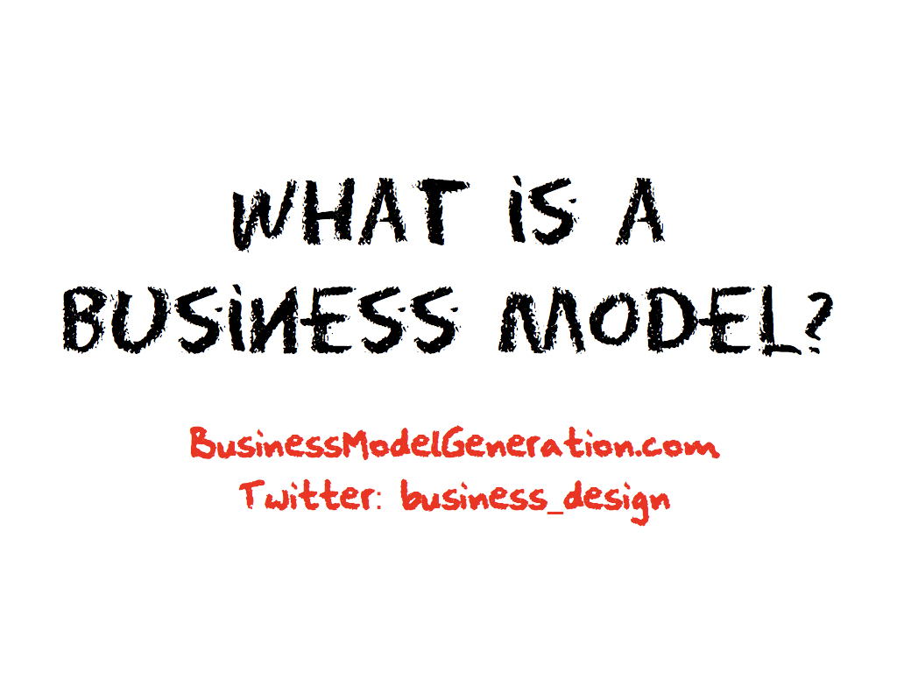

Slide 3
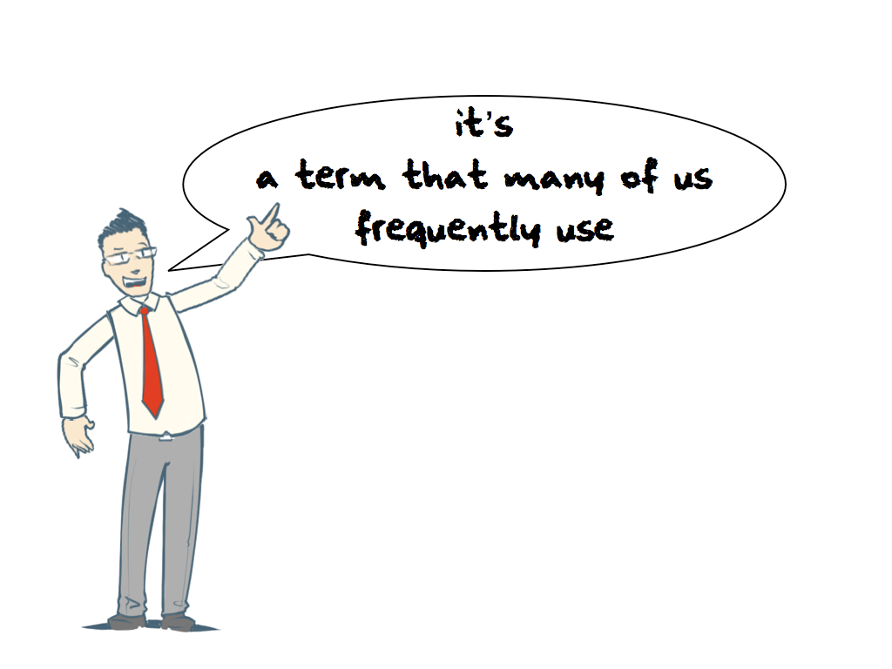

Slide 4
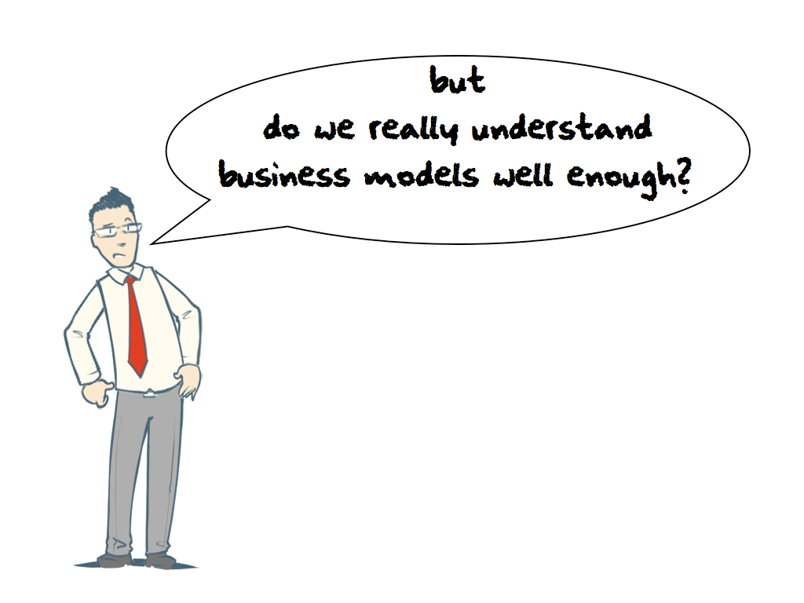

Slide 5
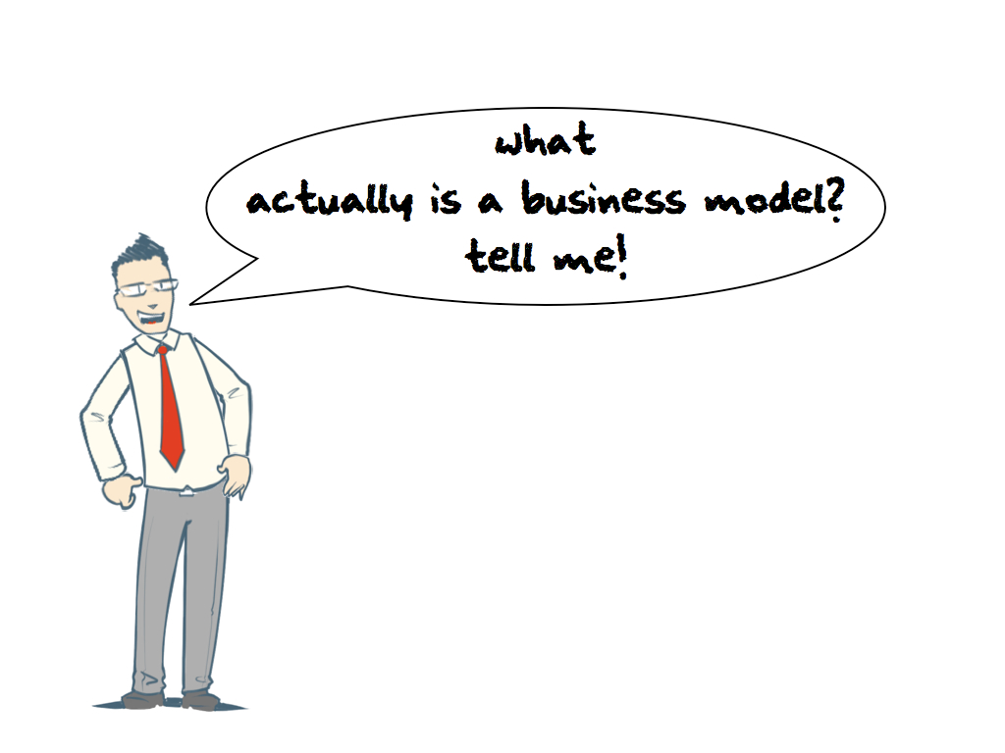

Slide 6
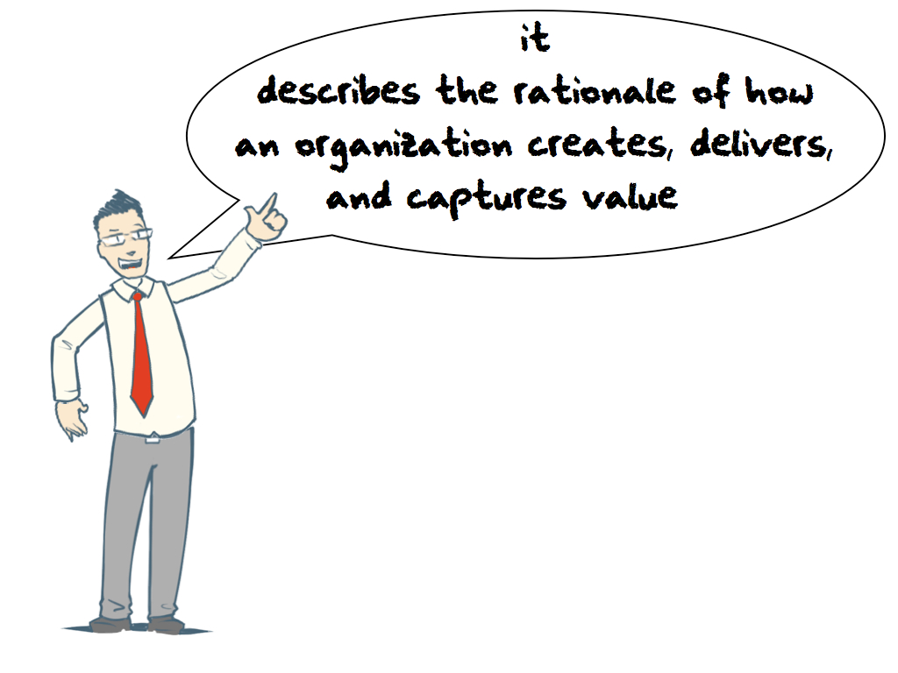

Slide 7
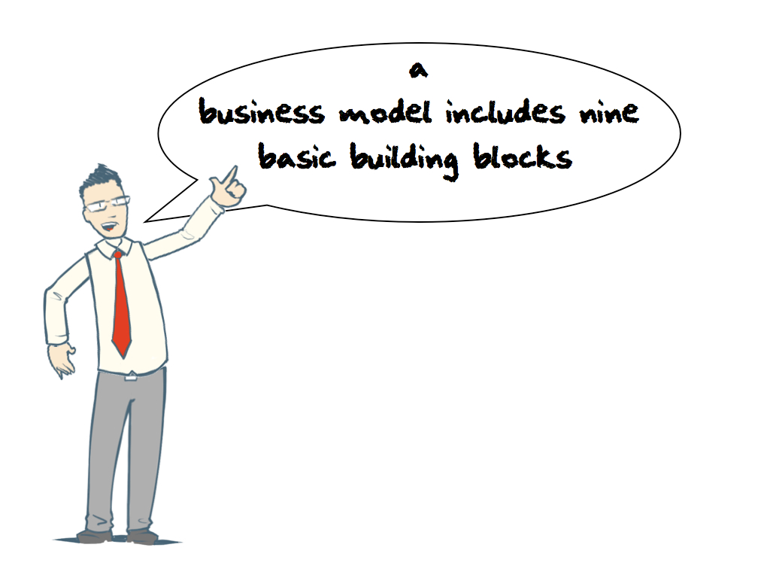

Slide 8
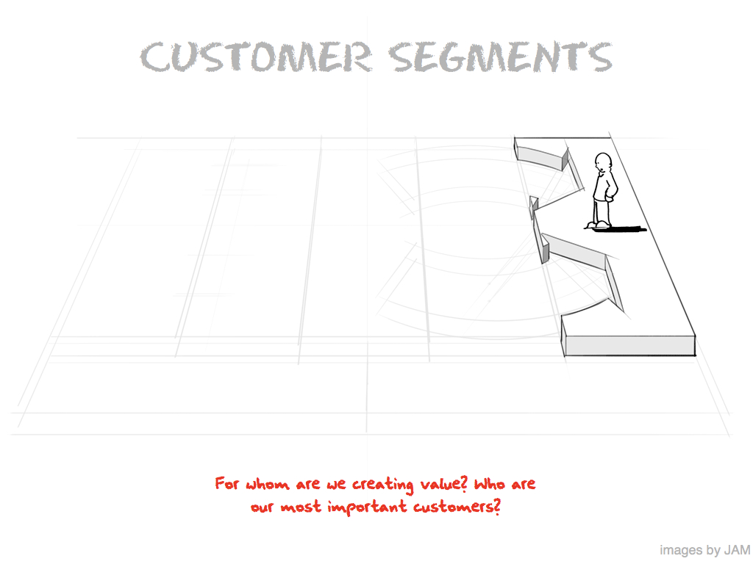

Slide 9
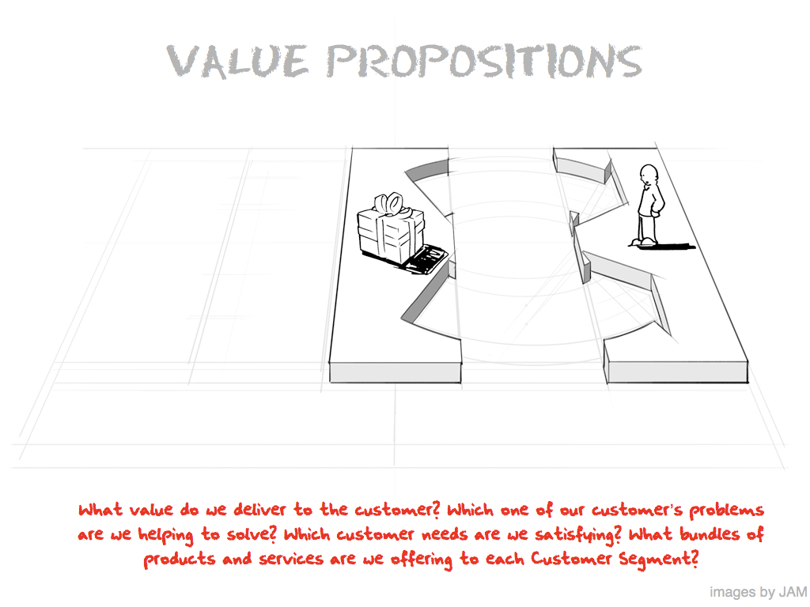

Slide 10
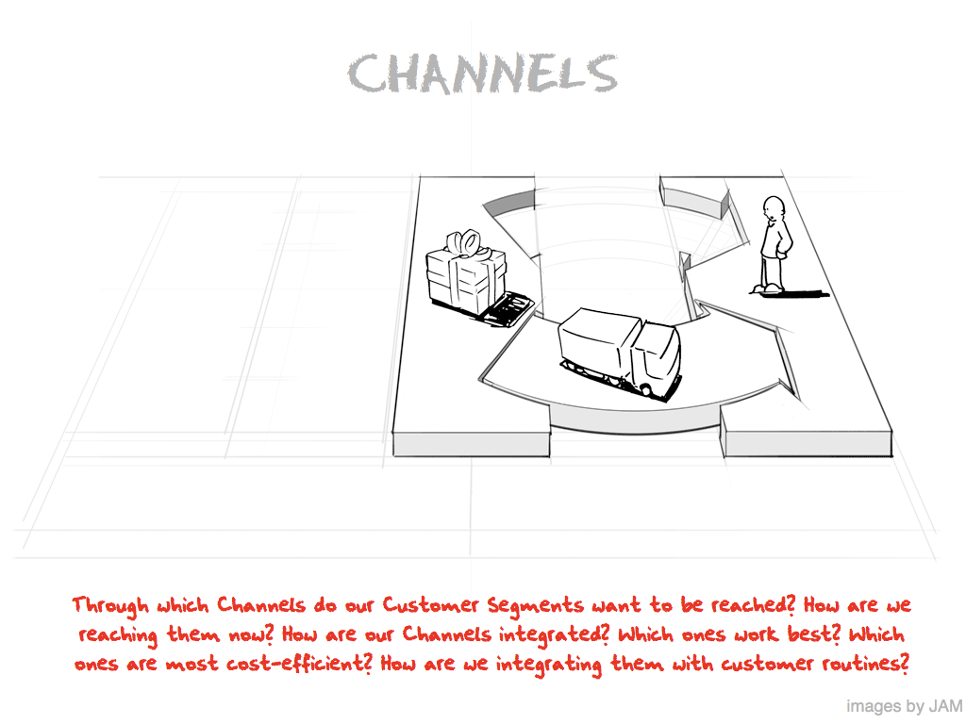

Slide 11
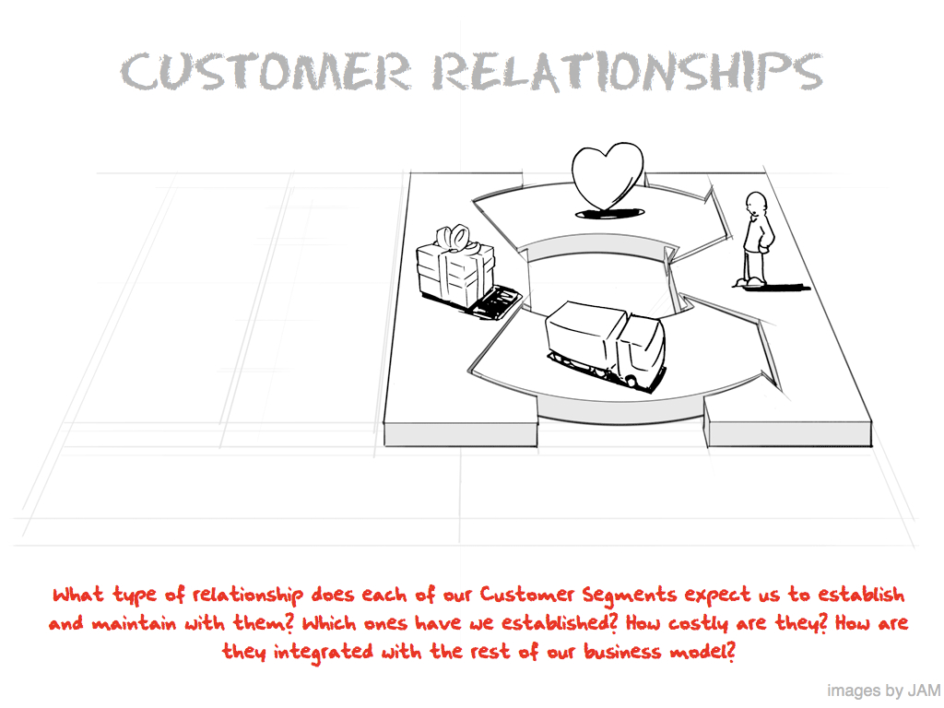

Slide 12
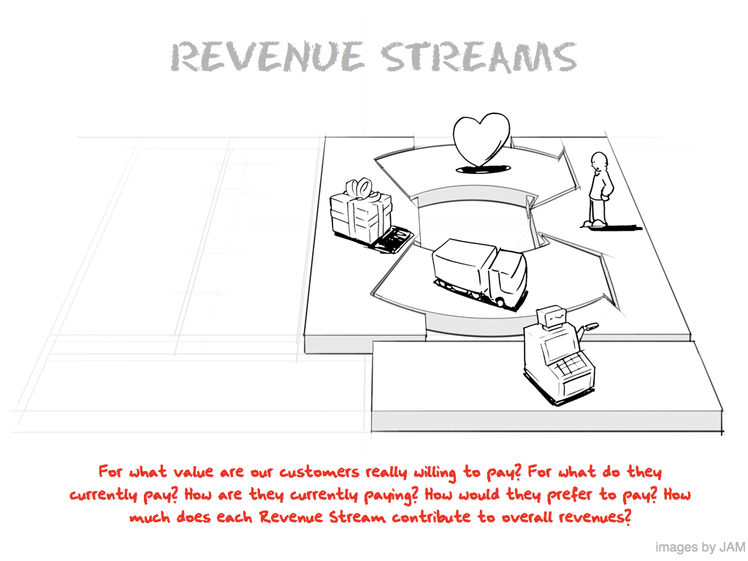

Slide 13
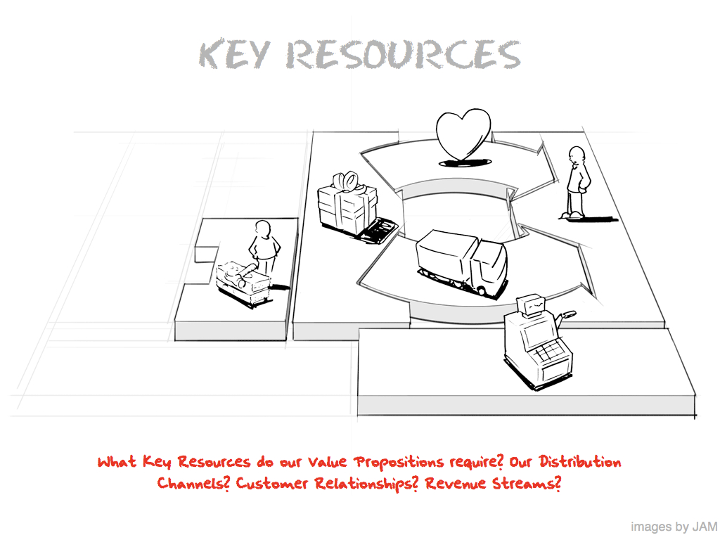

Slide 14
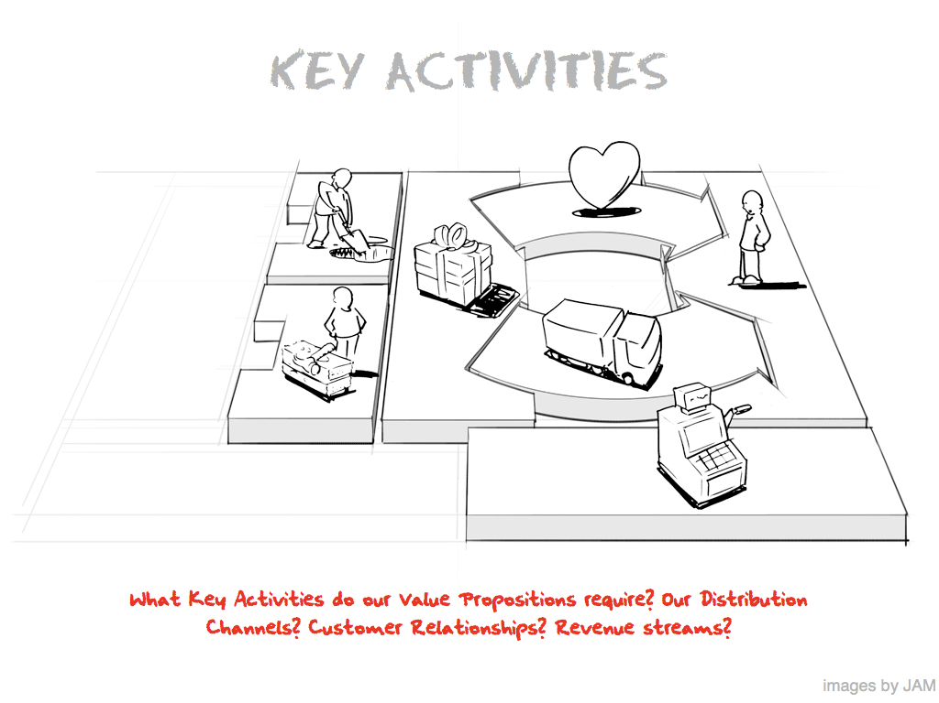

Slide 15
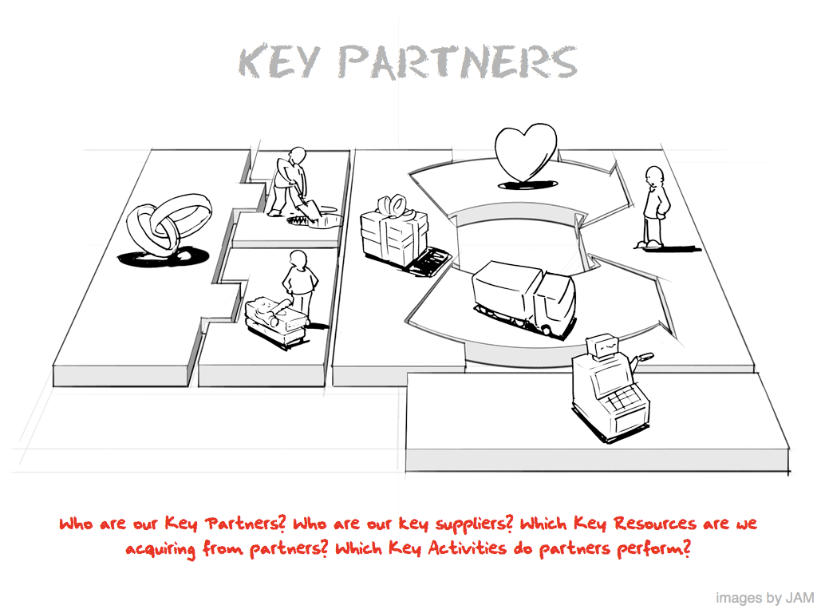

Slide 16
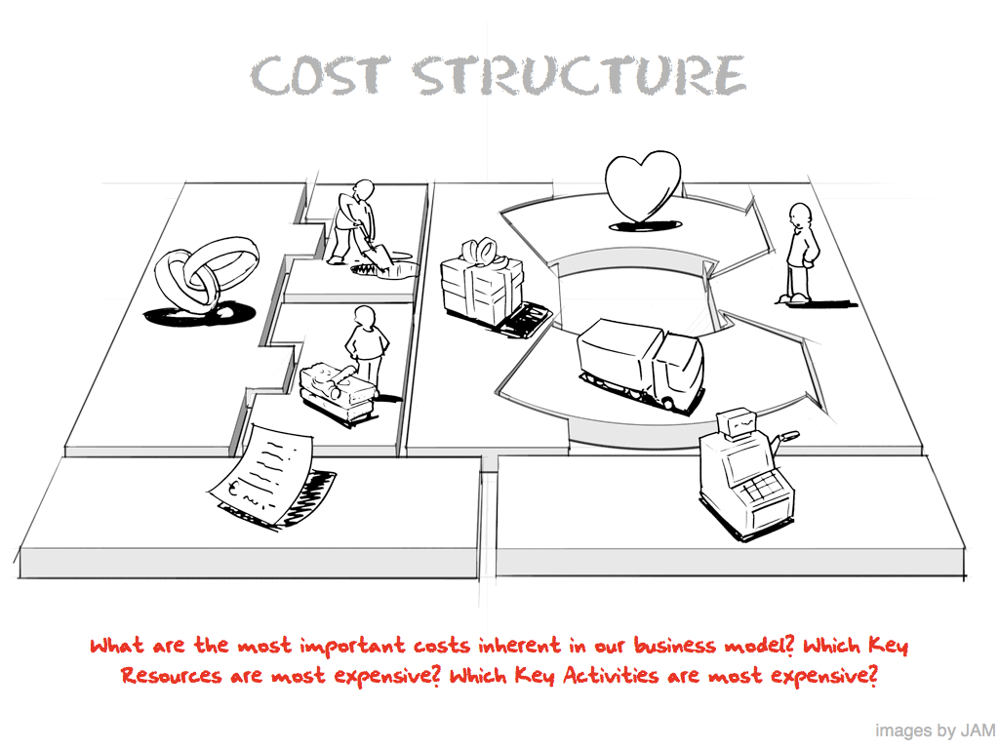

Slide 18
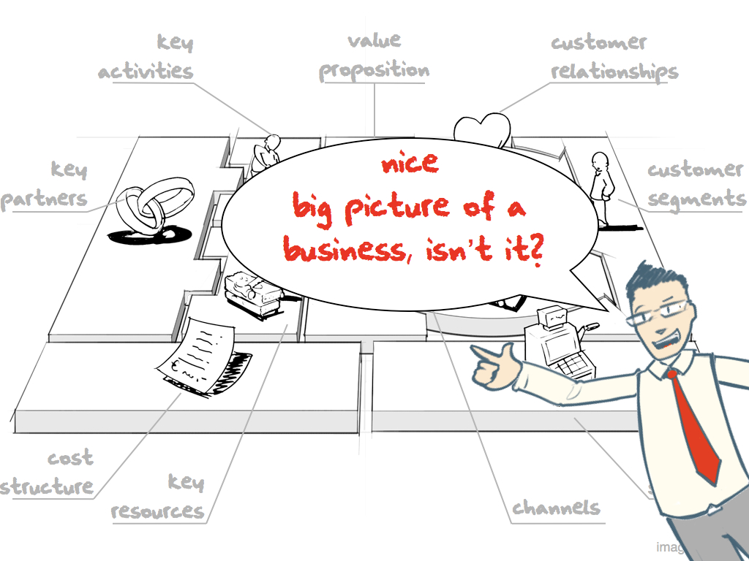

Slide 19
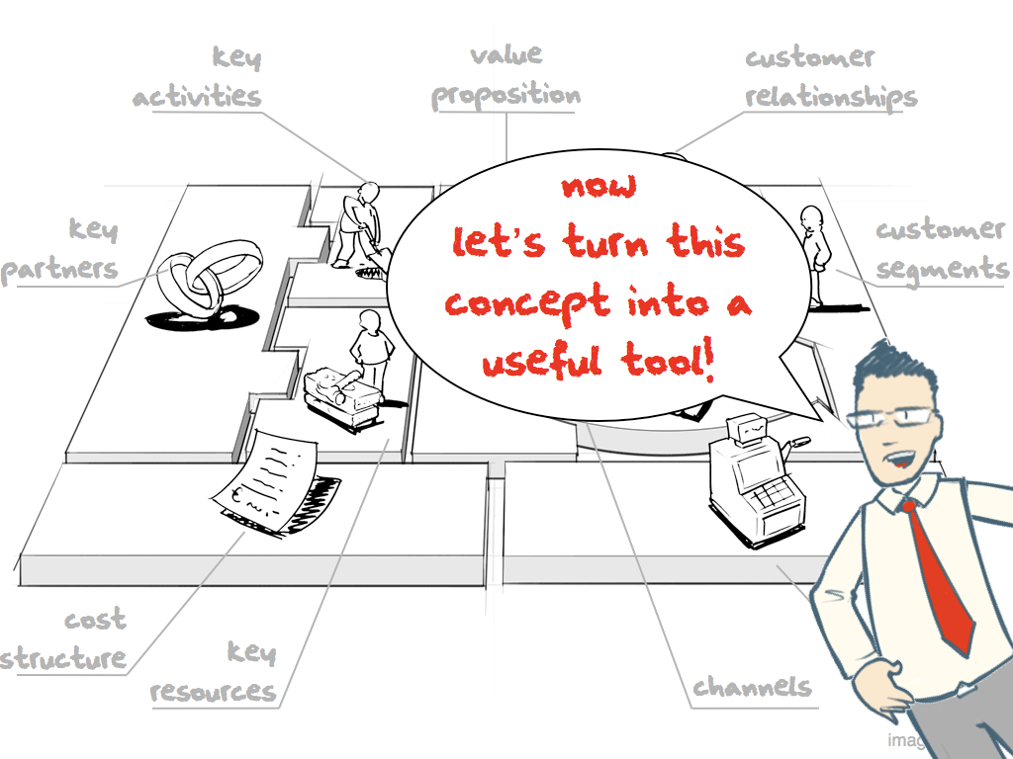

Slide 20
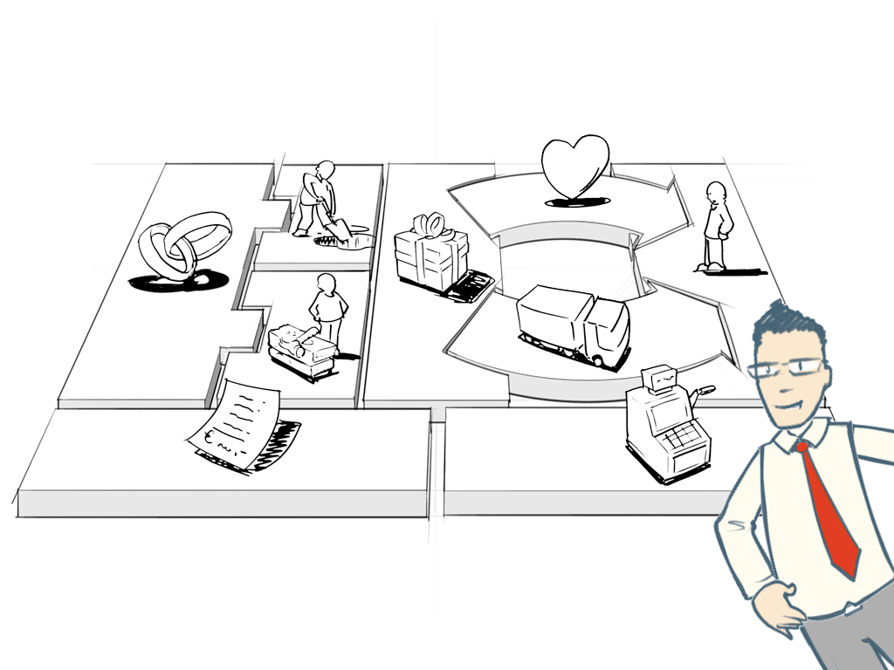

Slide 21
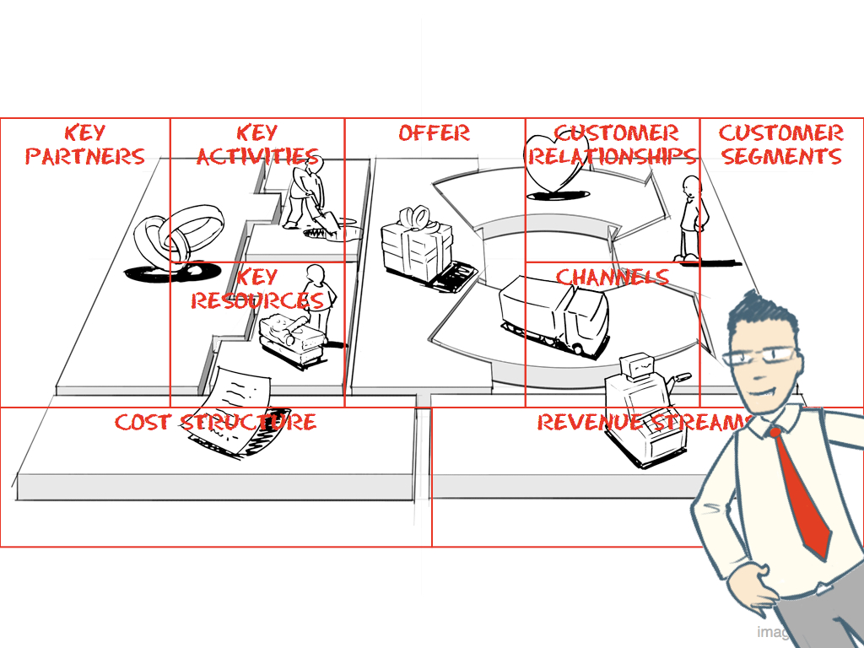

Slide 22
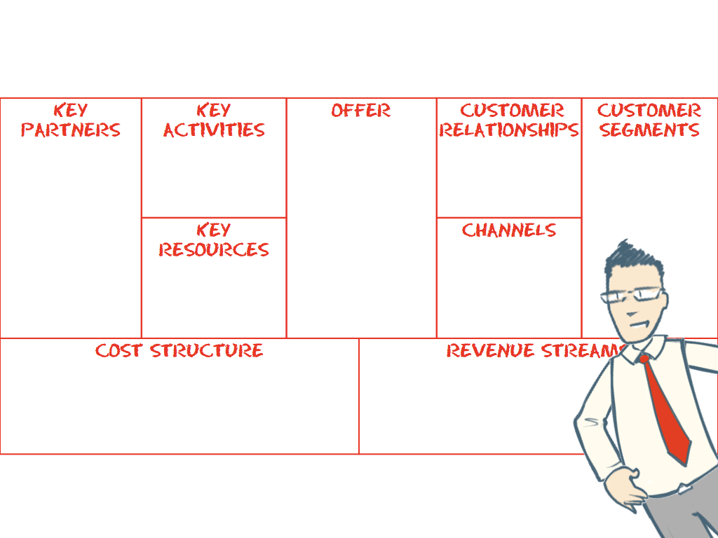

Slide 23
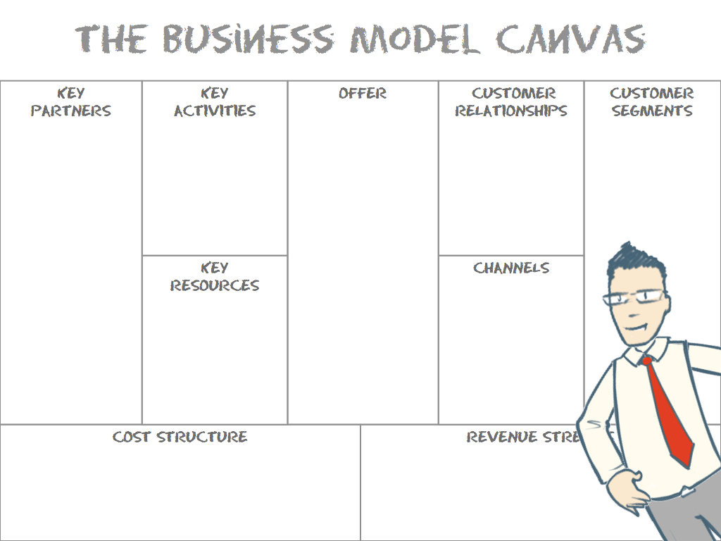

Slide 24
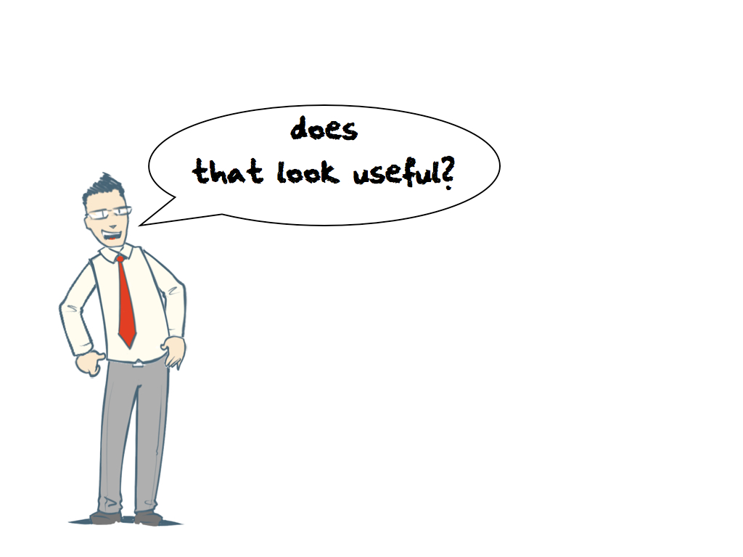

Slide 25
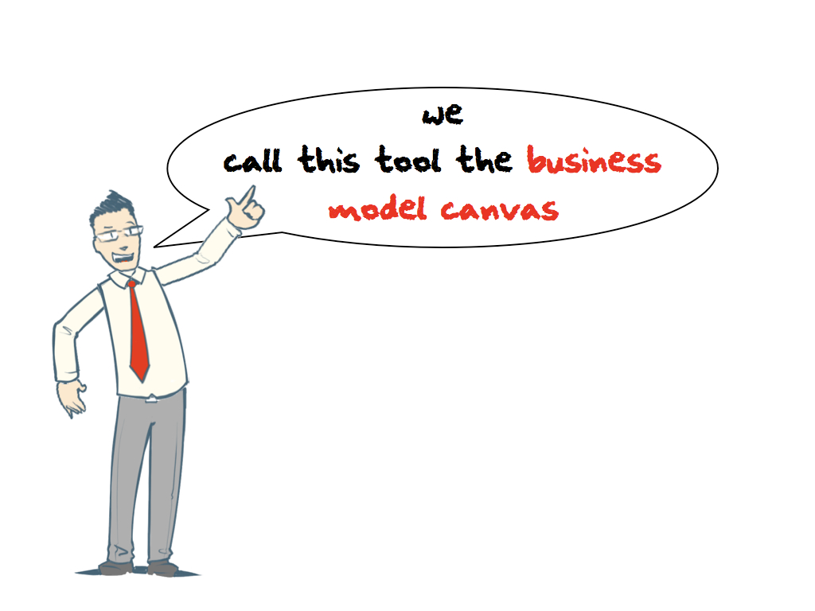

Slide 26


Slide 27
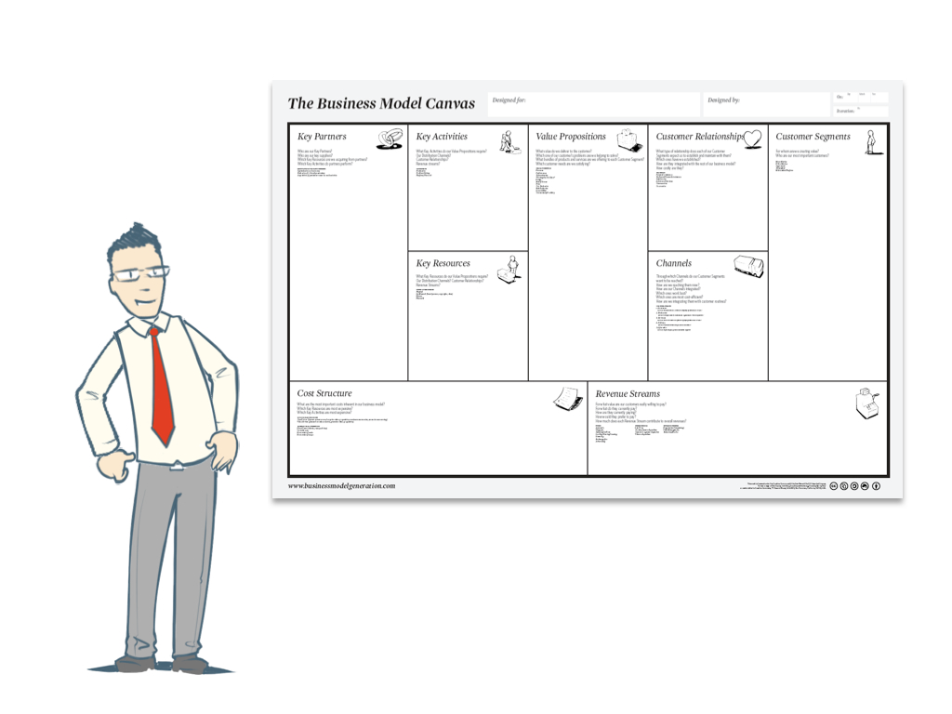

Slide 28
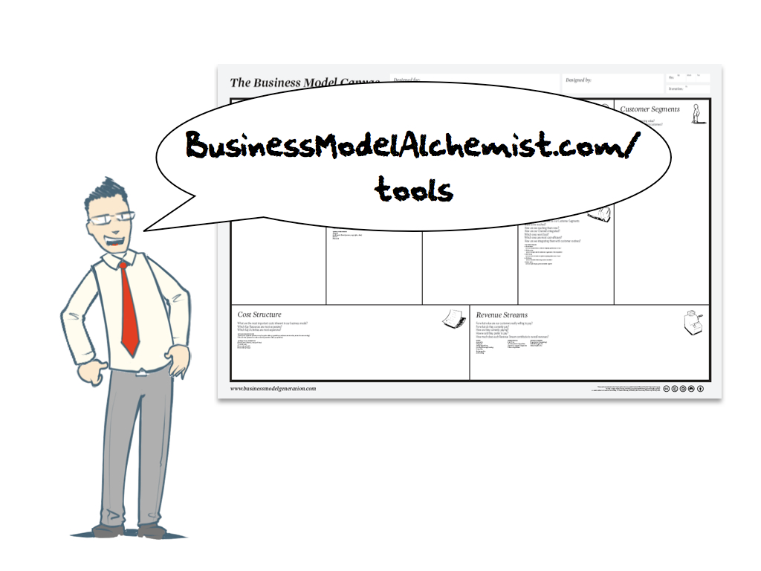

Slide 29


Slide 30




Game Changers in
your Generation?
World
Wide
Web
Open Source
Software
LAMP
Stack
Cloud
Computing

Slide 31
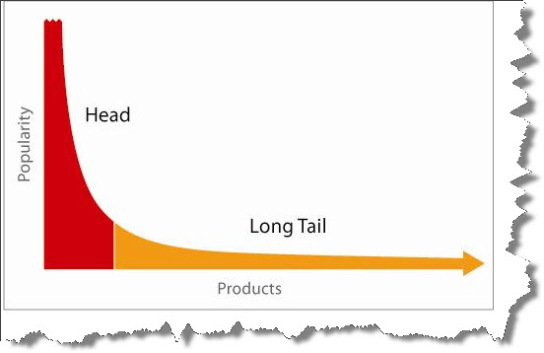
The Long Tail
What Business Models
were Enabled?

Slide 32

"We sold more books today that didn't sell at all yesterday than we sold today of all the books that did sell yesterday.“
Josh Petersen, Amazon Employee explaining the long tail to a colleague that did not get it

Slide 33
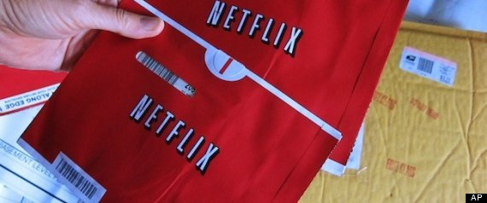
Quick Poll
What do you think about Netflix's price hike and plan change?
Love it
15.71%
Hate it
84.29%
"Netflix members love watching instantly, but we've come to recognize there is still a very large continuing demand for DVDs by mail," said Andy Rendich, Netflix Chief Service and Operations Officer. "By better reflecting the underlying costs and offering our lowest prices ever for unlimited DVD, we hope to provide a great value to our current and future DVD-by-mail members."
Verdict?
15.71% Love it 84.29% Hate it
Source: Huffington Post

Slide 34

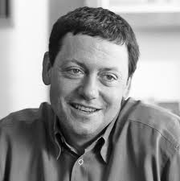

“Give your service away for free, possibly ad supported but maybe not, acquire a lot of customers very efficiently through word of mouth, referral networks, organic search marketing, etc., then offer premium priced value added services or an enhanced version of your service to your customer base.” Fred Wilson, Union Square Ventures

Slide 35



Freemium Services

Slide 36

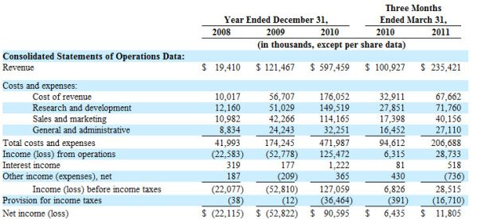
Virtual Goods?!?

Slide 37

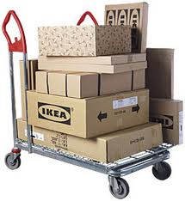
Shout-out for Non-Tech
Innovative Business Model
Co-opted Customer to Provide Key Activities
to Improve the Value Proposition

Slide 38
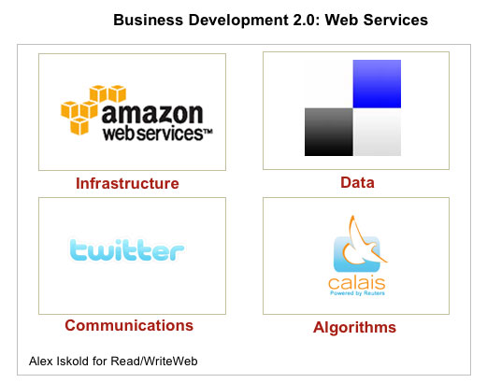
New Models for Partnering

Slide 39
Business Models
What’s new?
Dave Mawhinney
Donald H. Jones Center for Entrepreneurship
Managing Director, Open Field Entrepreneurs Fund
October 10, 2011

