Slide 1
Intro to Matlab
Yipei Wang & Qihui Li
{yipeiw, qihuil}@cmu.edu

Slide 2
Installation
http://www.cmu.edu/computing/software/all/matlab/
Interpreted Language
Interactive/script
Avoid loop if possible
Find built-in function for matrix manipulation first before implementing by yourself

Slide 3
Basics
Workspace (command, whos)
“;”
clear variable
Index starts from 1
help function_name

Slide 4
Matrix
Create matrices
A=[1,2,3; 4,5,6]
A=1:2:10 %start at 1, increment by 2, stop at 10
A=zeros(2,3), A=ones(2,3)
Check out the functions:
randn, eye, diag

Slide 5
Matrix
Indexing (starts from 1)
A=[1,2,3; 4,5,6];
A(1,2) %row 1, column2
A(end, 2) %last row, column2
A(1:2, 2:3) % elements in row 1-2, column 2-3
A(:, 1:2) %elements in all rows, column 1-2
Logical indexing
B=A>2

Slide 6
Matrix
Operations on matrix
Transpose, A’
inverse inv(A)
sum, mean, max, min
concatenating
A=[[1,2]; ones(1,2)]
Element-wise arithmetic
3.*A, A./3 A.^2
A./B, A.*B
Check these functions:
repmat, det, trace, svd, rank, sparse

Slide 7
Variables & Data Structure
Matrix, vector
String
Check these functions:
str2num, strcat, strcmp
Cell (support holding elements of different types)
Ex. A={[1,2], ‘hello’; ‘yes’, {3}}

Slide 8
Flow of Control
If, else, elseif
For loop

Slide 9
Function
Define
In the file myfunction.m
function [output1 ,output2, output3] = myfunction(input1, input2)
…
Call the function
[a1, a2, a3] = myfunction(param1, param2);
Note:
File name must be the same with the function name
Filepath, you can only call the function which the file put in the same directory

Slide 10
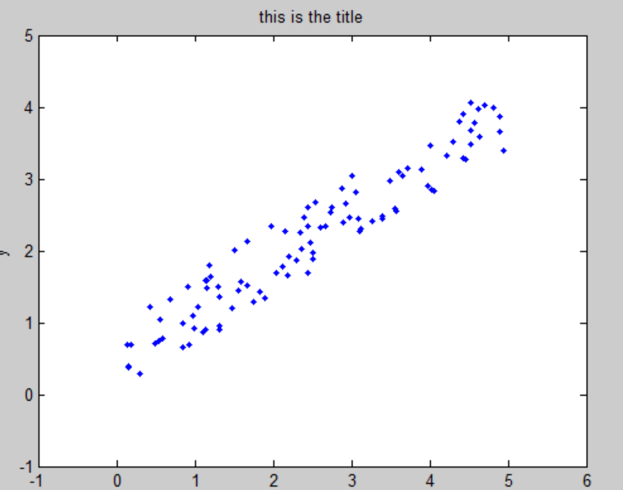
Plotting
Example
(plot_example.m)
Check these functions: plot, scatter, subplot
axis

Slide 11
Useful Tricks
Speed up
Timing the code
call tic before your code starts andtoc afterwords
Vectorization
Use vectorized built-in functions
Ex. log(A)
Logical indexing
Ex. B = A(A<0.2)

Slide 12
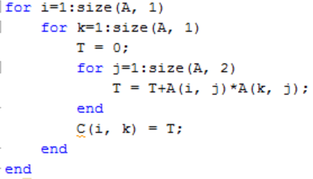
Complex example (e1.m)
Non-vectroization
Vectorization

Slide 13
Others
Debugging
Set breakpoint and check variables in workspace
http://www.mathworks.com/help/matlab/matlab_prog/debugging-process-and-features.html
Reference
http://ubcmatlabguide.github.io

Slide 14
Questions?

