Slide 1
Experimentally Evaluating Classifiers
William Cohen

Slide 2
Practical Lessons In Comparing Classifiers

Slide 3
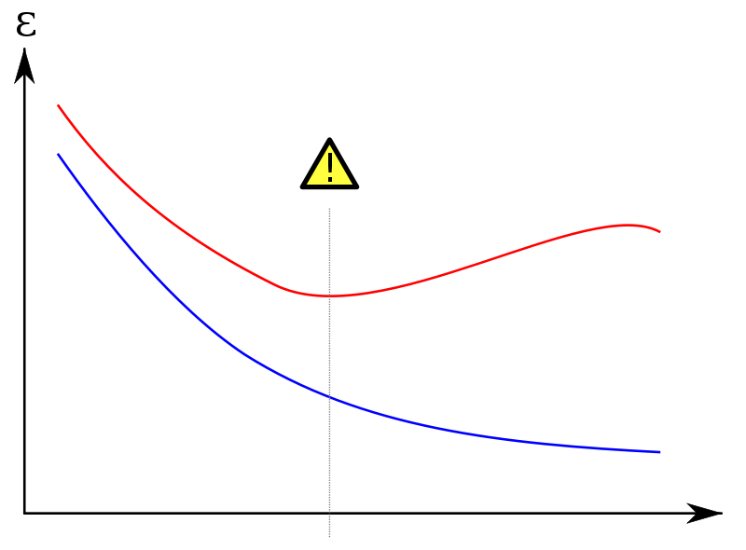
Learning method often “overfit”
Overfitting is often a problem in supervised learning.
When you fit the data (minimize loss) are you fitting “real structure” in the data or “noise” in the data?
Will the patterns you see appear in a test set or not?
hi error
Error/Loss on an unseen test set D^{test}
Error/Loss on training set D
“complexity”

Slide 4
Kaggle
http://techtalks.tv/talks/machine-learning-competitions/58340/
Quick summary:
Kaggle runs ML competitions – you submit predictions, they score them on data where you see the instances but not the labels.
Everyone sees the same test data and can tweak their algorithms to it
After the competition closes there is usually one more round:
Participants are scored on a fresh dataset they haven’t seen
Leaders often change….

Slide 5
Why is this important?
Point: If there’s big data, you can just use error on a big test set, so confidence intervals will be small.
Counterpoint: even with “big data” the size of the ideal test sets are often small
Eg: CTR data is biased

Slide 6
Why is this important?
Point: You can just use a “cookbook recipe” for your significance test
Counterpoint: Surprisingly often you need to design your own test and/or make an intelligent choice about what test to use
New measures:
mention ceaf ? B³ ?
New settings:
new assumptions about what’s random (page/site)?
how often does a particular type of error happen? how confident can we be that it’s been reduced?

Slide 7
CONFIDENCE INTERVALS ON THE ERROR RATE ESTIMATED BY A SAMPLE: Part 1, The Main Idea

Slide 8
A practical problem
You’ve just trained a classifier h using YFCL* on YFP**. You tested h on a sample S and the error rate was 0.30.
How good is that estimate?
Should you throw away the old classifier, which had an error rate of 0.35, are replace it with h?
Can you write a paper saying you’ve reduced the best known error rate for YFP from 0.35 to 0.30?
Would it be accepted?
*YFCL = Your Favorite Classifier Learner
**YFP = Your Favorite Problem

Slide 9
Two definitions of error
The true error of h with respect to target function f and distribution D is the probability that h will misclassify an instance drawn at random from D:
The sample error of h with respect to target function f and sample S is the fraction of instances in S that h misclassifies:

Slide 10
Two definitions of error
The true error of h with respect to target function f and distribution D is the probability that h will misclassify an instance drawn at random from D:
The sample error of h with respect to target function f and sample S is the fraction of instances in S that h misclassifies:
Usually error_{D}(h) is unknown and we use an estimate error_{S}(h). How good is this estimate?

Slide 11
Why sample error is wrong
Bias: if S is the training set, then error_{S}(h) is optimistically biased: i.e.,
This is true if S was used at any stage of learning: feature engineering, parameter testing, feature selection, ...
You want S and h to be independent
A popular split is train, development, and evaluation

Slide 12
Why sample error is wrong
Bias: if S is independent from the training set, and drawn from D, then the estimate is “unbiased”:
Variance: but even if S is independent, the error_{S}(h) may still vary from error_{D}(h):

Slide 13
A simple example
Hypothesis h misclassifies 12 of 40 examples from S.
So: error_{S}(h) = 12/40 = 0.30
What is error_{D}(h)?
Is it less than 0.35?

Slide 14
A simple example
Hypothesis h misclassifies 12 of 40 examples from S.
So: error_{S}(h) = 12/40 = 0.30
What is error_{D}(h) ? error_{S}(h)
The event “h makes an error on x” is a random variable (over examples X from D)
In fact, it’s a binomial with parameter θ
With r error in n trials, MLE of θis r/n = 0.30.
Note thatθ= error_{D}(h) by definition

Slide 15
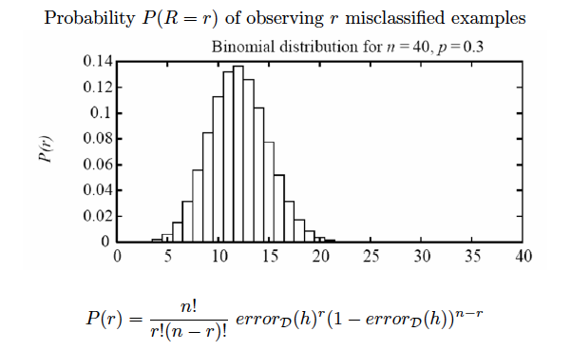
A simple example
In fact for a binomial we know the whole pmf (probability mass function):
This is the probability of actually seeing 14 errors (and thus computing an MLE of 14/30 = 0.35) if the true error rate is 0.3
With 40 examples estimated errors of 0.35 vs 0.30 seem pretty close…

Slide 16
Aside: credibility intervals
What we have is:
Pr(R=r|Θ=θ)
Arguably what we want is:
Pr(Θ=θ|R=r) = (1/Z) Pr(R=r|Θ=θ)Pr(Θ=θ)
which would give us a MAP for θ, or an interval that probably contains θ….
This isn’t common practice

Slide 17
A simple example
To pick a confidence interval we need to clarify what’s random and what’s not
Commonly
h and error_{D}(h) are fixed but unknown
S is random variable
sampling is the experiment
R = error_{S}(h) is a random variable
depending on S
We ask: what other outcomes of the experiment are likely?

Slide 18
A simple example
Is θ<0.35 (=14/40)?
Given this estimate of θ, the probability of a sample S that would make me think that θ>= 0.35 is fairly high (>0.1)

Slide 19
A simple example
I can pick a range of θsuch that the probability of a sample that would lead to an estimate outside the range is low
Given my estimate of θ, the probability of a sample with fewer than 6 errors or more than 16 is low (say <0.05).

Slide 20
A simple example
If that’s true, then [6/40, 16/40] is a 95% confidence interval for θ
Given my estimate of θ, the probability of a sample with fewer than 6 errors or more than 16 is low (say <0.05).

Slide 21
A simple example
You might want to formulate a null hypothesis: eg,
“the error rate is 0.35 or more”. You’d reject the null if the null outcome is outside the confidence interval.
We don’t know the true error rate, but anything between 6/40 = 15% and 16/40=40% is plausible value given the data.

Slide 22
Confidence intervals
You now know how to compute a confidence interval.
You’d want a computer to do it, because computing the binomial exactly is a chore.
If you have enough data, then there are some simpler approximations.

Slide 23
CONFIDENCE INTERVALS ON THE ERROR RATE ESTIMATED BY A SAMPLE: Part 2, Common Approximations

Slide 24
Recipe 1 for confidence intervals
If
|S|=n and n>30
All the samples in S are drawn independently of h and each other
error_{S}(h)=p
Then with 95% probability, error_{D}(h) is in
Another rule of thumb: it’s safe to use this approximation when the interval is within [0,1]

Slide 25
Recipe 2 for confidence intervals
If
|S|=n and n>30
All the samples in S are drawn independently of h and each other
error_{S}(h)=p
Then with N% probability, error_{D}(h) is in
For these values of N:

Slide 26
Why do these recipes work?
Binomial distribution for R= # heads in n flips, with p=Pr(heads)
Expected value of R: E[R]=np
Variance of R: Var[R]=E[R-E[R]] = np(1-p)
Standard deviation of R:
Standard error:
SE = expected distance between a sample mean for a size-n sample and E[X]
SD = expected distance between a single sample of X and E[X]

Slide 27
Why do these recipes work?
Binomial distribution for R= # heads in n flips, with p=Pr(heads)
Expected value of R: E[R]=np
Variance of R: Var[R]=E[R-E[R]] = np(1-p)
Standard deviation of R:
Standard error:

Slide 28
Why do these recipes work?
So:
E[error_{S}(h)] = error_{D}(h)
standard deviation of error_{S}(h) = standard error of averaging n draws from a binomial with parameter p, or
For large n the binomial mean approximates a normal distribution with same mean and sd

Slide 29
Why do these recipes work?
Rule of thumb is considering “large” n to be n>30.

Slide 30
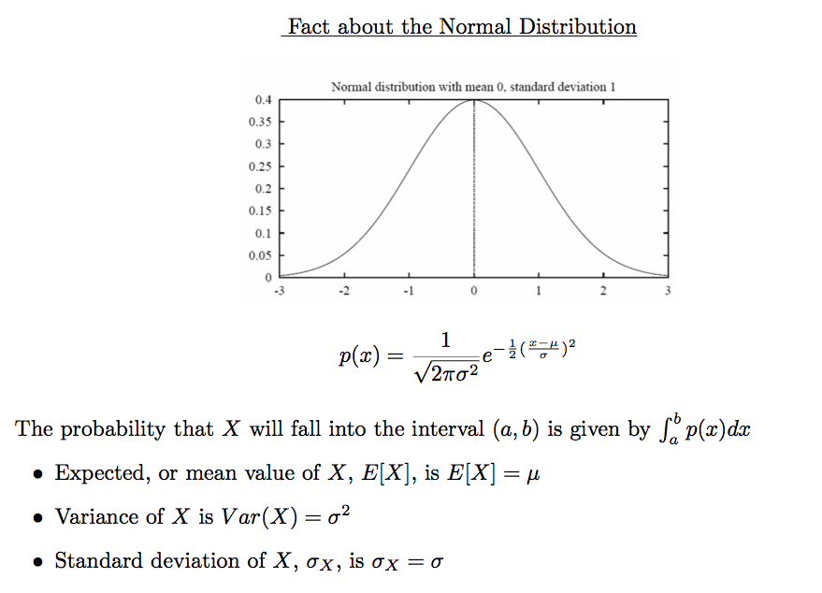
Why do these recipes work?

Slide 31
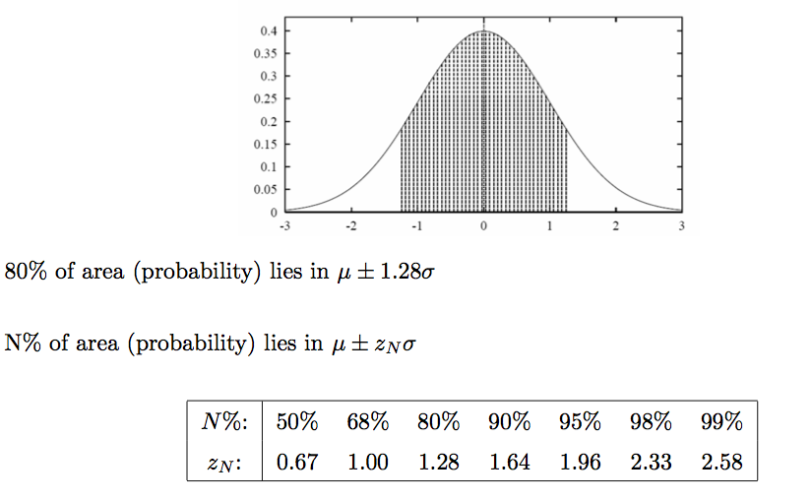
Why do these recipes work?

Slide 32
Why recipe 2 works
By CLT, we’re expecting the normal to be a good approximation for large n (n>30)
If
|S|=n and n>30
All the samples in S are drawn independently of h and each other
error_{S}(h)=p
Then with N% probability, error_{D}(h) is in
z_{n} * SE(error_{S}(h))
For these values of N - taken from table for a normal distribution

Slide 33
Importance of confidence intervals
This is a subroutine
We’ll use it for almost every other test

Slide 34
PAIRED TESTS FOR CLASSIFIERS

Slide 35
Comparing two learning systems
Very common problem
You run YFCL and MFCL on a problem
get h₁ and h₂
test on S1 and S2
You’d like to use whichever is best
how can you tell?

Slide 36
Comparing two learning systems: Recipe 3
We want to estimate
A natural estimator would be
It turns out the SD for the difference is
And you then use the same rule for a confidence interval:

Slide 37
Comparing two learning systems
Very common problem
You run YFCL and MFCL on a problem
YFCL is a clever improvement on MYCL
it’s usually about the same
but sometimes a little better
Often the difference between the two is hard to see because of the variance associated with error_{S}(h)

Slide 38
Comparing two learning systems with a paired test: Recipe 4
We want to estimate
Partition S into disjoint T1,…,Tk and define
By the CLT the average of the Y_{i}’s is normal assuming that k>30
To pick the best hypothesis, see if the mean is significantly far away from zero.
SAME sample
Key point: the sample errors may vary a lot, but if h₁ is consistently better than h₂, then Y_{i} will usually be negative.
Question: Why should the Ti’s be disjoint?

Slide 39
Comparing two learning systems with a paired test: Recipe 4
We want to estimate
Partition S into disjoint T1,…,Tk and define
By the CLT the average of the Y_{i}’s is normal assuming that k>30
To pick the best hypothesis, see if the mean is significantly far away from zero, according to the normal distribution.
Key point: the sample errors may vary a lot, but if h₁ is consistently better than h₂, then Y_{i} will usually be negative.
The null hypothesis is that Y is normal with a zero mean. We want to estimate the probability of seeing the sample of Y_{i}’s actually observed given that hypothesis.

Slide 40
Comparing two learning systems with a paired test: Recipe 4
partition | error_{Ti}(h1) | error_{Ti}(h2) | diff
T1 | 0.35 | 0.30 | 0.05
T2 | 0.17 | 0.16 | 0.01
…
avg | 0.23 | 0.21 | 0.03
We only care about the SD
and average of the last column

Slide 41
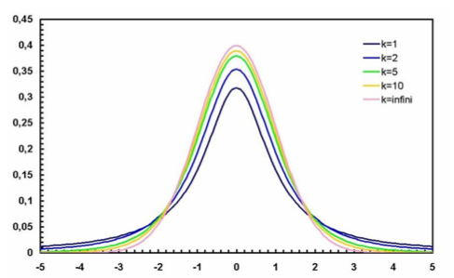
Comparing two learning systems with a paired test: Recipe 4
We want to estimate
Partition S into disjoint T1,…,Tk and define
If k<30, the average of the Y_{i}’s is a t-distribution with k-1 degrees of freedom.
To pick the best hypothesis, see if the mean is significantly far away from zero, according to the t distribution.

Slide 42
A Sign Test

Slide 43
A slightly different question
So far we’ve been evaluating/comparing hypotheses, not learning algorithms.
Comparing hypotheses:
I’ve learned an h(x) that tells me if a Piazza post x for 10-601 will be rated as a “good question”. How accurate is it on the distribution D of messages?
Comparing learners:
I’ve written a learner L, and a tool that scrapes Piazza and creates labeled training sets (x1,y1), for any class’s Piazza site, from the first six weeks of class. How accurate will L’s hypothesis be for a randomly selected class, say 10-701?
Is L1 better or worse than L2?

Slide 44
A slightly different question
Train/Test Datasets | error_{Ui}(h1) h1 = L1(Ti) | error_{Ui}(h2) h2 = L2(Ti) | diff
T1/U1 | 0.35 | 0.30 | 0.05
T2/U2 | 0.37 | 0.31 | 0.06
T3/U3 | 0.09 | 0.08 | 0.01
T4/U4 | 0.06 | 0.07 | -0.01
…
avg | 0.23 | 0.21 | 0.03
SCS courses
English courses
Problem: the differences might be multimodal - drawn from a mix of two normals
We have a different train set T and unseen test set U for each class’s web site.

Slide 45
The sign test for comparing learners across multiple learning problems
Ignore ties!
Train/Test Datasets | error_{Ui}(h1) h1 = L1(Ti) | error_{Ui}(h2) h2 = L2(Ti) | diff | sign(diff)
T1/U1 | 0.35 | 0.30 | 0.05 | +1
T2/U2 | 0.37 | 0.31 | 0.06 | +1
T3/U3 | 0.09 | 0.08 | 0.01 | +1
T4/U4 | 0.06 | 0.07 | -0.01 | -1
…
avg | 0.23 | 0.21 | 0.03
More robust: create a binary random variable, true iff L1 loses to L2
Then estimate a confidence interval for that variable - which is a binomial
…given that L1 and L2 score differently

Slide 46
Another variant of the sign test: McNemar’s test
Ignore ties!
Make the partitions as small as possible: so Ti contains one example {xi}
partition | error_{Ti}(h1) | error_{Ti}(h2) | diff
{x1} | 1.0 | 0.0 | +1.0
{x2} | 0.0 | 1.0 | -1.0
{x3} | 1.0 | 1.0 | 0.0
…
More robust: create a binary random variable, true iff L1 loses to L2
Then estimate a confidence interval for that variable - which is a binomial
…given that L1 and L2 score differently

Slide 47
Cross Validation

Slide 48
A slightly different question
What if there were ten sections of 10-601?
Comparing hypotheses:
I’ve learned an h(x) that tells me if a Piazza post x for 10-601 will be rated as a “good question”. How accurate is it on the distribution D of messages?
Comparing learners:
I’ve written a learner L, and a tool that scrapes Piazza and creates labeled training sets (x1,y1), from the first six weeks of class. How accurate will L’s hypothesis be for another section of 10-601?
Is L1 better or worse than L2?

Slide 49
A slightly different question
What if there were ten sections of 10-601?
Comparing hypotheses:
I’ve learned an h(x) that tells me if a Piazza post x for 10-601 will be rated as a “good question”. How accurate is it on the distribution D of messages?
Comparing learners:
I’ve written a learner L, and a tool that scrapes Piazza and creates labeled training sets (x1,y1), from the first six weeks of class. How accurate will L’s hypothesis be for another section of 10-601?
Is L1 better or worse than L2?
How to account for variability in the training set?

Slide 50
A paired- t-test using cross validation
T = train/U=unseen test
We want to use one dataset S to create a number of different-looking Ti/Ui that are drawn from the same distribution as S.
One approach: cross-validation.
Split into K random disjoint, similar-sized “folds”.
Let Ti contain K-1 folds and let Ui contain the last one.
Train/Test Datasets | error_{Ui}(h1) h1 = L1(Ti) | error_{Ui}(h2) h2 = L2(Ti) | diff
T1/U1 | 0.35 | 0.30 | 0.05
T2/U2 | 0.37 | 0.31 | 0.06
T3/U3 | 0.09 | 0.08 | 0.01
T4/U4 | 0.06 | 0.07 | -0.01
…
avg | 0.23 | 0.21 | 0.03

Slide 51
Some Other Metrics Used In Machine Learning

Slide 52
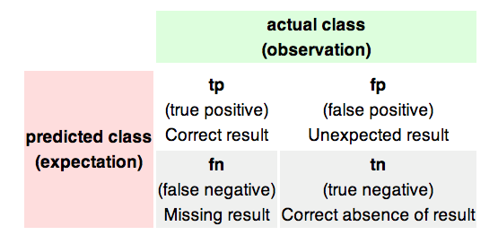
Two wrongs vs two rights
Problem: predict if a YouTube video will go viral
Problem: predict if a YouTube comment is useful
Problem: predict if a web page is about “Machine Learning”

Slide 53
Two wrongs vs two rights
Problem: predict if a YouTube video will go viral
Problem: predict if a YouTube comment is useful
Problem: predict if a web page is about “Machine Learning”

Slide 54
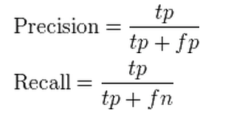
Precision and Recall
~= Pr(actually pos|predicted pos)
~= Pr(predicted pos|actually pos)

Slide 55
F-measure

Slide 56
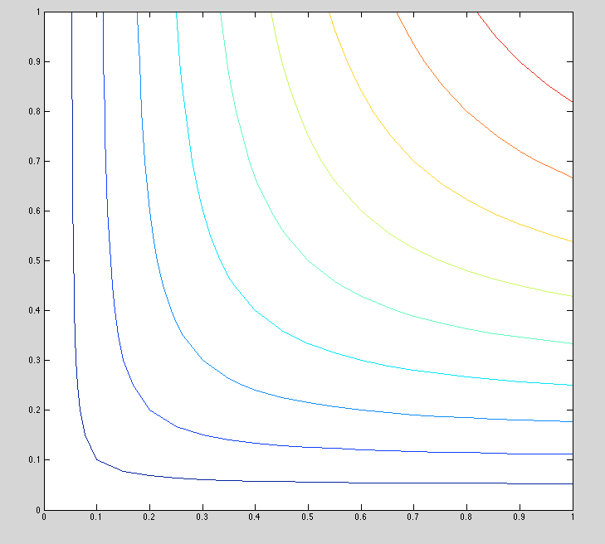
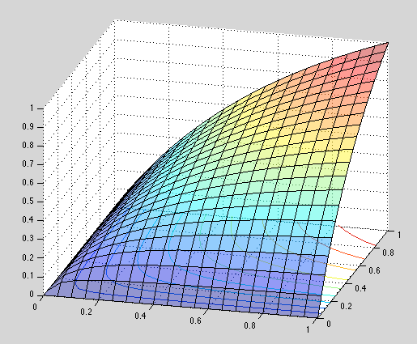
F-measure
precision
*
#
recall
Precision, Recall, and F-Measure vary as the threshold between postive and negative changes for a classifier

Slide 57
Two wrongs vs two rights
Problem: predict if a YouTube video will go viral
Problem: predict if a YouTube comment is useful
Problem: predict if a web page is about “Machine Learning”

Slide 58
Average Precision
precision
recall
mean average precision (MAP) is avg prec averaged over several datasets

Slide 59
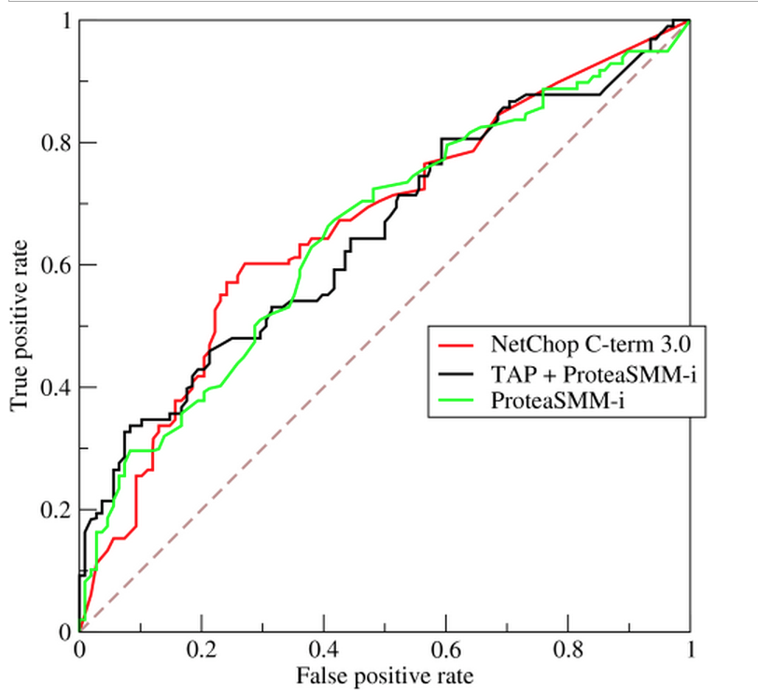
ROC Curve and AUC
Receiver Operating
Characteristic
curve
Area Under Curve (AUC)

