Slide 1
Naïve Bayes for Large Vocabularies
William W. Cohen

Slide 2
Summary to date
Computational complexity: what and how to count
Memory vs disk access
Cost of scanning vs seeks for disk (and memory)
Probability review
Classification with a “density estimator”
Naïve Bayes as a density estimator/classifier
How to evaluate classifiers and density estimators
How to implement Naïve Bayes
Time is linear in size of data (one scan!)
Assuming the event counters fit in memory
We need to count
C(Y=label), C( X=word ^ Y=label), C(X=word)

Slide 3
Today
Naïve Bayes with huge feature sets
i.e. ones that don’t fit in memory
Pros and cons of possible approaches
Traditional “DB” (actually, key-value store)
Memory-based distributed DB
Stream-and-sort counting
Optimizations
Other tasks for stream-and-sort
A detail about large-vocabulary Naïve Bayes…..

Slide 4
Complexity of Naïve Bayes
Assume hashtable holding all counts fits in memory
Sequential reads
You have a train dataset and a test dataset
Initialize an “event counter” (hashtable) C
For each example id, y, x₁,….,x_{d} in train:
C(“Y=ANY”) ++; C(“Y=y”) ++
For j in 1..d:
C(“Y=y ^ X=x_{j}”) ++
For each example id, y, x₁,….,x_{d} in test:
For each y’ in dom(Y):
Compute log Pr(y’,x₁,….,x_{d}) =
Return the best y’
Complexity: O(n), n=size of train
where:
q_{j} = 1/|V|
q_{y} = 1/|dom(Y)|
m=1
Sequential reads
Complexity: O(|dom(Y)|*n’), n’=size of test

Slide 5
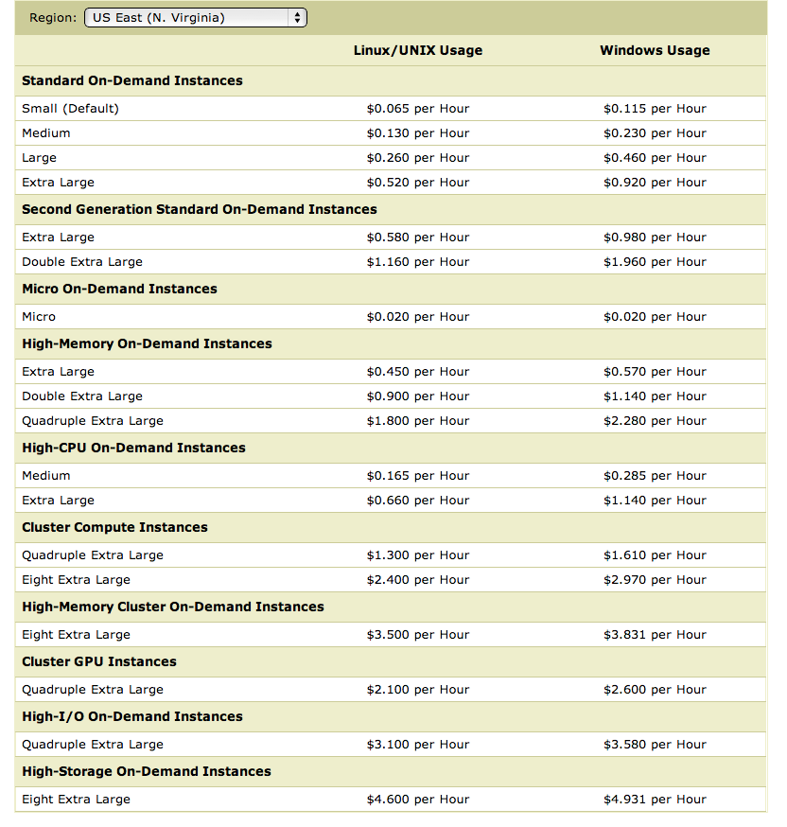
What’s next
How to implement Naïve Bayes
Assuming the event counters do not fit in memory
Why?
Micro:
0.6G memory
Standard:
S: 1.7Gb
L: 7.5Gb
XL: 15Mb
Hi Memory:
XXL: 34.2
XXXXL: 68.4

Slide 6
What’s next
How to implement Naïve Bayes
Assuming the event counters do not fit in memory
Why?
Zipf’s law: many words that you see, you don’t see often.

Slide 7
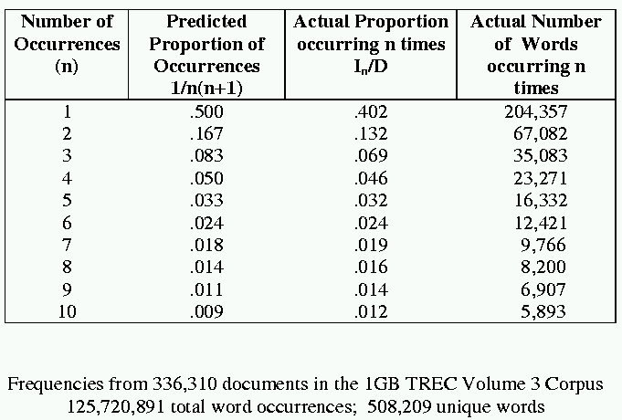
[Via Bruce Croft]

Slide 8
What’s next
How to implement Naïve Bayes
Assuming the event counters do not fit in memory
Why?
Heaps’ Law: If V is the size of the vocabulary and the n is the length of the corpus in words:
Typical constants:
K ≈ 1/10−1/100
β ≈ 0.4−0.6 (approx. square-root)
Why?
Proper names, missspellings, neologisms, …
Summary:
For text classification for a corpus with O(n) words, expect to use O(sqrt(n)) storage for vocabulary.
Scaling might be worse for other cases (e.g., hypertext, phrases, …)

Slide 9
What’s next
How to implement Naïve Bayes
Assuming the event counters do not fit in memory
Possible approaches:
Use a database? (or at least a key-value store)

Slide 10
Numbers (Jeff Dean says) Everyone Should Know
~= 10x
~= 15x
40x
~= 100,000x
Notes:
150x – commercial flight vs a brisk walk
100,000x – 5 hr flights would take 57 years
100,000x – 500 miles vs about 8 meters
15,000,000x – here to beijing vs 100 meters

Slide 11
Using a database for Big ML
We often want to do random access on big data
E.g., different versions of examples for q/a
E.g., spot-checking parameter weights to see if they are sensible
Simplest approach:
Sort the data and use binary search ➔ O(log₂n) seeks to find query row

Slide 12
Using a database for Big ML
We often want to do random access on big data
E.g., different versions of examples for q/a
E.g., spot-checking parameter weights to see if they are sensible
Almost-as-simple idea based on fact that disk seek time ~= reading 1Mb
Let K=rows/Mb (e.g., K=1000)
Scan through data once and record the seek position of every K-th row in an index file (or memory)
To find row r:
Find the r’, last item in the index smaller than r
Seek to r’ and read the next megabyte
Cheap since index is size n/1000
Cost is ~= 2 seeks

Slide 13
A simple indexed store (e.g., Hadoop MapFile)
Data on disk
Key | Value
Y=sports | 134,242
Y=sports^X=aardvark | 2
Y=sports^X=aaron | 7,212
….
Y=sports^X=bengals | 5,432
…
…
Y=sports^X=zymurgist | 7
Y=worldNews | 345,007
Y=worldNews^…
…
Index in memory
Key | Ptr
Y=sports | 0
Y=sports^X=bengals | 10324523
Y=sports^X=zymurgist | 20434314
… | 30431411
…
1Mb
1Mb
Accessing r:
Scan index to find last r’<= r
(no disk access)
Seek to r’s position in DB (10ms)
Read next 1Mb sequentially (10ms)
1Mb

Slide 14
Using a database for Big ML
Summary: we’ve gone from ~= 1 seek (best possible) to ~= 2 seeks---plus finding r’ in the index.
If index is O(1Mb) then finding r’ is also like 1 seek
So we’re paying about 3 seeks per random access in a Gb
What if the index is still large?
Build (the same sort of index) for the index!
Now we’re paying 4 seeks for each random access into a Tb
….and repeat recursively if you need
This is called a B-tree
It only gets complicated when we want to delete and insert.

Slide 15
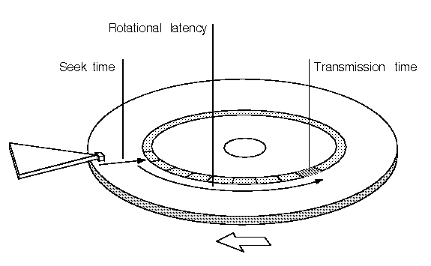

Slide 16
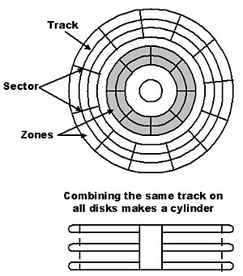

Slide 17
Numbers (Jeff Dean says) Everyone Should Know
~= 10x
~= 15x
40x
~= 100,000x
Best case (data is in same sector/block)
Notes:
150x – commercial flight vs a brisk walk
100,000x – 5 hr flights would take 57 years
100,000x – 500 miles vs about 8 meters
15,000,000x – here to beijing vs 100 meters

Slide 18
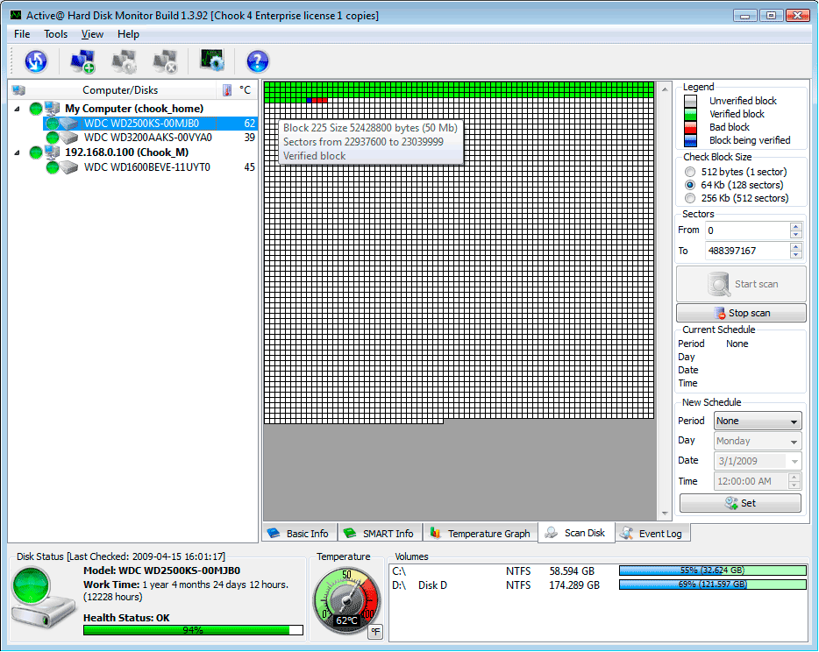
A single large file can be spread out among many non-adjacent blocks/sectors…
and then you need to seek around to scan the contents of the file…
Question: What could you do to reduce this cost?

Slide 19
What’s next
How to implement Naïve Bayes
Assuming the event counters do not fit in memory
Possible approaches:
Use a database?
Counts are stored on disk, not in memory
…So, accessing a count might involve some seeks
Caveat: many DBs are good at caching frequently-used values, so seeks might be infrequent …..
O(n*scan) ➔ O(n*scan*4*seek)

Slide 20
What’s next
How to implement Naïve Bayes
Assuming the event counters do not fit in memory
Possible approaches:
Use a memory-based distributed database?
Counts are stored on disk, not in memory
…So, accessing a count might involve some seeks
Caveat: many DBs are good at caching frequently-used values, so seeks might be infrequent …..
O(n*scan) ➔ O(n*scan*???)

Slide 21
Counting
example 1
example 2
example 3
….
“increment C[x] by D”
Hash table, database, etc
Counting logic

Slide 22
Counting
example 1
example 2
example 3
….
“increment C[x] by D”
Hash table, database, etc
Counting logic
Hashtable issue: memory is too small
Database issue: seeks are slow

Slide 23
Distributed Counting
Hash table1
example 1
example 2
example 3
….
Machine 1
Hash table2
Machine 2
“increment C[x] by D”
Counting logic
. . .
Hash table2
Machine K
Machine 0
Now we have enough memory….

Slide 24
Distributed Counting
Hash table1
example 1
example 2
example 3
….
Machine 1
Hash table2
Machine 2
“increment C[x] by D”
Counting logic
. . .
New issues:
Machines and memory cost $$!
Routing increment requests to right machine
Sending increment requests across the network
Communication complexity
Hash table2
Machine K
Machine 0

Slide 25
Numbers (Jeff Dean says) Everyone Should Know
~= 10x
~= 15x
40x
~= 100,000x
Notes:
150x – commercial flight vs a brisk walk
100,000x – 5 hr flights would take 57 years
100,000x – 500 miles vs about 8 meters
15,000,000x – here to beijing vs 100 meters

Slide 26
What’s next
How to implement Naïve Bayes
Assuming the event counters do not fit in memory
Possible approaches:
Use a memory-based distributed database?
Extra cost: Communication costs: O(n) … but that’s “ok”
Extra complexity: routing requests correctly
Note: If the increment requests were ordered seeks would not be needed!
O(n*scan) ➔ O(n*scan+n*send)
1) Distributing data in memory across machines is not as cheap as accessing memory locally because of communication costs.
2) The problem we’re dealing with is not size. It’s the interaction between size and locality: we have a large structure that’s being accessed in a non-local way.

Slide 27
What’s next
How to implement Naïve Bayes
Assuming the event counters do not fit in memory
Possible approaches:
Use a memory-based distributed database?
Extra cost: Communication costs: O(n) … but that’s “ok”
Extra complexity: routing requests correctly
Compress the counter hash table?
Use integers as keys instead of strings?
Use approximate counts?
Discard infrequent/unhelpful words?
Trade off time for space somehow?
Observation: if the counter updates were better-ordered we could avoid using disk
O(n*scan) ➔ O(n*scan+n*send)
Great ideas which we’ll discuss more later

Slide 28
Large-vocabulary Naïve Bayes
Counting
One way trade off time for space:
Assume you need K times as much memory as you actually have
Method:
Construct a hash function h(event)
For i=0,…,K-1:
Scan thru the train dataset
Increment counters for event only if h(event) mod K == i
Save this counter set to disk at the end of the scan
After K scans you have a complete counter set
Comment:
this works for any counting task, not just naïve Bayes
What we’re really doing here is organizing our “messages” to get more locality….

Slide 29
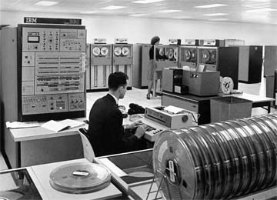
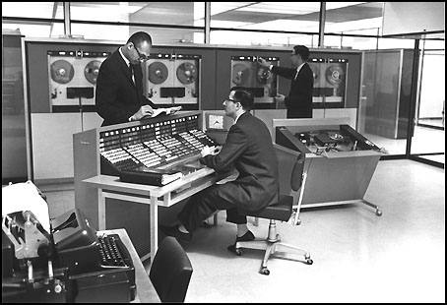
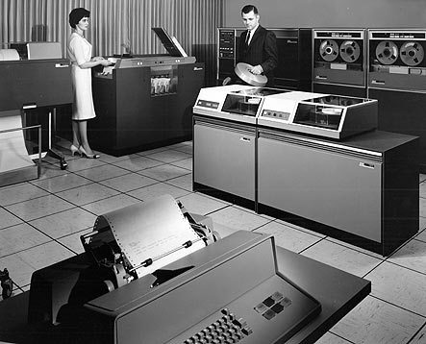

Slide 30
Large vocabulary counting
Another approach:
Start with
Q: “what can we do for large sets quickly”?
A: sorting
It’s O(n log n), not much worse than linear
You can do it for very large datasets using a merge sort
sort k subsets that fit in memory,
merge results, which can be done in linear time

Slide 31
Alternative visualization

Slide 32
Large-vocabulary Naïve Bayes
Create a hashtable C
For each example id, y, x₁,….,x_{d} in train:
C(“Y=ANY”) ++; C(“Y=y”) ++
For j in 1..d:
C(“Y=y ^ X=x_{j}”) ++

Slide 33
Large-vocabulary Naïve Bayes
Create a hashtable C
For each example id, y, x₁,….,x_{d} in train:
C(“Y=ANY”) ++; C(“Y=y”) ++
Print “Y=ANY += 1”
Print “Y=y += 1”
For j in 1..d:
C(“Y=y ^ X=x_{j}”) ++
Print “Y=y ^ X=x_{j} += 1”
Sort the event-counter update “messages”
Scan the sorted messages and compute and output the final counter values
Think of these as “messages” to another component to increment the counters
java MyTrainertrain | sort | java MyCountAdder > model

Slide 34
Large-vocabulary Naïve Bayes
Y=business += 1
Y=business += 1
…
Y=business ^ X =aaa += 1
…
Y=business ^ X=zynga += 1
Y=sports ^ X=hat += 1
Y=sports ^ X=hockey += 1
Y=sports ^ X=hockey += 1
Y=sports ^ X=hockey += 1
…
Y=sports ^ X=hoe += 1
…
Y=sports += 1
…
Create a hashtable C
For each example id, y, x₁,….,x_{d} in train:
C(“Y=ANY”) ++; C(“Y=y”) ++
Print “Y=ANY += 1”
Print “Y=y += 1”
For j in 1..d:
C(“Y=y ^ X=x_{j}”) ++
Print “Y=y ^ X=x_{j} += 1”
Sort the event-counter update “messages”
We’re collecting together messages about the same counter
Scan and add the sorted messages and output the final counter values

Slide 35
Large-vocabulary Naïve Bayes
Scan-and-add:
streaming
previousKey = Null
sumForPreviousKey = 0
For each (event,delta) in input:
If event==previousKey
sumForPreviousKey += delta
Else
OutputPreviousKey()
previousKey = event
sumForPreviousKey = delta
OutputPreviousKey()
define OutputPreviousKey():
If PreviousKey!=Null
print PreviousKey,sumForPreviousKey
Y=business += 1
Y=business += 1
…
Y=business ^ X =aaa += 1
…
Y=business ^ X=zynga += 1
Y=sports ^ X=hat += 1
Y=sports ^ X=hockey += 1
Y=sports ^ X=hockey += 1
Y=sports ^ X=hockey += 1
…
Y=sports ^ X=hoe += 1
…
Y=sports += 1
…
Accumulating the event counts requires constant storage … as long as the input is sorted.

Slide 36
Distributed Counting → Stream and Sort Counting
Hash table1
example 1
example 2
example 3
….
Machine 1
Hash table2
Machine 2
“C[x] +=D”
Message-routing logic
Counting logic
. . .
Hash table2
Machine K
Machine 0

Slide 37
Distributed Counting → Stream and Sort Counting
example 1
example 2
example 3
….
C[x1] += D1
C[x1] += D2
….
“C[x] +=D”
Logic to combine counter updates
Sort
Counting logic
Machine A
Machine C
Machine B

Slide 38
Stream and Sort Counting → Distributed Counting
Standardized message routing logic
example 1
example 2
example 3
….
C[x1] += D1
C[x1] += D2
….
“C[x] +=D”
Logic to combine counter updates
Counting logic
Sort
Machines A1,…
Machines C1,..,
Machines B1,…,
Trivial to parallelize!
Easy to parallelize!

Slide 39
Locality is good
Micro:
0.6G memory
Standard:
S: 1.7Gb
L: 7.5Gb
XL: 15Mb
Hi Memory:
XXL: 34.2
XXXXL: 68.4

Slide 40
Large-vocabulary Naïve Bayes
For each example id, y, x₁,….,x_{d} in train:
Print Y=ANY += 1
Print Y=y += 1
For j in 1..d:
Print Y=y ^ X=x_{j} += 1
Sort the event-counter update “messages”
Scan and add the sorted messages and output the final counter values
Complexity: O(n), n=size of train
(Assuming a constant number of labels apply to each document)
Complexity: O(nlogn)
Complexity: O(n)
O(|V||dom(Y)|)
java MyTrainertrain | sort | java MyCountAdder > model
Model size: max O(n), O(|V||dom(Y)|)

Slide 41
Today
Naïve Bayes with huge feature sets
i.e. ones that don’t fit in memory
Pros and cons of possible approaches
Traditional “DB” (actually, key-value store)
Memory-based distributed DB
Stream-and-sort counting
Optimizations
Other tasks for stream-and-sort

Slide 42
Optimizations
java MyTrainertrain | sort | java MyCountAdder > model
O(n)
Input size=n
Output size=n
O(nlogn)
Input size=n
Output size=n
O(n)
Input size=n
Output size=m
m<<n … say O(sqrt(n))
A useful optimization: decrease the size of the input to the sort
Reduces the size from O(n) to O(m)
Compress the output by using simpler messages
(“C[event] += 1”) ➔ “event 1”
Compress the output more – e.g. string→integer code
Tradeoff – ease of debugging vs efficiency – are messages meaningful or meaningful in context?

Slide 43
Optimization…
For each example id, y, x₁,….,x_{d} in train:
Print “Y=ANY += 1”
Print “Y=y += 1”
For j in 1..d:
Print “Y=y ^ X=x_{j} += 1”
Sort the event-counter update “messages”
Scan and add the sorted messages and output the final counter values
Initialize hashtable C
For each example id, y, x₁,….,x_{d} in train:
C[Y=ANY] += 1
C[Y=y] += 1
For j in 1..d:
C[Y=y ^ X=x_{j}] += 1
If memory is getting full: output all values from C as messages and re-initialize C
Sort the event-counter update “messages”
Scan and add the sorted messages
java MyTrainertrain | sort | java MyCountAdder > model

Slide 44
Some other stream and sort tasks
Coming up: classify Wikipedia pages
Features:
words on page: src w₁ w₂ ….
outlinks from page: src dst₁ dst₂ …
how about inlinks to the page?

Slide 45
Some other stream and sort tasks
outlinks from page: src dst₁ dst₂ …
Algorithm:
For each input line src dst₁ dst₂ … dst_{n} print out
dst₁ inlinks.= src
dst₂ inlinks.= src
…
dst_{n} inlinks.= src
Sort this output
Collect the messages and group to get
dst src₁ src₂ … src_{n}

Slide 46
Some other stream and sort tasks
prevKey = Null
sumForPrevKey = 0
For each (event += delta) in input:
If event==prevKey
sumForPrevKey += delta
Else
OutputPrevKey()
prevKey = event
sumForPrevKey = delta
OutputPrevKey()
define OutputPrevKey():
If PrevKey!=Null
print PrevKey,sumForPrevKey
prevKey = Null
linksToPrevKey = [ ]
For each (dst inlinks.= src) in input:
If dst==prevKey
linksPrevKey.append(src)
Else
OutputPrevKey()
prevKey = dst
linksToPrevKey=[src]
OutputPrevKey()
define OutputPrevKey():
If PrevKey!=Null
print PrevKey, linksToPrevKey

Slide 47
Some other stream and sort tasks
What if we run this same program on the words on a page?
Features:
words on page: src w₁ w₂ ….
outlinks from page: src dst₁ dst₂ …
Out2In.java
w₁ src_{1,1} src_{1,2} src_{1,3} ….
w₂ src_{2,1} …
…
an inverted index for the documents

Slide 48
Some other stream and sort tasks
outlinks from page: src dst₁ dst₂ …
Algorithm:
For each input line src dst₁ dst₂ … dst_{n} print out
dst₁ inlinks.= src
dst₂ inlinks.= src
…
dst_{n} inlinks.= src
Sort this output
Collect the messages and group to get
dst src₁ src₂ … src_{n}

Slide 49
Some other stream and sort tasks
prevKey = Null
sumForPrevKey = 0
For each (event += delta) in input:
If event==prevKey
sumForPrevKey += delta
Else
OutputPrevKey()
prevKey = event
sumForPrevKey = delta
OutputPrevKey()
define OutputPrevKey():
If PrevKey!=Null
print PrevKey,sumForPrevKey
prevKey = Null
linksToPrevKey = [ ]
For each (dst inlinks.= src) in input:
If dst==prevKey
linksPrevKey.append(src)
Else
OutputPrevKey()
prevKey = dst
linksToPrevKey=[src]
OutputPrevKey()
define OutputPrevKey():
If PrevKey!=Null
print PrevKey, linksToPrevKey

Slide 50
Some other stream and sort tasks
Later on: distributional clustering of words

Slide 51
Some other stream and sort tasks
Later on: distributional clustering of words
Algorithm:
For each word w in a corpus print w and the words in a window around it
Print “wi context .= (w_{i-k},…,w_{i-1},w_{i+1},…,w_{i+k} )”
Sort the messages and collect all contexts for each w – thus creating an instance associated with w
Cluster the dataset
Or train a classifier and classify it

Slide 52
Some other stream and sort tasks
prevKey = Null
sumForPrevKey = 0
For each (event += delta) in input:
If event==prevKey
sumForPrevKey += delta
Else
OutputPrevKey()
prevKey = event
sumForPrevKey = delta
OutputPrevKey()
define OutputPrevKey():
If PrevKey!=Null
print PrevKey,sumForPrevKey
prevKey = Null
ctxOfPrevKey = [ ]
For each (w c.= w₁,…,w_{k}) in input:
If dst==prevKey
ctxOfPrevKey.append(
w₁,…,w_{k} )
Else
OutputPrevKey()
prevKey = w
ctxOfPrevKey=[w₁,..,w_{k}]
OutputPrevKey()
define OutputPrevKey():
If PrevKey!=Null
print PrevKey, ctxOfPrevKey

Slide 53
Some other stream and sort tasks
Finding unambiguous geographical names
GeoNames.org: for each place in its database, stores
Several alternative names
Latitude/Longitude
…
Lets you put places on a map (e.g., Google Maps)
Problem: many names are ambiguous, especially if you allow an approximate match
Paris, London, … even Carnegie Mellon

Slide 54
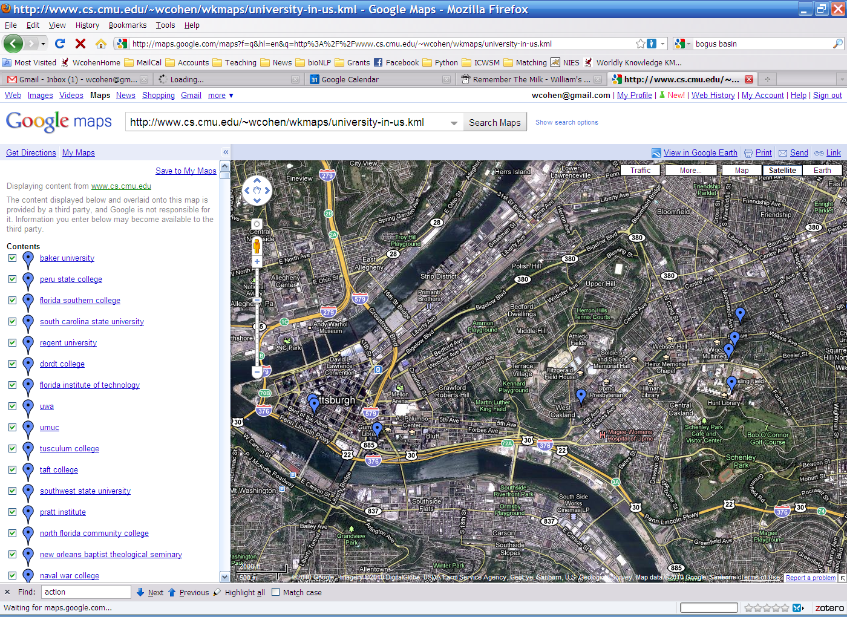
Point Park (College|University)
Carnegie Mellon [University [School]]

Slide 55
Some other stream and sort tasks
Finding almost unambiguous geographical names
GeoNames.org: for each place in the database
print all plausible soft-match substrings in each alternative name, paired with the lat/long, e.g.
Carnegie Mellon University at lat1,lon1
Carnegie Mellon at lat1,lon1
Mellon University at lat1,lon1
Carnegie Mellon School at lat2,lon2
Carnegie Mellon at lat2,lon2
Mellon School at lat2,lon2
…
Sort and collect… and filter

Slide 56
Some other stream and sort tasks
prevKey = Null
sumForPrevKey = 0
For each (event += delta) in input:
If event==prevKey
sumForPrevKey += delta
Else
OutputPrevKey()
prevKey = event
sumForPrevKey = delta
OutputPrevKey()
define OutputPrevKey():
If PrevKey!=Null
print PrevKey,sumForPrevKey
prevKey = Null
locOfPrevKey = Gaussian()
For each (place at lat,lon) in input:
If dst==prevKey
locOfPrevKey.observe(lat, lon)
Else
OutputPrevKey()
prevKey = place
locOfPrevKey = Gaussian()
locOfPrevKey.observe(lat, lon)
OutputPrevKey()
define OutputPrevKey():
If PrevKey!=Null and locOfPrevKey.stdDev() < 1 mile
print PrevKey, locOfPrevKey.avg()

Slide 57
Today
Naïve Bayes with huge feature sets
i.e. ones that don’t fit in memory
Pros and cons of possible approaches
Traditional “DB” (actually, key-value store)
Memory-based distributed DB
Stream-and-sort counting
Optimizations
Other tasks for stream-and-sort
A detail about large-vocabulary Naïve Bayes…..

Slide 58
Complexity of Naïve Bayes
Assume hashtable holding all counts fits in memory
Sequential reads
You have a train dataset and a test dataset
Initialize an “event counter” (hashtable) C
For each example id, y, x₁,….,x_{d} in train:
C(“Y=ANY”) ++; C(“Y=y”) ++
For j in 1..d:
C(“Y=y ^ X=x_{j}”) ++
For each example id, y, x₁,….,x_{d} in test:
For each y’ in dom(Y):
Compute log Pr(y’,x₁,….,x_{d}) =
Return the best y’
Complexity: O(n), n=size of train
where:
q_{j} = 1/|V|
q_{y} = 1/|dom(Y)|
m=1
Sequential reads
Complexity: O(|dom(Y)|*n’), n’=size of test

Slide 59
Using Large-vocabulary Naïve Bayes
For each example id, y, x₁,….,x_{d} in test:
Sort the event-counter update “messages”
Scan and add the sorted messages and output the final counter values
For each example id, y, x₁,….,x_{d} in test:
For each y’ in dom(Y):
Compute log Pr(y’,x₁,….,x_{d}) =
Model size: max O(n), O(|V||dom(Y)|)

Slide 60
Using Large-vocabulary Naïve Bayes
[For assignment]
For each example id, y, x₁,….,x_{d} in test:
Sort the event-counter update “messages”
Scan and add the sorted messages and output the final counter values
Initialize a HashSet NEEDED and a hashtable C
For each example id, y, x₁,….,x_{d} in test:
Add x₁,….,x_{d} to NEEDED
For each event, C(event) in the summed counters
If event involves a NEEDED term x read it into C
For each example id, y, x₁,….,x_{d} in test:
For each y’ in dom(Y):
Compute log Pr(y’,x₁,….,x_{d}) = ….
Model size: O(|V|)
Time: O(n₂), size of test
Memory: same
Time: O(n₂)
Memory: same
Time: O(n₂)
Memory: same

Slide 61
Large-Vocabulary Naïve Bayes
Learning/Counting
Using Counts
Counts on disk with a key-value store
Counts as messages to a set of distributed processes
Repeated scans to build up partial counts
Counts as messages in a stream-and-sort system
Assignment: Counts as messages but buffered in memory
Assignment:
Scan through counts to find those needed for test set
Classify with counts in memory
Put counts in a database
Use partial counts and repeated scans of the test data?
Re-organize the counts and test set so that you can classify in a stream

