Slide 1
Outline
Randomized methods
SGD with the hash trick (review)
Other randomized algorithms
Bloom filters
Locality sensitive hashing

Slide 2
Learning as optimization for regularized logistic regression
Algorithm:
Initialize arrays W, A of size R and set k=0
For each iteration t=1,…T
For each example (x_{i},y_{i})
Let V be hash table so that
p_{i} = … ; k++
For each hash value h: V[h]>0:
W[h] *= (1 - λ2μ)^{k-A[j]}
W[h] = W[h] + λ(y_{i} - p^{i})V[h]
A[j] = k

Slide 3
Learning as optimization for regularized logistic regression
Initialize arrays W, A of size R and set k=0
For each iteration t=1,…T
For each example (x_{i},y_{i})
k++; let V be a new array of size R; let tmp=0
For each j: x_{i} ^{j} >0: V[hash(j)%R] += x_{i} ^{j}
Let ip=0
For each h: V[h]>0:
W[h] *= (1 - λ2μ)^{k-A[j]}
ip+= V[h]*W[h]
A[h] = k
p = 1/(1+exp(-ip))
For each h: V[h]>0:
W[h] = W[h] + λ(y_{i} - p^{i})V[h]
regularize W[h]’s

Slide 4
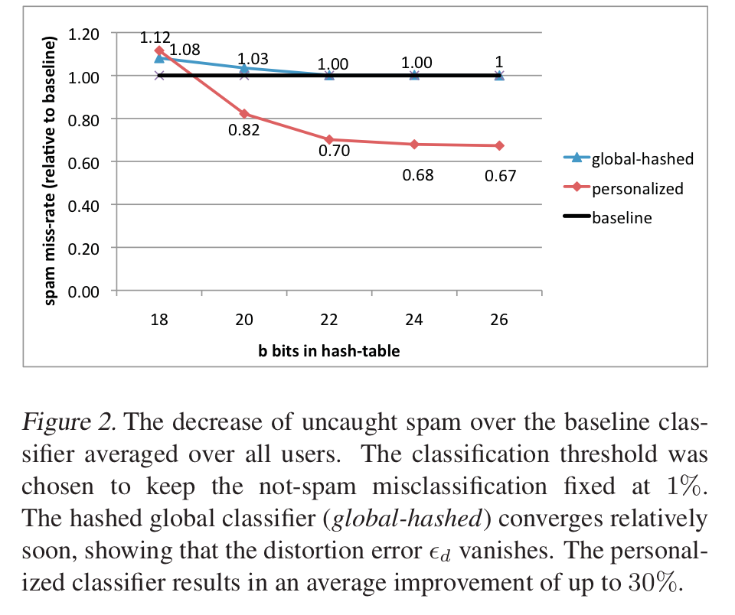
An example
2^26 entries = 1 Gb @ 8bytes/weight
Notes:
3,2M emails
400k users
40M tokens

Slide 5
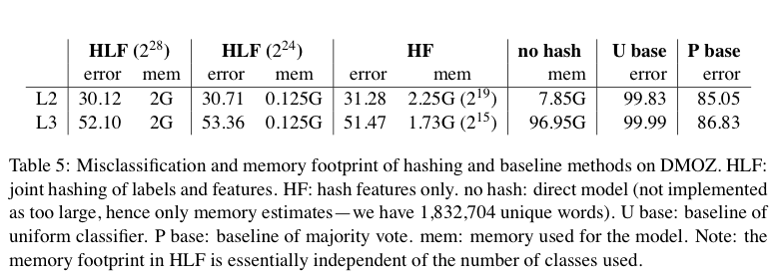
Results

Slide 6
A variant of feature hashing
Hash each feature multiple times with different hash functions
Now, each w has k chances to not collide with another useful w’
An easy way to get multiple hash functions
Generate some random strings s₁,…,s_{L}
Let the k-th hash function for w be the ordinary hash of concatenation w•s_{k}

Slide 7
A variant of feature hashing
a!=b
Hash each feature multiple times with different hash functions
Now, each w has k chances to not collide with another useful w’
An easy way to get multiple hash functions
Generate some random strings s₁,…,s_{L}
Let the k-th hash function for w be the ordinary hash of concatenation w•s_{k}
V(a)
1 | 0 | 1 | 0
0 | 1 | 1 | 0
1 | 0 | 1 | 0
1 | 1 | 0 | 0
V(a)
1 | 0 | 1 | 0
1 | 0 | 1 | 0
1 | 1 | 2 | 0
V(b)
V(b)
1 | 1 | 1 | 0

Slide 8
A variant of feature hashing
Why would this work?
Claim: with 100,000 features and 100,000,000 buckets:
k=1 ➔Pr(any feature duplication) ≈1
k=2 ➔Pr(any feature duplication) ≈0.4
k=3 ➔ Pr(any feature duplication) ≈0.01

Slide 9
Hash Trick - Insights
Save memory: don’t store hash keys
Allow collisions
even though it distorts your data some
Let the learner (downstream) take up the slack
Here’s another famous trick that exploits these insights….

Slide 10
Bloom filters
Interface to a Bloom filter
BloomFilter(int maxSize, double p);
void bf.add(String s); // insert s
bool bd.contains(String s);
// If s was added return true;
// else with probability at least 1-p return false;
// else with probability at most p return true;
I.e., a noisy “set” where you can test membership (and that’s it)
Notes:
note a hash table would do this in constant time and storage
the hash trick does this as well

Slide 11
Bloom filters
An implementation
Allocate M bits, bit[0]…,bit[1-M]
Pick K hash functions hash(1,2),hash(2,s),….
E.g: hash(i,s) = hash(s+ randomString[i])
To add string s:
For i=1 to k, set bit[hash(i,s)] = 1
To check contains(s):
For i=1 to k, test bit[hash(i,s)]
Return “true” if they’re all set; otherwise, return “false”
We’ll discuss how to set M and K soon, but for now:
Let M = 1.5*maxSize // less than two bits per item!
Let K = 2*log(1/p) // about right with this M

Slide 12
Bloom filters
Analysis (m bits, k hashers):
Assume hash(i,s) is a random function
Look at Pr(bit j is unset after n add’s):
… and Pr(collision):
…. fix m and n and minimize k:
p =
k =

Slide 13
Bloom filters
Analysis:
Plug optimal k=m/n*ln(2) back into Pr(collision):
Now we can fix any two of p, n, m and solve for the 3rd:
E.g., the value for m in terms of n and p:
p =

Slide 14
Bloom filters
Interface to a Bloom filter
BloomFilter(int maxSize /* n */, double p);
void bf.add(String s); // insert s
bool bd.contains(String s);
// If s was added return true;
// else with probability at least 1-p return false;
// else with probability at most p return true;
I.e., a noisy “set” where you can test membership (and that’s it)
Notes:
note a hash table would do this in constant time and storage
the hash trick does this as well

Slide 15
Bloom filters: demo

Slide 16
Bloom filters
An example application
Finding items in “sharded” data
Easy if you know the sharding rule
Harder if you don’t (like Google n-grams)
Simple idea:
Build a BF of the contents of each shard
To look for key, load in the BF’s one by one, and search only the shards that probably contain key
Analysis: you won’t miss anything, you might look in some extra shards
You’ll hit O(1) extra shards if you set p=1/#shards

Slide 17
Bloom filters
An example application
discarding singleton features from a classifier
Scan through data once and check each w:
if bf1.contains(w): bf2.add(w)
else bf1.add(w)
Now:
bf1.contains(w) ⬄ w appears >= once
bf2.contains(w) ⬄ w appears >= 2x
Then train, ignoring words not in bf2

Slide 18
Bloom filters
An example application
discarding rare features from a classifier
seldom hurts much, can speed up experiments
Scan through data once and check each w:
if bf1.contains(w):
if bf2.contains(w): bf3.add(w)
else bf2.add(w)
else bf1.add(w)
Now:
bf2.contains(w) ⬄ w appears >= 2x
bf3.contains(w) ⬄ w appears >= 3x
Then train, ignoring words not in bf3

