Slide 1
10-605 ML from Large Datasets

Slide 2
Announcements
HW1b is going out today
You should now be
on autolab
have a an account on ’stoat’
a locally-administered Hadoop cluster
shortly receive a coupon for Amazon Web Services (AWS) for $50
problems to 10605-instructors@cs but please check the class web site first

Slide 3
Announcements
About AWS:
good: Class deadlines are not a problem for it
bad: It takes a little while to provision a cluster and start it up (10min?)
Basically it’s rent-a-cluster by the hour
Don’t leave the meter running
Don’t leave your credentials unprotected
You are responsible for the $$$ if something goes wrong!
Sign up for AWS Educate
So they know you are a student

Slide 4
Parallelizing Stream And Sort

Slide 5
Stream and Sort Counting → Distributed Counting
Standardized message routing logic
example 1
example 2
example 3
….
C[x1] += D1
C[x1] += D2
….
“C[x] +=D”
Logic to combine counter updates
Counting logic
Sort
Machines A1,…
Machines C1,..,
Machines B1,…,
Trivial to parallelize!
Easy to parallelize!

Slide 6
Stream and Sort Counting → Distributed Counting
example 1
example 2
example 3
….
C[x1] += D1
C[x1] += D2
….
Spill 1
Spill 2
Merge Spill Files
Spill 3
Logic to combine counter updates
Counting logic
…
Sort
“C[x] +=D”
Machines A1,…
Machines C1,..,

Slide 7
Stream and Sort Counting → Distributed Counting
Sort key
example 1
example 2
example 3
….
C[x1] += D1
C[x1] += D2
….
Spill 1
Spill 2
Merge Spill Files
Spill 3
Logic to combine counter updates
Counting logic
…
Sort
“C[x] +=D”
Reducer Machine
Counter Machine
Combiner Machine
Observation: you can “reduce” in parallel (correctly) as no sort key is split across multiple machines

Slide 8
Stream and Sort Counting → Distributed Counting
Reducer Machine 1
example 1
example 2
example 3
….
C[“al”] += D1
C[“al”] += D2
….
Spill 1
Merge Spill Files
combine counter updates
Spill 2
Spill 3
Counting logic
…
Sort
C[“bob”] += D1
C[“joe”] += D2
….
“C[x] +=D”
Spill 4
Merge Spill Files
Counter Machine
combine counter updates
Observation: you can “reduce” in parallel (correctly) as no sort key is split across multiple machines
Reducer Machine 2

Slide 9
Stream and Sort Counting → Distributed Counting
Reducer Machine 1
example 1
example 2
example 3
….
C[“al”] += D1
C[“bob”] += D2
….
Spill 1
Merge Spill Files
combine counter updates
Spill 2
Spill 3
Counting logic
…
Sort
C[“bob”] += D1
C[“joe”] += D2
….
“C[x] +=D”
Spill 4
Merge Spill Files
Counter Machine
combine counter updates
Observation: you can “reduce” in parallel (correctly) as no sort key is split across multiple machines
Reducer Machine 2

Slide 10
Same holds for counter machines: you can count in parallel as no sort key is split across multiple reducer machines
Counter Machine 1
Reducer Machine 1
example 1
example 2
example 3
….
C[x1] += D1
C[x1] += D2
….
Spill 1
Spill 2
Spill 3
Merge Spill Files
Logic to combine counter updates
Counting logic
Partition/Sort
…
Spill n
example 1
example 2
example 3
….
Spill 1
C[x2] += D1
C[x2] += D2
….
Spill 2
Merge Spill Files
Spill 3
Counting logic
combine counter updates
Partition/Sort
…
Counter Machine 2
Reducer Machine 2

Slide 11
Stream and Sort Counting → Distributed Counting
Counter Machine 1
Reducer Machine 1
example 1
example 2
example 3
….
C[x1] += D1
C[x1] += D2
….
Spill 1
Spill 2
Spill 3
Merge Spill Files
Logic to combine counter updates
Counting logic
Partition/Sort
…
Spill n
example 1
example 2
example 3
….
Spill 1
C[x2] += D1
C[x2] += D2
….
Spill 2
Merge Spill Files
Spill 3
Counting logic
combine counter updates
Partition/Sort
…
Counter Machine 2
Reducer Machine 2

Slide 12
Stream and Sort Counting → Distributed Counting
Mapper Machine 1
Mapper/counter machines run the “Map phase” of map-reduce
Input different subsets of the total inputs
Output (sort key,value) pairs
The (key,value) pairs are partitioned based on the key
Pairs from each partition will be sent to a different reducer machine.
example 1
example 2
example 3
….
Spill 1
Spill 2
Spill 3
Counting logic
Partition/Sort
…
Spill n
example 1
example 2
example 3
….
Spill 1
Spill 2
Spill 3
Counting logic
Partition/Sort
…
Mapper Machine 2

Slide 13
Stream and Sort Counting → Distributed Counting
Reducer Machine 1
The shuffle/sort phrase:
(key,value) pairs from each partition are sent to the right reducer
The reducer will sort the pairs together to get all the pairs with the same key together.
The reduce phase:
Each reducer will scan through the sorted key-value pairs.
C[x1] += D1
C[x1] += D2
….
Spill 1
Spill 2
Spill 3
Merge Spill Files
Logic to combine counter updates
…
Spill n
Spill 1
C[x2] += D1
C[x2] += D2
….
Spill 2
Merge Spill Files
Spill 3
combine counter updates
…
Reducer Machine 2

Slide 14
Stream and Sort Counting → Distributed Counting
Counter Machine 1
Reducer Machine 1
example 1
example 2
example 3
….
C[x1] += D1
C[x1] += D2
….
Spill 1
Spill 2
Spill 3
Merge Spill Files
Logic to combine counter updates
Counting logic
Partition/Sort
…
Spill n
example 1
example 2
example 3
….
Spill 1
C[x2] += D1
C[x2] += D2
….
Spill 2
Merge Spill Files
Spill 3
Counting logic
combine counter updates
Partition/Sort
…
Counter Machine 2
Reducer Machine 2

Slide 15
Distributed Stream-and-Sort: Map, Shuffle-Sort, Reduce
Map Process 1
Distributed Shuffle-Sort
Reducer 1
example 1
example 2
example 3
….
C[x1] += D1
C[x1] += D2
….
Spill 1
Spill 2
Spill 3
Merge Spill Files
Logic to combine counter updates
Counting logic
Partition/Sort
…
Spill n
example 1
example 2
example 3
….
Spill 1
C[x2] += D1
C[x2] += D2
….
Spill 2
Merge Spill Files
Spill 3
Counting logic
combine counter updates
Partition/Sort
…
Reducer 2
Map Process 2

Slide 16
Hadoop as Parallel Stream-and-sort

Slide 17
Hadoop: Distributed Stream-and-Sort
Map Process 1
Distributed Shuffle-Sort
Reducer 1
example 1
example 2
example 3
….
C[x1] += D1
C[x1] += D2
….
Spill 1
Spill 2
Spill 3
Merge Spill Files
Logic to combine counter updates
Counting logic
Partition/Sort
…
Spill n
example 1
example 2
example 3
….
Spill 1
C[x2] += D1
C[x2] += D2
….
Spill 2
Merge Spill Files
Spill 3
Counting logic
combine counter updates
Partition/Sort
…
Reducer 2
Map Process 2

Slide 18
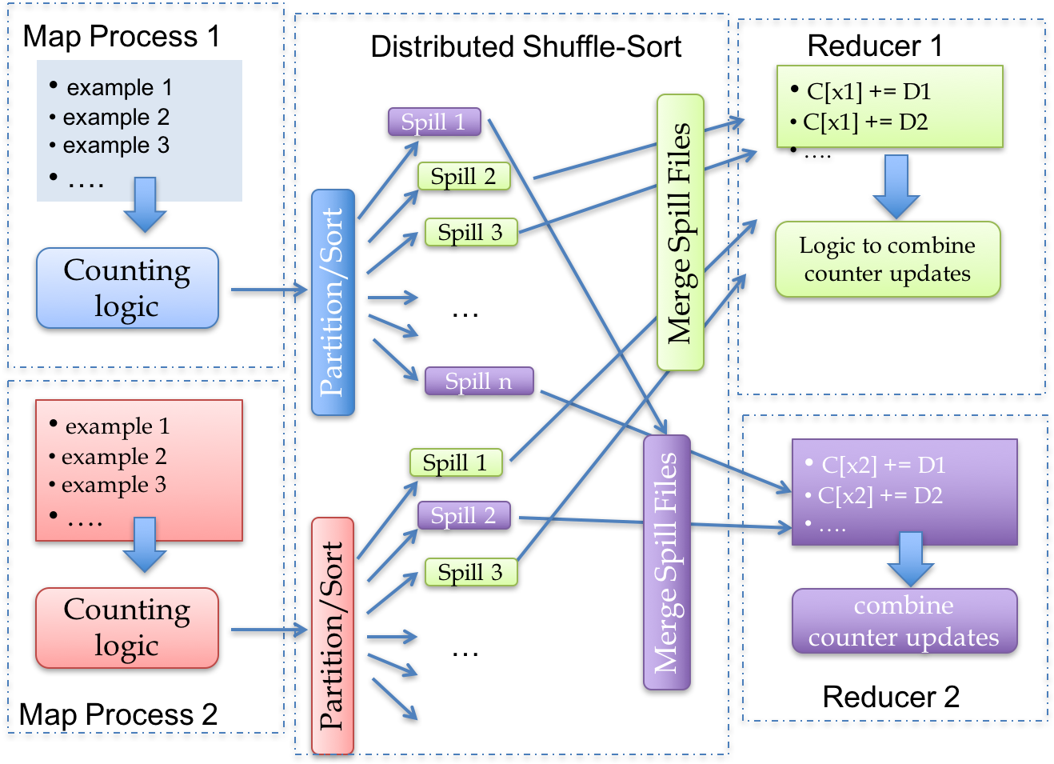
Hadoop: Distributed Stream-and-Sort
Local implementation:
cat input.txt | MAP | sort | REDUCE > output.txt
Split the input across N mapper machines: input1.txt, ….
In parallel, run N mappers mout.txt, mout2.txt, …
In parallel, partition mouti.txt for the M mapper machines: part1.1.txt, part1.2..txt, … partN.M.txt
In parallel, send each partition to the right reducer

Slide 19
Hadoop: Distributed Stream-and-Sort
Local implementation:
cat input.txt | MAP | sort | REDUCE > output.txt
How could you parallelize this?

Slide 20
Hadoop: Distributed Stream-and-Sort
Local implementation:
cat input.txt | MAP | sort | REDUCE > output.txt
In parallel
Run N mappers mout.txt, mout2.txt, …
Partition mouti.txt for the M mapper machines: part1.1.txt, part1.2..txt, … partN.M.txt
Send each partition to the right reducer

Slide 21
Hadoop: Distributed Stream-and-Sort
Local implementation:
cat input.txt | MAP | sort | REDUCE > output.txt
Map
Partition
Send
In parallel:
Accept N partition files, part1.j.txt, … partN.j.txt
Sort/merge them together to rinj.txt
Reduce to get the final result (reduce output for each key in partition j)
If necessary concatenate the reducer outputs to a single file.

Slide 22
Hadoop: Distributed Stream-and-Sort
Local implementation:
cat input.txt | MAP | sort | REDUCE > output.txt
In parallel
Map
Partition
Send
In parallel:
Accept
Merge
Reduce
You could do this easily as a class project ... but …

Slide 23
Motivating Example*
* not to scale
INTERNET
Your dataset

Slide 24
Hadoop: Distributed Stream-and-Sort
Robustness: with 10,000 machines, machines and disk drives fail all the time.
How do you detect and recover?
Efficiency: with many jobs and programmers, how do you balance the loads? How do you limit network traffic and file i/o?
Usability: can programmers keep track of their data and jobs?
In parallel
Map
Partition
Send
In parallel:
Accept
Merge
Reduce

Slide 25
Hadoop: Intro
pilfered from: Alona Fyshe, Jimmy Lin, Google, Cloudera
http://www.umiacs.umd.edu/~jimmylin/cloud-computing/SIGIR-2009/Lin-MapReduce-SIGIR2009.pdf
http://code.google.com/edu/submissions/mapreduce-minilecture/listing.html
http://code.google.com/edu/submissions/mapreduce/listing.html

Slide 26
Surprise, you mapreduced!
Mapreduce has three main phases
Map (send each input record to a key)
Sort (put all of one key in the same place)
handled behind the scenes
Reduce (operate on each key and its set of values)
Terms come from functional programming:
map(lambda x:x.upper(),["william","w","cohen"])➔['WILLIAM', 'W', 'COHEN']
reduce(lambda x,y:x+"-"+y,["william","w","cohen"])➔”william-w-cohen”

Slide 27
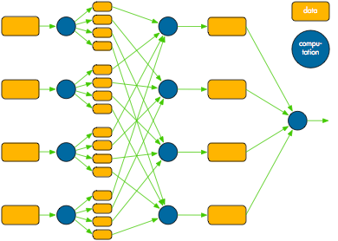
Mapreduce overview
Map
Shuffle/Sort
Reduce

Slide 30
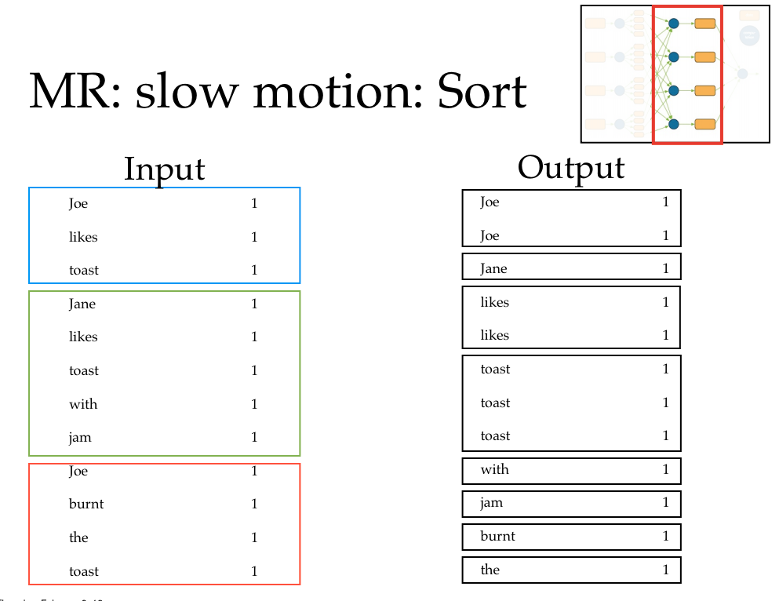

Slide 31
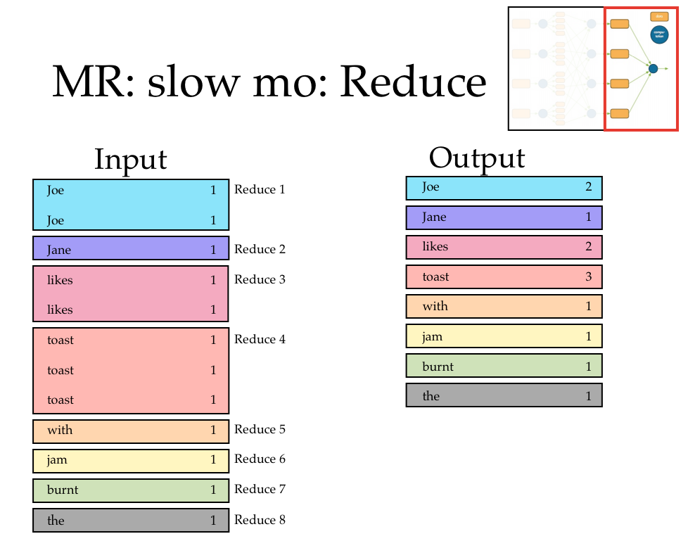

Slide 32
Issue: reliability
Questions:
How will you know when each machine is done?
Communication overhead
How will you know if a machine is dead?
Remember: we can to use a huge pile of cheap machines, so failures will be common!
Is it dead or just really slow?

Slide 33
Issue: reliability
What’s the difference between slow and dead?
Who cares? Start a backup process.
If the process is slow because of machine issues, the backup may finish first
If it’s slow because you poorly partitioned your data... waiting is your punishment

Slide 34
Issue: reliability
If a disk fails you can lose some intermediate output
Ignoring the missing data could give you wrong answers
Who cares? if I’m going to run backup processes I might as well have backup copies of the intermediate data also

Slide 35
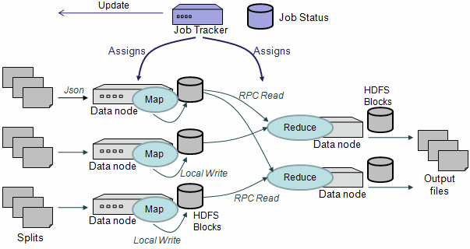

Slide 36
HDFS: The Hadoop File System
Distributes data across the cluster
distributed file looks like a directory with shards as files inside it
makes an effort to run processes locally with the data
Replicates data
default 3 copies of each file
Optimized for streaming
really really big “blocks”

Slide 37
$ hadoop fs -ls rcv1/small/sharded
Found 10 items
-rw-r--r-- 3 … 606405 2013-01-22 16:28 /user/wcohen/rcv1/small/sharded/part-00000
-rw-r--r-- 3 … 1347611 2013-01-22 16:28 /user/wcohen/rcv1/small/sharded/part-00001
-rw-r--r-- 3 … 939307 2013-01-22 16:28 /user/wcohen/rcv1/small/sharded/part-00002
-rw-r--r-- 3 … 1284062 2013-01-22 16:28 /user/wcohen/rcv1/small/sharded/part-00003
-rw-r--r-- 3 … 1009890 2013-01-22 16:28 /user/wcohen/rcv1/small/sharded/part-00004
-rw-r--r-- 3 … 1206196 2013-01-22 16:28 /user/wcohen/rcv1/small/sharded/part-00005
-rw-r--r-- 3 … 1384658 2013-01-22 16:28 /user/wcohen/rcv1/small/sharded/part-00006
-rw-r--r-- 3 … 1299698 2013-01-22 16:28 /user/wcohen/rcv1/small/sharded/part-00007
-rw-r--r-- 3 … 928752 2013-01-22 16:28 /user/wcohen/rcv1/small/sharded/part-00008
-rw-r--r-- 3 … 806030 2013-01-22 16:28 /user/wcohen/rcv1/small/sharded/part-00009
$ hadoop fs -tail rcv1/small/sharded/part-00005
weak as the arrival of arbitraged cargoes from the West has put the local market under pressure…
M14,M143,MCAT The Brent crude market on the Singapore International …

Slide 39
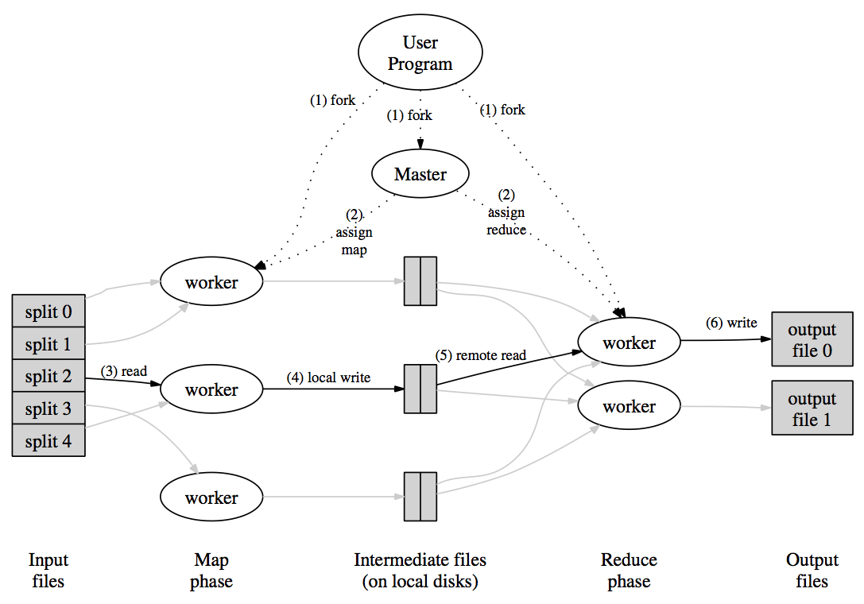
MR Overview

Slide 40
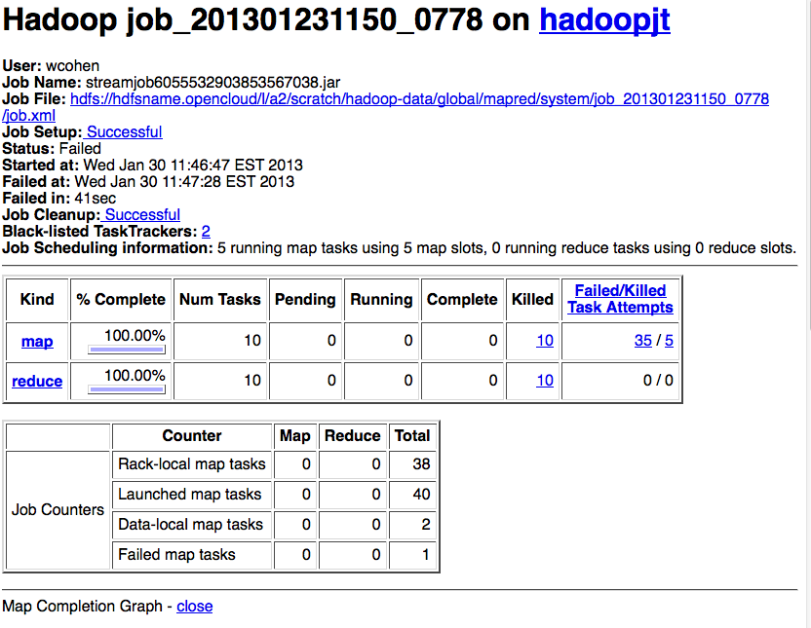

Slide 41
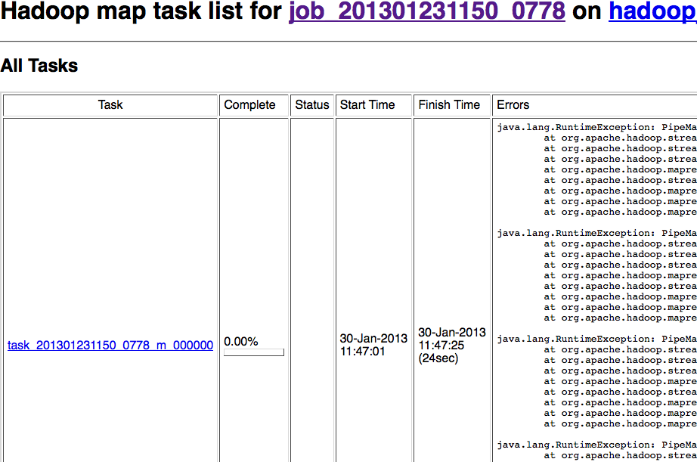

Slide 42
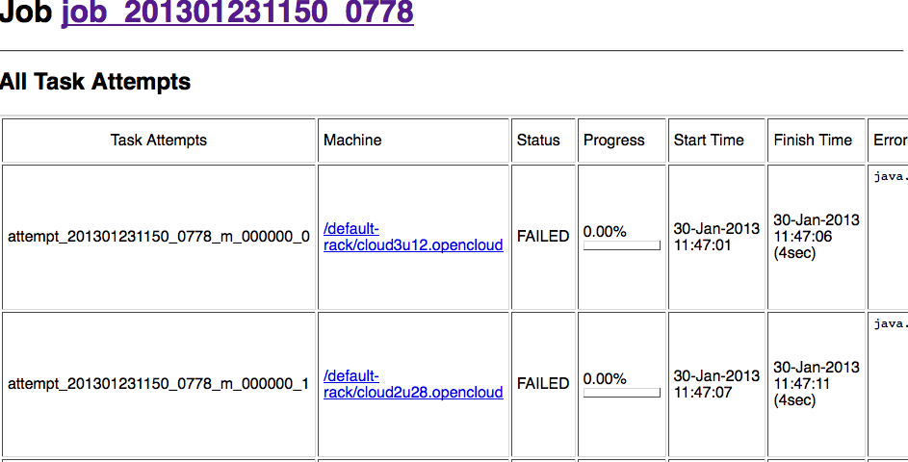

Slide 43
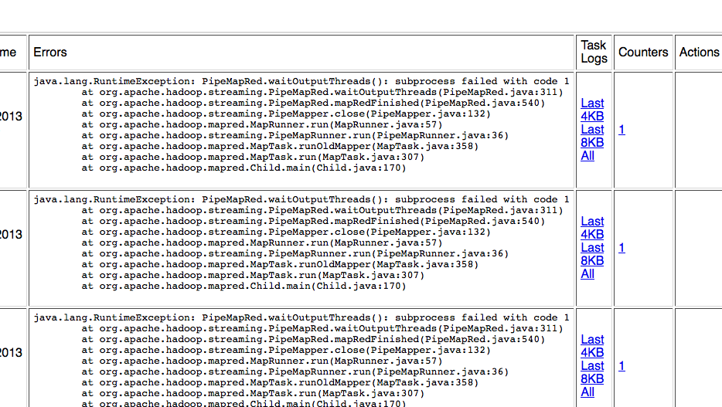

Slide 44
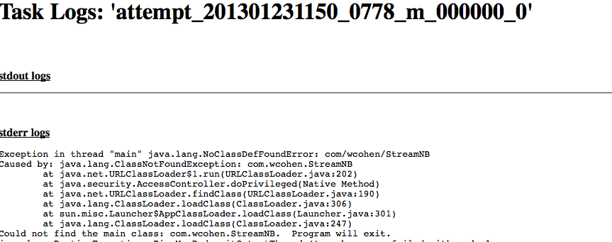

Slide 45
This would be pretty systems-y (remote copy files, waiting for remote processes, …)
It would take work to make run for 500 jobs
Reliability: Replication, restarts, monitoring jobs,…
Efficiency: load-balancing, reducing file/network i/o, optimizing file/network i/o,…
Useability: stream defined datatypes, simple reduce functions, ….

Slide 46
Map reduce with Hadoop streaming

Slide 47
Breaking this down…
Our imaginary assignment uses key-value pairs. What’s the data structure for that? How do you interface with Hadoop?
One very simple way: Hadoop’s streaming interface.
Mapper outputs key-value pairs as:
One pair per line, key and value tab-separated
Reducer reads in data in the same format
Lines are sorted so lines with the same key are adjacent.

Slide 48
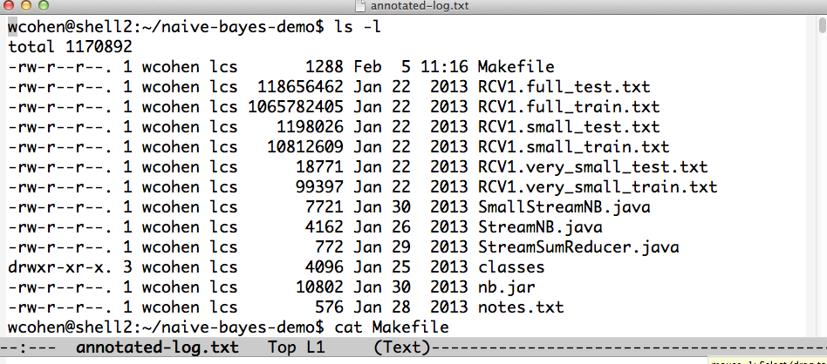
An example:
SmallStreamNB.java and StreamSumReducer.java:
the code you just wrote.

Slide 49
To run locally:

Slide 50
To train with streaming Hadoop you do this:
But first you need to get your code and data to the “Hadoop file system”

Slide 51
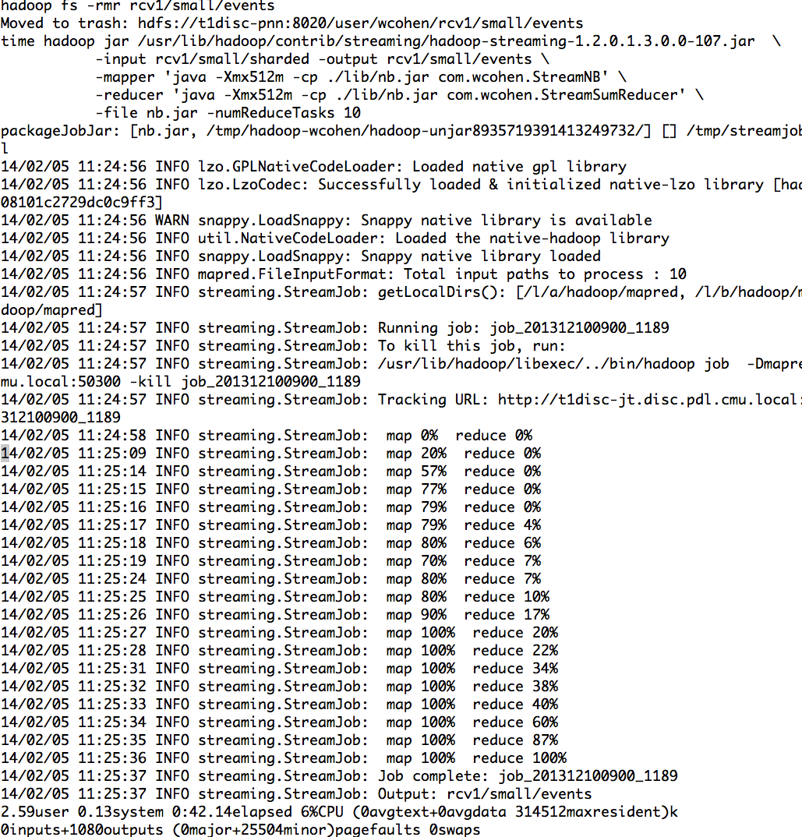

Slide 52
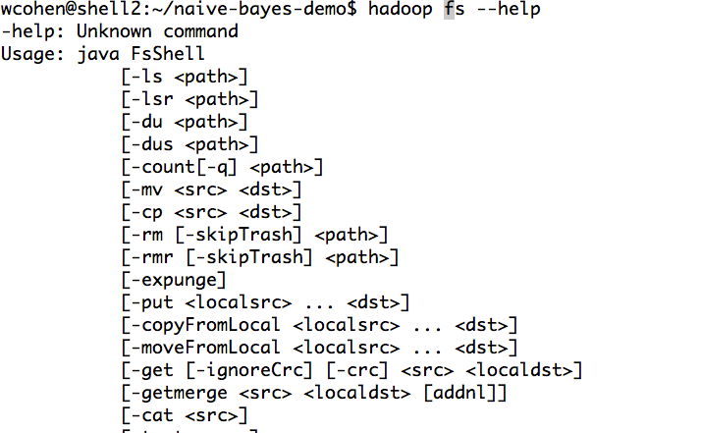
To train with streaming Hadoop:
First, you need to prepare the corpus by splitting it into shards
… and distributing the shards to different machines:

Slide 54
To train with streaming Hadoop:
One way to shard text:
hadoop fs -put LocalFileName HDFSName
then run a streaming job with ‘cat’ as mapper and reducer
and specify the number of shards you want with option
-numReduceTasks

Slide 55
To train with streaming Hadoop:
Next, prepare your code for upload and distribution to the machines cluster

Slide 56
To train with streaming Hadoop:
Next, prepare your code for upload and distribution to the cluster

Slide 57
Now you can run streaming Hadoop:

Slide 58
Map reduce without Hadoop streaming

Slide 59
“Real” Hadoop
Streaming is simple but
There’s no typechecking of inputs/outputs
You need to parse strings a lot
You can’t use compact binary encodings
…
basically you have limited control over the messages you’re sending
i/o costs = O(message size) often dominates

Slide 63
“Real” Hadoop vs Streaming Hadoop
Tradeoff: simplicity vs control
In general:
If you want to really optimize you need to get down to the actual Hadoop layers
Often it’s better to work with abstractions “higher up”

Slide 64
Debugging Map-Reduce

Slide 65
Some common pitfalls
You have no control over the order in which reduces are performed
You have no* control over the order in which you encounter reduce values
*by default anyway
The only ordering you should assume is that Reducers always start after Mappers

Slide 66
Some common pitfalls
You should assume your Maps and Reduces will be taking place on different machines with different memory spaces
Don’t make a static variable and assume that other processes can read it
They can’t.
It appear that they can when run locally, but they can’t
No really, don’t do this.

Slide 67
Some common pitfalls
Do not communicate between mappers or between reducers
overhead is high
you don’t know which mappers/reducers are actually running at any given point
there’s no easy way to find out what machine they’re running on
because you shouldn’t be looking for them anyway

Slide 68
When mapreduce doesn’t fit
The beauty of mapreduce is its separability and independence
If you find yourself trying to communicate between processes
you’re doing it wrong
or
what you’re doing is not a mapreduce

Slide 69
When mapreduce doesn’t fit
Not everything is a mapreduce
Sometimes you need more communication
We’ll talk about other programming paradigms later

Slide 70
What’s so tricky about MapReduce?
Really, nothing. It’s easy.
What’s often tricky is figuring out how to write an algorithm as a series of map-reduce substeps.
How and when do you parallelize?
When should you even try to do this? when should you use a different model?

Slide 71
Performance
IMPORTANT
You may not have room for all reduce values in memory
In fact you should PLAN not to have memory for all values
Remember, small machines are much cheaper
you have a limited budget

Slide 72
Combiners in Hadoop

Slide 73
Some of this is wasteful
Remember - moving data around and writing to/reading from disk are very expensive operations
No reducer can start until:
all mappers are done
data in its partition has been sorted

Slide 74
How much does buffering help?
BUFFER_SIZE | Time | Message Size
none |  | 1.7M words
100 | 47s | 1.2M
1,000 | 42s | 1.0M
10,000 | 30s | 0.7M
100,000 | 16s | 0.24M
1,000,000 | 13s | 0.16M
limit |  | 0.05M

Slide 75
Combiners
Sits between the map and the shuffle
Do some of the reducing while you’re waiting for other stuff to happen
Avoid moving all of that data over the network
Only applicable when
order of reduce values doesn’t matter
effect is cumulative
Notes:
Reduce must be commutative and associative Input and output formats must match

Slide 77
Deja vu: Combiner = Reducer
Often the combiner is the reducer.
like for word count
but not always
remember you have no control over when/whether the combiner is applied

