Slide 1
Midterm Exam Review Notes
William Cohen

Slide 2
When and where the exam will be
This room seats 217
Enrollment as of this morning
10-605A: 171
10-605B: 63
10-805: 10
total: 244
So we have an overflow room: NSH 1507
It seats 63
Go there if you are enrolled in 10-605B and your last name starts with D,E,…Z
Margin is now 7 ☺
Otherwise come to this room

Slide 3
General hints in studying
Understand what you’ve done and why
There will be questions that test your understanding of the techniques implemented
why will/won’t this shortcut work?
what does the analysis say about the method?
We’re mostly about learning meets computation here
there won’t be many “pure 601” questions
but 601 topics that are discussed in lecture are fair game for questions

Slide 4
General hints in studying
Techniques covered in class but not assignments:
When/where/how to use them
That usually includes understanding the analytic results presented in class
Eg:
is the lazy regularization update an approximation or not? when does it help? when does it not help?

Slide 5
General hints in studying
What about assignments you haven’t done?
You should read through the assignments and be familiar with the algorithms being implemented
There won’t be questions about programming details that you could look up on line
but you should know how architectures like Hadoop work (eg, when and where they communicate, how they recover from failure, ….)
you should be able to sketch out simple map-reduce algorithms and answer questions about GuineaPig
you should be able to read programs in workflow operators and discuss how they’d be implemented and/or how to optimize them

Slide 6
General hints in studying
There are not detailed questions on the guest speakers
There might be high-level questions
Notes:
, so if “first order learning methods” seem competely unfamiliar there might be a reason

Slide 7
General hints in exam taking
You can bring in one 8 ½ by 11” sheet (front and back)
Look over everything quickly and skip around
probably nobody will know everything on the test
If you’re not sure what we’ve got in mind: state your assumptions clearly in your answer.
This is ok even on true/false
If you look at a question and don’t know the answer:
we probably haven’t told you the answer
but we’ve told you enough to work it out
imagine arguing for some answer and see if you like it

Slide 8
Outline – major topics before midterm
Hadoop
stream-and-sort is how I ease you into that, not really a topic on its own
Phrase finding
Similarity joins
Parallelizing learners (perceptron, …)
Hash kernels and streaming SGD
Distributed SGD for Matrix Factorization
Some of these are easier to ask questions about than others.

Slide 9
More Review Slides

Slide 10
HADOOP

Slide 11
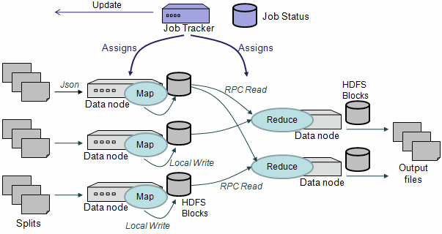
What data gets lost if the job tracker is rebooted?
If I have a 1Tb file and shard it 1000 ways will it take longer than sharding it 10 ways?
Where should a combiner run?

Slide 12
$ hadoop fs -ls rcv1/small/sharded
Found 10 items
-rw-r--r-- 3 … 606405 2013-01-22 16:28 /user/wcohen/rcv1/small/sharded/part-00000
-rw-r--r-- 3 … 1347611 2013-01-22 16:28 /user/wcohen/rcv1/small/sharded/part-00001
-rw-r--r-- 3 … 939307 2013-01-22 16:28 /user/wcohen/rcv1/small/sharded/part-00002
-rw-r--r-- 3 … 1284062 2013-01-22 16:28 /user/wcohen/rcv1/small/sharded/part-00003
-rw-r--r-- 3 … 1009890 2013-01-22 16:28 /user/wcohen/rcv1/small/sharded/part-00004
-rw-r--r-- 3 … 1206196 2013-01-22 16:28 /user/wcohen/rcv1/small/sharded/part-00005
-rw-r--r-- 3 … 1384658 2013-01-22 16:28 /user/wcohen/rcv1/small/sharded/part-00006
-rw-r--r-- 3 … 1299698 2013-01-22 16:28 /user/wcohen/rcv1/small/sharded/part-00007
-rw-r--r-- 3 … 928752 2013-01-22 16:28 /user/wcohen/rcv1/small/sharded/part-00008
-rw-r--r-- 3 … 806030 2013-01-22 16:28 /user/wcohen/rcv1/small/sharded/part-00009
$ hadoop fs -tail rcv1/small/sharded/part-00005
weak as the arrival of arbitraged cargoes from the West has put the local market under pressure…
M14,M143,MCAT The Brent crude market on the Singapore International …
Where is this data? How many disks is it on?
If I set up a directory on /afs that looks the same will it work the same? what about a local disk?

Slide 13
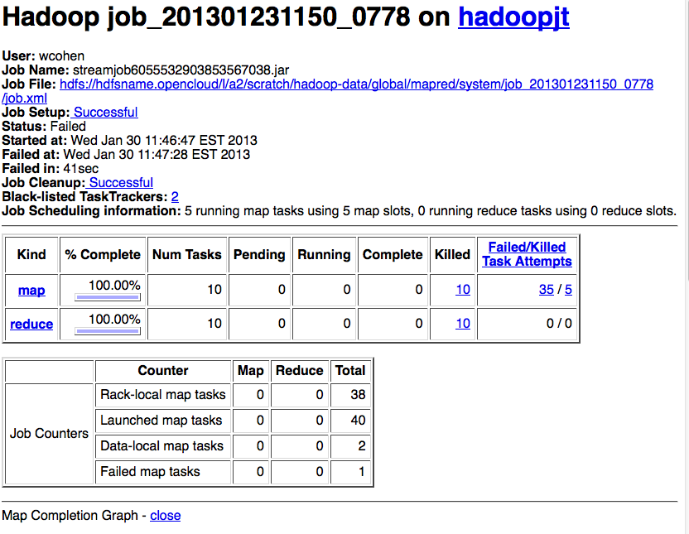

Slide 14
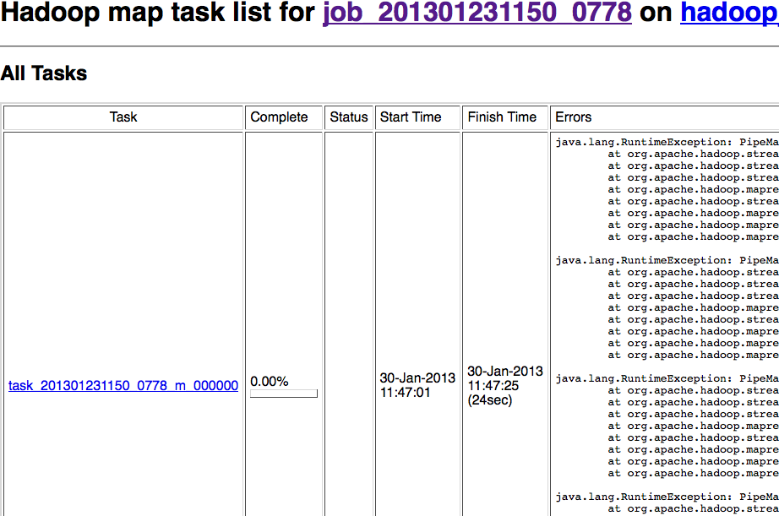

Slide 15
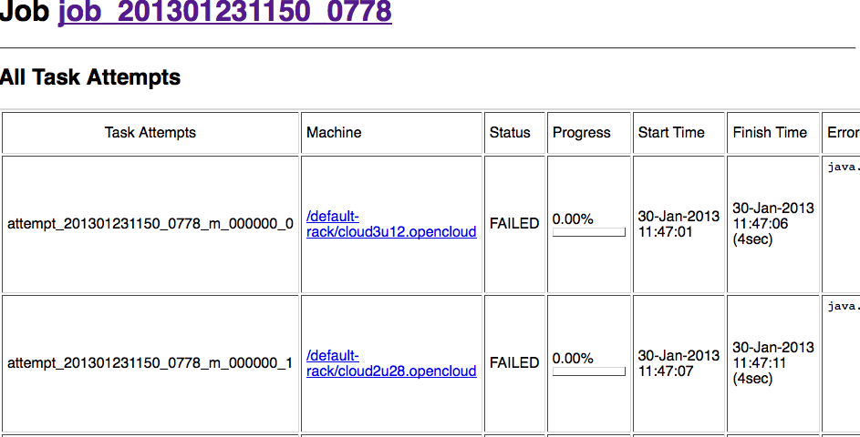

Slide 16
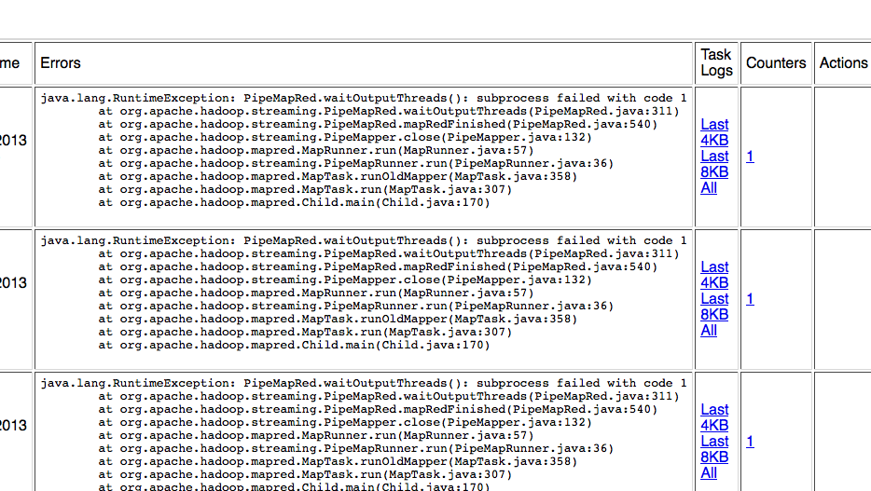
Why do I see this same error over and over again?

Slide 17
PARALLEL LEARNERS

Slide 18
Parallelizing perceptrons – take 2
w (previous)
Instances/labels
Split into example subsets
Instances/labels – 1
Instances/labels – 2
Instances/labels – 3
Compute local vk’s
w -1
w- 2
w-3
Combine by some sort of weighted averaging
w

Slide 19
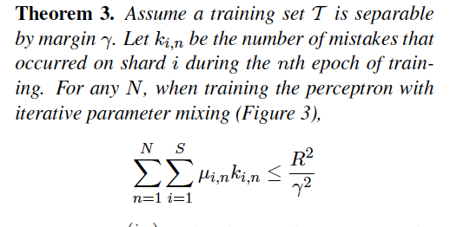
A theorem
I probably won’t ask about the proof, but I could definitely ask about the theorem.
Corollary: if we weight the vectors uniformly, then the number of mistakes is still bounded.
I.e., this is “enough communication” to guarantee convergence.

Slide 20
NAACL 2010
What does the word “structured” mean here? why is it important? would the results be better or worse with a regular perceptron?

Slide 21
Streaming SGD

Slide 22
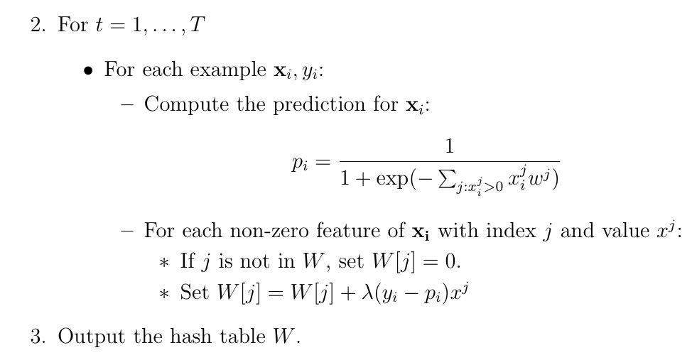
Learning as optimization for regularized logistic regression
what if you had a different update for the regularizer?
Algorithm:
Time goes from O(nT) to O(mVT) where
n = number of non-zero entries,
m = number of examples
V = number of features
T = number of passes over data

Slide 23
Formalization of the “Hash Trick”:
First: Review of Kernels
What is it? how does it work? what aspects of performance does it help?
What did we say about it formally?

Slide 24
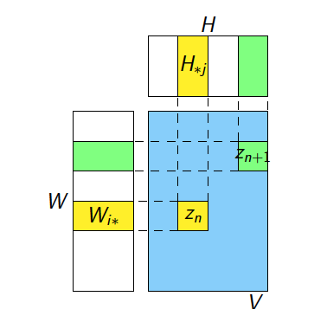
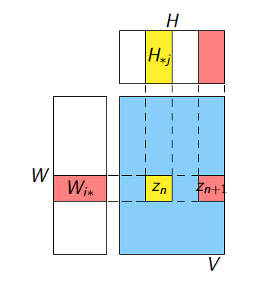
Matrix factorization
What is this picture trying to show?

Slide 25
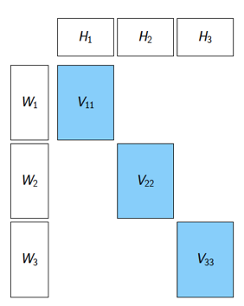
Matrix factorization
What is this picture trying to show?
What would be another possible “stratum”?

